Slide 1


UNCLASSIFIED
Presented to:
Prognostic Working Group
15 October 2014
Prognostics for Electronic Systems
Presented by:
Danny Parker, Ph.D.
Danny.L.Parker20.ctr@mail.mil
Diagnostic / Prognostic Laboratory
U.S. Army Aviation and Missile Research, Development, and Engineering Center
UNCLASSIFIED

Slide 3
What is Prognostics?
Prognosis: The prediction of life / degradation of a component or the time before failure based on the current and accumulated parameter data (ADS-79)
Remaining Useful Life (RUL): An estimate of remaining time on-wing for failure free operation of the described component or system based on statistics, physical measurements, test results, or a combination of the analytical methods, thereof.
Early detection of incipient flaws
Reduction of test flights
Reduced inspections and increase part life
Faster troubleshooting
Increased Operational Availability (A_{o})
Reduced Cost of Ownership

Slide 4
When is Prognostics Useful?
When you save more than it costs to implement (duh)
What does that entail?
  Development costs
  Data migration and infrastructure costs
  Data storage costs
  Data processing costs
Ultimately getting the right information to the decision makers in a timely manner
Who are the decision makers
  Maintainers
  Commanders
  Logistic
Each decision maker requires different types of information and at different intervals

Slide 5
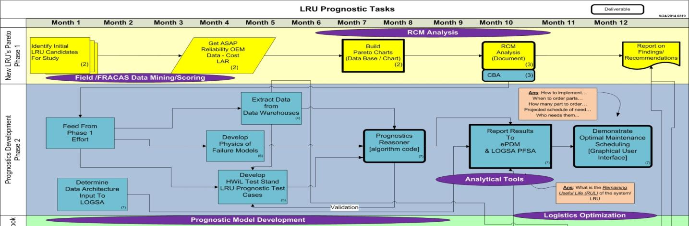
“The Process”
Reliability Centered Maintenance attempts to answer if and how a prognostics solution should be done
  Who are the consumers of the information (decision makers)
  What data should be monitored and if it is currently collected
  Cost Benefit Analysis
  What processing is required to turn the data into information
  Where the information is stored and how will it be retrieved for use

Slide 6
One Process Example
Embedded GPS Inertial Navigation System (EGI)
  “First-Look” due to high No Evidence of Failure (NEOF)
  High B16 item on AMCOM’s “Top Driver’s” list
Questions that need to be answered for Cost-Benefit Analysis
  What are root causes of failures?
  What measurements would be useful in predicting the failures?
    Would the predictions be accurate enough?
  What is the box capable of reporting?
  What data, if any, is captured? Stored?

Slide 7
RCM – Root Cause
EGI Pareto Charts
Honeywell (OEM/Depot) Data - Normalized Percent chart to show failure distribution
14.00%
Type of Issues by Percent of Installed EGIs
Honeywell Repair Results
Jan 2011 thru Jan 2013
12.00%
GEM is Most Prevalent Root Cause of Failures
10.00%
Possible CBM+ Candidates
All Army (2708)
8.00%
AH
-
64D (1198)
XX
-
60M (876)
6.00%
XH
-
47F (300)
OH
-
58D (334)
4.00%
2.00%
0.00%

Slide 8
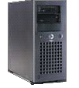
Data Sources
Interface Control Documents (ICDs)
  How the box operates
  What it can report
Data Collected from Digital Source Collector (DSC) on board one aircraft for the same EGI
  Captured parametric data
  Failure modes projected into stored data
  117 data records
  03 Jan 2011 to 17 Jun 2011
Aviation 2410 database
  Maintenance Logs
Depot Repair Data
At Enterprise
Logs A
- DB Tools
7770
- Storage
AMRDEC
- Analysis Tools

Slide 9

Prognostics & RUL
Understanding the EGI System
GPS Antenna
On Platform
EGI
Heading, Position, Velocity
GPS
Baro
DSC
Kalman Filter
GYROs
Errors
Accel
…a good-news story in data mining
Added Value Effort / Off Platform
Condition Indicator
Maintenance
Mission & Logistics View
RUL Estimate

Slide 10
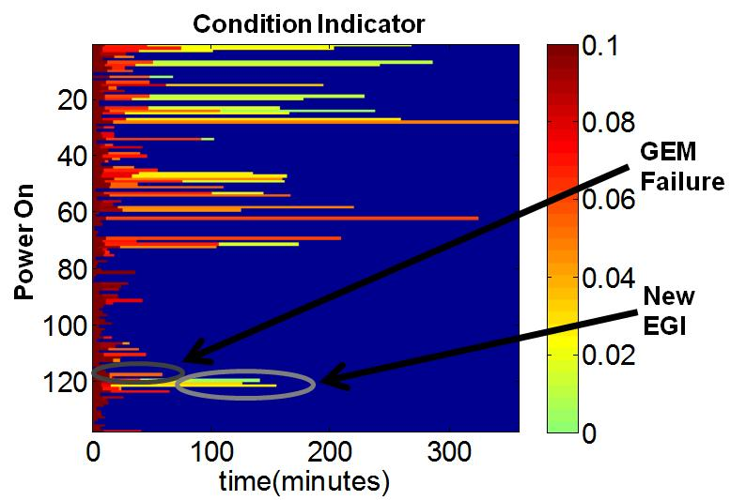
Prognostics & RUL
EGI Condition Indicator (CI)
Processed Data From DSC
Data Collected
  117 data records
  03 Jan 2011 to 17 Jun 2011
    Historical data extracted from CBM data warehouse
    Validated with US Army Safety Center
    GEMS failure confirmed by OEM
Used EGI Inertial Heading Error
    EGI capable of reporting more… but data is not captured
    Potential to improve prediction accuracy
  This is “Validated field data”
Notes:
DATA REPEAT FROM 2 CHARTS PRIOR!!!!! The humanity!

Slide 11
RCM
CBA Results
Estimated cost avoidance with diagnostics and prognostics would be:
  $2.8M and 638 maintenance man hours (MMH) per year for EGI
    --- Ultra-Conservative ---
      Based off past 6 months of requisitions
      Doesn’t account for logistics optimization
      Doesn’t account for mission affecting failures
    EGI prognostics pilot program cost is low..
      Data readily available… already collected on certain aircraft
    Applicable Across All Aviation Platforms
Notes:
What do we have to do to get an EGI cost avoidance

Slide 12
Multi-Apache EGI CI Analysis
Relative Change
Failing Group (Red) Shows A Clear Upward Trend…
Control Group (Green) Stays Flat
Shows differentiation of failed or healthy units

Slide 13
Prognostics & RUL
Logistics View
zoomED
Provides Logisticians Strategic Health of a component
Allows for Effective and Efficient Spare Parts Management
Decrease in Unscheduled Maintenance

Slide 14
Prognostics & RUL
Logistics View Zoomed
THE BOTTOM LINE
Accurate RUL
  Supports anticipatory parts requests for the logistician…
  With 5 flight hours remaining system predicted 4.8 hours before failure…

Slide 15
Prognostics & RUL
Mission Planner View
Reliability
Risk
Margin 2 hrs
Margin 4 hrs
10000
Margin 8 hrs
3162
1000
316
Odds of Failure
100
32
10
3
1
0
10
20
30
40
50
60
70
80
Flight Hours (hrs)
Provides Mission Planners Strategic Health of the Fleet…
Allows for Effective and Efficient Supply Chain Management…
Increase in Mission Success…
Notes:
At this point in the EGI’s life it had a good chance of not failing during a 2 hour mission, a medium chance of failure during a 4 hour one, and it would be very likely to fail if it was flown for 8 hours. As the number of EGI flight hours increases the odds of failure increase from 1 in 10,000 to 1 in 3.

Slide 16
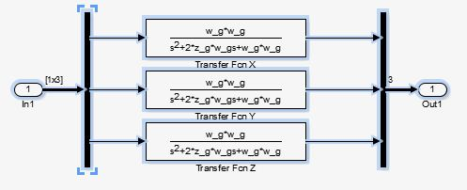
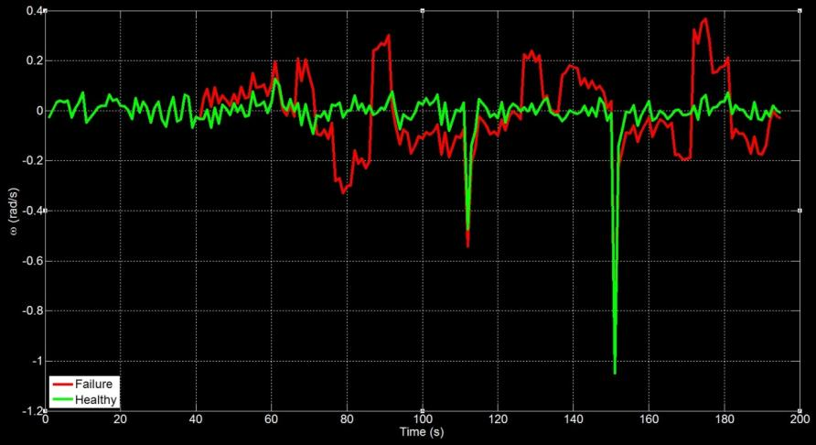
Prognostics & RUL
New Digital EGI
A BETTER CANDIDATE
Virtual Twin
Allows exploration of various failure modes
  Currently captured signals
  Potential signal candidates
  Effects on RUL prediction
  This is the “Digital model to induce controlled faults”

Slide 17
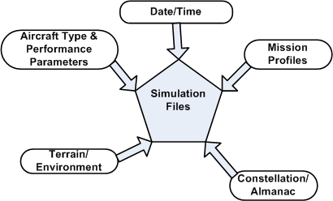
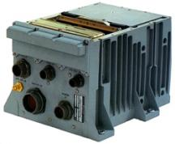
Prognostics & RUL
CAST 3000 HwiL
Used by Missouri TASM for EGI screening
Loads almanac (satellite constellation) for simulation of Satellites
Allows development of flight scenarios to test/exercise EGI
Provides a ‘Range of Flight’ profiles for test
Includes EMT3500 mode to download and examine BIT codes
Fault Insertions
Performance
Scenario
GPS Simulation
Saves $$$$
  This is the “Hardware in the Loop (HwiL) to validate digital models”

Slide 18

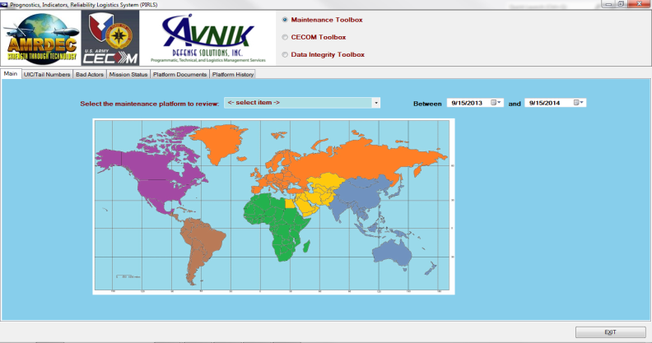

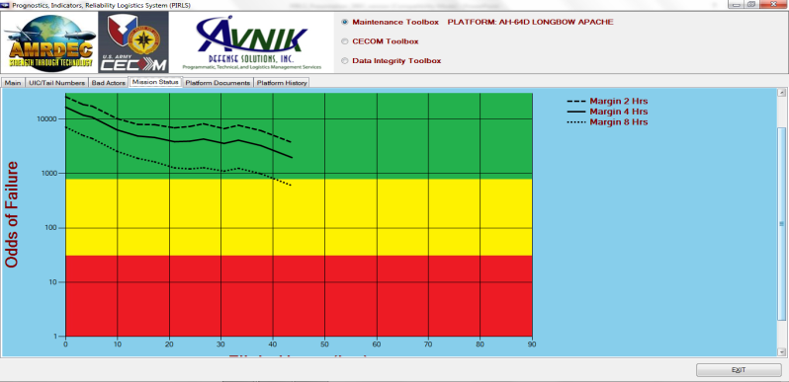
Analytical Tools
Fleet / Supply Chain Data Miner
A Strategic Tool For:
  Aggregated field data from different sources
  Organize data by LRU serial number
  Visualize Health State
    Unit, Battalion, Brigade, Division, Corp, Major Command, Country, Continent, Fleet
  Flags Bad Actors
    Repeated NEOF’s
Lab Demo
Notes:
disparate

Slide 19
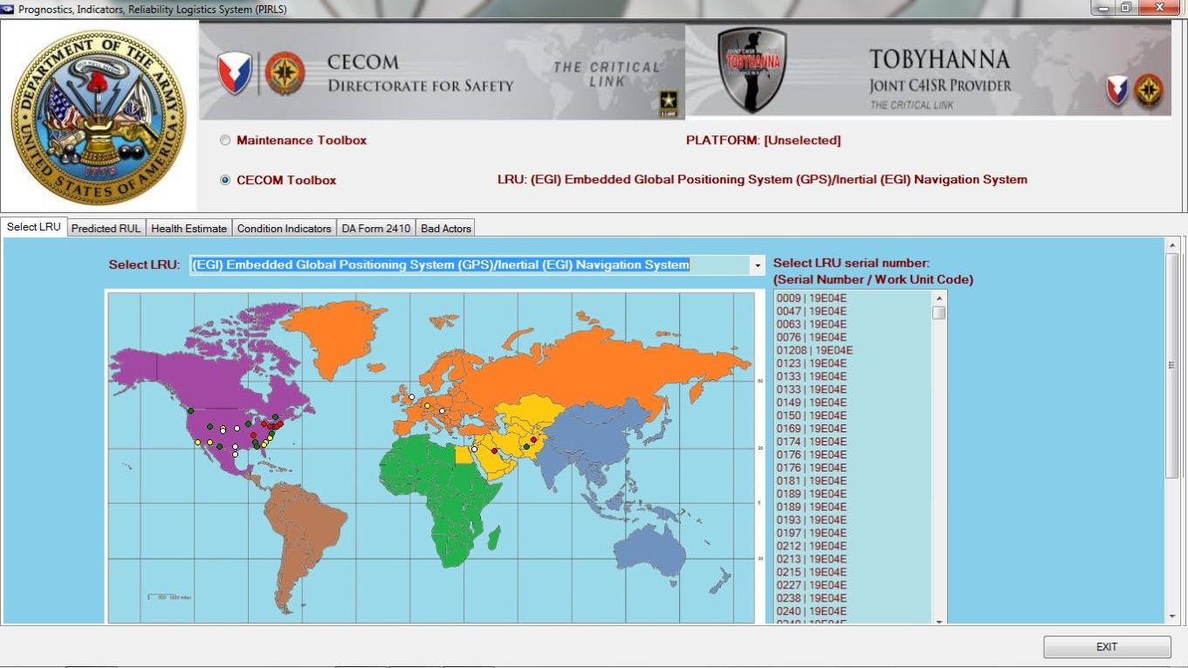
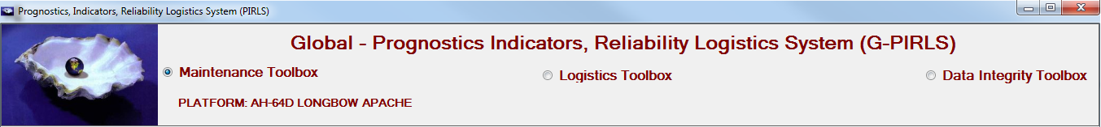
PIRLS Initial View
Press

Slide 20
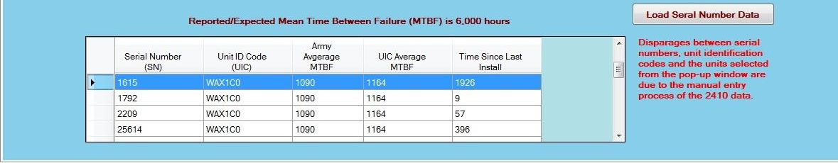
Red Location
Clicking a location generates a list of serial numbers ordered by health status

Slide 21
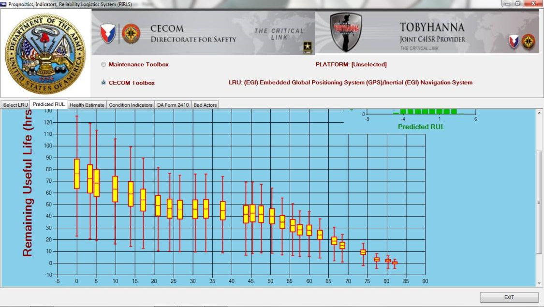
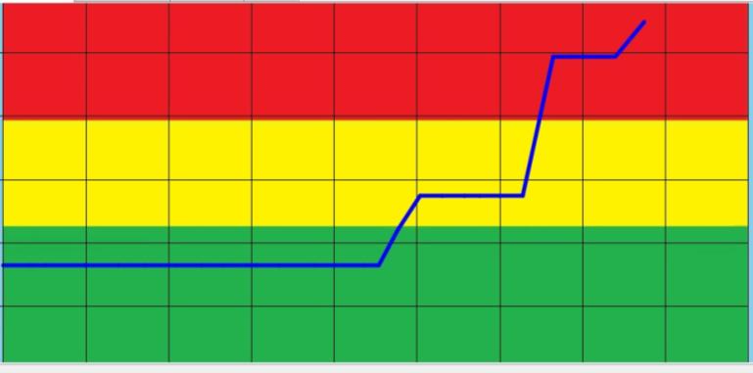
LRU Information
Selecting a particular serial number gives you the information on its history and health state

Slide 22
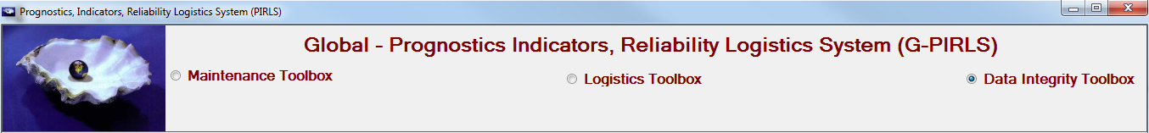
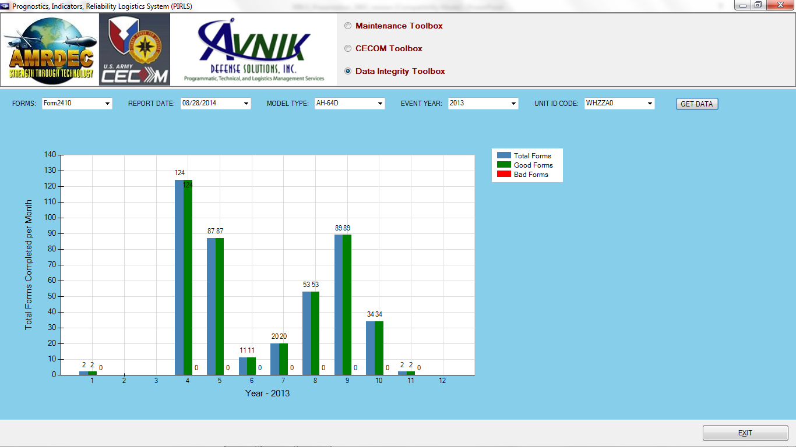
Data Integrity Toolbox
Notes:
After selecting all of the criteria, and clicking on the Get Data button the data review chart displays the “Total Forms” reported, the “Good Forms” and if any, the “Bad Forms”. The total of the good and bad forms will equal the total number of forms reported.
Currently all five criteria/parameters are required, but toolbox can be modified to allow the user to select just one or any combination of the five parameters to view the data.

Slide 23
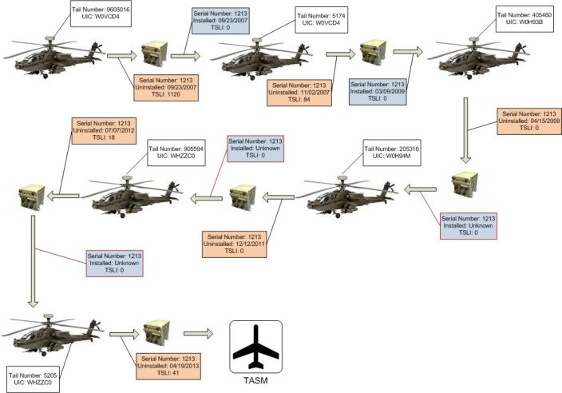
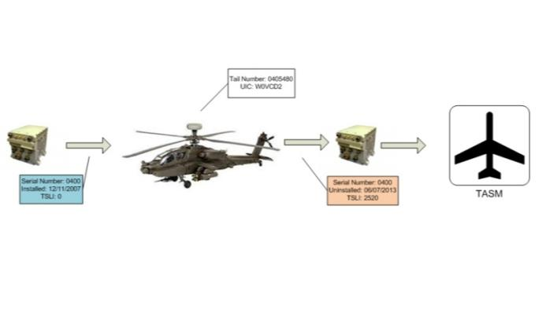
Analytical Tools
Supply Chain Analysis
Good Actor
Bad Actor
Visual Perspective Comparing Expected LRU Behavior VS a REAL Event

Slide 24
Conclusions
Successful prognostics requires many things
  Good measurements
  Good algorithms
  Good data infrastructure
Most important: getting the right information to the right user…

