Slide 2
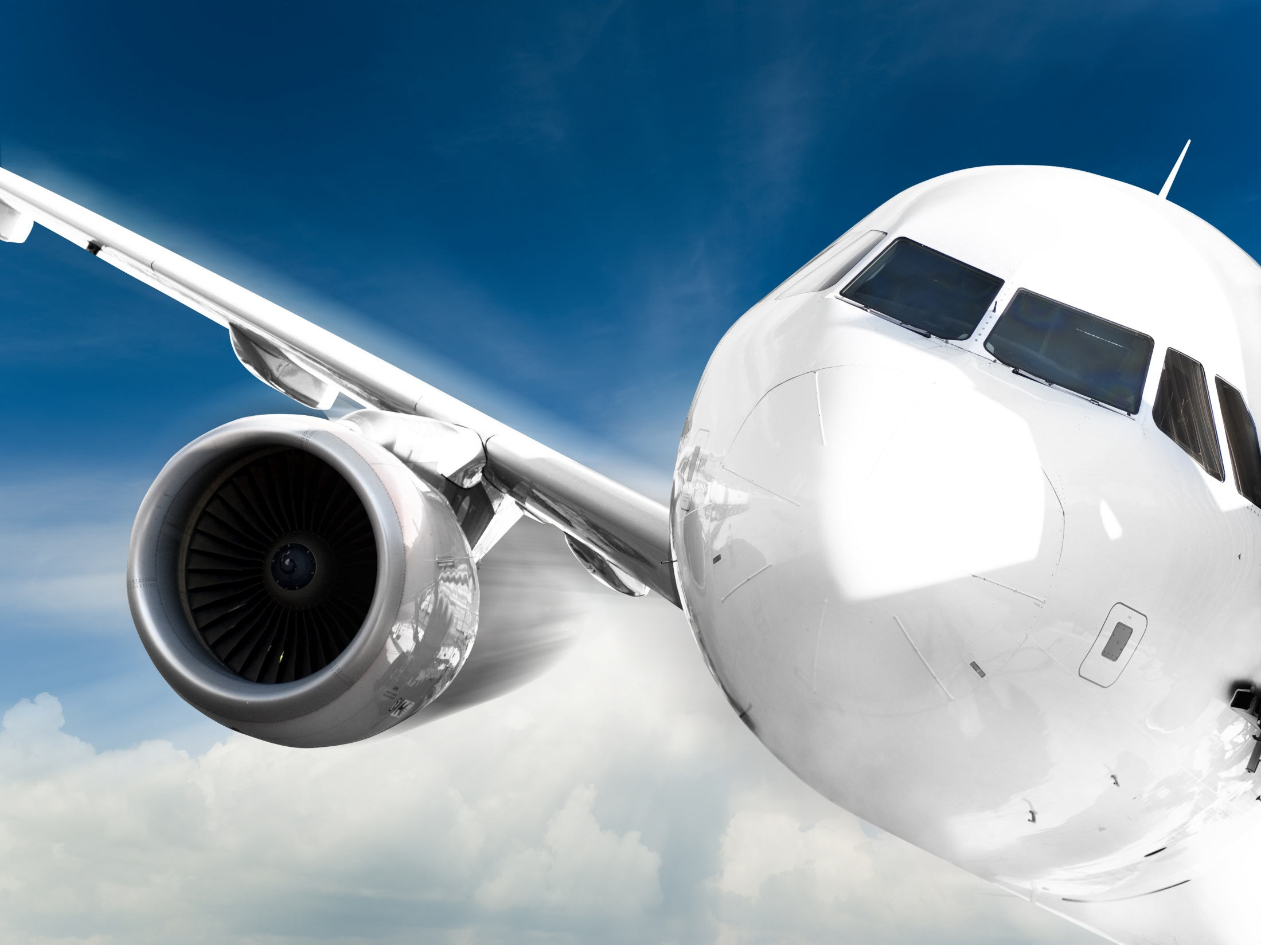

SKF Aerospace Sealing Solutions

Slide 3
SKF technology platforms
Services
Notes:
Page 3
29 October, 2014
Our 5 technology platforms

Slide 4
Seals have a long history at SKF…
  1907 SKF is founded
  1910 Enquiry from Henry Ford for wheel seals
  1928 First patented oil seal
  1962 CR Mexicana Joint Venture established
  1974 SKF founded RFT
  1990 SKF acquires Chicago Rawhide
  1992 CR Europe is founded
  1994 SKF acquires Goetze Elastomere GmbH
  1997 CR China is formed
  1998 CR India and CR Korea established
  2000 SKF acquires Sealpool Scandinavia
  2003 Relocation of CR China to new Plant in Wuhu
  2005 CR brand transition to SKF and formation of SKF Sealing Solutions
  2006 SKF acquires Macrotech Polyseal Inc. and ECONOMOS
  2013 SKF acquires Blom & Voss and Kaydon

Slide 5
…and a global footprint
Sweden
Netherlands
Landskrona
Illinois
Niewegein
Kansas
Elgin
Utah
Seneca
Austria
Korea
Salt Lake City
Germany
Judenburg
China
Daegu
Leverkusen
Wuhu
Utah
North Carolina
La Verkin
Bulgaria
China
Franklin
Kalofer
Mexico
Italy
Shanghai
Guadalajara
Oklahoma
Villanova, Varese
India
India
Hobart
Mysor
Bangalore

Slide 6
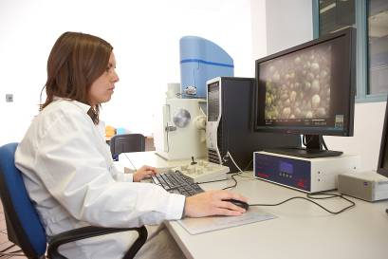
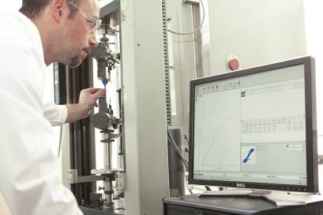
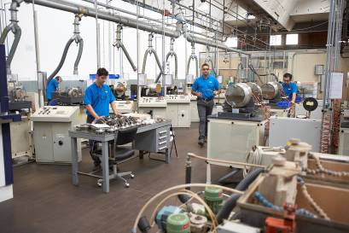

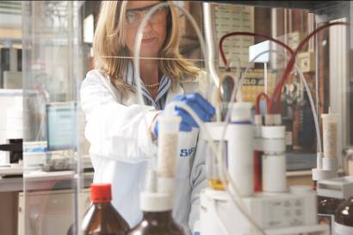
Technical leadership and engineering support
Technical leadership
  Active role in industry technical organizations
  Leader in developing industry standards
  Large number of active patents worldwide
Engineering support
  Custom design to suit application & customer requirements
  Development according Customer specifications
  Prototype development
  Finite Element Analysis to optimize designs & performance

Slide 7
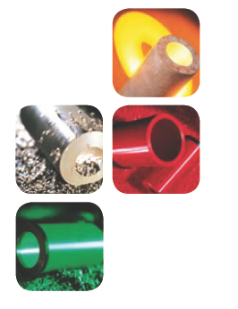
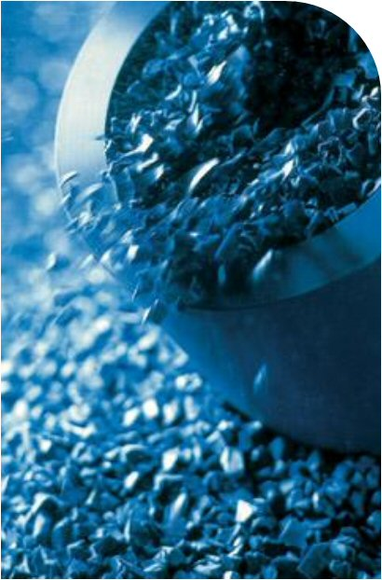
Strong materials development capabilities
  Development of polymeric materials (elastomers and plastics)
  Application specific compound formulation
  Optimization of the use of materials (including adhesives/phosphating/ metals)
  Magnetization development
  In-house testing equipment for chemical, physical, rheological, low temperature, ageing (air, oils, fluids), etc.

Slide 8
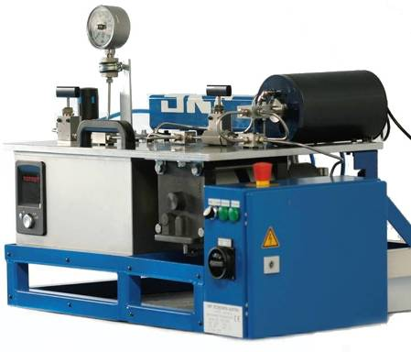
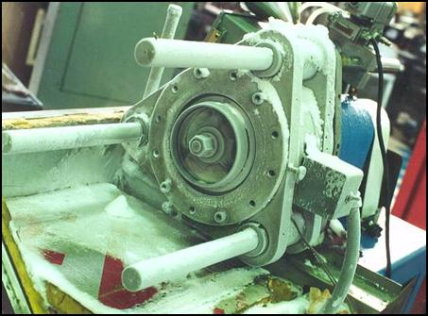
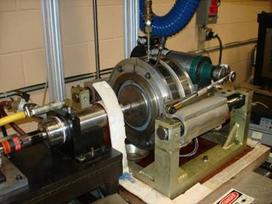
Global testing capacities
SKF has 9 seal testing labs worldwide with ~285 seal testing machines
Test lab Elgin, USA
Hydraulic seal testing, Judenburg, Austria
Torque measurement,
Leverkusen, Germany
Cold temperature testing,
Elgin, USA

Slide 9

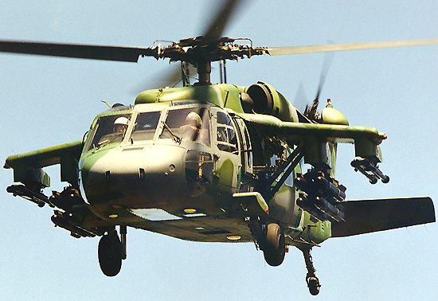
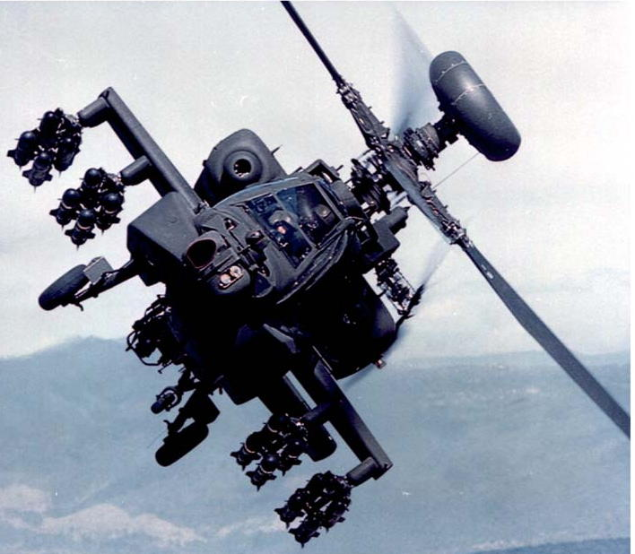
Seal platform in Aerospace

Slide 10
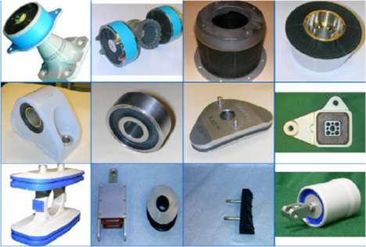
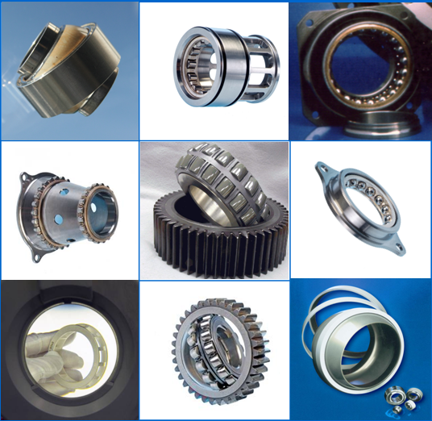
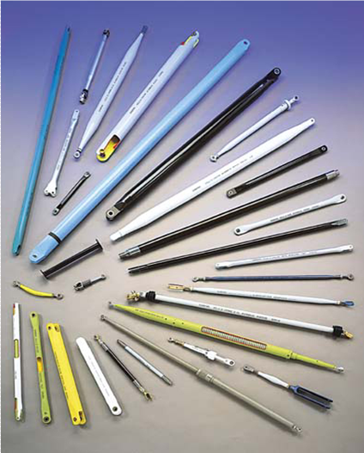
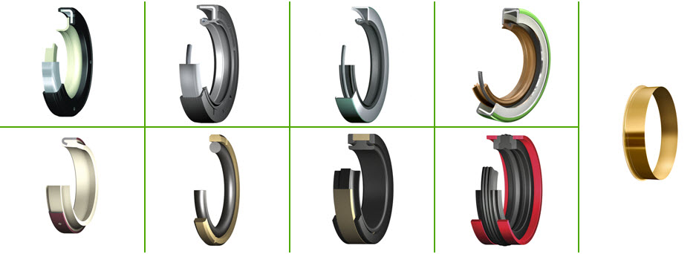
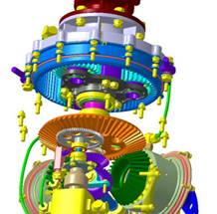
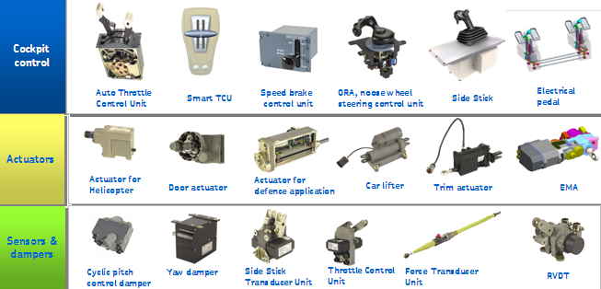
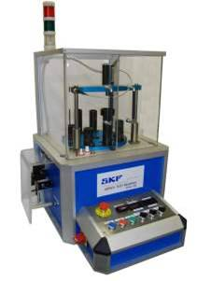
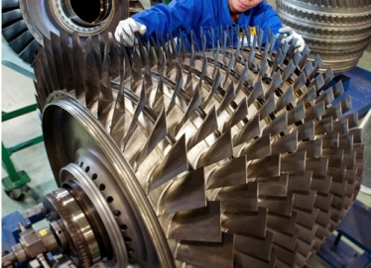
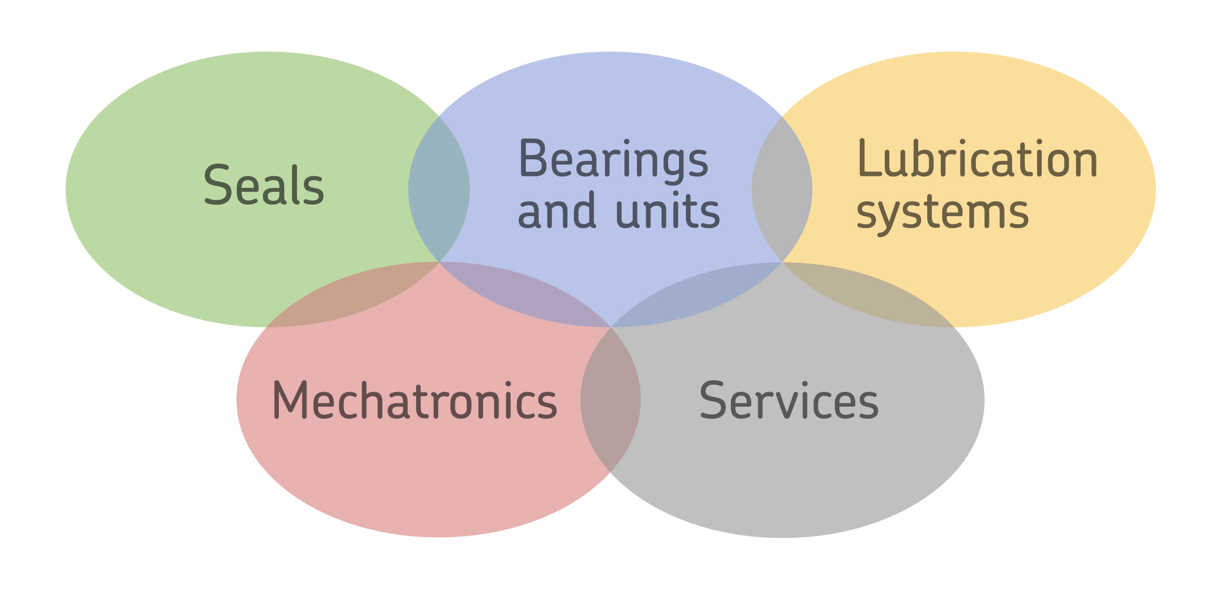
SKF Aerospace capabilities
Precision
Elastomeric
Devices
Seals

Slide 11
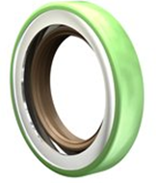
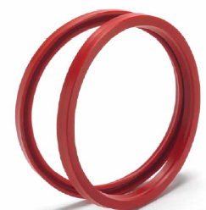
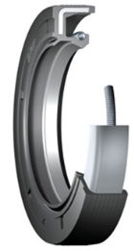
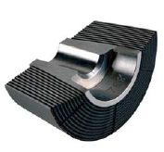
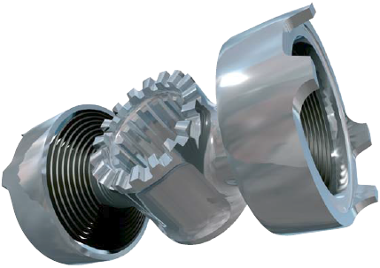
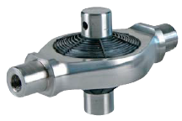
SKF Aerospace sealing solutions
Seals and beyond…
Seals bonded to advanced materials
like stainless , titanium, aluminum, composites
Seal design knowledge
Rubber bonding knowledge
Rubber material knowedge
Precision Elastomeric Devices – PED
Mechanical reactive rubber products
like isolaters, mounts, dampers

Slide 12
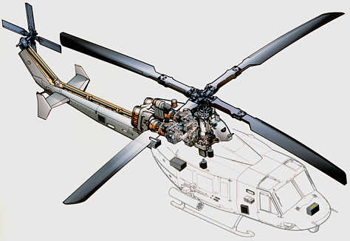
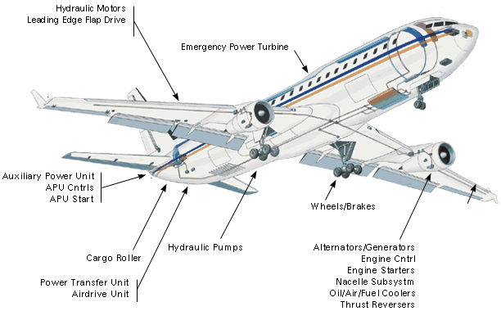
Seal and PED applications
Applications
  Landing gear
  Auxiliary power units
  Engines
  Tail and boom
  Gearboxes, transmissions & drive shafts
  Rotor systems
Applications
  Cabin noise isolation
  Stow bin suspension
  Engine mounts
  Bird strike / impact isolators
Notes:
Gearboxes

Slide 13

Component re-use considerations

Slide 14
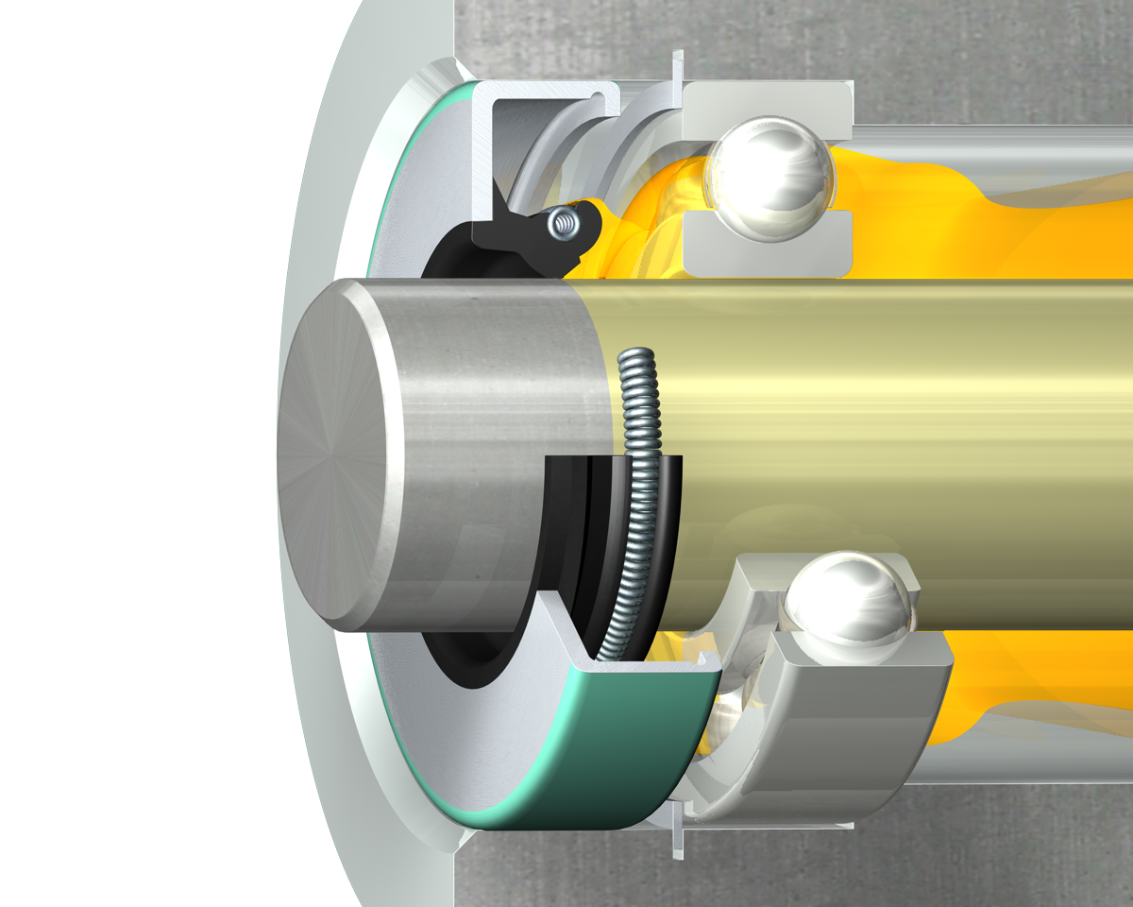
The sealing system
The sealing system consists of more than just a seal
Internal environment
Lubricant
Housing
Seal
Shaft
External environment

Slide 15
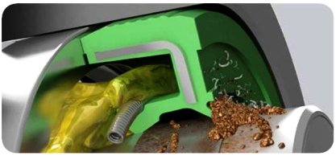
Component re-use considerations
  SKF does not recommend re-using seals
  Initial installation
    Special tools, was it done correctly
  Initial seal and running surface break in
  Resizing of seal metal OD
  Disassembly
    Seal, bearing, wear sleeve, shaft removal, special tools
  Cleaning and inspection
  Re-installation
    Damage, location change, special tools

Slide 16
Plan for component re-use
  Design in seal retainers
  Design in spacers for location changes
  Use wear sleeves or speedi-sleeves
  Sealing surfaces should be smaller than bearing IDs
  Determine which applications are candidates
  Purchase inspection equipment
  Develop dimensional and visual guidelines
  Track total hours and number of installations
  Train, train, train

Slide 17
Failure analysis

Slide 18
Critical information needed
Know the operating conditions
  (Use the PDS as a guide)
  Mechanical
  Chemical
  Thermal
  Environmental
  Time of Failures (Hours)
Type of Leakage (I.D. / O.D.)
  Static / Dynamic / Both
Severity of Failure / Leakage
  Intermittent / Trace / Heavy
Learn the history
  Is this sealing system used often?
  Is this the first failure?
  Is this a “typical” failure?
  What is unusual about this failure?
  What was different about the:
    Installation (including the installer)?
    Application?
    Duty cycle?
    Lube (new type or supplier)?

Slide 19
System operating conditions
Mechanical
  Shaft
    New or Reworked
    Finishing Method
    Shaft Lead
    Surface Finish
    Size
    Motion
    Speed
    D.R.O.
    Keyways, Splines, Cross Holes
    Lead in Chamfer/Radius
    Damage
  Bore
    Size
    Surface
    S.T.B.M.
    Chamfer
    Damage
Chemical
  Fluid Type
  Max. Sump Temperature
  Shaft Material
Thermal
  Fluid Quantity
  Min. & Max. Sump Temperature
  Bore Material
  Sump Pressure
Environmental
  External Contamination
  Internal Contamination
  Operating Cycle
  Installation Method

Slide 20
Additional system questions
System type
  Prototype or production?
Components and processes used
  Prototype or production?
Handling and assembly processes used
  Prototype or production?
Fluid used
  Prototype or production?

Slide 21
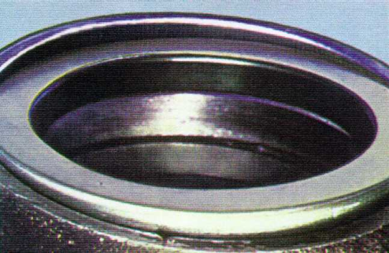
Cocked installation
Installation
One of the most common causes of early seal failure is a bad installation. Without the proper tool (or at least a soft tool spanning the seal diameter) the seal may become cocked in the bore. You may be able to see this from the outside.

Slide 22
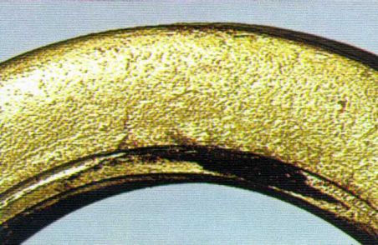
Foreign material
Painting
If the machinery has been painted without protecting the seal, the lip may be damaged. Also, oven drying the paint, or some paint solvents, can destroy the seal. Either remove the seal or mask the area well before painting.

Slide 23
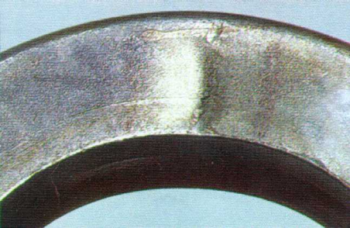
Damaged seal case
Dents and dings
An early leak is often the result of installing the seal without the proper tool. The evidence shows up as telltale marks on the seal shell. When an installation tool isn’t available, a soft material, like wood, will work as long as it spans the seal.

Slide 24
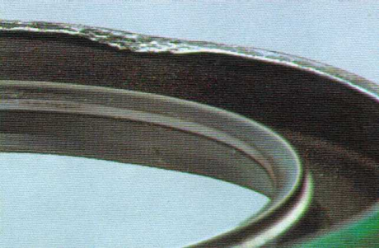
Damaged seal case
No chamfer
The beveled edge (chamfer) on the leading edge of the bore provides a ramp for starting the seal straight. Without it, it is virtually impossible to get the seal installed correctly. A 15-30 degree angle, clean and burr free, is recommended.

Slide 25
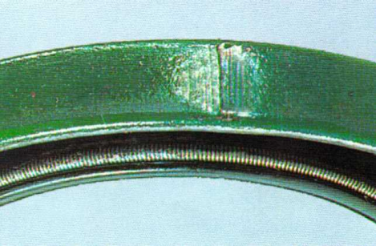
Damaged seal case
Burr damage
A deep scratch in the outer diameter that scribes a line across the seal width is usually the sign of a burr (or contamination) in the bore. This line creates a leak path. Short, light scratch marks are usually the result of normal installation.

Slide 26
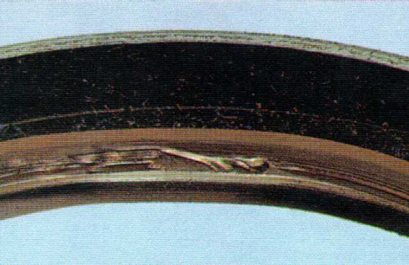
Damaged primary lip
No chamfer
The beveled edge (or chamfer) at the end of the shaft provides a ramp for the seal to ride up on. Without it, the seal lip cannot be installed without being damaged or torn, as shown here. The lead-in chamfer must be smooth and burr free.

Slide 27
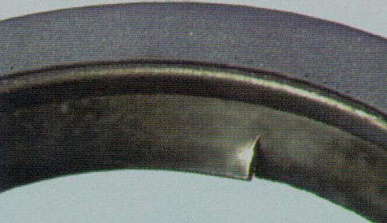
Damaged primary lip
Torn lip
Another way for the lip to be damaged is by attempting to install the seal over unprotected threads, splines or key-ways. Using Mylar or other types of adhesive tape will usually provide enough protection to mount the seal successfully.

Slide 28
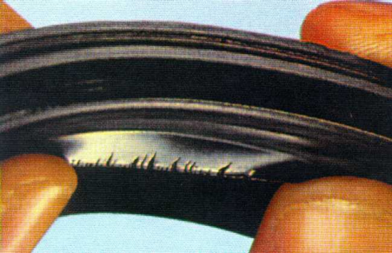
Heat aged primary lip
Heat damage
When operating speeds increase, seal lip temperatures may soar. One indication of high heat is a dry, brittle lip. The lip will feel stiff and hard, and pressing on it will reveal cracks and breaks in the lip. A think line of carbonized oil may also be visible.

Slide 29
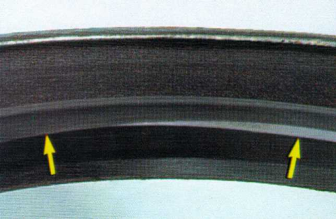
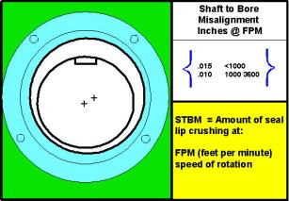
Uneven primary lip wear
STBM
Misaligned components in a power train create Shaft-to-Bore Misalignment (STBM) and leaks. The seal lip will appear worn on one side and relatively untouched on the other. Shaft alignment should always be checked before installing a new seal.

Slide 30
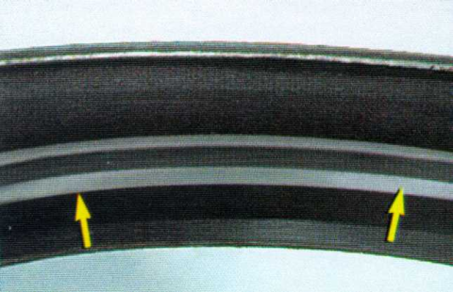
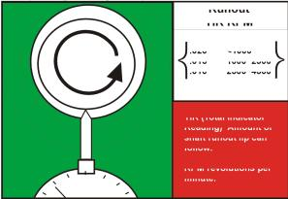
Excessive, but even primary lip wear
DRO
Dynamic Run Out (DRO) is the result of a bent, unbalanced or misaligned shaft. The sealing lip will be severely worn around the entire diameter. A dial indicator attached to the bore or housing while the shaft is rotated through 360 degrees will reveal DRO.
Runout
TIR RPM
.020 <1000
.015 1000 2500 .010 2500 4500
TIR (Total Indicator Reading) - amount of shaft runout lip can follow.
RPM – revolutions per minute.

Slide 31
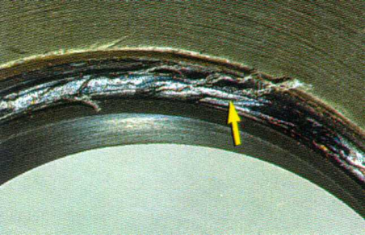
Primary lip contamination
Foreign matter
Nothing but lubricant should come in contact with the sealing lip. In this instance, too much bore sealant was applied and was forced into the seal housing. As the sealant dries it hardens on the lip and causes the seal to fail.

Slide 32
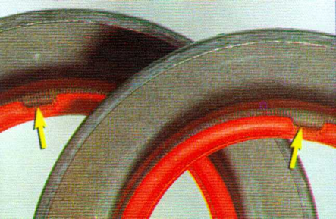
Manufacturing defects
Defects
Always inspect a new seal before installing it. While process controls have nearly eliminated manufacturing errors, not every seal maker uses them. Here, the seal lips were destroyed during the molding process.

Slide 33
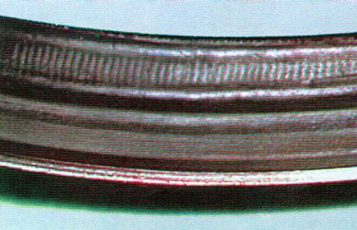
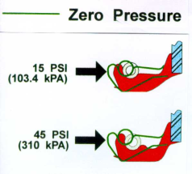
Pressure wear
Pressure wear
A heavily worn or scuffed path on the air side of the seal lip may indicate pressure buildup in the sump. Here, wear has allowed the spring to show through. Every application should be properly vented to allow heated air to escape.

Slide 34
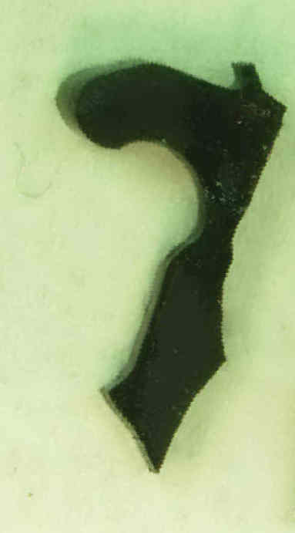
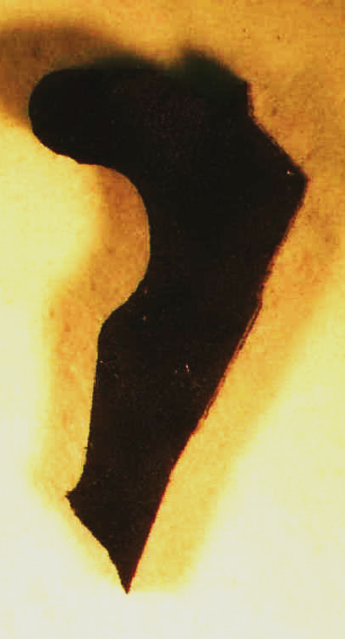
Pressure wear
Pressure wear
A cross section of the seal lip is instrumental in viewing the profile of the wear path. In the case on the left, the wear took place low on the air side of the seal and left a concaved or cupped wear track. This indicates excessive pressure for the seal design. On the right is a cross section of the same part number run the same number of hours with no pressure.

Slide 35
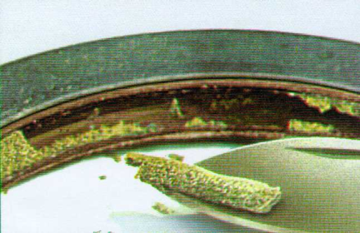
Lip contamination
Dirt and grit
Traces of metal particles or sand on the inner seal surfaces point to some type of internal contamination. An improperly cleaned casting will eventually contaminate the seals, as will failing gears or bearings. These residues collect in the spring area.

Slide 36

Primary lip bond failure
Debonding
Lip materials are bonded, or held in place, in a variety of ways. Chemicals that are incompatible with the lip material or bonding agent can cause the seal to literally come apart. Compatibility information is available from your seal suppliers.

Slide 37

Fluid compatibility
Deformation
Incompatibility between the lip material and the operating media, including lubricants, can produce major swelling of the seal material. Above is a before (1) and after (2) example of the gross damage you may see from chemical incompatibility.

Slide 38

Fluid compatibility
Chemical attack
Some chemicals, including some lubricants additives, cause sealing materials to swell and soften. Dirt and grit particles can become embedded and the lip wears rapidly. Changing from mineral to synthetic lubes can cause this problem.

Slide 39

Damaged spring
Spring damage
The garter spring should be inspected for kinks or other damage. Springs can be damaged during installation or rough handling. A damaged spring will produce an out-of-round condition and create a leak at the seal lip.

Slide 40

Missing spring
No spring
People have been known to remove the garter spring in order to make installation easier. That it does. But it also reduces the effectiveness and life of the seal. The spring can also be lost through rough handling before or during installation.

Slide 41

Dislodged spring

Slide 42

Dislodged spring

Slide 43

Wrong seal installed
Wrong part number
This mistake is easy to overlook. The seal should be checked against specifications for both size and type. Also the size of the bore and shaft should be measured accurately with a micrometer.

Slide 44

Ozone damage
Ozone damage
Excessive ozone can damage some elastomers. This is often overlooked or misdiagnosed. Typically, it is not seen unless the seal lip is flexed.

Slide 45

Shaft surface – machine lead
Machine lead
The surface of a shaft, especially a reconditioned one, may contain a nearly, or actually, invisible screw-like pattern that augers lubricant under the seal lip. Special literature exists that can provide help on eliminating machine lead.

Slide 46



Shaft surface – damage
Damage
Poor manufacturing processes or handling and installation processes can result in nicks, scrapes, axial scratches and burrs on the sealing surface.

Slide 47

Seal installed backwards
Backwards installation
Make sure that the seal lip is facing in the correct direction. This seal lip has been intentionally installed backwards because excluding the contamination is more important then containing the lubricant.

Slide 48
Re-use conclusions
  SKF does not recommend re-using seals
  If you plan on re-using seals, consider:
    Remember the entire sealing system
    Identify candidate applications
    Consider the risk of failure
    Failure / seal analysis training
    Proper inspection and measuring equipment
    Develop visual and dimensional standards and guidelines
    Design for re-use
    Maintain history based on part number AND application
    Every seal and wear surface must be evaluated individually

Slide 49
THANK YOU!

Slide 50


