Slide 1


UNCLASSIFIED
Presented to:
RAM Training Summit
Aviation Data Mining
IAW DoD Directive 5230.24, insert appropriate distribution statement
Presented by:
Scott Moyers
Program Manager
INTUITIVE Research & Technology Corp
U.S. Army Aviation and Missile Research, Development, and Engineering Center
4-5 Nov 2014
UNCLASSIFIED

Slide 2

Agenda
Definition
Why the need
Data Relationships
Elements of Data Mining
The Process
Keys to Success
Example

Slide 3
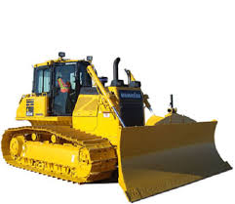
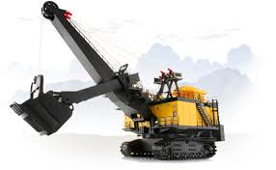
Data Mining
da·ta min·ing
  noun: Computing
  the practice of examining large databases in order to generate new information
The term data mining first appeared in the 1990s while before that, statisticians used the terms “Data Fishing” or “Data Dredging” to refer to analyzing data without an a prior hypothesis
The most important objective of any data mining process is to find useful information that is easily understood in large data sets
Notes:
In aviation sense we want to turn anecdotal information and tribal lore into quantifiable information or disprove tribal lore
-

Slide 4
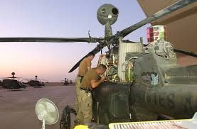
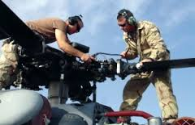
Why?
Data Mining can:
  Identify patterns or trends
  Identify failure modes
  Identify root cause
  Identify process and procedural impacts
To:
  Justify modification or redesign of a component or system
  Justify procedural modifications
  Justify/quantify BCAs
Ultimate Goal to:
  Reduce maintenance burden
  Increase aircraft availability
  Reduce scheduled maintenance events
  Rectify safety/training issues

Slide 5

The Relationships
Classes--data is mined to locate data in predetermined groups
  Aircraft Model
  Repair Activity
Clusters--data is mined to be grouped according to logical relationships
  Source of Supply
  Common Equipment or Systems
Associations--data can be mined to identify associations
  Environmental Impacts
  OEM/Vendor
Sequential Patterns--data is mined to anticipate patterns or trends
  Failure Indications/Failure Modes
  Root Cause
  Corrective Actions
Notes:
Generally any of the four types of relationships are sought
As it pertains to aviation data mining all have a function

Slide 6

The Elements
Extract, transform, and load data
  ULLS-A(E)
  SAMS-E
  SARRS
Store and manage the data in a database system
  JTDI/CAPS
  LIW
  LOGSA
Provide data access to analysts
  ASAP
  RIMFIRE
  WEBLIDB
“Mine” and Analyze the data
  The process
Present the data in a useful format
  Tables and graphs
  Reports
  BCAs
DA Form 2410
DA Form 2408-13-1
DA Form 2408-12
FEDLOG
DA Form 1352
ILAP
Phase Books
MWO and ECP
DA Form 2408-13-2
Work Order Logs
DA Form 2408-5

Slide 7
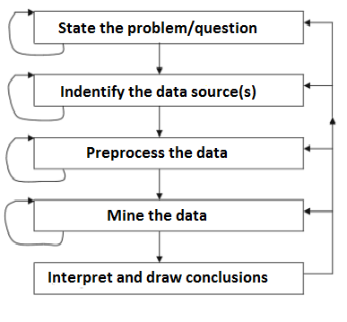
The Process
One studies the data, examines it using some analytical technique, decides to look at it another way, perhaps modifying it, and then goes back to the beginning and applies another data analysis tool reaching either better or different results. This can go around many times; each technique is used to probe slightly different aspects or data to ask (or answer) a slightly different question of the data.

Slide 8
Keys to Success
Challenges
  Multiple databases and sources
  Vague expectations
  Labor intensive
  Developing automation
  Managing expectations
Elements that make prospecting easier
  Understand the goal
  Know the available resources
  Eliminate the “white noise”
  Document the process
  Document assumptions
  Automate
DA Form 2410
DA Form 2408-13-1
DA Form 2408-12
FEDLOG
DA Form 1352
ILAP
Phase Books
MWO and ECP
DA Form 2408-13-2
Work Order Logs
DA Form 2408-5

Slide 9
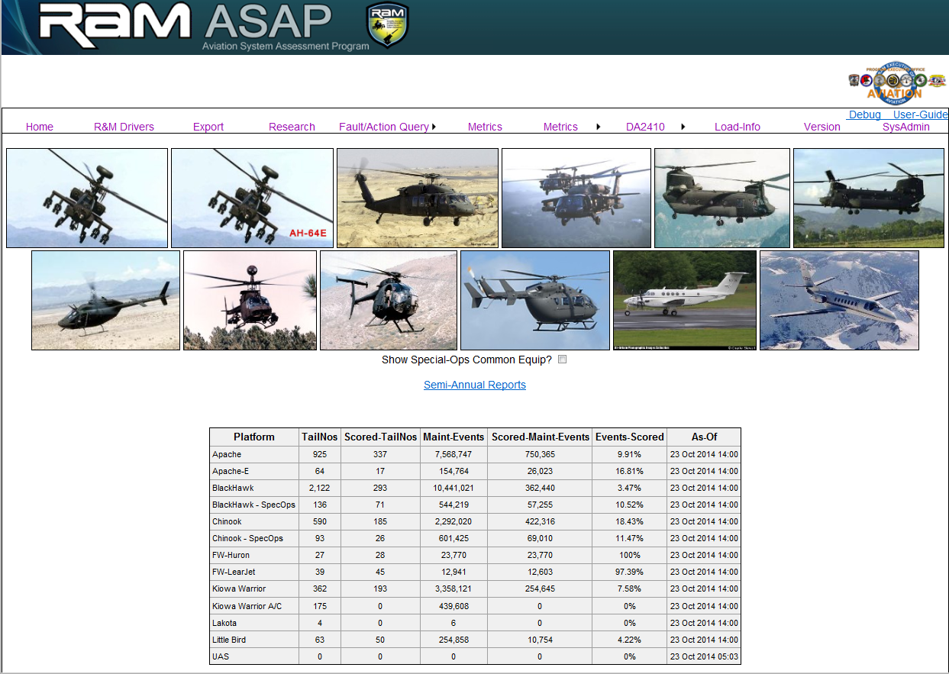
ASAP

Slide 10
Example
What are the maintenance and logistical impacts of
MWO 1-1520-271-50-10 on the fielded CH-47F population?
Does the problem/question clearly define the expectations of the analysis?
Are there available databases and resources?
Gather the data
Eliminate the “white noise”
Conduct the analysis
Report the conclusions

Slide 11
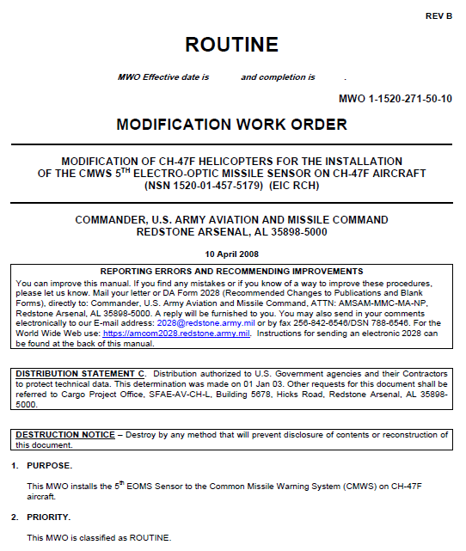
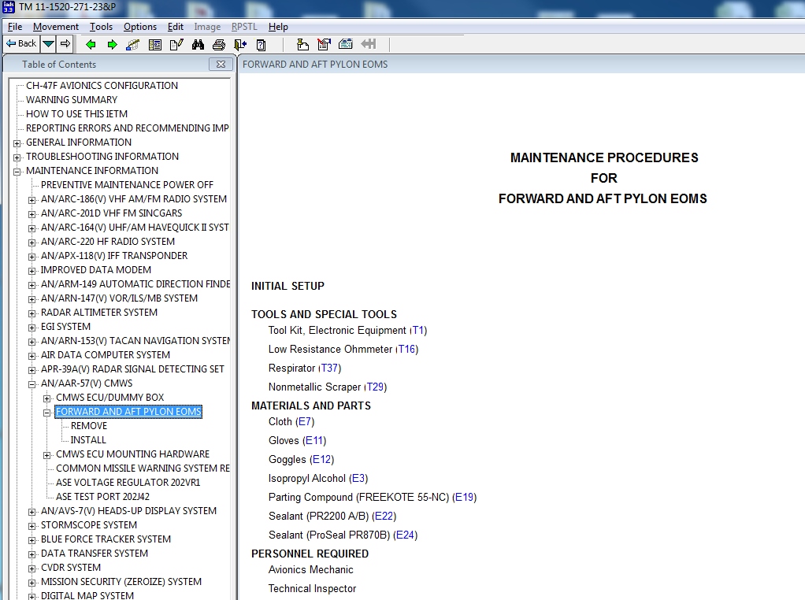
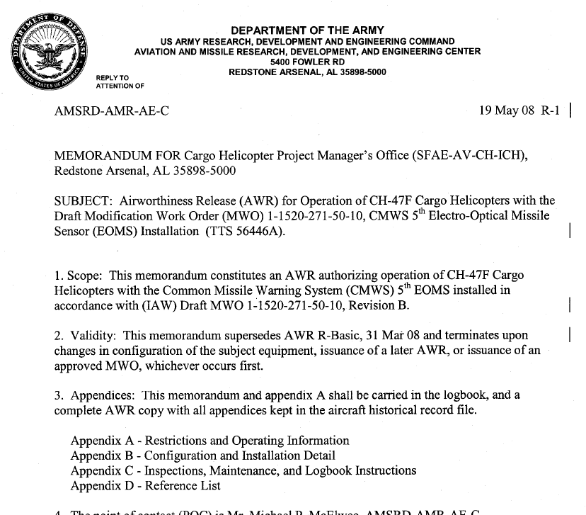
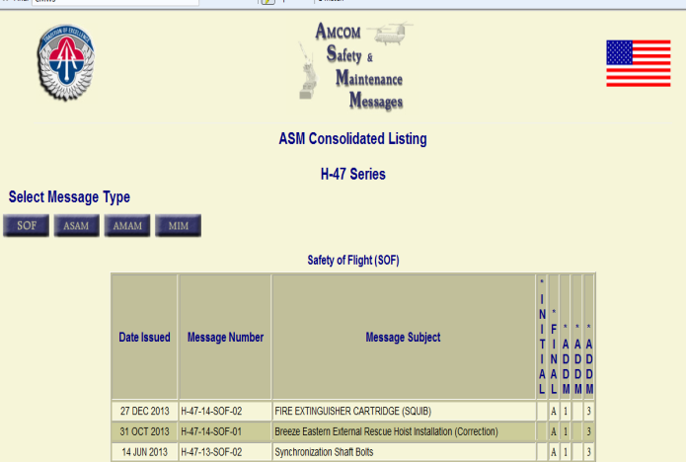
Maintenance Sources
Defines maintenance requirements:
Personnel
Skill sets
Special tools/test equipment
Expendables
Scheduled maintenance requirements
Maintenance Allocation
  MMH
  Level

Slide 12
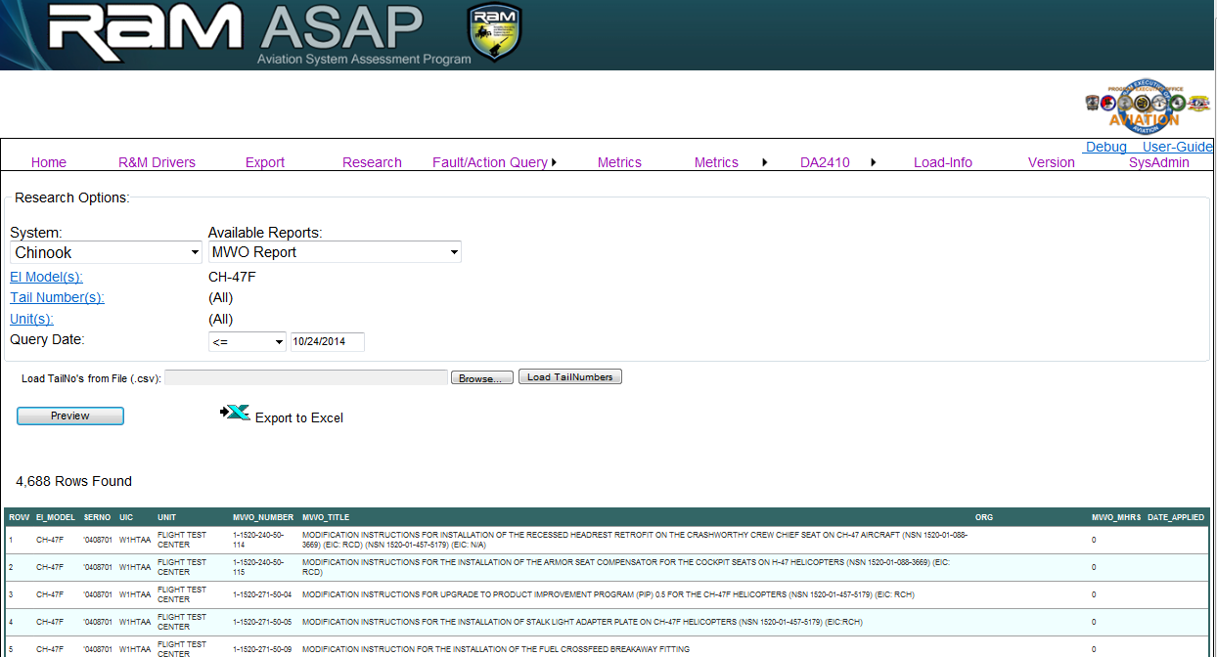
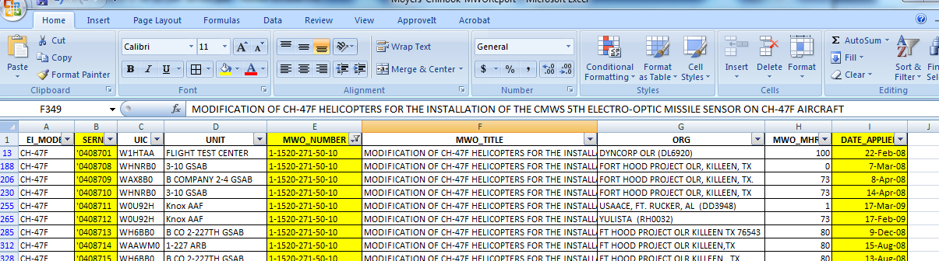
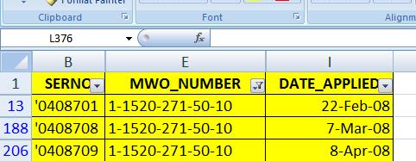
Reliability Data
Source:
DA Form 2408-5, Equipment Modification Record
ULLS-A(E) Aircraft Historical Record
Data:
Aircraft serial number
Date of MWO application

Slide 13
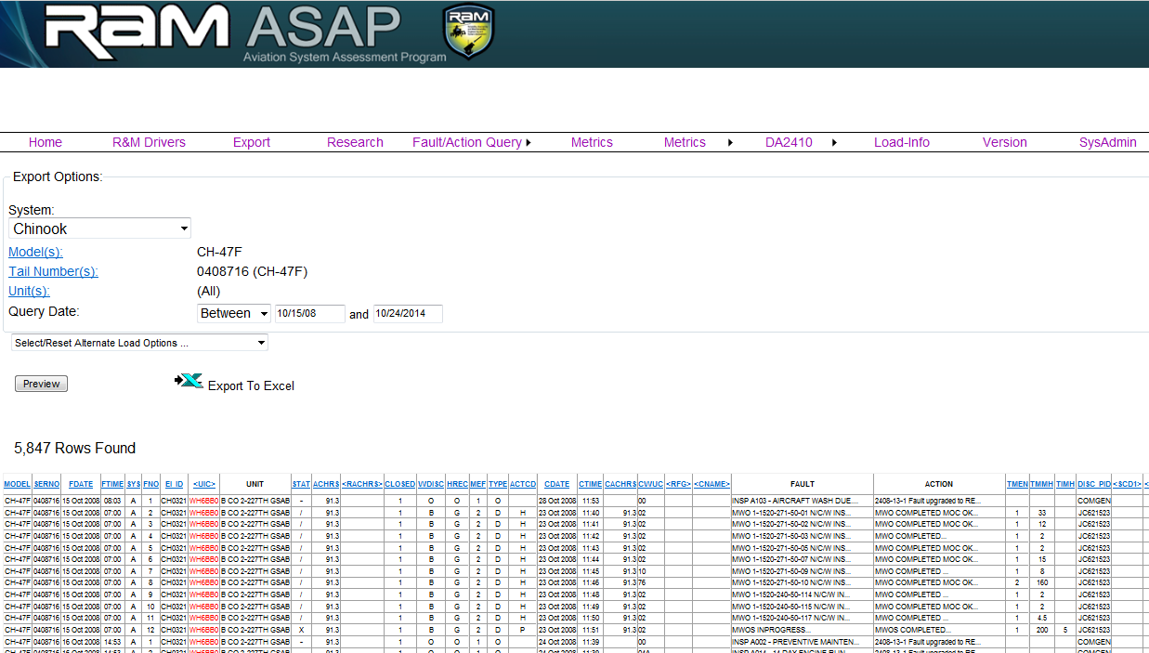
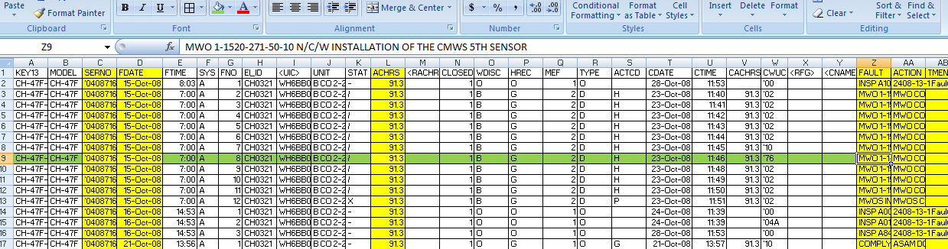
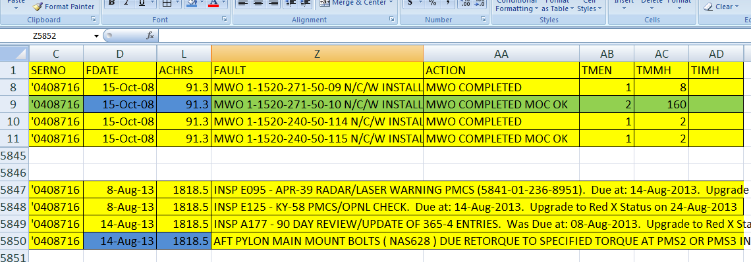
Reliability Data (cont)
Source:
DA Form 2408-13-1, Aircraft Inspection and Maintenance Record
ULLS-A(E) Aircraft Logbook Records
Data:
Total installed aircraft hours
System/component faults
Component(s) replaced/repaired
MMH to replace/repair

Slide 14
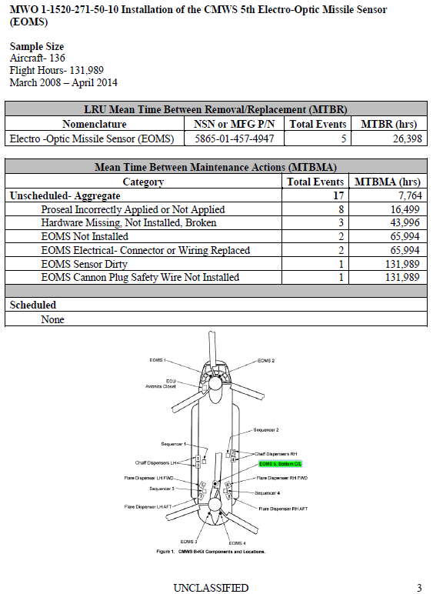
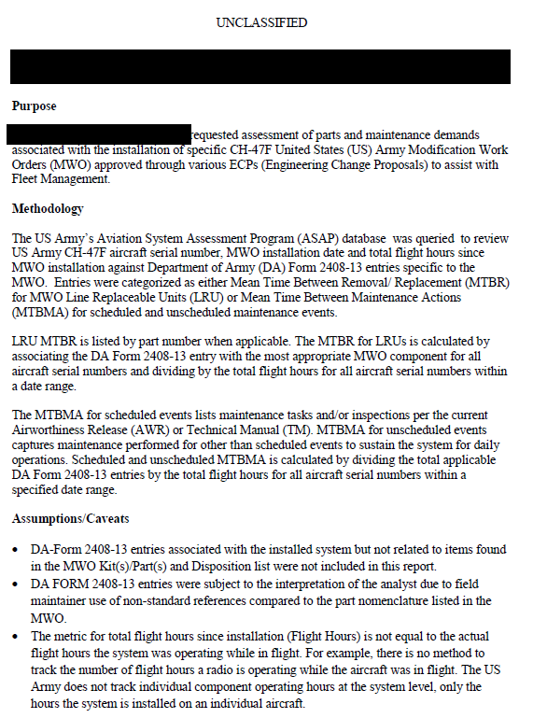
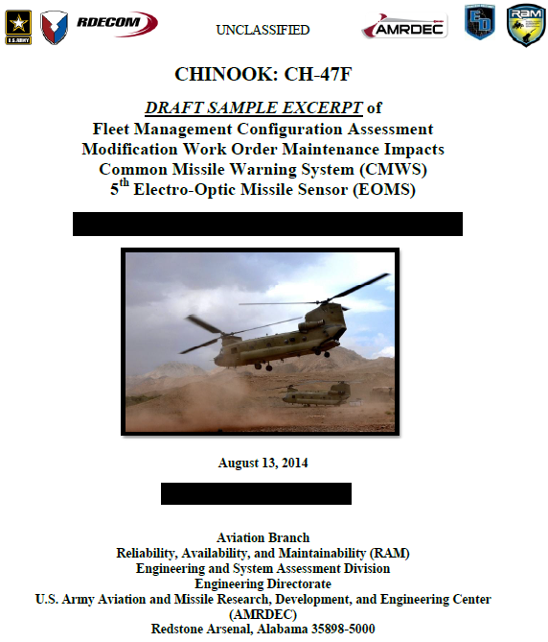
Report
Executive summary
States the purpose
Clearly defines methodology and sample size
Defines databases and source documents
Documents assumptions and caveats
Concisely responds to the problem/question

Slide 15
Other Examples
OH-58D Main Rotor Blade
  Identified low to no-cost training and procedural changes
OH-58D FADEC
  Identified specific unit training issue
UH-60 Main Rotor Damper
  Identified poorly performing repair activity
CH-47 Hinge Pin
  Identified ineffective maintenance procedure
AH-64 Generator Seal
  Identified vendor issues
UH-60 MFD
  Identified reliability issue that led to vendor modification

Slide 16

Summary
  Manage expectations
    Time consuming
    Labor intensive
  Understand the goal
    Will define the depth of the mine
  Know the available resources
    Gather all resources before you start mining
  Eliminate the “white noise”
    Reduce the raw data to pertinent information
    Never delete
  Document the process and assumptions
  Report concisely
  Automate
    The question will come up again

Slide 17



