Slide 1


UNCLASSIFIED
Presented to:
Society of Reliability Engineers
Huntsville Chapter
PROTOCOL+
Product Reliability On-Line Tools Collection +
Distribution authorized to DoD and DoD contractors only; Critical Technology; August 2001. Other requests for this document shall be referred to the U.S. Army RDECOM, ATTN: RMDR-WDS.
Presented By:
Jessica Glover
jessica.t.glover.civ@mail.mil 256.876.2781
RAM Engineering and Systems Assessment Division
Aviation and Missile Research,
Development and Engineering Center
14 October 2014
UNCLASSIFIED

Slide 2
PROTOCOL+
Corporate knowledge
Continuous improvement
Visibility
PROTOCOL+ = Knowledge for the AMRDEC RAM Division

Slide 3
PROTOCOL+ Purpose
PROTOCOL+ is primarily intended to capture corporate knowledge
  Loss of key personnel
  Misplaced documentation
  Prevent reinvention of the wheel
PROTOCOL+ captures key information specific to the Reliability, Availability, Maintainability (RAM) Engineering and System Assessment Division
  Documentation, plans, reports, briefings, real-world numerical examples and “Go-By’s”
PROTOCOL+ also provides common tools and resources
  Standard references, handbooks, tutorials, tools, etc.
PROTOCOL+ provides visibility and continuous improvement to guidance
  Everyone in the division is constantly updating examples, content, etc.
  Most important items are always “on top” so they are not forgotten
PROTOCOL+ is NOT intended for everything
  PROTOCOL+ is not a general purpose filing system

Slide 4
Assessing PROTOCOL+
PROTOCOL+ is a web-based application used by the AMRDEC RAM Division
Click the desired tab
  If necessary, select the desired function from the drop-down box
See following charts for a brief overview of available functions
Every page has a “Help” button
  Detailed instructions provided for each PROTOCOL+ function
Sources tab is a good place to start
  Almost everything in PROTOCOL+ can be found under “Sources”

Slide 5
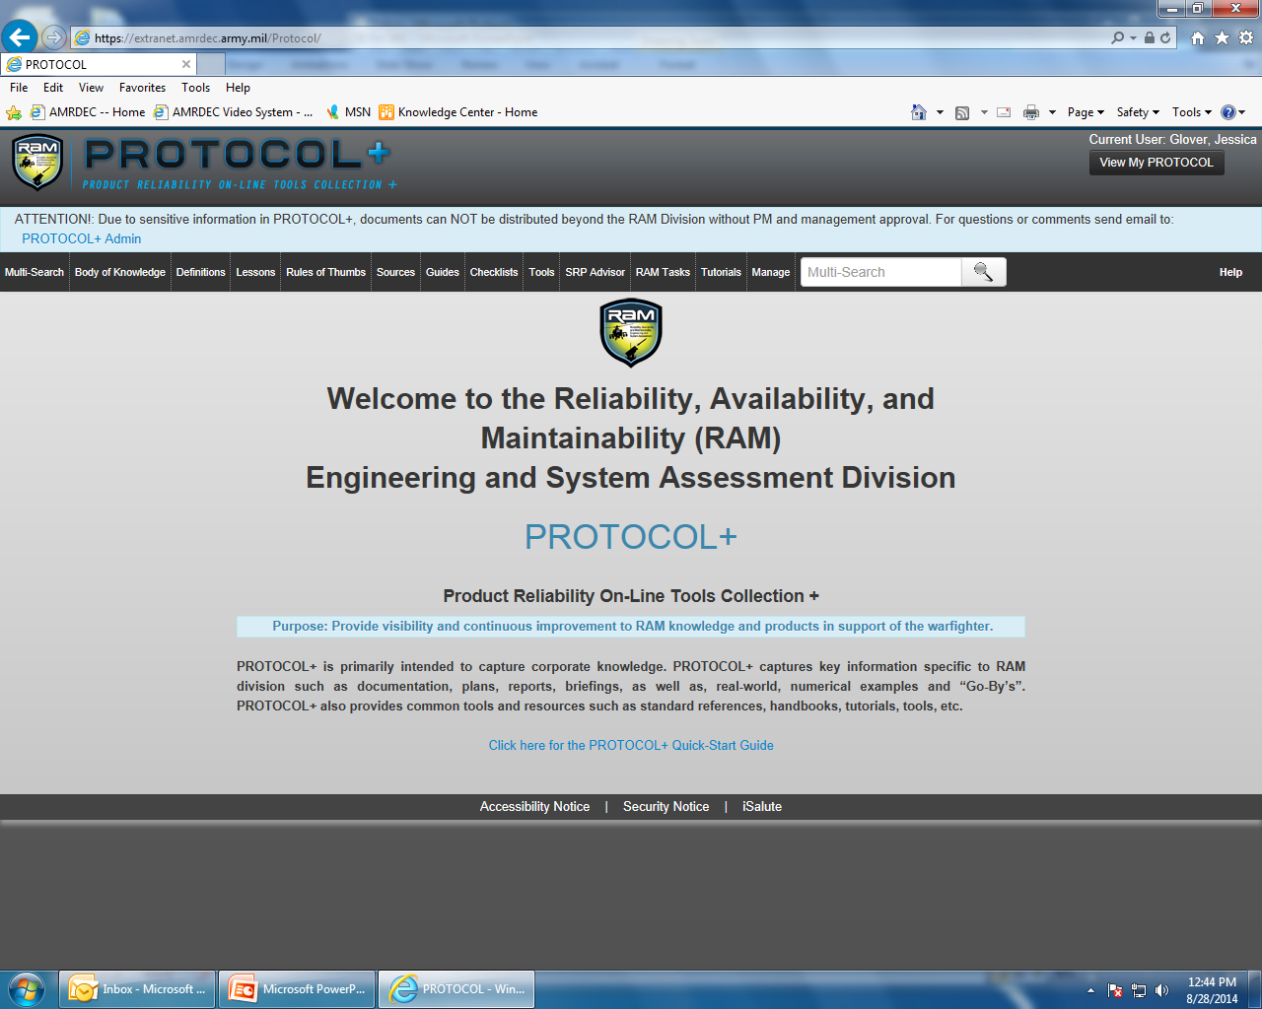
PROTOCOL+ Welcome Screen

Slide 6
PROTOCOL+ Overview
Multi-Search
  Allows for searching all areas simultaneously
Body of Knowledge
  Top-down guide to most useful information
  Ability to drill down to specific topics
  Easily updated and expanded
  Need to fill in more content (you can help)
Definitions
  Important RAM Definitions and references the source for the definition

Slide 7
PROTOCOL+ Overview
Lessons
  Informative lessons from previously developed systems & equipments
Rules of Thumbs
  RAM insight from previously developed systems & equipments
Sources
  Every document in PROTOCOL+
    Reports, Excel Spreadsheets, PowerPoint
  Specific examples
  Customized searches

Slide 8
PROTOCOL+ Overview
Guides
  Short list of key RAM documents
  Each person can customize
  Just a list; Can’t drill down
Checklists
  Helps to ensure consistency and completeness
  Lays out tasks to be done according to lifecycle phase
Tools
  Simple tools that you might need
  Can be expanded in the future

Slide 9
PROTOCOL+ Overview
Stockpile Reliability Program (SRP) Advisor
  Understanding SRPs by stepping through a number of areas of knowledge.
RAM Tasks
  RAM Tasks provides recommended RAM statement of work (SOW) tasks based on selected criteria.
Tutorials
  PROTOCOL+ is intended for the beginner, as well as, the experienced Reliability engineer.
  Contains RAM presentations, RAM class material, and videos.
MyPROTOCOL
  Your own list of documents, guides, tools, etc. that YOU use

Slide 10
PROTOCOL+ Conclusion
PROTOCOL+
In-House Tool for the AMRDEC RAM Division
Contains sensitive data that should NOT be shared outside the RAM Division
Used for approximately 6 months and gaining popularity.
BOTTOM LINE:
PROTOCOL+ (or similar tool) may benefit your company.

Slide 11
PROTOCOL+ Overview
Back up Charts

Slide 12
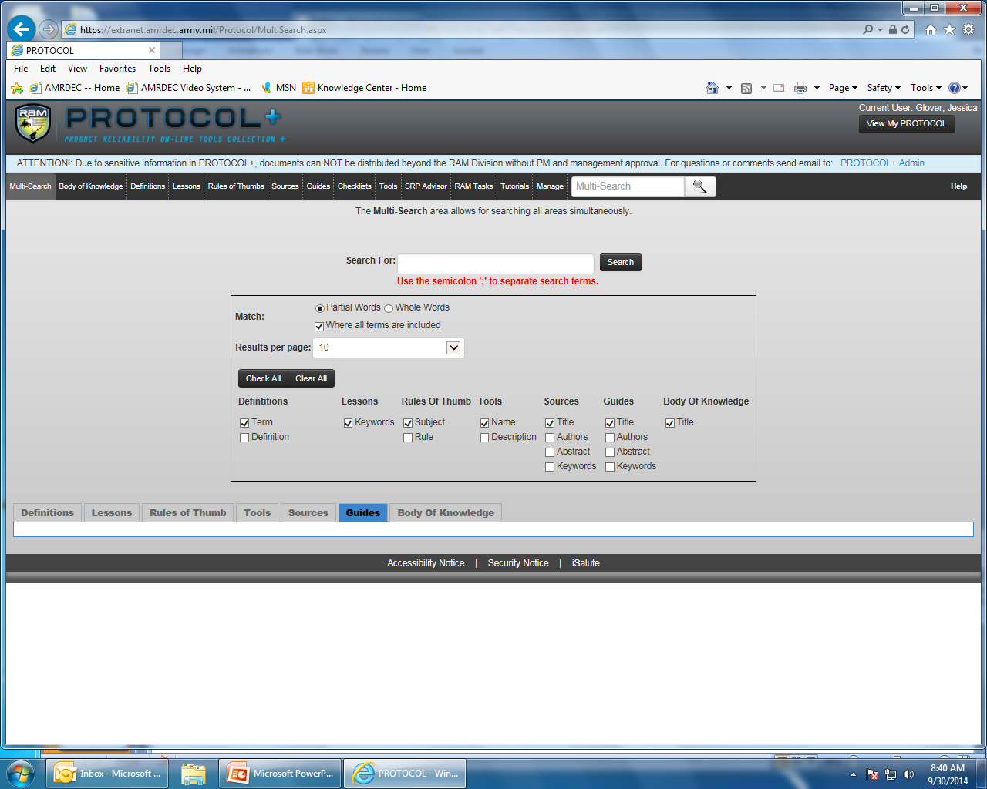
PROTOCOL+ Overview

Slide 13
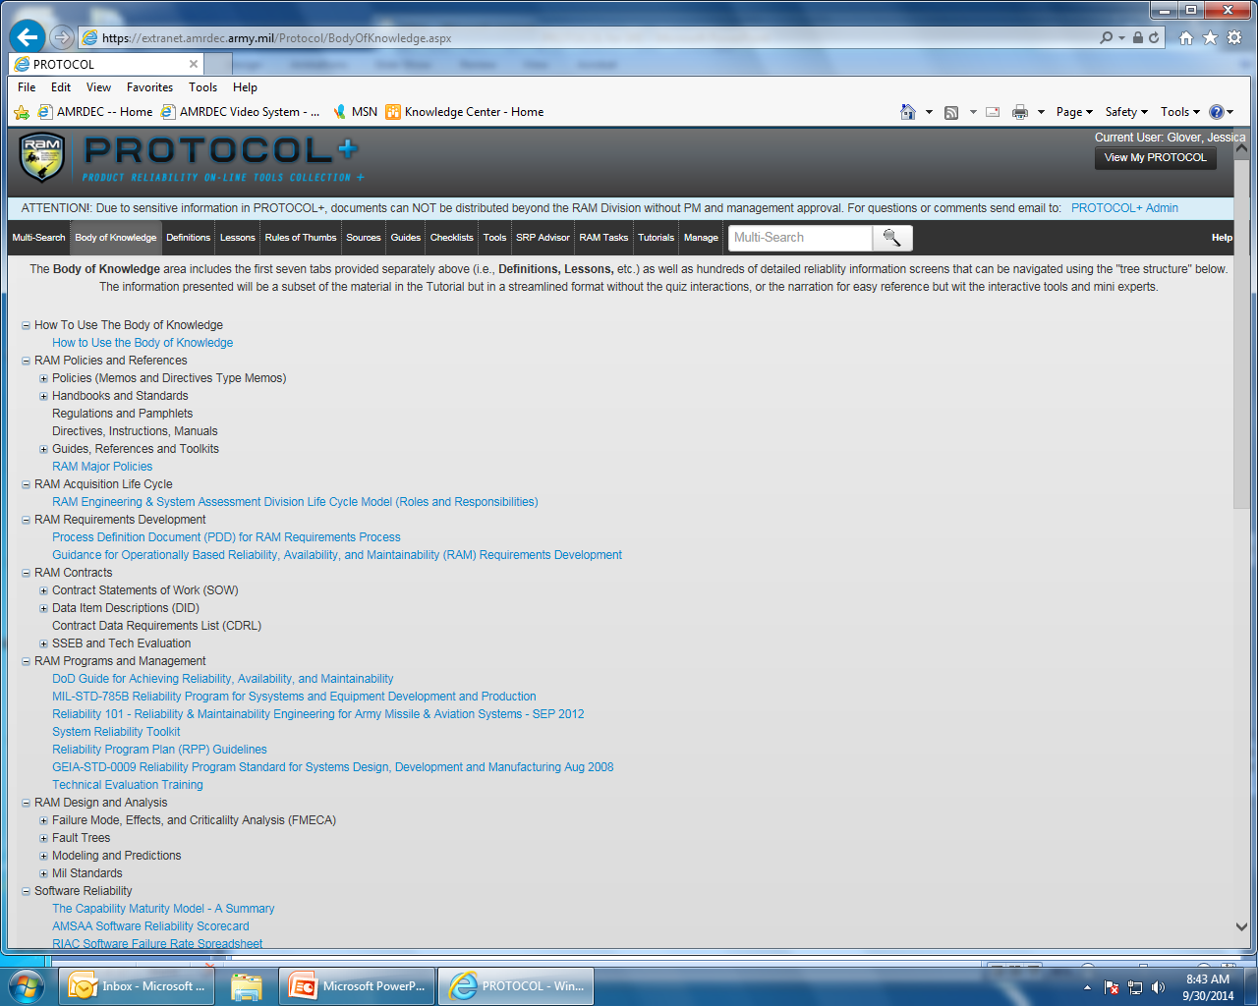
PROTOCOL+ Overview

Slide 14
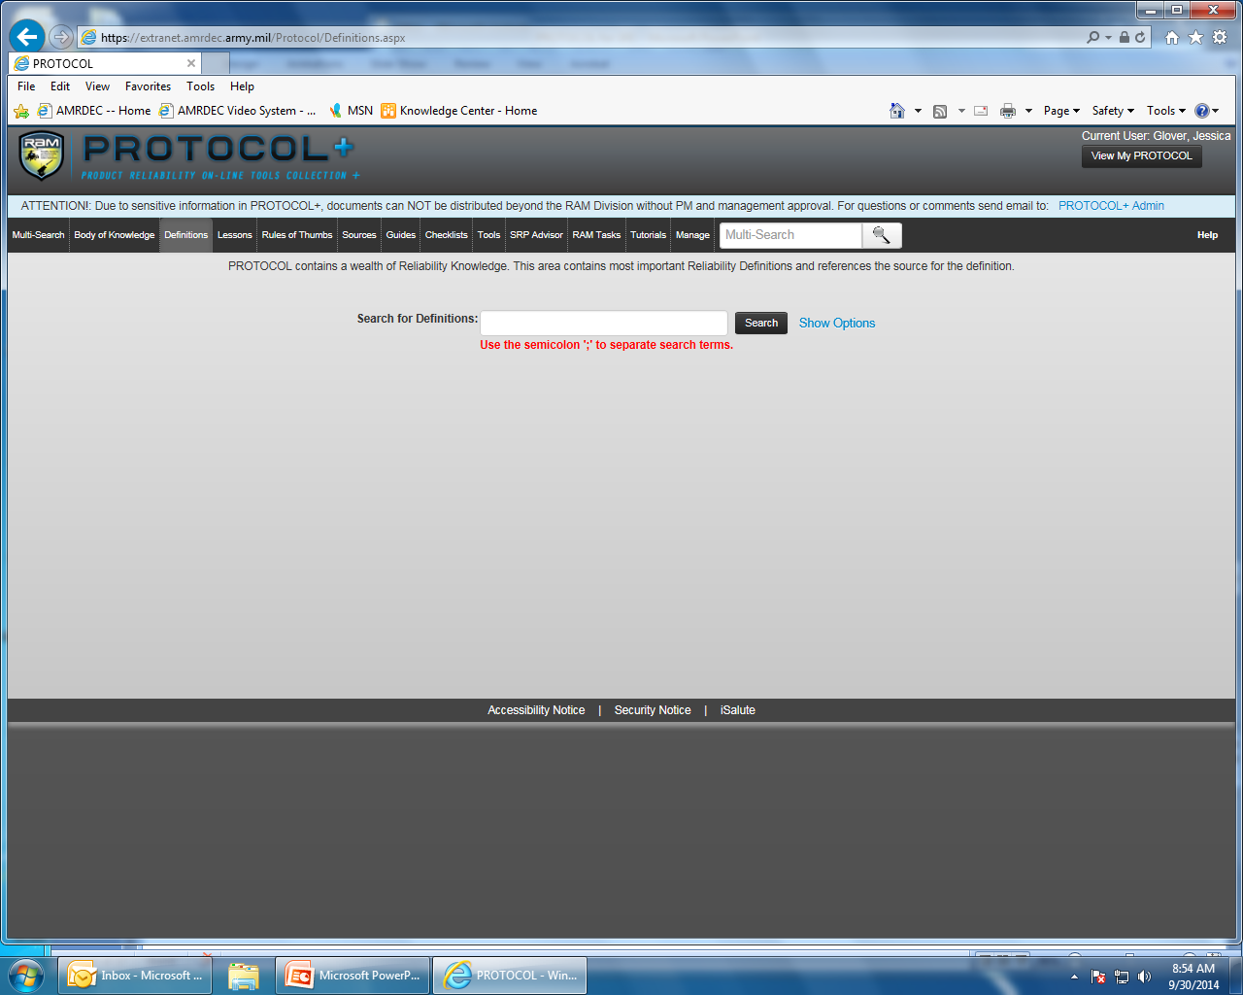
PROTOCOL+ Overview
NOTE: Definitions, Lessons, and Rules of Thumb have this screen.

Slide 15
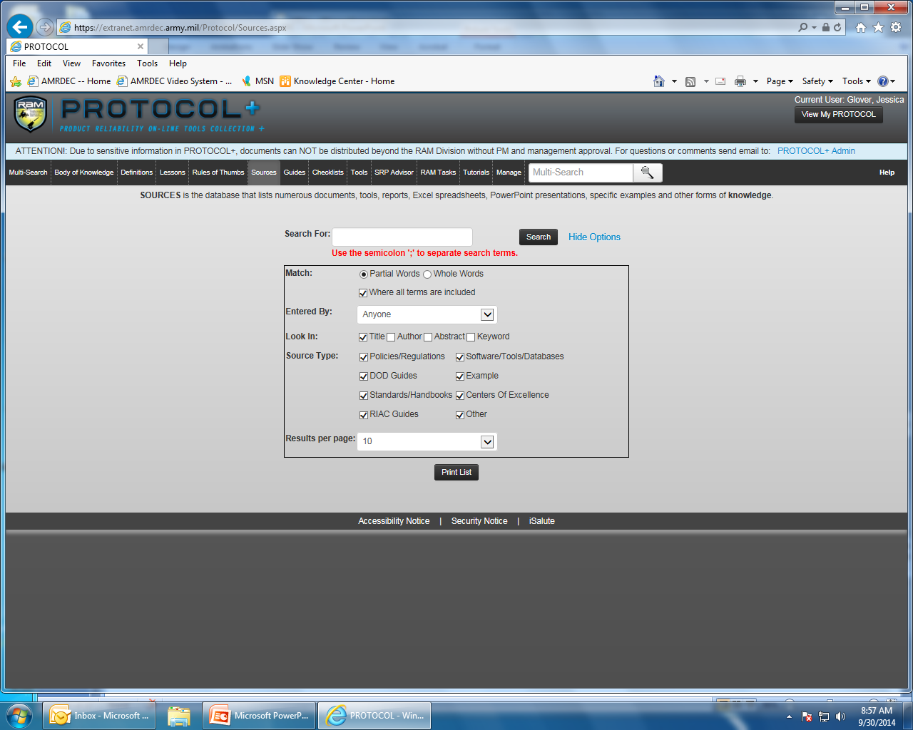
PROTOCOL+ Overview

Slide 16
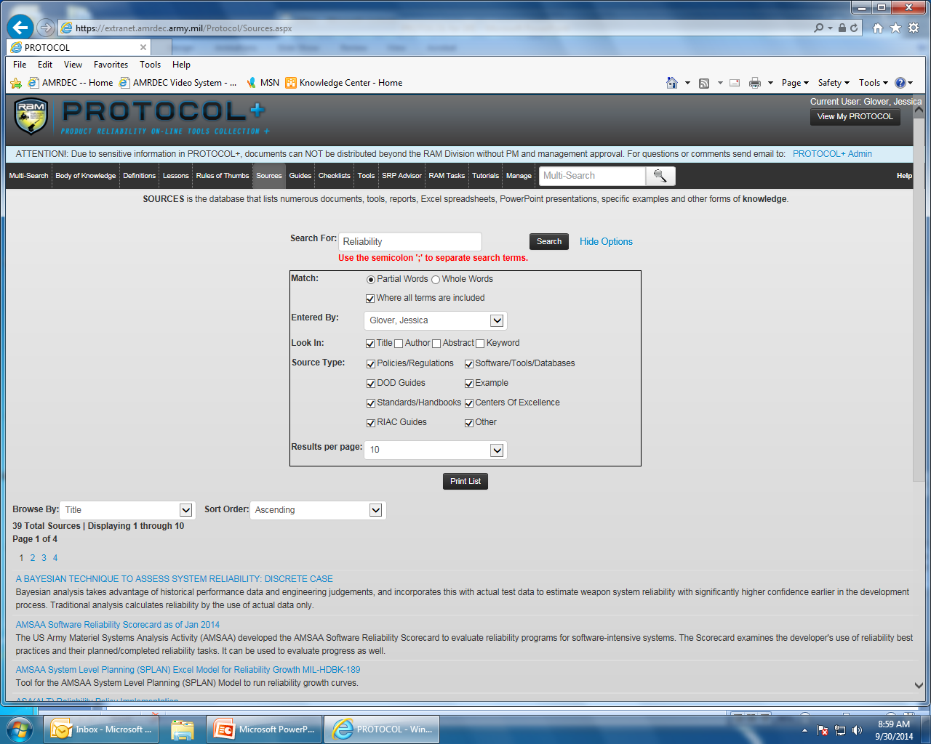
PROTOCOL+ Overview

Slide 17
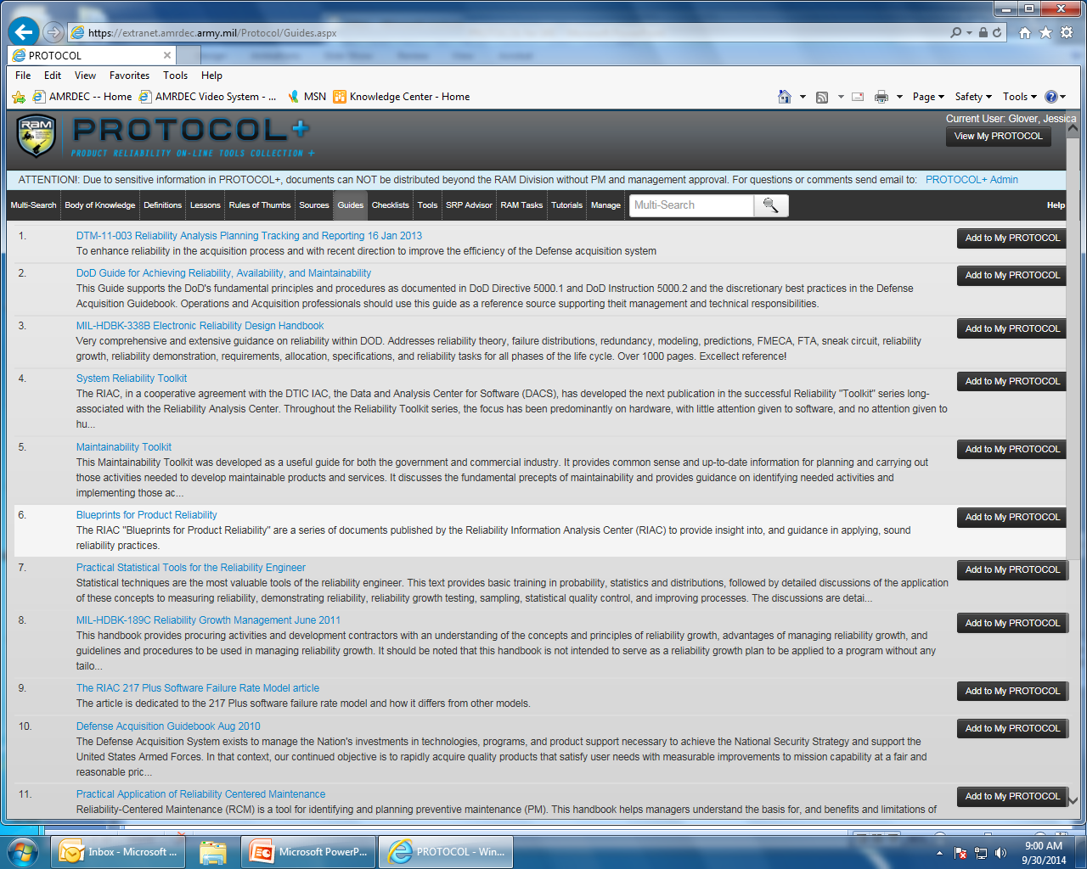
PROTOCOL+ Overview

Slide 18
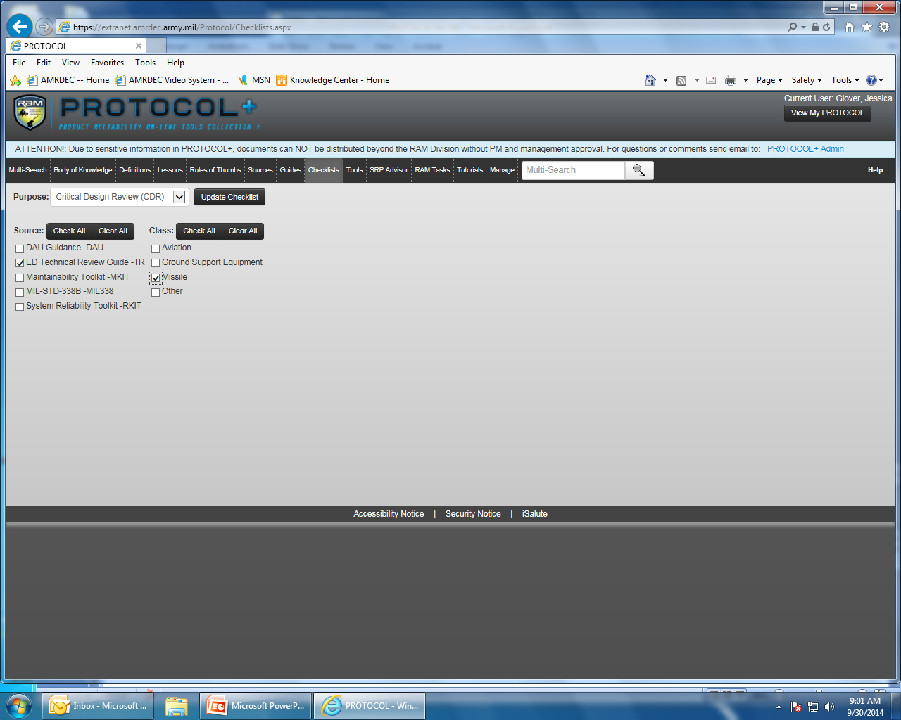
PROTOCOL+ Overview

Slide 19
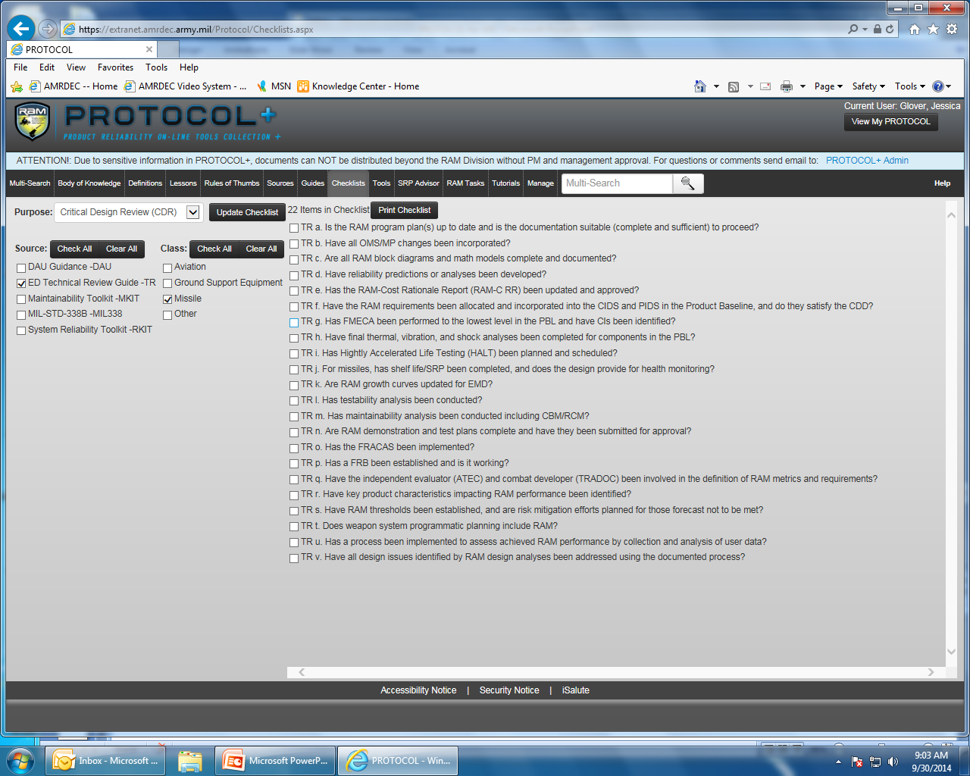
PROTOCOL+ Overview

Slide 20
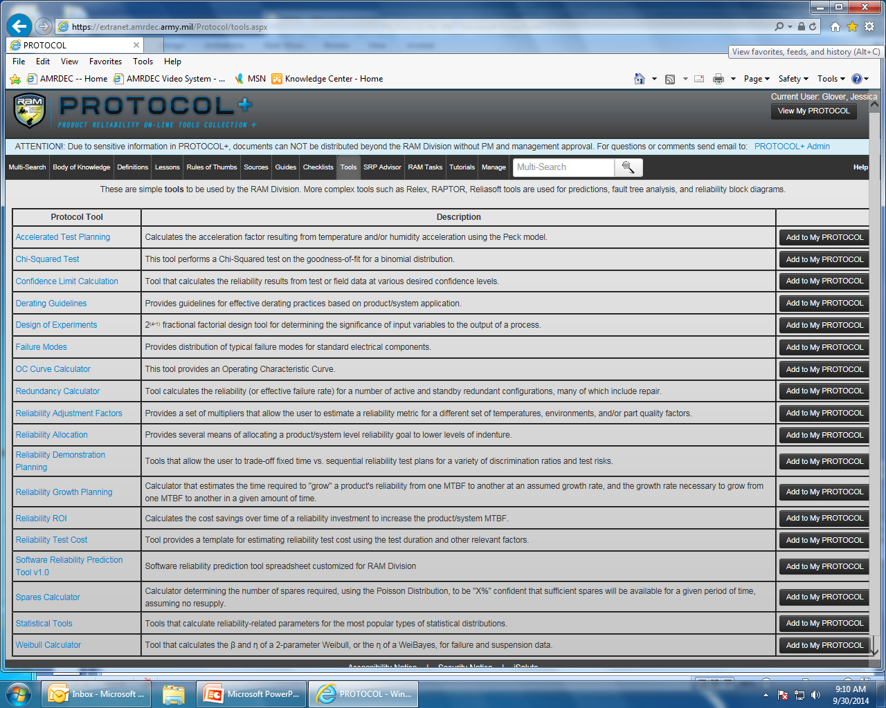
PROTOCOL+ Overview

Slide 21
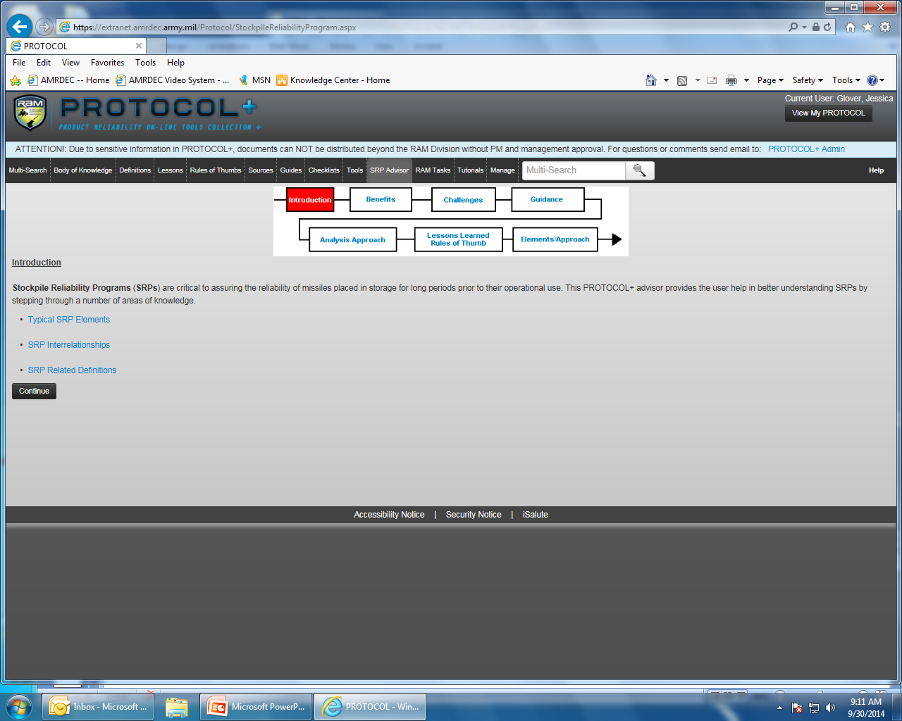
PROTOCOL+ Overview

Slide 22
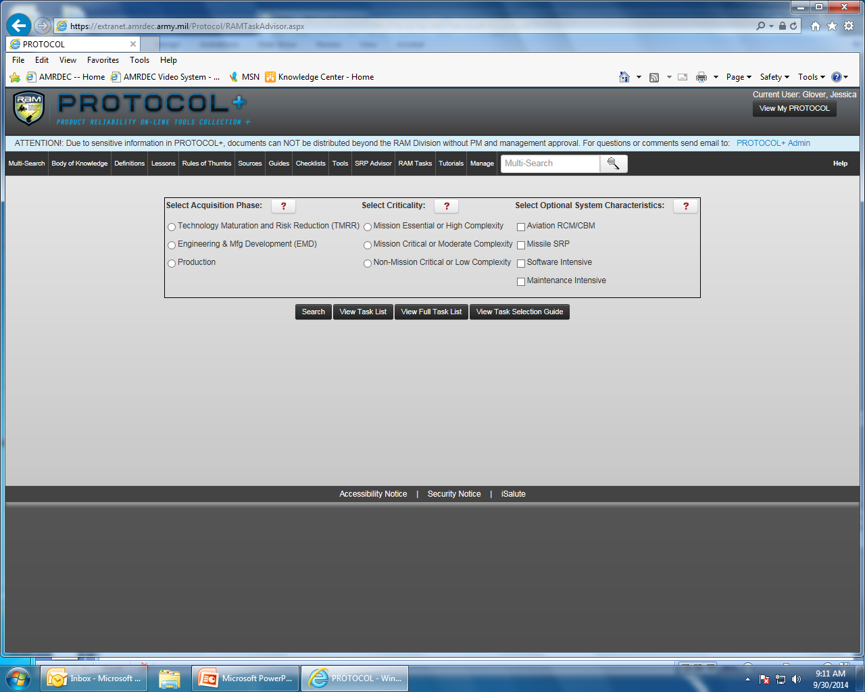
PROTOCOL+ Overview

Slide 23
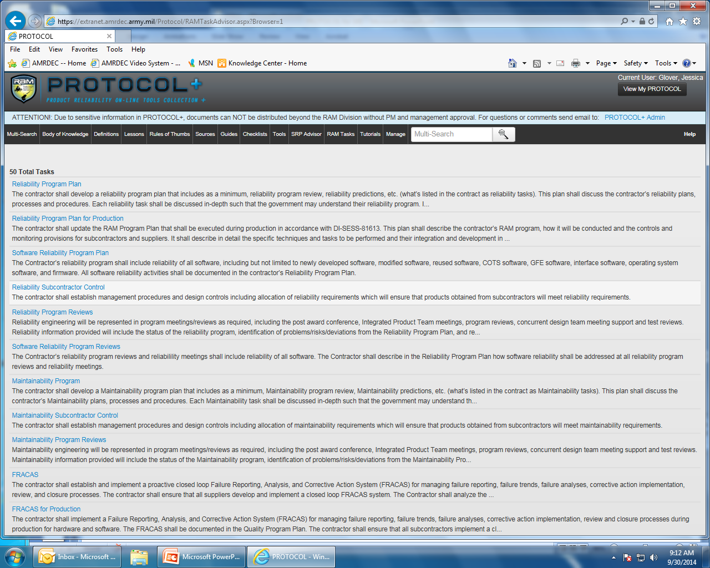
PROTOCOL+ Overview

Slide 24
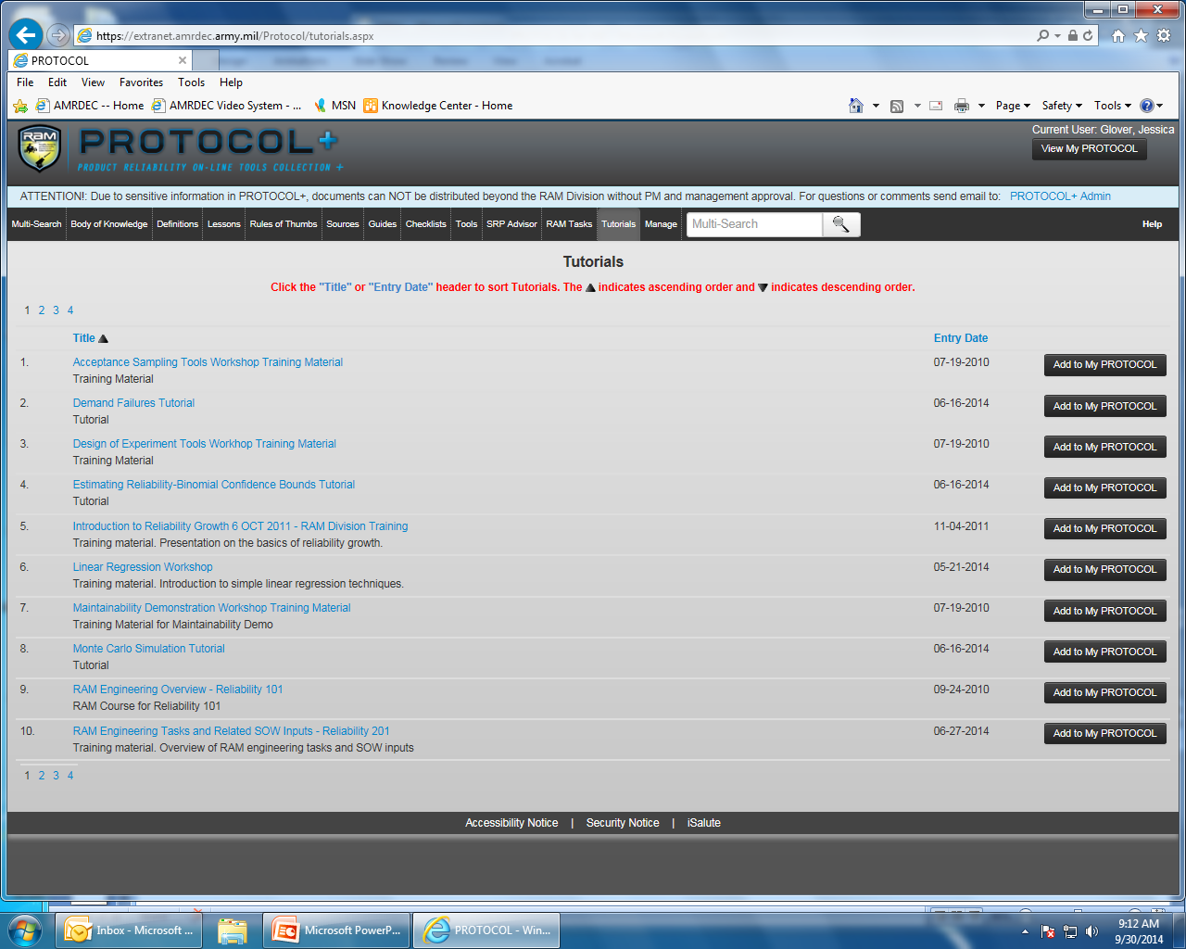
PROTOCOL+ Overview

Slide 25
PROTOCOL+ Overview
Questions????

Slide 26
PROTOCOL+ Overview

