Slide 1


Operations Support and Sustainment Technologies Phase II (OSST-II) and Transition
RAM VIII Training Summit
Society of Reliability Engineers – Huntsville
Huntsville, AL November 2015
This research was partially funded by the Government under Agreement No. W911W6-11-2-0003 . The U.S. Government is authorized to reproduce and distribute reprints for Government purposes notwithstanding any copyright notation thereon. The views and conclusions contained in this document are those of the authors and should not be interpreted as representing the official policies, either expressed or implied, of the Aviation Applied Technology Directorate or the U.S. Government.
Distribution Statement A: Approved for Public Release; distribution is unlimited

Slide 2
Presentation Outline
The OSST-II Projects
    Electrical System
    Propulsion System
    Vehicle Management System
Transition Development
    The Multifunctional Lubrication Monitoring System
Summary
Acknowledgements

Slide 3
OSST-II Overview
Objective: Transition OSST II Enabling Technologies to Modernize Rotorcraft Platforms – CBM Capable
OSST-II program focuses on providing the technologies and transition capability to extend CBM capabilities on current and future Army products.
Technologies demonstrated on the AH-64 (VMS and Electrical) and AH-6 MELB (Propulsion)
Technical Objectives:
Three thrust areas to a Technology Readiness Level (TRL) 4
  Industry participation – Leverage SBIR and IRAD Funded strategic enablers
  Army Focus for demonstration and integration into current and future platforms
Enable 2013-2018 follow-on maturity to TRL6
Transition Production path to Army rotorcraft platforms

Slide 4
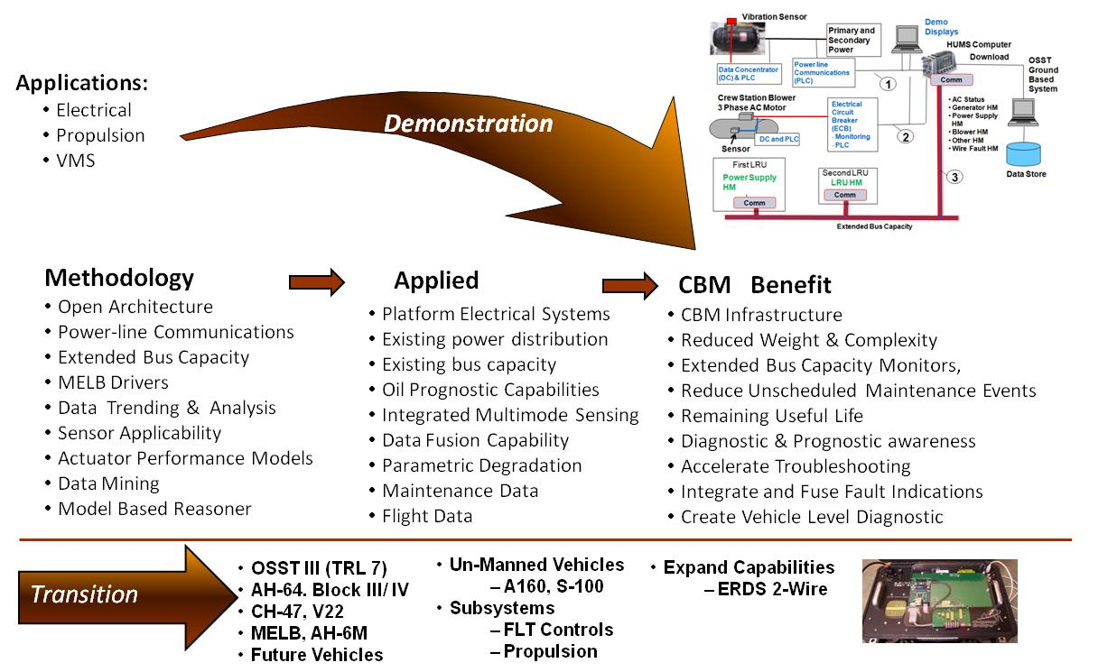

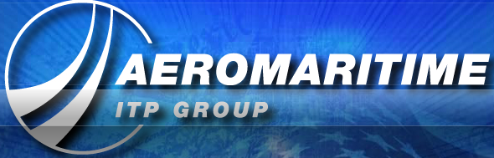
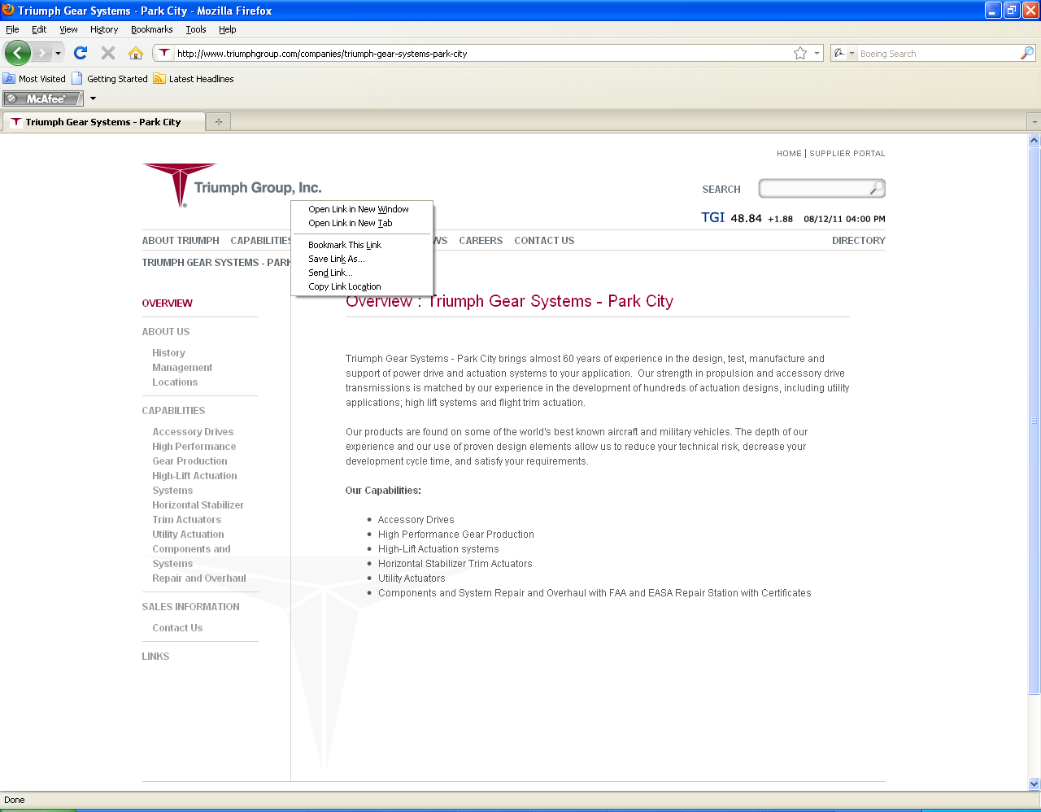





OSST-II Applications
Team:

Slide 5
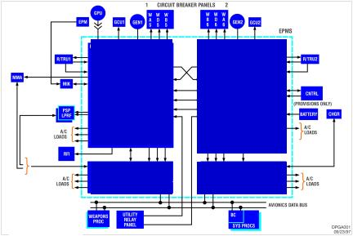
OSST-II Electrical System
Aircraft Electrical System
Technologies
CBM+
Power Line Communications (PLC)
Smart Sensor Interface to PLC
ECB HM Data Acquisition
Single Wire Power, Control & HM
Extended Bus Capacity
Wire Fault
Affordable,
Pervasive
Diagnostics
And
Prognostics
+
=

Slide 6
OSST-II Propulsion System

Slide 7
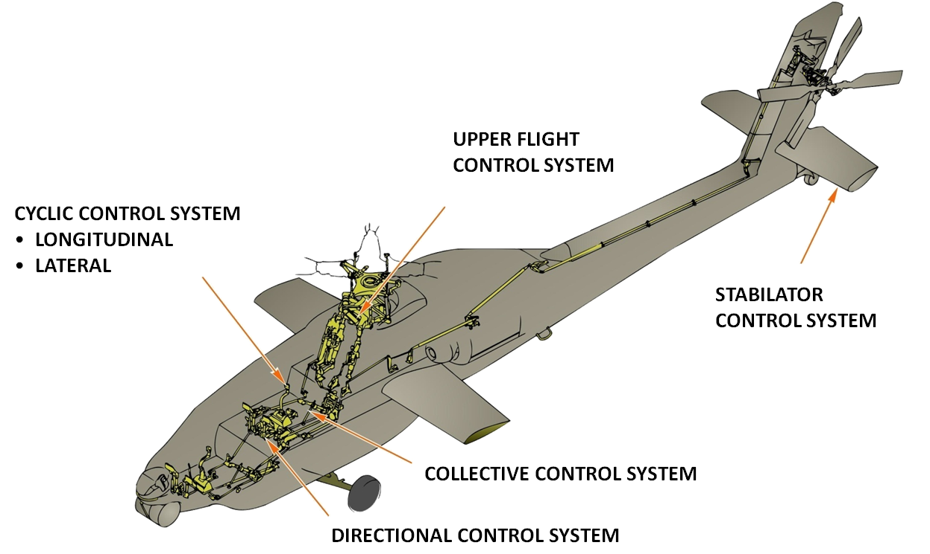
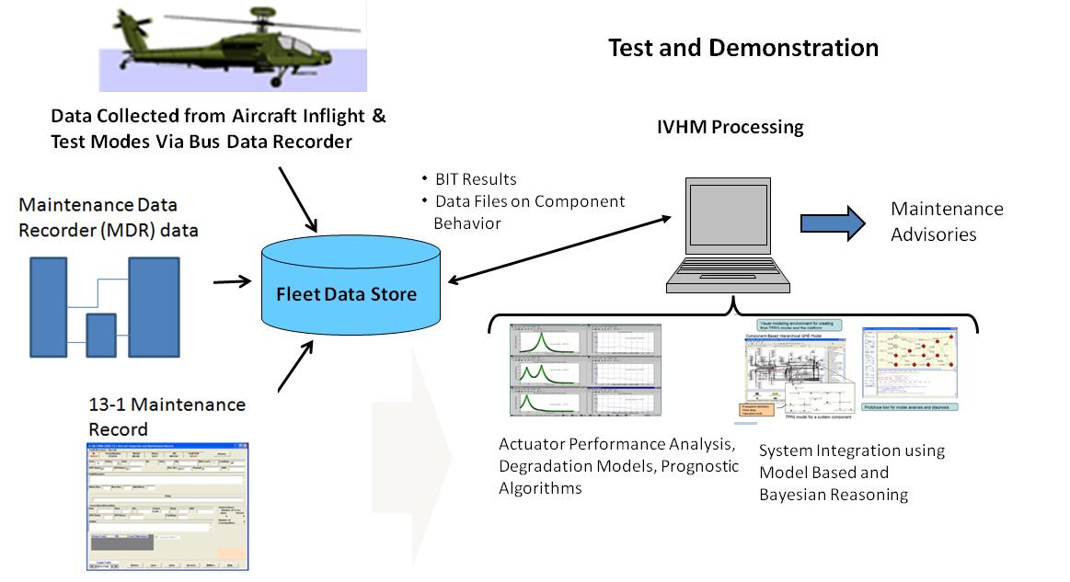
OSST-II Vehicle Management System
Mechanical Flight Controls
Horizontal Stabilator Control System
Data Analysis

Slide 8
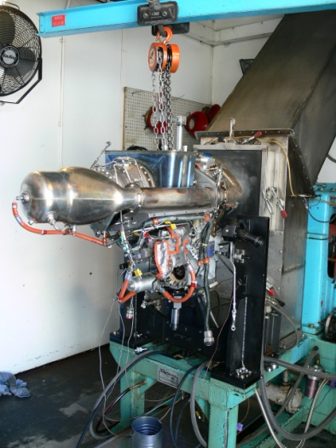
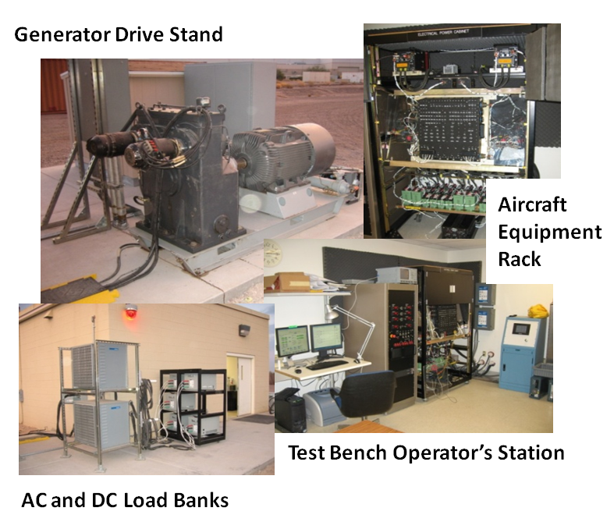
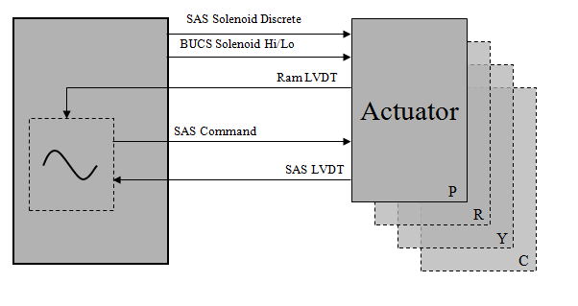
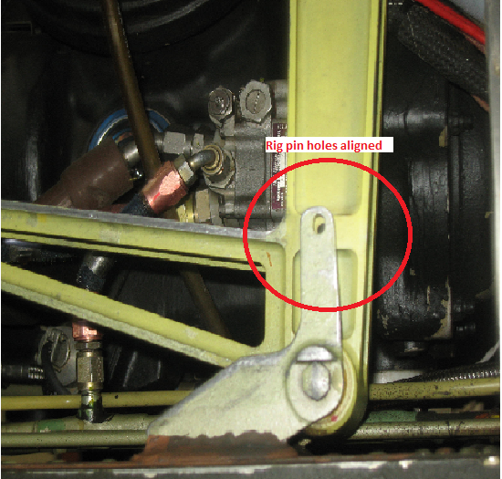
OSST-II Readiness Level TRL-4
Demonstrations
Propulsion
System Effort:
Electrical System Effort:
VMS System Effort:

Slide 9
OSST-II Program Supporting Follow-On
Specific Capabilities
Drive System / Propulsion Objectives:
  Improved Planetary Gear and Bearing Failure Detection: isolate faults within the planetary system for improved failure detection.
  Reduced Weight of the CBM System: develop methods to reduce the size and weight impact, or increase capability without increasing the size and weight.
  Interim Power Rating Methodology: develop a methodology that allows operations above the maximum continuous rating for limited periods of time.
  Integration of the Technology into the AH-64 Architecture: integrate all of the developed technologies into the AH-64 architecture and demonstrate.
Improved Planetary Gear and Bearing Failure Detection:
Reduced Weight of the CBM System:
Interim Power Rating Methodology:
DEMO
Integration of the Technology into the AH-64 Architecture:

Slide 10

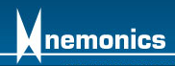


Transition Overview
Technologies and methodologies to enable more efficient designs and reduce the maintenance burden for current and future vertical lift aircraft
Enable design methodologies that leverage monitoring technologies to:
  Reduce Weight
  Improve Life
  Optimize Performance
  Reduce Maintenance Burden
Team:

Slide 11
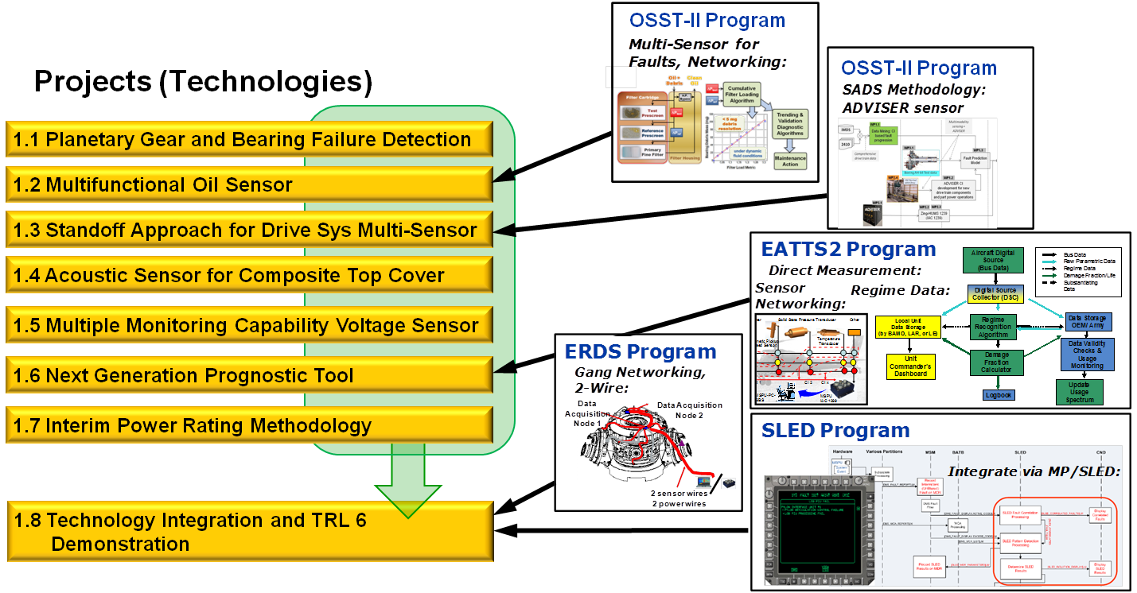
Applications
Leveraged OSST and Technologies
Sponsored by AATD, RAM, Apache PMO
Technologies:

Slide 12
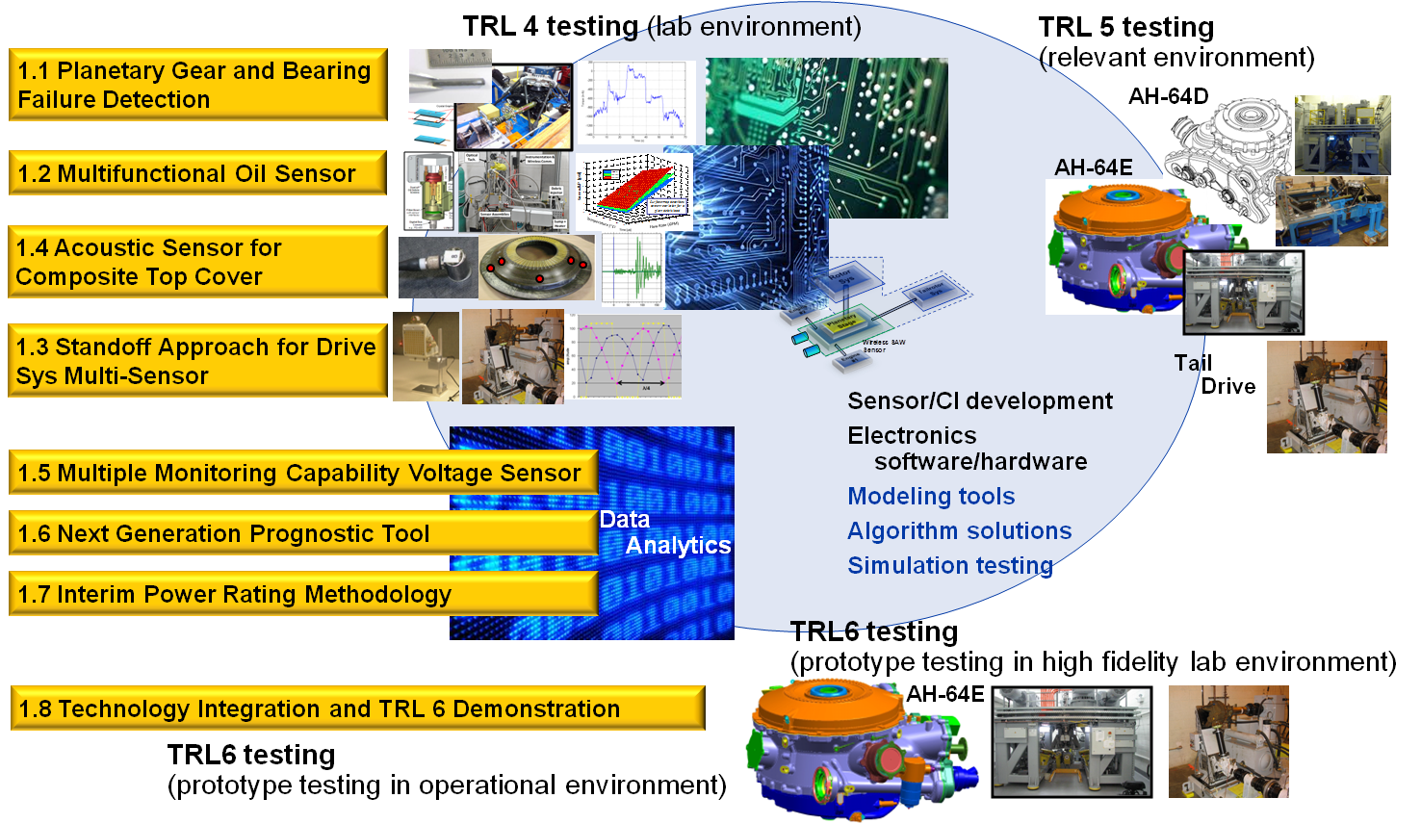
Propulsion - Drive System Supporting

Slide 13
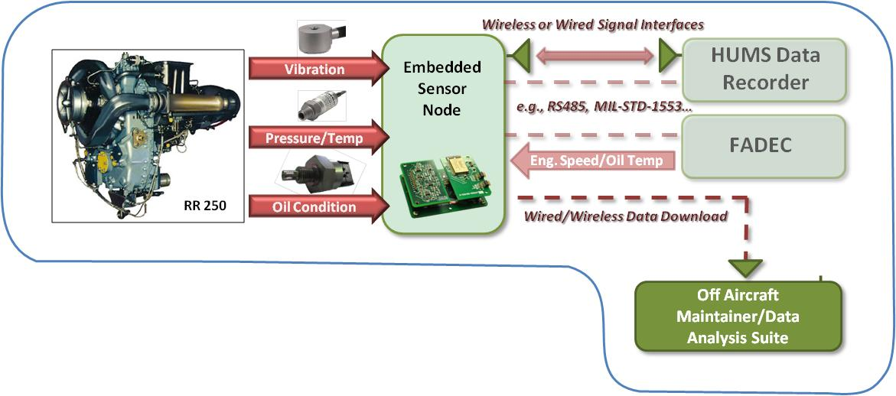
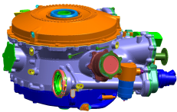
Multifunctional Lubrication Monitoring System
Improved lube system monitoring coverage enhances state awareness and provides basis for effective CBM
    Lube effectiveness and RUL, condition change
    Physical oil parameter measurement can also feed other monitoring strategies
OSST-II
AH-6 MELB
ECU
AH-64-E Model

Slide 14
Introduction
Propulsion and drive systems require lubricating oil to reduce friction, reject heat, and prevent corrosion
Lube system maintenance can be significant cost driver
  Routine offline oil analysis and other lube system scheduled maintenance
  Oil leaks and metal contamination are most common removal reasons
Improved lube system monitoring coverage enhances state awareness and provides basis for effective CBM
Under U.S. Army Operations Support and Sustainment Technology Phase II (OSST-II) 6.2 Program, team developed lube system sensor suite targeting wide range of degraders
  A/H-6 Mission Enhanced Little Bird (MELB) platform
  Engine and Transmission test stand demonstrations (TRL4)

Slide 15
Fault Detection
Bearing / Gear Wear
  Multifunctional Lubrication Monitoring System
    Quantitative Debris Monitoring: High capture efficiency, Provides trending capability
    Dual ΔP Screen Debris Sensor :
      Captures particles > limit,
      allows others to pass to filter
      Screen resistance to flow (ΔP) increases with captured chips
      Downstream screen subject to same flow, temp but not chips
      Ratio of upstream (test) and downstream (ref) screen ΔP provides cumulative debris measurement
      Trend provides generation rate
      Filter performance maintained
      Integrated with Gearbox Sensors for Data Fusion
  Replacing ---Chip Detectors
    Low capture efficiency with No trending capability
    Normal ‘fuzz’ can produce alarms
Test DP (psid)
DP ratio (dim)
Reference DP (psid)

Slide 16
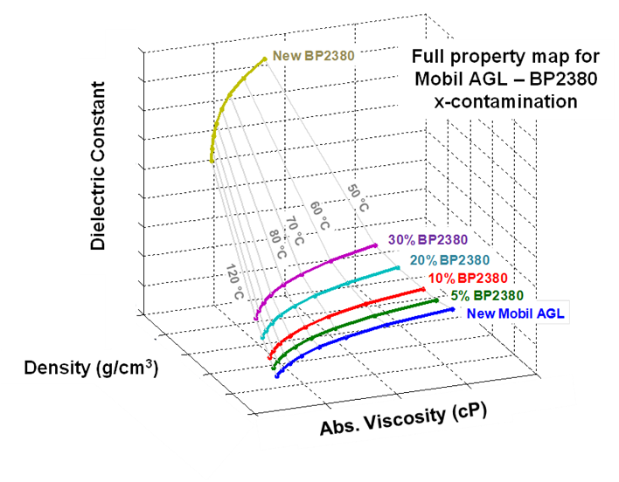
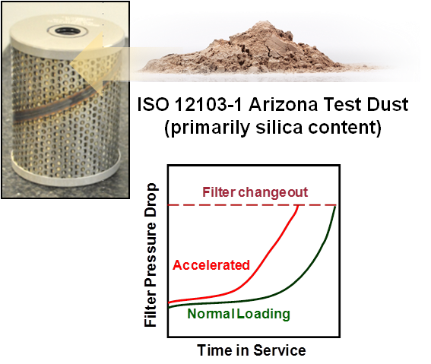
State Detection
Oil Debris
Oil Degradation / Contamination
  Primary lubricant degraders
  Lubricant condition monitoring
Multiparameteric Fluid Property Sensing
  Absolute viscosity, density, dielectric constant
  Temperature
Water Contamination
Filter Element Loading
  ΔP across element indicative of filter load
  Filter Changing
Lubricant Flow Rate (virtual)
  Pump Performance; Design Limits
Lubricant RUL Model based on TAN, Viscosity evolution

Slide 17
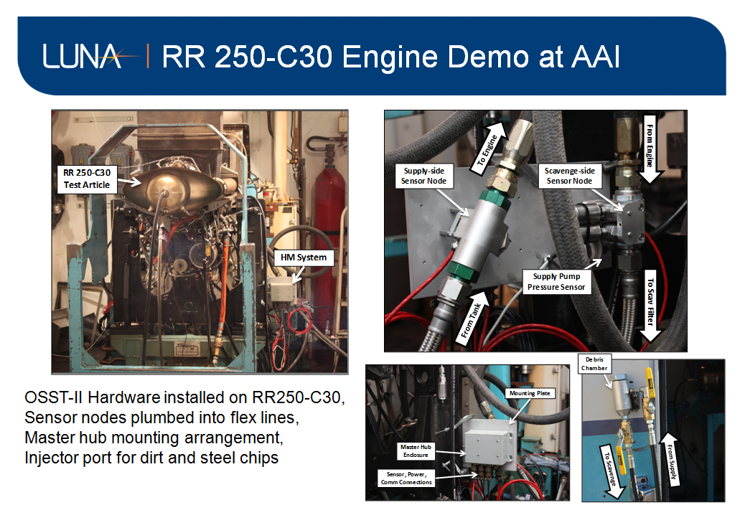

Slide 18
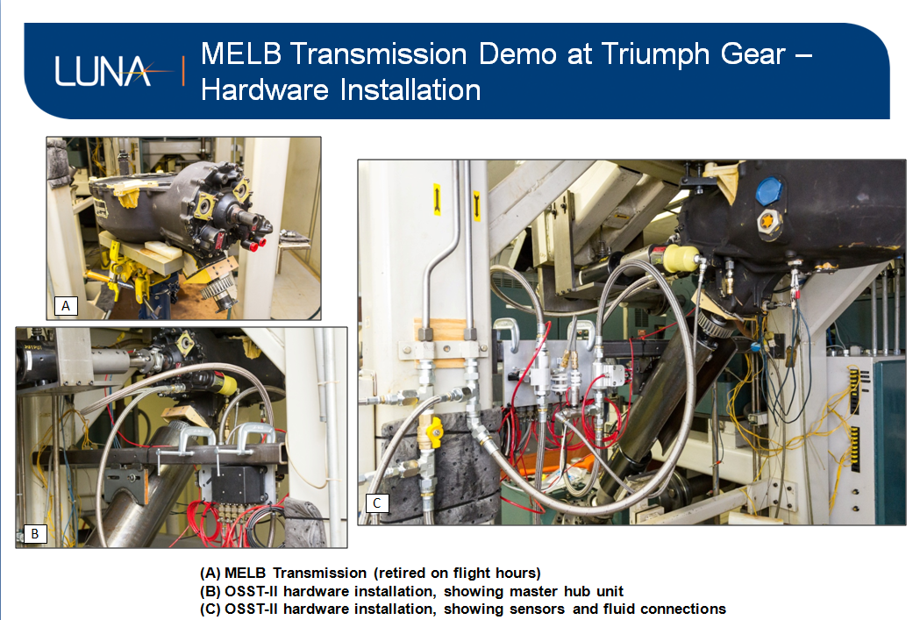

Slide 19
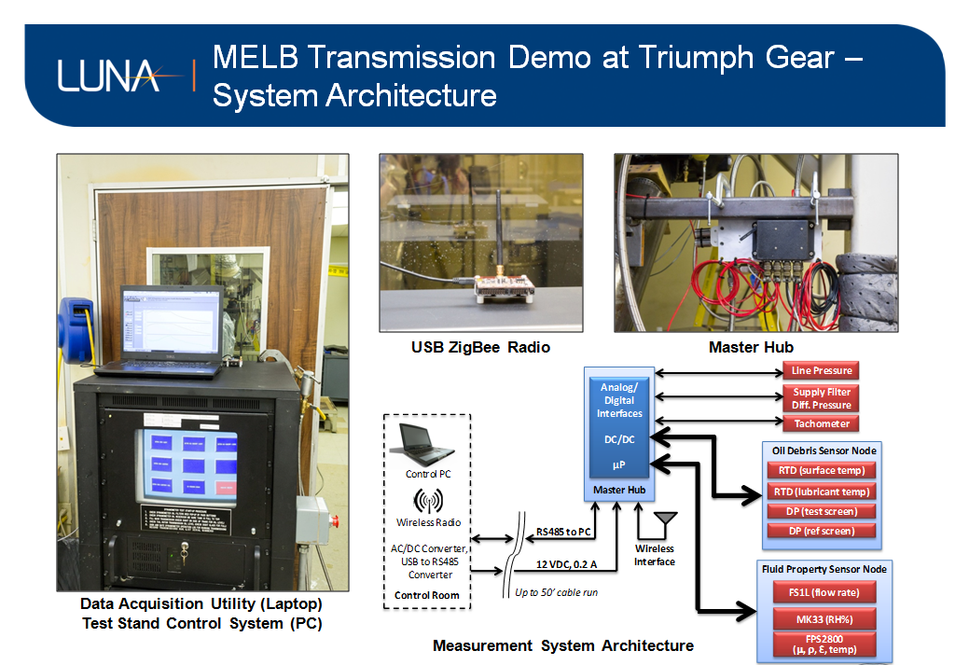

Slide 20
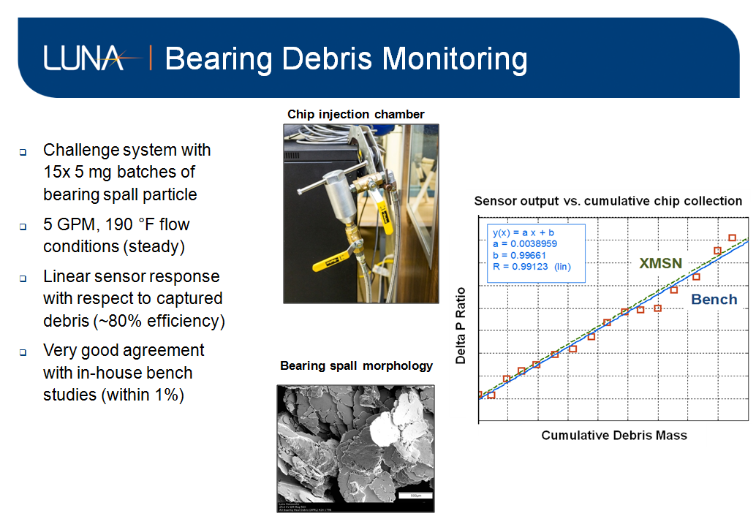

Slide 21
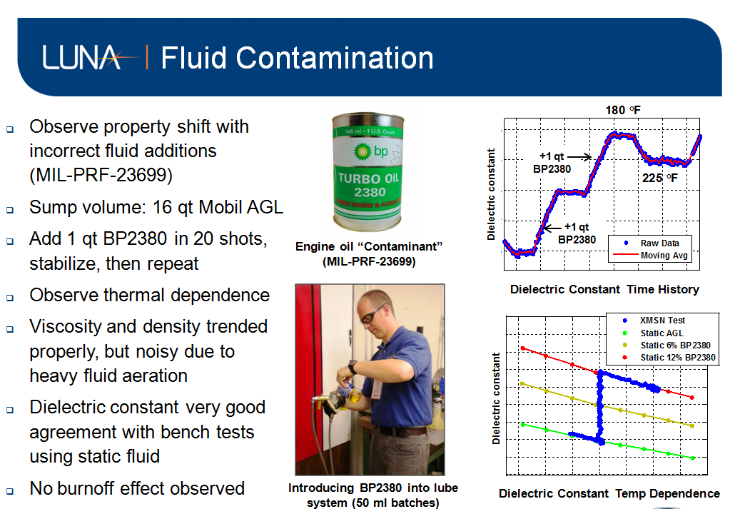

Slide 22
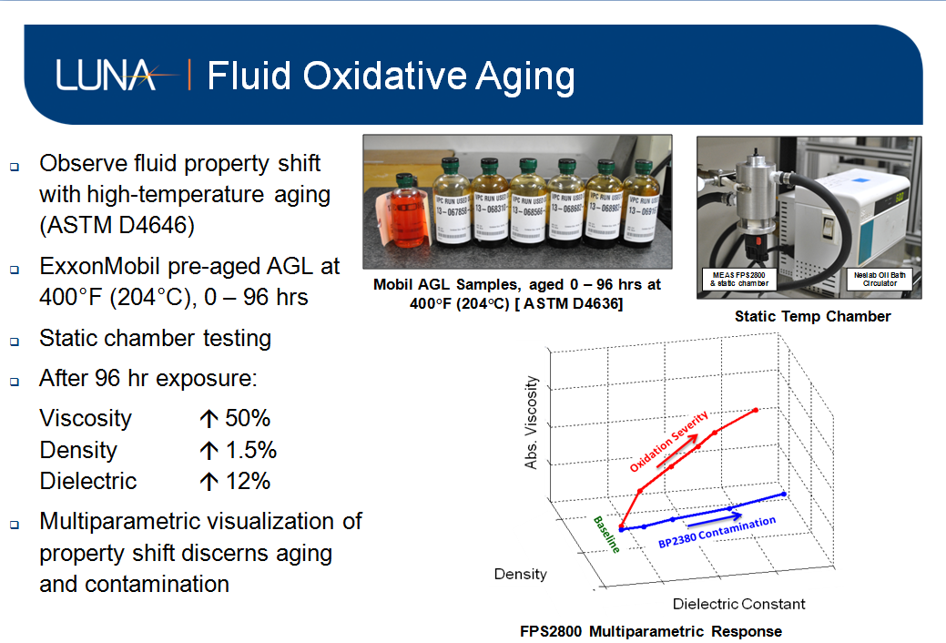

Slide 23
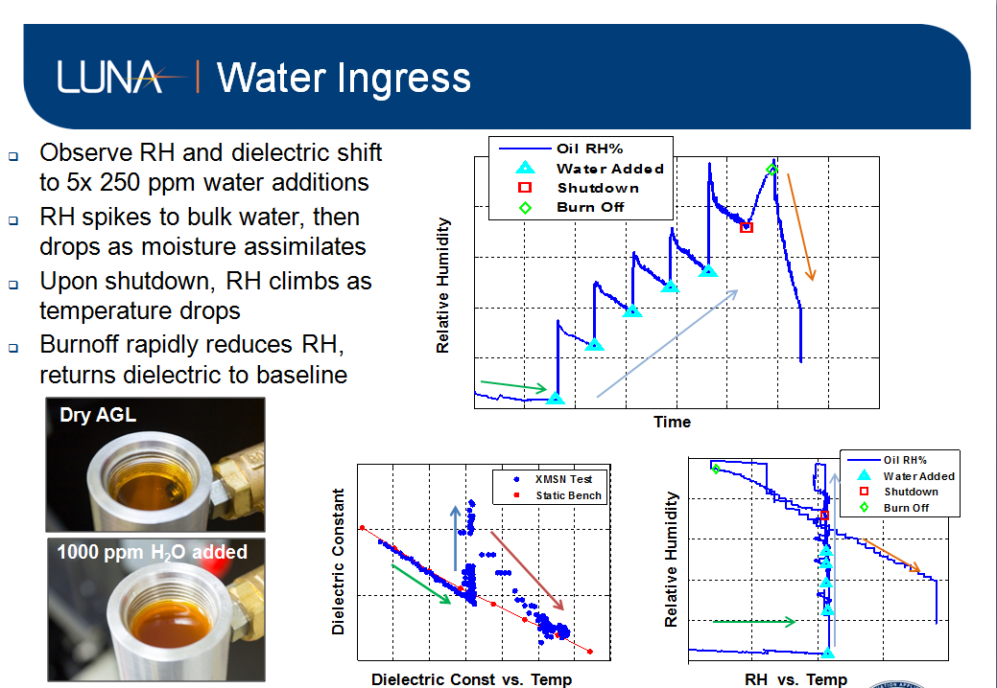

Slide 24
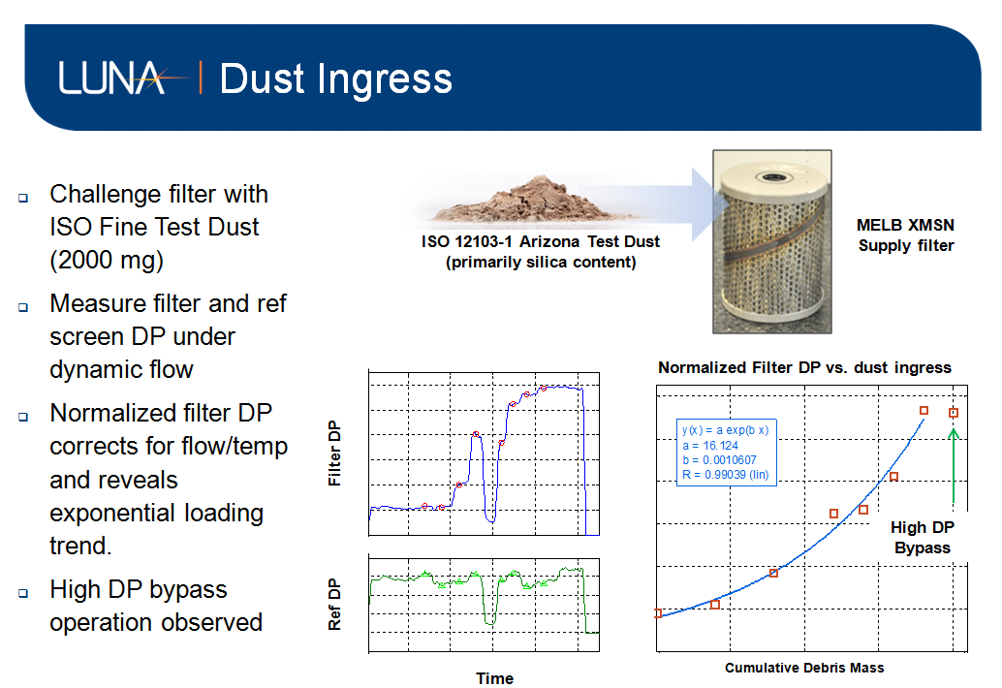

Slide 25
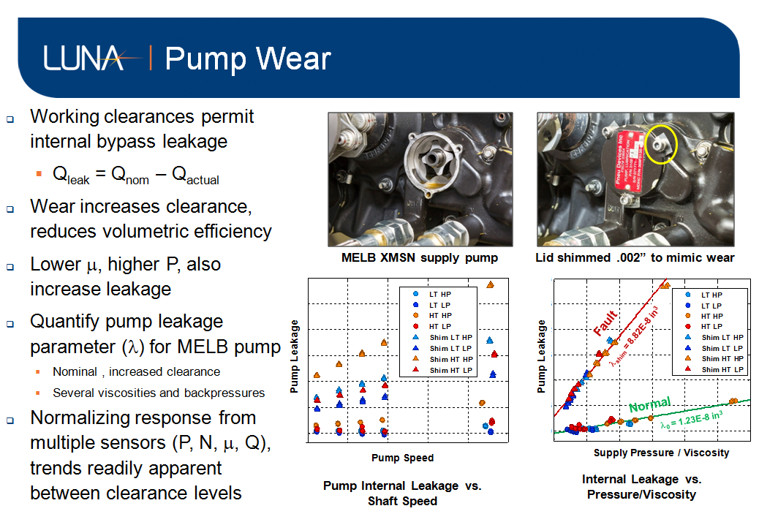

Slide 26
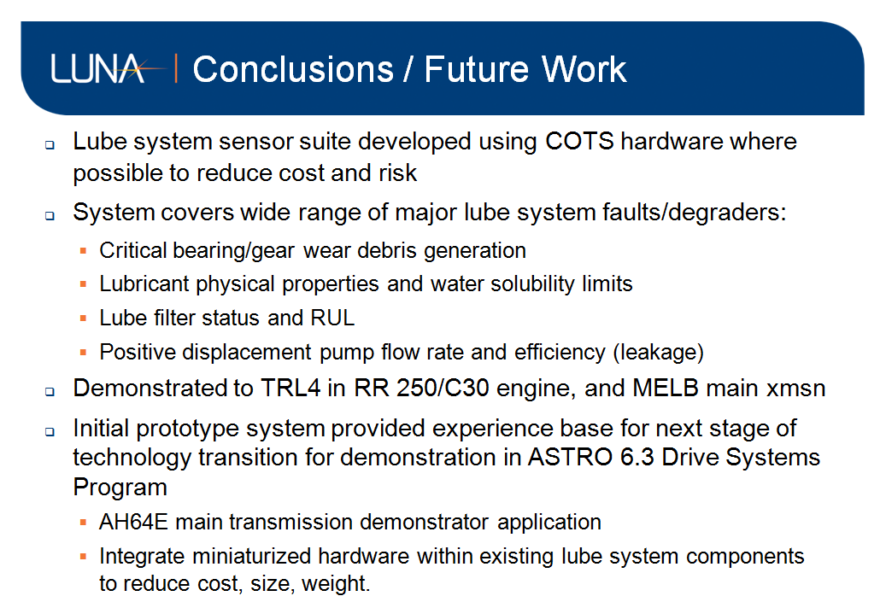

Slide 27
Summary
OSST-II Demonstration, Three (3) Project Areas
  Electrical, Propulsion and Vehicle Management Systems
Demonstration Testing to a TRL4
Transition Supportive to Follow-On Efforts
  Drives Systems
  Leveraging OSST-II and Other Technologies
Supports Transition with Current and Future Aircraft

Slide 28
AATD Acknowledgements
AATD Leadership: Mr. Ming Lau, Associate Director for Platforms
  OSST II Program – AATD Team:
    Program Manager, Paul Pantelis
    Technical / Program Agent, Christopher Lyman
    Contracts, Robert Waible

