Slide 1
Insights into Data Driven Fleet Management
Nov 3-4 2015
Josh Kennedy/Charlie Bonne
US Army Aviation & Missile Command

Slide 2
Data Driven Fleet Management
Definition of Fleet Management (PEO-AVN Policy Memo # 11-07)
A sustained proactive strategy to maintain platform and system visibility by gathering and exploiting data with a goal of increasing operational availability, reducing maintenance burden on the Soldier, and decreasing or controlling overall fleet operating costs.
Data-Driven Fleet Management Process for Army Aviation is about Harnessing & Exploiting our Full Array of Available Data Systems (Massive & Disparate) to our Advantage
- Operational Usage Data - Engineering Data - Reliability & Maintainability Scoring
- Maintenance Data - Supply/Logistics Data - FRACAS, Teardown Analysis
Harnessing & Exploiting Airworthiness Information Happens at three District Levels:
- Individual Aircraft - CO/BN Level - Redstone Arsenal (National) Level
One Part of the CBM+ Program Involves Technology Insertions (HW/SW) to Enable the Generation of Additional Airworthiness Data about each Aircraft, e.g. HUMS/DSC, corrosion detection technologies
The Primary Airworthiness Information from the Flight Line Includes:
- 1553 Bus Data, HUMS/DSC-Generated, Anything Generated at Aircraft Logbook Level (ULLS-A, 1352/1352-1, 2410)
- National-Level Data Including LMP, QDR-like info, RAM Scoring, FRACAS/Teardown Data from the Depot, and Other Data
Systems Available at Redstone
The “Systems Engineering” Approach Includes:
- System Acquisition (1553 Bus + HUMS on the Production Baseline)
- Modernization (MWO for DSC on Fielded Aircraft)
- Sustainment (Extend TBOs, Root Cause Analysis, Product Improvement)
- Operations (Improved Rotor Smoothing, Fault Isolation, and Prognostics)
These Activities are Focused on Guaranteeing Continued Airworthiness Under
Fiscal Constraints Reminiscent of the 1990s

Slide 3
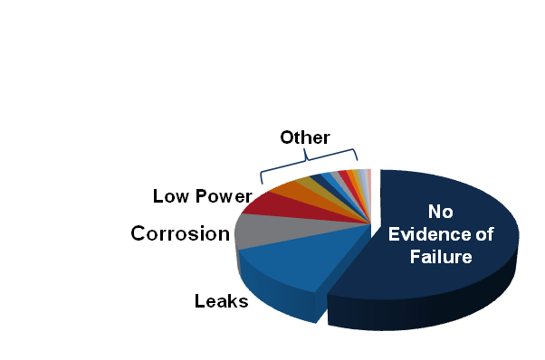

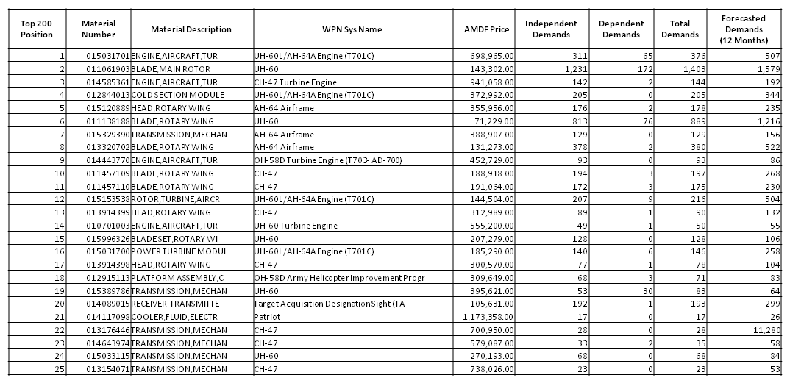
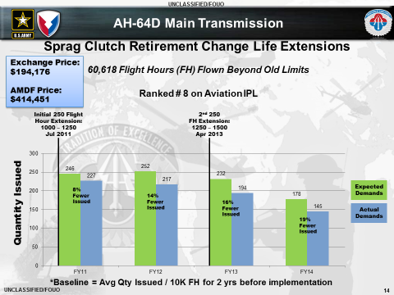
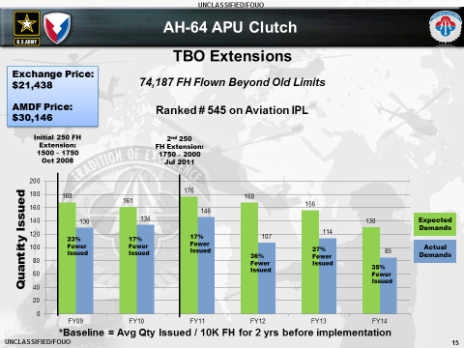
As an Enterprise, We Need to Generate Combat Power for the Warfighter at a Lower Cost
1
Where do our $$ go?
2
Why and Where?
AMCOM Managed Items
(18K+ Active NIINs)
Top 200 Position | Material Number | Material Description | WPN Sys Name | AMDF Price | Independent Demands | Dependent Demands | Total Demands | Forecasted Demands (12 Months)
1 | 015031701 | ENGINE,AIRCRAFT,TUR | UH-60L/AH-64A Engine (T701C) | 698,965.00 | 311 | 65 | 376 | 507
2 | 011061903 | BLADE,MAIN ROTOR | UH-60 | 143,302.00 | 1,231 | 172 | 1,403 | 1,579
3 | 014585361 | ENGINE,AIRCRAFT,TUR | CH-47 Turbine Engine | 941,058.00 | 142 | 2 | 144 | 192
4 | 012844013 | COLD SECTION MODULE | UH-60L/AH-64A Engine (T701C) | 372,992.00 | 205 | 0 | 205 | 344
5 | 015120889 | HEAD,ROTARY WING | AH-64 Airframe | 355,956.00 | 176 | 2 | 178 | 235
6 | 011138188 | BLADE,ROTARY WING | UH-60 | 71,229.00 | 813 | 76 | 889 | 1,216
7 | 015329390 | TRANSMISSION,MECHAN | AH-64 Airframe | 388,907.00 | 129 | 0 | 129 | 156
8 | 013320702 | BLADE,ROTARY WING | AH-64 Airframe | 131,273.00 | 378 | 2 | 380 | 522
9 | 014443770 | ENGINE,AIRCRAFT,TUR | OH-58D Turbine Engine (T703- AD-700) | 452,729.00 | 93 | 0 | 93 | 86
10 | 011457109 | BLADE,ROTARY WING | CH-47 | 188,918.00 | 194 | 3 | 197 | 268
11 | 011457110 | BLADE,ROTARY WING | CH-47 | 191,064.00 | 172 | 3 | 175 | 230
12 | 015153538 | ROTOR,TURBINE,AIRCR | UH-60L/AH-64A Engine (T701C) | 144,504.00 | 207 | 9 | 216 | 504
13 | 013914399 | HEAD,ROTARY WING | CH-47 | 312,989.00 | 89 | 1 | 90 | 132
14 | 010701003 | ENGINE,AIRCRAFT,TUR | UH-60 Turbine Engine | 555,200.00 | 49 | 1 | 50 | 55
15 | 015996326 | BLADE SET,ROTARY WI | UH-60 | 207,279.00 | 128 | 0 | 128 | 106
16 | 015031700 | POWER TURBINE MODUL | UH-60L/AH-64A Engine (T701C) | 185,290.00 | 140 | 6 | 146 | 258
17 | 013914398 | HEAD,ROTARY WING | CH-47 | 300,570.00 | 77 | 1 | 78 | 104
18 | 012915113 | PLATFORM ASSEMBLY,C | OH-58D Army Helicopter Improvement Progr | 309,649.00 | 68 | 3 | 71 | 83
19 | 015389786 | TRANSMISSION,MECHAN | UH-60 | 395,621.00 | 53 | 30 | 83 | 64
20 | 014089015 | RECEIVER-TRANSMITTE | Target Acquisition Designation Sight (TA | 105,631.00 | 192 | 1 | 193 | 299
21 | 014117098 | COOLER,FLUID,ELECTR | Patriot | 1,173,358.00 | 17 | 0 | 17 | 26
22 | 013176446 | TRANSMISSION,MECHAN | CH-47 | 700,950.00 | 28 | 0 | 28 | 11,280
23 | 014643974 | TRANSMISSION,MECHAN | CH-47 | 579,087.00 | 33 | 2 | 35 | 58
24 | 015033115 | TRANSMISSION,MECHAN | UH-60 | 270,193.00 | 68 | 0 | 68 | 84
25 | 013154071 | TRANSMISSION,MECHAN | CH-47 | 738,026.00 | 23 | 0 | 23 | 53
26 | 001344803 | ENGINE,AIRCRAFT,TUR | AH-1, UH-1, OV-1 Turbine Engine | 555,476.00 | 30 | 0 | 30 | 0
27 | 012397004 | BLADE,ROTARY WING | OH-58D Army Helicopter Improvement Progr | 106,431.00 | 153 | 4 | 157 | 205
28 | 014426926 | SPINDLE,HEAD,ROTARY | UH-60 | 26,351.00 | 597 | 127 | 724 | 788
29 | 011431226 | SERVO ASSY,PRIMARY | UH-60 | 25,842.00 | 599 | 121 | 720 | 773
30 | 013753160 | CYLINDER ASSEMBLY,A | UH-60 | 39,291.00 | 367 | 36 | 403 | 502
31 | 015169622 | RECEIVER,FLIR,TARGE | Target Acquisition Designation Sight (TA | 266,269.00 | 54 | 1 | 55 | 91
32 | 014503535 | INVERTER,POWER,STAT | Patriot | 249,372.00 | 56 | 0 | 56 | 84
33 | 013765089 | TRANSMISSION,MECHAN | UH-60 | 74,429.00 | 186 | 32 | 218 | 239
34 | 014131061 | TRANSMITTER CONTROL | AH-64 Longbow | 976,573.00 | 14 | 0 | 14 | 17
35 | 015268299 | TURRET,ASSEMBLY,INF | UH-60 | 437,758.00 | 31 | 1 | 32 | 37
36 | 015796215 | CABIN CONVERTED | OH-58D Army Helicopter Improvement Progr | 6,573,808.00 | 2 | 2 | 4 | 0
37 | 012737610 | SERVOCYLINDER | AH-64 Airframe | 58,190.00 | 221 | 2 | 223 | 227
38 | 013976050 | ELECTRONIC COMPONEN | AH-64 Longbow | 1,597,772.00 | 8 | 0 | 8 | 15
39 | 014504834 | HUB,ROTOR,HELICOPTE | UH-60 | 81,073.00 | 154 | 36 | 190 | 212
40 | 013950007 | SWASHPLATE,CONTROLL | CH-47 | 125,137.00 | 99 | 1 | 100 | 138
41 | 014133826 | TARGET DESIGNATOR S | AH-64 Longbow | 2,924,699.00 | 4 | 0 | 4 | 11
42 | 013692818 | POWER UNIT,GAS TURB | UH-60 | 69,949.00 | 161 | 31 | 192 | 187
43 | 014907030 | ELECTRON TUBE | Patriot | 449,988.00 | 23 | 1 | 24 | 30
44 | 010945547 | COLD SECTION MODULE | UH-60 Turbine Engine | 229,287.00 | 44 | 0 | 44 | 65
45 | 012413334 | COMPUTER,FLIGHT CON | CH-47 | 99,595.00 | 101 | 3 | 104 | 161
46 | 010131339 | ENGINE,AIRCRAFT,TUR | T63-A-700 and T63-A-720 | 333,946.00 | 30 | 0 | 30 | 14
47 | 014434904 | TRANSMISSION,MECHAN | OH-58D Army Helicopter Improvement Progr | 255,871.00 | 39 | 12 | 51 | 68
48 | 015183635 | M-PNVS RECEIVER | Target Acquisition Designation Sight (TA | 232,064.00 | 43 | 1 | 44 | 56
49 | 015034177 | TARGET DESIGNATOR S | OH-58D Army Helicopter Improvement Progr | 247,039.00 | 38 | 1 | 39 | 54
50 | 015370124 | TARGET ACQUISITION | Improved Bradley Acquisition System (ISB | 665,862.00 | 14 | 0 | 14 | 23
51 | 014923907 | FUEL CONTROL,MAIN,T | UH-60L/AH-64A Engine (T701C) | 35,910.00 | 259 | 43 | 302 | 277
52 | 015584785 | DISPLAY UNIT | UH-60 | 58,100.00 | 160 | 0 | 160 | 233
53 | 014693420 | ENGINE,GAS TURBINE, | CH-47 Turbine Engine | 109,599.00 | 82 | 2 | 84 | 166
54 | 014659232 | SHOCK STRUT ASSY | AH-64 Airframe | 56,984.00 | 149 | 5 | 154 | 219
55 | 012575800 | RAMP ASSY,CARGO | CH-47 | 561,582.00 | 15 | 0 | 15 | 11
56 | 012077228 | PUMP,HYDRAULIC | UH-60 | 14,936.00 | 555 | 116 | 671 | 777
57 | 013122387 | BLADE,ROTARY RUDDER | AH-64 Airframe | 23,544.00 | 340 | 8 | 348 | 443
58 | 014129325 | PROCESSOR,SIGNAL DA | AH-64 Longbow | 999,461.00 | 8 | 0 | 8 | 13
59 | 015904884 | TURRET,SENSOR-SIGHT | Target Acquisition Designation Sight (TA | 554,236.00 | 14 | 0 | 14 | 23
60 | 014113039 | POWER SUPPLY | Patriot | 549,623.00 | 14 | 0 | 14 | 17
61 | 014940084 | SERVOCYLINDER | AH-64 Airframe | 68,021.00 | 112 | 2 | 114 | 185
62 | 014647113 | TRANSMISSION,MECHAN | CH-47 | 178,955.00 | 42 | 0 | 42 | 113
63 | 015683122 | PROCESSOR,SIGNAL DA | AH-64 Longbow | 141,561.00 | 53 | 0 | 53 | 89
64 | 013201191 | SHAFT ASSY,FLEX | CH-47 | 146,932.00 | 51 | 0 | 51 | 54
65 | 015461148 | BLADE,ROTARY WING | UH-60 | 178,388.00 | 42 | 0 | 42 | 0
66 | 014924556 | FUEL CONTROL,MAIN,T | UH-60 Turbine Engine | 30,322.00 | 241 | 0 | 241 | 349
67 | 015278175 | GEARBOX,ACCESSORY D | UH-60 | 86,787.00 | 83 | 59 | 142 | 184
&
Primary Causes
Differences by Unit/Geography
AMCOM Top 200
Inherent Reliability
Why
Units
Buy Spare Parts
Design
Quality
Application
Obsolescence
~80% of AWCF
Spend
Other Causes
NEOF
Time Based
Removals
Bad Pubs
Training Gaps
Corrosion
Handling / Accident
DEMANDS
OPTEMPO
3
UNITS by LOCATION
What actions do we take?
4
Which Leads to Targeted Action
How did we do?
Focusing Our Efforts on the Process To Save $$$
Notes:
Mark Moe

Slide 4
Key Take Aways
AMCOM has Developed a Consolidated Analysis Playbook Process to Focus its AWCF Investments for Systems in the Sustainment Lifecycle Phase
In Partnership with PEO AVN and PEO MS, AMCOM Invests Approximately $60M/year of AWCF in New Technology and Product or Process Improvements to Lower Ownership Costs and Fight Obsolescence, While Maintaining or Improving Readiness
Numerous Ways for Industry (any size) to “Get Into the Game” with AMCOM:
  Semi-Annual Data Call for Projects
    Projects that Mitigate/Eliminate Obsolescence
    Projects that Reduce Sustainment Burden (Demands and/or Price)
  Competitive Solicitations for Specific Root Causes via FedBizOps (as Marketed through CASL)
    Relevant Findings from Sustainment Analysis Process Yield Solicitations
Always Working to Improve Process and Results
4

Slide 5


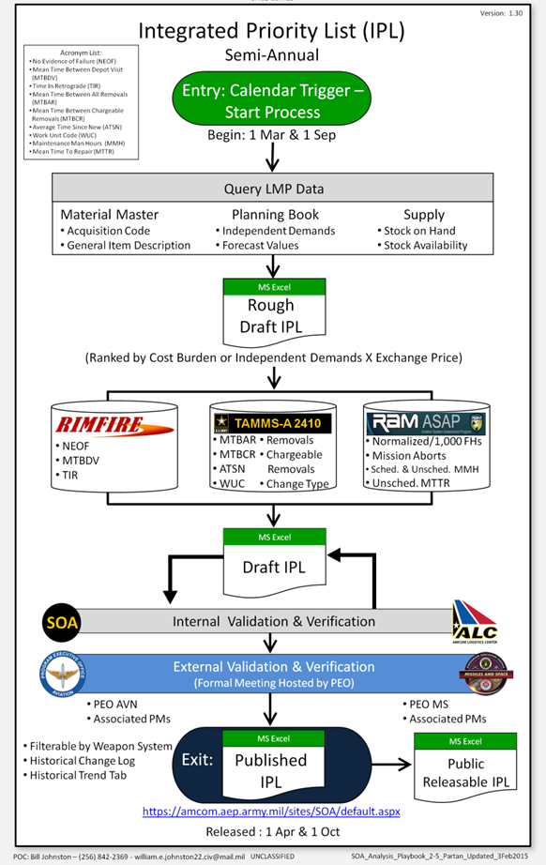
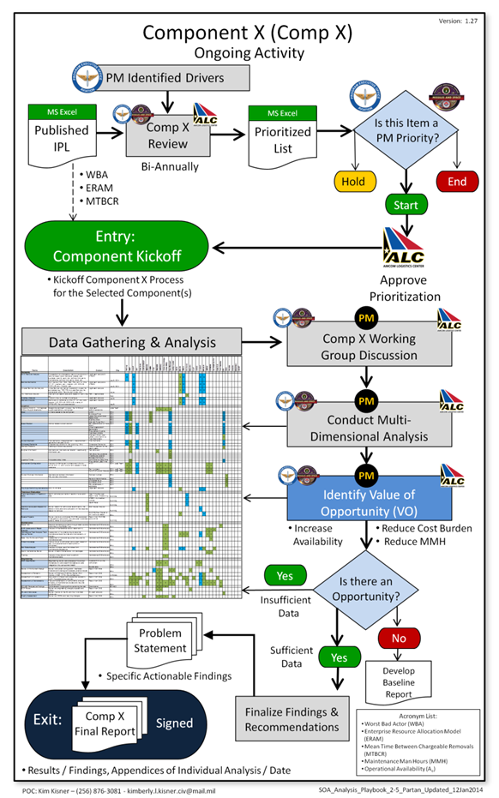
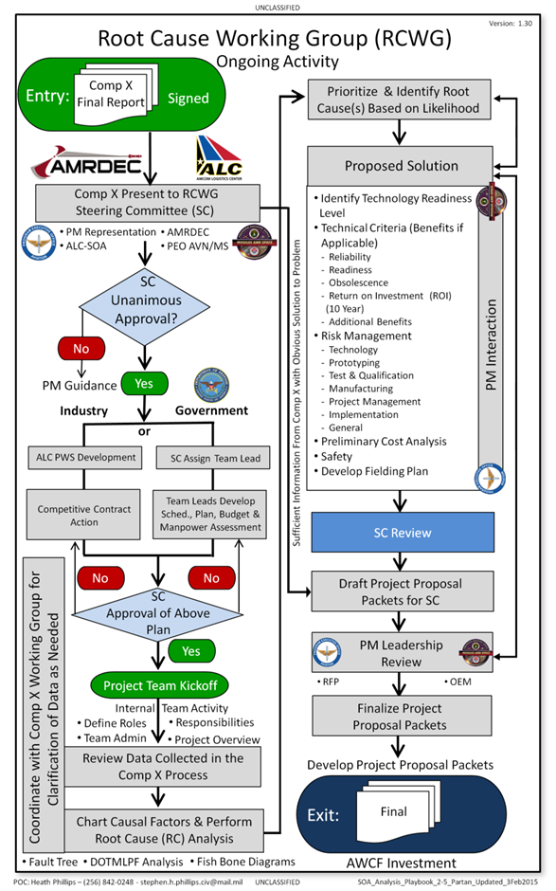
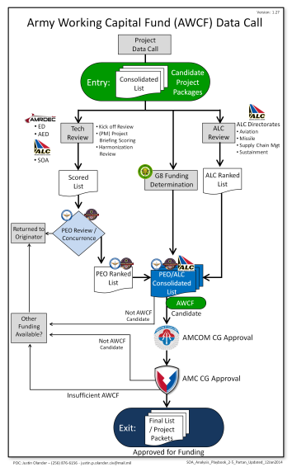
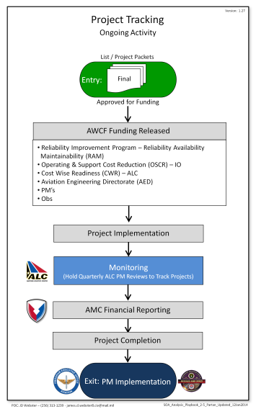
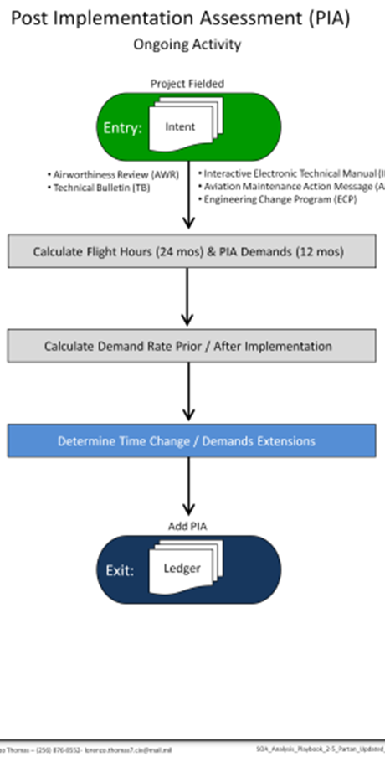




How We Are Tackling “Spend” Drivers
End-To-End Sustainment Analysis Process
AVN/MSL
Communities
Prioritize
(IPL)
Analyze
(Comp X)
Develop
(RCWG)
Implement
(Data Call)
Track
(PIA/Ledger)
Induced Causes
Enduring Efforts/Processes
Fielded
Results
NEOF
Time Based
Bad Pubs
Training Gaps
Corrosion
Accident
Process Improvement
Why Units Buy Spare Parts
Behavior Change
Sustainment Analysis
Improvement Projects
Product Improvement
Inherent Reliability
Process Formalized in AMCOM-PEOAVN MOU (27 March 2015)
Design
Quality
Application
Obsolescence

Slide 6

Integrated Priority List (IPL)
Purpose:
The AMCOM Integrated Priority List (IPL) provides a comprehensive list of metrics for all active AMCOM-managed components to facilitate analysis of historical component performance in the areas of maintenance, supply, demand, operational performance and other related areas.
IPL Process:
Entry: Calendar Trigger – Start Semi- Annual
Process on 1 Mar & 1 Sep
Query LMP Data, integrate other data sources
keyed to NIINs
Ranked by Cost Burden
Internal & External Validation & Verification
Exit: Published IPL
IPL Posted to AMCOM CMO’s webpage
Information to Industry
http://amcomdmz.redstone.army.mil/casl_cmo/casldba.casl_cmo_home
Notes:
The IPL is a key document which lists all AMCOM-managed items, about 18,000 of them, in a rank order according to their per unit cost and annual demands
It’s generated twice each year on the 1st of October and the 1st of April and is available to industry through the CASL
Legal, contractual, and security constraints limit the amount of data we can include in the public release version of the IPL; however, you can see from the list where AMCOM spends the majority of our AWCF dollars

Slide 7


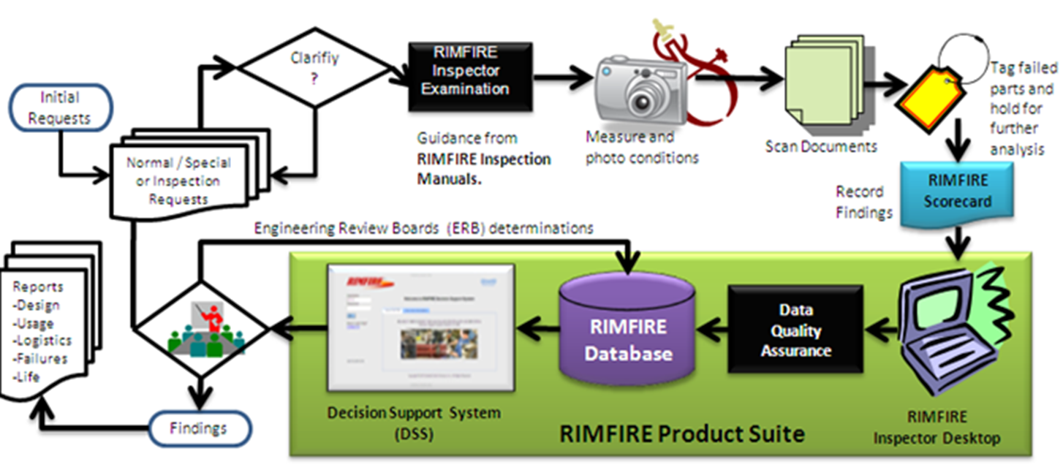

Data Source Enablers
Standardized Reliability Analysis Across Aviation Fleet
Semi Automated RAM Analysis Tool Accessible through Secure Web Portal
Turns Logbook Data into R&M Metrics
Multiple Data Sources Including ULLS-A (Electronic Logbooks) and DA-2410
Tracks Weapon System R&M Performance
  - Weapon System Review Reports
  - Component Performance Trending
Methods are consistent with Model Designating Series (MDS) specific Failure Definition and Scoring Criteria (FD/SC)
Provide evidence to support Component Improvements, Maintenance Enhancements, and Policy Changes Implemented by the PMOs
Scope Emerging Issues
Customers include: PEOAVN (UH-60, AH-64, CH-47), AMRDEC, ALC, ACLC, Industry
Formal Teardown Analysis and Root Cause Assessment at Depot
Semi Automated RAM Analysis Tool Accessible through Secure Web Portal
Identifies root cause for depot returned hardware, establishing field removals drivers
Used to correlate health/condition indicators with actual hardware condition
Provides Component Failure Mode analysis and trending
Provide failure data on Critical Safety Items
  - SOF, AWIS, PQDRs
Provides data for reducing Maintenance Costs
  - Overhaul Process Optimization & Remediation
  - Retirement Life and TBO changes
Enables component and System reliability improvements
  - Supports CBM; RCM; OCM implementation
  - Documents No Evidence of Failure (NEOF)
  - Identifies Field Repairable issues
TAMMS-A 2410/MCDS
The Army Maintenance Management System – Aviation (TAMMS-A) and Maintenance Consolidated Database System (MCDS)
Accessible through Secure Web Portal
HQ DA directed and supported
Authoritative Data Source for Aviation component Lifecycle Data
Authoritative Data Source for Aviation component Legitimate Code File (LCF) and Enterprise Material Master
Item Unique Identification (IUID) data verification and registration in the DoD IUID Registry
Serialized Item Management (SIM) (1972)
Serial Number Reporting Requirement (SNRR) (1987)
Disposition Instructions (Surplus) (1998)
Unique Identification (UID) (2004)
ERP interfaces include
  - LMP ERP Central Component (ECC)
  - LMP Complex Assembly Manufacturing Solution (CAMS)
  - GCSS-Army and AESIP

Slide 8
Integrated Priority List (IPL)
Serves as a Focusing Mechanism for spending limited resources (funding, personnel)
Priority: Rack-and-stack of all AMCOM-Managed items by annual Cost Burden (price x demands)
Integrated: ‘One-Stop Shop’ of info on a given NIIN across a wide variety of Sustainment Metrics
  LMP/Demand, ASAP/R&M , MCDS/2410, RIMFIRE, PDREP, RIDB, FEDLOG & other sources as identified
IPL has evolved, each semi-annual iteration has new features: Additional ranking by Supply, Availability, Maintainability; Demand vs. Rank tab; Component Trending tab; and more
AH-64 Apache
26.3%
1OCT15 IPL AWCF Cost Burden:
 | AVN
Total AWCF Aviation Cost Burden | $1.228B
Top 200 Aviation Cost Burden | $996M
Percentage | 81.1%
 | MSL
Total AWCF Missile Cost Burden | $123.8M
Top 200 Missile Cost Burden | $103.4M
Percentage | 83.5%
Aviation Rank | Material Number | FEDLOG Nomenclature (NEW) | Cost Burden (Last 12 Mos Ind. Demands) | Other Metrics
1 | 011061903 | BLADE,MAIN ROTOR | $80,621,310 | 80+ Other Metrics Integrated from Disparate Sources
2 | 015031701 | ENGINE,AIRCRAFT,TURBO-SHAFT | $70,611,528
3 | 014585361 | ENGINE,AIRCRAFT,TURBO-SHAFT | $43,220,312
4 | 012844013 | COLD SECTION MODULE, AIRCRAFT GAS | $35,107,382
5 | 015120889 | HEAD,ROTARY WING | $33,410,080
… | … | … | …
11,329 Total AVN Items |  | 115 New; 373 Dropped
Missile Rank | Material Number | FEDLOG Nomenclature (NEW) | Cost Burden (Last 12 Mo) | Other Metrics
1 | 015882460 | COOLER,FLUID,ELECTRONIC EQUIPMEN | $10,163,712 | 40+ Other Metrics Integrated from across LMP, PDREP, and FEDLOG
2 | 014907030 | ELECTRON TUBE | $7,198,152
3 | 014589987 | INTERFACE ELECTRONIC ASSEMBLY | $6,384,357
4 | 014446570 | TRANS PANEL ASSEMBL | $5,629,176
5 | 014503535 | INVERTER, POWER, STATIC | $3,537,420
… | … | … | …
6,888 Total MSL Items |  | 100 New; 81 Dropped
Notes:
XSN: Two visible examples of the CBM and CWR umbrella that no doubt many of you have seen already are maintenance TTP changes to the AH-64 Main XMSN and the TRGB….the upper change is a CBM approach based on MSPU technology, the lower is CBM approach based on smarter level of repair that has nothing to do with the MSPU
Engineering Analysis of CBM+ DSC Data and RTC Test Stand Data Revealed that the Time Before Overhaul (TBO) was too conservative
Analysis Resulted in Two Fleet Wide 250 Hour APU Clutch TBO Extensions and a Cost Avoidance of an Average $1.03M / Year
Cost Avoidance methodology was Validated by AMCOM G3 Command Analysis Directorate (CAD)
ROI is based only on Hardware Cost Avoidance
Additional Unit Benefit is MMH Previously Dedicated to APU Clutch Removal / Replacement can be used to Enhance Overall Quality of Unit Maintenance
Note: “Present Cost Avoidance” and “Avg Cost Avoidance / Yr” refers to the period of time reflected in the “After” column
XSN: Coming back to C-WR and to close out…

Slide 9
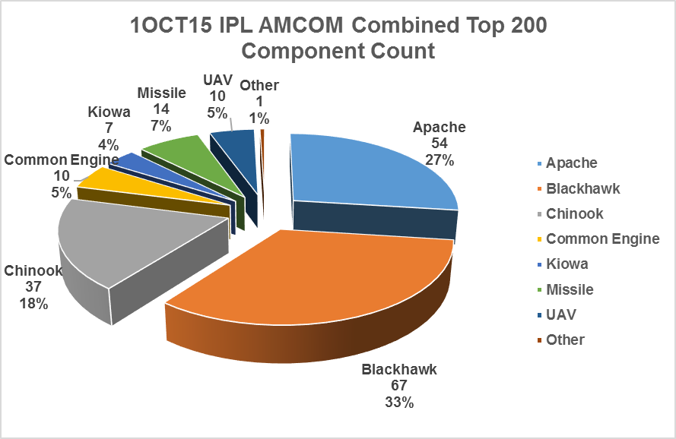
Integrated Priority List (IPL)

Slide 10
Integrated Priority List (IPL)
1Apr15 IPL AMCOM Combined Top 200
Component Count
Top 200 Components by Platform

Slide 11

Component X
Purpose:
Component X (Comp-X) performs exhaustive exploratory analysis on a component to identify where additional effort could lead to large payoff reductions in the sustainment cost burden by extending usable life, reducing demands, reducing Maintenance Man-Hours (MMH), and/or improving readiness. These components are collectively referred to as Values of Opportunity (V_{o}O).
Comp X Process:
Entry: Published IPL & PM Priority List
Data Gathering & Analysis
Identify the Value of Opportunity (V_{o}O)
Exit: Generate Problem Statement for the Final
Signed Report
Industry:
Relevant Comp-X Findings may be provided as part of a competitive RFQ/RFP for
Root Cause

Slide 12

Comp X Data Gathering
Comp X Data Gathering:
Feeds the Comp X Working
Group Discussion
Facilitates Multi-Dimensional
Analysis
Helps Identify the VO

Slide 13
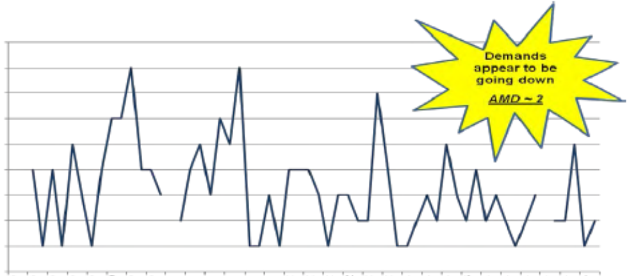
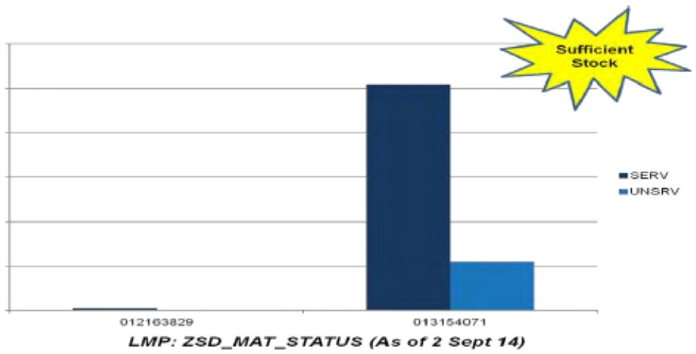
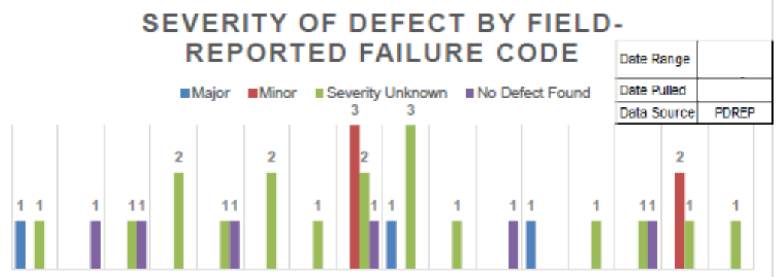
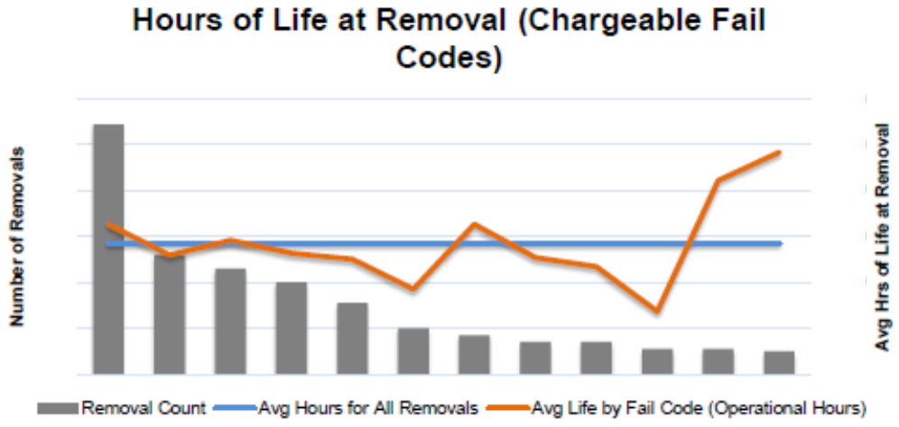
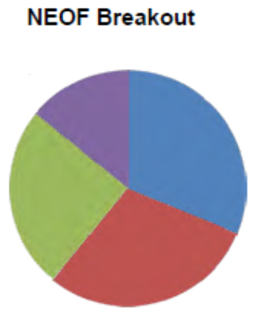
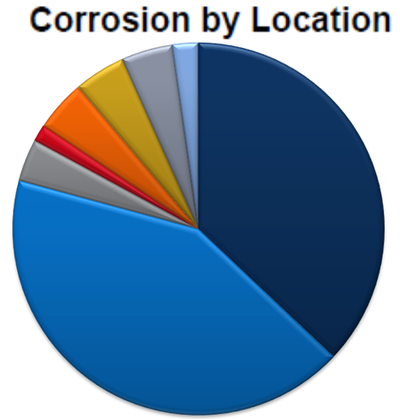
Comp-X = In-depth Exploratory Analysis

Slide 14

Root Cause Working Group (RCWG)
Purpose:
For a specific component, the Root Cause Working Group (RCWG) determines associated root cause and recommends possible courses of action (COAs) to address problem statements identified by the Component X (Comp X) process.
RCWG Process:
Entry: Signed Comp X Final Report
Steering Committee Unanimous Approval Decision
goes to Industry or Government
Prioritize & Identify Root Cause(s) Based on
Likelihood
Steering Committee Review
Exit: Root Cause Determination & Develop
Project Proposal Packets for AWCF Investment
Industry Opportunity
Industry: AMCOM
Has Option to Utilize Industry to Perform Root Cause Process via Competitive
RFQ/RFP
Competitive Solicitation
14

Slide 15
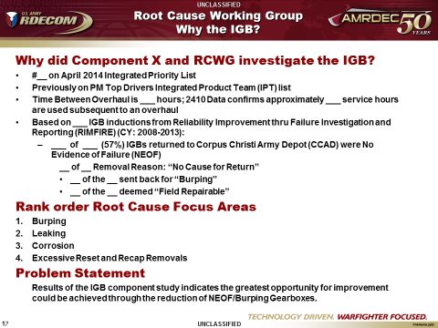
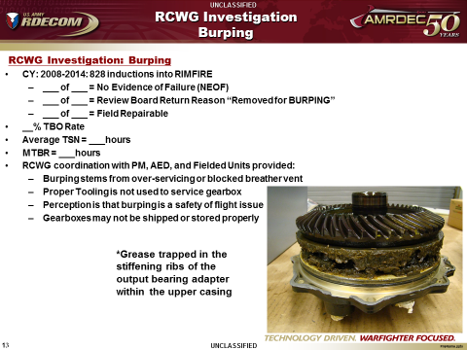
RCWG Investigation Example
Why?
Root Cause

Slide 16
AWCF Data Call
AWCF Data Call Process:
Purpose:
Entry: Consolidated list of Candidate Project Packages
Technical Evaluation
PEO/PM and ALC Review / Ranking
PEO/ALC Prioritized List
CG / PEO Approval
Exit: Final List Approved for Funding with Feedback to Government/Industry
Solicit and fund project candidates that will provide implementable solutions to mitigate known obsolescence issues, reduce sustainment costs, improve component reliability & usable life, and/or improve readiness. This process strives to vet and prioritize projects based on technical merit and stakeholder priority.
Two (2) Month
Submittal Period
One (1) Month
Evaluation Period
Two (2) Week
Ranking / Prioritization
AMC
Approval
1 Month
Submittal Cut-off:
15 July
15 January
Project Approval/
Disapproval Feedback
PEO/PM
Ranking
Government
Data Call
Technical
Evaluation
CG / PEO
Approval
Funding
Release
ALC with AMRDEC-ED/IO
Project
Submittal
Incomplete
Project
Package
ALC
Ranking
Industry
Data Call
Project
Submittal
Government Single
Entry Point
Project Approval/
Disapproval Feedback
Project Feedback
Located on CASL Website
http://amcomdmz.redstone.army.mil/casl_cmo/casldba.casl_cmo_casl
Industry Feedback includes:
Receipt of submittal
Notification of incomplete package
Notification of CG/PEO decision
ALC with
AMRDEC-ED/IO
CASL Website contains:
Advanced Planning Briefing to Industry (APBI )
Integrated Priority List (IPL)
Candidate Project Template
Process Explanation/Overview
Frequently asked Questions
Notes:
All project proposals are evaluated thoroughly, scored, and ranked according to technical merit and criticality of the root cause
Scored projects are then rank ordered by the affected PM and prioritized by the respective PEO
If your proposal addresses issues on systems that are deployed to an operational theater you can bet that PM interest will be higher
Once submitted, the project evaluation process takes approximately five months to complete all gates
Once AMC approval is obtained, Government leads are notified and contract actions are initiated

Slide 17
Project Evaluation
 | Assessment Rating
Category
AMCOM Managed | Yes | No; However positively effects an AMCOM supported weapon system | No; Does not effect an AMCOM supported weapon system
Technical | TRL ≥ 6; Acceptable Risk; Solution addresses problem | TRL ≥ 6; Areas of Risk exist; Concerns with solution | TRL ≤ 6; One or more High Risk areas; Does not fully address problem
Logistics | Solution supportable; Logistics elements addressed; Positive impact to sustainment | Solution supportable with some risk; Most Logistics elements addressed; Minor impact to sustainment | Solution not supportable; Logistics elements not addressed; Negative impact to sustainment
Financial | Fully meets AWCF Policy & Procedures | Meets DoD/DA AWCF Policy & Procedure with some exceptions to AMC and/or AMCOM P&P | Does not meet DoD/DA AWCF Policy & Procedure
AMCOM Managed Secondary Item
Aviation platform
Missile Weapon System
Associated ground support equipment
Technical Evaluation
Considers:
Obsolescence impacts
Reliability improvement
Return on Investment
Risk areas including Technical; Programmatic; and Schedule
Safety impacts
Logistical Evaluation
Considers IPS elements:
Maintenance Planning
Supply Support
Support Equipment
Publications
Training
Financial Evaluation
Considers Policy:
10 U.S. Code § 2208
AR 70-1 / AR 70-3
DA PAM 70-3
AMC Policy Memo, Supply Management Army (SMA), AWCF Procedures
DFAS-IN Manual 37-100-08
Subject Matter Expertise Involved:
PM Project Leads; Industrial Operations Engineering; Aviation Engineering; RAM Engineering; Manufacturing Technology Engineering; Value Engineering; Obsolescence; Cost Analysis; APEOs for Logistics; Command Logisticians, ALC Analysis; AWCF Financial Management

Slide 18
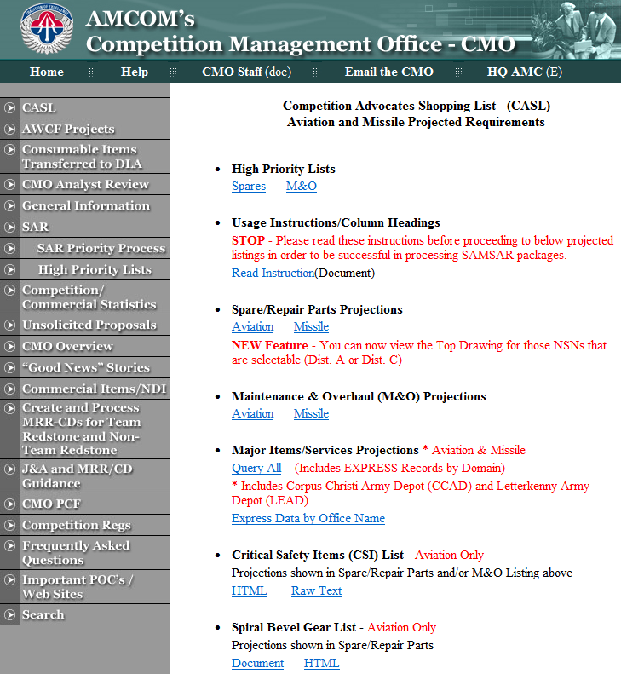
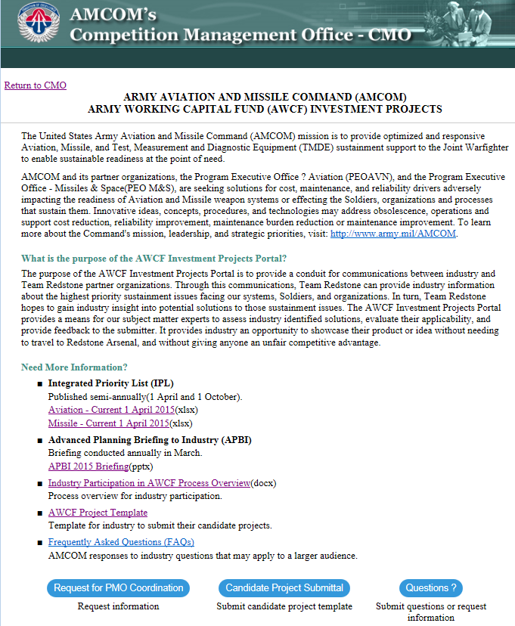
AWCF Website Demo
http://amcomdmz.redstone.army.mil/casl_cmo/casldba.casl_cmo_casl

Slide 19
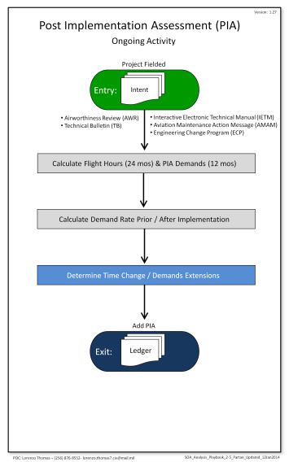


Project Tracking and Assessments
General Officer
Quarterly Reviews

Slide 20
PIA Examples
AH-64D Main Transmission Sprag Clutch Retirement Change Life Extensions
AH-64 APU Clutch TBO Extensions
60,618 Flight Hours (FH) Flown Beyond Old Limits
Ranked # 8 on Aviation IPL
74,187 FH Flown Beyond Old Limits
Ranked # 545 on Aviation IPL
Exchange Price:
$194,176
AMDF Price:
$414,451
Exchange Price:
$21,438
AMDF Price:
$30,146
Initial 250 Flight Hour Extension:
1000 – 1250
Jul 2011
2nd 250
FH Extension:
1250 – 1500
Apr 2013
Initial 250 FH Extension:
1500 – 1750
Oct 2008
2nd 250
FH Extension:
1750 – 2000
Jul 2011
Expected Demands
Expected Demands
Actual Demands
Actual Demands
8% Fewer Issued
14% Fewer Issued
23% Fewer Issued
17% Fewer Issued
17% Fewer Issued
Quantity Issued
Quantity Issued
16% Fewer Issued
36% Fewer Issued
27% Fewer Issued
19% Fewer Issued
35% Fewer Issued
*Baseline = Avg Qty Issued / 10K FH for 2 yrs before implementation

Slide 21

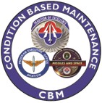








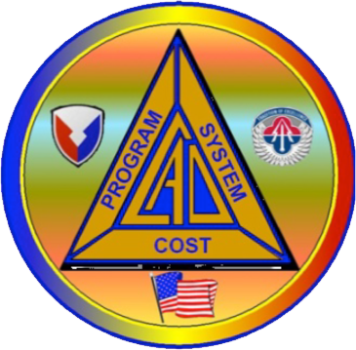
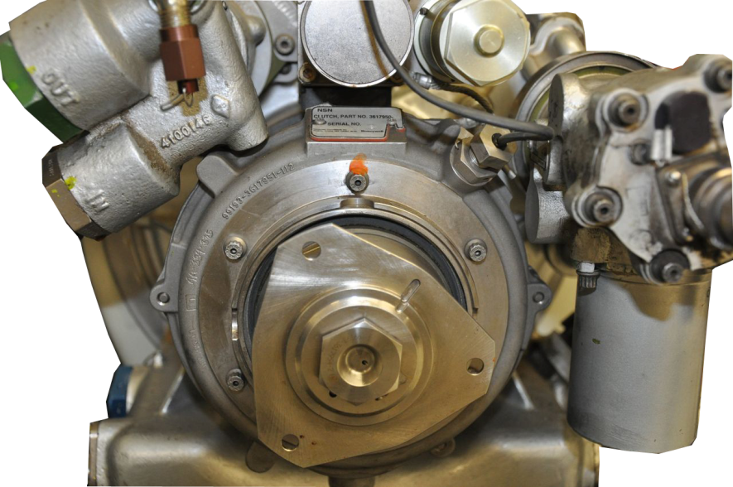
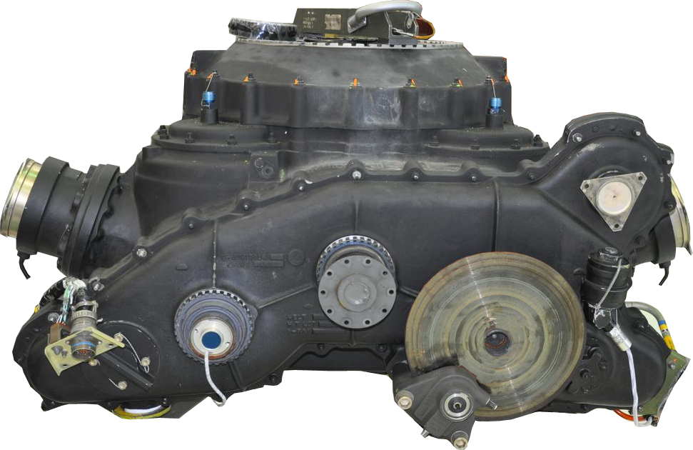
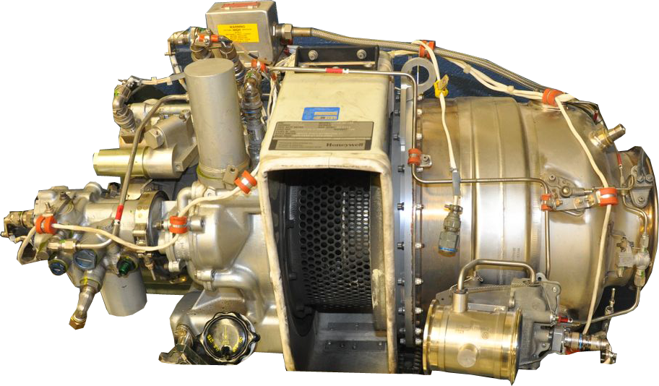
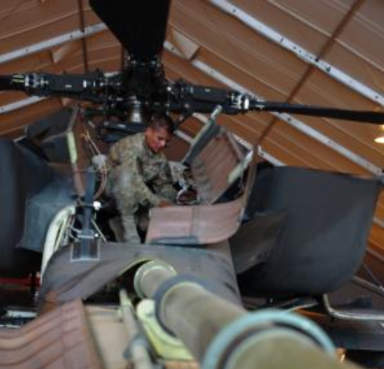
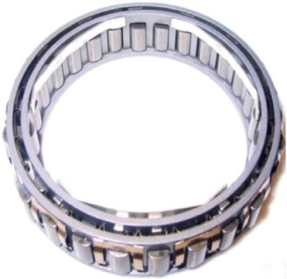
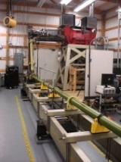
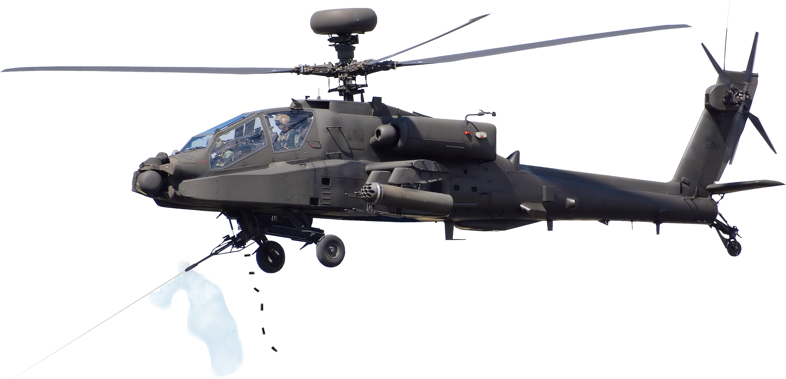
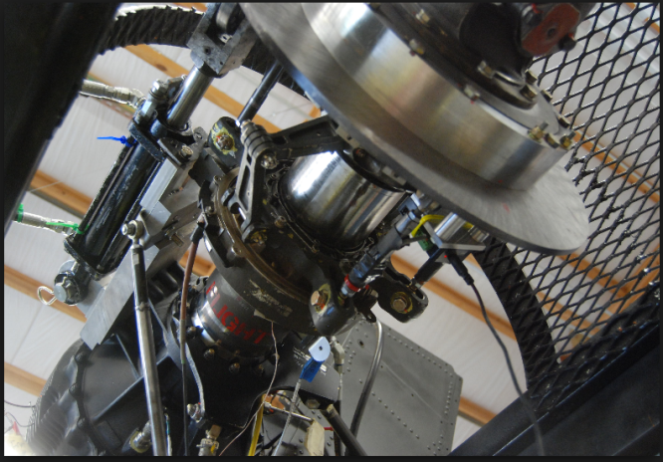
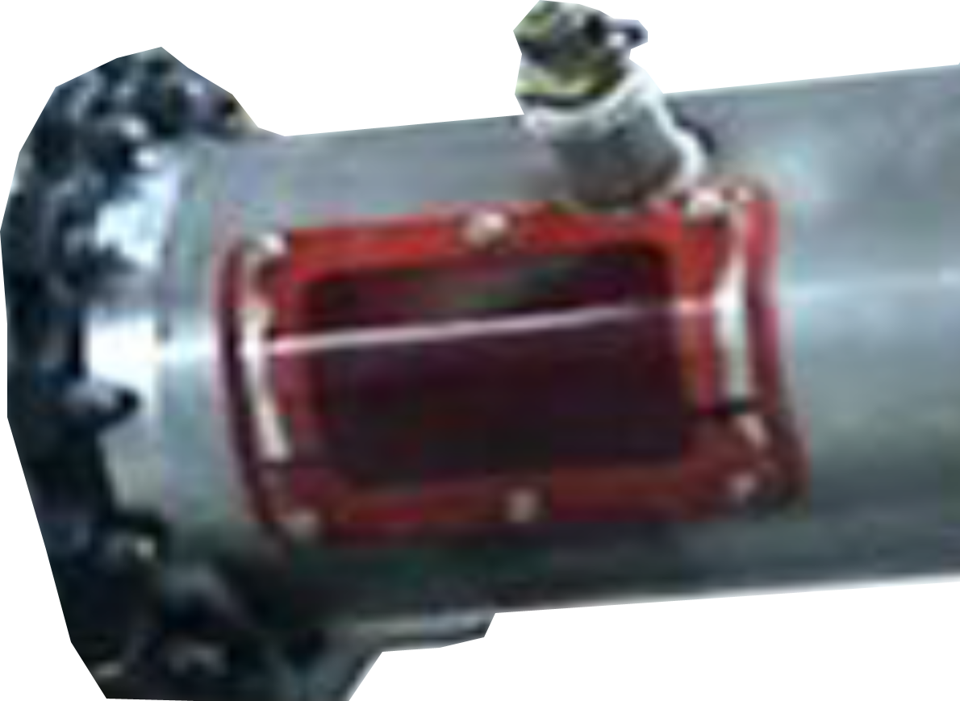

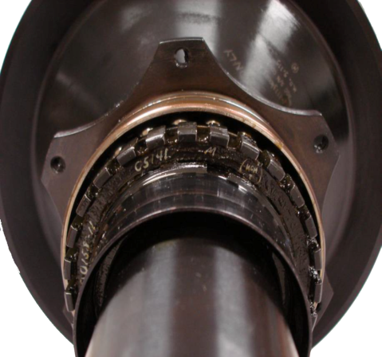
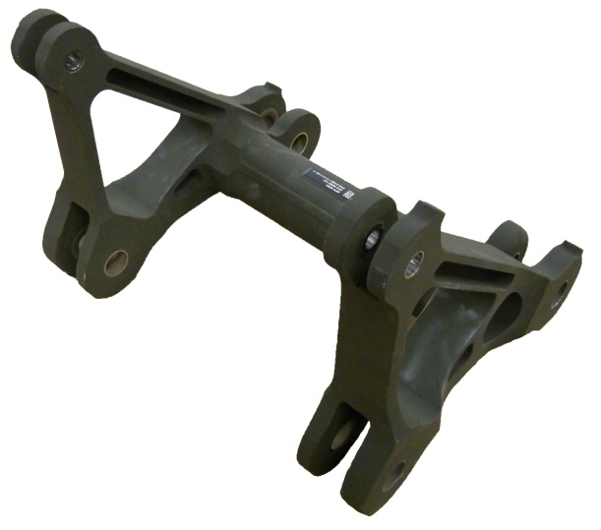
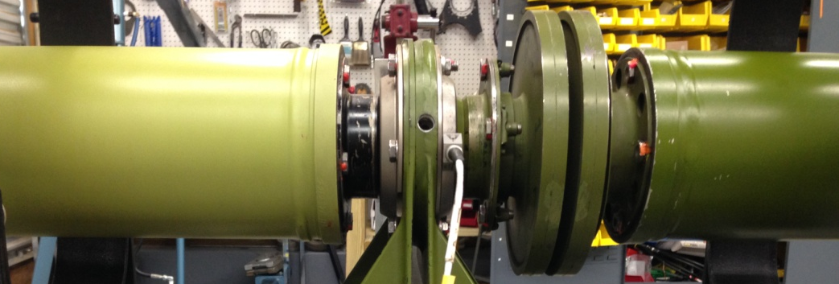
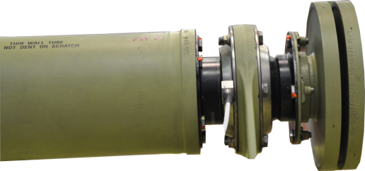
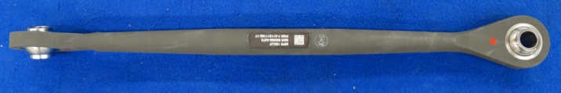
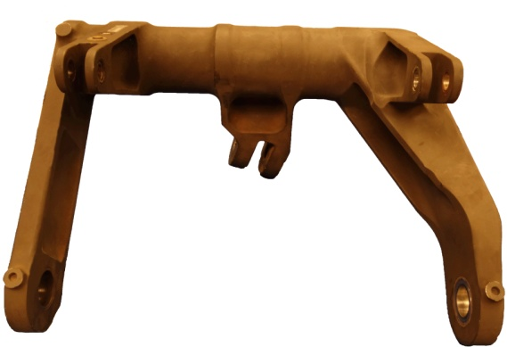
Time on Wing Increases = Cost-Wise Readiness
APU Clutch TBO
Sprag Clutch RC
Tail Rotor Bearing TBO
Tail Rotor Swash Plate TBO
Tail Rotor Gear Box
Fwd & Aft Hanger Bearing TBO
Lateral Link
Fwd & Aft Bell Crank
CBM+ Projects & CAD Validated Methodology Support CWR Cost Avoidance

Slide 22
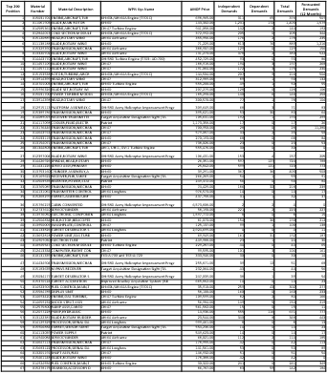
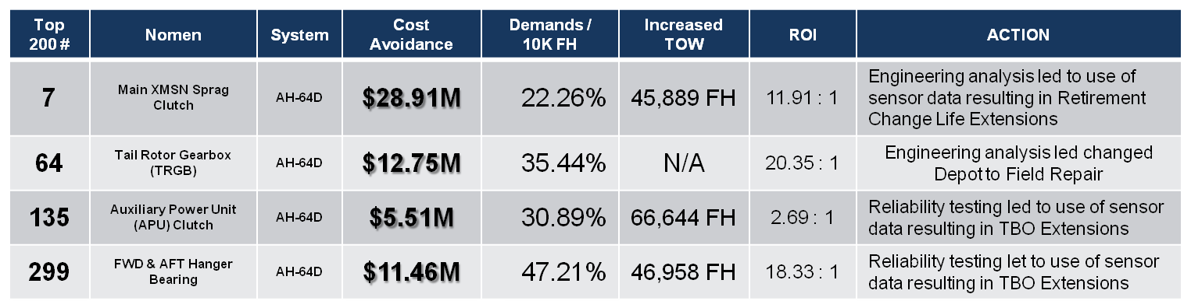
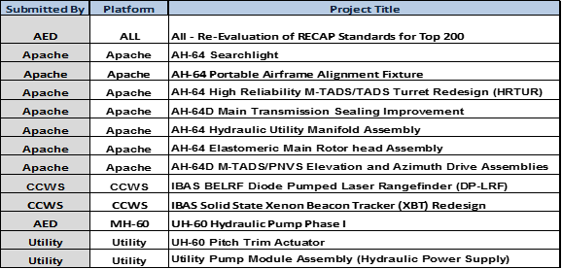
Summary
1
Where do our $$ go?
2
Why and Where?
AMCOM Managed Items
(18K+ Active NIINs)
&
Primary Causes
Differences by Unit/Geography
AMCOM Top 200
Inherent Reliability
Why
Units
Buy Spare Parts
Design
Quality
Application
Obsolescence
~80% Spend
Other Causes
NEOF
Time Based
Removals
Bad Pubs
Training Gaps
Corrosion
Handling / Accident
DEMANDS
OPTEMPO
3
UNITS by LOCATION
What actions do we take?
4
How did we do?
Which Leads to Targeted Action
Focusing Our Efforts on the Process To Save $$$
Notes:
Mark Moe

Slide 23
Key Results
Obsolescence Mitigation
  Since 2005, 145 projects funded, $367M invested; 10yr Cost Avoidance ~$793M
Operating and Support Cost Reduction (OSCR)
  Since 1996, 128 projects funded; $110M redesign funding; $535M invested by PM; 10yr Cost Avoidance ~$1.4B
Cost Wise Readiness (CWR)
  Since 2014, 11 projects funded; $18M redesign funding; 10yr Cost Avoidance ~$330M
Reliability Improvement Program (RIP)
  Since 2004, 116 projects/studies funded, $170M
Industry Projects (Previously known as CTR)
  Since 2003, 13 Completed Qualification; 10 year Cost Avoidance ~$58M
Awaiting reconfirmation from Blair/Tom R
Awaiting reconfirmation from Blair/Tom R
Awaiting reconfirmation from Blair/Tom R
Confirmed 9/22 via J. Peterson email
23

Slide 24
Where We Can Still Improve
Faster [idea to implementation]
Use of small business and competitive sourcing
Contracting methods that offer all an opportunity
Etc.
24

Slide 25
Questions

Slide 26
Backup
Examples

Slide 27
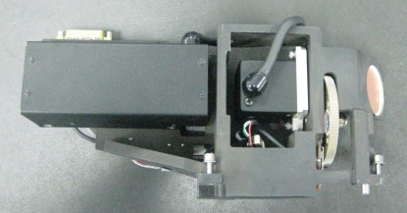
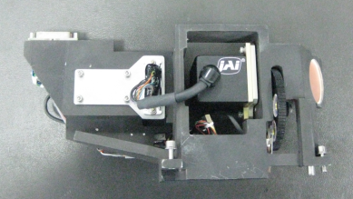
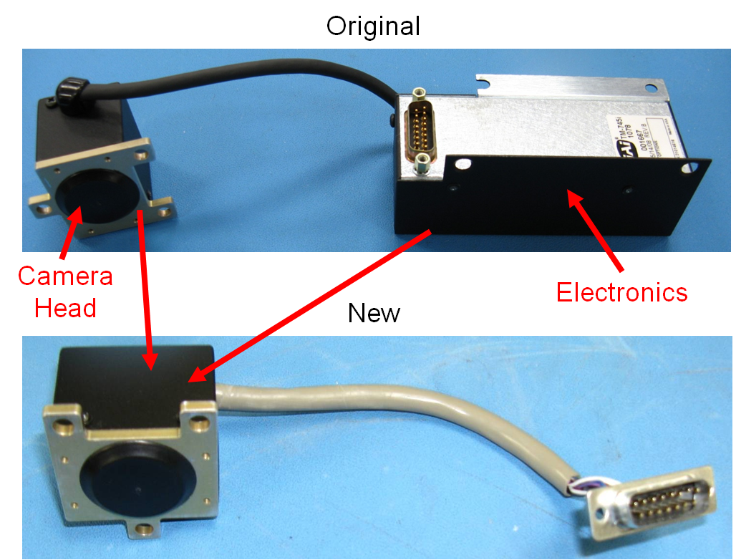
Charged Coupled Device (CCD)
Camera Redesign
Description
Schedule
Situation:
  Charged Coupled Device (CCD) camera used by the Improved Bradley Acquisition System (IBAS) has high failure rate and is obsolete
Solution:
  Qualify a replacement camera
Tasks | Plan Date | Actual
Funding $410K | 01 Oct 2010 | 01 Oct 2010
Obligation | 30 Nov 2010 | 31 Dec 2010
Engineering | 31 Dec 2011 | 31 Dec 2011
Testing | 30 May 2012 | 30 May 2012
Fielding | 31 Jul 2012 | 30 Jun 2012
~ 10yr Savings | $12.543M
Accomplishments
Original Camera Assembly
New Camera Assembly
Implemented: 3rd Qtr 2012
Implementation:
  Increases performance
  Lowers replacement costs
  Increases reliability
  Replace through attrition

Slide 28
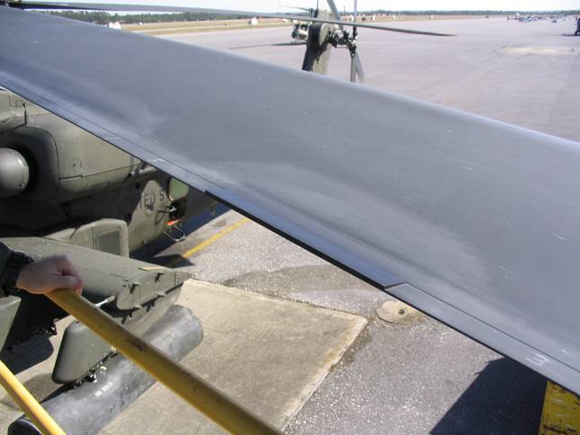
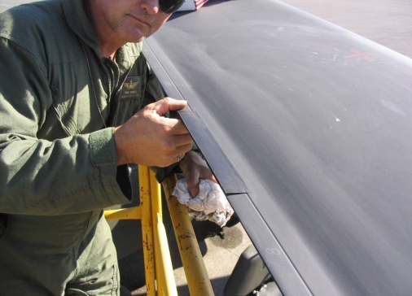
AH-64/CH-47 Elastomeric Wedges Self
Adhering Track Adjustment
Description
Schedule
Situation - Currently scrapping 30% of all depot AH-64 blades due to blown trailing edges or trim tabs (#1 Reason for Removal)
  Tracking tab susceptible to damage and internal delamination resulting from excessive and/or incorrect bending procedure
  144 removed from service from 2009-2011 due to weak/cracked tabs
  Leads to inaccurate tracking and multiple Maintenance Test Flights (MTF) and wasted Maintenance Man Hours (MMH)
  Approximately $25K per blade to repair
Solution - Qualify Block III elastomeric wedge kits to bring forward wedge technology to the legacy blades. Modify Modernized Signal Processing Unit (MSPU) tracking software to optimize wedge placement. Eliminate weak/cracked trim tab failure mode and improve readiness through improved tracking.
Tasks | Date
AH-64: Initial Investment $710K | July 2006
AH-64: Supplemental Investment $175K | Jan 2009
AH-64: ECP Completed | Feb 2012
AH-64: AWR Issued | Nov 2012
AH-64: Fielding Date | June 2013
CH-47: Investment $325K | Jan 2009
CH-47: NSN Issued | Nov 2012
CH-47: AWR Issued | July 2013
Accomplishments
Soldier Benefit:
  50% reduction in tracking test flights and MMH per aircraft
  Saves 2 hours flight time and 12 man-hours per tracking event
AWCF Cost Avoidance
  44% reduction in cracked and delaminated blades returned to CCAD (172 fewer blades returned from FY13 to FY14)
  $4M in cost avoidance.
Other Benefit:
  Cost avoidance/risk reduction of $1.1M for AH-64E Composite Main Rotor Blade Development
  CH-47: 1,000 wedge kits distributed (July 2013)
Collaboration between ED, PEO AVN, PM Apache, PM Cargo, DLA, AED, AATD, 3M, and Boeing
“Get these to us now…what a time saver”
- CW4 Paul Stein, Pilot, 3rd Bn/3 ID
“I was hesitant about using these, but after seeing how easy it is, this is something we need now.”
- CW4 Scott Reagan, Pilot, 3rd Bn/3 ID
Notes:
POC: Kris Walker
Soldier benefit – The traditional method to track and balance the rotor system is bending the MRB trim tabs which requires at least two maintenance test flights. The wedge completes this maintenance task in one test flight thus creating the 50% reduction in test flights and MMH per aircraft.
Savings from:
Notes:
1 From LIW via CAST database
2 Equals Fleet AC Flt Hrs x 4
3 Number of 2410 chargeable removals for specified FY
4 Percentage of all chargeable removals for spec. FY
5 Fleet Blade Hours divided by number of chargeable removals 6 80% Lower Confidence Level for Blade MTBRc
Fleet AC Flt Hrs¹ = 191606
Fleet Blade Hours² = 766424
For the $4M reduction, there were 172 fewer returns to CCAD during the FY13 to FY14 time period...just assuming 20% of those were a result of wedge implementation would mean that 34 fewer blades were returned to CCAD as a result of fewer cracked or weak trailing edges. Since the blades are approximately $120K each, this results in a savings of approximately $4M.
FYI: The operating cost of the AH-64D is $3,758.43 per flight hour.

