Slide 1
Data Applicability
of Heritage and New Hardware
For Launch Vehicle Reliability Models
Huntsville Society of Reliability Engineers
RAM VIII Training Summit
November 3-4, 2015
Mohammad AL Hassan,
Steven Novack ,
Rob Ring
^{Bastion Technologies, Inc.}

Slide 2
Purpose
Introduce heuristic guidelines for Launch Vehicles (LV) to apply a consistent method for estimating uncertainty across all LV elements
Define uncertainty and applicability
Discuss the heuristic approach
Provide a brief method for uncertainty reduction

Slide 3
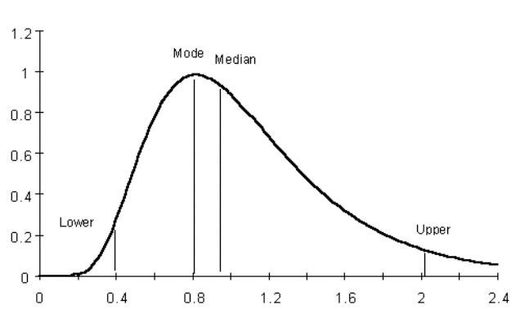
Uncertainty
Point Estimate is single statistic value
Generic failure data are often provided in reliability databases as point estimates (mean or median)
Random Variable is s statistical distribution of probable values
A component’s failure rate is considered a random variable where all possible values are represented by a probability distribution
Uncertainty is represented as the bounds of a probability distribution for a parameter
Median
Mean
Probability Density
0
0 5th 50th 65th 95th
Lognormal (PDF) representing Random Variable uncertainty

Slide 4
Background on Uncertainty
Understanding the sources of uncertainty, how to estimate it, and methods for reducing it supports better decision making
Design and Development of Complex Launch Vehicles
Launch Readiness Decisions
Scenario and System Trade Studies
Two types of uncertainty
Aleatory (inherent physical random variability)
Typically inherent in every system and cannot be reduced
Epistemic (lack of knowledge or ignorance)
Can be reduced by increasing knowledge
Epistemic uncertainty includes:
Completeness (missing scope/scenarios)
Parameter (component/subsystem)
Model (assumptions and development)
This presentation will focus on epistemic uncertainty associated with the parameters of reliability data

Slide 5
Parameter Data Sources and the Concern of Applicability
New Launch vehicles (LV) comprise heritage and new hardware
Generic reliability data are collected from a wide spectrum of sources:
Component databases (NPRD, EPRD, NUCLARR, etc.)
Aerospace historical data
Other industry historical data
Piece part count method (MIL-HDBK-217F)
Engineering judgment
This variety of data sources raises the concern of source data applicability to target parameter

Slide 6
What is Data Applicability and why is it important
Applicability is the degree of credibility and relevance of the source data
Data applicability is a significant source of epistemic uncertainty that affects the spread of the distribution
The heuristic approach is one way to consistently incorporate subjective judgments about applicability into the modeling process that fits in well with the Bayesian methods permit the use of subjective information
The evaluation of applicability with a heuristic approach is most useful
When other Bayesian statistical methods are not available or yield poor results
To ensure consistent judgments throughout the model

Slide 7
An approach for quantifying data applicability
Source applicability is divided into two categories
Data source application
Rank most applicable to least applicable data sources
Data source environment
Uncertainty increases when converting from one type of environment to another (i.e., GF to AUF, or AUF to AIF)
Classify the applicability of the reliability data source
Assess the environmental conditions between the source and the target parameter
Apply the appropriate K factor (Logistic Performance Factors) to adjust the source data mean from its environment to predict the mean failure rate of the component in the application environment
For each data source, apply the heuristic guidelines to quantify the uncertainty due to applicability

Slide 8
Data Source Classification Approach The complete Table

Slide 9
Process to Reduce Uncertainty
Data Sources
Collect failure rate data for the components
Assign lognormal prior distributions to failure rates by selecting the appropriate error factor for each unique reliability block
Assign Applicability values (Uncertainty)
Assign Correlation
Correlate reliability blocks
Loop
Uncertainty Analysis
Run uncertainty analyses (i.e., MC)
Iterative
Uncertainty Importance
Analyses
Run uncertainty importance analyses and determine which blocks drive the lower and upper bounds

Slide 10
Case Study Simple Fault Tree
A simple model consists of 4 components 1, 2, 3 and 4
Component 1 is in parallel with components 2, 3, and 4
Components 2, 3, and 4 are connected in a series configuration

Slide 11
Case Study Uncertainty Quantification Results Run1
Model Error Factor (EF) = 95th/ Median = 16.2
Notes:
Restate the following: An EF is a measure of uncertainty

Slide 12
Case Study Uncertainty-Importance Analysis
The Uncertainty-importance routine identified component 1 as a major driver of the model uncertainty
A data research on Component 1 yielded more applicable data
Found historical data for a like component from the aerospace industry

Slide 13
Case Study Uncertainty Quantification Results Run2
Model Error Factor (EF) = 95th/ Median = 5.6
Notes:
Restate the following: An EF is a measure of uncertainty

Slide 14
Conclusion
Uncertainty represents the spread of the parameter estimate. How confident are we that the estimate is correct
Useful for decision makers
Communicates credibility or lack of it
Highly applicable data improves the certainty of model estimates
Crucial step that increases the confidence level of the components and subsequent uncertainty estimate
Translating between environments may be a significant source of parameter uncertainty
Uncertainty-Importance routines can be a basis for data analysis efforts
By prioritizing the need to collect additional parameter data

Slide 15
Questions?
POC: Mohammad AL Hassan (Mo)
Mohammad.i.alhassan@nasa.gov
205-544-2410

