Slide 1
Burden versus Capability Statistical Analysis for Structural Probabilistic Risk Assessments
RAM XI Training Summit
October 2018
Becky Green, QD35, Bastion Technologies, Inc.
Frank Hark, QD35, Bastion Technologies, Inc.

Slide 2
Background
The purpose of the burden versus capability analysis is to analyze the ability of components to withstand the loads that they are subjected to
When designing a launch vehicle, there is always a trade-off for the strength of the components versus the weight of the vehicle
The vehicle needs to have some margin built in to the design, but this added margin should not add a significant amount of weight to the vehicle
When the material properties and limits are known, estimated loads can be used to ensure that the vehicle will survive launch loads
If the variation in the distributions can be quantified, the probability of failure can be estimated more accurately
Notes:
The vehicle has to be strong enough to survive the loads, yet light enough to reach its destination
Eventually, a point is reached where increasing the margin of safety does not provide sufficient benefit to the strength of the vehicle, and only adds unnecessary weight

Slide 3
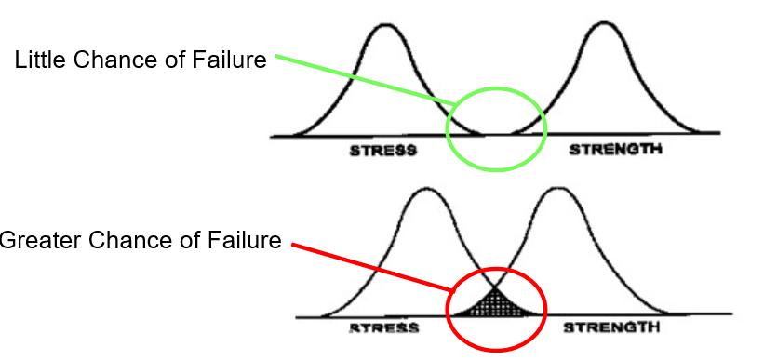
Introduction
A burden versus capability analysis is the analysis of the strength of the component and the interference of the stresses placed on the component
The overlap of the stress and strength distributions estimates the probability of failure
Notes:
http://slideplayer.com/slide/6207332/

Slide 4
Factor of Safety
The burden versus capability analysis relies on the ratio of the ultimate strength of the component to the stress of the component under design loads
To simplify calculations, the realized factor of safety and max stress are used in place of the ultimate strength of the component and stress of the component under design loads
$$\frac{Realized Factor of Safety}{1}=\frac{Ultimate Strength of the Component}{Stress of Component under Design Loads}$$
Notes:
http://www.writeopinions.com/safety-factor
Understanding the variability of stresses and strengths is useful in preventing overlap of the stress distribution onto the strength distribution in order to improve the reliability of a design
This ratio is defined as the realized factor of safety
Many systems are purposefully built much stronger than needed for normal usage to allow for unexpected loads
The factor of safety can be interpreted as the structural capacity of a component beyond the expected loads
It essentially defines how much stronger the system is than it typically needs to be for an intended load

Slide 5
Margin of Safety, Safety Factor, and Factor of Safety
By definition, as long as the margin of safety is greater than zero, the design is meeting its safety factor requirements
For example, if the design safety factor is 1.4 and the margin of safety is 0, the realized factor of safety will be 1.4
$$Margin of Safety=\frac{Failure Load}{Design Load×Design Safety Factor}−1$$
$$Margin of Safety=\frac{Realized Factor of Safety}{Design Safety Factor}−1$$

Slide 6
Estimating the Stress Distribution
Three parameters are used to create the lognormal distribution for the stress, or burden, estimated for the components:
${CV}_{Stress}$– The coefficient of variation assumed for the loads that the component is subjected to
$Z_{Max}$– The number of transformed normal standard deviations that is assumed between the loads that are used in the analysis (design loads) and the load mean
${Stress}_{Max}$– The stress that is expected for the component when applying the design loads
Notes:
Generally, CV(stress) = 0.2
Generally, Zmax = 3
If using actual stresses for the strength vs. stress calculation, this value is the expected stress when design loads are applied
If using “Realized Factor of Safety” for the strength estimate, then “Stress max” = 1

Slide 7
Estimating the Strength Distribution
Similar parameters are used to create the lognormal distribution for the strength, or capability, estimated for the component:
${CV}_{Strength(mean)}$– The coefficient of variation assumed for the strength distribution, which is used to calculate the mean strength
${CV}_{Strength(prob)}$– The coefficient of variation assumed for the strength distribution, which is used to calculate the standard deviation of the strength
$K_{Strength}$ – The number of transformed normal standard deviations that is assumed between the mean material stress capability and the stress capability assumed in the stress analysis
Ultimate strength of the component – The predicted stress needed for the component to fail
Notes:
For the purposes of calculations, Cvmean is usually left constant (i.e. 0.05), and Cvprob can be varied depending on the component material. These two parameters are commonly the same.
Generally, CV(strength) = 0.05 to 0.2
Generally, “K-strength” = 3
Mean strength is then used to calculate mu strength
Standard Deviation Strength is then used to calculated sigma strength
This stress is assumed to be “$K_{Strength}$” standard deviations from the mean stress capability of the component
If using actual stresses, this value is the stress capability of the component material assumed in the material
Use Realized Factor of Safety if setting “Stress max” = 1

Slide 8
Explanation of Equations and Calculations
Assume that both the design load (L) and the material strength (S) are random variables that have lognormal probability density functions (pdf) with parameters, $μ_{L}, σ_{L }$and $μ_{S}, σ_{S }$, respectively
With these assumptions, Ln(L) ≈ N($μ_{L}, σ_{L })$ and Ln(S) ≈ N($μ_{S}, σ_{S }$)
Which leads to S – L ≈ $N\left(μ_{L}−μ_{S}, \sqrt{{σ_{L }}^{2}+{σ_{S }}^{2}}\right)$
Failure occurs when the applied load exceeds the ultimate strength of the structural component, and the probability of failure of the component is calculated as Pr(S-L<0)
Using normal distribution theory, we can transform S-L to a standard normal distribution z ≈ N(0,1) by subtracting the means and dividing by the standard deviations
Notes:
Once the lognormal parameters of the distributions are established, those parameters are used to estimate the failure probability of the component
Then it is simple to calculate the probability of failure using Excel functions rather than by numerical integration

Slide 9
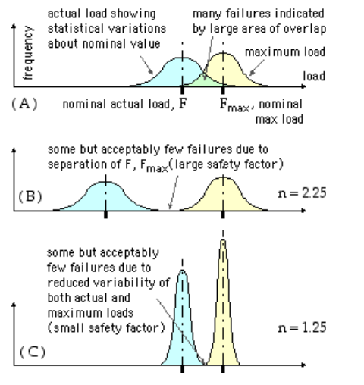
Examples
As can be seen in the three graphs on this slide, the factor of safety and the variability within each of the distributions greatly influences the probability of failure of the component
Having a high factor of safety and a low variability in the stress and strength distributions can help lower the probability of failure
Notes:
http://www-mdp.eng.cam.ac.uk/web/library/enginfo/textbooks_dvd_only/DAN/SSS/safety/strenPops.gif

Slide 10
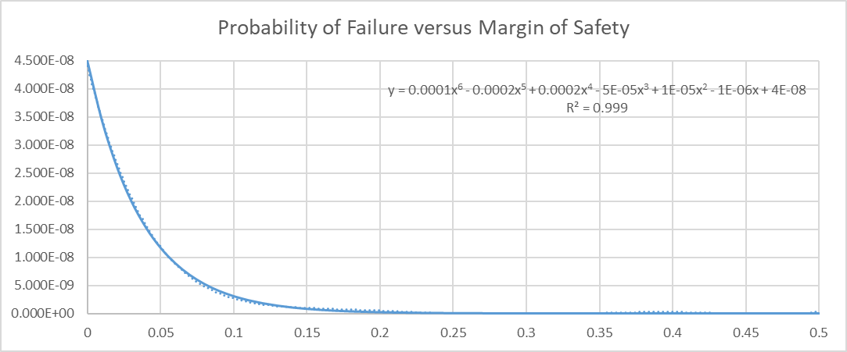
Safety Factor = 1.4
${CV}_{Stress}$ = 0.2
$${CV}_{Strength}=0.05$$
Notes:
*Assuming a safety factor of 1.4, which is the typical value used for safety factor requirements.
The margin of safety is the realized factor of safety divided by the design safety factor minus 1.
The factor of safety graph follows the same curve.
Diminishing return, when is factor/margin of safety enough
At a margin of safety of ~0.15 (FS 1.61), it can be seen that any increases in the margin of safety only result in a minimal decrease in the probability of failure. At a margin of safety of 0.20 (FS 1.68), any increase in the margin of safety would result in practically no change to the probability of failure.

Slide 11
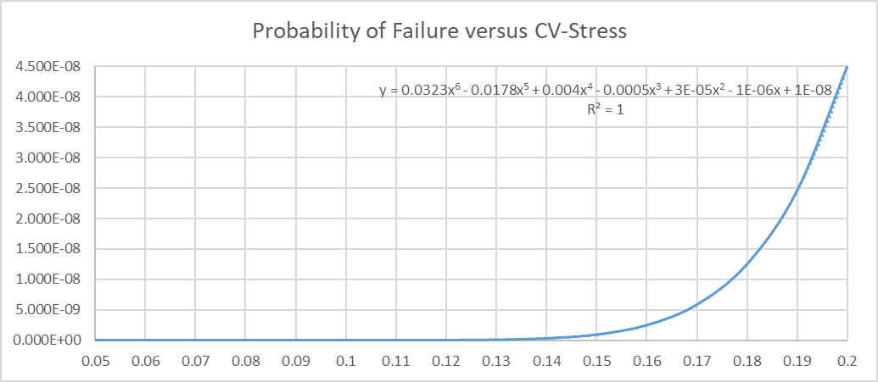
Safety Factor = 1.4
Margin of Safety = 0
$${CV}_{Strength}=0.05$$
Notes:
*Assuming 0 margin of safety, 1.4 safety factor, and 0.05 CV-Strength.
The CV-Strength graph follows the same curve with a slightly different y equation.
Y=13.008x6-6.3037x5+1.3381x4-0.1531x3+0.0099x2-0.0003x+5E-06 with an R2 value of 1.
At a CV-Stress greater than 0.14, the probability of failure increases substantially.

Slide 12
Conclusions
Understanding the variability of stresses and strengths is useful in preventing overlap of the stress distribution onto the strength distribution in order to improve the reliability of a design
Having less variability in the distributions, and having a higher factor of safety, are two ways to help improve the reliability of structural components

Slide 13
References
http://slideplayer.com/slide/6207332/
http://www.writeopinions.com/safety-factor
http://www.mdp.eng.cam.ac.uk/web/library/enginfo/textbooks_dvd_only/DAN/SSS/safety/strenPops.gif

