Slide 1
Knowing When to Stop: An Examination of Methods to Minimize the False Negative Risk of Automated Abort Triggers
RAM XI Training Summit
October 2018
Patrick Fussell, QD35, Bastion Technologies, Inc.
Esha Rahaman, QD35, Bastion Technologies, Inc.

Slide 2
Introduction
Crewed launch vehicles contain a series of abort options
Ground Control and Range Safety are able to manual initiate aborts and the flight safety system
However, due to the very fast response time required to ensure safety of the crew in many abort scenarios, the flight computers are able to initiate automatic aborts
An automated abort will safe the vehicle by cutting off the engines, get the crew capsule away from the vehicle, and if necessary activate the flight safety system
Notes:
General abort information

Slide 3
Automated Aborts
Flight computers monitor sensor data to determine if abort actions should be initiated based on current flight conditions
These range from simply warnings to immediately aborting and initiating the flight safety system
Failure to identify an out of range condition it is considered a false negative failure
If the flight computer takes an abort action when conditions are nominal it is considered a false positive failure
Notes:
Chart 1 shows a simulated sensor signal nominally functioning in range.
Chart 2 shows a simulated sensor signal nominally functioning, showing the measured condition out of range at 45s

Slide 4
Sensor Failure Modes
Sensor failure modes include ‘fail high’ and ‘fail low’
Fail High - upon failure the signal will be at the upper range
Fail Low - upon failure the signal be at the lower range
Either sensor failure can potentially lead to a false positive OR a false negative failure depending on the limits for that parameter
Notes:
Chart 1 shows a simulated failed high sensor signal at 45s going out of range
Chart 2 shows a simulated failed low sensor signal at 45s

Slide 5
Sensor False Negative Mitigation
To protect against false negative failures a variety of methods are used
Sensor Redundancy
Sensor failure logic resiliency
Sensors for multiple independent flight conditions
Unfortunately, most of these will inadvertently increase the false positive risk
This presentation will review PRA analysis of several common methods to mitigate false negative risks and present sensitivities showing how the methods affect false negative and positive risks

Slide 6
Additional Considerations
Software used to interpret the signals will be modified when using any of these methodologies
This increase in complexity, will in turn decrease software reliability
This can be a driver in decreasing over-all reliability when you are trying to mitigate it
Notes:
Once the lognormal parameters of the distributions are established, those parameters are used to estimate the failure probability of the component
Then it is simple to calculate the probability of failure using Excel functions rather than by numerical integration

Slide 7
Quantitative Analysis Using Notional Sensor Hardware
In the following examples we will be looking at two kinds of sensors
The first has a failure mode distribution of 15% Fails High, and 85% Fails Low with a reliability of 0.99999
The second sensor has a failure mode evenly split with a reliability of 0.999995
These are notional, but realistic failure probabilities
A false negative will be defined as a failed low signal from all sensors
In our examples this would cause a failure to abort when the situation would require an abort
A false positive will be defined as any failed high sensor
In our example this causes a spurious abort
Notes:
Once the lognormal parameters of the distributions are established, those parameters are used to estimate the failure probability of the component
Then it is simple to calculate the probability of failure using Excel functions rather than by numerical integration

Slide 8
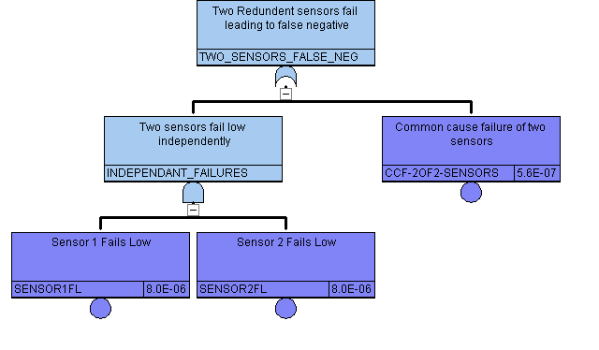
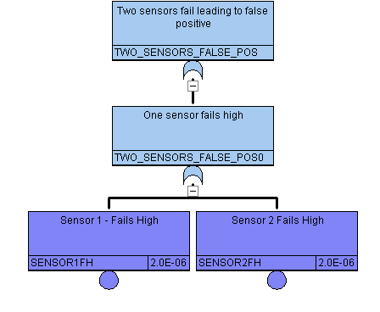
Sensor Redundancy
Scenario | Fails to Abort | Spurious Abort | Total | Total+SW
One Sensor | 1 in 120,000 | 1 in 670,000 | 1 in 100,000 | 1 in 91,000
Two Sensors | 1 in 1,700,000 | 1 in 330,000 | 1 in 280,000 | 1 in 210,000
Failure to Abort
Adding another sensor reduces the false negative risk exposure
This however increases exposure to false positive failures
Depending on the sensor configuration’s failure mode distribution this can end up leading to a higher over-all loss of mission risk
Increase in software complexity decreases software reliability
False negative is not lowered as much as may be expected due to Common Cause
Spurious Abort

Slide 9
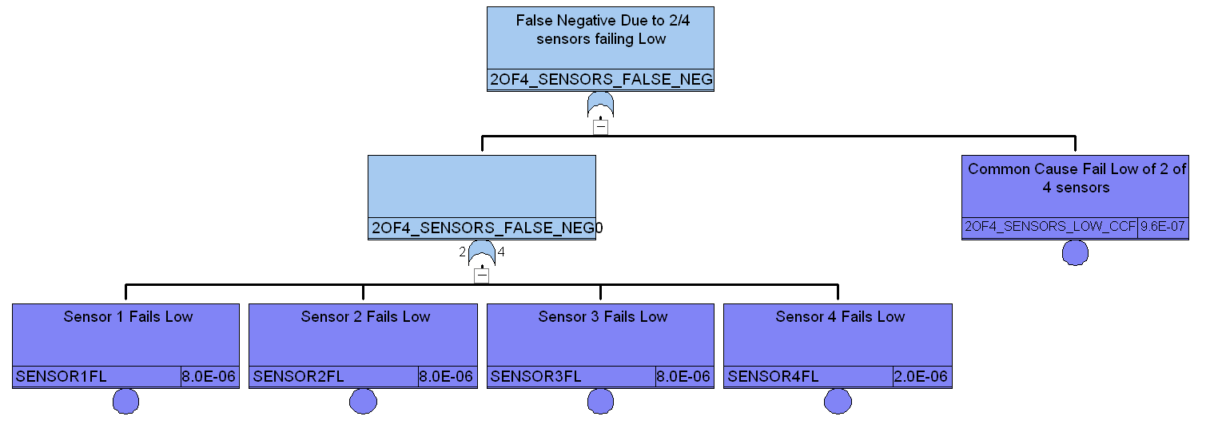
Sensor Failure Logic Resiliency
Scenario | Fails to Abort | Spurious Abort | Total | Total+SW
One Sensor | 1 in 120,000 | 1 in 670,000 | 1 in 100,000 | 1 in 91,000
3/4 Sensor logic | 1 in 980,000 | 1 in 5,600,000 | 1 in 830,000 | 1 in 310,000
Adding a three of four required sensor logic reduces both false negative and positive
This will again decrease software reliability, but generally not enough to outweigh the benefits
While this lowers the overall risk, it also increases flight sensor hardware, and may not be feasible when modifying a current design due to cost and schedule constraints
Failure to Abort
Spurious Abort logic will be identical, but with fails high.

Slide 10
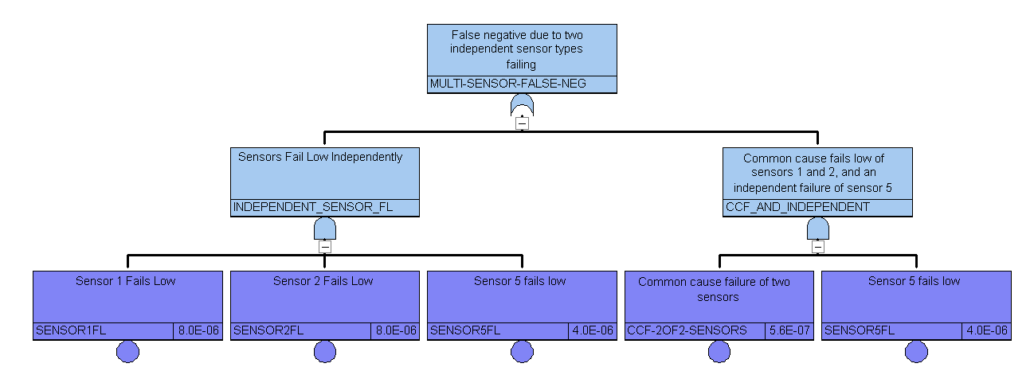
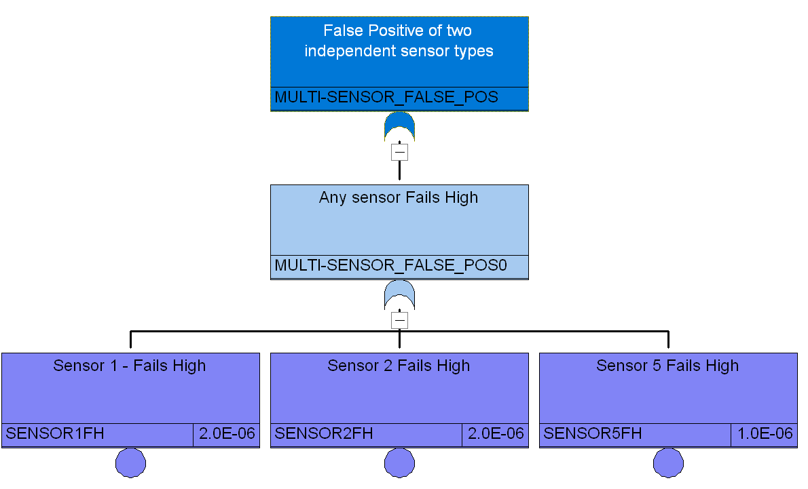
Applying Independent Sensor Check
Scenario | Fails to Abort | Spurious Abort | Total | Total+SW
One Sensor | 1 in 120,000 | 1 in 670,000 | 1 in 100,000 | 1 in 91,000
Independent Sensor added | < 1 in 1,000,000,000 | 1 in 250,000 | 1 in 250,000 | 1 in 190,000
Using multiple parameters, such as temperature and pressure to self check
3/3 low signals leads to a false negative
1/3 high signals triggers the abort
Essentially reduces all risk due to a false negative, due to independent sensor failure allowing common cause to be less of an issue
Adds significant software complexity, decreasing reliability of software
Failure to Abort
Spurious Abort
Notes:
Once the lognormal parameters of the distributions are established, those parameters are used to estimate the failure probability of the component
Then it is simple to calculate the probability of failure using Excel functions rather than by numerical integration

Slide 11
Design Change
Scenario | Fails to Abort | Spurious Abort | Total | Total+SW
Two Sensors | 1 in 1,700,000 | 1 in 330,000 | 1 in 280,000 | 1 in 210,000
Independent Sensor added | 1 in 250,000 | < 1 in 1,000,000,000 | 1 in 250,000 | 1 in 190,000
In a hypothetical design change, a redundant sensor design was found to be too susceptible to false positive failure, driven by common cause failures
This leads to an effort to redesign the sensors to make use of an independent sensor already available
The change will essentially remove the chance of a false negative failure
However, due to the software changes required and the additional risk of false positive from the added sensor, PRA results show that the change will lead to an overall decrease in reliability

Slide 12
Summary /Conclusion
The failure of sensors used in automatic aborts can lead to two very different failure scenarios based on the failure mode
Components, such as sensors, that have multiple failure modes and effects, can lead to unintentional risk increases if design changes are focused on improving only one of these effects.
When performing a design change, risk-based analysis with a PRA model is a critical input for risk-based decision making
This gives decision makers a full picture of the risk that will be incurred/removed from the system based on the proposed change
When analyzing sensors, or any component with varying failure modes and effects, using a fully integrated system model to ensure all risk changes are captured is vital
The best option reliability wise is resiliency using a voting logic. This has a higher reliability for both failure modes. Cost, vehicle weight, and schedule often require a compromise, using a PRA in tandem with design will help balance risk vs. costs

