Slide 1
Component Specific Environmental Conversion Factors
RAM XI Training Summit
October 2018
Aaron Young, QD35, Bastion Technologies, Inc.
Frank Hark, QD35, Bastion Technologies, Inc.
Spence Hatfield, QD22, Bastion Technologies, Inc.

Slide 2
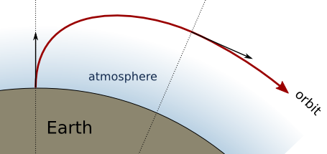
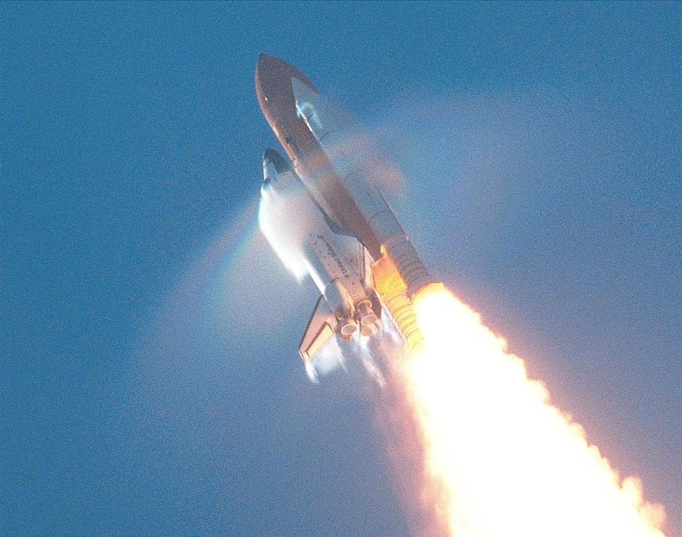
Introduction
Spacecraft face the unique challenge of experiencing several different environments (e.g. temperature, pressure, gravitational forces) over the course of a single mission.
Risk and reliability analyses must consider the period of performance within and the impacts of each environment to the mission.
Unfortunately data for operating environments of interest is often unavailable for the operating environment.
Therefore it is common practice in reliability analyses to refer to a handbook (e.g. MIL-HBK-338B) to provide guidance and environmental conversion factors for electrical components to apply data across multiple environments.
However due to the wide range of differences between mechanical and electrical components, using a standard set of environmental conversion factors for all components could result in over- or underestimating the reliability for components based on their sensitivity to various environments.
Notes:
We are unaware of guidance for converting between environments for mechanical components.

Slide 3
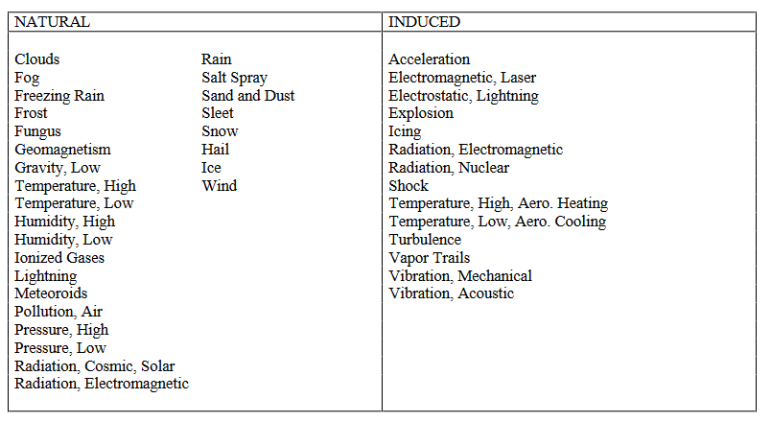
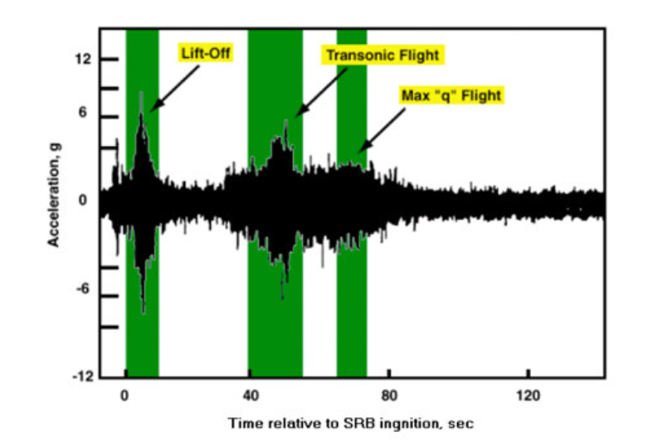
The Environments
The three commonly recognized environments that a spacecraft must undergo over the course of a mission are on-pad , ascent (through atmosphere), and space operations.
Depending on the environment, the impact of natural and induced factors vary in their effect on a given component’s reliability.
Vibration Time History During Space Shuttle Launch²
MIL-HBK-337F: Table 7.6-1¹
Notes:
http://slideplayer.com/slide/6207332/

Slide 4
Military Handbooks
MIl-HDBK-217F provides environmental tables for converting the provided failure rate point estimate from one environment to another, but does not estimate the uncertainty associated with this conversion.³
Using a microelectronic part-type as an example, the environmental factor (π_{E}) conversion formula was first derived from the failure rate ($λ_{p}$) reference
$λ_{P}=\left(C_{1}π_{T}+C_{2}π_{E}\right)π_{Q}$
C₁ is the circuit complexity, C₂ is the packaging complexity
π_{T} is the component joint temperature factor, π_{Q} is the component quality factor
π_{L} is the learning factor (assumed 1 by the handbook)
Solving for π_{E} , the equation becomes
$π_{E}=\frac{\left(\frac{λ_{p}}{π_{Q}}\right)−C_{1}π_{T}}{C_{2}}$
Notes:
http://slideplayer.com/slide/6207332/

Slide 5
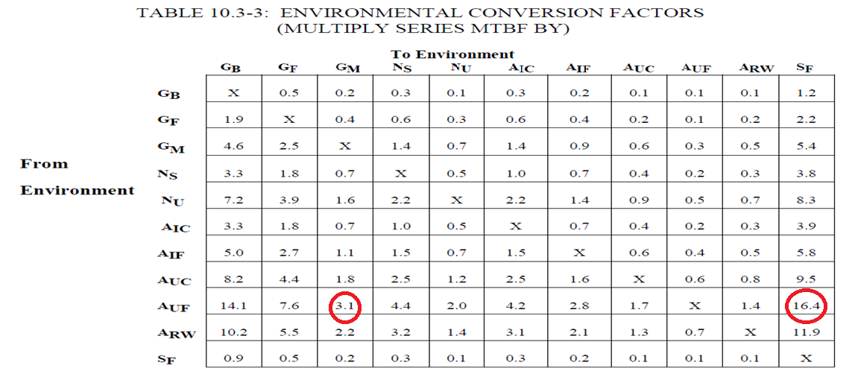
Military Handbooks (cont.)
MIL-HBK-338B provides guidance to determine an electrical component’s reliability by evaluating performance shaping factors, including environmental factors.
Table 10.3-3 provides a conversion factor to apply to a failure rate when transitioning from one environment to another.
Notes:
http://slideplayer.com/slide/6207332/

Slide 6
Databases (Historical Experience)
The Nonelectric Part Reliability Data (NPRD-2016)⁵ and the Electric Part Reliability Data (EPRD-2014)⁶ provide one of the largest existing general collections of failure data today.
By comparing the failure rates for the same component in different environments, it is possible to generate an environmental conversion factor for that given component based on historical experience.
The resulting environmental conversion factor will then be compared to the value within MIL-HBK-338B.
Notes:
http://slideplayer.com/slide/6207332/

Slide 7
Ground Rules & Assumptions/Limitations
Ground Rules & Assumptions
Only Military Grade equipment are considered in this evaluation.
Any data used in the evaluation must have at least 100,000 hours of operating experience and at least 1 failure.
Since data is often provided in the context of an Airborne Uninhabited (AUF) environment, the cases evaluated will be limited to conversions between the AUF and Space Flight (SF) and the AUF to Ground Mobile (GM) environments.
Limitations
Data pertaining to components operating in a space flight environment is limited, thus reducing the possible number of comparisons.
Data does not account for specific manufacturing processes.
Notes:
http://slideplayer.com/slide/6207332/

Slide 8
AUF to GM Comparison – Electrical Components
The following table is a comparison of components operating within the AUF and GM environments.
The conversion factor from AUF to GM is 3.1.
Component | Type | Airborne Uninhabited (AUF) Environment |  |  |  | Ground Mobile (GM) Environment |  |  |  | Demonstrated Conversion Factor | % Difference Between MIL-338B (Demonstrated/MIL-338B)
 |  | Failure Rate (per million hours) | Failures | Data Time (hrs) | Data Source | Failure Rate (per million hours) | Failures | Data Time (hrs) | Data Source
Circuit Card | Electrical | 0.81 | 33 | 40,739,000 | 17718-000 | 0.03 | 1 | 30,420,000 | 17718-000 | 24.64 | 694.88%
Connector | Electrical | 1.07 | 40 | 37,229,582 | 265827-000 | 0.31 | 2 | 6,404,060 | 14851-000 | 3.44 | 10.98%
Power Transmitter | Electrical | 5.41 | 12 | 2,217,000 | 16953-000 | 0.44 | 7 | 15,774,000 | NPRD-106 | 12.20 | 293.46%
Relay | Electrical | 3.49 | 20 | 5,727,628 | 265827-000 | 1.38 | 9 | 6,528,340 | 23037-000 | 2.53 | -18.29%
Switch | Electrical | 17.09 | 6 | 351,096 | 23035-000 | 17.48 | 23 | 1,315,971 | 23037-000 | 0.98 | -68.46%
Transformer | Electrical | 0.70 | 6 | 8,591,442 | 265827-000 | 0.21 | 2 | 9,606,090 | 14851-000 | 3.35 | 8.20%
Notes:
http://slideplayer.com/slide/6207332/

Slide 9
AUF to GM Comparison – Mechanical Components
The following table is a comparison of components operating within the AUF and GM environments.
The conversion factor from AUF to GM is 3.1.
Component | Type | Airborne Uninhabited (AUF) Environment |  |  |  | Ground Mobile (GM) Environment |  |  |  | Demonstrated Conversion Factor | % Difference Between MIL-338B (Demonstrated /MIL-338B)
 |  | Failure Rate (per million hours) | Failures | Data Time (hrs) | Data Source | Failure Rate (per million hours) | Failures | Data Time (hrs) | Data Source
Actuator | Mechanical | 48.13 | 76 | 1,579,000 | 16953-000 | 2.21 | 1 | 453,000 | 10812-000 | 21.80 | 603.34%
Filter | Mechanical | 8.55 | 1 | 117,000 | 16953-000 | 2.75 | 14 | 5,098,000 | NPRD-106 | 3.11 | 0.40%
Generator | Mechanical | 256.41 | 60 | 234,000 | 16953-000 | 18.87 | 2 | 106,000 | NPRD-095 | 13.59 | 338.38%
Heat Exchanger | Mechanical | 13.31 | 6 | 450,900 | 13514-000 | 0.69 | 3 | 4,354,000 | NPRD-106 | 19.31 | 522.98%
Valve (Hydraulic) | Mechanical | 104.11 | 147 | 1,412,000 | 16953-000 | 14.42 | 3 | 208,000 | NPRD-095 | 7.22 | 132.84%
Notes:
http://slideplayer.com/slide/6207332/

Slide 10
AUF to SF Comparison
The following table is a comparison of components operating within the AUF and SF environments.
The conversion factor from AUF to SF is 16.4
Lack of data in the space flight environment results in limited comparisons.
Component | Type | Airborne Uninhabited (AUF) Environment |  |  |  | Space Flight (SF) Environment |  |  |  | Demonstrated Conversion Factor | % Difference Between MIL-338B (Demonstrated/MIL-338B)
 |  | Failure Rate (per million hours) | Failures | Data Time (hrs) | Data Source | Failure Rate (per million hours) | Failures | Data Time (hrs) | Data Source
Relay | Electrical | 3.491847 | 20 | 5,727,628 | 265827-000 | 0.714796 | 2 | 2,798,000 | 10219-034 | 4.89 | -70.21%
Switch | Electrical | 17.089343 | 6 | 351,096 | 23035-000 | 0.418235 | 1 | 2,391,000 | NPRD-106 | 40.86 | 149.15%
Generator | Mechanical | 256.410256 | 60 | 234,000 | 16953-000 | 1.223446 | 11 | 8,991,000 | NPRD-056 | 209.58 | 1177.93%
Notes:
http://slideplayer.com/slide/6207332/

Slide 11
Summary & Conclusions
When comparing the conversion factor based on demonstrated data against the conversion factor in the handbook, applying a conversion factor intended for electrical components to mechanical components results in under- and over-estimating the risk contribution.
Potential significant reliability assessment impacts (i.e. single point failures)
Furthermore, historical experience reveals a wide variance in environmental conversion factors on a component by component basis.
Implementing component specific environmental conversion provides a path forward to aptly estimate the reliability rates for components operating across multiple environments.
However, in order to do so, more work needs to be performed into gathering component reliability data across the operating environments.
Notes:
http://slideplayer.com/slide/6207332/

Slide 12
References
https://www.navsea.navy.mil/Portals/103/Documents/NSWC_Crane/SD-18/Test%20Methods/MILHDBK338B.pdf
https://pdfs.semanticscholar.org/b658/f300dd0f46cc746a7de31f1d21b341894619.pdf
Source Data Impacts on Epistemic Uncertainty for Launch Vehicle Fault Tree Models. Mohammed Hassan, Steven Novack, Rob Ring.
https://www.nasa.gov/sites/default/files/files/NP-2015-03-015-JSC_Space_Environment-ISS-Mini-Book-2015-508.pdf
NPRD-2016
EPRD-2014
https://open.nasa.gov/blog/being-the-nasa-trajectory-analyst-for-the-launch-vehicle-on-mars-science-lab-2/

