Slide 1
CBM+ and Cost Wise Readiness (CWR) Overview
04 November 2014

Slide 3
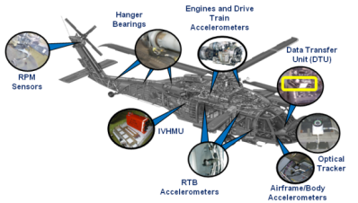
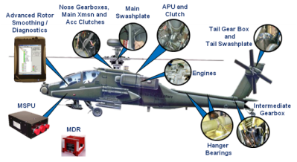
AMCOM CBM+
Preventive -- Indicators -- Diagnostics -- Prognostics -- On-Condition
Digital Source Collector Installation
Health Monitoring Unit (HMU) Installation
Knowledge Development
CI / HI Development
Flight Line Diagnostics
Institutionalized Training
Remaining Useful Life Calculation
Inspection Targeting
Mission-Based Forecasting
CBM+ Program Supporting ARFORGEN
CBM+ Program Objectives:
The Purpose of Army Maintenance is to Generate Combat Power. AR 750-1
Decrease Maintenance Burden on the Soldier
Increase Platform Availability & Readiness
Enhance Safety
Reduce Operations & Support (O&S) Costs
Army-Approved CBA; $2B Life-Cycle Cost Avoidance
87% of AVN Fleet CBM+ Enabled
Averted 4 Class A Mishaps
Monitors 290 Gears, Bearings, & Shafts
IVHMS
Rotor Smoothing
Engine Health
Drive Train Health
Logbook
Interface
Key CBM+ Enablers
Structural Health
Digital Source Collectors
Health Monitoring Units
Flight Line Diagnostics
Data Fusion/Analysis
Exceedance Monitoring
MSPU
Validated post-investment assessments with 16% of completed projects evaluated
10% MMH avoided due to CBM
Cost-Wise Readiness Through CBM+

Slide 4
CBM+ Implementation
Where Are We Today
Where Are We Today
Where Are We Going
Where Are We Going
87% CBM Enabled Legacy Fleet
87% CBM Enabled Legacy Fleet
100% CBM Enabled Fleet by 2020 (all MDS)
No Additional Funding Needed
1. Equip/Collect
3,347 Aircraft
2. Transmit
40,000 Weapon System Users
Sustained 99.47% availability
300 Servers / 2900 Aircraft
Windows 7/Server 2008 Compatibility
X Delta Enhanced Compression
CIMS Technology Insertion
Army Should Fund this for all Commodities [Infrastructure]
Moves data from tactical to enterprise
Links enterprise to tactical unit (TM updates, SOF, AWR, etc.)
3. Warehouse
101.52TB Data
DREN Connectivity to JTDI Top Tier
IRB Approved
Single repository for 5 data feeds
Tiered storage (nearly infinite capacity at reduced cost)
Common CBM DW transition to LOGSA
Interface to LOG domain data cloud
Houses all engineering, parametric, and logistics data
Supports analysis across materiel enterprise (S&T through DEMIL)
4&5. Analyze/Take Action
Only scratched the surface – full potential not yet realized:
Improved readiness
Fewer mission aborts
Fewer MMHs
Lower parts cost
Right-sizing analysis / refining functions
Informal training
“Tribal knowledge”
Target & Prioritize Investment by Readiness & ROI (spend $ on right stuff)
Unified approach to reduce $ / Flight Hour (CBM+, RCM, & all other RAM programs)
Empirical data drives decisions
Transition from 98% OCO Funding to Base
Prioritize, assess value opportunity, identify root causes, develop solutions
Improve maint. / training
Implement process change
Re-design
Optimize Supply
Change Behavior
Continuous Effort that Enables Cost-Wise Readiness

Slide 5
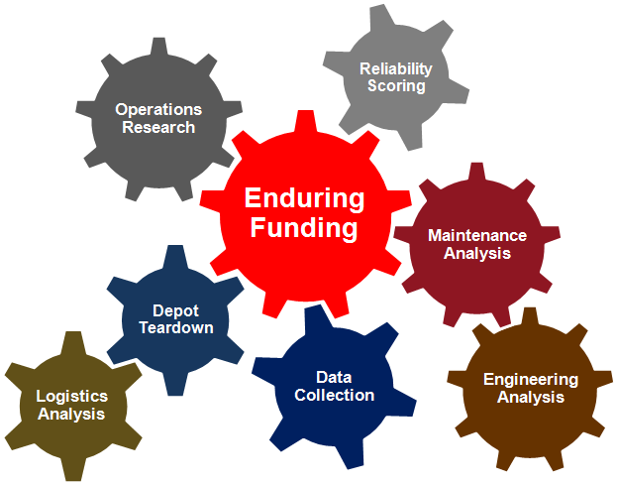
What We Are Doing…
Achieve Cost-Wise Readiness [Goal]
Objectives:
1
Decrease Cost Per Operating Hour to Soldiers/Units for SPARES with NO Loss in Readiness (Demands x Cost = Total Spend)
2
Decrease Maintenance Downtime/Increase Combat Power Generation
(Maintenance Tasks x Duration x Frequency = Total Burden)
Condition
Based
Maintenance
Reliability Improvement
RAM
Objectives
Fleet Management
Enabled By
Obsolescence Mitigation
Corrosion
Prevention & Control
Reliability Centered Maintenance
Stockpile
Reliability

Slide 6
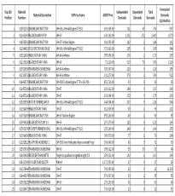
Generate Combat Power for the Warfighter at a Lower Cost
Why and Where?
1
Where do the dollars go?
2
Primary Causes &
Differences by Unit/Geography
Induced Causes
AMCOM Top 200
NEOF
Time Based Removals
Bad Pubs
Training Gaps
Corrosion
Accident
~80% of AWCF
Spend
Demand
DEMANDS
OPTEMPO
Readiness
Inherent Reliability
MMH
UNITS BY LOCATION
Design
Quality
Application
Obsolescence
Low Power
Corrosion
No Evidence of Failure
Leaks
What actions do we take?
How did we do?
3
4
…with Proven, Validated Results
Which Leads to Targeted Action
CBA:
Potential
$2.3B over
20 Years
30 - 40 More PIAs to do; More Projects Started Annually
Focusing Our Efforts on the Process To Save $$$
Notes:
We know that 80% of our annual parts spend thru AMCOM is on the top 200 cost-burden items, which typically also bring highest labor burden and our usually critical safety items. We get after components and practices that are high demand burdens, are not meeting reliability goals, are driving undue Soldier maintenance burden, as well as showing gaps in training and even tech pubs.
As we begin to wrestle together the array of data systems and subject-matter expertise knowledge, we are developing ways to figure out where problems lie (location, unit, etc) and seeking hard answers as to WHY they are kicking our collective rear ends.
This leads to targeted action and focused investments of dwindling dollars (from the AWCF or other appropriations), then studying its quantitative and qualitative effects to make sure we achieved intended results across the Aviation formation.
XSN: One example in our C-WR toolbox has been the CBM program of which many of you are aware.

Slide 7
How We Are Doing It…
End-To-End Sustainment Analysis Process
AVN/MSL
Communities
Prioritize
(IPL)
Analyze (Comp X)
Develop
(RCWG)
Implement
(Data Call)
Track
(PIA/Ledger)
Data Sources & Tools
Induced Causes
NEOF
Time Based Removals
Bad Pubs
Training Gaps
Corrosion
Handling/ Accident
HUMS Sensors
TAMMS-A
Why Units Buy Spare Parts
PQDR
LAR
Reports
LMP
OSMIS
Process Improvement
Behavior Change
Enduring Efforts/Processes
Results
Product Improvement
Sustainment Analysis
Improvement Projects
Inherent Reliability
Prioritize High Cost/Demand Components
Analyze Root Causes Driving Demand Levels
Develop Corrective Actions (Design & Process)
Apply AWCF Funds to Implement Solutions
Track Cost Avoidances to Justify Future Funding
Design
Quality
Application
Obsolescence

Slide 8
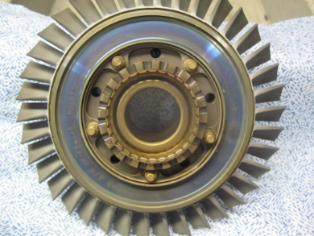
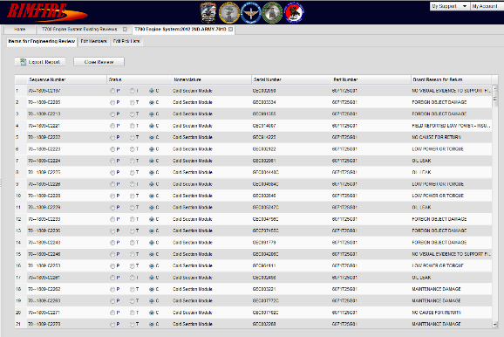
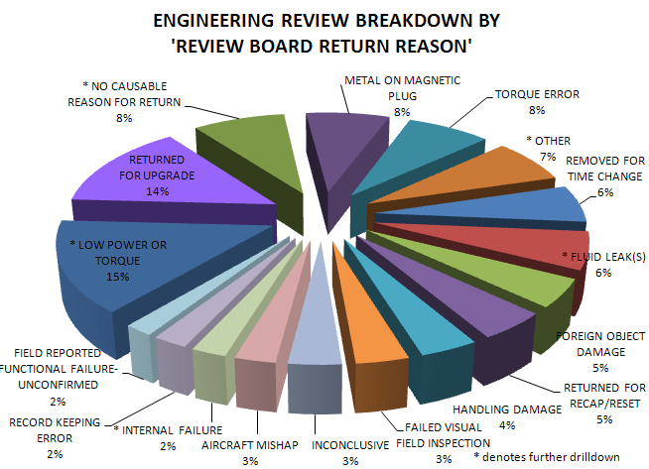
Reliability IMprovement thru Failure Identification & REporting
Provides Failure Reporting & Corrective Action Monitoring of Inducted Equipment Which Enables the Optimization of Overhaul Processes.
Rimfire’s Role is to Help Ensure Successful Execution of the Mission through the Following Initiatives:
Provide Data for Reducing Maintenance Costs
- Overhaul Process Optimization
- Design Improvements
- Remediation
- Increase/Eliminate Retirement Life & TBOs
Enable Component & System Reliability Improvements
- Failure Mode Analysis &Trending
- Condition Based Maintenance (CBM)
- Reliability Centered Maintenance (RCM)

Slide 9
Aviation System Assessment Program
Provides Operational & Maintainability Metrics That Enhances the Focus of Pre-Shop Analysis & Subsequent Overhaul Methods.
Feedback & Attack
ASAP
RCM
Analysis
Candidate Lists
Improvement Program
Compare Analytical Reports to Reality (Soldiers Perspective)
Top RAM Driver Database
Provides Unprecedented Component Visibility
Maintenance Triage Quad
Ties Component History to Maintenance Impact
Aggregates Maintenance, Operational & Cost Data
Provides Holistic Picture of Component Performance
Multiple Reporting Parameters
Consolidates Historical Failure Data
Links Component Performance to Specific Failure Mode Groups

Slide 10
How We Are Doing It…
Prioritize
Analyze
Develop
Implement
Track
End-To-End Sustainment Analysis Process

Slide 11
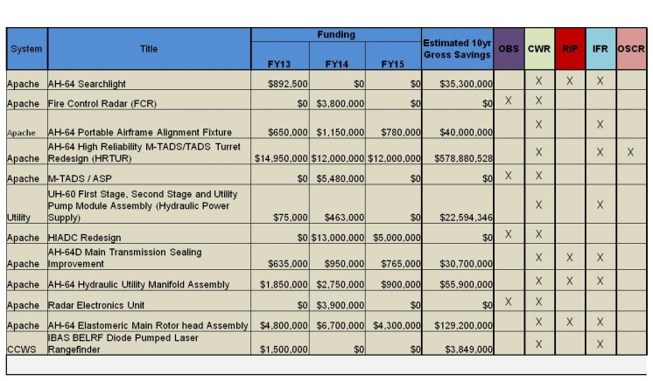
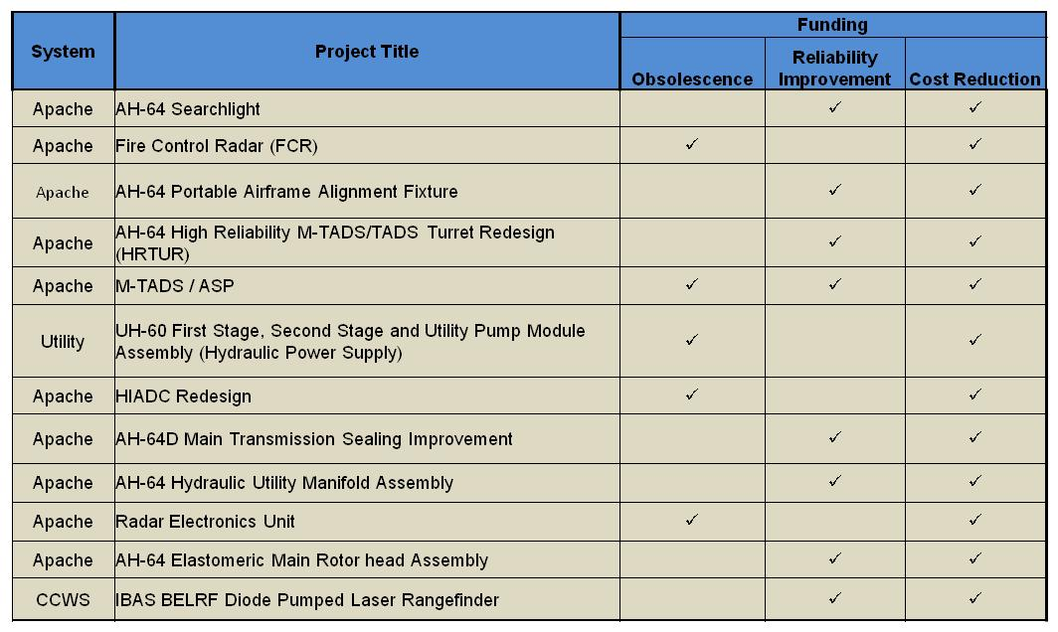
How We Invest
Submit AWCF Investment Project Candidates Twice / Year
Deliverables to AMC
Summary List of Projects, with back data available:
Target(s): Obsolescence, Reliability, Cost Reduction
Include “Mini-BCA”
Project Plan (Description, Objective, Cost & Schedule)
Project List Submitted in SEP and APR for Next Year’s Funding
From This . . .
Achieve Cost Wise Readiness
2.5%Total AWCF Investment
To This . . .
One List
2x Each Year
Fully Vetted* List of ALL AWCF Investment Project Candidates

Slide 12
Project Submittal Checklist
Project Submittal for Individual Course of Action
Problem Statement
Root Cause
Substantiating Data
Proposed Solution
Identify Technology Readiness Level
Technical Criteria (Benefits If Applicable)
Obsolescence
Reliability
Readiness
Return on Investment (10 Year)
Additional Benefits
Risk
Technology
Prototyping
Test and Qualification
Manufacturing
Project Management
Implementation
General
Safety
Fielding Plan
Points of Contact
Data Call Objectives:
Inputs: Proposed CoAs Developed Into Vetted Project Proposals
Project Submittals Scored/Ranked and Amongst Stakeholders
Output: Resources Identified and Approved to Begin Project Implementation

Slide 13
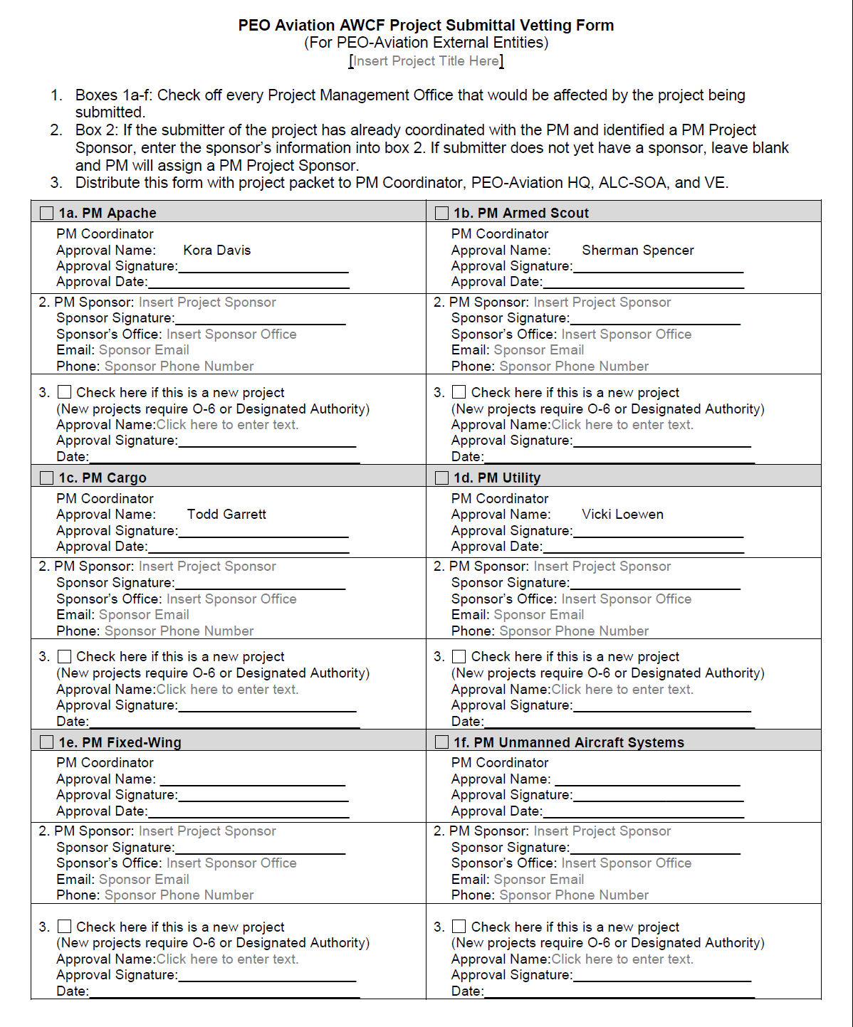
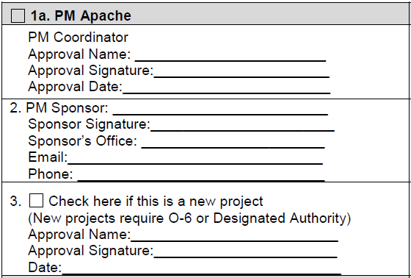
PEO Aviation Vetting Form

Slide 14
Results: Moving Towards CWR
Decreasing trend due to:
Fleet Modernization, RECAP, RESET, Cost-Wise Readiness, Corrosion Prevention, CBM+, etc…
Effective Strategy – Driving Down Cost of Ownership

Slide 15
Summary
Army has made Significant Investment in CBM+/CWR Infrastructure
CBM+ Efforts Require a Sustained Funding Solution to Continue to Drive Down O&S Costs and Sustain Readiness
Takes Time from Investment to Flow of Verified Cost Avoidance
Verified Cost Avoidance / ROI Beginning to be Realized
AMCOM G3 CAD Validated Methodology Support CWR Cost Avoidance
Initial 10 Post-Investment Assessments (PIA) Results Demonstrate a Current Cost Avoidance of $61M (and growing)

Slide 16
QUESTIONS

Slide 18
ALC/SOA Analysis Playbook Overview 04 November 2014

Slide 19
How We Are Doing It…
Prioritize
Analyze
Develop
Implement
Track
End-To-End Sustainment Analysis Process

Slide 20
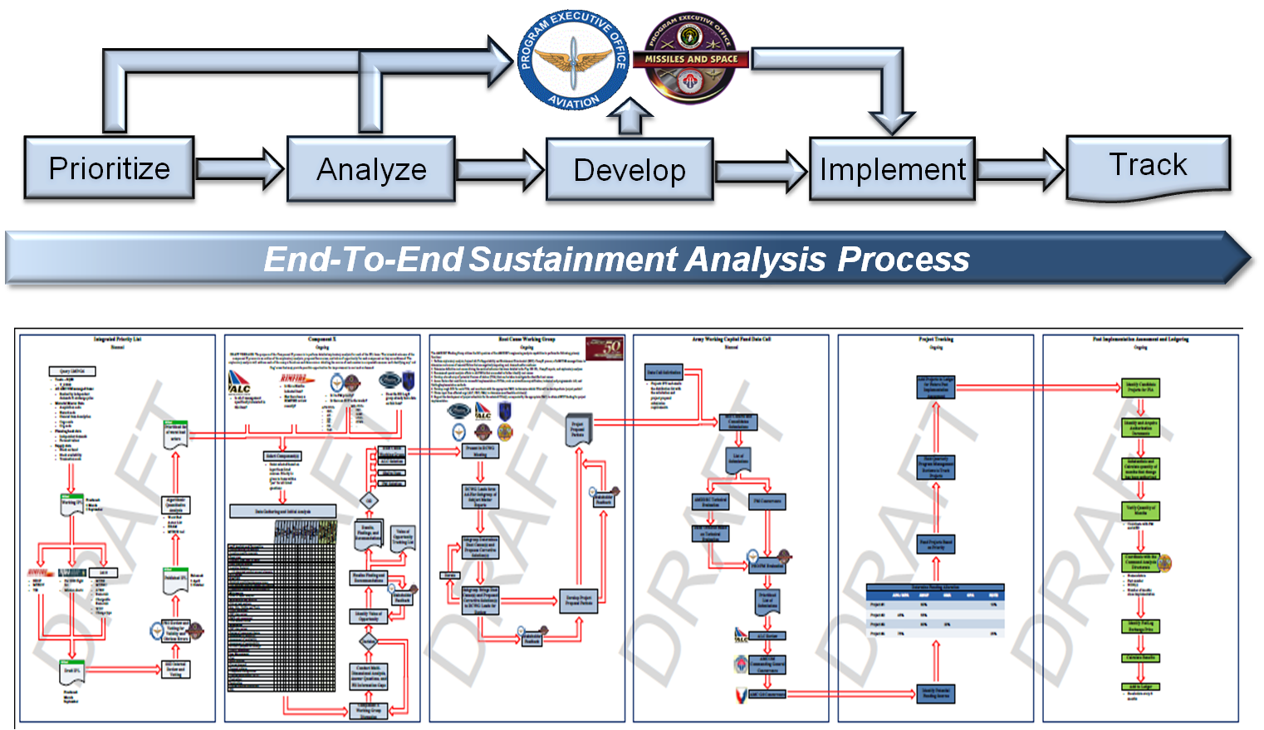
Integrated Priority List (IPL)
Objectives:
Inputs: LMP, 2410, ASAP, RIMFIRE
“Worst Bad Actors” (WBA) – 1 to N List / Methodology
Output: Focusing Mechanism For Further Value of Opportunity Analysis

Slide 21
Integrated Priority List (IPL)

Slide 22
Integrated Priority List (IPL)

Slide 23
Integrated Priority List (IPL)

Slide 24
Integrated Priority List (IPL)

Slide 25
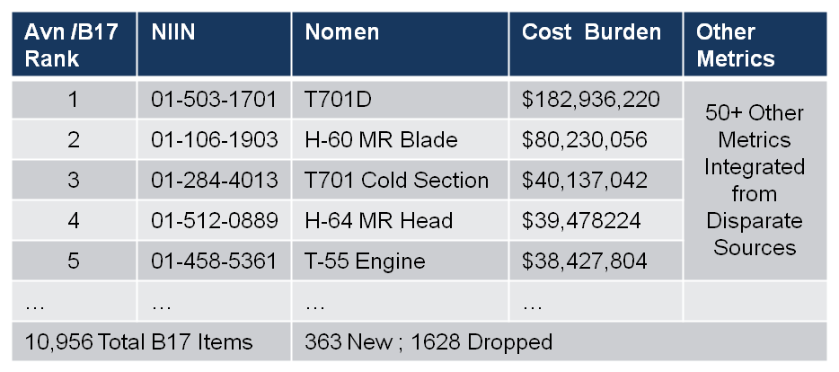
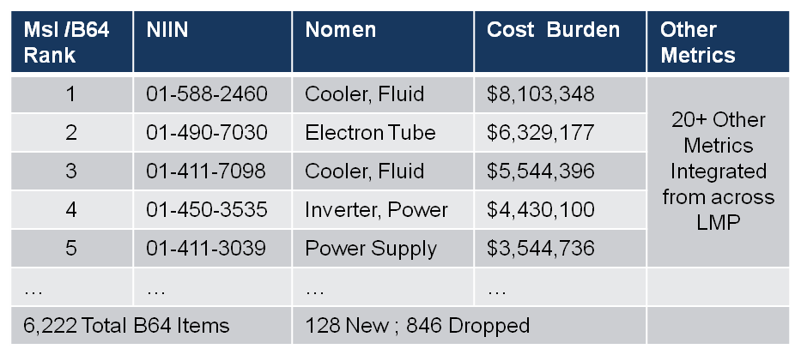
Integrated Priority List (IPL)
Serves as a Focusing Mechanism for Spending Limited Resources (funding, personnel, time)
Priority: Rack-and-stack of All AMCOM-Managed Items by Annual Cost Burden (Price x Demands)
Integrated: ‘One-Stop Shop’ of Info on a Given NIIN Across a Wide Variety of Sustainment Metrics
LMP/Demand, ASAP/R&M , MCDS/2410, RIMFIRE, & Other Sources as identified
IPL Has Evolved, each Semi-Annual Iteration Has New Features: Visibility on B16/AVN Items, Filter by Platform, Costing Data, NEOF rates, and more
AH-64 Apache 26.3%
AWCF Cost Burden:
 | AVN/B17 | MSL/B64
Total AWCF AMCOM Cost Burden | $1.373B | $122.6M
Top 200 AMCOM Cost Burden | $1.134B | $102.4M
Percentage | 82.5% | 83.5%
Notes:
XSN: Two visible examples of the CBM and CWR umbrella that no doubt many of you have seen already are maintenance TTP changes to the AH-64 Main XMSN and the TRGB….the upper change is a CBM approach based on MSPU technology, the lower is CBM approach based on smarter level of repair that has nothing to do with the MSPU
Engineering Analysis of CBM+ DSC Data and RTC Test Stand Data Revealed that the Time Before Overhaul (TBO) was too conservative
Analysis Resulted in Two Fleet Wide 250 Hour APU Clutch TBO Extensions and a Cost Avoidance of an Average $1.03M / Year
Cost Avoidance methodology was Validated by AMCOM G3 Command Analysis Directorate (CAD)
ROI is based only on Hardware Cost Avoidance
Additional Unit Benefit is MMH Previously Dedicated to APU Clutch Removal / Replacement can be used to Enhance Overall Quality of Unit Maintenance
Note: “Present Cost Avoidance” and “Avg Cost Avoidance / Yr” refers to the period of time reflected in the “After” column
XSN: Coming back to C-WR and to close out…

Slide 26
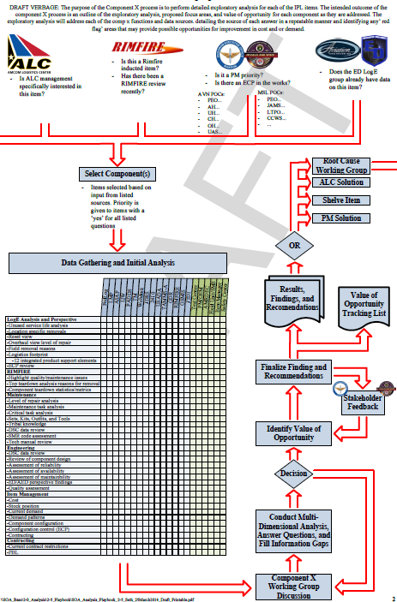
Component “X”
Objectives:
Inputs: Ranked List (IPL), LOG E, RIMFIRE
Output: Identify Value of Opportunity (VO) Through Component Assessment

Slide 27
Component “X” – Component Selection

Slide 28
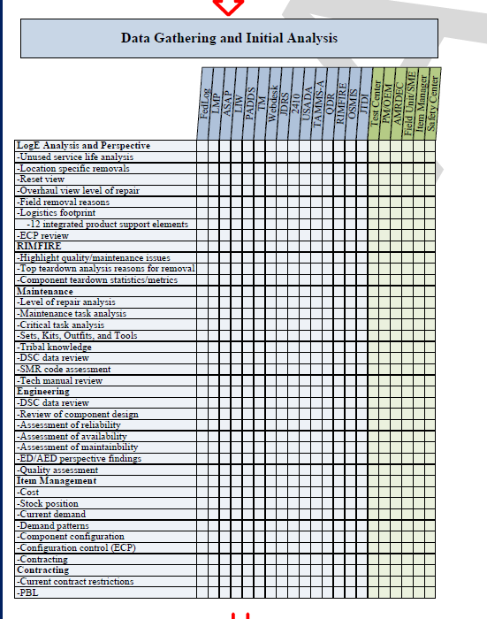
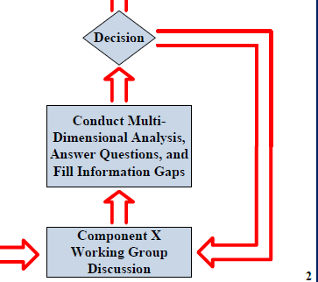
Component “X” - Analysis

Slide 29
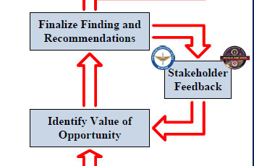
Component “X” – Value of Opportunity

Slide 30
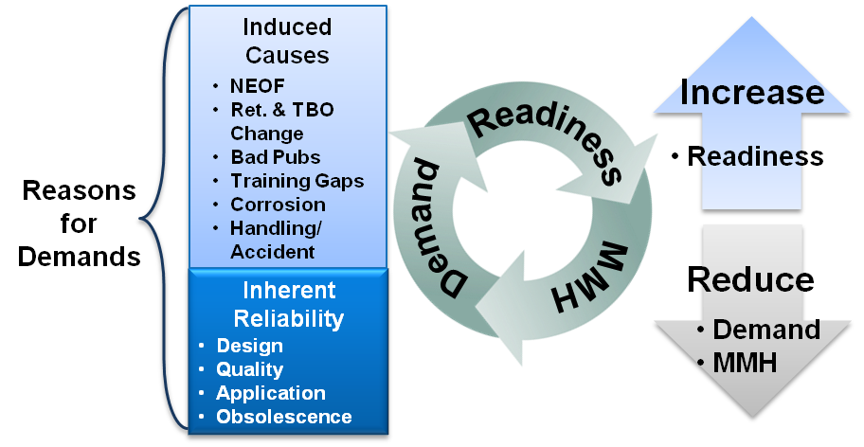
Value of Opportunity
VO is the potential net effect of reducing life cycle costs to the Army as a result of increased availability and readiness rates
Reducing cost burden through decreasing demands
Reducing Soldier maintenance burden by decreasing MMHs
Increasing Operational Availability through increasing Readiness

Slide 31
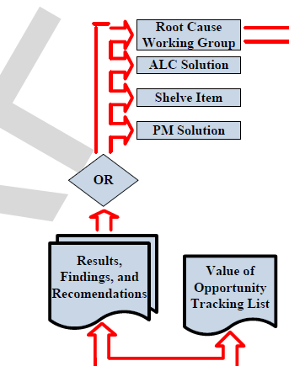
Component “X” – Results

Slide 32
Value of Opportunity Tracking List
Prioritized List of Problem Sets Sent to the RCWG
Cost
Readiness
Maint. Burden
 | CM₁ | CM₂ | CM₃ | RM₁ | RM₂ | RM₃ | MM₁ | MM₂ | MM₃
NSN
NSN
NSN
What Contributes to Components Cost?
$
CM = Cost Metric
RM = Reliability Metric
MM = Maintenance Metric
What Contributes to Down Time?
What Contributes to Maintenance Burden?
Down Time
MMH
Priority given to components that may impact all three categories

Slide 33
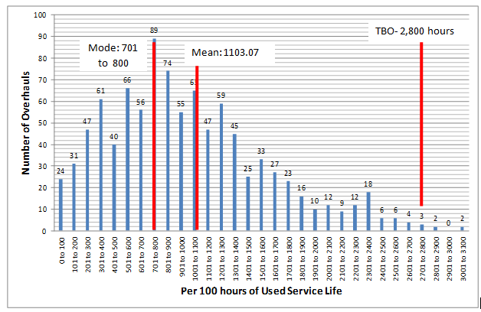
T-55 Engine Results
Majority of the T-55 engines did NOT reach the AWR-mandated time between overhaul (TBO) of 2,800 FH with a mean time of 1,103 FH

Slide 34
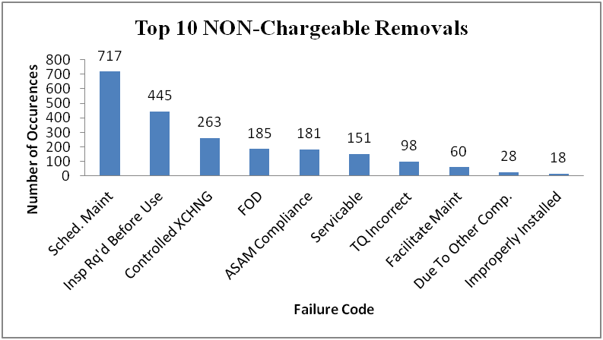
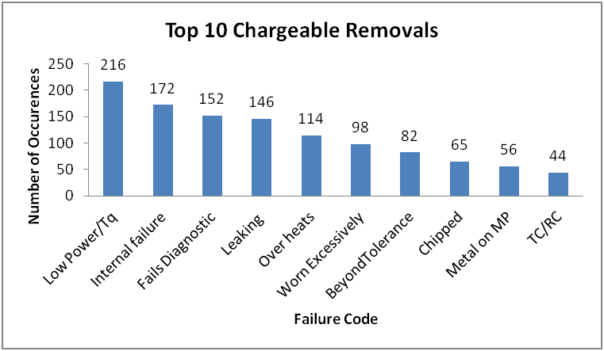
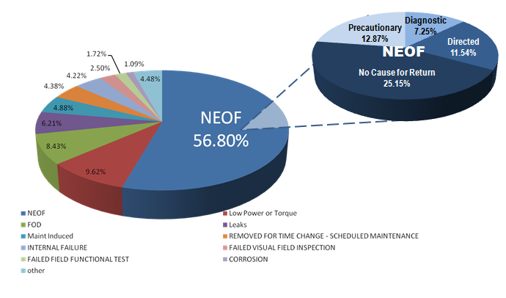
T-55 Engine Results
2410-reported engine removal causes
RIMFIRE analysis results

Slide 35
T-55 Engine Recommendations
Both RIMFIRE and 2410 data indicate degradation of Time on Wing (TOW) after overhauls, with additional degradation occurring after subsequent overhauls
Avoiding unnecessary overhauls may help extend TOW
Teardown analysis in RIMFIRE showed the highest removal reason was No Evidence of Failure (NEOF) at a rate of 56.80%
Field units have limited testing/triage abilities to avoid unnecessary returns to depot
Additional NEOF issue (7.25% of returns) is Metal on Magnetic Plug - lack of supporting evidence for Metal on Magnetic Plug due to the current drain/flush procedure of the engine prior to sending to RIMFIRE for analysis.
Low Power/Torque is #1 field-reported cause for removal, and RIMFIRE data showed the primary cause is compressor blade erosion (86.7% of Low Power/Torque removals)
RIMFIRE data showed the second highest cause of failure is Foreign Object Damage (FOD) at 8.43% of all engine returns
Both RIMFIRE and 2410 data show a difference in NEOF rate by location; Ft Rucker has a 17.1% lower NEOF rate than the fleet average
Nascent Condition Indicators (CIs) cannot yet be used to trigger maintenance actions and consequently avoid unnecessary engine overhauls (Note: CH-47F fleet does not currently have Digital Source Collectors (DSCs) installed)

Slide 36
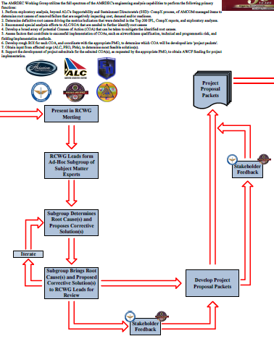
Root Cause Working Group (RCWG)
Objectives:
Input: CompX baseline Metrics and Recommendations; PM Input
AMRDEC Team Performs Specialized In-Depth Component Analysis
Output: Root Cause Determination and Proposed Courses of Action

Slide 37
RCA Process
Problem Definition
Include qualitative and quantitative attributes of harmful outcomes
Includes specifying magnitudes, locations, and timing of events
Data Collection
To completely understand event
To accurately identify causal factors and root causes
Causal Factor Charting
A sequence diagram with logic tests
Describes the events leading up to an occurrence
Root Cause Identification
Develop the decision diagram or Root Cause Map
Helps investigator answer why particular causal factors exist
Corrective Actions
Generate achievable recommendations to prevent recurrence
Support stakeholder with project submittal development

Slide 38
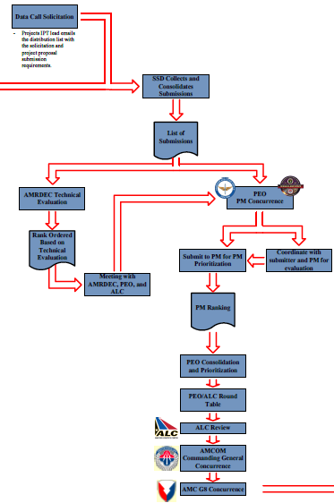
AWCF Data Call
Objectives:
Inputs: Proposed CoAs Developed Into Vetted Project Proposals
Project Submittals Scored/Ranked and Amongst Stakeholders
Output: Resources Identified and Approved to Begin Project Implementation

Slide 39
Project Evaluation Flow Chart
Data Call
AMRDEC Evaluation
PEO Priority
AWCF Pass/Fail
= AMCOM Secondary Item
= Obligated by 30 Sep
Technical Ranking Criteria
= Obsolescence
= Reliability
= Return on Investment (ROI)
= Risk
= Safety Improvement
Prioritization Categories
= Systems In The Fight
= Systems Supporting The Fight
= Systems In Production/Sustainment But Not In Theater
= All Others
Criteria for Prioritization within Categories
= Criticality Of System To The Fight
= Criticality Of Obsolescent Item To The System
= Risk To Warfighter Due To Obsolescent Item
= Benefits If Funded (To The Warfighter, Etc.)
= Cost
= Funding Potential/Likelihood
PEOAVN
PEOMS
AMRDEC
ALC
Scored List…
Project Candidates…
Prioritized List
FAD
(Funding Authorization Document)
AMC Approval
Approved List…
AMCOM CG Approval
Contracting Strategy
PM Engineering Services Contract (OEM Specific)
AMCOM Express (Services) – RFQ (Specific to Vendors) BPA

Slide 40
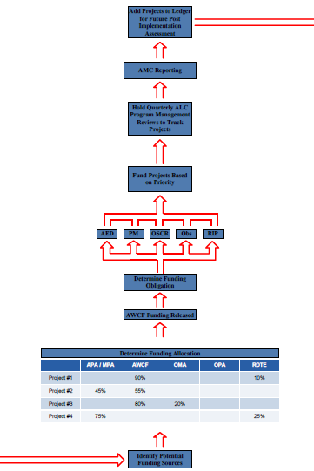
Project Tracking
Objectives:
Inputs: Fully Implemented Projects
Assessing Actual Demand/Cost Benefits Derived From Completed Projects
Output: CAD Validated Benefits

Slide 41
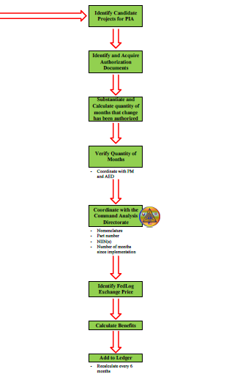
PIAs & Ledgering
Objectives:
Component Cost per FH
Cost Avoidance
ROI
Historical Average Annual Cost Avoidance
Demands/10,000 FH
Number of Fewer Components Required After Implementation
* Results in a PIA Report

Slide 42
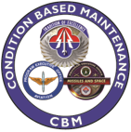
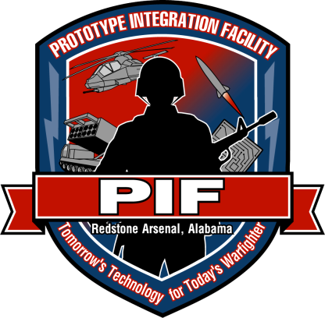
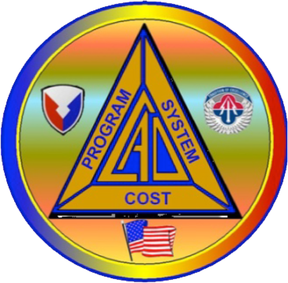
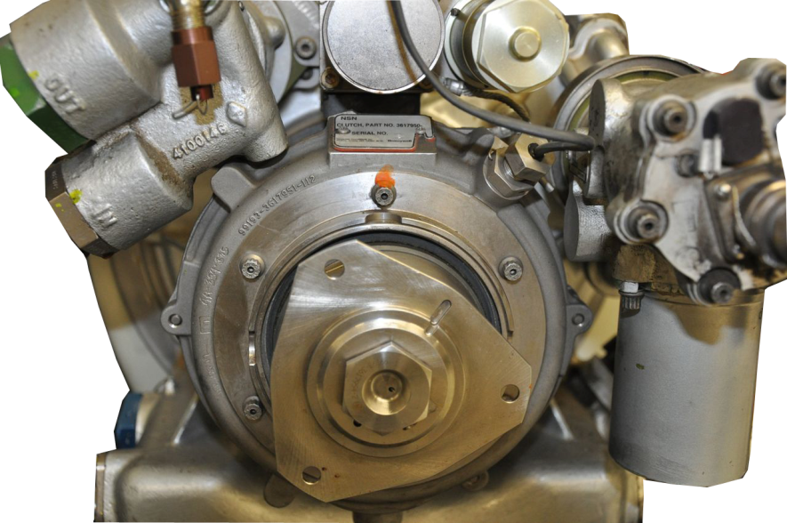
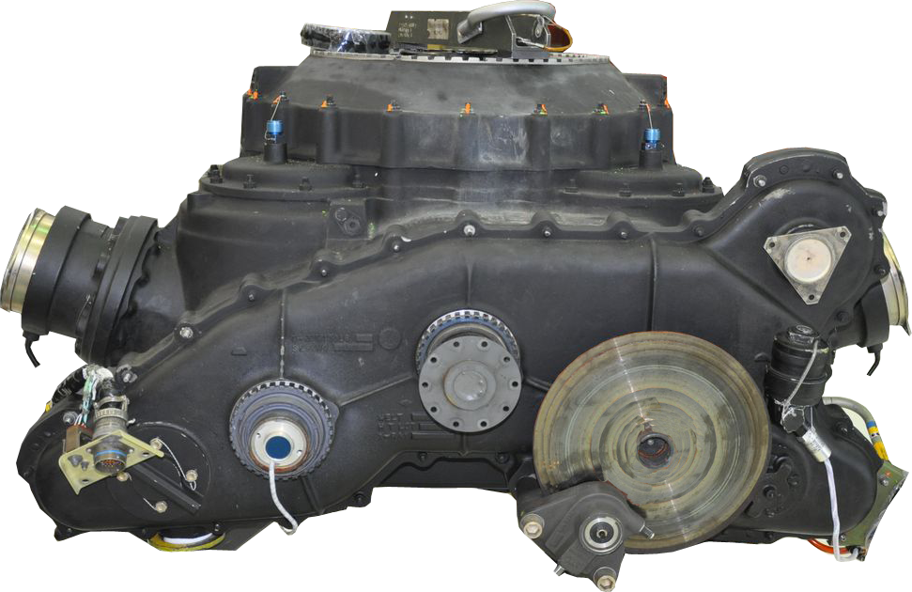
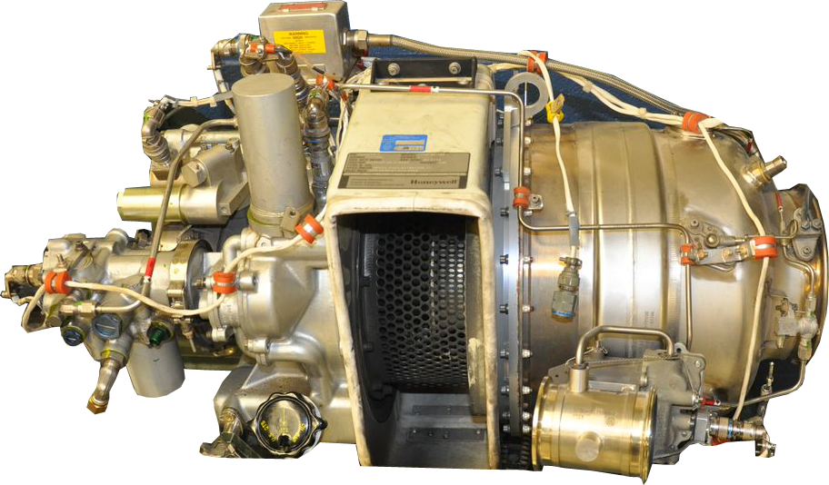
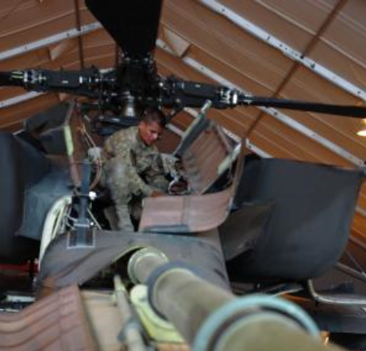
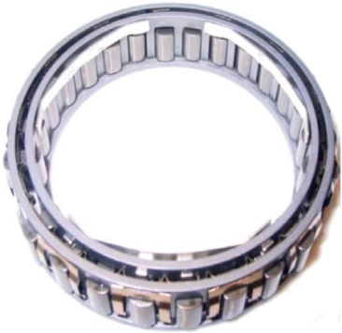
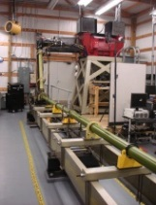
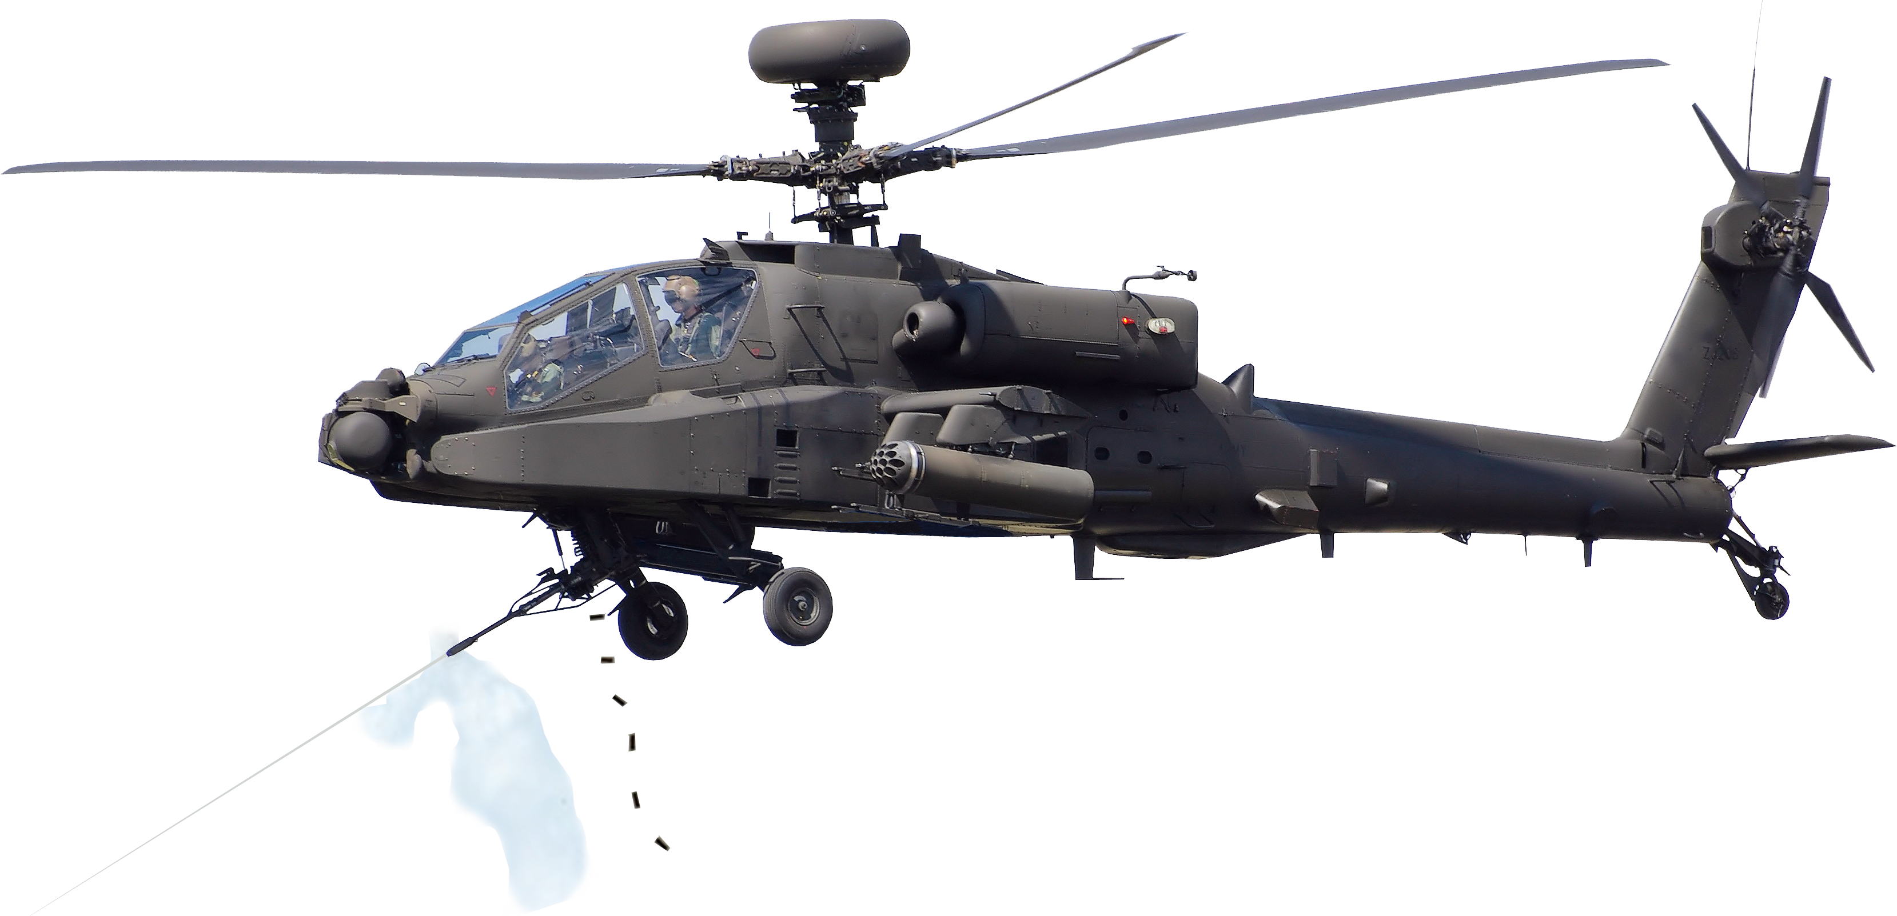
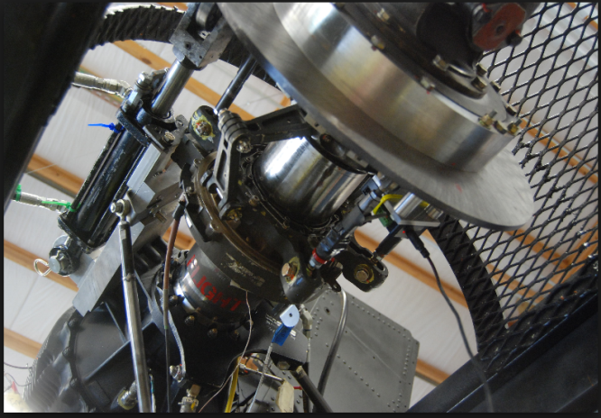
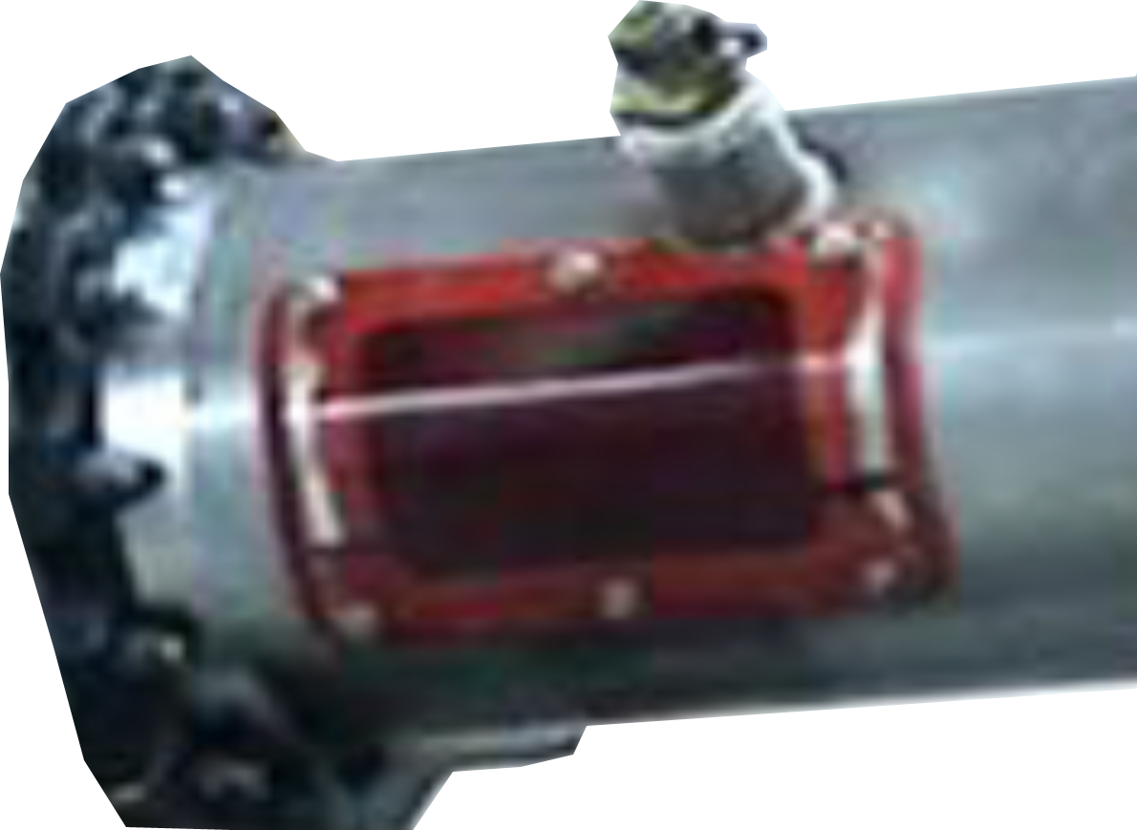
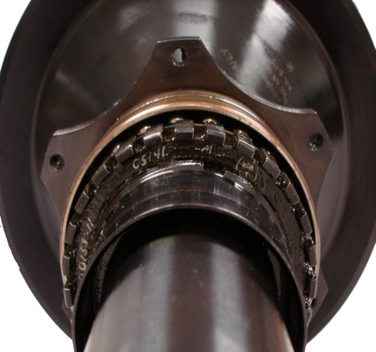
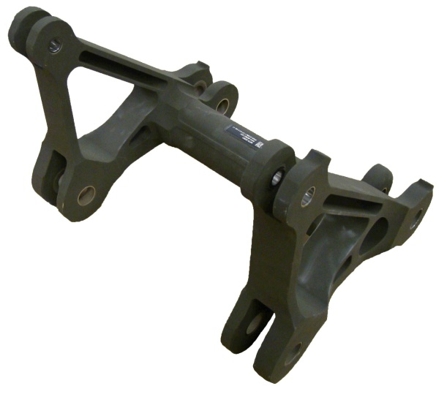
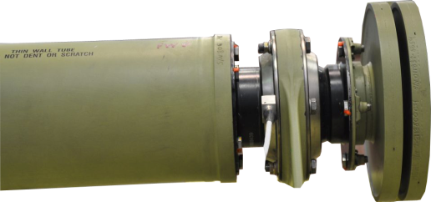
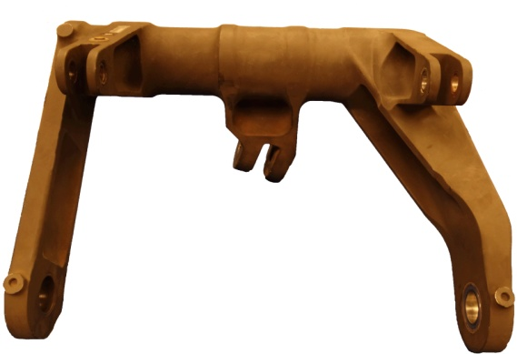
Cost-Wise Readiness (CWR) Executed through Time on Wing (TOW) Increases
APU Clutch TBO
Sprag Clutch RC
Tail Rotor Bearing TBO
Tail Rotor Swash Plate TBO
Tail Rotor Gear Box
Fwd & Aft Hanger Bearing TBO
Lateral Link
Fwd & Aft Bell Crank
CBM+ Projects & CAD Validated Methodology Support CWR Cost Avoidance
Notes:
2008-2012 Analysis of RIMFIRE (CCAD) Data on Apache XMSN revealed a high XMSN removal rate due to highly conservative Sprag Clutch Retirement life limit
Engineering Analysis of CBM+ DSC Data and RTC Test Stand Data Revealed that the Retirement Life was too conservative
Analysis Resulted in Two Fleet Wide 250 Hour Extensions of the Retirement Life of the Sprag Clutch and a Cost Avoidance of an Average $11.15M / Year
Cost Avoidance methodology was Validated by AMCOM G3 Command Analysis Directorate (CAD)
ROI is based only on Hardware Cost Avoidance
Additional Unit Benefit is MMH Previously Dedicated to XMNS Removal / Replacement can be used to Enhance Overall Quality of Unit Maintenance
Note: “Present Cost Avoidance” and “Avg Cost Avoidance / Yr” refers to the period of time reflected in the “After” column

Slide 43
QUESTIONS

