Slide 1
Estimating Flight Software Risk for a Space Launch Vehicle
2014 RAMS VII Workshop
November 4, 2014
S. Novack¹, S.Hatfield¹, M. Al Hassan¹,J.Bales²,
P. Britton², F.Hark¹, J.Stott²
¹Bastion Technologies, Inc.
²NASA Marshall Space Flight Center
Notes:
Failure cause: Software defects are mainly design defects.
Wear-out: Software does not have an energy related wear-out phase. Errors can occur without warning.
Repairable system concept: Periodic restarts can help fix software problems.
Environmental factors: These do not affect software reliability, although they may affect program inputs.
Reliability prediction: Software reliability cannot be predicted from any physical basis, since it depends completely on human factors in design.
Redundancy: Software reliability identical software components.
Interfaces: Software interfaces are purely conceptual rather than tangible.
Failure rate motivators: Origins of software failures are usually not predictable from analyses of separate statements.
Standard components: Well-understood and extensively-tested standard parts will help improve hardware maintainability and reliability. The software industry has not observed this trend. Code reuse has been around for some time, but to a very limited extent. There are no standard parts for software, although there are some standardized logic structures.

Slide 2
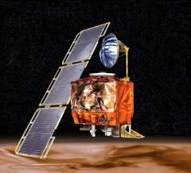
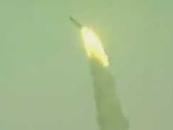
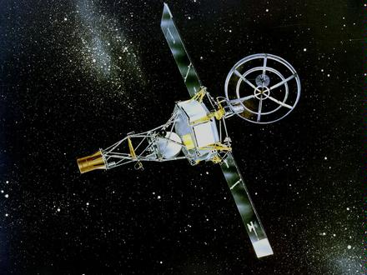
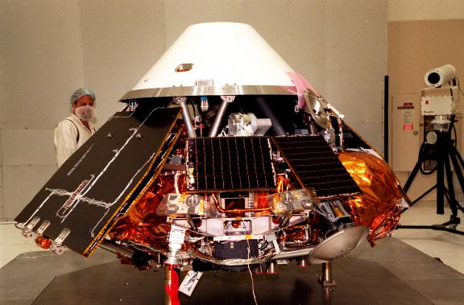
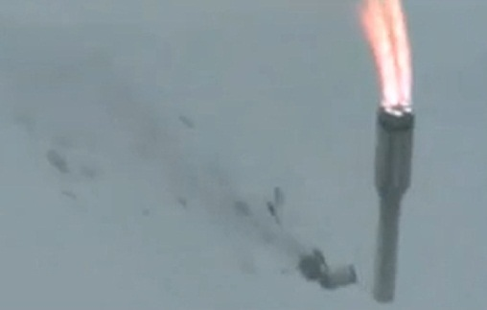
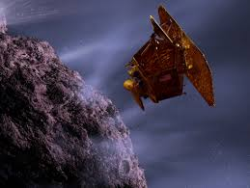
Why is Understanding Software Risk Important to NASA?
“Software had a critical role in a large share (~ 60% in quantitative terms) of the failures suffered by NASA in high-stakes missions during the 1998 – 2007 decade.” (NASA PRA Procedures Guide, 2010)
1962 - Mariner 1 (incorrect formula coded)
1988 - Phobos (deactivated thrusters)
1996 - Ariane 5 (reused Ariane 4 software)
1999 - Mars Polar Lander (mistook turbulence for landing)
1999 - Mars Climate Orbiter (unit conversion)
2004 - Spirit (flash memory full)
2005 - CryoSat-1 (missing shutdown command)
2006 - Mars Global Surveyor (assumption of motor failure)
2011 - Express-AM4 (faulty parameter)

Slide 3
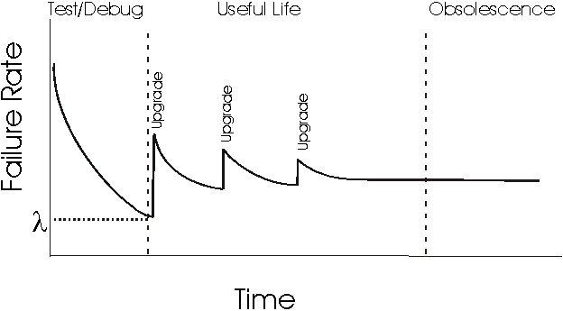
Software versus Hardware Characteristics
The NASA definition of software failure is “Flight Computer Software (FSW) performs the wrong action, fails to perform the intended action, or performs the intended action at the wrong time.” NASA Shuttle Probabilistic Risk Assessment (PRA), SSA-08-11 rev B
Failure cause
Wear-out
Repairable system concept
Environmental factors
Reliability prediction
Redundancy
Interfaces
Failure rate motivators
Standard components

Slide 4
Potential Methods Used to Obtain Software Risk
Mathematical model using Space Launch Vehicle software data from flights
Best possible data (assuming large data sets)
Unavailable for first flight
Mathematical model using historical data on a “like” system
Low/moderate uncertainty
May require modifications to fit Space Launch Vehicle
Will provide a path to incorporate Space Launch Vehicle specific software data (test and flight)
Heuristic method using generic statistical data
Moderate uncertainty
Different approaches, different results
Context-based Software Risk Model (CSRM)
Off-nominal scenarios
Can be based on specific failure modes
SOFTREL
Ann Marie Neufelder
Expert judgment
Highest uncertainty

Slide 5
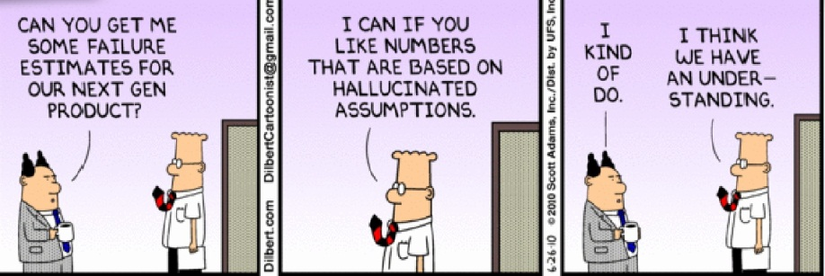
Software Reliability Metrics
Product
Code complexity, which is directly related to reliability
Project Management
Organizational and management influence on the code outcome and reliability
Process
Function of upgrades and software improvements to reach some steady state
Fault and Failure
Reliability trending estimated from software fault and failure data

Slide 6
Desired Software Reliability Characteristics
Vetted approach
Quantitative and Complete
Tractable
Easily understood and traceable
Assumptions
Sensitive to environmental (context) failures
Uses available test results and operational experience
Quantifies uncertainty
Can account for Common Cause Failures

Slide 7
Considerations for Applying a Historical Data Approach
Software Process
Coding practices
Testing schemes
Programming Language and Operating system
Comparable language or equivalent basis
Flight time
Mission versus Ascent or Reentry
Software errors during different phases of flight
Accounting
Reliability basis Source Lines of code (SLOC)
Computer system structure
Redundancy
Independence or backup systems

Slide 8
Different Categories of Software Failures
Coding errors
Errors introduced into the code by human design or error
Are not detected during testing prior to first flight
Have the potential to manifest during nominal mission conditions
Context Latent Errors (LEs)
Errors manifest during off-nominal conditions
May need very specific conditions to manifest
Would typically not be caught during testing
“A segment of code that fulfills its requirements except under certain off-nominal and probably unanticipated conditions.”
Operating system errors
Includes response to application errors
Memory allocation problems
Background processes
3 software failure types
Coding Error
Latent Context Error
Operating System Errors

Slide 9
Approach for Coding and Latent Errors
Identify selected scenarios for off-nominal conditions
Ex: Spacecraft navigation errors
Determine how software contributes to selected scenarios (i.e., the software failure mode)
Software causes a hardover
Determine what portion of the code could cause the software error (e.g., modules, partitions, functions)
Calculate Total Source Line of Codes (SLOCs) for each failure mode
Adjust reliability if needed to match historical data
Estimate risk for each software failure mode based on Total SLOC per software failure mode

Slide 10
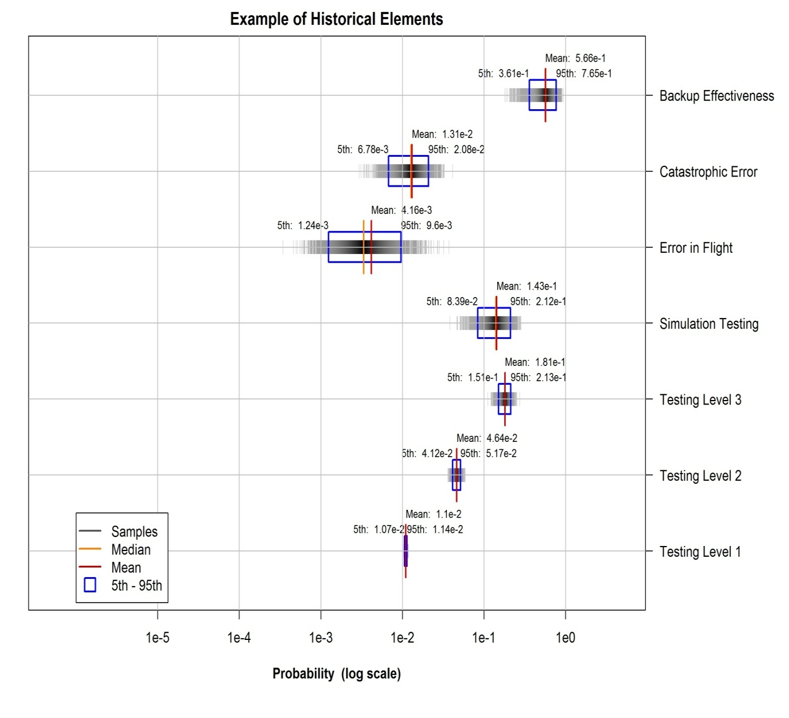
Example of Historical Reliability Data
Uncertainty increases with higher levels of testing
Quantify historic system differences (redundancy)
Operational errors making it through testing onto flight
Establishes a reliability constant for SLOC that can be corrected for new system

Slide 11
Example of Software Failure Modes by Code Segments
Software Failure Mode | Associated Software
Conversion/corruption data on navigation | Data Conversion | Engine Code
Last Good Data on BUS (Stale Data) | Input Data Exchange | OutPut Data Exchange | Application Code | Data Conversion | Data In | Infrastructure | Command Code
Loss of Computer Communication | Communication Code | System Code
Booster hardover (left) | Booster Code
Booster hardover (right) | Booster Code
Navigation Whole Vehicle Hardover | Navigation Code | Booster Code
No Booster Sep Command | Application Code | System Code
Command Early or Late | System Code
Inadvertent Command | Data Conversion | Application Code
No Command | Application Code

Slide 12
A Nominal Software Risk Example and Ranges
Reliability growth curves can provide ranges
Uncertainty may be affected by extrapolation of historical data

Slide 13
Special Considerations
Treatment of Software Common Cause Failures (CCFs)
Software CCF basic events can parallel hardware events (NUREG CR-6268)
Uncertainty
Historical or statistical based failure rates can have associated distributions
Variability can be propagated via the distributions and standard uncertainty analysis methods
Software basic events can be correlated for Monte Carlo routines
Software support
Provide prioritized for software testing due to risk-informed data
Model estimates can be provided for software reliability requirements per system
Focus on software testing schemes
Firmware
Many of the major systems contain independently developed firmware or software (e.g., Navigation system, engine)
Similar approach coupled with hardware reliability data can be used to estimate firmware reliability

Slide 14
Summary and Conclusions
Software reliability is very difficult to predict and standard hardware reliability methods may be inappropriate
Software groupings (e.g., modules, functions) can be used with a base unit of complexity (SLOC) to determine reliability
This approach allows testing information to be rolled into a module failure scheme at the functional level
May be directly linked to physical partitions and processes
Can be broken down into a component level to support software development needs
Provides a meaningful resolution in the Reliability (how and why a system fails)
May have a direct correlation with vehicle specifications and requirements

Slide 15
Questions?
POC: Steven Novack, Bastion Technologies, Inc.
steven.d.novack@nasa.gov
1-256-544-2739

