Slide 1



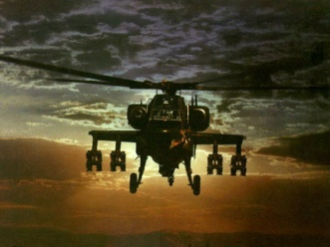
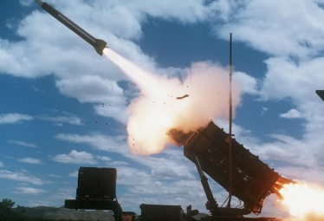
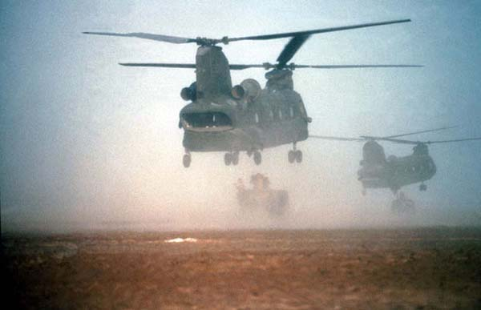


Performance-Based
Logistics
(PBL)
aka - Performance-Based Life-Cycle Product Support
Notes:
1
UT kudos
What do you think is the number one driver of increasing O&S cost in Army Aviation?

Slide 2
CH-47 Cost of Operation Growth over 4 years
(7/99-6/03)
Flight Hours
Notes:
In 2003, we did an investigation into O&S cost growth on the CH-47. As part of an analysis of the top 30 drivers on the Chinook we compared demand rate to component cost normalized for flight hours. This is getting a bit dated at this point, but I suspect that the situation still exists.
First we looked at fleet flight hours over a period of 48 months…

Slide 3
CH-47 Cost of Operation Growth over 4 years
(7/99-6/03)
Flight Hours
Demands
Notes:
Next we looked at total demands for the top thirty components. As you can see, both show a similar rate of increase…about 40%

Slide 4
CH-47 Cost of Operation Growth over 4 years
(7/99-6/03)
Component
Cost
Flight Hours
Demands
Can PBL Help?
Notes:
When we add the cost the units paid for the demanded parts, the rate of increase is dramatically higher…approaching 160%. So, at least for this platform, for this period of time and for the top 30 drivers, component cost far outweighs aircraft aging or declining reliability as a contributor to O&S cost increase.
So what are the causes of unit cost increases?
Can we attack this?
Can PBL help?

Slide 5
What is PBL?

Slide 6
PBL Definition
“PBL is the purchase of support as an integrated, affordable, performance package designed to optimize system readiness and meet performance goals for a weapon system through long-term support arrangements with clear lines of authority and responsibility.”
Source: Defense Acquisition Guidebook (Section 5.3)
The Essence of PBL is Buying Performance Outcomes, Not Individual Parts & Repair Actions
Notes:
Textbook definition of PBL from the DAG. We will discuss in more detail but a couple of key words you can be keeping in mind…integrated, affordable, performance and long term
Rotor blade example

Slide 7

PBL Misconceptions
“PBL doesn’t work”…
Actually, there is ample data from the Services, OSD PBL Awards, various data calls, and published material showing PBL to be a successful product support strategy.

Slide 8
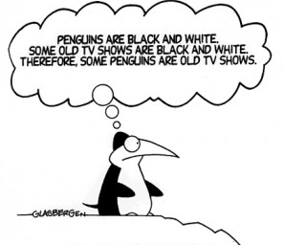
PBL Misconceptions
“PBL equals outsourcing”…
In fact, the vast majority of support is a blend of public/private partnering, and the organic base is protected by law, policy, and guidance.

Slide 9

PBL Misconceptions
“PBL is a threat to the Depots”…
PBL can actually be an enabler for the depots. The depot workforce is protected by Law. PBLs (implemented with Partnerships) enable depots to get vital assistance in areas where they traditionally have had problems – getting needed spares and on-site technical support.

Slide 10
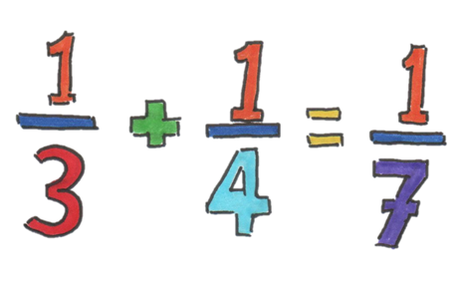
PBL Misconceptions
“PBL doesn’t produce savings”…
Even GAO has not been able to disprove the savings/cost avoidance numbers provided by PBL programs – only saying it is difficult to validate the savings (cost accounting systems).

Slide 11


PBL Misconceptions
“PBL is easy”…
Nope, it’s hard work!
PBL is not just about slapping metrics and incentives on a current contract.
It’s a business model shift – and a mindset shift. Both the Government and the Product Support Provider must be on board, or it won’t work!

Slide 12
PBL Has Evolved
Concept
Policy
Adoption
NextGen
Section 912, 1998 NDAA: DoD to report back to Congress on “Product Support Reengineering”
Product Support Reengineering Report to Congress
DoD QDR
mandates
“PBL”
– First
official Use
of Term
DoD 5000
policy
updated:
PBL is
“preferred”
Support
Strategy
OSD PBL
Policy
memos:
BCA’s used
to evaluate
transition to
PBL
Over
200 current
or planned
PBL
Programs
Revised DoDI 5000.2 Issued
AR 700-127
Revised
ACAT 1 & 2
systems to
use PBL or justify
non-use
Product
Support
Assessment
Team
Launched
Program
Managers
Guidebook
published
30 RTOC
Pilot Programs
DAU PBL Course
Launched
Univ of Tenn
Course
Launched
F-117, APU PBLs
1998
1999
2001
2003
2004
2006
2008
2012 >

Slide 13

PBL is not a Choice
DoDD 5000.01
The Defense Acquisition System
May 12, 2003
E1.17. Performance-Based Logistics.
PMs shall develop and implement performance-based logistics strategies that optimize total system availability while minimizing cost and logistics
There are degrees of freedom in how much to implement, not whether to implement.
Notes:
This is very prescriptive language, and it is a directive at the highest level. Anybody who thinks that PBL isn’t required needs to revisit policy.

Slide 14
PBL is not a Choice
DoDD 5000.01 The Defense Acquisition System
  Performance-Based Logistics. PM’s shall develop and implement performance-based logistics strategies that optimize total system availability while minimizing cost and logistics footprint . . . shall include best use of public and private sector capabilities
DoDI 5000.02 Operation of the Defense Acquisition System 28
  The PM shall employ effective Performance-Based Life-Cycle Product Support (PBL…PBL offers the best strategic approach for delivering required life cycle readiness, reliability, and ownership costs. Sources of support may be organic, commercial, or a combination, with the primary focus optimizing customer support, weapon system availability, and reduced ownership costs.
Defense Acquisition Guidebook
  PBL optimizes the best public and private sector competencies based upon a best-value determination, evidenced through an appropriate analysis of the provider's product support capability to meet set performance objectives.
Best Value is Central to PBL
Notes:
The Defense Acquisition guidance establishes the PBL requirement and introduces the terms best value/best use .

Slide 15


What does “best value” really mean?
From the FAR:
  2.101 Definitions
  “Best value” means the expected outcome of an acquisition that, in the Government’s estimation, provides the greatest overall benefit in response to the requirement.
Notes:
And, this doesn’t really clarify things. Hence the requirement for comprehensive BCA

Slide 16
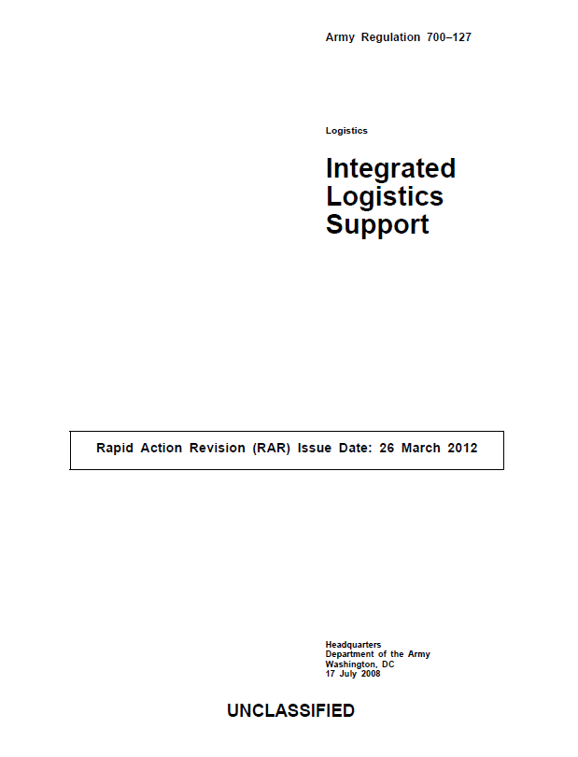
PBL Requirement is in
Army Policy
2–12. Program executive officer and program managers
g. Ensure that PBL is considered as a support alternative and used if it is determined to be economically and
operationally feasible.
4–2. General policy
Performance-based product support strategies are preferred for weapon system/materiel that employ either blended (organic and vendor) or vendor support as an integrated performance package designed to optimize system readiness.
Notes:
And the Army is explicit in requiring PBL. It must be done.

Slide 17
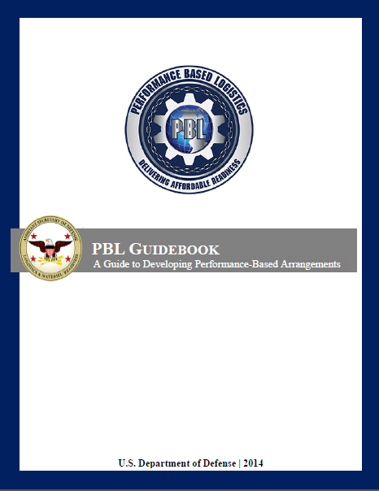
DoD’s Primary Reference
May 2014
PBL Guidebook
PBL Guidebook
To download complete document, go to –
https://acc.dau.mil/pbl-guidebook
FIX
Notes:
The PBL Guidebook lays out the 12 steps to PBL implementation

Slide 18
Why PBL?

Slide 19

The Motivation for PBL
Budget pressures…do more with less.
  We are buying fewer systems and keeping them longer, creating additional upward pressure on Operations and Support cost.
  Aging systems bring along baggage: obsolescence, decreasing reliability, diminishing manufacturing sources, and increasing prices.
DoD must use innovative strategies and incentives to fund both current requirements and continuing readiness investments - mandates don’t work.
Notes:
19
Traditional contracts put the entire onus on DoD to innovate and find a way to reduce costs – industry just responds to requirements.
PBL finally makes DoD and Industry full partners in innovation, continuous improvement, consistent operational readiness, and affordability. It’s the first (and only, so far) strategy to do so. PBL leverages and unleashes the full power and knowledge of industry, because the PBL business model incentivizes them to do so. That’s a compelling strategy.
.

Slide 20
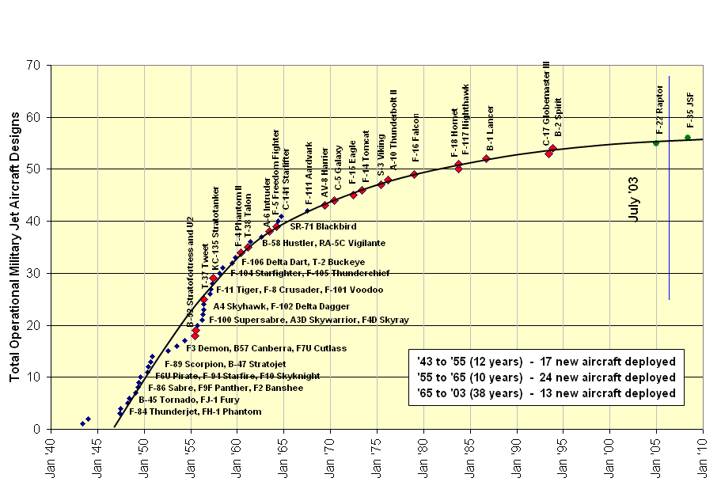
Fact: The Times Have Changed
There are fewer new systems…and they are expected to last longer.
Out of Service Aircraft
In Service Aircraft
Planned Aircraft
Source: Pratt and Whitney
Notes:
And it will not get any better. Airframes are aging, so the support tail is growing. And the cost is increasing

Slide 21
Augustine’s Laws
“Why can’t we buy just one aeroplane and let the aviators take turns flying it?”
President Calvin Coolidge, 1928

Slide 22
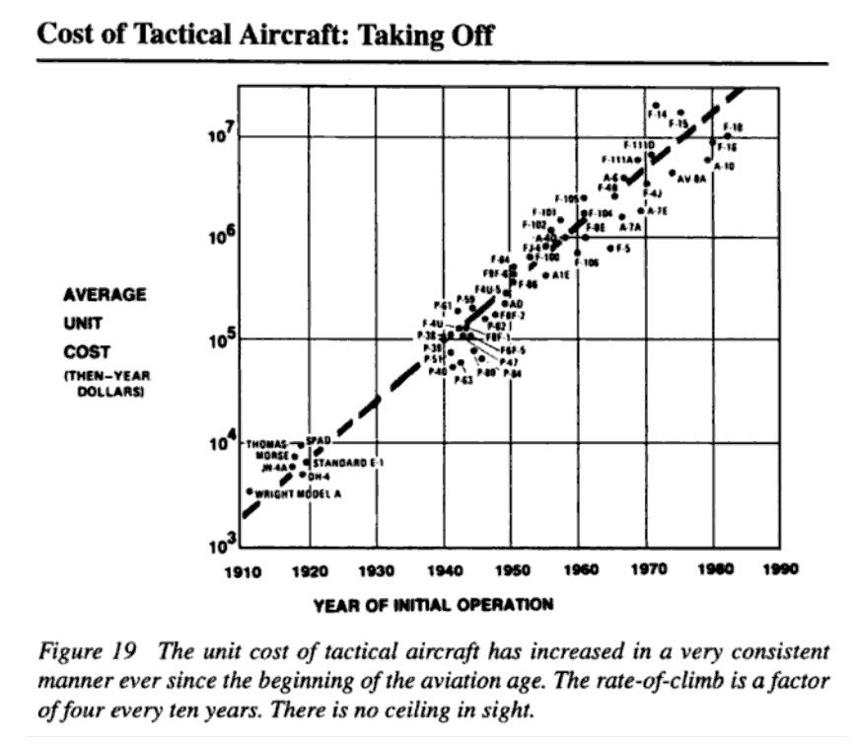
Augustine’s Laws
Source: Norman Augustine, Augustine’s Laws, 1983

Slide 23
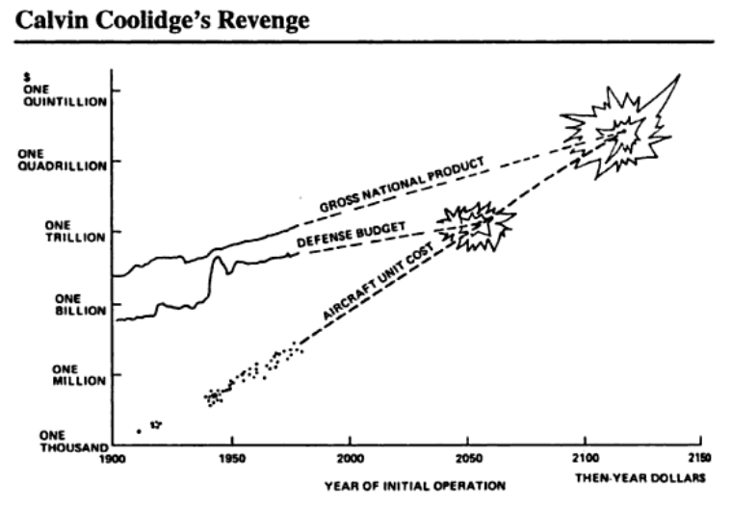
Augustine’s Laws
Law Number XVI
In the year 2054, the entire defense budget will purchase just one aircraft. This aircraft will have to be shared by the Air Force and Navy 3-1/2 days each per week except for leap year, when it will be made available to the Marines for the extra day.
Source: Norman Augustine, Augustine’s Laws, 1983

Slide 24
Has PBL Been
Successful?

Slide 25

PBL WORKS!
Even the GAO Admits It…
GAO PBL Report 05-966 Sep 2005
Examined 15 PBL programs
  USAF (C-17, F-117, JSTARS, C-130J), ALR-67 (V3)
  Navy APUs, F/A-18 E/F, F-404 engine, T-45 engines, V-22 Engines, KC-130J
  Army HIMARS, Javelin, TOW ITAS, Shadow TUAV
“Of the 15 programs, 10 reported that performance levels
exceeded contract requirements,
and 5 reported that performance levels
were meeting contract requirements.”
Notes:
You always have to read GAO reports closely . . . When was the last time you saw a report that had DoD going 15 for 15 . . . A 100% success rate on a new initiative?
But GAO did not focus on that. They are all about finding weakness, so they focused on record keeping shortfalls. Valid, but not the big story.

Slide 26
Navy PBL Growth
NAVICP PBL Profile
Business Scope
  143 contracts/51 MOAs
    Mech = 69 contracts/42 MOAs
    Phil = 74 contracts/9 MOAs
  38,940 NSNs
    Mech = 15,190
    Phil = 23,750
  24.4% of total demand (FY09)
    Mech = 13.1%
    Phil = 31.3%
    * through May ’09
$M
$1156
$1040
$1067
$919
$712
$739
$481
$525
$245
$331
$35
$85

Slide 27
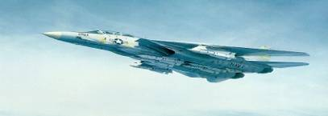
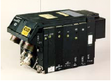
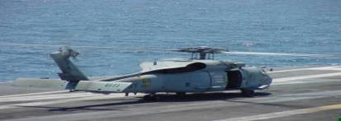

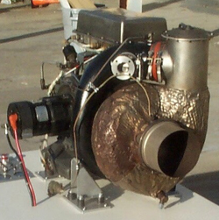
Logistics Response Time
Successes
Navy Program
Pre-PBL
Post-PBL
56.9 Days
5 Days
F-14 LANTIRN
ARC-210
22.8 Days
5 Days
Logistics Response Times (LRTs)
decreased an average of 70%-80% through PBL
H-60 Avionics
52.7 Days
8 Days
42.6 Days
2 Days CONUS
7 Days OCONUS
F/A-18 Stores
Mgmt System (SMS)
28.9 Days
2 Days CONUS
4 Days OCONUS
Tires
APU
35 Days
6.5 Days

Slide 28
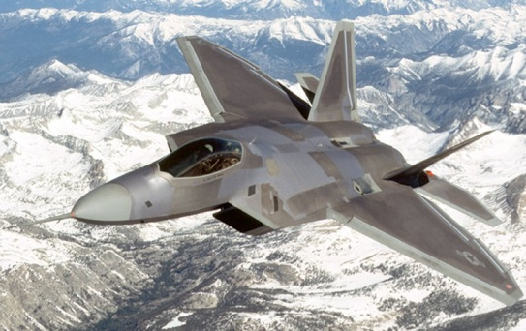
Robust PBL: F-22 Raptor
Mission Capable (MC) rates
  15% improvement
Ownership Cost
  $14B projected savings over the life of the aircraft
  14% improvement in repair costs per flight hour in 2007
  50% reduction in diagnostics ambiguity and a 15% reduction in faulty isolation
Footprint Reduction
  47 % projected reduction from 2007 to 2010
  Reduction factors include electronic technical orders, highly reliable diagnostics and molecular electronics and technological advances in aircraft components and reliability
Reliability, Maintainability and Supportability Improvements
  Over past 3 years, increased MTBM 69% across the F-22 fleet - life cycle program improvements and CIP in weapon system reliability and maintainability
Notes:
28
This is a very contemporary example. And it is at the weapons system level.

Slide 29
Department of Defense PBL Award Winners
Year | Level | Department of Defense PBL Award Winners | Service | Commercial Partner
2005 | System | F-117 | USAF | Lockheed Martin
 | Sub-System | F-404 Engine | USN | General Electric
 | Component | Navy APU | USN | Honeywell
 | Special GWOT | Shadow 200 Tactical UAS | USA | AAI
2006 | System | HIMARS | USA | Lockheed Martin
 | Sub-System | H-60 FLIR | USN | Raytheon
 | Component | F/A-18 & F-14D Cockpit Displays | USN | Rockwell
2007 | System | F/A-18 (FIRST) | USN | Boeing
 | Sub-System | ITAS | USA | Raytheon
 | Component | GE T700 Engine | USN | General Electric
2008 | System | F-22 | USAF | Lockheed Martin
 | Sub-System | ARL-67 Radar Warning System | USN | Raytheon
 | Component | TAIS ATC System | USA | General Dynamics
2009 | System | CASS | USN | Lockheed Martin
 | System | HIMARS | USA | Lockheed Martin
 | Sub-System | AN/ALQ-126B ECS | USN | BAE Systems
 | Sub-System | F-404 Synchronized Supply Chain | DLA | General Electric
 | Component | AN/UYQ-70(V) Display System | USN | Lockheed Martin
2010 | System | TUAS- Shadow | USA | AAI Corp
 | Sub-System | AH-64D Apache | USA | Boeing
 | Component | H-46 Sea Knight& H-53 Sea Stallion APU’s | USN | Hamilton Sundstrand
Notes:
High Mobility Artillery Rocket System (HIMARS)
Consolidated Automated Support System (CASS)
Mission Success: Rating
Remarks:
Materiel Availability: Rating
Remarks:
Materiel Reliability: Rating
Remarks:
Ownership Cost Management: Rating
Remarks:
Public/Private Partnering: Rating
Remarks:
System Engineering Approach: Rating
Remarks:
Footprint Reduction: Rating
Remarks:
Obsolescence Management: Rating
Remarks:
Reliability, Maintainability, and Supportability Improvements: Rating
Remarks:

Slide 30
What’s Different
Under PBL?

Slide 31
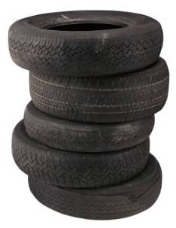
Traditional Support Approach
DoD
Forecast Requirements
Specify Buy Quantities
Pay for each on a Unit Price basis
Assume all risk for:
  right parts
  right repairs
  right time
  right quantities
High Risk
Parts Supplier
Repair Provider
DoD
Product
Support
Manager
Technical
Support Provider
Notes:
So, with a traditional support approach, every support provider, either organic or industry, is rewarded by system failures.
What motivates improvement? Demand reduction?
Reward (incentive) structure does not reward proper behavior.
Does this make sense to anybody?
This slide is central to the case for PBL. Foot stomp.

Slide 32

PBL Buys Outcomes
PBL Approach:
Desired Outcomes
Materiel Availability
Materiel Reliability
Ownership Cost
DoD
PM
Product
Support
Integrator
Product
Support
Provider(s)

Slide 33
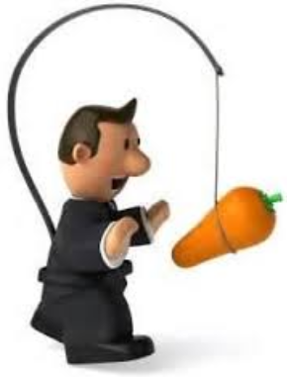
PBL rewards good behavior
PBL leverages rational economic behavior to drive readiness investments:
Under PBL, DoD pays for system performance and outcomes, not transactions. A shift in business strategy that creates a cost avoidance opportunity.
The PBL multi-year strategy uses this cost avoidance opportunity as an incentive to drive investments in affordability, reliability, & availability.
Support Providers with system knowledge and investment oriented business models innovate to convert cost avoidance into performance gains.
PBL can provide the incentives to apply a long term continuous
improvement strategy for product support
Notes:
33
Critical Success Factors
Continual rational investment in reliability, a constant and never ending search to reduce the life cycle cost across the life cycle of the program. This can be contractor driven (i.e., suppliers and supplier's suppliers) or programmed in by the DoD (how successful has that been?)
There should be a reliability improvement road map on procured systems. We should be ready to make the investment every year, or structure contracts that stimulate that investment by the contractor.
Weapon System SPOs were structured and organized to bring new technology to modernize radars, engines, etc. Now that new material, technology and process needs to be brought in to modernize reliability.
Need long term commitment (not option, 3 – 5 years) in order to stimulate investment. The more stable the funding, the higher the likelihood of investment
Partnership approach, not adversarial relationship. Trust and Teamwork
Issues to be concerned about:
What are the top level outcomes we care about in Product support? Availability, reliability, affordability.
Government PM remains accountable, but in addition must establish Clear Lines of Authority and Responsibility
Government PM defines the “what,” the Product Support Integrator (PSI) figures out the how. PSI must be given the freedom to innovate and invest in order to achieve improvement
Work hard on Public-Private partnering – make best use of commercial and organic capabilities in a long term “arm-in-arm” vs. “arms length” relationship; Ensure equitable sharing of the resultant cost reductions
Requires a rethinking of a fair and equitable profit. Those who invest must be compensated for the risk.
O&S Costs are driven by design and the resulting maintenance and performance profile. Excellence in inventory management is a way of coping with design that is fielded. O&S is bigger than inventory management.

Slide 34
Cost-Value Benefits of PBL
Traditional vs. Performance-Based Contract*
Investment
Recovery Period
Total Cost to the Government is lower
Investment to improve reliability or service costs
Cost
Industry’s profits are higher with PBL
PBL Investment
Starts to Pay Back
Time
Traditional Industry Price
PBL Industry Price
Industry Profit
Traditional Industry Cost
PBL Industry Cost
Contract Duration is Key
Source: PRTM Management Consultants
*Notional Example
Notes:
The green and blue line represent the OLD price curve. The difference is very minimal (but known) profit for the contractor.
In a PBL contract – the support provider invests in improvements that at some point have a good ROI if they get it right.
But this curve also illustrates the fundamental challenge facing the organic structure. To make PBL work, you need to invest up front and then harvest the savings . . . With a CONTRACT that can be done, but it is very difficult to fence savings in the defense budget.

Slide 35
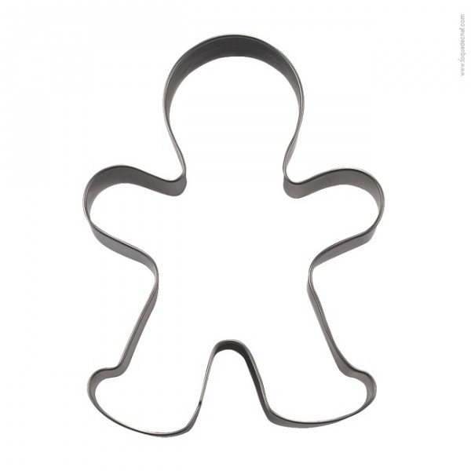
No Cookie Cutter Approach
Notes:
It is important to understand that there is no cookie cutter approach to PBL

Slide 36
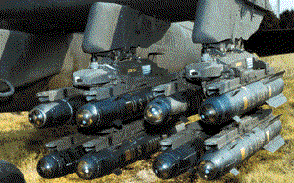
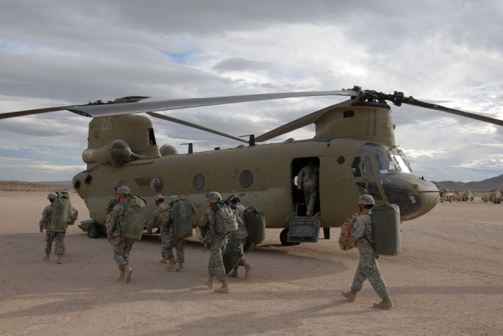
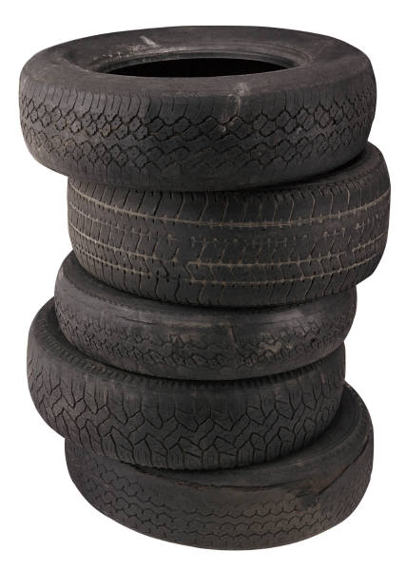
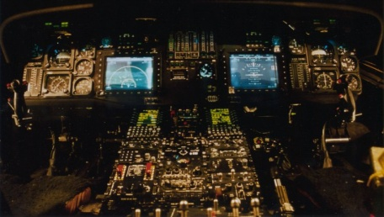
The Scope of a PBL Can Span Various “Levels”
Sub-Process
or Parts
Subsystem
Full System
Complexity
Notes:
Simple message . . . There is nothing that says it has to be at the system level. There just has to be a clear path to managing the portfolio to deliver the required capabilities at the weapons system, or in the enterprise portfolio.
A less than full system PBL must be carefully integrated into the overall support strategy.

Slide 37
Spectrum of PBL Strategies
Traditional
DVD
CLS
TSPR
ORGANIC SUPPORT
Government Risk
Government Risk
Public / Private
Partnering
Opportunities
Supplier Responsibility
Government Responsibility
COMMERCIAL SUPPORT
PBL
PBL
PBL
PBL
PBL: Performance-Based Logistics
DVD: Direct Vendor Delivery
CLS: Contractor Logistics Support
TSPR: Total System Program Responsibility
PBL can fall anywhere along the spectrum (PBL  CLS) … depends on System Age, Life Cycle Phase, Existing Infrastructure, Organic / Commercial Capabilities, Legislative & Regulatory Constraints
Notes:
There is an almost infinite number of alternative PBL strategies

Slide 38
Key Roles in PBL
Warfighter
DoD PM
Contracting Officer
Product Support Provider
Product Support Integrator

Slide 39
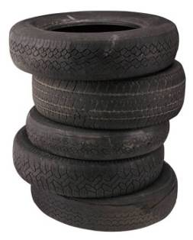

The PSI Integrates System Support
Across the Various PSP(s)
Supply/DLA
Technical Support
Commodities
The DoD Program Manager works with a Product Support Integrator to align the various support providers to meet agreed upon performance requirements
Depot Repair
DoD
PM
Transportation
Organizational
Maintenance
DoD
Manager
Product
Support
Integrator
Notes:
Think carefully on the skills required to integrate, and where they can be sourced.
Integration is a core competency, and it is not easy to do.

Slide 40
Who can be a PSI?
Prime Vendor/OEM
  Has knowledge of system; technical data, proprietary rights & licenses; unique parts; maintenance expertise
3PL (Third Party Logistics Provider)
  Good candidate for narrow scope, supply chain management services work
  Good “integration” skills could potentially make them a good candidate for “System of Systems” platforms without one “Prime”; a Neutral Party
Program Management Office
Organic Depot or ICP
  Good for legacy systems with large organic support infrastructure in place, and for small systems or sub-systems with no real OEM or Prime Vendor
Notes:
Who are the logical range of candidates to assume the PSI role?
For large ACAT I and II systems, we have tended to turn to the Prime Vendor/OEM, and with good reason (talk to sub-bullet)
Other options are…(talk to chart)

Slide 41

Summary
At the operational level, all of our systems
still require the same resources to keep
them operational…Spare, Repairs, Technical Support, etc.
PBL doesn’t CHANGE this…
What it changes is the way in which
we acquire the support!
We move away from transaction-based support where the Government assumes all risk…
To buying long-term support packages based on performance.
Notes:
Specify the outcome, the what . . . Not the how.
Provide the freedom to innovate and improve, and be rewarded for being successful.
Still need to do product support . . . But with PBL you have an incentive structure to do it better.

Slide 42
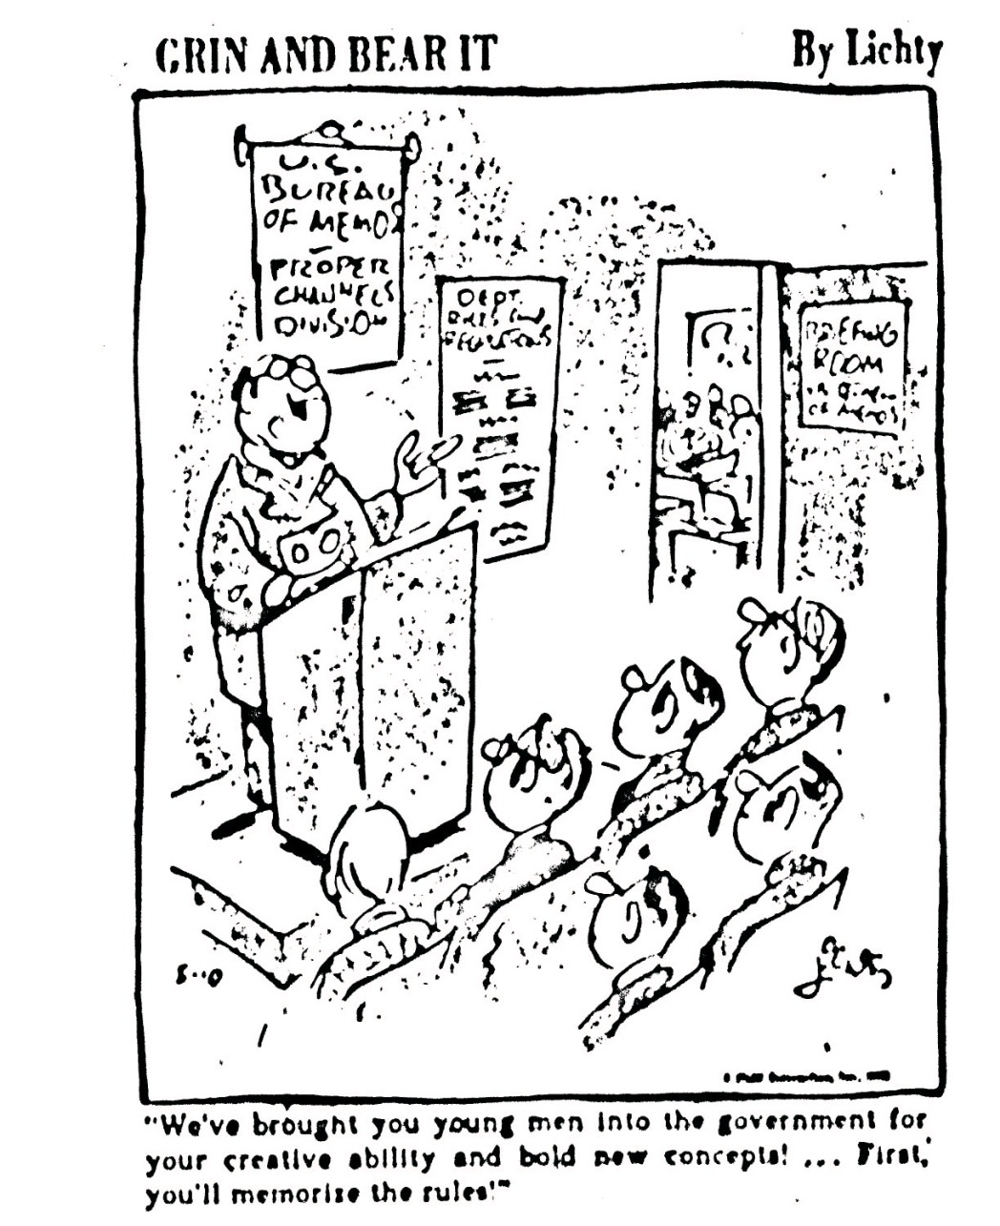
Questions?
“We’ve brought you young men into the government for your creative ability and bold new concepts!...First, you’ll memorize the rules!”

