Slide 1
Extrusion of Ionic Liquid Rayon
R. Hunter Bray
rhb0004@uah.edu
Reliability and Failure Analysis Lab
http://rfal.uah.edu

Slide 2
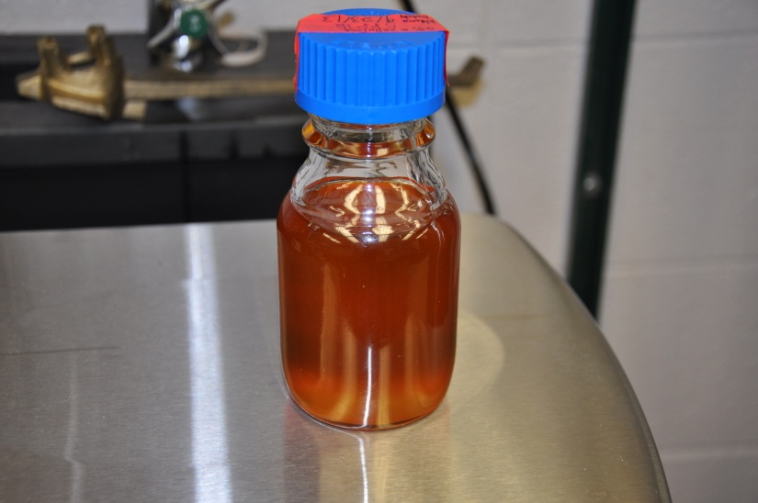
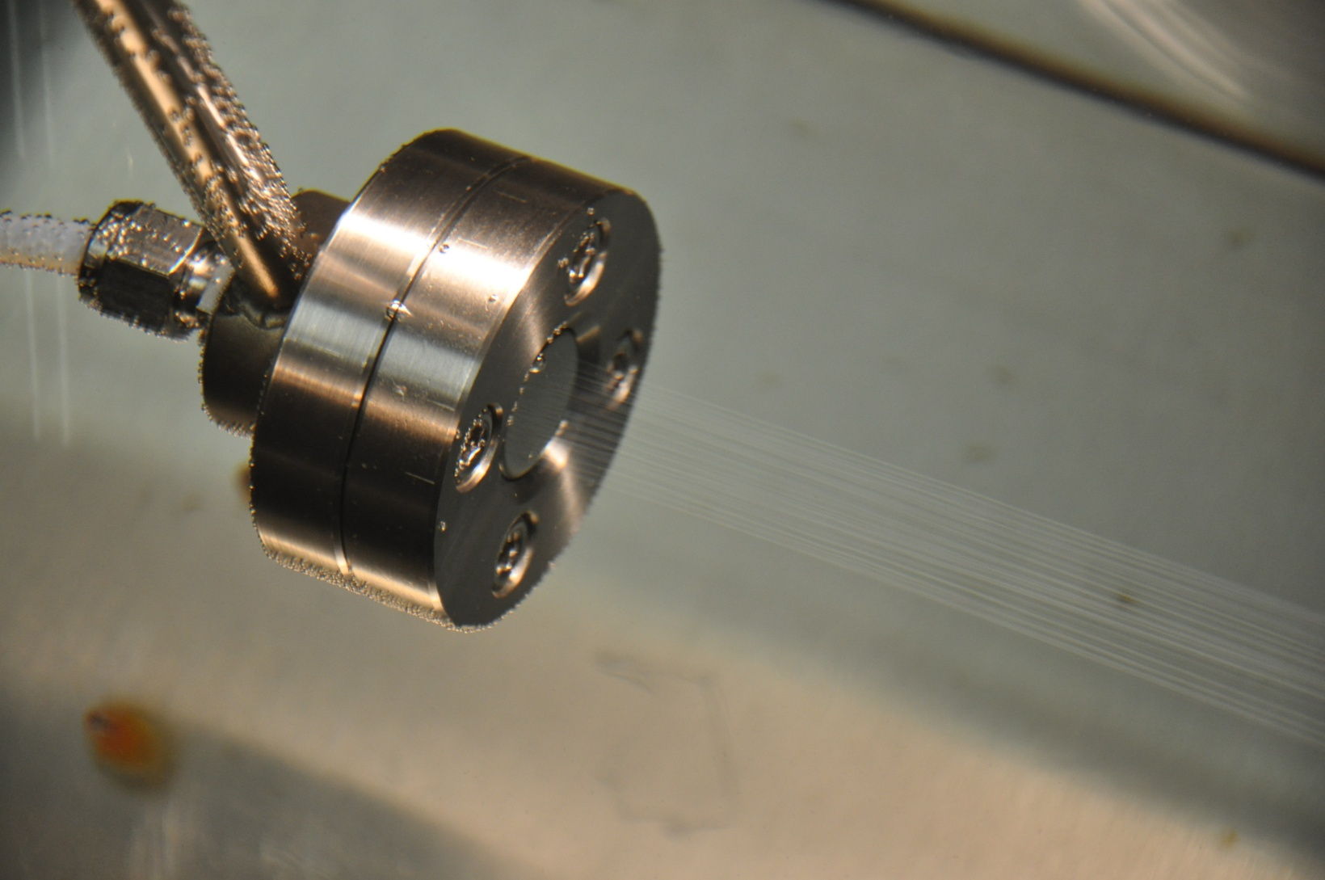
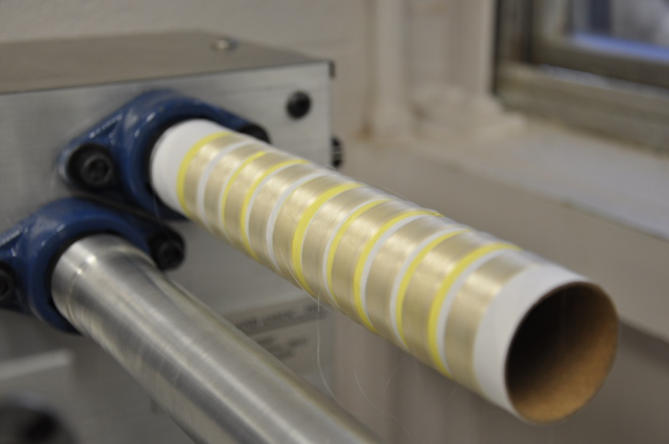
Ionic Liquid Rayon
What is Ionic Liquid Rayon?
Smaller-than-hair, cellulose based fiber currently in development
Created by dissolving cellulose in IL and extruding the mixture into a coagulation bath
Has many potential uses including clothing and carbon fiber precursor
Our goal: develop this process to match current industrial rayon processes.
Notes:
Talk about pictures; walk through extrusion

Slide 3
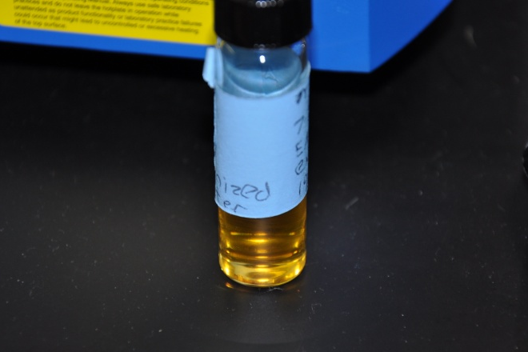
Ionic Liquids
What are Ionic Liquids?
Organic compounds that are ionic and behave as a molten salt at temperatures under 100 deg. C.
Act as organic solvents
Almost nonexistent vapor pressure; can be dissolve in solutions and recovered

Slide 4
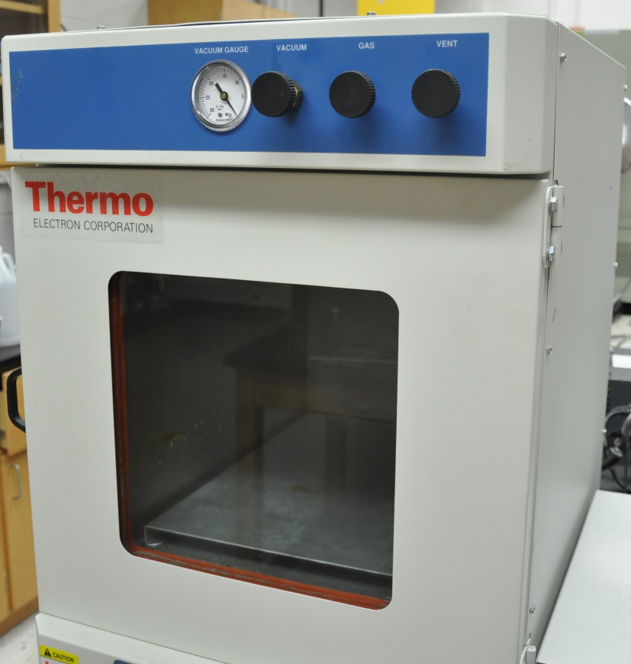
Making the Mixture
The Process:
Dry the Ionic Liquid and cellulose
Weigh dried Ionic Liquid to determine the amount of dry cellulose needed
Slowly add in cellulose while applying heat and mixing

Slide 5
Early Mixing Methods
Hot Plate Method:
Oil Bath Method:
How it works:
Magnetic stir bar inside bottle used to mix IL and cellulose
Heated with plate from the bottom
Issues:
Mixing takes a very long time
Shear throughout mixture for mixing is difficult to achieve with stir bar
Temperature difference between plate and mix is significant
Cellulose may get burned
Mixture may take days to achieve
How it works:
Mixture is heated from the bottom and sides with an oil bath
Electric motor turns an impeller for mixing
Issues:
Mixing still takes a long time
Advantages over the hot plate:
Faster heating time
Higher shear for mixing is achieved

Slide 6
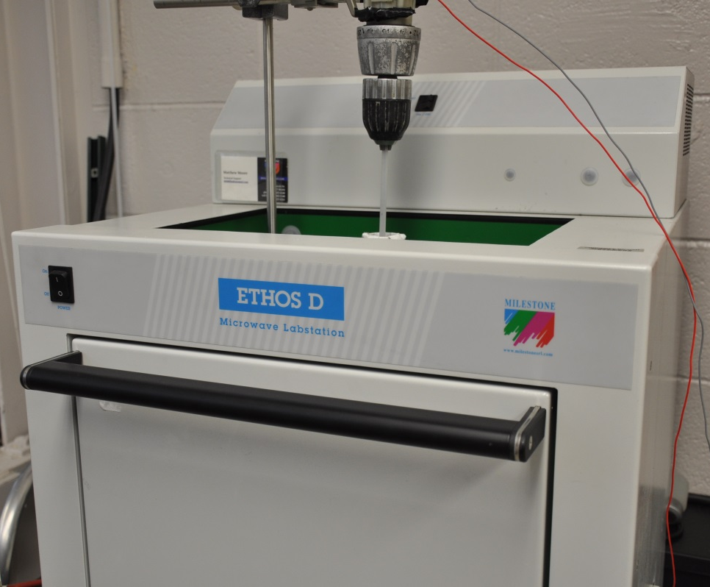
Current Mixing Methods:
Industrial Microwave:
How it works:
Mixture is heated in intervals using microwaves
Electric motor turns an glass impeller for mixing
Issues:
If heating isn’t carefully monitored cellulose will burn
Care must be taken with glass impeller due to cost
Advantages over other methods:
Mixing generally takes < 1 day

Slide 7
Extrusion Process
Basic Idea:
A mixture is heated to reduce its viscosity
The hot mixture is forced through a hole into a coagulation medium
The mixture exits the hole/holes and enters the coagulation bath.
Causes the IL to dissipate into the coagulation and the cellulose to precipitate into a fiber

Slide 8
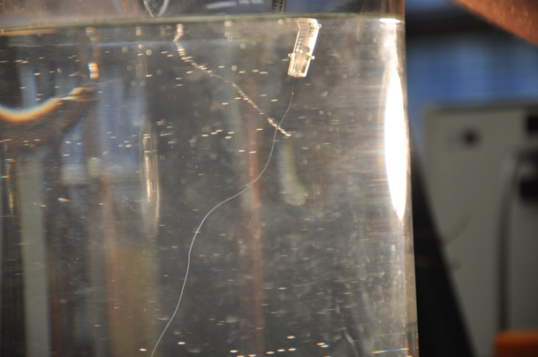
First Extrusions:
Hypodermic Needles
How the extrusions were done:
Hypodermic needle with tips ground flat
Coagulation medium was heated water in a beaker
Fibers were extruded by hand into these beakers and then were collected and dried
Made fibers no more than around a couple feet long
Lessons learned:
#1 that we could successfully created fibers using this method
Learned the importance of wash time
Observed shrinking of fibers as they dried

Slide 9
First Evolution
Hydraulic Press
Process:
2-ton hydraulic press was outfitted with a custom extrusion head made using needles
Heated water was placed into coagulation tank where the fibers were extruded
Increased length of fibers to around 20 feet
Lessons learned:
Multiple fibers spun stuck together
Observed that when fibers dried on a surface, a flat spot would develop

Slide 10
Current Extrusions:
Wet spinning
How the extrusions are done:
Bottle of mixture is loaded into a pressure vessel
Mixture is forced through a spinnerette head into a coagulation bath
Fibers receive additional washing in additional baths
Three main sections of the extrusion line:
Pressure vessel assembly and spinnerette
Coagulation and wash baths
Drying and Collection

Slide 11
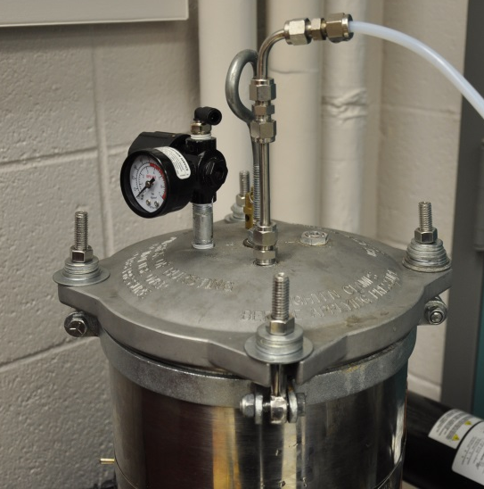
Pressure Vessel & Spinneret
Pressure vessel:
Uses pressure to force the mixture to the spinneret
Line is heated to reduce the viscosity of the mixture
Gear pump is an option if higher pressures are desired
Spinneret:
Fits into an assembly attached to the pressure vessel
Contains hair sized and smaller holes for the mixture to enter the coagulation
Hole size affects fiber size more than anything

Slide 12
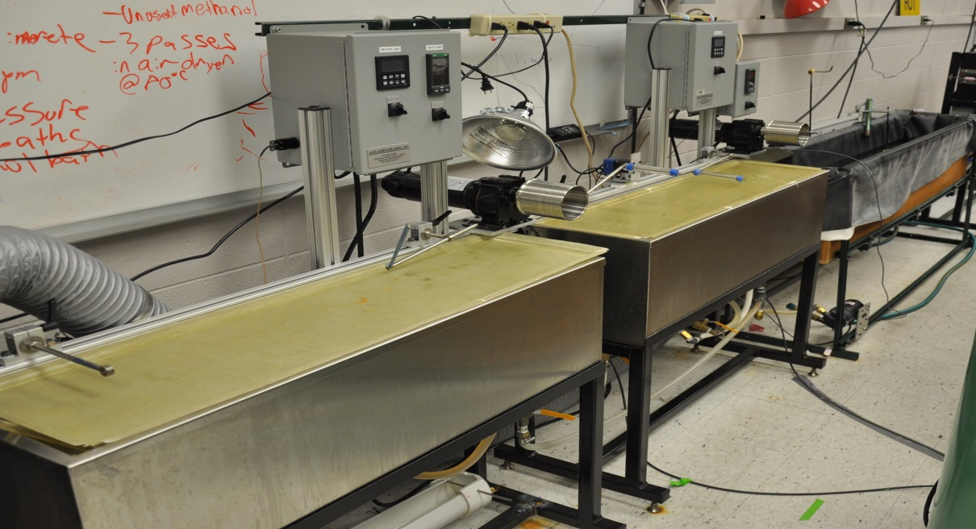
Coagulation and Wash Baths
Coagulation:
Bath where fibers are precipitated
Heated bath of either water or alcohol
Most of Ionic Liquid is washed out in this bath
Wash Baths:
Baths that provide additional washing
Rollers pull fibers through baths and keep fibers under tension
Heated baths of either water or alcohol
Should wash out most of remaining Ionic liquid

Slide 13
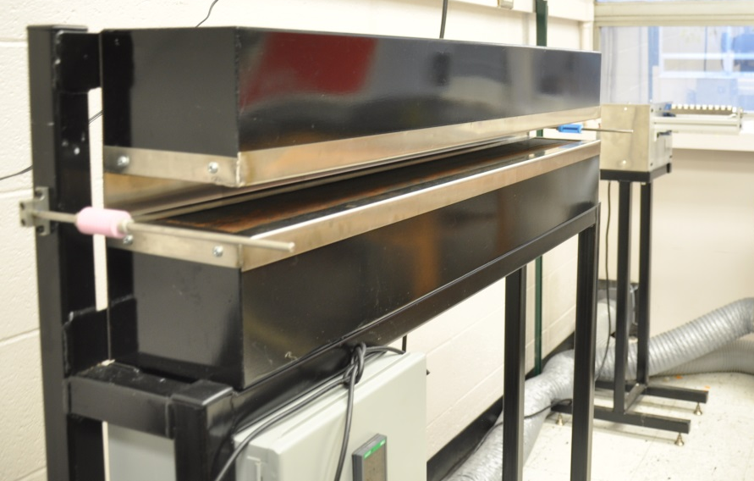
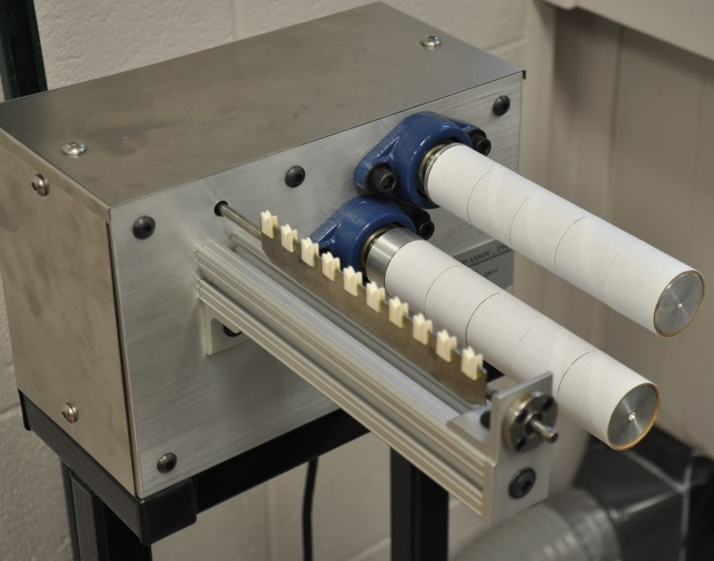
Drying and Collecting
Dryer:
Uses hot, slow moving air to dry the fibers
Fan is occasionally added to improve drying
Very important, fibers drying on collector may stick together
Collector:
Simple spooling mechanism used to collect fibers

Slide 14
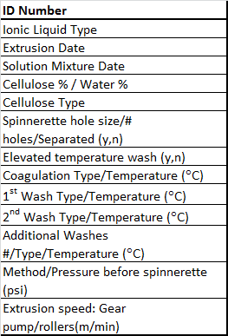
Post Extrusion Verification
Each extrusion’s variables differ:
Issues with extrusion can be present
Fibers in a tow sticking together
Unusual geometry of fiber
Fibers containing excess IL after collected
Issues with the fiber due to mixture problems
Tests to analyze and verify fibers
Physical observation
Tensile testing
Purity testing
Microscopy
Comparisons to industrial rayon

Slide 15
Recap
Making of mixtures:
Has gone through three evolutions reducing time required for mixing
Extruding:
Also has experienced three evolutions
Fibers are made by extruding a mixture of IL and cellulose into a coagulant
Has moved from 6” to thousands of meters of fiber
Requires verification because each extrusion is usually different and various problems can appear in the fibers

Slide 16
Questions?
UAHuntsville
R. Hunter Bray
RFAL
Rfal.uah.edu
rhb0004@uah.edu

