Slide 1
Reliability-Based Life-Cycle Economic Analysis
Dr Bill Wessels, PE CRE
Principal Research Scientist
UAH Research Institute
Reliability & Failure Analysis Lab

Slide 2
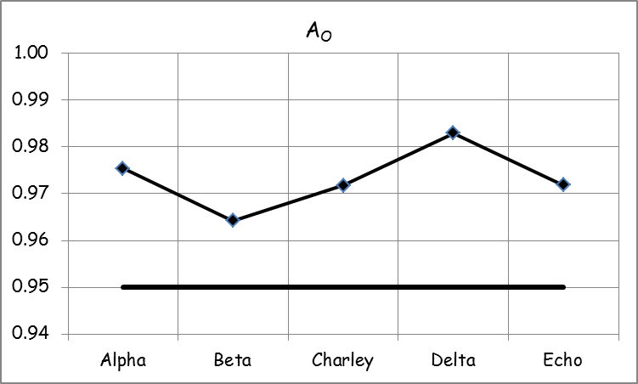
Part Alternatives
Five Vendors offer part that meets or exceeds reliability requirements
Acquisition Costs
A - $6,064
B - $3,803
C - $5,398
D - $6,919
E - $4,376

Slide 3
Part Failure – Maintenance Cycle

Slide 4
Labor Allocation & Costs/hr – Part Alpha

Slide 5
Labor Allocation & Costs/hr – Parts Beta & Charlie

Slide 6
Labor Allocation & Costs/hr – Parts Delta & Echo

Slide 7
Overhead Costs

Slide 8
Deterministic Part Alternatives

Slide 9
Part A Baseline Simulation

Slide 10
Part B Baseline Simulation

Slide 11
Part C Baseline Simulation

Slide 12
Part D Baseline Simulation

Slide 13
Part E Baseline Simulation

Slide 14
Tests of Hypotheses for Means

Slide 15
Costs Table – Part Alpha

Slide 16
Costs Table – Part Beta
Costs Table – Part Charlie

Slide 17
Costs Table – Part Delta
Costs Table – Part Echo

Slide 18
Engineering Economic Analysis
r_{d} = APR
n = θ
m = CP/yr
i = r_{d}/m
A = uniform cost per hr
PV[A] = PV(i, n, A)
F = Σ [Costs at n]
PV[F]= PV(i, n,_, F)
NPV = PV[A] + PV[F]
A_{Equiv} = PMT(i, n, NPV)

Slide 19
Part A Life-Cycle Economic Analysis

Slide 20
Part Alternatives Life-Cycle Economic Analyses

Slide 21
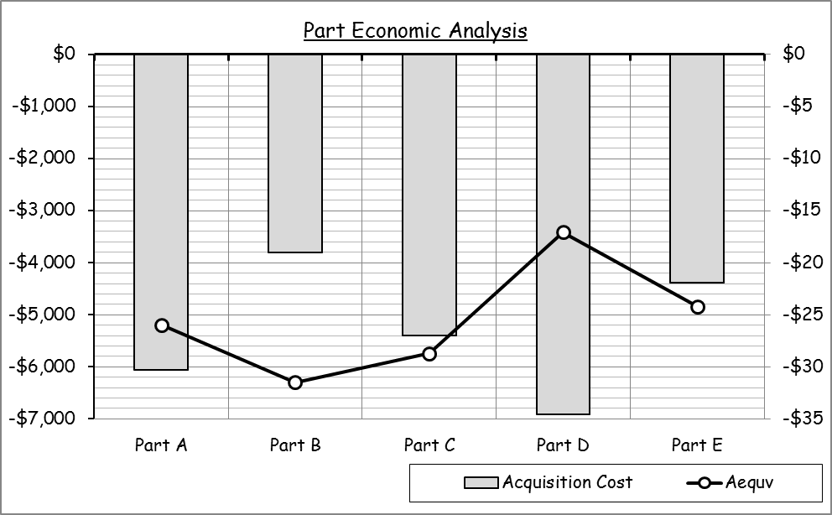

Slide 22
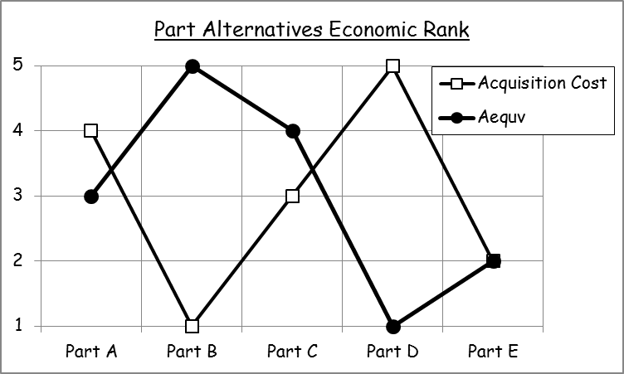
Part Alternatives Economic Ranking

