Slide 1


Practical Applications of RAM Analyses for
UH-1Y and AH-1Z Helicopters
Continuously Pushing the Limits of Innovation, Technology & Conventional Thinking
November 2015

Slide 2
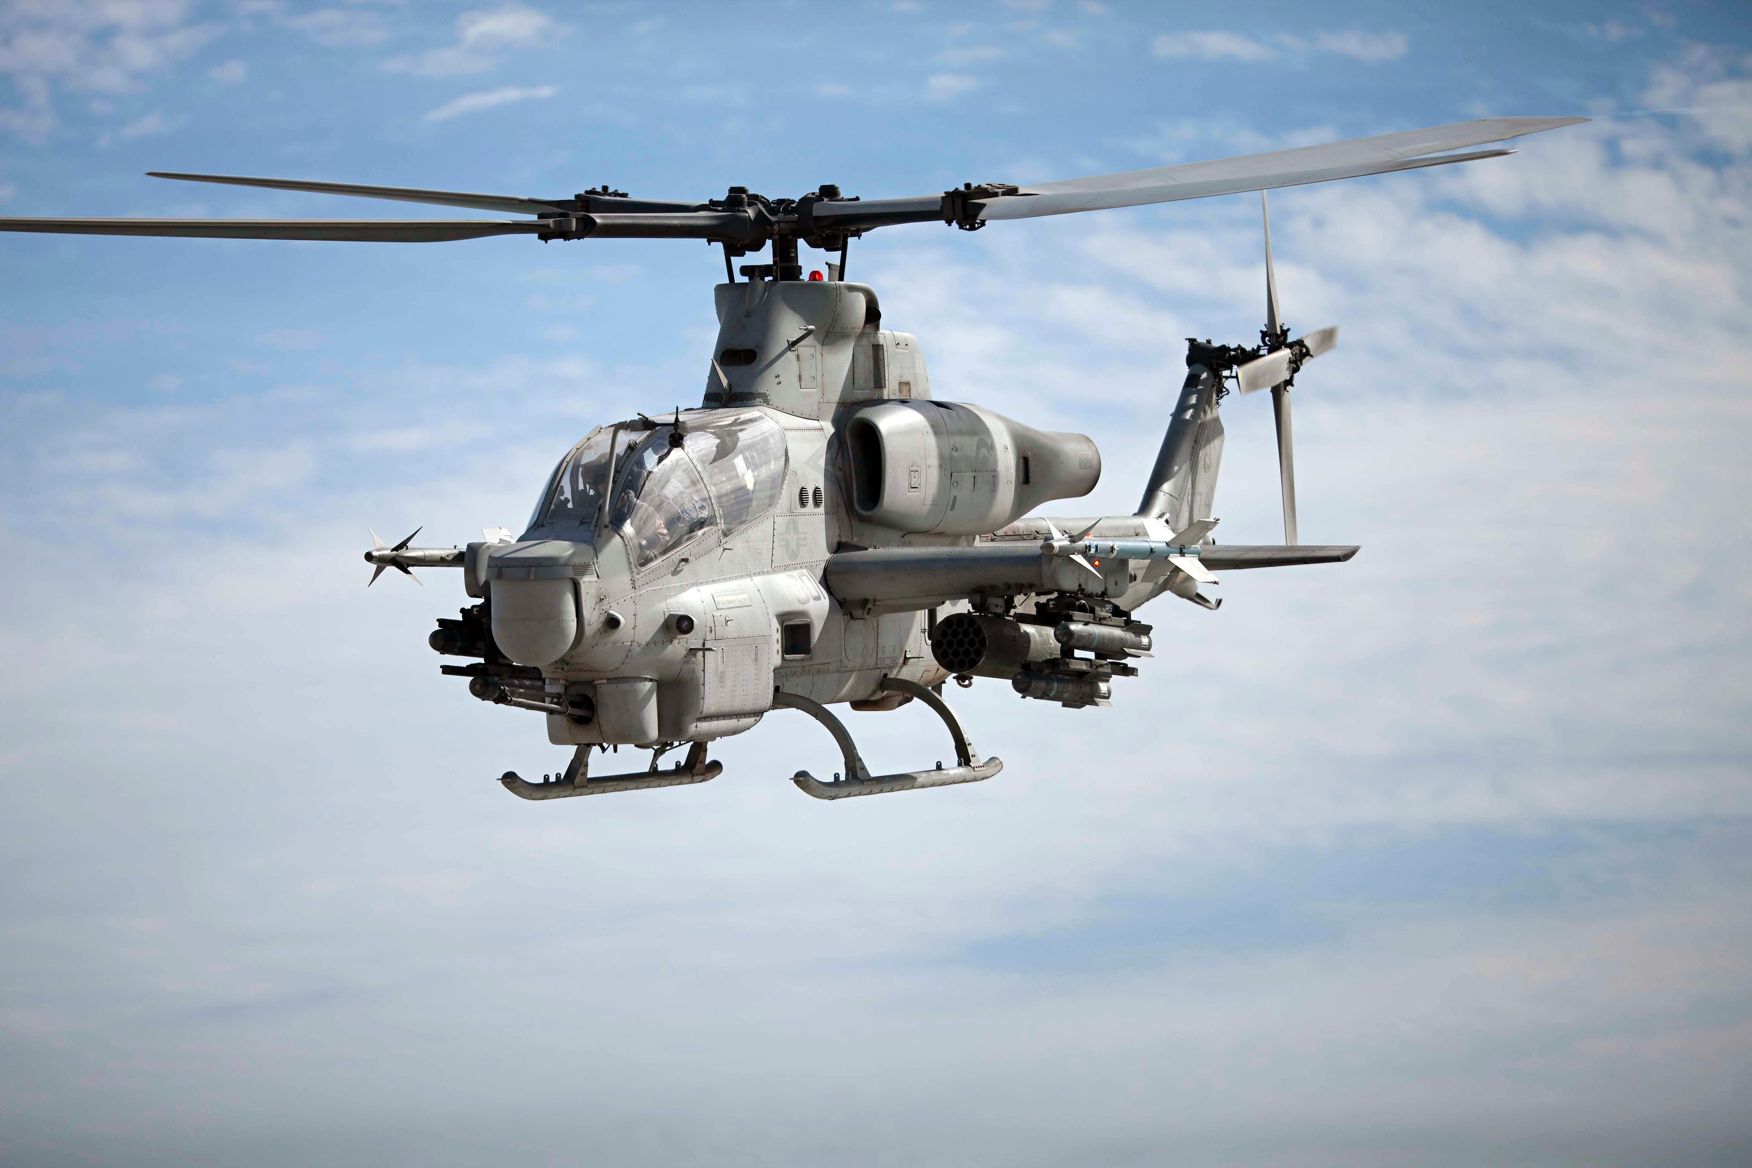
Background
UH-1Y and AH-1Z are upgraded aircraft
  Replaced the legacy UH-1N and AH-1W
  Procured by USN/USMC from BHTI
  Currently about 79 UH-1Ys and 34 AH-1Zs fielded
  Still in production (Planned UH-1Y: 132 / AH-1Z: 64)

Slide 3
Background
Previous Efforts Completed by ASI RAM Team for H-1 FST:
RCM Analysis
  Identified all failure modes and determine severities, criticalities, and failure rates (full FMECA)
  Determined appropriate failure mitigation strategies for all failure modes
  Ensured safe operation of aircraft while minimizing costs and downtimes associated with preventive and corrective maintenance
  Analysis initially performed during Acquisition stage, then updated once fielded
Reliability Block Diagrams (RBDs)
  Assessed Reliability, Availability, Maintenance costs, etc. for all major systems
  Identified top cost and downtime drivers
  Evaluated maintenance policies

Slide 4
Background
Recent analyses performed ASI RAM Team:
Weibull/Life-Data Analyses
  Analyzed Reliability and Failure Behavior of certain components
  Identified adverse trends being observed
  Determined if current maintenance processes were properly mitigating failures and/or minimizing cost and downtime
  Identified potential improvements to Reliability and Mission Effectiveness
Spares Prediction Modeling
  Utilized Weibull Analysis results to predict future failures for both current and future fielded aircraft
  Predicted spares requirements based on operational scenarios
  Predicted costs, downtime, etc.

Slide 5
Weibull Analysis
Extensive data cleansing and analysis performed
  Collected failure and usage data from OOMA/DECKPLATE (NAVAIR System)
  Cleansed data so that only verified failures were included
  Included data from all UH-1Y and AH-1Z BUNOs
  Failure data and Suspension data was used
Raw discrepancy data was cleansed with several assumptions made to convert into useful data for this type of analysis
  Items not serialized - Time-in-Service and Time-to-Failure (TTF) had to be derived using flight data reports
  Isolated wear/fatigue failure modes for failure points. Other Failure Modes requiring replacement considered as suspensions.
  For some components, further in-depth cleansing and filtering of data required to determine accurate TTFs
  For certain components with insufficient data, legacy (UH-1W) data was used for same/similar component
  For items with insufficient data at current time, analyses
  could not be performed
Notes:
Similar to ASAP data collection system for the Army – takes direct inputs from logbooks (ULLS-A, etc.)

Slide 6




Weibull Analysis
Analyses ultimately performed on 20 components
  Graphical representation provided
  Identified how components were failing and their impact to operations
  Predicted Reliability at various ages
Data was a fairly good fit for Weibull -2 Distribution
Beta: 1.58
Eta: 1654
80% Reliability at 642 FHs
Increasing conditional probability of failure with age
50% Reliability at 1313 FHs

Slide 7
Weibull Analysis
For each component analyzed, RAM team performed the following:
  Identified number of data points and discussed level of confidence in results and predictions
  Identified the Distribution Parameters along with Confidence Intervals and determined whether component was experiencing:
    Wear-out characteristics – due to possible poor Reliability of components, or life-limiting material.
    Random failures due to unpredictable events such as Operator errors, environmental factors, etc.
    Infant mortality – typically due to Quality Control issues or manufacturing defects. Other possibilities include maintenance induced damage, or installation errors.
  Evaluated current maintenance practices and whether failure behavior was properly being addressed
    Determined if safety risks were being mitigated
    Evaluated cost and downtime implications
  Evaluated possible corrective actions to improve Reliability and Availability of components
    Potential corrective actions were evaluated on the basis of safety implications, cost, feasibility, packaging with other costs, and predicted impact
Notes:
3rd bullet - Discuss RCM and how the Weibull results tied back to what the maintenance recommendations were

Slide 8
Weibull Analysis
ASI RAM team worked with FST to formulate and implement recommendations:
  Data collection recommendations
    Identified components that needed additional data to better refine results and predictions
    Recommended better data collection practices for future efforts
  Maintenance recommendations
    Integrated results into RCM analysis
    Utilized modeling and simulation capabilities to evaluate various maintenance actions and their predicted impact (# of failures, total costs, total downtime, etc.)
    Identified the ideal interval for various maintenance actions (inspections, removals, etc.)
  Corrective action recommendations
    Identified root cause of Reliability issues being experienced
    Identified best practices to minimize preventable failures
Implementation of recommendations currently on-going
  Joint effort between FST and ASI RAM team
Effort is predicted to significantly improve component Availability and minimize failures and associated costs
  Results will be validated using future data
  Additional components identified for future analyses

Slide 9
Spares Prediction Modeling
ASI RAM team implemented structured approach to predicting spares demand for UH-1Y and AH-1Z Helicopters:
  Utilized results from Weibull Analyses as inputs into Spares Model
    Failure behavior/Reliability of components were key determinants for spares demand
  Derived and utilized actual part ages for each individual component
    Factored in the starting age for parts in the current fleet, then aged the parts for 5 year period
  Incorporated planned roll-out/deployment schedule for future UH-1Y and AH-1Z aircraft for 5 year period (all parts considered new)
  Incorporated planned flight hour profile to conduct simulations
  Included data from additional failure modes not included in Weibull Analysis to account for all spares required
Notes:
Before this, the FST was using a simple linear approach to predicting spares

Slide 10
Spares Prediction Modeling
Spares Modeling Process
  Component ages, failure behavior characteristics, and flight profiles inputted into simulation application
    All were key determinants for spares demand
  Monte-Carlo simulations performed on 10 selected components for each individual part
    Included both currently fielded Helicopters as well as predicted new Helicopters to be deployed
  Once simulations were completed, incorporated additional failure modes not included in previous Weibull analyses into spares predictions
  Results documented for each year in the 5 year period
  Results detailed # of spares required for all 10 components in both UH-1Y and AH-1Z aircraft
Notes:
4th bullet – Talk about how they wanted results for each individual year, and we couldn’t just divide the results by 5.

Slide 11
Example of Simulation Results
449-001-717-111 Spares Predictions for UH-1Y Fleet
Year into Rollout | Current UH-1Y Fleet Spares Demand | Planned UH-1Y Fleet Spares Demand | UH-1Y Other FM Spares Demand | Total UH-1Y Spares Demand | UH-1Y Spares Cost
Year 1 (7/1/2013-6/30/2014) | 9.02 | 0.00 | 0.39 | 9.41 | $19,364.47
Year 2 (7/1/2014-6/30/2015) | 10.60 | 1.17 | 0.48 | 12.25 | $25,214.45
Year 3 (7/1/2015-6/30/2016) | 10.65 | 2.72 | 0.55 | 13.92 | $28,656.41
Year 4 (7/1/2016-6/30/2017) | 10.60 | 4.62 | 0.63 | 15.85 | $32,623.14
Year 5 (7/1/2017-6/30/2018) | 10.78 | 5.90 | 0.65 | 17.34 | $35,691.81
Grand Total | 51.64 | 14.41 | 2.71 | 68.77 | $141,550.28
449-001-717-111 Spares Predictions for AH-1Z Fleet
Year into Rollout | Current AH-1Z Fleet Spares Demand | Planned AH-1Z Fleet Spares Demand | AH-1Z Other FM Spares Demand | Total AH-1Z Spares Demand | AH-1Z Spares Cost
Year 1 (7/1/2013-6/30/2014) | 3.26 | 0.00 | 0.17 | 3.42 | $7,050.15
Year 2 (7/1/2014-6/30/2015) | 4.08 | 0.33 | 0.19 | 4.60 | $9,462.04
Year 3 (7/1/2015-6/30/2016) | 4.37 | 0.49 | 0.19 | 5.05 | $10,390.41
Year 4 (7/1/2016-6/30/2017) | 4.29 | 0.59 | 0.19 | 5.07 | $10,439.81
Year 5 (7/1/2017-6/30/2018) | 4.34 | 1.30 | 0.24 | 5.88 | $12,097.70
Grand Total | 20.34 | 2.70 | 0.99 | 24.02 | $49,440.11
449-001-717-111 Spares Predictions for BOTH UH-1Y and AH-1Z Fleets
Year into Rollout | Current UH-1Y & AH-1Z Fleets' Spares Demand | Planned UH-1Y & AH-1Z Fleets' Spares Demand | UH-1Y & AH-1Z Other FM Spares Demand | UH-1Y & AH-1Z Fleets' Total Spares Demand | UH-1Y & AH-1Z Fleets' Total Spares Cost
Year 1 (7/1/2013-6/30/2014) | 12.27 | 0.00 | 0.56 | 12.83 | $26,414.62
Year 2 (7/1/2014-6/30/2015) | 14.68 | 1.50 | 0.67 | 16.85 | $34,676.50
Year 3 (7/1/2015-6/30/2016) | 15.02 | 3.21 | 0.75 | 18.97 | $39,046.81
Year 4 (7/1/2016-6/30/2017) | 14.89 | 5.21 | 0.82 | 20.92 | $43,062.95
Year 5 (7/1/2017-6/30/2018) | 15.12 | 7.20 | 0.89 | 23.22 | $47,789.51
Grand Total | 71.98 | 17.11 | 3.70 | 92.78 | $190,990.39

Slide 12
Spares Analysis Conclusions
Prediction accuracy highly dependent on # of data points
  Data collected after 1st year to evaluate accuracy of predictions
  Components with numerous data points had highly accurate spares predictions. Other components had wide margins of error
  Some error attributed to small sample size of one year’s worth of predictions used in verification.
Predictions also highly dependent on accurate FH predictions
  Individual Helicopters had wide range of FHs for 1st year
  Original spares predictions assumed a fixed 316 FHs (average) per year for each Helicopter
  When actual FHs from 1st year were inputted into model, predictions improved drastically
  Yearly spares predictions increase as more aircraft introduced into the fleet
ASI RAM Team working with FST to improve model
  Compiling more data to refine predictions
  More accurate usage profiles
  More accurate roll-out schedule for new Helicopters

Slide 13
Spares Analysis Conclusions
Process expected to significantly improve spares procurement process
  More accurate forecasting of failures and spare requirements
  Components available at the right place at the right time
  Lower maintenance and spares costs
  Higher Aircraft Availability
Current/Future RAM efforts
  RAM Team implementing improvements for better forecasting models (discussed on previous slide)
  Identified additional components for both Weibull analyses and spares predictions
  Currently updating RCM analysis and RBDs to include latest results

Slide 14
Backup Slides

Slide 15
Part Parameters
PART DESCRIPTION | PART NUMBER | Weibull Beta | Weibull Eta | Price/Spare | # Parts/Aircraft
Idler Assy, Actuator Guide | 449-001-717-111 | 1.4 | 2238.83 | $2,058.46 | 1
Bellcrank Assy (Vertical Fin Upper) | 449-001-725-107 | 1.58 | 1654 | $522.00 | 1
Clamp Plate Set, Shear Restraint | 449-010-113-101 | 1.47 | 2749.87 | $4,134.00 | 4
Tube Assy, Pitch Link (Short) | 449-010-435-103 | 1.969 | 2825.02 | $3,131.80 | 2
Rod End Assy, Pitch Link (Lower) | 449-010-444-101 | 2.05 | 1769.93 | $3,470.88 | 4
Rod End Assy, Pitch Link (Upper) | 449-010-444-103 | 1.67 | 1239 | $3,320.47 | 4
Pitch Link Assy, Inboard Hub | 449-012-114-101 | 1.5 | 1476.25 | $3,145.59 | 2
Pitch Link Assy, Outboard Hub | 449-012-122-101 | 1.5037 | 1199.78 | $5,741.62 | 2
Link Assy, Idler | 449-012-136-101 | 1.5 | 2062 | $2,733.72 | 1
Shear Restraint | 449-310-101-103 | 1.58 | 2004.1 | $5,133.00 | 4

Slide 16
Parts for 2014 Spares Reporting
PART DESCRIPTION | PART NUMBER
Idler Assy, Actuator Guide | 449-001-717-111
Bellcrank Assy (Vertical Fin Upper) | 449-001-725-107
Clamp Plate Set, Shear Restraint | 449-010-113-101
Tube Assy, Pitch Link (Short) | 449-010-435-103
Rod End Assy, Pitch Link (Lower) | 449-010-444-101
Rod End Assy, Pitch Link (Upper) | 449-010-444-103
Pitch Link Assy, Inboard Hub | 449-012-114-101
Pitch Link Assy, Outboard Hub | 449-012-122-101
Link Assy, Idler | 449-012-136-101
Shear Restraint | 449-310-101-103

Slide 17
UH-1Y and AH-1Z Fleet Data
 | # of Aircraft
Planned Total UH-1Y: | 132
Current UH-1Y: | 79
Future UH-1Y: | Year 1: (7/2013-6/2014) | 18
 | Year 2: (7/2014-6/2015) | 15
 | Year 3: (7/2015-6/2016) | 16
 | Year 4: (7/2016-6/2017) | 4
 | Year 5: (7/2017-6/2018) | 0
Planned Total AH-1Z: | 64
Current AH-1Z: | 34
Future AH-1Z: | Year 1: (7/2013-6/2014) | 5
 | Year 2: (7/2014-6/2015) | 0
 | Year 3: (7/2015-6/2016) | 0
 | Year 4: (7/2016-6/2017) | 10
 | Year 5: (7/2017-6/2018) | 15

