Slide 1
Essential Failure Modes and Effects Analysis (FMEA)
and the
Design Influence of Space Launch Vehicle
Avionics Systems
RAM XI Training Summit
Huntsville - Alabama
October 23-24, 2018
Mohammad Al Hassan
Paul Britton
NASA

Slide 2
Background
Sophisticated electronics are prevalent in modern launch vehicle avionics system
  Such as flight control computers and engine controllers
Schedule, cost and safety risk constraints result in increased reliance on analysis over integrated testing
Avionic system circuits use plenitudes of passive and active electrical components
  such as resistors, capacitors, inductors, transistors, amplifiers, etc.
The cost of single electrical components is small compared to entire space exploration missions.
FMEA can effectively influence design and reduce loss of mission risks

Slide 3
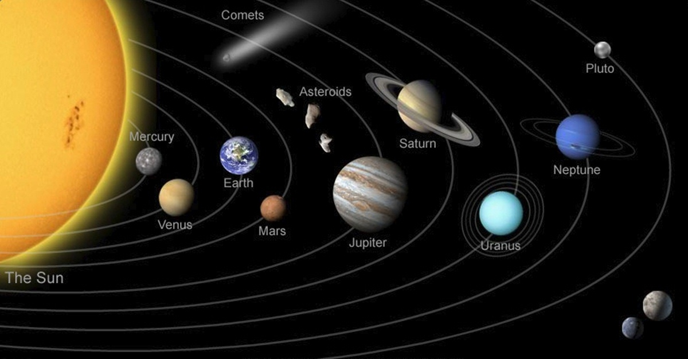
Our Solar System

Slide 4
Presentation Outline
Background
Electrical Component Review
Electrical Diagram Tutorial
Circuit-Level FMEA
Design Solution

Slide 5
1. Electrical Component Review
Passive Components
  Does not require a power supply to perform its intended function
  Includes resistors, capacitors, inductors, transformers, etc.
  Includes RC, RL, and RLC filters
Active Components
  Requires a power supply to perform its function
  Includes diodes, transistors, operational amplifiers, etc.
Notes:
Requires power supply with specific voltage and proper polarity to perform its intended function

Slide 6
1.a Active Components
Transistors are semiconductors doped with impurities to manipulate current flow
Mostly used as electronic on/off switches and amplifiers
They come in different types:
BJT (N-P-N and P-N-P)
FET
MOSFET

Slide 7
1.b Passive Components
Resistors have several functionalities and can be utilized as:
  Current Limiter
  Voltage divider
  Wheatstone Bridge Circuits (Gage Strain)
  Heat-sense application (photoresistor)
  Light brightness
Capacitors store electric charge to be available when needed for immediate use
  The reactance nature of capacitors is utilized in signal noise filtering

Slide 8
1.b Passive Components Cont.
Filters are used in circuits to be responsive to certain frequencies
  Very effective at filtering noise from signals
For instance, an RC filter can be designed for a specific cutoff frequency, and comes in two basic types:
  Low-pass filter (Filters AC signals)
  High Pass filter (Filters DC signals)

Slide 9
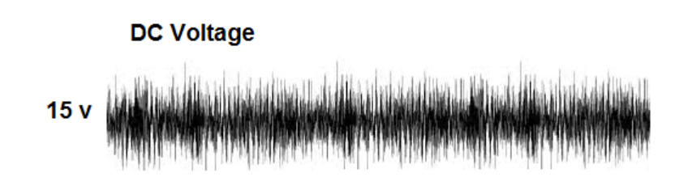
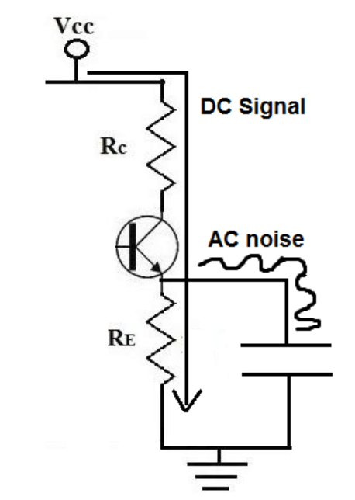
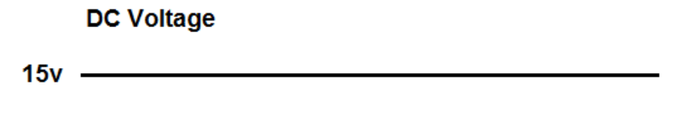
1.c Low Pass Filter
Images Source:
http://www.learningaboutelectronics.com/Articles/What-is-a-bypass-capacitor.html

Slide 10
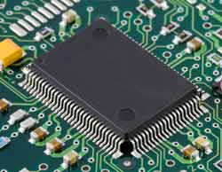
1. d Integrated Circuits
A chip containing discrete electronic components (passive and active) functioning together as a larger circuit

Slide 11
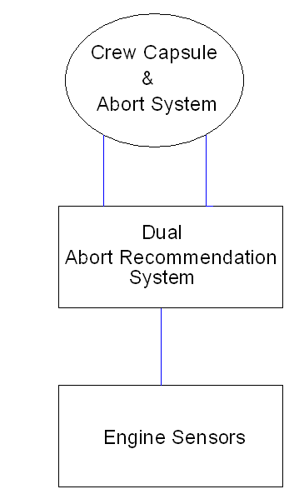
2. Notional Vehicle Block Diagram

Slide 12
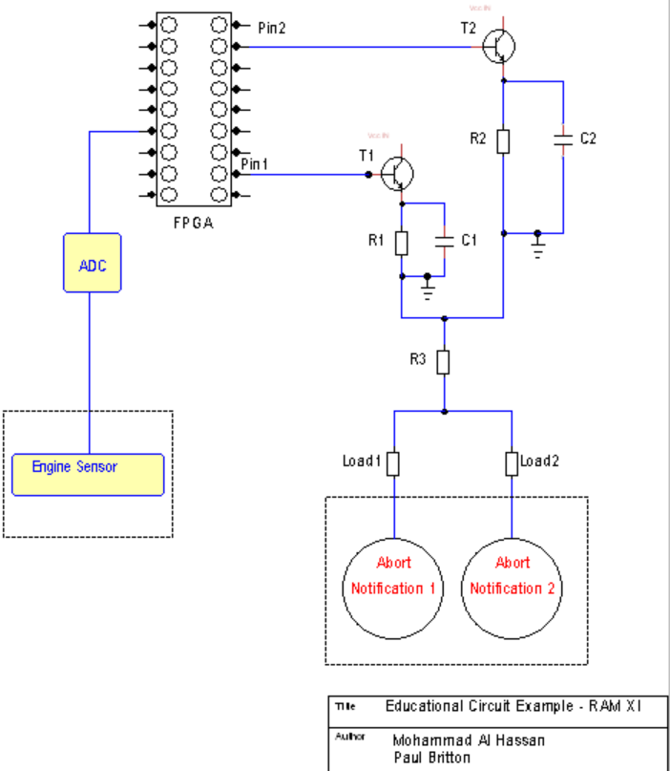
2. Reading Electrical Diagrams

Slide 13
3. Circuit Level FMEA
Component | Failure Mode | Immediate Effect | Next Effect | Final Effect
Transistor 1 | Fails short | Collector-to-emittor shunts (makes), allowing Vcc to supply power to R1 | Load 1 energizes, as well as Load 2 due to common wiring. False-positive Abort recommendation is sent to crew | Loss of mission, vehicle and crew
Transistor 2 | Fails short | Collector-to-emittor shunts (makes), allowing Vcc to supply power to R2 | Load 2 energizes, as well as Load 1 due to common wiring. False-positive Abort recommendation is sent to crew | Loss of mission, vehicle and crew
FPGA - Pin1 | Fails high | Pin1 supplies power to the base pin of Transistor1, collector-to-emitter shunts, allowing Vcc to supply power to R1 | Load 1 energizes, as well as Load 2 due to common wiring. False-positive Abort recommendation is sent to crew | Loss of mission, vehicle and crew

Slide 14
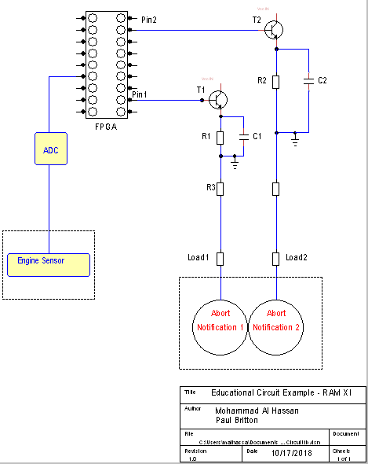
4. Design Solution

Slide 15
4. Design Solution FMEA
Component | Failure Mode | Immediate Effect | Next Effect | Final Effect
Transistor 1 | Fails short | Collector-to-emittor shunts (makes), allowing Vcc to supply power to R1 | Load 1 energizes | No False-positive Abort recommendation is sent to crew
Transistor 2 | Fails short | Collector-to-emittor shunts (makes), allowing Vcc to supply power to R2 | Load 2 energizes | No False-positive Abort recommendation is sent to crew
FPGA - Pin1 | Fails high | Pin1 supplies power to the base pin of Transistor1, collector-to-emitter shunts, allowing Vcc to supply power to R1 | Load 1 energizes | No False-positive Abort recommendation is sent to crew

Slide 16
5. Concluding Comments
FMEAs is a bottom-up analysis tool
FMEA can effectively influence design and reduce loss of mission risks
FMEA techniques are highly effective at facilitating the identification and elimination of single-point failures

Slide 17
Questions
www.nasa.gov/marshall
Mohammad al Hassan (Mo)
mohammad.i.alhassan@nasa.gov
256-544-2410
Paul Britton
Paul.t.britton@nasa.gov
256-544-8301
Notes:
Thank you for your time. I hope this is a good introduction to what we do. I’d be glad to answer questions, but I also hope you will explore Marshall through the web site you see up there. There’s a lot to learn and a lot to be enthusiastic about.

