Slide 1

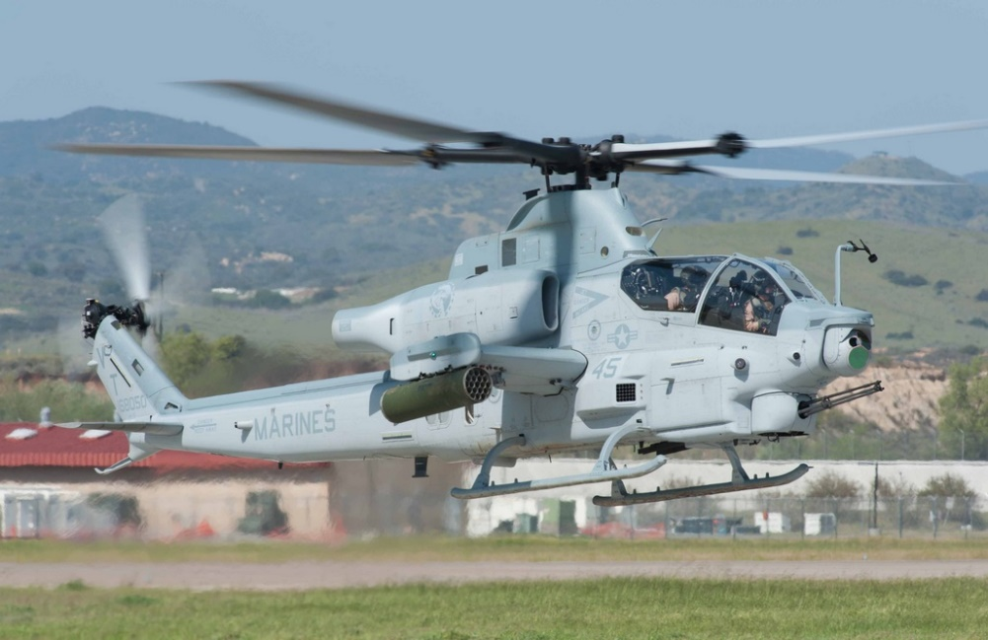
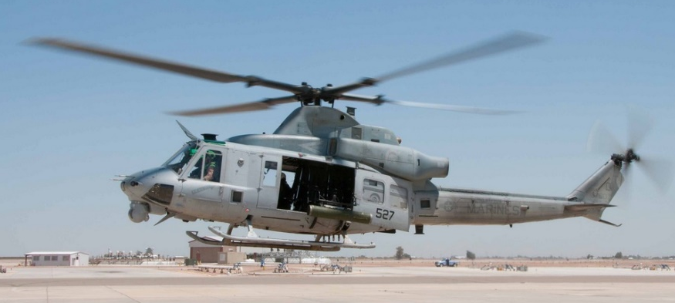
H-1 Modeling & Simulation
November 2025

Slide 2
Background
RAM XVII Training Summit
ASI presented previous RAM Engineering projects:
Reliability-Centered Maintenance (RCM) Analysis
Supportability Optimization Model (SOM)
Weibull (Life Data) analysis
Reliability Block Diagrams (RBDs) to predict spares procurements
Incorporating AI into Data Analytics and Visualization
RAM projects involved numerous types of physical assets:
Aircraft (Fixed Wing, Helicopters, UAVs)
Ground Vehicles (BFV, FMTV, LVSR)
Facilities (Data centers, Hospitals)
Mining Equipment (Scalers, Elevators, Conveyors)
Other equipment (Engines, Tug Boats, S.E.)

Slide 3
Background
RAM XVII Training Summit
ASI tasked with utilizing M&S tools and processes to:
Evaluate various maintenance concepts and compare results
Evaluate various scenarios and Courses of Action (COAs)
Incorporate aircraft schedules (Fleet introductions, Depot inductions, Retirements) at the BUNO level
Incorporate resource allocation and identify excesses and shortages
Simulate variations in Processes and Turnaround times (TATs) to minimize risk
Conduct Sensitivity Analyses by altering numerous factors
Identify the optimal allocation and scheduling/utilization of resources
Models were developed to calculate and predict key metrics:
Downtime
Wait time
Availability
RBA
Resource utilization
Throughput
Costs
etc.

Slide 4
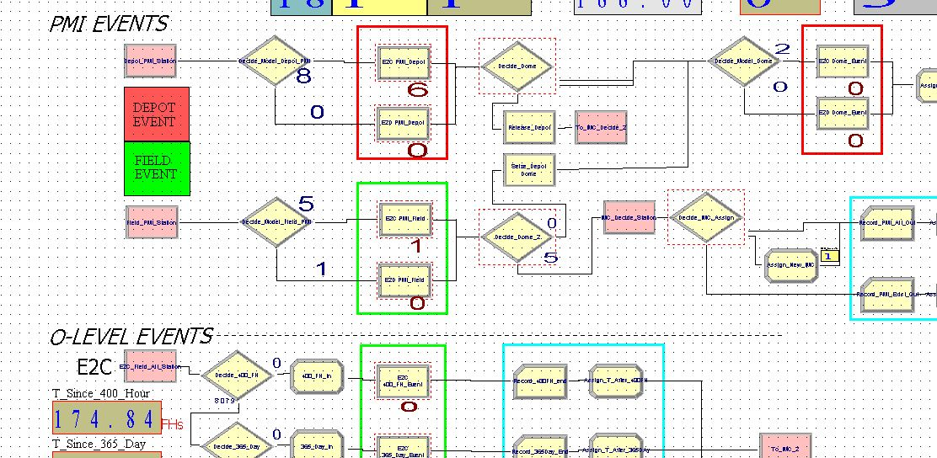
Modeling Application
RAM XVII Training Summit
Analysis Tool: Simulation with Arena
Utilizes discrete event simulation capabilities to evaluate current situation as well as alternative solutions
Sensitivity analyses also performed
Example – Impact of 1 additional Electrician?
Example – Impact of reducing TAT by 6 days?
Example – Impact of additional hangar space?
Optimization module identifies “best solution” based on inputs and objectives
Currently used in numerous industries, including DoD services

Slide 5
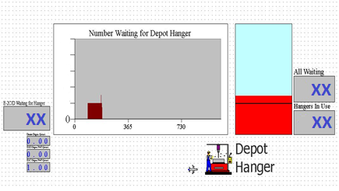
Inputs and Outputs
RAM XVII Training Summit
Inputs include:
All current Aircraft with Delivery, Induction, Preservation, and Retirement schedules
Future Aircraft
Maintenance concepts (Intervals, schedules, locations, etc.)
Depot locations and resources (labor, special equipment, hangar space, etc.)
Process and TATs for Depot events, ISRs, modifications/changes/upgrades
Courses of Action (COA) scenarios
Alternative Maintenance concepts
Cost information
Supply chain/logistics information
Outputs included:
Total Downtime and Wait time
Aircraft Throughput
Availability
Available aircraft (RBA)
Resource utilization metrics for various COAs
Cost metrics for various COAs
Optimal strategies based on desired Availability/Cost

Slide 6
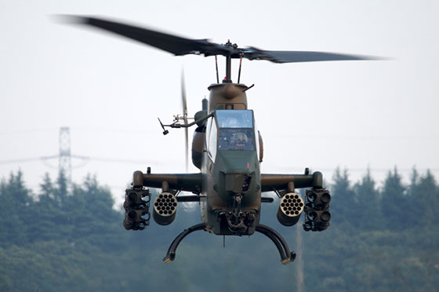
H-1 IMP Modeling
RAM XVII Training Summit
Objectives
Model Depot inductions, ISRs, and Depot Modifications for UH-1Y and AH-1Z at each site
Identify excess aircraft above RBA requirements to send for preservation
Identify which sites will experience shortfalls/delays, and what additional resources would be required to meet Availability/Readiness requirements
Incorporate predicted ISR occurrences
Run sensitivity analyses on all inputs (ISRs, Depot mods, TATs, resources, etc.)
Identify optimal allocation of resources
Evaluate FH based IMC Concept
Evaluate COAs provided by FST
Run optimization routines on various factors
Status
Model created with inputs/data from FST
All BUNOs with locations and induction schedules
Expected retirement dates calculated/incorporated
ISRs and Depot modifications incorporated
FRC Capacities at each site
Current preservation schedule in effect

Slide 7
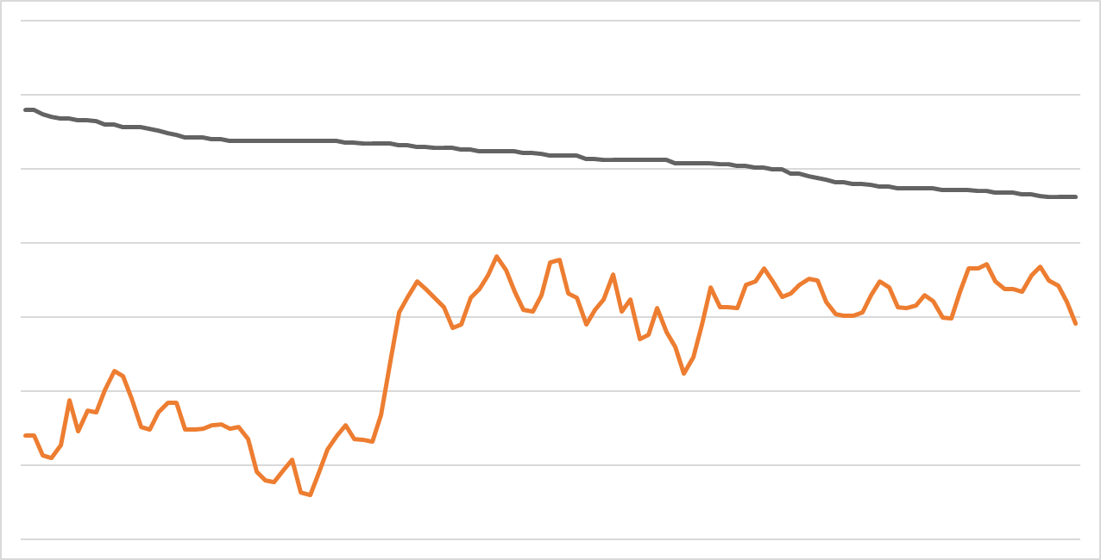
H-1 IMP Modeling – Results
RAM XVII Training Summit
UH-1Y Aircraft Over 10-Year Period
Total UH-1Y
Available UH-1Y
Goal

Slide 8
H-1 IMP Modeling – Results
RAM XVII Training Summit
Average excess UH-1Y aircraft over PAA and depot requirements
Minimum of X aircraft and a maximum of X.
Number varied due to inductions, retirements, WIP, ISRs, MODs, etc.
Depending on maintenance requirements, excess UH-1Y aircraft may be insufficient over 10 year period
Based on the results, an additional Long-Term Preservation policy of X BUNOs was simulated to reduce excess UH-1Y aircraft and approach the baseline inventory.

Slide 9
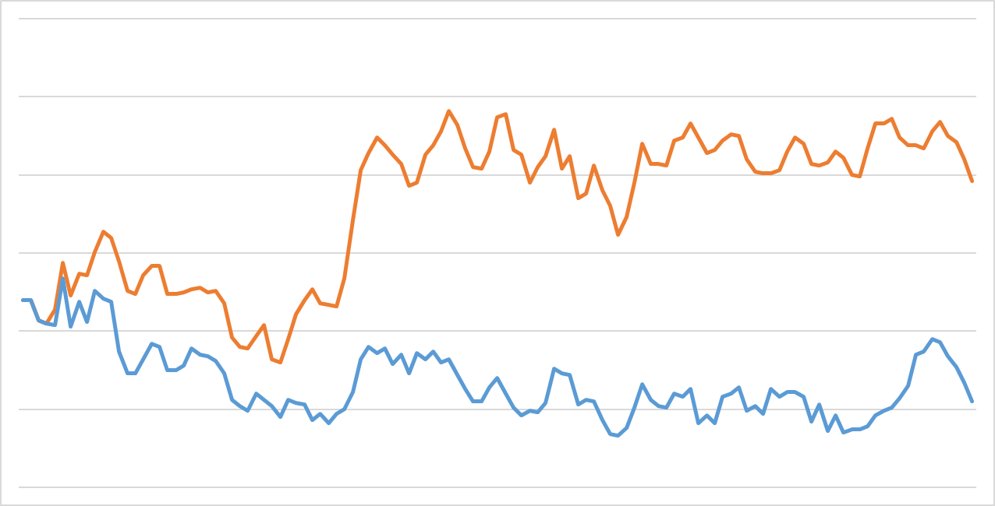
H-1 IMP Modeling – Results
RAM XVII Training Summit
UH-1Y Aircraft Over 10-Year Period
Current Plan
Proposed Plan
Goal

Slide 10
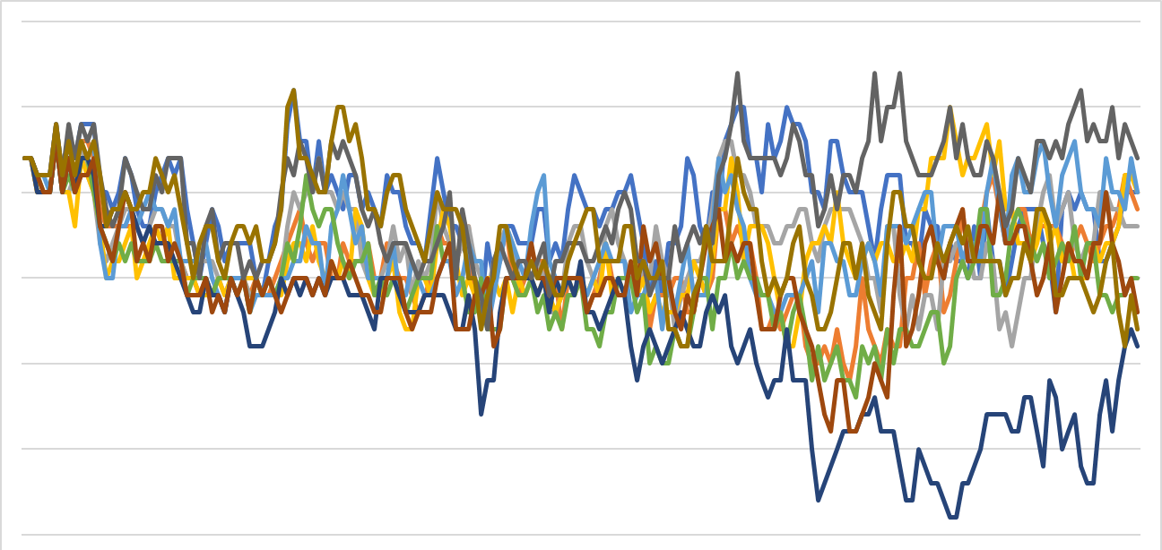
H-1 IMP Modeling - Results
RAM XVII Training Summit
UH-1Y Aircraft Over 10-Year Period (10 Iterations)
Goal

Slide 11
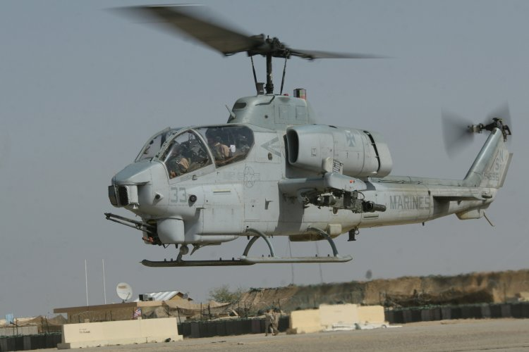




H-1 IMP Modeling – Results
RAM XVII Training Summit
Considerations for long term preservation scenario
BUNOs selected for preservation (IMP history, location, flight hours, etc.)
Additional maintenance requirements due to long term preservation
Aircraft condition and configuration
Selecting specific BUNOs for preservation allows regulation of IMP schedule
This offsets IMP to a desirable time frame
Allows control of which aircraft will compensate for BUNOs in AMARG

Slide 12
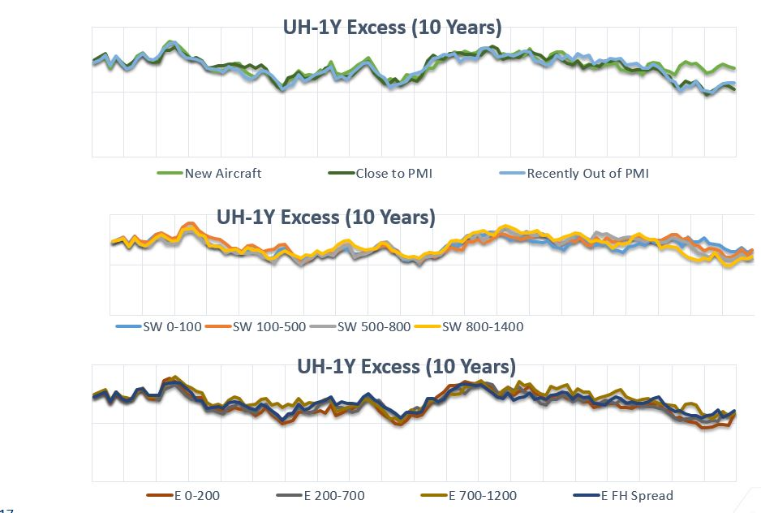
H-1 IMP Modeling - Results
RAM XVII Training Summit

Slide 13
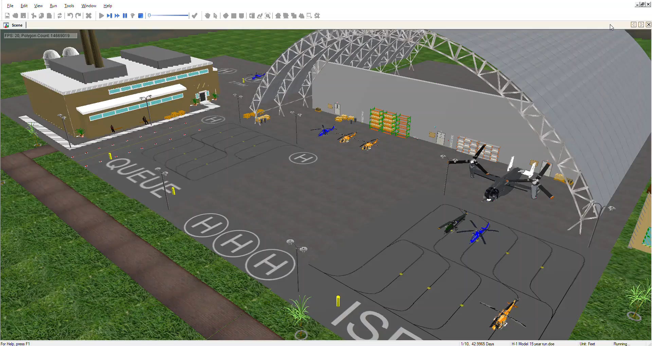
H-1 IMP Modeling - Demonstration
RAM XVII Training Summit

Slide 14
H-1 IMP Modeling – Status Update
RAM XVII Training Summit
Continue to update and validate model against actual induction schedules
Simulate various COAs for preservation
Determine impact on fleet inventory
Vary number of aircraft selected for preservation
Vary preservation schedule
Run optimization and sensitivity analyses on various factors to determine impact
IMP TAT, Depot Mods, increased ISRs, etc.

Slide 15
H-1 Manpower Study
RAM XVII Training Summit
Model current state (As-Is) operations and predict and evaluate proposed changes of the H-1 maintenance manpower.
Identify opportunities to improve process times and turnaround times associated with current squadron activities.
Run sensitivity analyses and optimization routines to minimize risk associated with implementing proposed changes.
Utilize Arena OptQuest to Optimize mission capable aircraft while minimizing staffing.

Slide 16
H-1 Manpower Study – Model Details
RAM XVII Training Summit
Model will run 10 repetitions with a simulation period of 10 years.
Each squadron will be modeled separately to account for differences in shifts, manning, aircraft, and productivity.
Three main work centers will be modeled.
Airframes
Avionics
Flightline
All activities utilizing maintainers will be implemented.
Maintenance
Non-MAF duties
Non-Aeronautical duties
Administrative tasks

Slide 17
H-1 Manpower Study – Inputs/Outputs
RAM XVII Training Summit
Inputs:
Shift schedules
Current resources and readiness correlation
Historical and current task turnaround times (FOD Walk, meetings, training, ATAF)
Historical aircraft downing rate
Historical maintenance manhour trends
Outputs:
Mission capable aircraft
MMH per aircraft
MMH per Marine by MOS
Hours spent on non-MAF, non-aeronautical, and administrative tasks.

Slide 18
H-1 Manpower Study - Constraints
RAM XVII Training Summit
Constraints are centered around staffing, working hours, and duties.
Staffing and working hours remain consistent throughout the simulation.
The simulation will not extend a Marine’s working hours before or after their assigned shift.
Aircraft assigned to each squadron is fixed throughout the simulation.
Actual down aircraft are taken into consideration at the beginning of the simulation.
Based on manpower allocations, aircraft readiness may change.

Slide 19
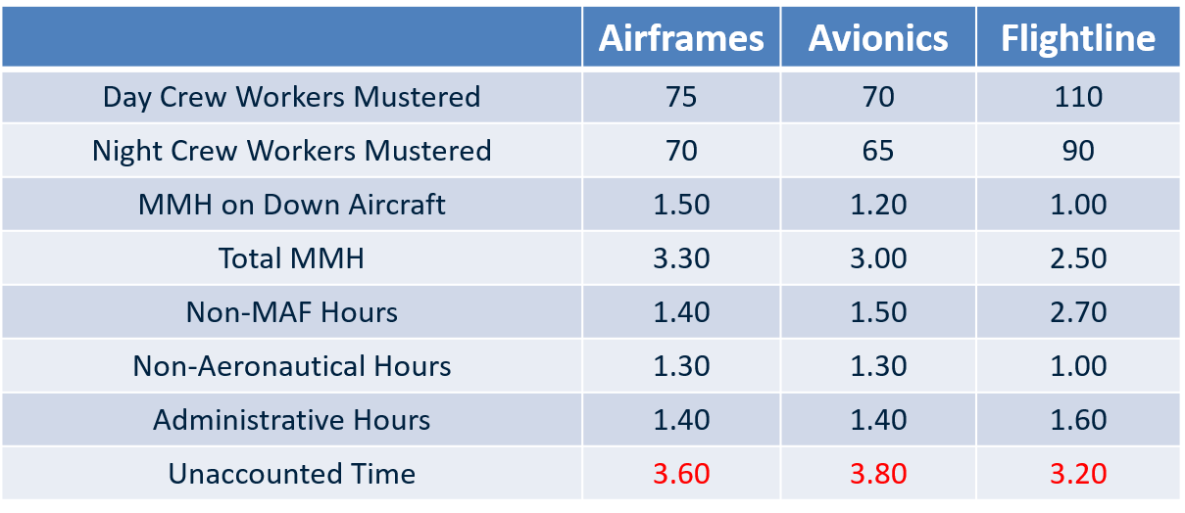
H-1 Manpower Study - Results
RAM XVII Training Summit
As-Is Manpower Breakdown per Day per Marine
NUMBERS DO NOT REFLECT ACTUAL DATA
Availability is considered 11 hours based on the shift length.
“Workers Mustered” is the average number of workers after Leave and FAPs are accounted for.
*Total hours include Qual utilization. “Per Marine” does not include Quals.

Slide 20
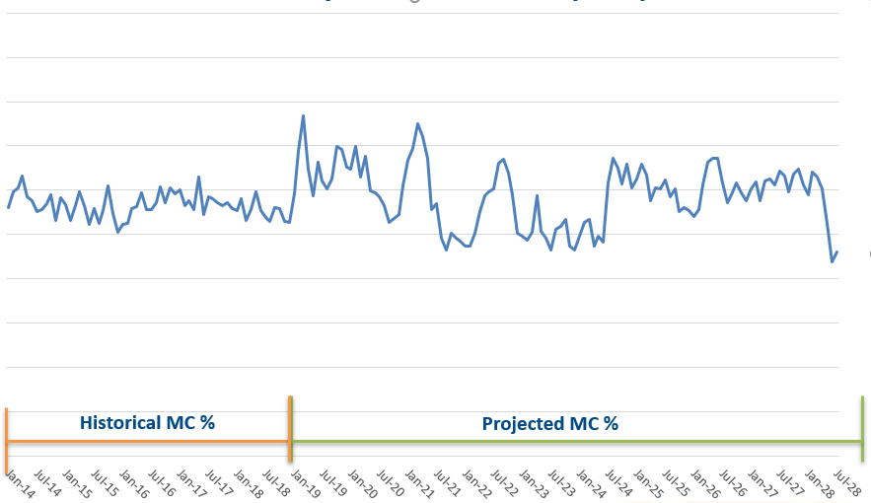
H-1 Manpower Study - Results
RAM XVII Training Summit
Mission Capable Aircraft % (PAA)
NUMBERS DO NOT REFLECT ACTUAL DATA

Slide 21
H-1 Manpower Study - Results
RAM XVII Training Summit
Average mission capable aircraft: 65.0%
It takes an average of 50.0 DMMH to bring an aircraft from “down” to “up” status.
After disregarding the top and bottom 25% of values (removing outliers), the average equates to 13.0 DMMH.
Average of 300 DMMH on down aircraft over 30 days.
Average of 700 DMMH on down aircraft over 180 days.
30.0% of a Marine’s time is spent on direct maintenance.
40.0% of total DMMH are spent working on down aircraft.
45.0% of a Marine’s time is spent on productive non-recorded activities.
41.0% of that time is in support of D/T’s, Fueling, Launch and Recovery, Towing, and Troubleshooting.
36.0% encompasses FOD Walks, end of shift cleanup and Field Day.
23.0% includes admin activities, tech training and meetings.
NUMBERS DO NOT REFLECT ACTUAL DATA

Slide 22
H-1 Manpower Study - Proposal
RAM XVII Training Summit
Mission capability goal: 75%
Two courses of action to increase MMH and decrease down aircraft turnaround time.
Increase maintenance productivity.
Increase staffing
FAPs/SAPs may also be reallocated among the work centers instead of overall increases.
It is assumed that productive activities not recorded on a MAF are required in support of the fleet and will not be adjusted.
The amount of time during a shift that a Marine has available to complete maintenance will stay the same.

Slide 23
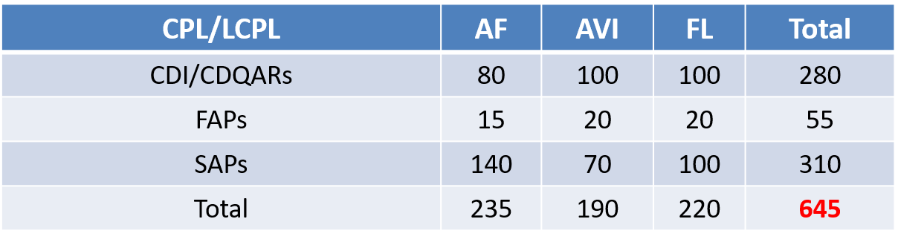
H-1 Manpower Study – FAP/SAPs
RAM XVII Training Summit
Muster/ASR Gap
NUMBERS DO NOT REFLECT ACTUAL DATA
Difference between available workers (510) and recorded On-Hand (1155) for CPL and below is 645 (CDI/CDQARs, SAPs and FAPs).
Difference between average daily muster (480) and available workers (510) is attributed to Leave (30).
Data collected between Jun ‘18 and Mar ’19.

Slide 24
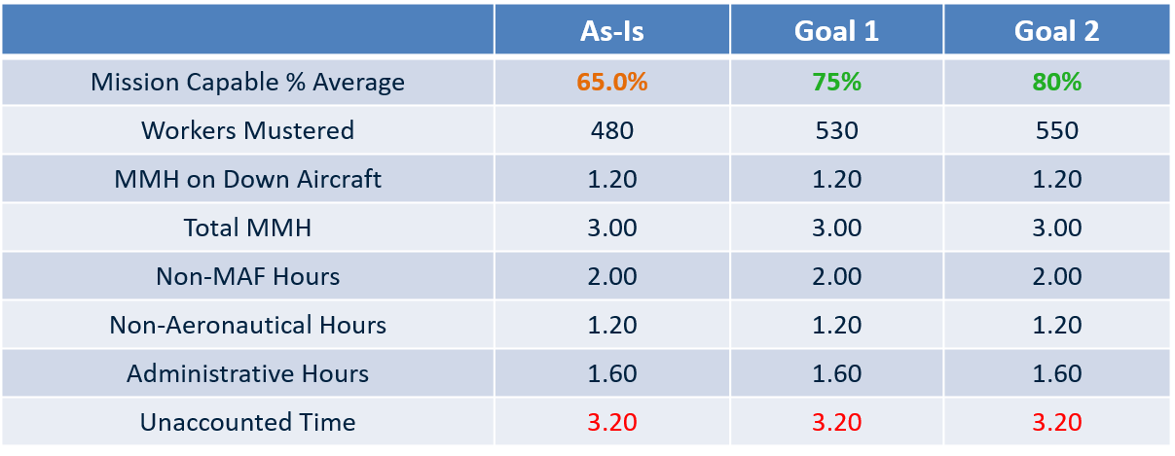
H-1 Manpower Study – Proposal Results
RAM XVII Training Summit
Various Manpower Breakdowns per Day per Marine
NUMBERS DO NOT REFLECT ACTUAL DATA
Availability is considered 11 hours based on the shift length.
Non-MAF tasks include D/T, Fueling, Launch and Recovery, Towing, and Troubleshooting.
Non-Aeronautical tasks include FOD Walk, ATAF, and Field Day.
Administrative tasks include Tech Training, Greenside Training, and Meetings.
Unaccounted Time includes all breaks, lunch, and irregular events (i.e. medical, missing tool search, travel to/from work centers, etc.).
Goal 1: +10 AF, +30 AVI, +10 FL. Goal 2: +20 AF, +30 AVI, +20 FL.
Without a change in current processes and policies,
inefficiencies will increase with added Marines.

Slide 25
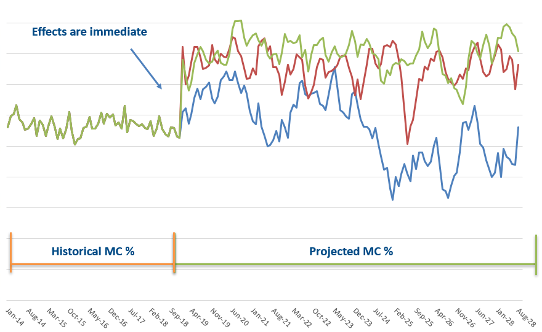
H-1 Manpower Study
RAM XVII Training Summit
Mission Capable Aircraft %
NUMBERS DO NOT REFLECT ACTUAL DATA

Slide 26
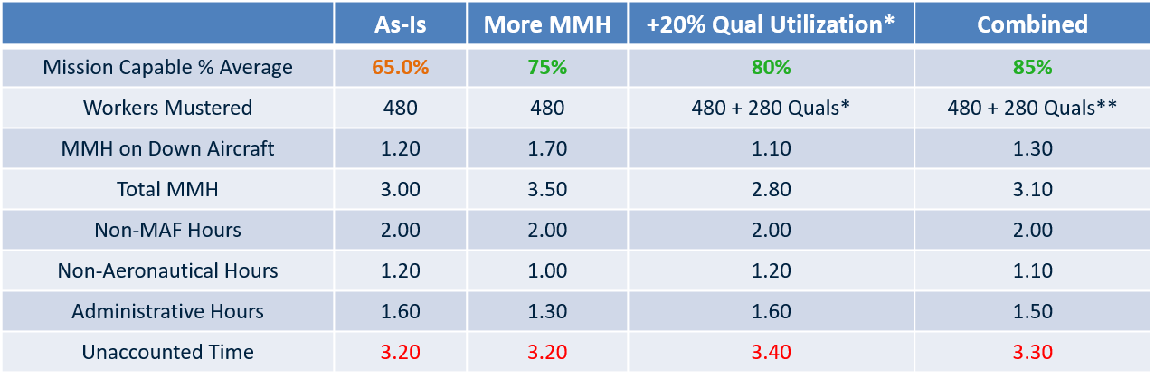
H-1 Manpower Study
RAM XVII Training Summit
Various Manpower Breakdowns per Day per Marine
NUMBERS DO NOT REFLECT ACTUAL DATA
Availability is considered 11 hours based on the shift length.
Non-MAF tasks include D/T, Fueling, Launch and Recovery, Towing, and Troubleshooting.
Non-Aeronautical tasks include FOD Walk, ATAF, and Field Day.
Administrative tasks include Tech Training, Greenside Training, and Meetings.
Unaccounted Time includes all breaks, lunch, and irregular events (i.e. medical, missing tool search, travel to/from work centers, etc.).
*All Quals (SSGT and below) were utilized for maintenance 20% of the allotted maintenance time.
**Quals were not considered in the total Marine count when
determining hours “per Marine.”

Slide 27
H-1 Manpower Study - OptQuest
RAM XVII Training Summit
Arena OptQuest searches for the most optimal solutions within a model when given controls, constraints, and objectives.
The quantity of workers for each shift and work center was optimized while maximizing mission capability and remaining within overall worker quantity.
100 simulations with 10 repetitions each were run for each scenario. Only one squadron was analyzed.

Slide 28
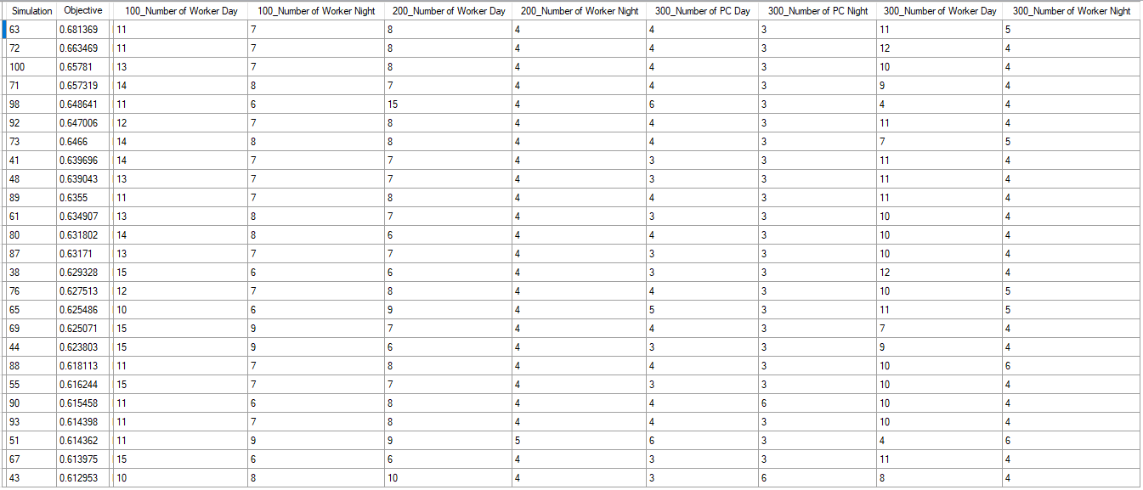
H-1 Manpower Study - OptQuest
RAM XVII Training Summit
Best Solutions Based on Current Staffing on 1 Squadron*
NUMBERS DO NOT REFLECT ACTUAL DATA
Mission Capability
*Current total worker quantity: 53 E1-E3

Slide 29
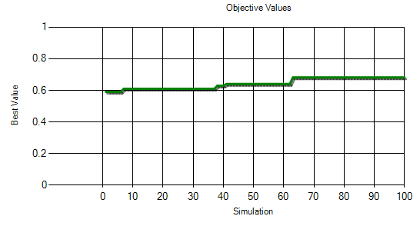
H-1 Manpower Study - OptQuest
RAM XVII Training Summit
NUMBERS DO NOT REFLECT ACTUAL DATA
Current
Best Solution
 | Airframes | Avionics | Flightline
Day | 9 | 8 | 7, PC: 4
Night | 8 | 7 | 6, PC: 4
 | Airframes | Avionics | Flightline
Day | 11 | 8 | 11, PC: 4
Night | 7 | 4 | 5, PC: 3
Highest average Mission Capability: 68.1%
11.0% increase from current maintainer placement.
Though Avionics has more Total MMH per Marine, Airframes and Flightline have a historically higher ratio of Down Aircraft MMH to Total MMH.

Slide 30
H-1 Manpower Study - OptQuest
RAM XVII Training Summit
Best Solution Based on T/O (78 E1-E3)
Mission capability increase: 3%
Current (76.6% MC)
Best Solution (80.6% MC)
Shift | Airframes | Avionics | Flightline
Day | 15 | 12 | 8, PC: 5
Night | 15 | 11 | 7, PC: 5
Shift | Airframes | Avionics | Flightline
Day | 18 | 16 | 13, PC: 5
Night | 8 | 5 | 5, PC: 8
NUMBERS DO NOT REFLECT ACTUAL DATA
Best Solution Based on ASR (72 E1-E3)
Mission capability increase: 5.1%
Current (73.5% MC)
Best Solution (78.6% MC)
Shift | Airframes | Avionics | Flightline
Day | 14 | 11 | 7, PC: 5
Night | 14 | 10 | 6, PC: 5
Shift | Airframes | Avionics | Flightline
Day | 15 | 13 | 12, PC: 4
Night | 7 | 7 | 4, PC: 8

Slide 31
RAM XV Training Summit
Questions???

