Slide 1

Unlocking Dormant Data
NOVEMBER 2025
INTUITIVE®, IT’S...INTUITIVE®, and our legacy lighthouse logo are all Registered
Trademarks of Intuitive Research and Technology Corporation.
© 2025 Intuitive Research and Technology Corporation. All Rights Reserved.

Slide 2
Overview and Outline
Digital Transformation​
RAM Challenges​
Traditional Systems Engineering​
MBSE Overview & Benefits​
NLP Overview & Applications​
Combining RAM, MBSE, and NLP​
Conclusions

Slide 3
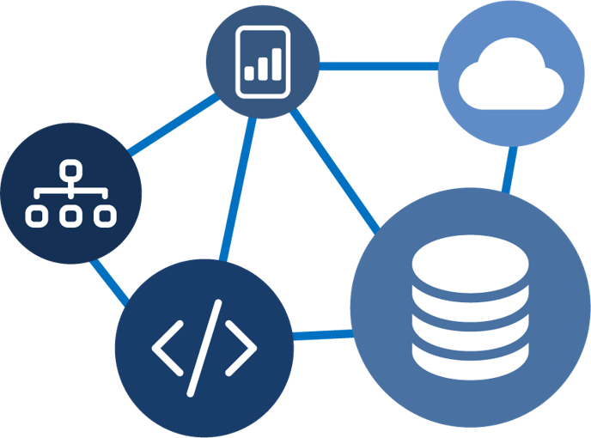
Digital Transformation​
Core Focus
Enhancing efficiency, personalization, and decision-making through automation, real-time analysis, and interconnected systems
Benefits
Data-Driven Decisions​
Agility & Innovation​
Sustainability​
Risk Mitigation

Slide 4



RAM Challenges​
Lack of Flexibility in File Format Types​
File Storage Limitations​
Data Traceability​
Increased Communication Structures (Obsolescence)​
Digital Native PDF:
Save
Digitized PDF:
Scan

Slide 5
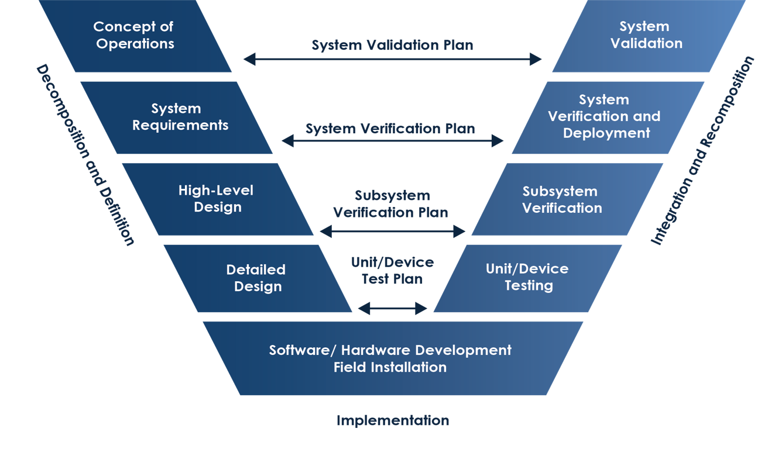
Systems Engineering Approach​
Document-Centric (static)​
Multiple Repositories​
Limited Stakeholder Involvement​
Unscalable Workflows​

Slide 6
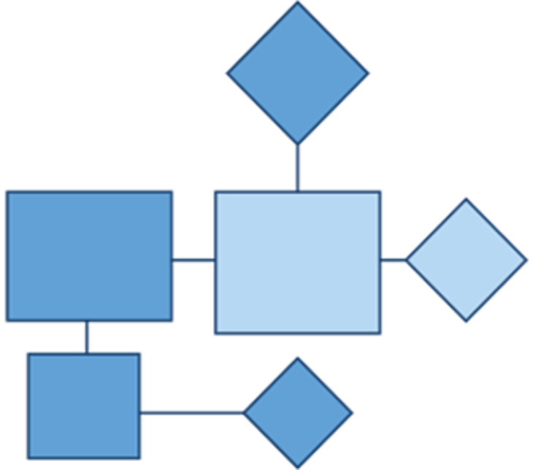
MBSE Overview
An evolution of traditional systems engineering that shifts its foundational methodology to a model-driven approach that defines a unified, digital model as the central artifact for system representation.​

Slide 7



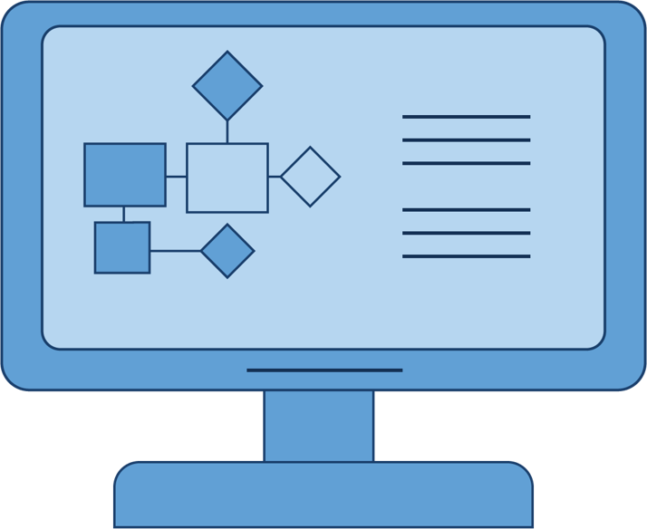

MBSE Benefits
Single Source of Truth​
Various System Views​
Increased Collaboration​
Traceability ​

Slide 8
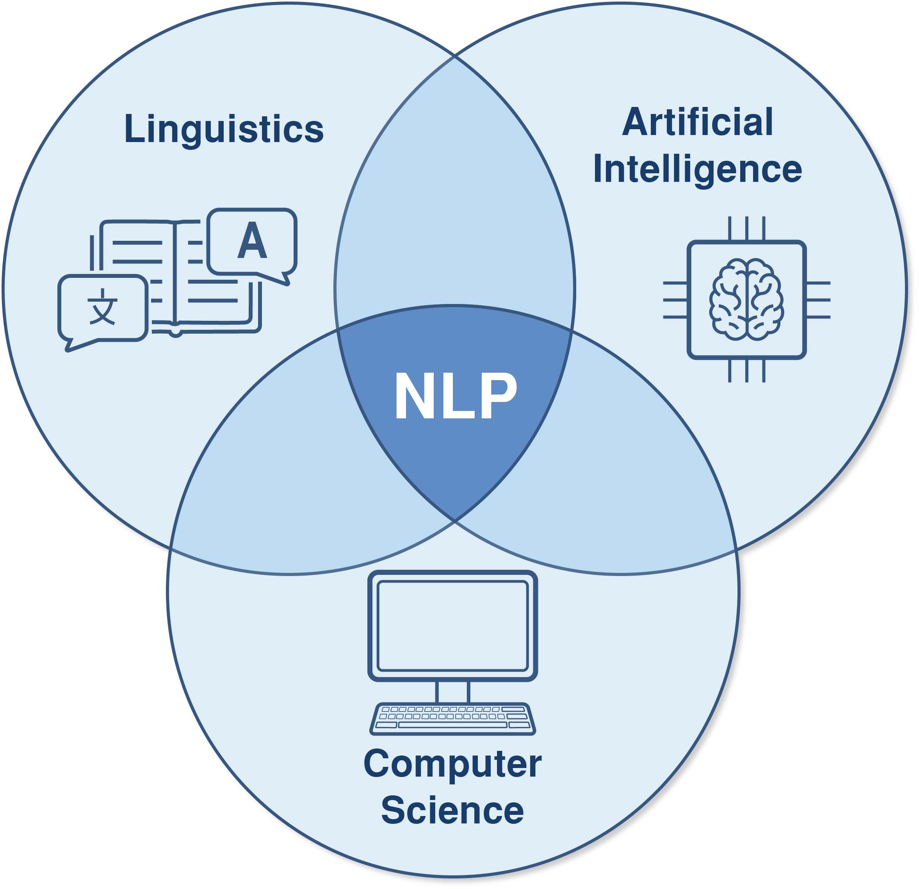
NLP Overview
NLP's core objective is to enable computers to comprehend and interpret human language in a manner that is both meaningful and practical.

Slide 9
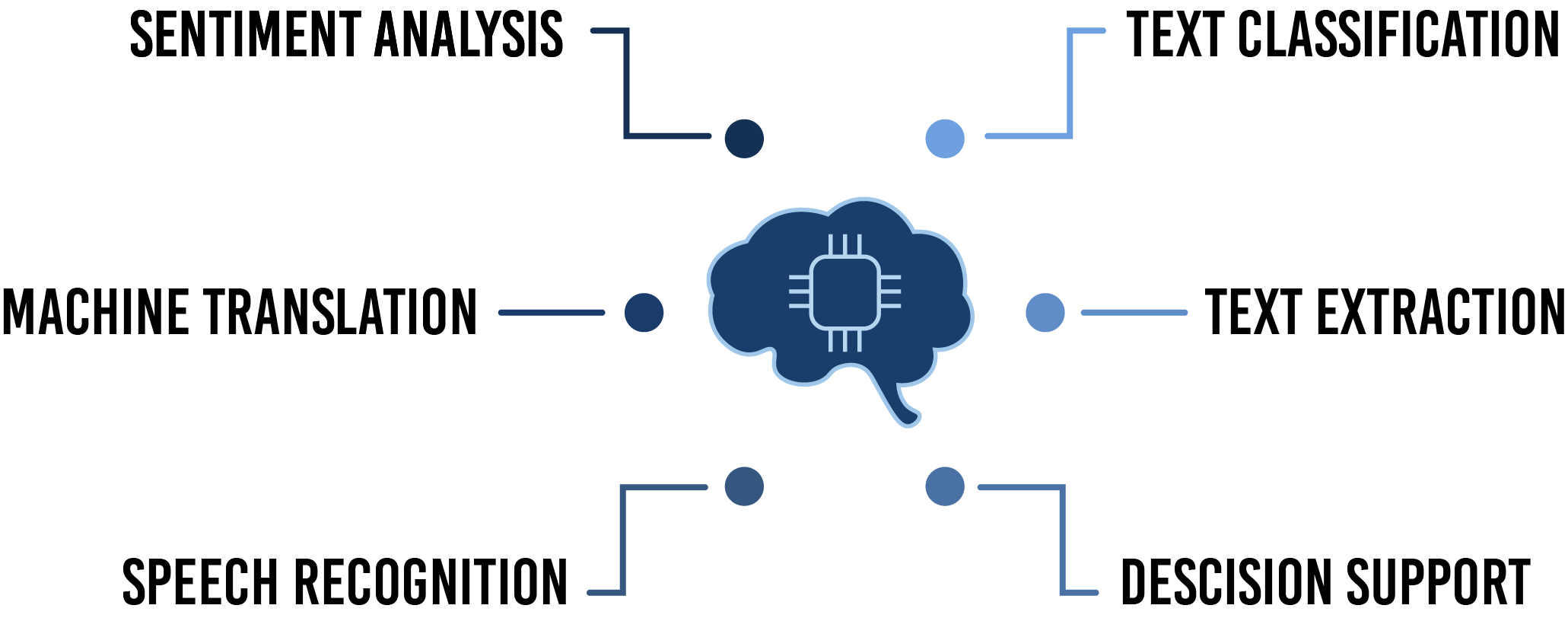
NLP Applications
Rule-Based Models
Statistical Models
Latent Semantic Indexing
Named Entity Recognition
LLMs
Image adapted from:
https://www.solulab.com/top-applications-of-natural-language-processing/

Slide 10
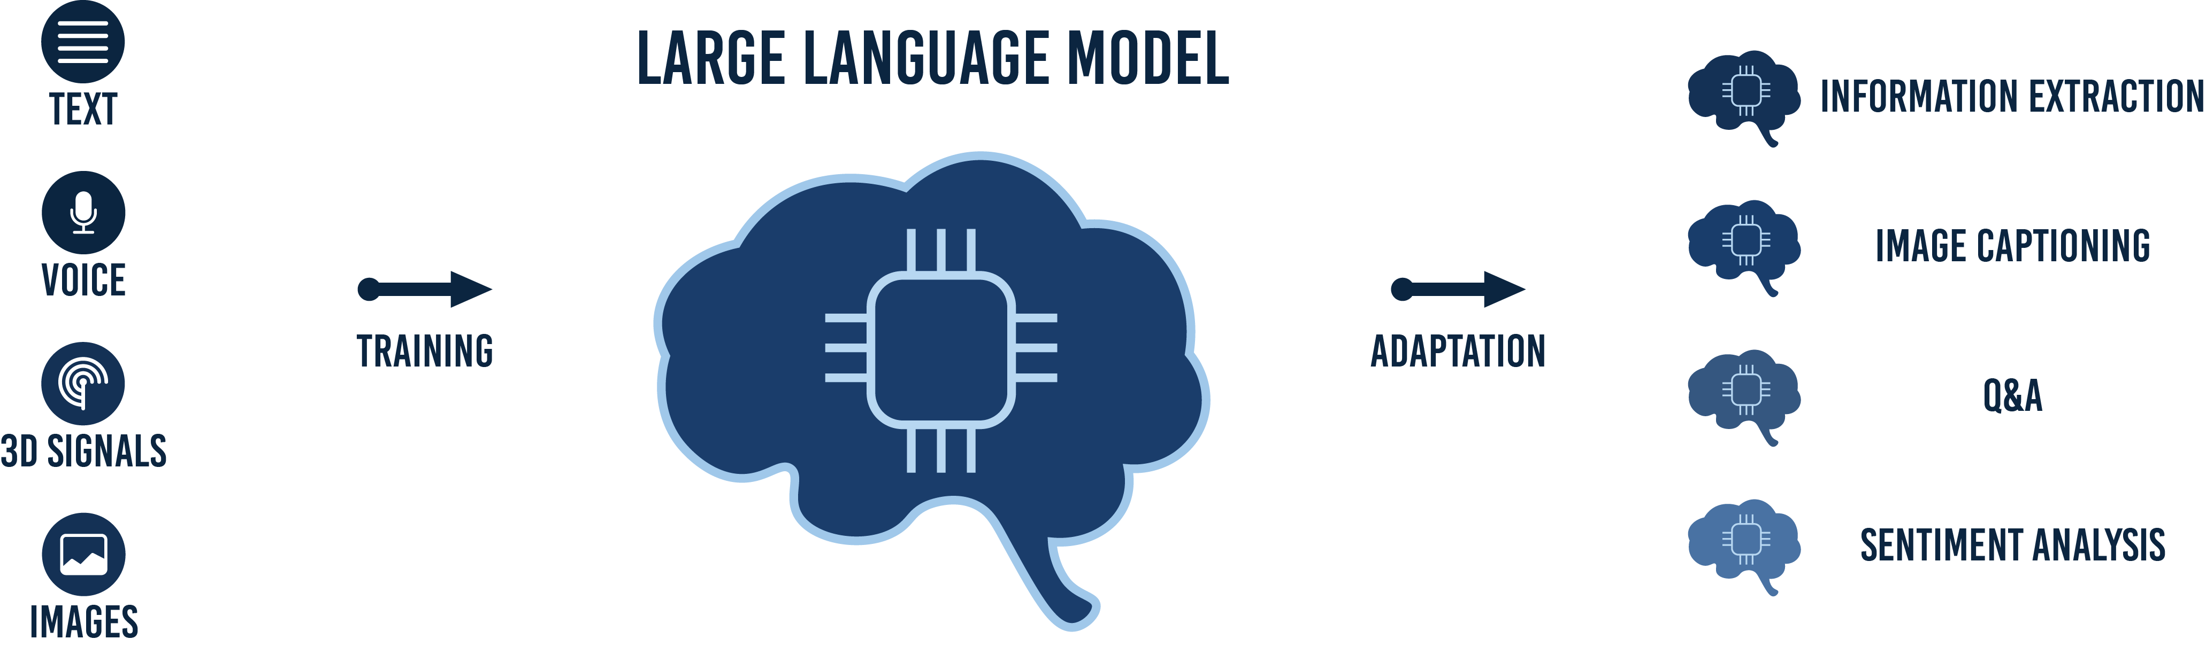
LLMs
An AI model trained on vast amounts of text data using deep learning techniques to understand, generate, and interact with human language.
Image adapted from:
https://dics.co/current-affairs/large-language-models-upsc

Slide 11
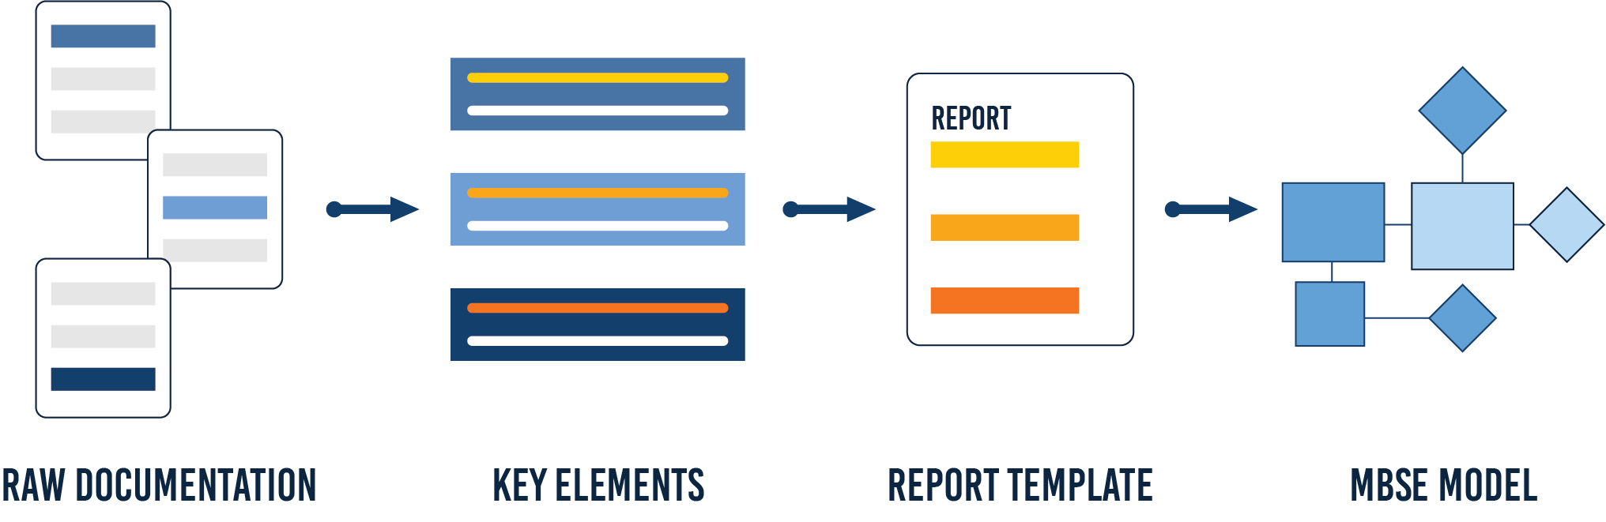
Combining MBSE and NLP
By integrating NLP techniques into early stages of the MBSE workflow, organizations can accelerate model development, improve consistency, and maintain a stronger alignment between stakeholder intent and system design.

Slide 12






MBSE, NLP Additional Use Cases
Requirements extraction from system specifications
Evaluation of requirements
Summarizing entire system specifications
Comparing textual content
….

Slide 13
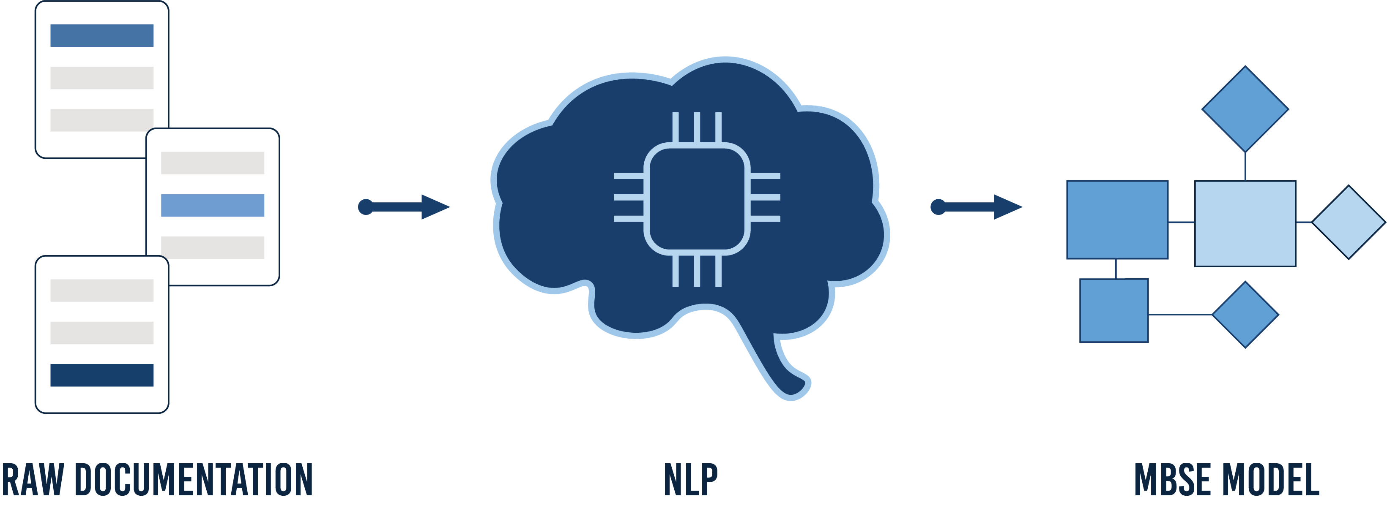
Summary & Conclusions
The combination of MBSE and NLP addresses the limitations of traditional RAM processes, offering a modern, data-driven approach to enhance system reliability and operational readiness.

Slide 14
BACKUP SLIDES

Slide 15
References​
Office of the Under Secretary of Defense for Research and Engineering. (2023, December 21). Digital engineering (DoD Instruction 5000.97). Department of Defense. https://www.esd.whs.mil/Portals/54/Documents/DD/issuances/dodi/500097p.PDF?ver=bePIqKXaLUTK_Iu5iTNREw%3D%3D
U.S. Government Accountability Office (Feb 29, 2024) Weapon System Sustainment: DOD Identified Operating and Support Cost Growth but Needs to Improve the Consistency and Completeness of Information to Congress. GAO-24-107378. https://www.gao.gov/products/gao-24-107378#:~:text=Fast%20Facts,Congress%20on%20these%20costs%20annually
M. Chami, C. Zoghbi, J. Bruel. (2019). A First Step towards AI for MSBE: Generating a Part of SysML Models from Text Using AI. INCOSE Artificial Intelligence for Systems Engineering: 2019 Conference Proceedings (pp123-136) https://www.researchgate.net/publication/337338933_A_First_Step_towards_AI_for_MBSE_Generating_a_Part_of_SysML_Models_from_Text_Using_AI
R. Alarcia, P. Russo, A. Renga, A. Golkar. (2024). Bringing Systems Engineering Models to Large Language Models: An Integration of OPM with an LLM to Design Assistants. https://mediatum.ub.tum.de/doc/1737156/uoz11bxy5cb2dqfc17ak4ctat.MBSE-AI%20Integration_2024_8_CR.pdf
D. Blei, A. Ng, M. Jordan. (2003). Latent Dirichlet Allocation. Journal of Machine Learning Research 3. 993-1022. https://www.jmlr.org/papers/volume3/blei03a/blei03a.pdf
Aeroplane Tech. (2024). Understanding Black Box Recorders: Crucial Tools in Aviation Safety. https://aeroplanetech.com/black-box-recorders/

