Slide 1
Missions To and Around the Moon How Historical Failures Provide Context for Present Decisions
Intro
Tries
Fails
Elise Doan, NASA Marshall Space Flight Center
Frank Hark, Bastion Technologies
This publication does not contain information which falls under the purview of the U.S. Munitions List (USML), as defined in the International Traffic in Arms Regulations (ITAR), 22 CFR 120-130, nor the Export Administration Regulation (EAR), 15 CFR 730-774, and is not export controlled.
Cases
Outro

Slide 2
Scope
Intro
Tries
All missions to or around the moon from Pioneer 0 in Aug 1958 to Lunar Trailblazer in Feb 2025 (142 over 66.5 years).
Who – Which countries and companies built and operated these missions?
What – What was the mass of the spacecraft and what came before?
Where – Where was the mission intended to go?
When – When did the mission launch, reach orbit, land, collect samples, return, end and/or fail?
Why – What was the mission objective? What was the failure mode?
How – Did they succeed or fail?
Fails
Cases
Outro

Slide 3
Attempts
Intro
Tries
142 Total Missions. 9 Crewed = 6% (Apollo)
Fails
Missions were categorized by their furthest objective.
It is assumed that the farther a mission goes, the more complicated it is.
More complicated missions are assumed to encompass the objectives of less complicated missions.
(e.g. To land, a mission must reach lunar orbit, and to reach lunar orbit, the spacecraft must fly near the moon.)
Cases
Outro

Slide 4
Intro
Tries
Fails
Return
Rove
Land
Impact
Cases
Orbit
Flyby
Outro

Slide 5
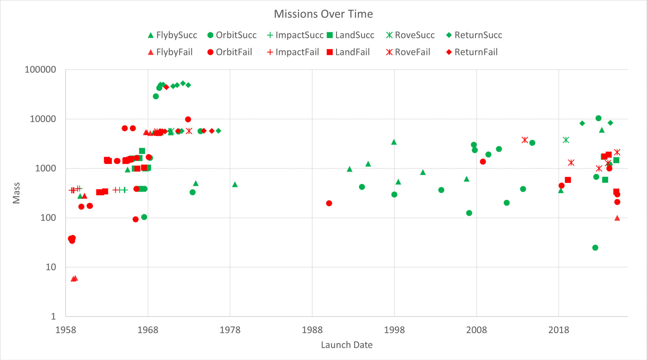
36%Failed 45%Failed 60%Failed 65%Failed 73%Failed 42%Failed
(9/25) (23/51) (6/10) (17/26) (8/11) (8/19)
Intro
50% failed
Tries
’76-’13
Apollo
HLS Announced
Zond
Fails
Luna
’78-’90
Ranger,
Lunar Orbiter
Cases
First Independent
Commercial Attempt
Outro
Notes:
Put %failed for each ambition

Slide 6
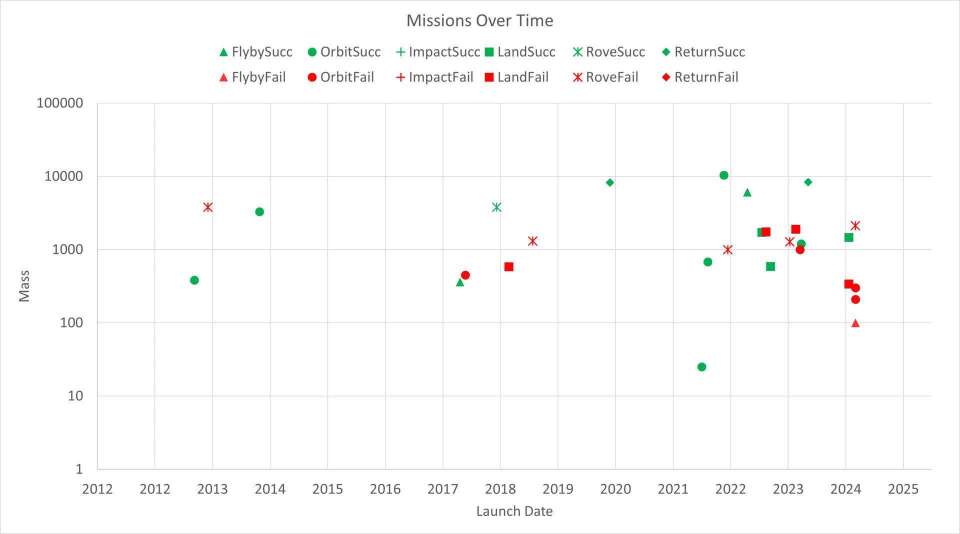
Intro
Tries
28 Missions since 2012
46% Failed (15/28)
HLS Announced
Fails
First Independent Commercial Attempt
Cases
Outro

Slide 7
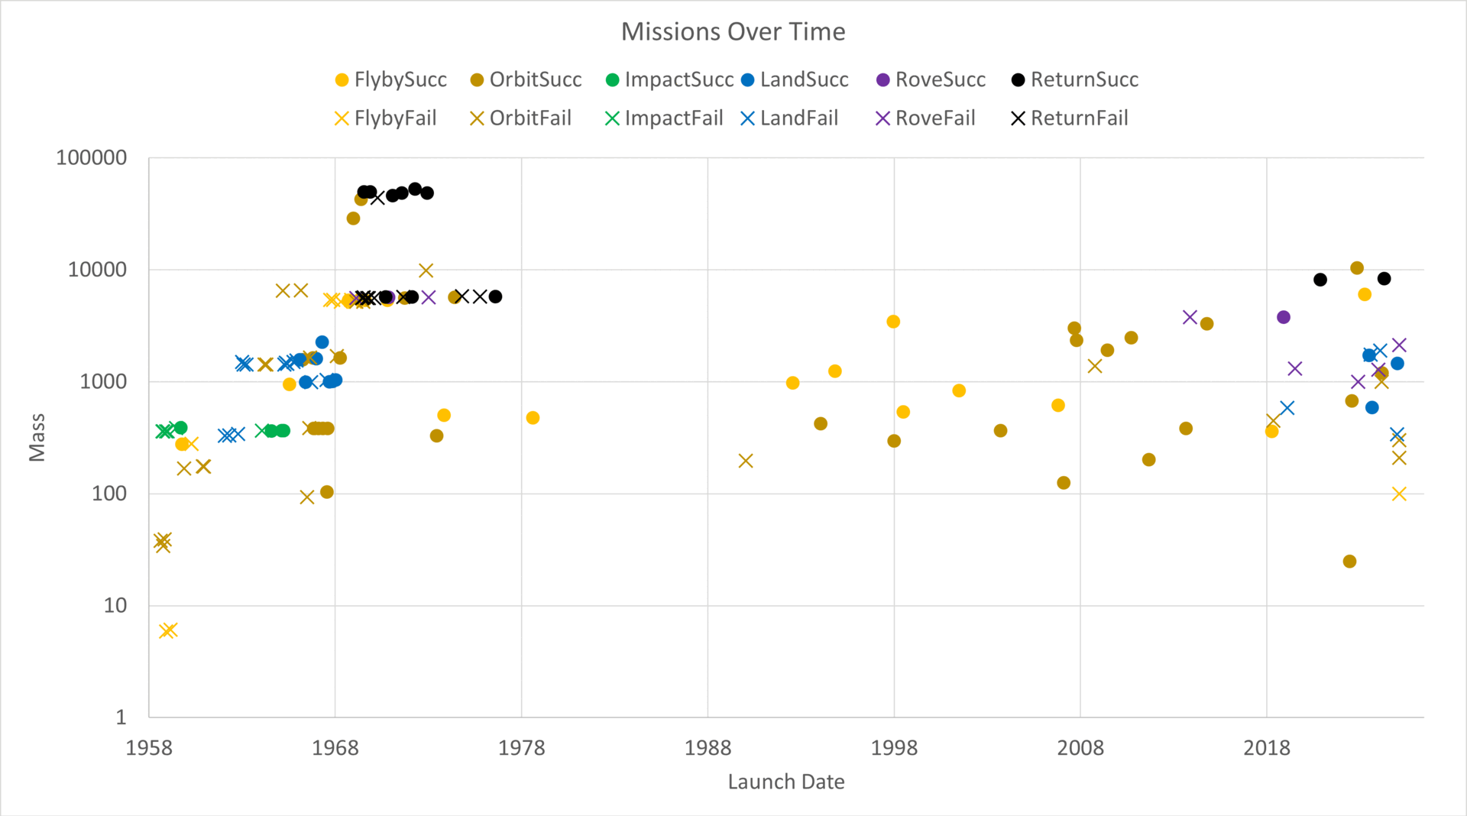
Intro
Tries
’76-’13
Apollo
HLS Announced
Zond
Fails
Luna
’78-’90
Ranger,
Lunar Orbiter
Cases
First Independent
Commercial Attempt
Outro

Slide 8
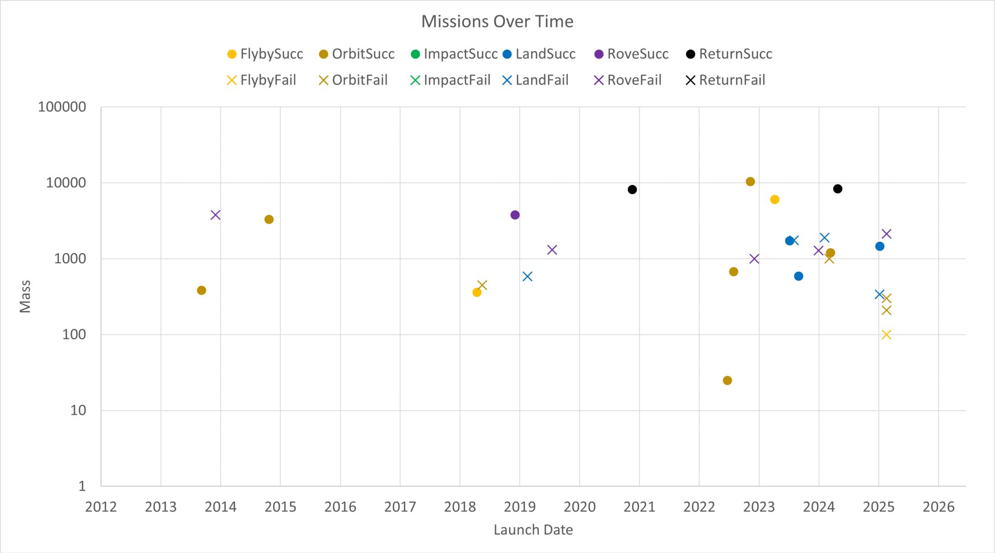
Intro
Tries
HLS Announced
Fails
Cases
First Independent Commercial Attempt
Outro

Slide 9
Intro
Tries
59% Failed (39/66)
Fails
Cases
Outro

Slide 10
Intro
These are conservative extrapolations, only based on demonstrated capability. They do not account for Reliability Growth.
Tries
Return
Rove
Fails
Land
Impact
Orbit
Flyby
Cases
Flyby Orbit Impact Land Rove Return
Outro

Slide 11
Intro
Tries
Fails
Cases
Outro

Slide 12
Intro
Tries
Fails
Cases
Outro

Slide 13
Intro
Tries
Fails
Return
Rove
Land
Impact
Cases
Orbit
Flyby
Outro

Slide 14
What Went Wrong?
Intro
Tries
Total Non-Launch Failures: 40, 57% of 70 Total Failures
Launch, EPS, and GNC failures are more likely to end a mission earlier.
Mechanical, propulsion, and communication failures are more likely to end a mission at a later stage.
Fails
Cases
Outro

Slide 15
Intro
Tries
9 GNC Failures During Landing
6 in the last decade
4 traced to lunar environment interfering with altimeters and range-finders, both radar and laser
(Others due to failed IMU, and/or software incorrectly commanding main engines in response to GNC sensor data)
Fails
Cases
Flyby
Orbit
Impact
Land
Rove
Return
Outro
Notes:
Label and explain GNC in landing

Slide 16
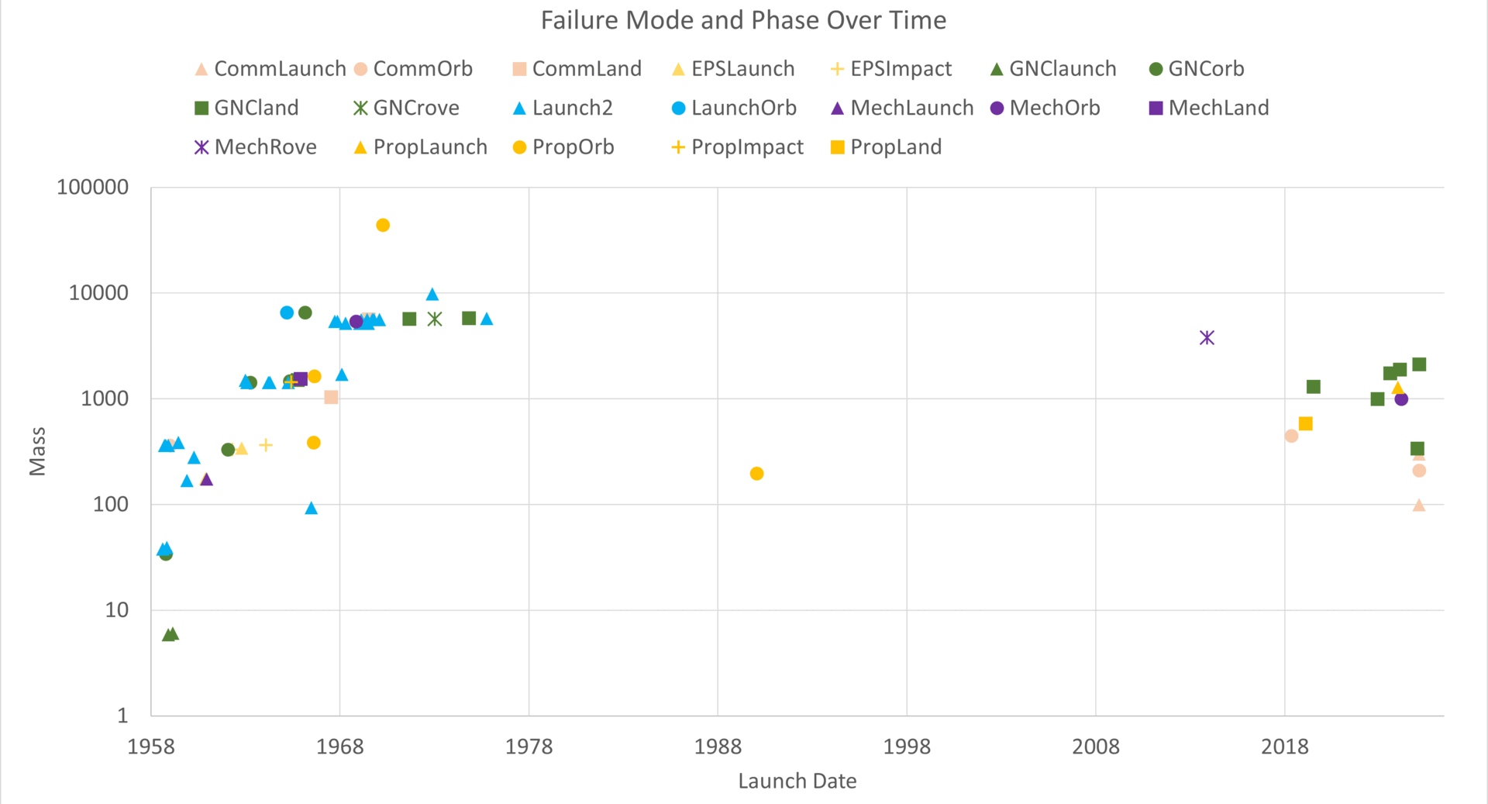
Intro
Tries
Fails
Cases
Outro

Slide 17
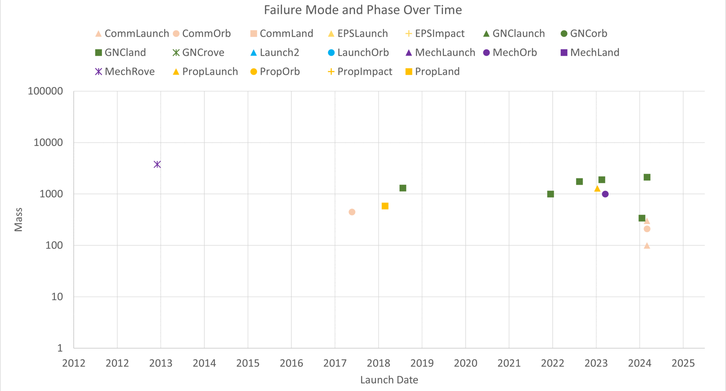
Intro
Tries
Fails
Cases
Outro

Slide 18
Notable Cases
Intro
Tries
Hakuto-R Mission 1: Communication lost during landing descent
Beresheet: Gyroscopes failed, triggering main engine shut off and crash landing
IM-2: Communication lost during landing, sideways when re-connected, thus power lost
Apollo/Artemis Con-ops comparison
Fails
Cases
Outro

Slide 19
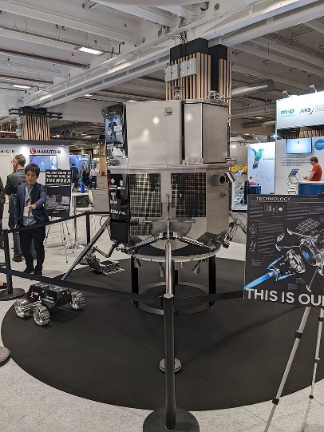
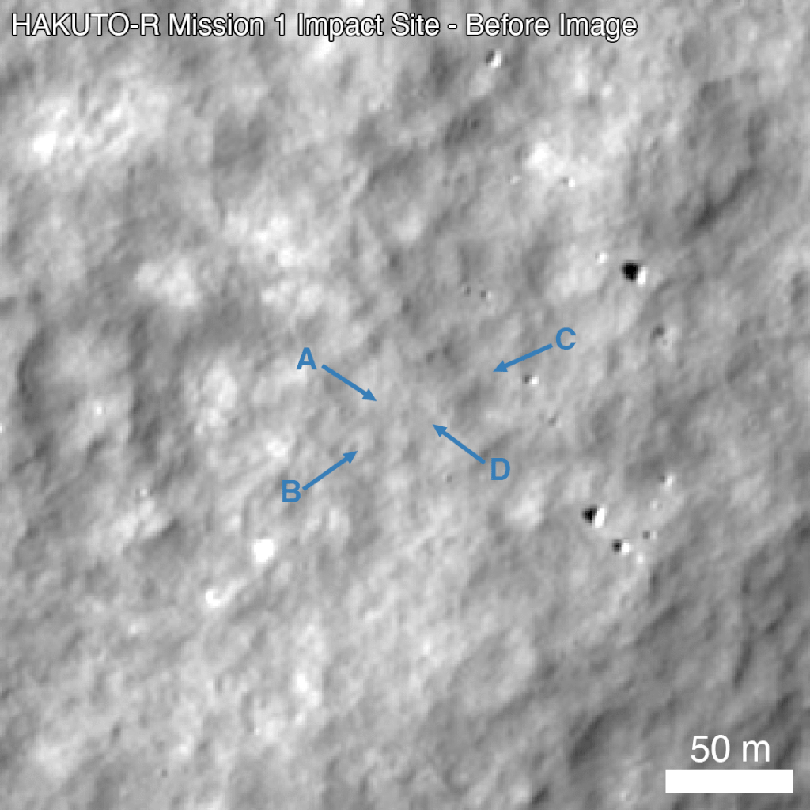
Hakuto-R Mission 1
Intro
Tries
Mission Objective: Rove
Started as a Google Lunar-X Prize project
Dec 22 Falcon 9 launch
Slow long travel to conserve fuel
Unreliable telemetry identified incorrect landing site
Communication lost during descent
Lander was hovering 5km above surface because the flight computer software assumed radar data was faulty
Crashed when propellant ran out
Fails
Cases
Outro

Slide 20
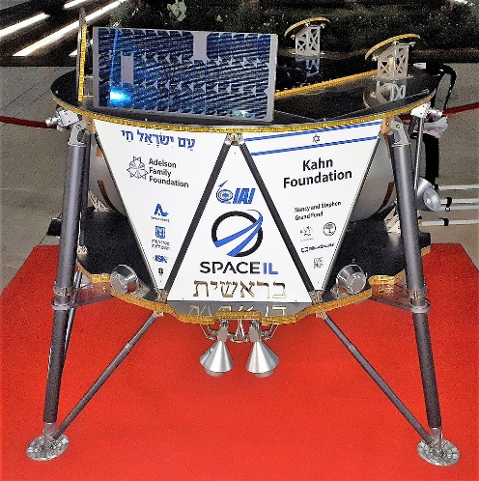
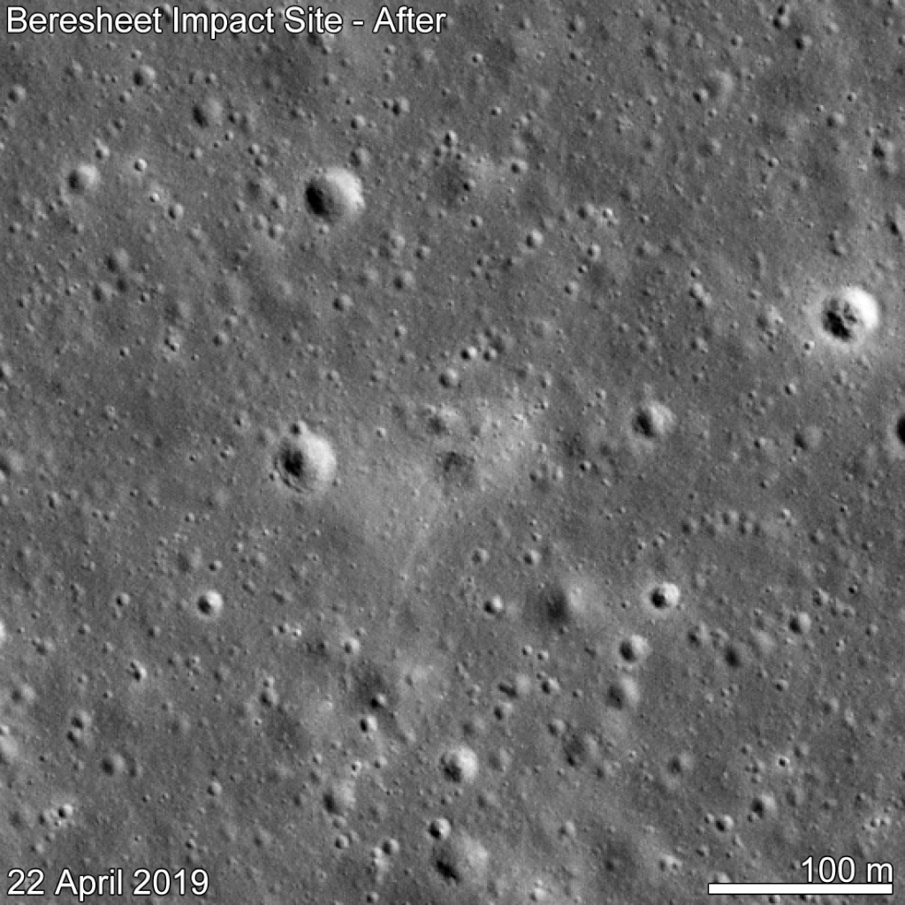
Beresheet
Intro
Tries
Mission Objective: Land
Google Lunar X Prize
Feb 2019 Falcon 9 Launch
Inspired/became Blue Ghost (Firefly)
During braking Gyroscopes failed leading to main engine shut off
Sudden loss of communication meant that the ground team could not reset the component
Comm regained too late to slow descent (500km/hr 150m above the surface)
Fails
Cases
Outro

Slide 21
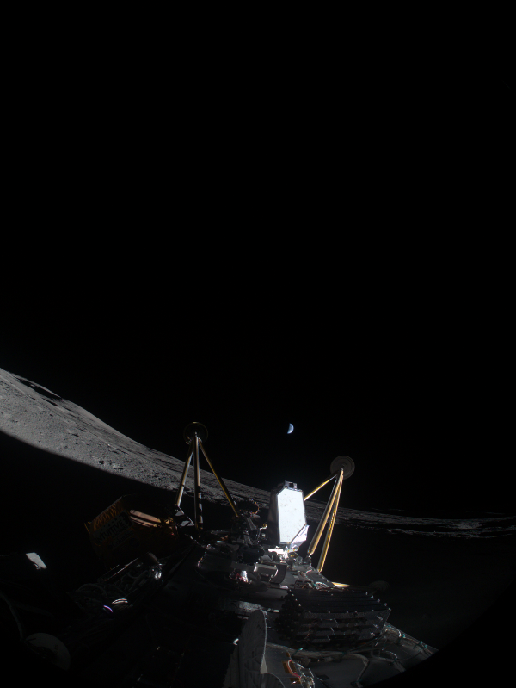
IM-2
Intro
Tries
Mission Objective: Rove
CLPS Program
Feb 25 Falcon 9 Launch
During descent, dust obscured laser and range, and radio comm.
After landing, low power and a broken antenna indicated it was on its side (imagery confirmed)
Altimeter failing caused computer to steer into a plateau edge.
Crash also coated solar panels in dust.
Fails
Cases
Outro

Slide 22
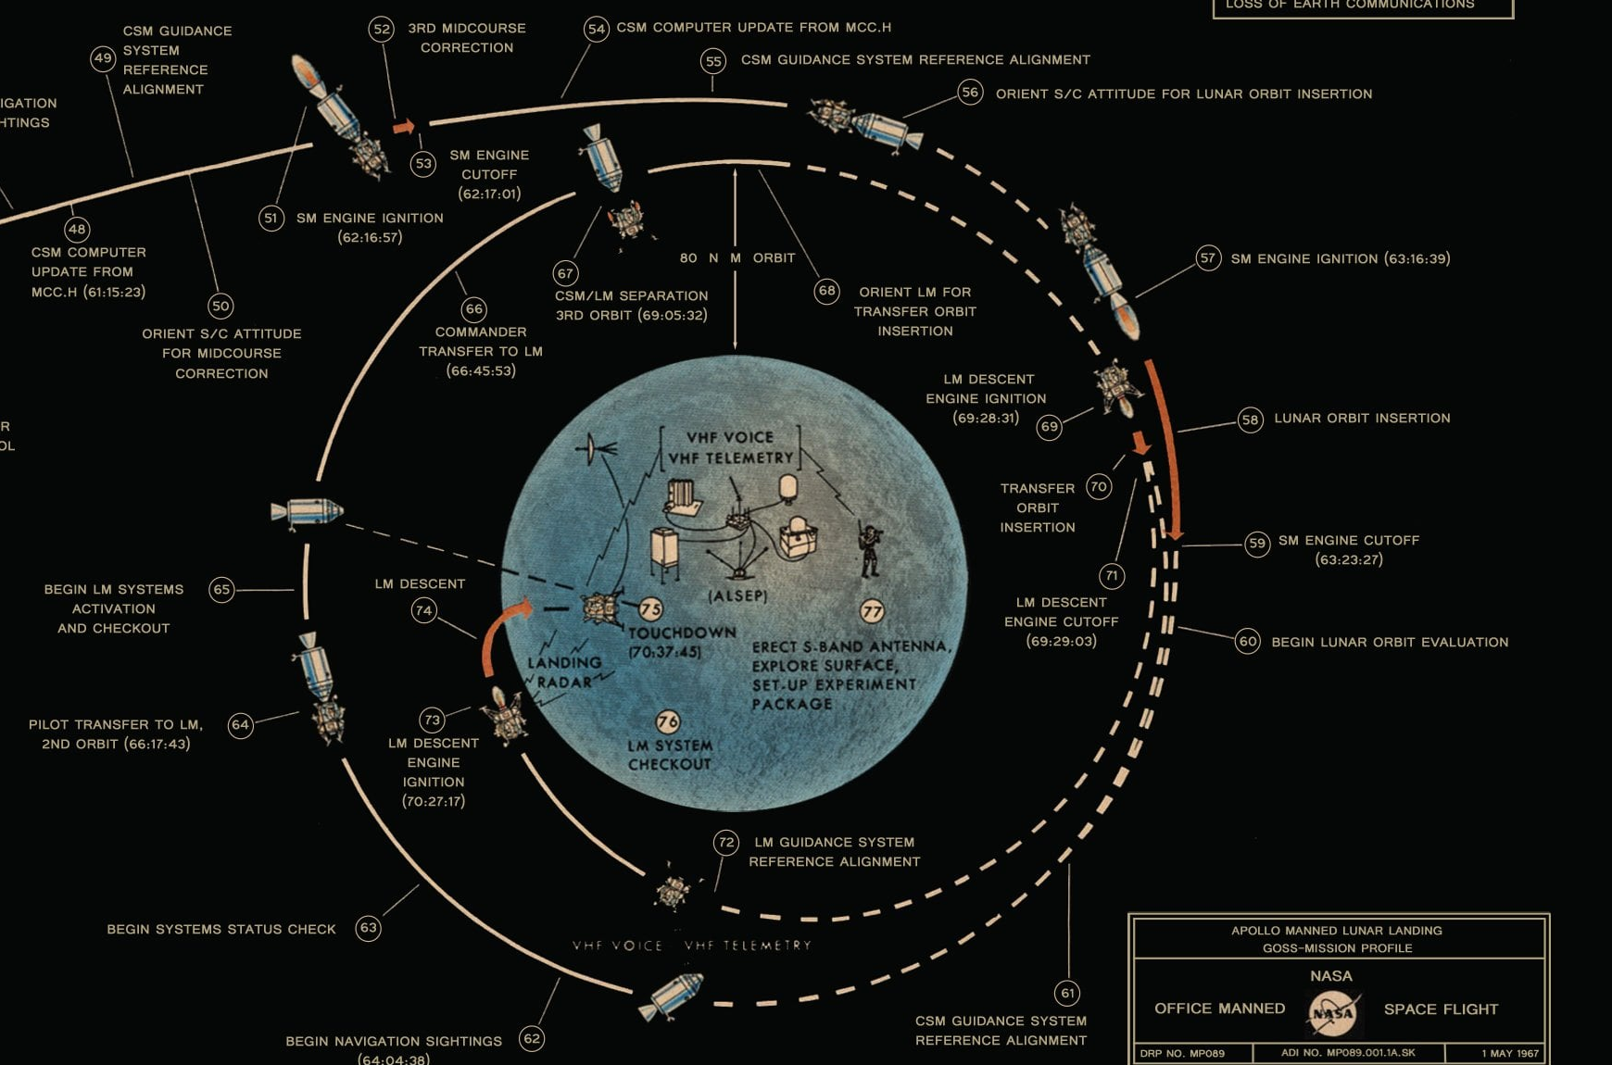
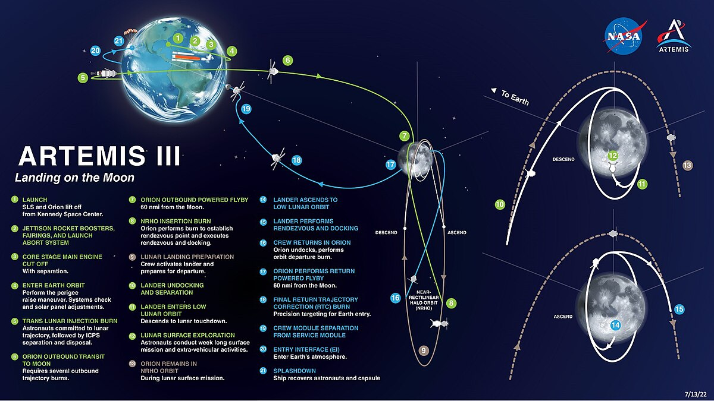
Apollo LEM vs Artemis HLS
Intro
Tries
Apollo Landings 1969-1972
Artemis III Con-ops
Fails
Cases
Outro
Notes:
Crew module in different orbit, will that affect comm relays?
Can crew control mitigate the reliance on impacted sensors?

Slide 23
Summary
Intro
Tries
Landing is a high-risk phase of moon missions
Primarily due to plume interactions that interfere with telemetry and communications
Loss of communication should be expected, creating increased reliance on sensor readings during landing
American Industry is re-learning how to do this after decades-long break, leading to a gap in knowledge
Fails
Cases
Outro

Slide 24
Missions to and Around Mars
Intro
Tries
By Elise Doan/ES61
For Frank Hark/QD35
Fails
This publication does not contain information which falls under the purview of the U.S. Munitions List (USML), as defined in the International Traffic in Arms Regulations (ITAR), 22 CFR 120-130, nor the Export Administration Regulation (EAR), 15 CFR 730-774, and is not export controlled.
Outro

Slide 25
Scope
Intro
Tries
All missions to or around Mars from Mars 1M No.1 in Oct. 1960 to Europa Clipper in Oct. 2024 (52 over 64 years).
Who – Which countries and companies built and operated these missions?
What – What was the mass of the spacecraft?
Where – Where was the mission intended to go?
When – When did the mission launch, reach orbit, land, collect data, end and/or fail?
Why – What was the mission objective? What was the failure mode?
How – Did they succeed or fail?
Fails
Outro

Slide 26
Attempts
Intro
52 Total Missions
Tries
Fails
Missions were categorized by their furthest objective.
It is assumed that the farther a mission goes, the more complicated it is.
More complicated missions are assumed to encompass the objectives of less complicated missions.
(e.g. To land, a mission must reach lunar orbit, and to reach lunar orbit, the spacecraft must fly near the moon.)
Outro

Slide 27
Intro
Tries
Fails
Flyby
Orbit
Land
Rove
Outro

Slide 28
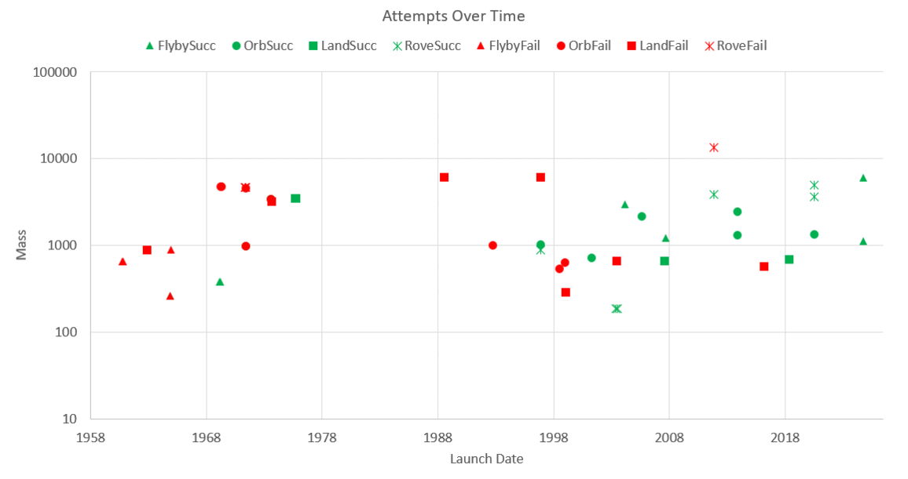
Intro
Tries
Fails
Outro
Notes:
Missions have generally gotten more complex and successful over time

Slide 29
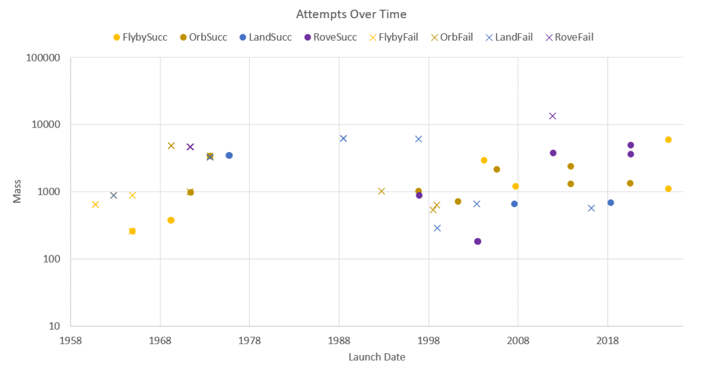
Intro
Tries
Fails
Outro

Slide 30
Intro
Tries
Fails
Outro
Notes:
We have had more success in the northern hemisphere of the planet than the southern (orbital tilt?)

Slide 31
These are conservative extrapolations, only based on demonstrated capability. They do not account for Reliability Growth.
Intro
Tries
Rove
Land
Orbit
Fails
Flyby
Outro
Notes:
Landing is still the highest risk phase of a Mars mission, despite extended duration of flybys and added complexity of roving.

Slide 32
Intro
Tries
Fails
Outro
Notes:
We see expected learning and reliability growth, with landing being consistently more risky than the overall, average, or other mission phases

Slide 33
Intro
Tries
Fails
Outro
Notes:
The USSR had nearly ubiquitous failures, most of them due to launch vehicles. Most of America’s failures have been on orbiter missions, with incredible success in rover missions. (Props to JPL).

Slide 34
What Went Wrong?
Intro
Tries
Fails
Outro
Notes:
Different than missions to the moon, computer radiation hardening seems to be a bigger challenge for Mars missions. Additionally, propulsion systems must be more robust during long distances.

Slide 35
Intro
Tries
Fails
Rove
Land
Orbit
Flyby
Outro

Slide 36
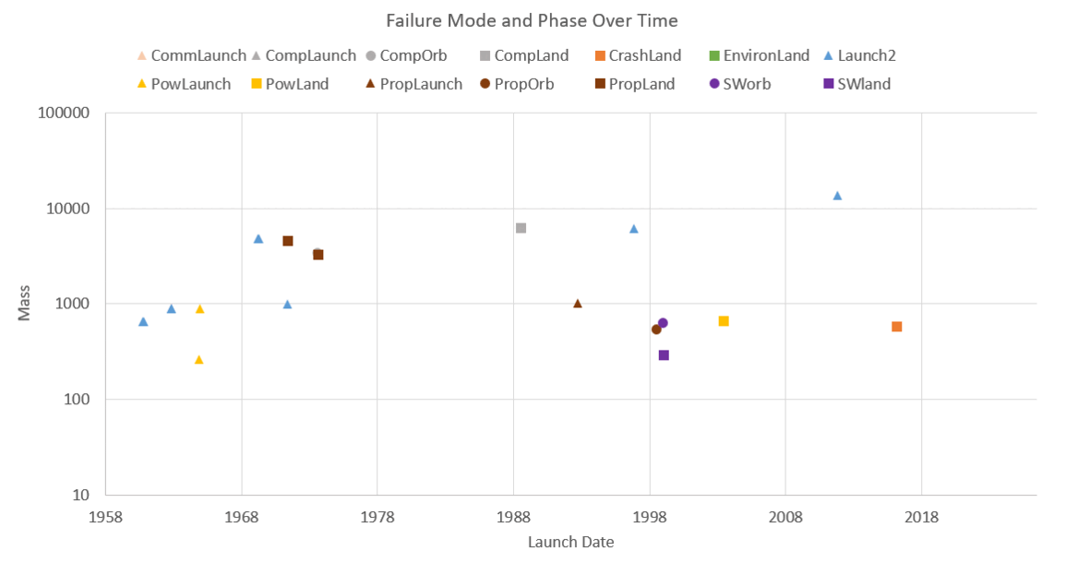
Intro
Tries
Fails
Outro
Notes:
Generally less launch failures over time

Slide 37
Summary
Intro
Tries
We see an expected amount of reliability growth, learning, and knowledge transfer from a more consistent cadence of Mars missions.
Landing is still the highest risk mission phase.
America is highly successful and remarkably dominant in this arena of space exploration (JPL led).
Fails
Outro

