Slide 1
U.S. ARMY COMBAT CAPABILITIES DEVELOPMENT COMMAND
AVIATION & MISSILE CENTER
An Overview of the Electrical Wiring Interconnect System (EWIS) and EWIS Data Analysis
3 October 2024
Candice Patterson – Chief, Cargo/Utility Section
Richard Knox – Chief, Attack section
Tom Harrington – UH-60 Senior analyst ctr/mta inc
RAm Engineering and System Assessment Division
Systems Readiness Directorate

Slide 2
agenda
What is EWIS
EWIS History
EWIS Standards
Implementation of EWIS Integrity Program
RAM Engineering
Work Unit Codes
Challenges of EWIS Data Analysis
EWIS Improvement Efforts

Slide 3
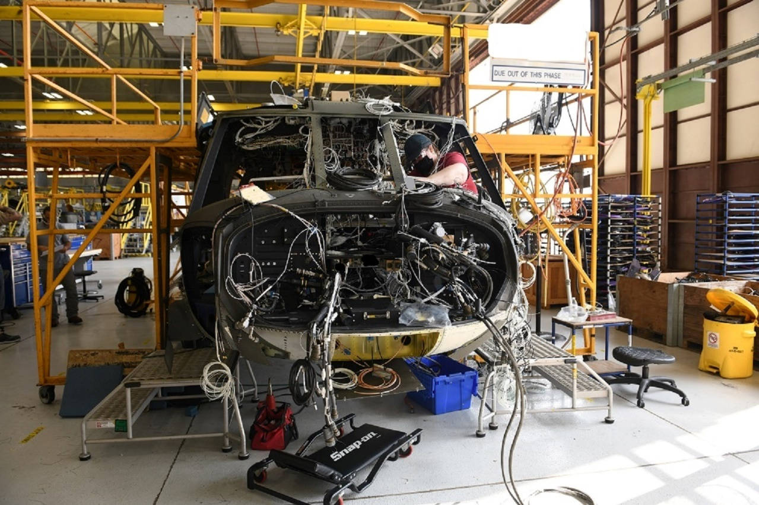
What is EWIS?
“Electrical Wiring Interconnect System: EWIS, also known as aircraft wiring, is defined as any wire, fiber optic link, wiring or fiber device, or a combination of these items (including terminations) installed in any area of the aircraft for the purpose of transmitting electrical energy, signals, or data between - two or more electrical end points.”
                TM 1-1520-323-24-1
                CHG 2 12Sept2023

Slide 4
EWIS history
FAA initiated programs to address EWIS integrity concerns in 1999 in response to high-profile aircraft accidents.
    TWA Flight 800
      July 17, 1996
      Boeing 747-100 exploded 12 minutes after takeoff.
      Probable cause from NTSB report explosion of fuel vapors in center fuel tank likely caused by a short circuit.
    Swiss Air Flight 111
      September 2, 1998
      McDonnell Douglas MD-11
      Crashed due to in-flight fire, arcing in the wiring system for the in-flight entertainment system was found to be a contributing factor.
Aging Transport Systems Rulemaking Advisory Committee ATSRAC tasked to characterize commercial EWIS integrity and recommend actions for improvement.
  Found evidence of aging wiring, material degradation, and inadequate installation and maintenance practices
Enhanced Airworthiness for Airplane Systems (EAPAS), FAA AC25-27A, was developed to communicate strategies for improve aircraft safety.
  Integrity of the EWIS system is emphasized in EAPAS.

Slide 5
Ewis standards
Common standard for installing, inspecting, and maintaining aircraft wiring throughout industry.
MIL-STD-1798D Mechanical Equipment and Subsystems Integrity Program
  Standard established in 1988
  Adapted from the highly successful Aircraft Structural Integrity Program (ASIP) first employed in the 1950’s
  Program reinstated in 2008 and has been continually updated.
  Encompasses all aircraft mechanical systems and subsystems.
    EWIS considered to be an aircraft system.
MIL-HDB-525 Electrical Wiring Interconnect System (EWIS) Integrity Program
  Introduced in 2013
  Based on lessons learned from FAA Advisory Circulars (AC’s)
  Provides framework to establish a successful EWIS integrity program using principles and processes developed by the FAA
  Establishes seven core process tasks to implement EWIS integrity program.
SAE AS50881 Wiring, Aerospace Vehicle
  Established as an industry replacement for MIL-W-5088.
  Covers all aspects of the EWIS system.
TM 1-1500-323-24-1 Aircraft Electric and Electronic Wiring
  Joint services manual with Navy and Air Force
    NAVAIR 01-1A-505-1
    TO 1-1A-14
Notes:
1798D purpose - “The goal of this integrity program is to achieve the desired level of safety and aircraft availability at the most economic cost across the life cycle of the weapon system.”

Slide 6
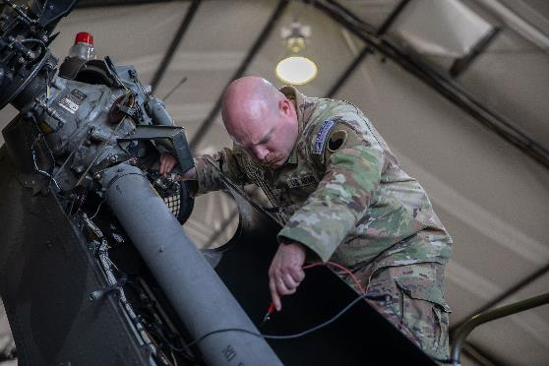
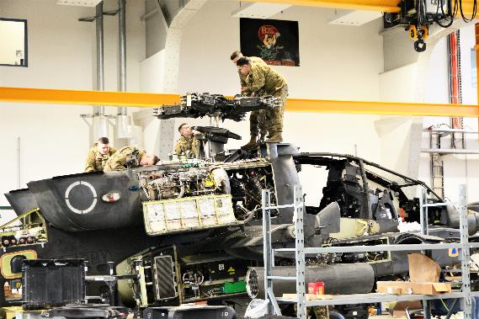
Implementation of ewis integrity program
How do we perform data analysis on components?
  MIL-STD-1798D
    Establishes tracking components by Work Unit Code (WUC) and using component WUC to;
      Determine Mean Time Between Faults (MTBF)
      Monitor failure trends
      Identify ‘Bad Actors’
      Monitor system aborts.
How do we implement EWIS Program?
  MIL-HDBK-525 Defines Implementation through Core Process Tasks
    Task 1 – Overall EWIS Documentation
    Task 2 – Data Analysis
    Task 3 – Physical Aircraft Inspection
    Task 4 – Component Assessment
    Task 5 – Risk Assessment
    Task 6 – Action Plan
    Task 7 – Iterative EWIS Assessment

Slide 7
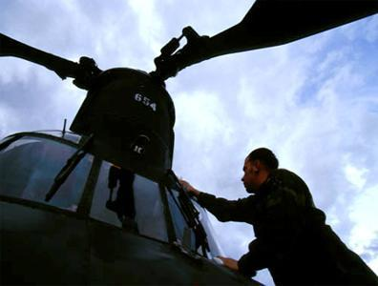
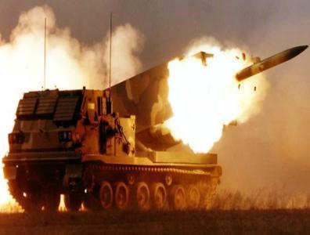
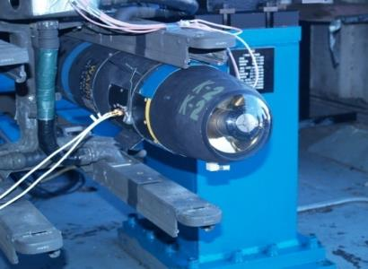
RAM Engineering & system assessment division: What we do
Aviation Systems
Missile Systems
RAM Technology
Supports All PEO Aviation PMOs
Aviation RAM Support
  Analyses / Assessments
  Models
  Design for Reliability & Maintainability (R&M)
Aviation System Assessment Program (ASAP) Analyses / Assessments
Reliability Centered Maintenance (RCM)
Reliability Improvement Projects (RIP)
Foreign Military Sales (FMS) RAM Analyses
All PEO M&S PMOs and MDA
Materiel Release RAM Certification
Missile and Ground Support Equipment RAM Support
Stockpile Reliability Programs (Army & FMS)
Sustainability Support for Missile Operations
Missile Health Monitoring
Supportability Analysis
Logistics Assessments
AvMC Energy Lab (AEL) and
Reliability, Availability, Maintainability Analysis
Failure Reporting and Corrective Action System (FRACAS)
Science &Technology (S&T) Development & Support
Data Driven Analytics/Machine Learning/Artificial Intelligence
Policies and Procedures
Improved Reliability, Availability, and Maintainability
Ensuring System Readiness

Slide 8
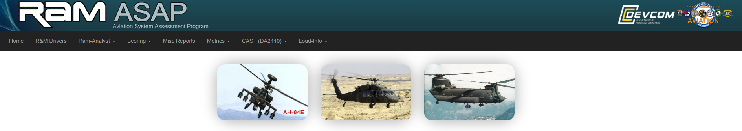
Aviation system assessment program (ASAP)
What is asap?
The Aviation System Assessment Program (ASAP) is a U.S. Government organically developed software tool used by the Reliability, Availability, and Maintainability (RAM) Aviation Branches to quickly analyze and display a host of reliability/maintainability metrics.
The U.S. Army ASAP tool contains scored data for rotary wing platforms and was developed over 20 years with millions of records scored.
Permissions/Access are vetted by the customer/platform PMO.
WHAT does RAM ASAP Do?
RAM ASAP is the recognized source for U.S. Army Aviation systems data, analysis, and interpretation throughout their life cycle.
The ASAP RAM team scores a sample of each army aircraft platform's maintenance records (DA FORM 2408-13-1) and uploads data for analysis and presentation via the ASAP Tool.

Slide 9
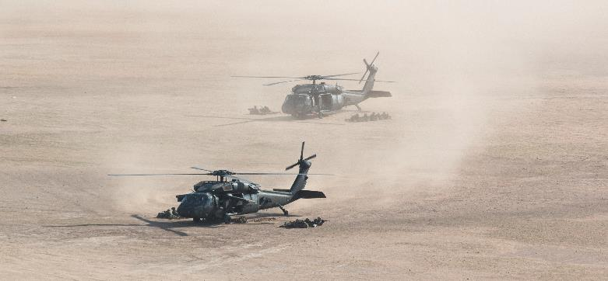
Work unit codes
FUNCTIONAL GROUP CODE
02 | AIRFRAME
03 | LANDING GEAR
04 | POWER PLANT
05 | ROTOR SYSTEM
06 | DRIVE TRAIN
07 | HYDRAULICS / PNEUDRAULICS
08 | INSTRUMENTS SYSTEMS
09 | ELECTRICAL SYSTEMS
10 | FUEL SYSTEMS
11 | FLT CONTROLS (MECH)
12 | UTILITIES SYSTEMS
13 | ENVIRONMENTAL CONTROLS
14 | HOISTS & WINCHES
15 | APU (AUXILLARY POWER PLANT)
16 | MISSION EQUIPMENT
17 | EMERGENCY EQUIPMENT
19 | AVIONICS (COMM/NAV/IFF)
30 | ARMAMENT SUB SYSTEM
31 | FIRE CONTROL SUB SYSTEM
32 | HELLFIRE
33 | TARGET ACQUISION & DESIGNATION SYSTEM (TADS)
34 | NIGHT VISION SIGHT (PNVS)
35 | AREA WEAPONS SYSTEM
36 | MILES INSTALLATION (OTHER WEAPONS)
37 | FIRE CONTROL / RADAR (FCR/RFI)
38 | SYMBOL GEN (DISP PROC)
39 | IHADSS
52 | AUTO PILOT (DAFCS)
76 | ELECTRONIC COUNTER MEASURES (ECM)
80 | SPECIAL TOOLS (ACTUATOR BLOCKS)
82 | FLYAWAY ITEMS
83 | GRD SUPPORT ITEMS
WUC’s grouped by function at the two-digit level.
All Army aircraft have the same functional group codes
WUC’s are used as ‘buckets’ for sorting data for Army Reliability and Maintainability Metrics
  ASAP top drivers sorted by WUC
All Army rotary wing aircraft have same basic WUC structure for similar systems.
  IE 07A is same for H-60, CH-47, and AH-64 as primary hydraulic system.

Slide 10
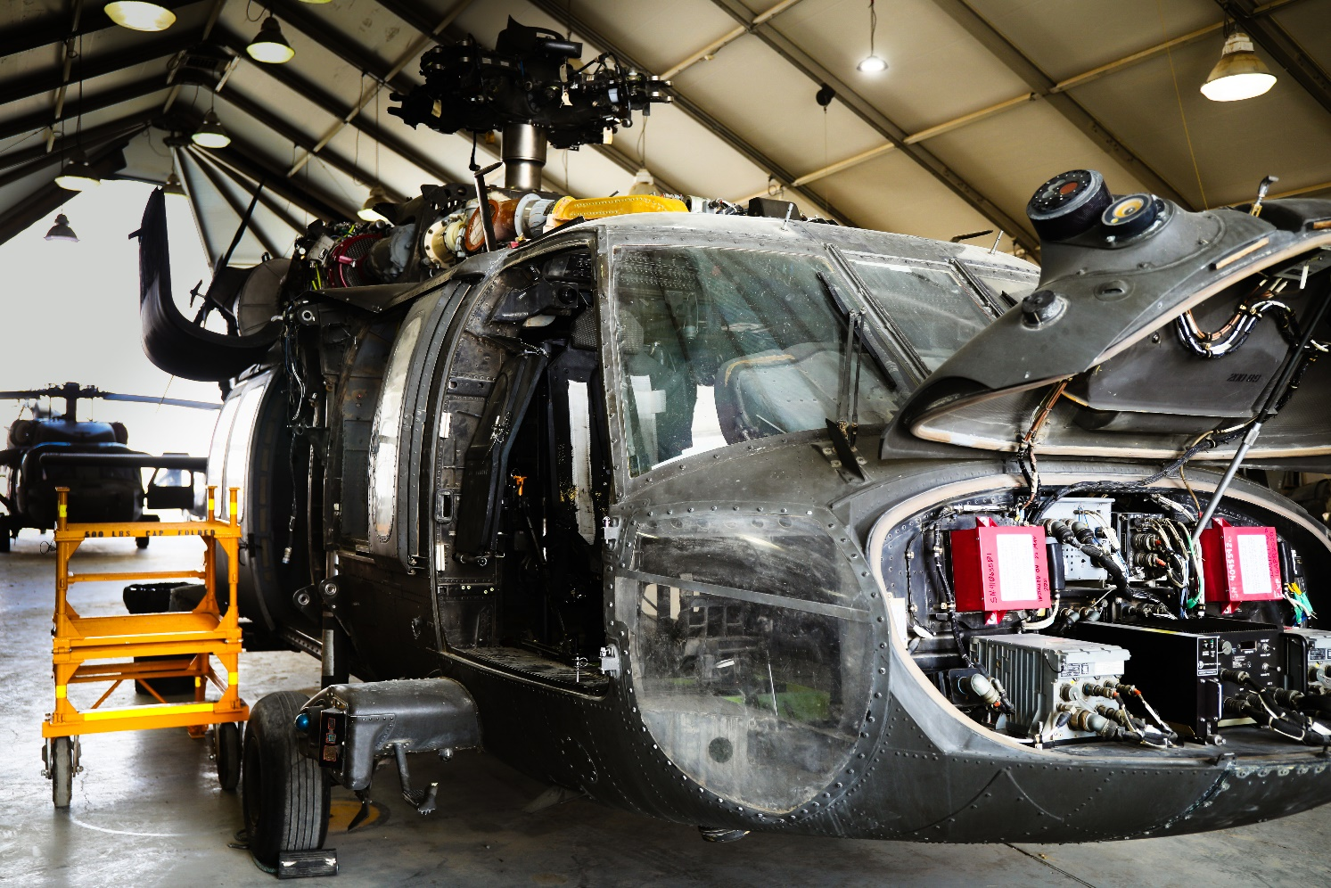
So how do we score ewis faults?

Slide 11
Challenges of ewis data analysis
EWIS is a system hidden within systems
  Data analysis efforts effectively ‘hid’ EWIS faults by scoring them to the parent system
    IE, Intercom System wiring issues would be scored to the Intercom System
  This ultimately led to ‘Bad Actor’ systems with EWIS faults scored as failures against these systems because there was no other WUC to charge these faults against
  Data fidelity from maintenance records
Other DoD services have selected FG/WUC for EWIS
  US Airforce selected WUC 35 or WUC 42 as required by airframe
  US Navy and US Marine Corps selected WUC 42.
  This implementation completed in 2019
US Army unable to implement WUC 35 or 42 across all aircraft platforms
In January 2024 WUC 59 selected as the US Army EWIS WUC for all US Army Aviation platforms.
  Leaves the platforms the same at the functional group WUC level
  Allows for comparative data analysis between aircraft platforms

Slide 12
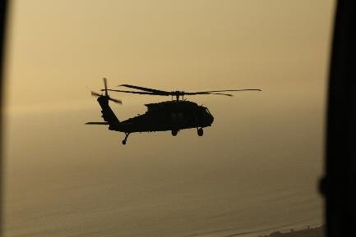
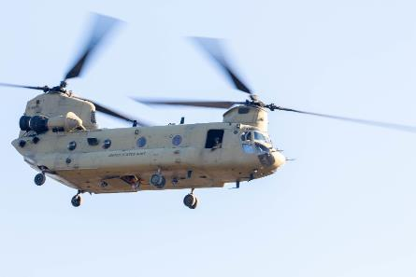
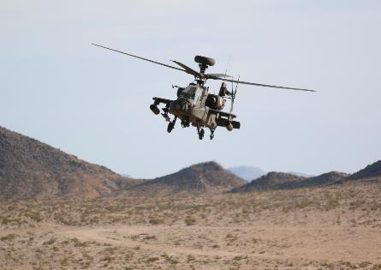
What does a EWIS wuc allow?
Common functional group structure across Army aircraft
All aircraft are built and maintained to the same EWIS standard.
  Avionics and aircraft electrical repairers are assigned to repair all models of Army aircraft
Data Analysis: We don’t know what we don’t know
  Allows for tracking maintenance trends across aircraft models related to EWIS faults
    EWIS ‘Bad Actors’ to be identified
      Accurate MTBF for EWIS failures
      Implement EWIS failure mitigations
MIL-HDBK-525 EWIS Integrity Program core process tasks implemented

Slide 13

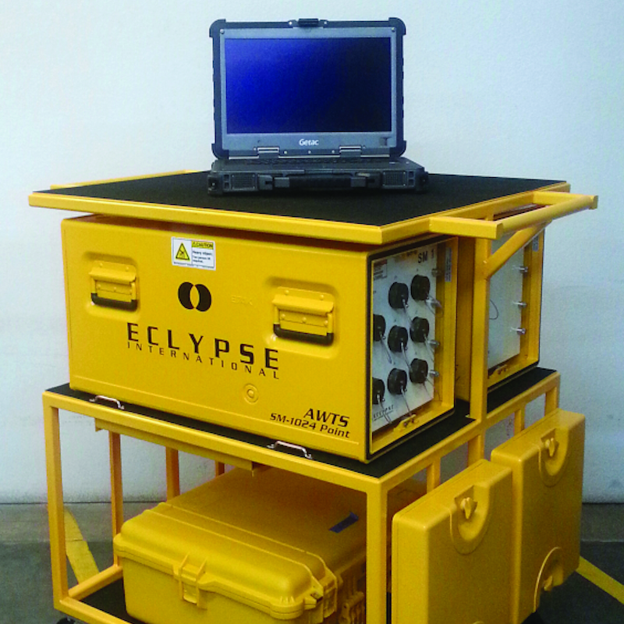
EWIS improvement efforts
Joint Services Wiring Action Group (JSWAG)/Joint Services Fiber Optics Working Group(JFOWG)
  Established in 1984 as Naval Aerospace Vehicle Wiring Action Group
  Became JSWAG in 2005, continuing to expand in participation with representatives from each branch of the Armed services
  JFOWG established 2005
  Made up of representatives from all Armed Services
  2024 JSWAG associated meeting will be held during the DoD Maintenance Symposium in Salt Lake City, Utah
  “The joint service forum provides advancement in safety, reliability, maintainability and readiness of all DoD aircraft by improving their Electrical Wire Interconnect Systems (EWIS)”
Automatic Detection and Determination of the Electrical Wiring Interconnected System (ADDEWIS)
  Automatic Wire Test Set (AWTS) that tests the physical uniformity of the aircraft wiring
  Detection of wiring anomalies prior to loss of function
  Provides accurate condition assessment of EWIS
  Validates circuit breaker condition
  Reduces LRU replacements
  Tracks aircraft wiring health over time
  Limited fielding in 2023

Slide 14
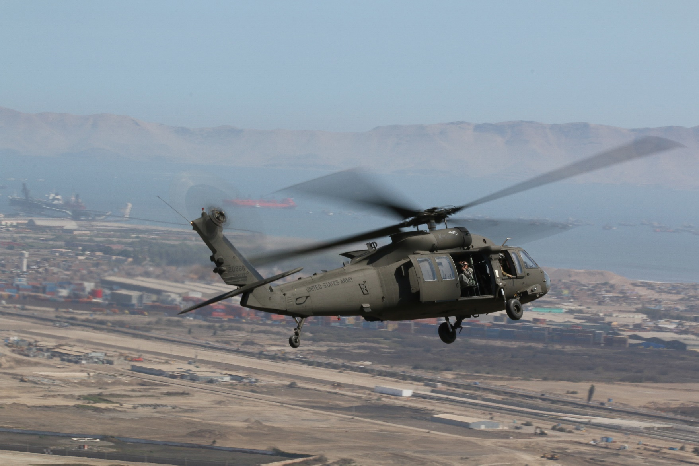
Questions?

Slide 15
Points of Contact
Utility/Cargo RAM Team Branch Chief
Candice Patterson
Apache RAM Team Branch Chief
Richard Knox
Utility/Cargo Team Senior Analysts
Tom Harrington
Ben Smallwood

