Slide 1
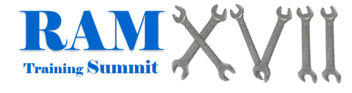
Improving Reliability of Human Motion Capture Systems Using Sensor Fusion
November 6, 2025
Hailey N. Hicks, Howard Chen, Sara A. Harper

Slide 2
Outline
Background
Methodology
Results
Discussion
Acknowledgments
References

Slide 3
Human Motion Capture
Many avenues exist for collecting human motion data with two of the most common being: Optical Motion Capture (OMC) and Inertial Motion Capture (IMC)
Most times, participants must come to the lab for data collection, leaving limited options for accurate field-based testing
Reliable and accurate measurements of human motion in the workplace setting are necessary
References: Cappozzo et al., 2005, Roetenberg et al., 2013.

Slide 4
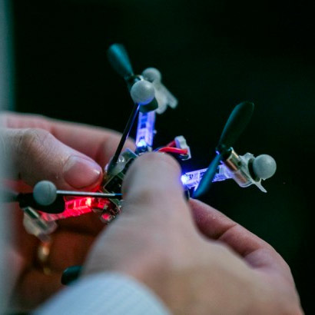
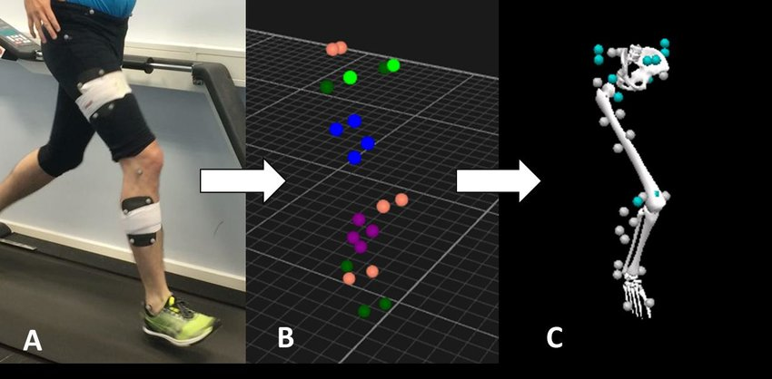
Optical Motion Capture
Advantages
Limitations
Markers On Any Object
Highly Accurate
Gold Standard
Numerous Applications
Marker Occlusion
Cost
Laboratory Setting
References: Hu et al., 2021, Cuesta-Vargas et al., 2010, Aurand et al., 2017.
Notes:
start by discussing what omc is high level, then advantages
image 1 source: https://www.researchgate.net/figure/Motion-capture-system-was-used-to-track-the-three-dimensional-positions-of-i-reflective_fig7_346053038

Slide 5
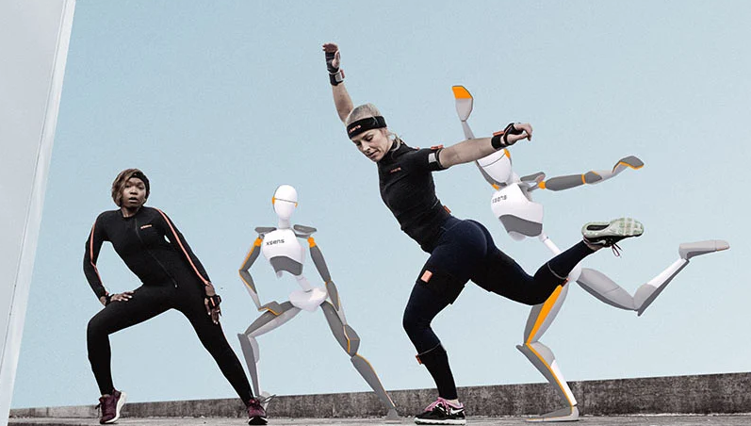
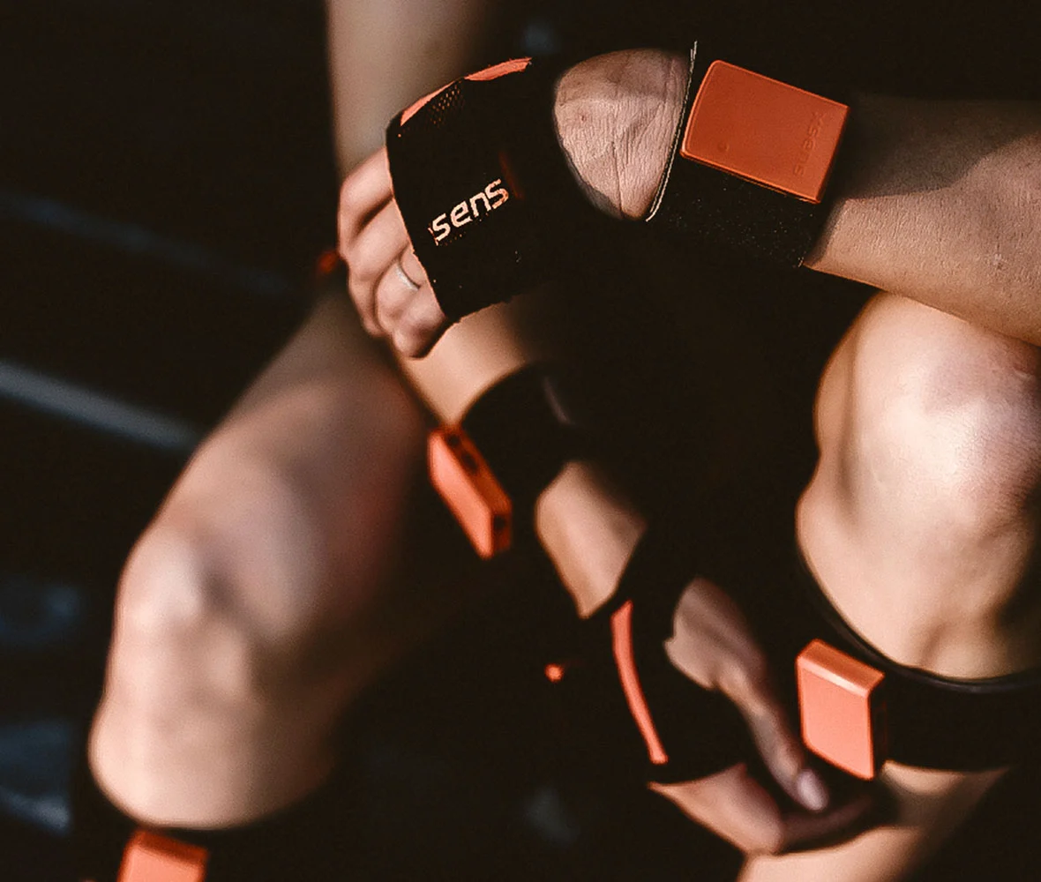
Inertial Motion Capture
Advantages
Limitations
Field-Based Testing
No Reliance On Markers
Relatively Inexpensive
Magnetic Disturbance
Drift Over Time
Bias and Noise
References: Hu et al., 2021, Cuesta-Vargas et al., 2010, Aurand et al., 2017.
Notes:
start by discussing what omc is high level, then advantages
image 1 source: https://www.researchgate.net/figure/Motion-capture-system-was-used-to-track-the-three-dimensional-positions-of-i-reflective_fig7_346053038

Slide 6
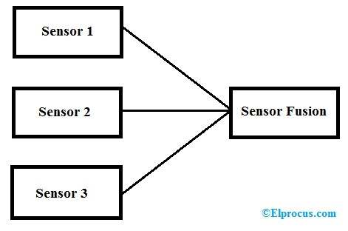
Sensor Fusion
What is it?
Method to bring two systems together
Mainly done through algorithms combining the data
Common Algorithms
Kalman Filter
Extended Kalman Filter
Complementary Filter
References: Plamondon et al., 2007, Cavallo et al., 2014, Fung et al., 2017.
Notes:
introduce it generally; tie into my fusion specifically; briefly discuss each filter
image source: https://www.elprocus.com/sensor-fusion/

Slide 7
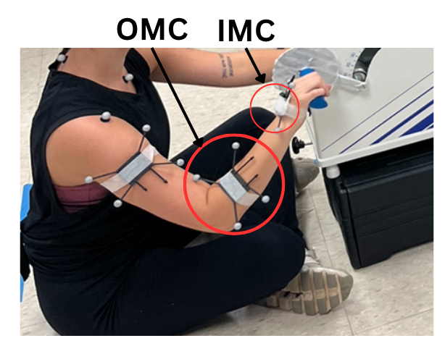
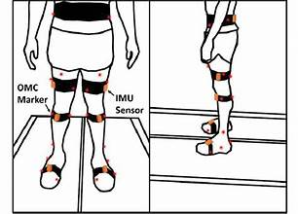
Bringing It All Together
This study aims to use sensor fusion techniques to combine OMC and IMC measurements for more reliable data collection
We can combat marker occlusion and gaps through the use of IMC as a constant data source
We can combat drift and bias by using OMC as a reference for the IMC measurements
Image source: Hicks et al., 2025. Sensors

Slide 8
Research Goal & Hypothesis
Goal was to demonstrate how IMU data can be integrated into motion capture data to provide a more efficient and reliable gap filling process for future research outside of the lab.
We hypothesized that total error would increase as time increases (1-, 2-, 5-, and 10-minute intervals).

Slide 9
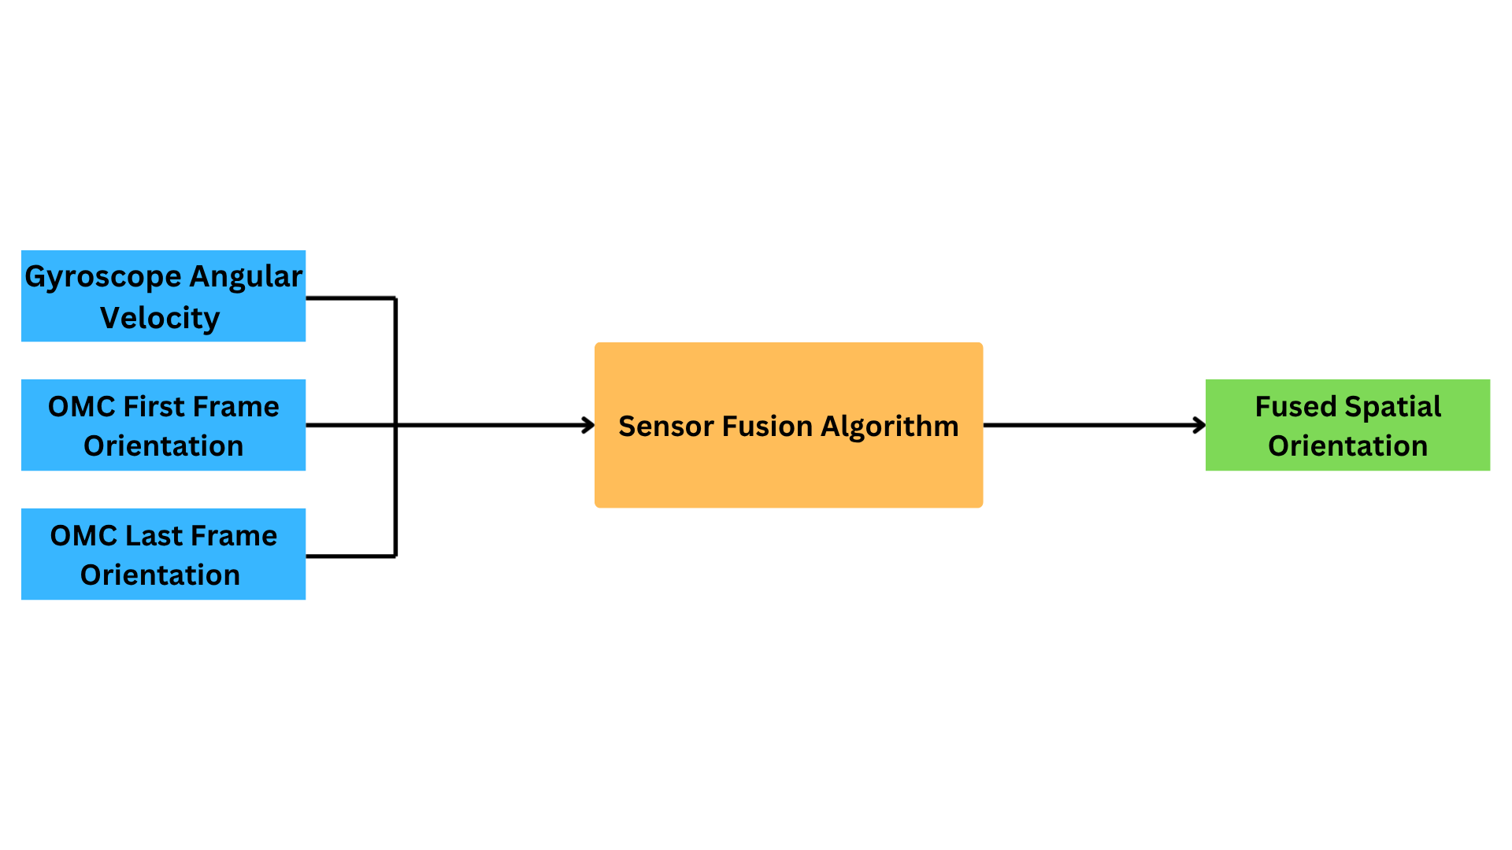
The Algorithm
Notes:
image source: www.researchgate.net

Slide 10
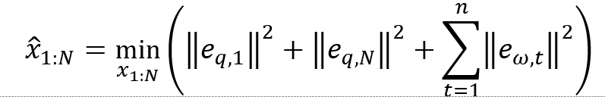
The Objective Function
An optimization-based sensor fusion method from Kok et al. (2017) was adopted to combine the gyroscope data from the IMU with the OMC-derived orientation.
Given a sequence of measurements from time T=1 to T=N, the optimization problem was formulated as:
OMC First Frame
OMC Last Frame
Gyroscope Angular Velocity
Notes:
discuss Kok - using algorithm 1 [smoothing (gauss-newton) based]; take their concept of gyro and mag and replaced mag w/ omc
fix why kok algorithm backup slide?

Slide 11
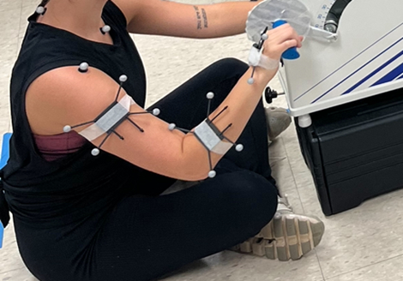
Experimental Protocol
Marker/IMU cluster on hand
Participants continuously arm cycled for 15 minutes
Manufacturer-specified calibration procedures followed
Both systems had a frequency of 60 Hz
Image source: Hicks et al., 2025. Sensors

Slide 12
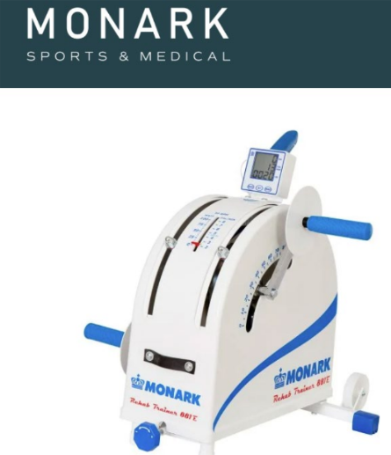
Participants
12 participants from the UAH community
Eligibility Criteria:
(i) no history of upper body injuries
(ii) no current upper body injuries prior to
enrollment
(iii) ability to continuously arm cycle for 15 mins
All study procedures were approved by UAH IRB

Slide 13

Data Processing
All post-processing was accomplished using MATLAB
The IMU measurements were linearly interpolated to a sampling period of 1/60 s to ensure time synchronization with the OMC.
The algorithm was executed once the OMC/IMC pair was successfully time-synced and rotationally aligned.
The algorithm was executed with increasingly longer time intervals from 1 to 10 minutes in one-minute increments.

Slide 14

Error Output
The sample-to-sample error is defined as the orientation derived by the fused solution relative to the orientation derived from the OMC(Faber et al., 2020):
Root-mean-square error (RMSE) was calculated to determine average total error over a given time period.
Notes:
need to calculate the relative orientation of fused data relative to the OMC orientation; therefore, we cannot just subtract the two; additionally, our total error is the rotational difference b/t the fused orientation and OMC orientation, so can’t subtract

Slide 15
Statistical Analysis
Conducted using Statistical Package for Social Sciences (SPSS) version 29
A one-way repeated measures analysis of variances (ANOVA) was used to compare the differences in total error over time (1, 2, 5, 10 min)
The intraclass correlation coefficients (ICCs) and the 95% confidence interval (CI) were presented for both the OMC and fused Z-, Y-, and X- axes for the 5 and 10-minute intervals of data collection.
Data are reported as mean 土 standard deviation
Statistical significance p ≤ .05.

Slide 16
Reliability of the Algorithm
Axis | Interval | ICC | 95% Confidence Interval
Z | 5 | 0.998 | (.992, .999)
Y | 5 | 1.000 | (.999, 1.000)
X | 5 | 0.995 | (.982, .999)
Z | 10 | 0.994 | (.979, .998)
Y | 10 | 0.900 | (.654, .971)
X | 10 | 0.986 | (.951, .996)
All ICCs are reported as excellent ( > .90) reliability
References: Koo & Li, 2016.

Slide 17
Error Outputs
 | 1-Minute | 2-Minute | 5-Minute | 10-Minute
Z Axis | 0.3(0.1) | 0.4(0.2) | 0.6(0.4) | 1.2(0.7)
Y Axis | 0.3(0.1) | 0.3(0.2) | 0.4(0.2) | 0.8(0.5)
X Axis | 1.1(0.7) | 1.5(0.9) | 1.8(1.1) | 2.0(1.3)
Overall | 1.2(0.7) | 1.6(0.9) | 2.0(1.1) | 2.5(1.4)
Error values for all three axes remained consistent for the 1, 2, and 5-minute intervals.
Slightly higher errors seen going from the 5 to 10-minute interval.
An average total error <2.5° was observed across the 10-minute interval.

Slide 18
Statistical Analysis
Shapiro-Wilk’s test of normality was used to assess whether the two within-subject factors were normally distributed.
All data were extremely positively skewed.
Therefore, all data were transformed by applying an inverse transformation, and normality (p > .05) was met for all
Notes:
shapiro wilk [used to see if data followed a normal distribution]; + skewed came from extreme high error outputs that were seen
being significant means that time was not independent

Slide 19
Statistical Analysis - Time Significance
Statistical Significance:
Between 1-min to 10-min interval (p = .006)
Between 2-min to 10-min interval (p = .034)
No significance:
Between 1-min to 2-min interval (p = .176)
Between 1-min to 5-min interval (p = .138)
Between 2-min to 5-min interval (p = .824)
Between 5-min to 10-min interval (p = .134)
Notes:
see that the upper arm is the common thread b/t time significance

Slide 20
Overview
The objective of this study was to develop and validate a custom sensor fusion algorithm that combines both OMC and IMC systems using an optimization-based technique
We hypothesized that the total error would increase as time increases (e.g., min 1, 2, 5, and 10)
Consistent with our hypothesis and other studies (Lebel et al., 2013), the effects of time on total error were observed
However, in our study, the difference in total error magnitude was not observed under 5 minutes (p < .05).

Slide 21
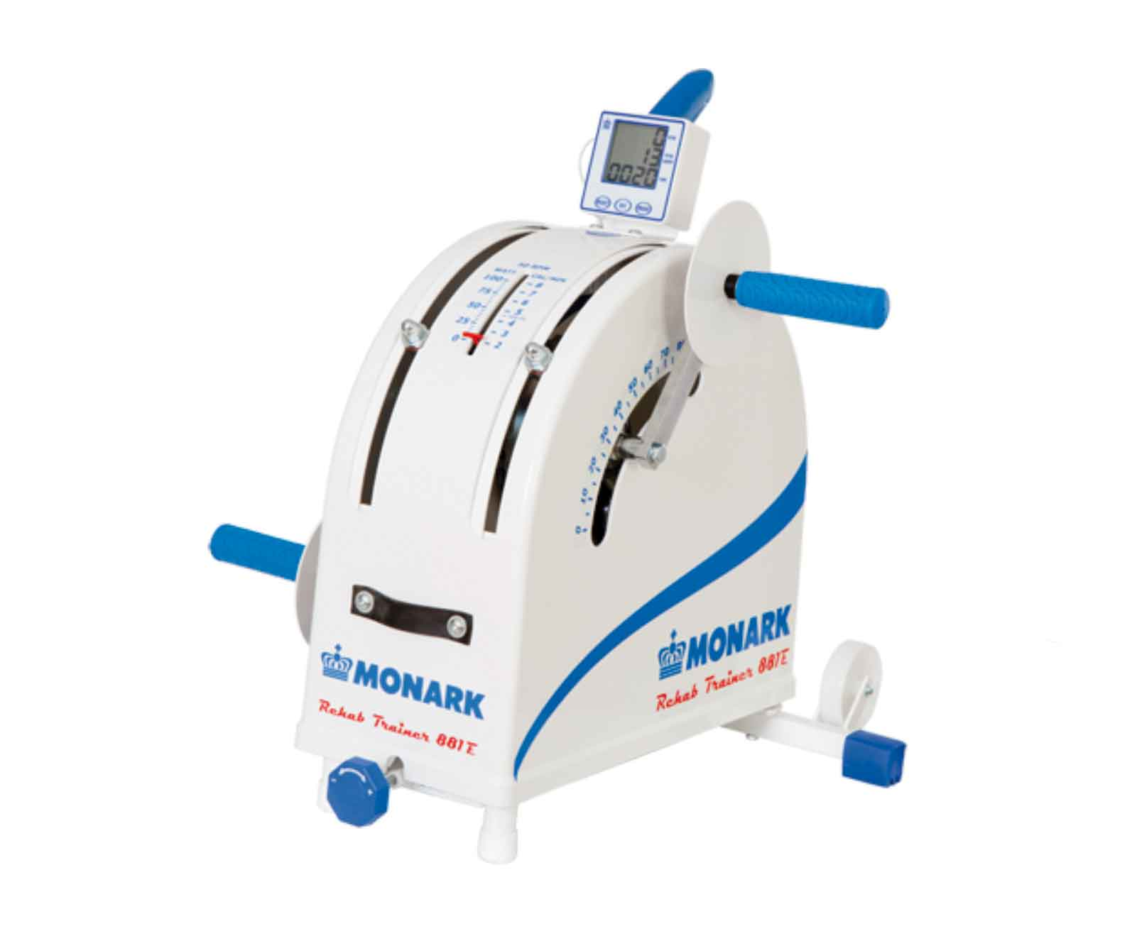
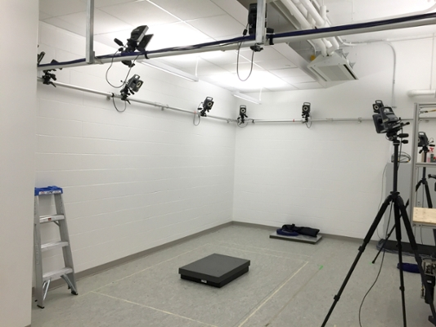
Limitations
The cycling motion
Wanted something simple & repeatable
A movement participants could do for longer periods of time
Test-setting environment
Used laboratory space already equipped with necessary “gold-standard” OMC tools and equipment
Notes:
image 2: https://research-groups.usask.ca/ergolab/our-lab.php

Slide 22
Implications
Demonstrated feasibility of combining OMC and IMC
Can lead to accurate data collection outside of the traditional laboratory setting
Provides additional options for future field-based biomechanical studies

Slide 23
Acknowledgements
Thank you to The University of Alabama in Huntsville Charger Robotics and Biomechanics Lab (CRABLAB) for providing the equipment and space to conduct this study.
This research was funded by the New Faculty Research Award administered by The University of Alabama in Huntsville Office of the Vice President for Research and Economic Development.

Slide 24
References
Aurand, A. M., Dufour, J. S., & Marras, W. S. (2017). Accuracy map of an optical motion capture system with 42 or 21 cameras in a large measurement volume. Journal of Biomechanics, 58, 237–240. https://doi.org/10.1016/j.jbiomech.2017.05.006
Brodie, M. A., Walmsley, A., & Page, W. (2008). Dynamic accuracy of inertial measurement units during simple pendulum motion. Computer Methods in Biomechanics and Biomedical Engineering, 11(3), 235–242. https://doi.org/10.1080/10255840802125526
Cappozzo, A., Della Croce, U., Leardini, A., & Chiari, L. (2005). Human movement analysis using stereophotogrammetry: Part 1: theoretical background. Gait & Posture, 21(2), 186–196. https://doi.org/10.1016/j.gaitpost.2004.01.010
Cavallo, A., Cirillo, A., Cirillo, P., De Maria, G., Falco, P., Natale, C., & Pirozzi, S. (2014). Experimental comparison of sensor fusion algorithms for attitude estimation. 19th IFAC World Congress, 47(3), 7585–7591. https://doi.org/10.3182/20140824-6-ZA-1003.01173
Chen, H., Schall, M. C., & Fethke, N. (2017). Effects of Movement Speed and Magnetic Disturbance on the Accuracy of Inertial Measurement Units. Proceedings of the Human Factors and Ergonomics Society Annual Meeting, 61(1), 1046–1050. https://doi.org/10.1177/1541931213601745
Cuesta-Vargas, A. I., Galán-Mercant, A., & Williams, J. M. (2010). The use of inertial sensors system for human motion analysis. Physical Therapy Reviews, 15, 462–473. https://doi.org/10.1179/1743288X11Y.0000000006

Slide 25
References
Enayati, N., Momi, E. D., & Ferrigno, G. (2015). A quaternion-based unscented kalman filter for robust optical/inertial motion tracking in computer-assisted surgery. IEEE Transactions on Instrumentation and Measurement, 64, 2291–2301. https://doi.org/10.1109/TIM.2015.2390832
Faber, G. S., Kingma, I., Chang, C. C., Dennerlein, J. T., & van Dieën, J. H. (2020). Validation of a wearable system for 3D ambulatory L5/S1 moment assessment during manual lifting using instrumented shoes and an inertial sensor suit. 3rd International Workshop on Spine Loading and Deformation, 102, 109671. https://doi.org/10.1016/j.jbiomech.2020.109671
Fung, M. L., Chen, M. Z. Q., & Chen, Y. H. (2017). Sensor fusion: A review of methods and applications. 2017 29th Chinese Control And Decision Conference (CCDC), 3853–3860. https://doi.org/10.1109/CCDC.2017.7979175
Gonzalez, R., & Dabove, P. (2019). Performance assessment of an ultra low-cost inertial measurement unit for ground vehicle navigation. Sensors, 19. https://doi.org/10.3390/s19183865
Hu, H., Cao, Z., Yang, X., Xiong, H., & Lou, Y. (2021). Performance Evaluation of Optical Motion Capture Sensors for Assembly Motion Capturing. IEEE Access, 9, 61444–61454. https://doi.org/10.1109/ACCESS.2021.3074260
Kok, M., Hol, J. D., & Schön, T. B. (2017). Using Inertial Sensors for Position and Orientation Estimation. Foundations and Trends® in Signal Processing, 11(1–2), 1–153. https://doi.org/10.1561/2000000094
Noiumkar, S., & Tirakoat, S. (2013). Use of optical motion capture in sports science: A case study of golf swing. 2013 International Conference on Informatics and Creative Multimedia, 310–313. https://doi.org/10.1109/ICICM.2013.58

Slide 26
References
Pellatt, L., Dewar, A., Philippides, A., & Roggen, D. (2021). Mapping vicon motion tracking to 6-axis IMU data for wearable activity recognition. In M. A. R. Ahad, S. Inoue, D. Roggen, & K. Fujinami (Eds.), Activity and Behavior Computing (pp. 3–20). Springer Singapore. https://doi.org/10.1007/978-981-15-8944-7_1
Richter, C., Daniels, K. A. J., King, E., & Franklyn-Miller, A. (2020). Agreement between Inertia and Optical Based Motion Capture during the VU-Return-to-Play- Field-Test. Sensors, 20(3). https://doi.org/10.3390/s20030831
Suvorkin, V., Garcia-Fernandez, M., González-Casado, G., Li, M., & Rovira-Garcia, A. (2024). Assessment of Noise of MEMS IMU Sensors of Different Grades for GNSS/IMU Navigation. Sensors, 24(6), Article 6. https://doi.org/10.3390/s24061953
Wang, L., Hu, W., & Tan, T. (2003). Recent developments in human motion analysis. Pattern Recognition, 36(3), 585–601. https://doi.org/10.1016/S0031-3203(02)00100-0
Yang, P.-F., Sanno, M., Brüggemann, G.-P., & Rittweger, J. (2012). Evaluation of the performance of a motion capture system for small displacement recording and a discussion for its application potential in bone deformation in vivo measurements. Proceedings of the Institution of Mechanical Engineers, Part H: Journal of Engineering in Medicine, 226, 838–847. https://doi.org/10.1177/0954411912452994
Yang, Z., Yan, S., Beijnum, B.-J. F. van, Li, B., & Veltink, P. H. (2021). Improvement of optical tracking-based orientation estimation by fusing gyroscope information. IEEE Transactions on Instrumentation and Measurement, 70, 1–13. https://doi.org/10.1109/TIM.2021.3073293
Notes:
once done w/ slides - ensure all citations are here

Slide 27
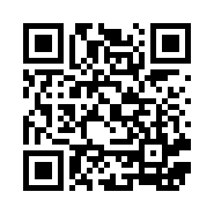
Thank You!
Questions?
Link to full journal article ->

Slide 28
Supplemental Slides
Notes:
including backup for:
why kok’s algorithm
why choose this motion?
extra visual graphics [i.e other plots]
more stats backup

Slide 29
More on IMU Errors
Bias/Drift
Bias is inevitable in an IMU, how much bias and noise there is depends on the specific sensor specifications
Bias turns into drift and drift compounds over time
Drift and bias are a function of the raw sensor; not much to do about this except for filters
Magnetic Disturbances
Affect the magnetometer readings; have to be careful of the magnetic fields in testing area
Filters
Used to combine measurements from gyro, accel, and mag., but are also used to correct the errors that arise from raw sensor measurements

Slide 30
Why Kok’s Algorithm? (1/2)
Kok et al. (2017) has a groundwork for combining gyroscope measurements with others such as magnetometer and accelerometer measurements, if desired
Algorithm 1 is a smoothing-based algorithm we were able to modify to include OMC measurements in lieu of other IMU data
This paper provided a great overview of finding orientation, error, and a flow for the algorithm, we just needed to modify it for this studies needs

Slide 31
Why Kok’s Algorithm? (2/2)
Chose smoothing method over filter method seen previously
Filters, such as those mentioned previously, can run as data comes in
These are mainly used for real-time analysis
Smoothing techniques use all data you have
They are less computationally efficient than filter, but have whole picture of data
This study focused on the challenge of post-processing and gap filling those gaps, not real-time data collection
Therefore, we did not need real-time filtering of the data, but rather a way to make post-processing more efficient and have more reliable gap filling

Slide 32
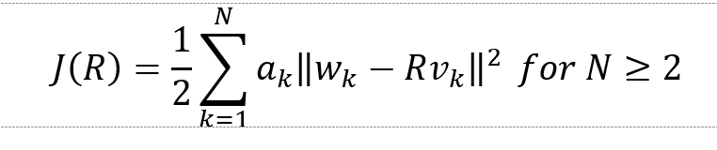
Wahba’s Problem Calculations
Used to calculate the rotation matrix between the IMU and OMC
Specifically, given k vectors in Frame b (vk), corresponding vectors in Frame a (wk), and a set of weights (ak) rotation matrix R can be solved by minimizing the following function:
Since the purpose is to transform the gyroscope measurements to the frame of the OMC, vk is defined as gyro measurements and wk is defined as the OMC-derived angular velocity measurements

Slide 33
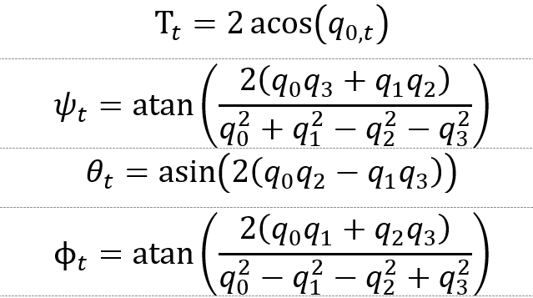
Error Calculations
Total error (Τ), error around the z-axis (ψ), y-axis (θ), and x-axis (ϕ) at time t is calculated as follows:

Slide 34
More Implications
Results demonstrate field-based testing is feasible
We acknowledge taking an entire OMC system to the workplace is impractical, but a few high-fidelity cameras on tripods is feasible
More gaps in the data, but IMC as constant data source can be used to fill those
Acknowledge IMUs are not always reliable, hence using a few OMC frames as a gold-standard reference to correct errors in the IMU data

