Slide 1


The Chi-Square Enigma
Calculating the Minimum Recommended Sample Size Required to Determine if Two Populations are Reliability-wise Different
11/5/2025
INTUITIVE®, IT’S...INTUITIVE®, and our legacy lighthouse logo are all Registered
Trademarks of Intuitive Research and Technology Corporation.
© 2025 Intuitive Research and Technology Corporation. All Rights Reserved.

Slide 2
Discussion Notes
Presenter:
  Eric Hunt is a subject matter expert in the field of Stockpile Reliability Programs with Missile Stockpile Reliability Solutions, LLC (MSRS).
Outline
  Origin and use of original Chi-square formula
  Purpose of modifying the formula
  Basic variable substitutions that enable the derivation
  Summary of the derivation, and the final equation
  Example of using the equation
  Value/applications for the equation
  Cautions/caveats for improper application
  Conclusion

Slide 3

Origin and Use of Original Chi-square Formula
In approximately 1997 the Presenter encountered the methodology for “COMPARING TWO LOTS THROUGH BINOMIAL TESTING” in this textbook:
It provided a simplistic statistical method “To determine whether the same product from two different manufacturers is reliability-wise different, or a redesign has improved the reliability of a product, or a process change has improved the reliability of a component” using a Chi-square test based on binomial (success / failure) tests of each population:
In missile Stockpile Reliability Program (SRP) data analysis, one often encounters the question of whether two populations are reliability-wise different.
  Storage, handling, or operational differences
  Production strata difference due to gaps or unknown process shift
  Major subcomponent supplier change
  Production process / facility change
The Presenter would use this many times in multiple SRP reports, and many peers adopted it for use in their reports.

Slide 4
Purpose of Modifying the Formula
In approximately 1999 the Presenter was asked to develop an SRP program for a foreign customer.
Foreign inventories are limited, and the expenditure of missiles for flight and component testing is prohibitive.
The plan proposed that if it could be shown that their missiles were being properly stored, properly maintained, and were not performing reliability-wise different, then the U.S. Army SRP data could be inferred to the foreign inventory.
Non-destructive pass / fail testing would be performed on a sample of the customer’s inventory to verify that they were not greater than 10% different in reliability from U.S. inventory at the 10% significance level…
Substitutions were made that enabled a basic derivation of the equation to be solved for the number of trials (n).
The Presenter never has found this equation or associated forms in any literature, and although it has been subsequently used in multiple test plans by multiple engineers, it has been used without attribution or known source, treated as ‘something that is mysterious and impossible to understand’…
…what quantity should be recommended to be sampled?
…thus, The Enigma.

Slide 5
Validating the Enigma
This presentation is the product of a collaborative effort between engineers from MSRS, INTUITIVE, and U.S. Army DEVCOM to document the origin, derivation and use of the ‘Enigma Equation’.

Slide 6
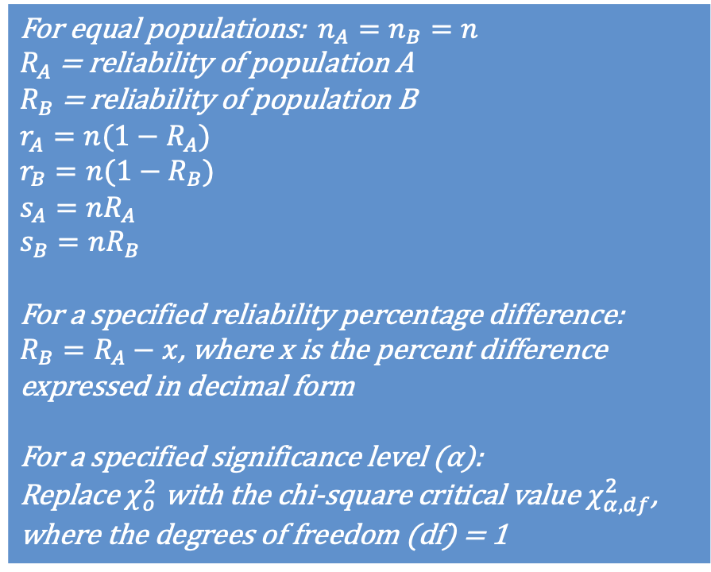
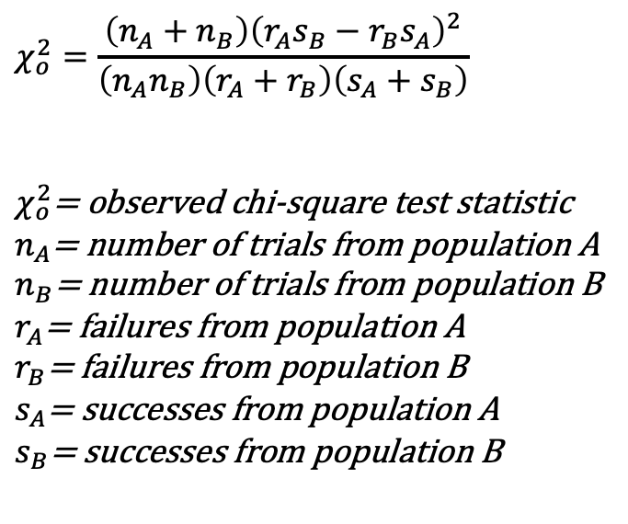
Basic Variable Substitutions that Enable the Derivation
For equal populations: $n_{A}=n_{B}=n$
$R_{A}$ = reliability of population A
$R_{B}$ = reliability of population B
$$r_{A}=n(1−R_{A})$$
$$r_{B}=n(1−R_{B})$$
$$s_{A}=nR_{A}$$
$$s_{B}=nR_{B}$$
For a specified reliability percentage difference:
$R_{B}=R_{A}−x$, where x is the percent difference expressed in decimal form
For a specified significance level (α):
Replace $χ_{o}^{2}$ with the chi-square critical value $χ_{α,df}^{2}$, where the degrees of freedom (df) = 1
$$χ_{o}^{2}=\frac{\left(n_{A}+n_{B}\right){\left(r_{A}s_{B}−r_{B}s_{A}\right)}^{2}}{\left(n_{A}n_{B}\right)\left(r_{A}+r_{B}\right)\left(s_{A}+s_{B}\right)}$$
$χ_{o}^{2}$= observed chi-square test statistic
$n_{A}$= number of trials from population A
$n_{B}$= number of trials from population B
$r_{A}$= failures from population A
$r_{B}$= failures from population B
$s_{A}$= successes from population A
$s_{B}$= successes from population B
By making these substitutions the number of variables is reduced, making the equation solvable for n.

Slide 7
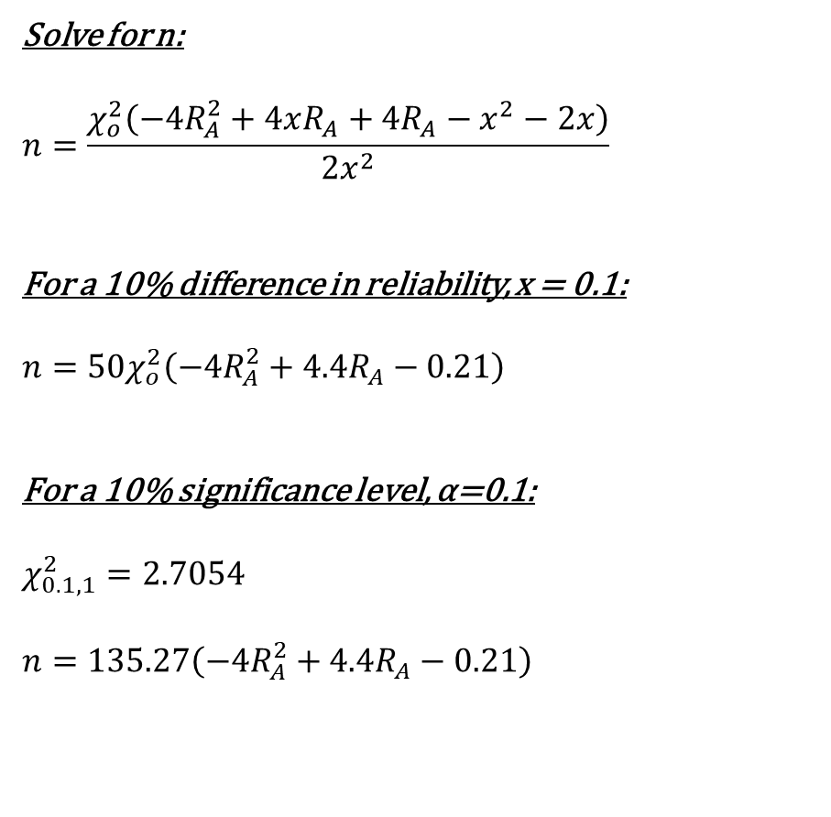
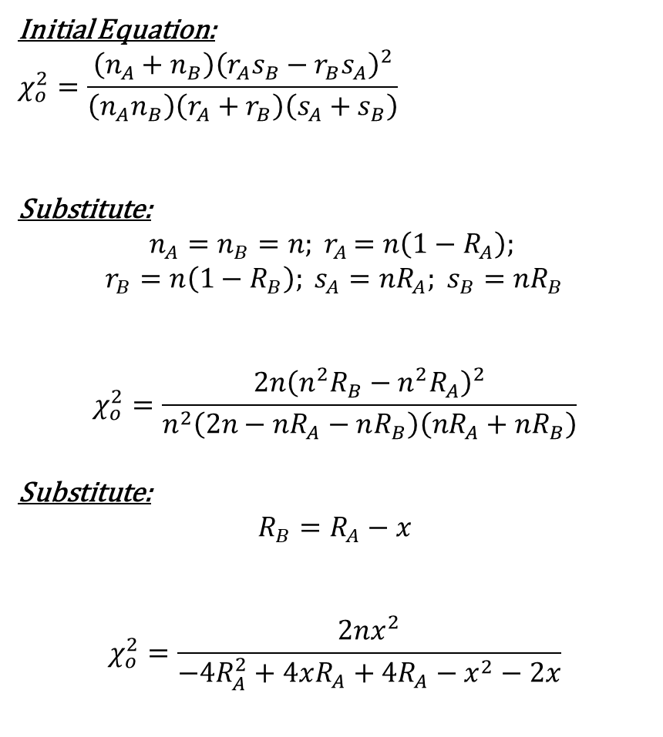
Summary of the Derivation
Initial Equation:
$$χ_{o}^{2}=\frac{\left(n_{A}+n_{B}\right){\left(r_{A}s_{B}−r_{B}s_{A}\right)}^{2}}{\left(n_{A}n_{B}\right)\left(r_{A}+r_{B}\right)\left(s_{A}+s_{B}\right)}$$
Substitute:
$$n_{A}=n_{B}=n{; r}_{A}=n\left(1−R_{A}\right);$$
$$r_{B}=n\left(1−R_{B}\right); s_{A}=nR_{A}; s_{B}=nR_{B}$$
$$χ_{o}^{2}=\frac{2n{\left(n^{2}R_{B}−n^{2}R_{A}\right)}^{2}}{n^{2}\left(2n−nR_{A}−nR_{B}\right)\left({nR}_{A}+{nR}_{B}\right)}$$
Substitute:
$$R_{B}=R_{A}−x$$
$$χ_{o}^{2}=\frac{2nx^{2}}{−4R_{A}^{2}+4xR_{A}+4R_{A}−x^{2}−2x}$$
Solve for n:
$$n=\frac{χ_{o}^{2}\left(−4R_{A}^{2}+4xR_{A}+4R_{A}−x^{2}−2x\right)}{2x^{2}}$$
For a 10% difference in reliability, x = 0.1:
$$n={50χ}_{o}^{2}\left(−4R_{A}^{2}+4.4R_{A}−0.21\right)$$
For a 10% significance level, α=0.1:
$$χ_{0.1,1}^{2}=2.7054$$
$$n=135.27\left(−4R_{A}^{2}+4.4R_{A}−0.21\right)$$
Thus, for a specified difference in reliability, and at a specified significance, the number of samples recommended from each population is only based upon the known reliability of Population A.

Slide 8
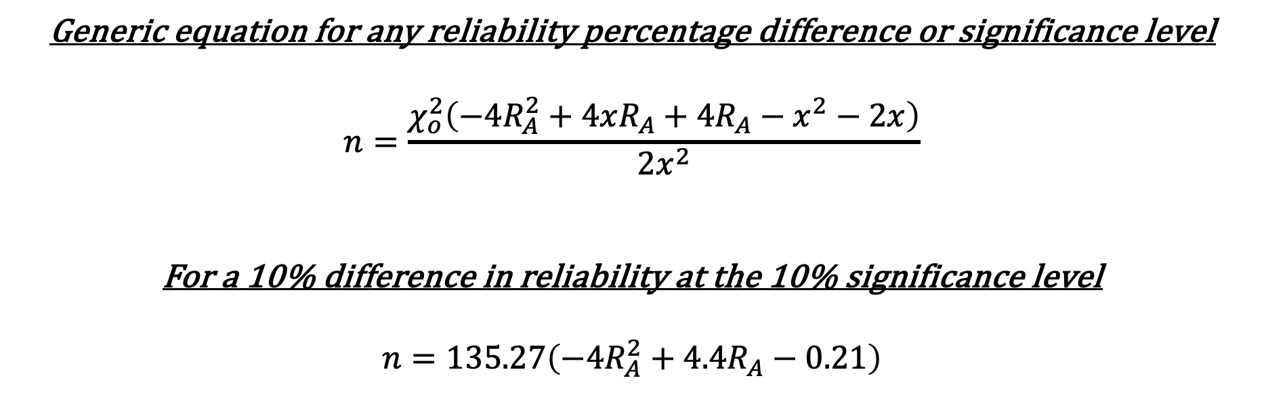
The Final Equation
Generic equation for any reliability percentage difference or significance level
$$n=\frac{χ_{o}^{2}\left(−4R_{A}^{2}+4xR_{A}+4R_{A}−x^{2}−2x\right)}{2x^{2}}$$
For a 10% difference in reliability at the 10% significance level
$$n=135.27\left(−4R_{A}^{2}+4.4R_{A}−0.21\right)$$

Slide 9
Example: One Scenario
For demonstration, assume the U.S. Army has a large inventory of DNGO missiles that have been fielded for 10+ years. The SRP program has the capability to pull a sample of DNGO missiles for depot level (non-destructive) testing, and from previous years of testing has established with confidence that the U.S. inventory has demonstrated a 0.98 reliability for DNGO missiles to pass the depot level testing. No degradation trends have been identified, and the system is considered to be within its operating life.
Last year, one quarter of the DNGO inventory was deployed to a combat zone, exposing them to transportation, handling and environmental exposure while the rest of the inventory remained in benign (earth-covered magazine) storage. The operations have concluded and only a small portion of the deployed missiles were expended. As these deployed missiles are integrated back into the regular inventory, should they be segregated and treated as a separate population? Should a ‘reset’ program to screen / rework 100% of them be implemented?
It has been decided to perform depot level testing on a sample of the deployed missiles to see if they have been degraded. What is the minimum quantity required from the deployed and non-deployed populations to determine if there is a 5% difference in reliability at the 20% significance level?

Slide 10
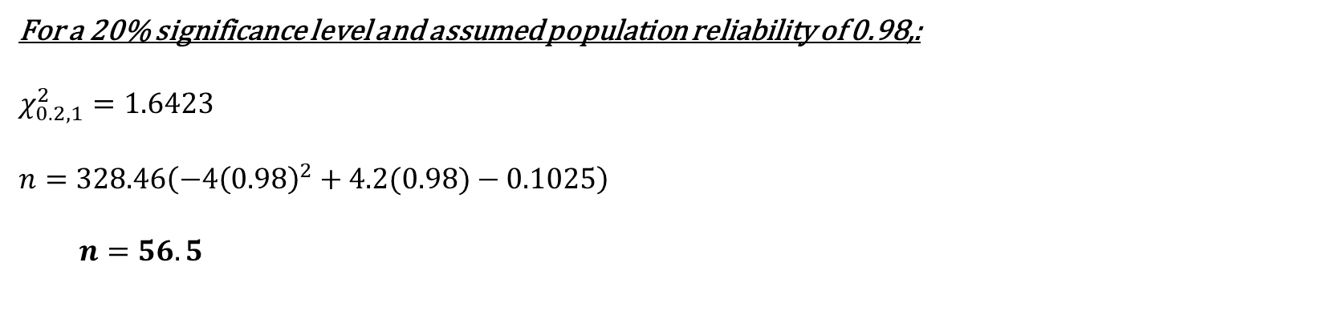
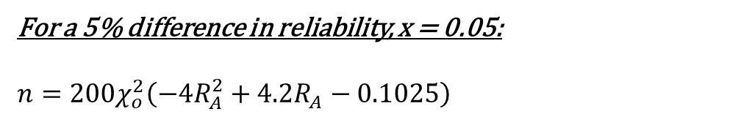
Example: The Solution
For a 5% difference in reliability, x = 0.05:
$$n={200χ}_{o}^{2}\left(−4R_{A}^{2}+4.2R_{A}−0.1025\right)$$
For a 20% significance level and assumed population reliability of 0.98,:
$$χ_{0.2,1}^{2}=1.6423$$
$$n=328.46\left(−4{\left(0.98\right)}^{2}+4.2(0.98)−0.1025\right)$$
  $$n=56.5$$
To achieve 20% significance level for identifying a 5% difference in reliability, 57* missiles from the non-deployed and 57 missiles from the deployed inventories should be sampled.
*When using this process, the calculated n should always be rounded up, as the reliability difference and significance level will not be met at the lower quantity.

Slide 11
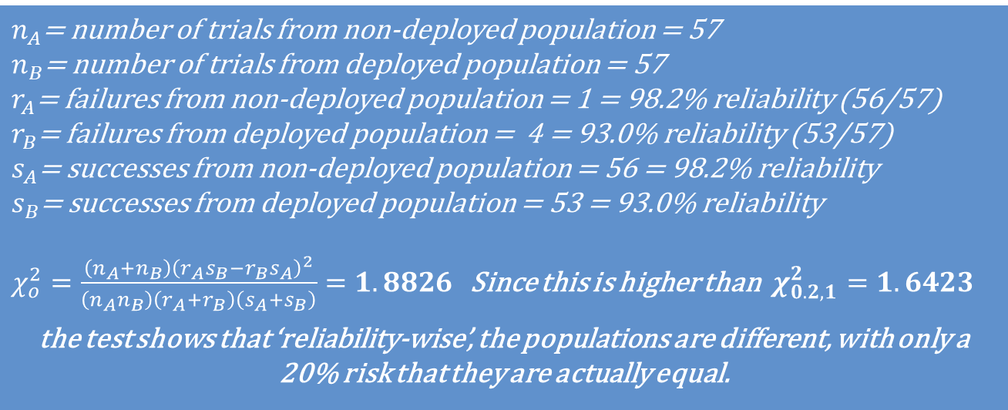
Example: Solution Demonstration
$n_{A}$= number of trials from non-deployed population = 57
$n_{B}$= number of trials from deployed population = 57
$r_{A}$= failures from non-deployed population = 1 = 98.2% reliability (56/57)
$r_{B}$= failures from deployed population = 4 = 93.0% reliability (53/57)
$s_{A}$= successes from non-deployed population = 56 = 98.2% reliability
$s_{B}$= successes from deployed population = 53 = 93.0% reliability
$χ_{o}^{2}=\frac{\left(n_{A}+n_{B}\right){\left(r_{A}s_{B}−r_{B}s_{A}\right)}^{2}}{\left(n_{A}n_{B}\right)\left(r_{A}+r_{B}\right)\left(s_{A}+s_{B}\right)}=1.8826$ Since this is higher than $χ_{0.2,1}^{2}=1.6423$
the test shows that ‘reliability-wise’, the populations are different, with only a 20% risk that they are actually equal.
}
A 5.2% difference in reliability between population A and B.
If exact failures/successes were entered [e.g., (1.14/55.86) and (3.99/53.01)], the chi-square value will equal the specified 1.6423 significance level.

Slide 12
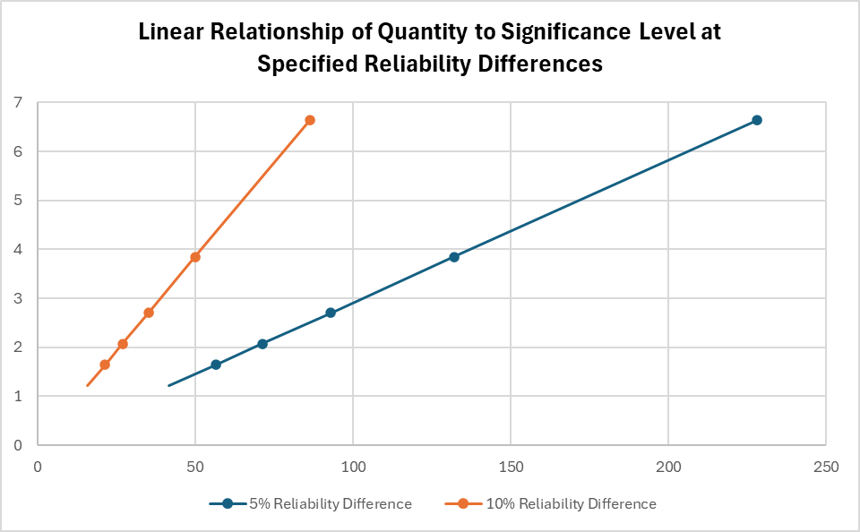
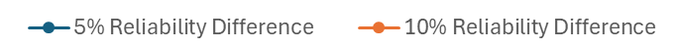

Relationship of Significance Level to Sample Quantity
1% Significance Level
Calculated $χ_{o}^{2}$ Value
5% Significance Level
10% Significance Level
15% Significance Level
20% Significance Level
Recommended Sample Size
With known reliability of Population A and a specified difference in reliability for Population B, the recommended quantity to be sampled is linearly associated to the desired Significance Level.

Slide 13
Value/Applications for the Equation
There can never be the perfect method to determine the sample size, because it would require knowing the result a priori, but the method outlined in this presentation provides an equation to calculate a recommended sample size required if the reliability of one population is ‘known’.
The calculation can be modified for specific reliability-wise difference and given significance level.
This equation potentially provides logistical and financial benefits by ensuring that the minimum number of units is selected while still meeting the required significance level.
  Eliminates need to “guess and check” sample sizes.
  Prevents wasted resources on unnecessarily large sample sizes.
A few examples of the applications of this equation include:
  Calculating the required sample size when comparing two or more production years of one-shot component pass/fail data.
  Calculating the required sample size when comparing two or more populations of flight-test pass/fail results.

Slide 14
Cautions/Caveats of Improper Application
The method outlined in this presentation utilizes the standard Chi-Square Test of Independence for a 2x2 contingency table. When any expected frequency in the 2x2 table is less than five, the result can be biased upwards, leading to false positives (Type I Error).
  This could be corrected for using the Yate’s Correction factor, a method that has not been investigated for the application laid out in this presentation.
The user should be careful in their conclusions that the results do not determine that two populations are the same, but that they are ‘reliability-wise’ the same. A toaster and a waffle iron could be shown to be ‘reliability-wise’ the same; that does not make a waffle iron a toaster.
If the two populations are dramatically different in reliability, the “recommended” minimum number of sample would not be required. For example, if the test was set to identify a 5% difference in reliability but they were 20% different in reliability, it could likely be proven well before the number recommended in this process.
The method outlined in this presentation is designed for the comparison of two populations. When three or more populations are compared, a pairwise approach must be employed, comparing Group 1 to Group 2, Group 2 to Group 3 and Group 1 to Group 3. . . For example, in comparing production years of items.

Slide 15
Conclusion
Questions? / Discussion

Slide 16
Acknowledgements
  Thank you to Jesse B. Buttler and William M. Tootle for their work supporting the research, validation and documentation of the information captured in this presentation.

