Slide 1
Leveraging Value Stream Mapping for Effective Digital Transformation
Sheri J. Leder
RAM 2025
Notes:
Good afternoon, everyone, and thank you for being here. My name is Sheri Leder. I am a PhD student in Engineering Management at UAH. Today, I will be presenting research on how value stream mapping could be leveraged as a strategic tool for digital transformation.

Slide 2
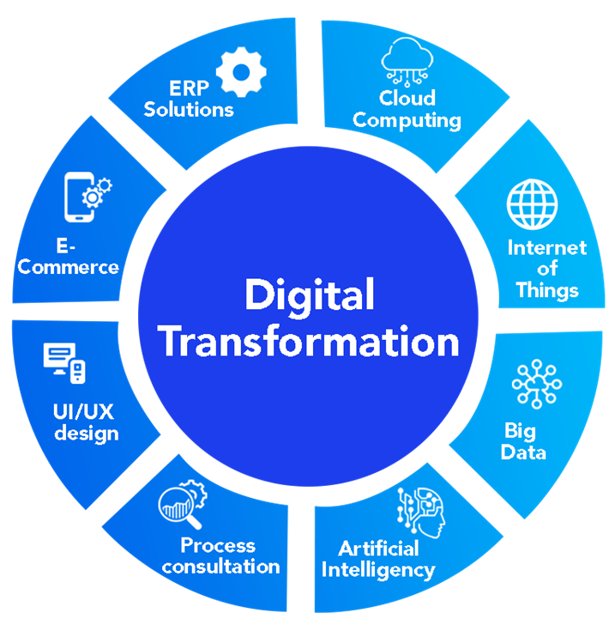
What is Digital Transformation (DT)?
1. Utilization of Digital Technologies
2. Modification/ Automation of:
Products
Processes
Organizational structures
Key Concepts¹:
Customer satisfaction
Customer experience
Productivity
Revenue from products & services
Cost reduction
Benefits²:
Notes:
Digital Transformation is critical for remaining competitive, but it is a complex organizational change process. When DT is examined in the literature, two key concepts consistently emerge, (1) utilizing digital technologies (2) and transforming products, processes, and organizational structures to create more agile and intelligent systems. Through DT, organizations aim to increase customer satisfaction and experience, productivity, and revenue – while also reducing costs.

Slide 3
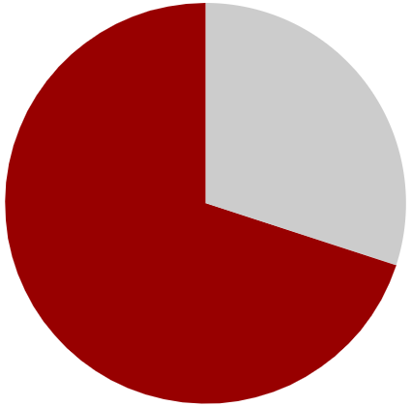
What are the challenges of DT?
Employee resistance³
Lack of clearly defined, achievable objectives³
~30% Succeed
Scarce management support/ commitment³
Poor communication³
~70% Fail³
Knowledge⁴
Lack resources or structure^{5,6}
Notes:
Unfortunately, achieving those benefits is far from guaranteed. Research shows that nearly 70% of DT initiatives fail. Often, this is due to employee resistance, especially when objectives are unclear or unrealistic. Without strong leadership and consistent communication, confusion spreads about what DT means. To make matters worse, smaller organizations often lack the structure, resources, or strategic support needed to implement these changes effectively.

Slide 4
Approaches and strategies to digital transformation
Author | Key Strategies / Dimensions | Contribution
[7] Li (2020) | • Experimentation • Incremental radical change • Temp → sustainable advantages | Iterative strategy execution
[8] Matt et al. (2015) | • Technology use • Value creation • Structural changes • Financial aspects | Framework for DT strategies
[9] Satweker et al. (2024) | Digital-by-Design (people, process, tech; PPT) | Extends PPT/DIM frameworks; actionable guidance
[10] Tian (2024) | DEA-BP + IoT for DT effectiveness | Quantitative, validated efficiency model
Notes:
According to a sample of research over the past 10 years, several approaches to digital transformation have emerged.
To name a few, Li highlights an iterative process — experimenting, taking incremental steps, and turning temporary wins into lasting advantages.
Matt and colleagues define four key strategy dimensions: technology use, value creation, structural changes, and financial aspects.
Satweker reframes DT as Digital-by-Design, orchestrating people, process, and technology holistically.
And Tian introduces a quantitative model using IoT and neural networks to evaluate DT effectiveness in manufacturing.

Slide 5
Limits of approaches to digital transformation
Author | Strengths | Limits vs. Common Challenges
[7] Li (2020) | Encourages experimentation & adaptability | May not overcome employee resistance or ensure management commitment; unclear objectives can derail experimentation.
[8] Matt et al. (2015) | Comprehensive view | Provides structure, but doesn’t resolve poor communication or employee buy-in; financial constraints may block resources.
[9] Satweker et al. (2024) | Holistic orchestration of PPT; moves beyond IT focus | Highlights people/process, but lacks concrete methods for resolving resistance, clear objectives, or sustaining leadership support.
[10] Tian (2024) | Offers measurable way to track DT effectiveness | Strong on metrics, weak on human/organizational issues (resistance, communication, management support).
Notes:
No single approach addresses all barriers to DT. Strategy frameworks, holistic orchestration, and evaluation models each contribute, but challenges like resistance, communication, leadership, and resource alignment remain unsolved — requiring integration of approaches.

Slide 6
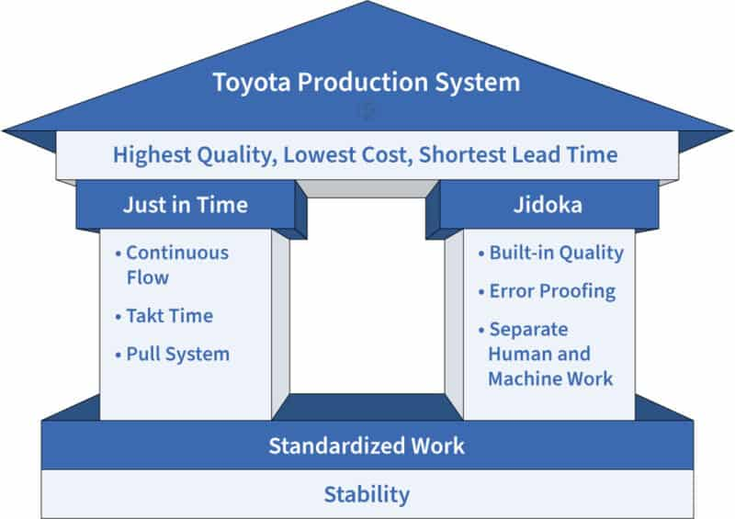
How have previous transformations addressed similar challenges?
“All we are doing is looking at the timeline, from the moment the customer gives us an order to the point when we collect the cash. And we are reducing the timeline by reducing the non-value adding wastes.”
~Taiichi Ohno, Toyota Production System pioneer
Notes:
To better understand how to overcome the challenges of DT, we can look back at how organizations addressed similar barriers during Lean Transformation. The Toyota Production System introduced the foundational principles of standardized and stable processes, anchored by the pillars of just-in-time delivery and built in quality. The primary goal was to improve processes and eliminate waste. As companies began adopting this new “Lean culture,” they faced many of the same challenges we see in DT today – especially around resistance to change and long-term planning.

Slide 7
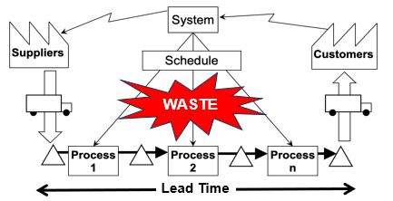
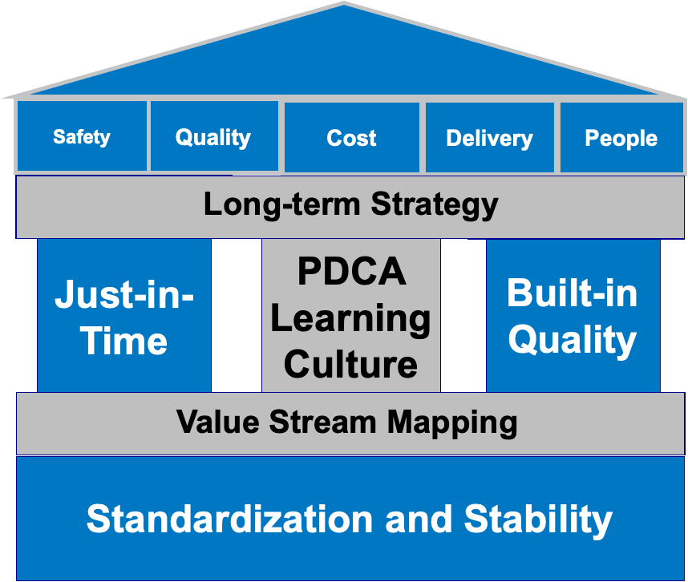

Value Stream Mapping (VSM)
Tools are just a way to accomplish the principles!
Notes:
This is where VSM proved critical. It gave organizations a structured, visual tool to guide strategic thinking and prioritize transformation efforts – laying the groundwork for more advanced transformation models in today’s digital era.

Slide 8
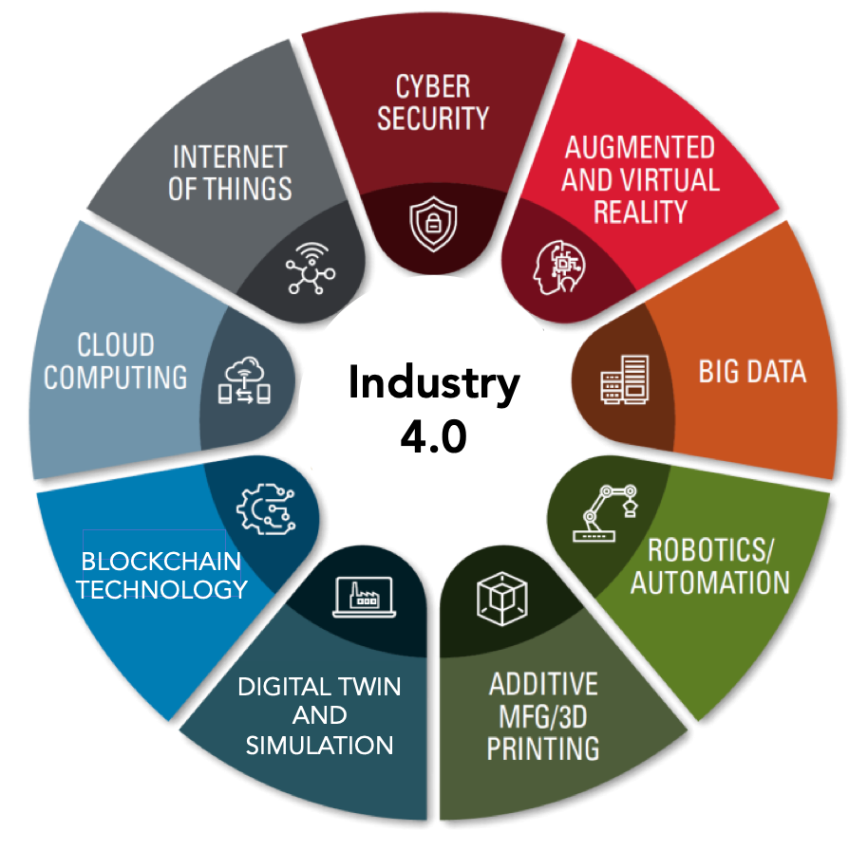

A new paradigm - Industry 4.0 (I4.0)
Notes:
Building on Lean foundations, Industry 4.0 - introduced in Germany in 2011 marks the next phase of transformation. It integrates technologies like the IoT and digital twins to drive real-time, system-wide optimization. By expanding the scope of DT, Industry 4.0 enables greater responsiveness, adaptability, and predictive capability across entire value chains. Although I4.0 offers the technological opportunities to achieve DT, strategic guidance remains unclear.

Slide 9
The Gap: Value Stream Mapping (VSM) in the era of I4.0
Traditional VSM
Static Lean Tool¹¹
I4.0 Emerges IoT, real-time data, simulation potential^{12,13}
Call for “Lean 4.0” Merge Lean with digital tools^{14,15}
Current Gap VSM rarely used to guide DT in I4.0^{16,17}
What We Know:
VSM can be enhanced with I4.0 technologies
What’s Missing:
VSM’s role in guiding DT remains underdeveloped
Integration with I4.0 is inconsistent, often superficial
Need for models that align VSM with sustainability
Notes:
Based on a preliminary investigation into the literature, we can follow the timeline of where VSM began and understand what is needed today. Traditionally, VSM originated as a static Lean tool, performed with pen & paper on the shop floor to map out the current state of operations, then using that to plan the desired future state, and finally to create an implementation roadmap to determine all the actions needed to get there. And of course repeating the process of the future state to the roadmap as many times as needed. With the emergence of I4.0, the IoT, real-time data, and simulation became possible, which led to the call for merging lean with digital tools; however, VSM is rarely used to guide DT in I4.0 and currently

Slide 10
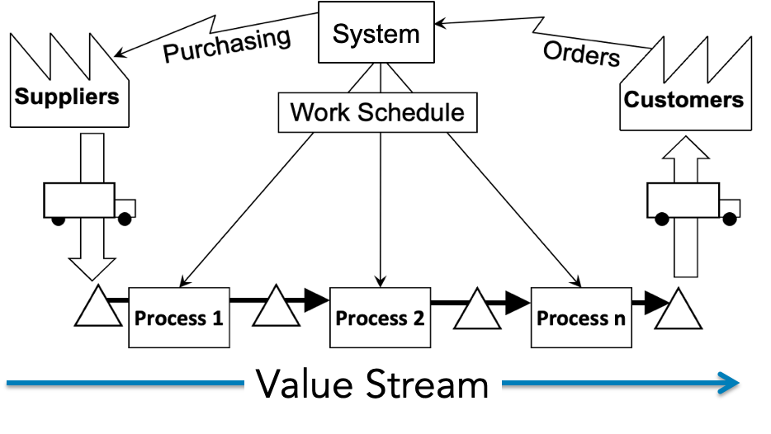
Can VSM guide DT via strategic I4.0 technology adoption?
If we implement technologies simply for the sake of implementing them, without first understanding & simplifying our system, we just automate a really bad system!

Slide 11
Objectives
This study aims to explore how VSM is applied in I4.0 contexts & assess its potential as a strategic tool for DT
RQ: How has VSM been applied within the context of I4.0?
RQ.a: In what ways has VSM improved process efficiency?
RQ.b: Which industry domains have adopted VSM?
RQ.c: How frequently is VSM explicitly stated in relation to I4.0?

Slide 12
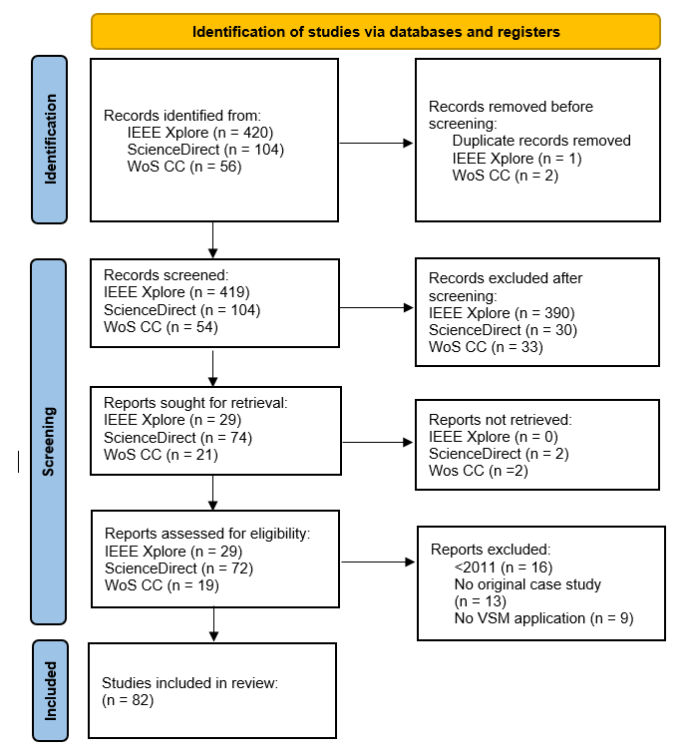
Methodology
Databases & Search Strings:
IEEE Xplore
(“All Metadata” : “value stream mapping”) OR
(“All Metadata” : “VSM”)
Science Direct
Title: “value stream mapping” OR “VSM”
Web of Science Core Collections
“value stream mapping” (Title) or “VSM” (Title)
Inclusion Criteria:
Peer-reviewed Journal Articles
English
2011-2025
Original Case Study
VSM application
Manual Coding:
Domain classification
VSM modification classification
Modified preferred reporting items for systematic reviews & meta-analyses (PRISMA) diagram¹⁸

Slide 13
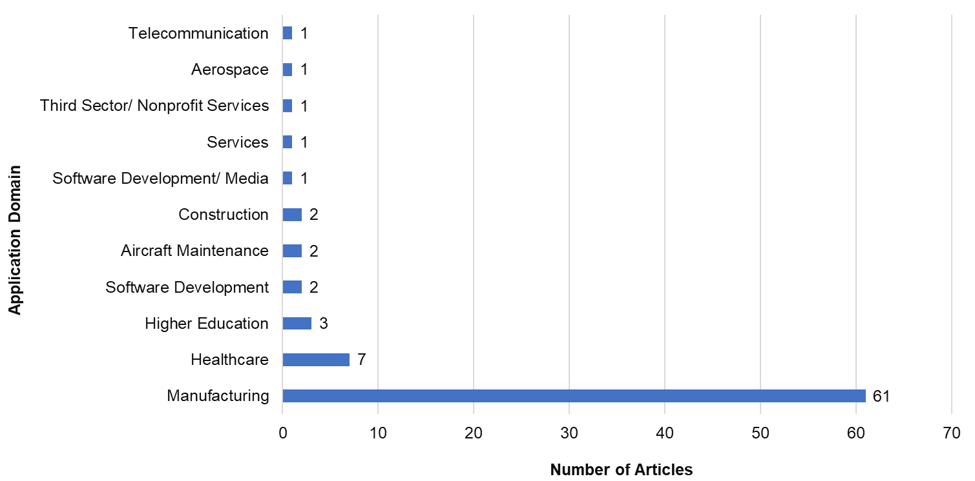
Where is VSM applied?
Distribution of VSM Applications by Industry Domain

Slide 14
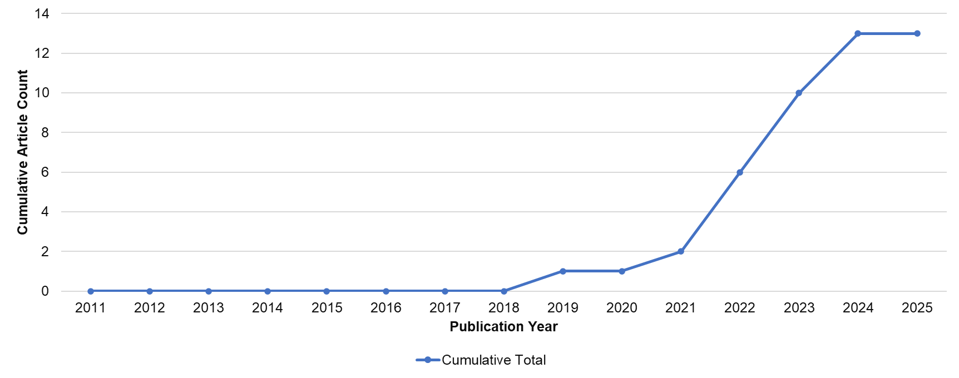
VSM + I4.0 integration is rare
Cumulative Count of Articles Linking VSM with Industry 4.0 Concepts (n = 13)
Note: Only 13 articles (15.85%) of the 82 explicitly integrated concepts from I4.0.

Slide 15
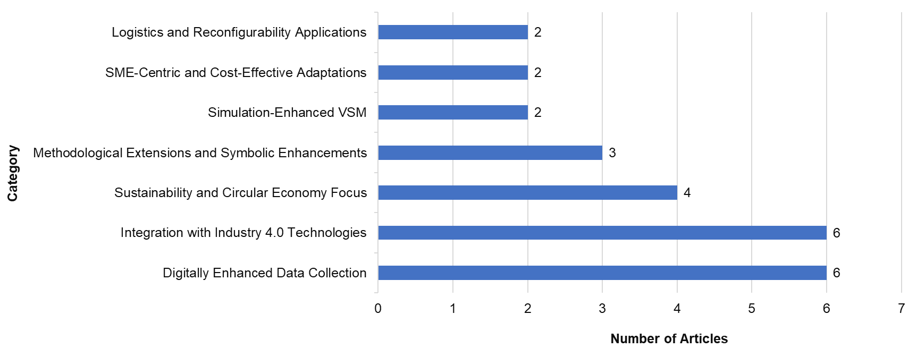
How VSM is being modified
Categorized Enhancements of VSM in I4.0 Articles
Note: Some articles addressed multiple modifications; totals exceed 13.
Notes:
And finally, looking deeper into that 16%, it was interesting to find that all of those articles modified or enhanced VSM in some way, sometimes addressing multiple modifications at one time. Mostly what we see here is that VSM is modified by the introduction of I4.0 technologies such as sensors or the IoT to digitally enhance data collection.

Slide 16
Discussion: Addressing the research questions
Research Question | Key Finding
RQ: How has VSM been applied within I4.0? | VSM has been digitally enhanced (e.g., real-time data, smart monitoring) – little evidence suggests its use to guide DT strategically.
RQ.a: In what ways has VSM enhanced process efficiency? | Integrations with IoT, simulation, & automation improve process visibility, accuracy, & responsiveness.
RQ.b: Which domains use VSM? | Manufacturing dominates; limited adoption in healthcare, education, logistics, etc.
RQ.c: How often is VSM discussed in relation to I4.0? | Only 13 of 82 articles (15.85%) explicitly integrate I4.0, with growth mainly after 2019.

Slide 17
How VSM can help overcome DT challenges
Challenge | How VSM Helps
Employee resistance | Involves cross-functional teams directly in mapping → employees see their role in the process, increasing buy-in and ownership.
Unclear objectives | Visualizes current vs. future state processes → makes goals concrete, measurable, and aligned with business priorities.
Lack of management support | Provides leadership with a clear, data-backed roadmap of inefficiencies, waste, and opportunities → makes benefits visible to secure commitment.
Poor communication | Creates a shared “single page” visual language that bridges gaps between departments, technical staff, and executives.
Knowledge gaps | Surfaces bottlenecks, handoffs, and data flows → reveals where training, upskilling, or new competencies are needed.
Limited resources/structure | Prioritizes initiatives based on value and waste elimination → helps allocate scarce resources to the highest-impact areas.
Notes:
Where strategy frameworks and models may overlook human/organizational barriers, VSM grounds DT in visible, collaborative, and actionable processes — aligning people, objectives, leadership, and resources.

Slide 18
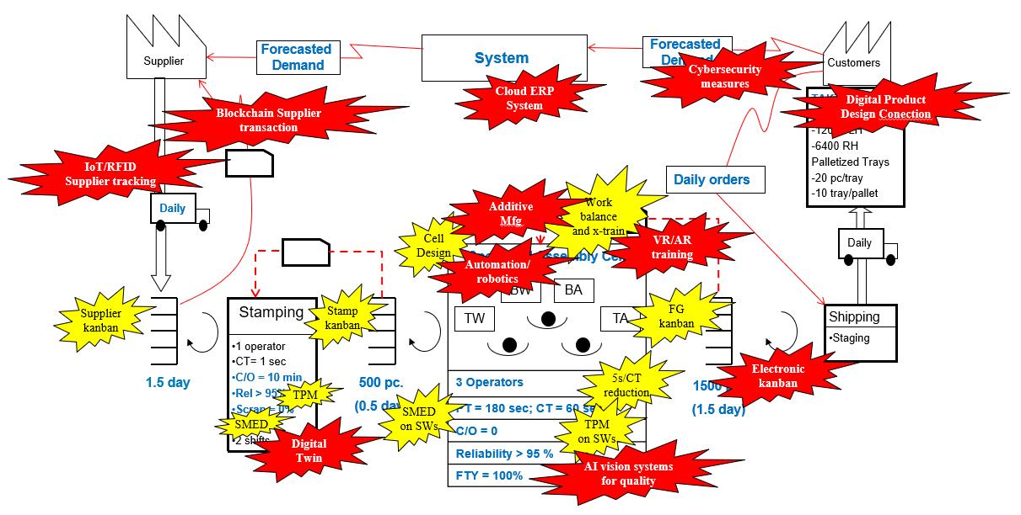
Conclusions & future directions
Notes:
In conclusion, from the SLR it was found that there is little evidence to suggest that VSM has been used to guide DT in the context of I4.0. We are currently exploring how to use VSM not to identify the appropriate Lean tools to reduce waste, use VSM to select digital technologies (seen here as red action bubble) & improve the system & implement them strategically. Future research will include an umbrella review of DT challenges, an adaptation of the VSM framework for DT, and validation through a case study.

Slide 19
References
[1] | Scriven, P., Ledwith, A., & Nagle, T. (2024). Towards a lean digital transformation research framework: a literature review. Journal of Decision Systems, 1-15.
[2] | Gebayew, C., Hardini, I. R., Panjaitan, G. H. A., & Kurniawan, N. B. (2018, October). A systematic literature review on digital transformation. In 2018 International Conference on Information Technology Systems and Innovation (ICITSI) (pp. 260-265). IEEE.
[3] | Bellantuono, N., Nuzzi, A., Pontrandolfo, P., & Scozzi, B. (2021). Digital transformation models for the I4. 0 transition: Lessons from the change management literature. Sustainability, 13(23), 12941.
[4] | Ahlskog, M., Badasjane, V., Granlund, A., Bruch, J., & Sauter, B. (2022). Differing Views of the Meaning of Digital Transformation in Manufacturing Industry. In SPS2022 (pp. 331-340). IOS Press.
[5] | Ghobakhloo, M., & Iranmanesh, M. (2021). Digital transformation success under Industry 4.0: a strategic guideline for manufacturing SMEs. Journal of Manufacturing Technology Management, 32(8), 1533-1556.
[6] | Kane, G. C., Palmer, D., Nguyen-Phillips, A., Kiron, D., & Buckley, N. (2017). Achieving digital maturity. MIT sloan management review, 59(1).
[7] | Li, F. (2020). Leading digital transformation: three emerging approaches for managing the transition. International Journal of Operations & Production Management, 40(6), 809-817.
[8] | Matt, C., Hess, T., & Benlian, A. (2015). Digital transformation strategies. Business & information systems engineering, 57(5), 339-343.
[9] | Satwekar, A., Miozza, M., Abbattista, C., Palumbo, S., & Rossi, M. (2024). Triad of digital transformation: Holistic orchestration for people, process, and technology. IEEE Transactions on Engineering Management, 71, 7815-7831.
[10] | Tian, Y. (2024). Evaluation of the Digital Transformation Effects in Manufacturing Using the DEA-BP Model and the Internet of Things. IEEE Access, 12, 47880-47887.
[11] | Rother, M., & Shook, J. (2003). Learning to see: value stream mapping to add value and eliminate muda. Lean enterprise institute.
[12] | Culot, G., Nassimbeni, G., Orzes, G., & Sartor, M. (2020). Behind the definition of Industry 4.0: Analysis and open questions. International Journal of Production Economics, 226. https://doi.org/10.1016/j.ijpe.2020.107617
[13] | Lugert, A., Batz, A., & Winkler, H. (2018). Empirical assessment of the future adequacy of value stream mapping in manufacturing industries. Journal of Manufacturing Technology Management, 29(5), 886-906.
[14] | Valamede, L. S., & Akkari, A. C. S. (2020). Lean 4.0: A new holistic approach for the integration of lean manufacturing tools and digital technologies. International Journal of Mathematical, Engineering and Management Sciences, 5(5), 851.
[15] | Lee, J. K. Y., Gholami, H., Saman, M. Z. M., Ngadiman, N. H. A. B., Zakuan, N., Mahmood, S., & Omain, S. Z. (2021). Sustainability-oriented application of value stream mapping: a review and classification. IEEE Access, 9, 68414-68434.
[16] | Moraes, A., Carvalho, A. M., & Sampaio, P. (2023). Lean and Industry 4.0: A Review of the Relationship, Its Limitations, and the Path Ahead with Industry 5.0. In Machines (Vol. 11, Issue 4). MDPI. https://doi.org/10.3390/machines11040443
[17] | Shrivastava, A., Khare, A., Gupta, N., Pratap, S., Rana, U., & Kushwaha, V. (2025). Enhancing Value Stream Map Effectiveness Through Business Capability Mapping: A Business Architecture Perspective. International Research Journal of Modernization in Engineering Technology and Science, 7(3), 17776–17781. https://www.doi.org/10.56726/IRJMETS71119
[18] | Page, M. J., McKenzie, J. E., Bossuyt, P. M., Boutron, I., Hoffmann, T. C., Mulrow, C. D., ... & Moher, D. (2021). The PRISMA 2020 statement: an updated guideline for reporting systematic reviews. bmj, 372.

Slide 20
Questions?

