Slide 1

Practical Applications of RAM Engineering for
UH-1Y and AH-1Z Helicopters
Continuously Pushing the Limits of Innovation, Technology & Conventional Thinking
November 2025

Slide 2




Introduction
  Name – Adam Mills
  Title – Department Head- R&M Analysis
  Company – Andromeda Systems Inc.
  E-mail Address – Adam.Mills@androsysinc.com

Slide 3
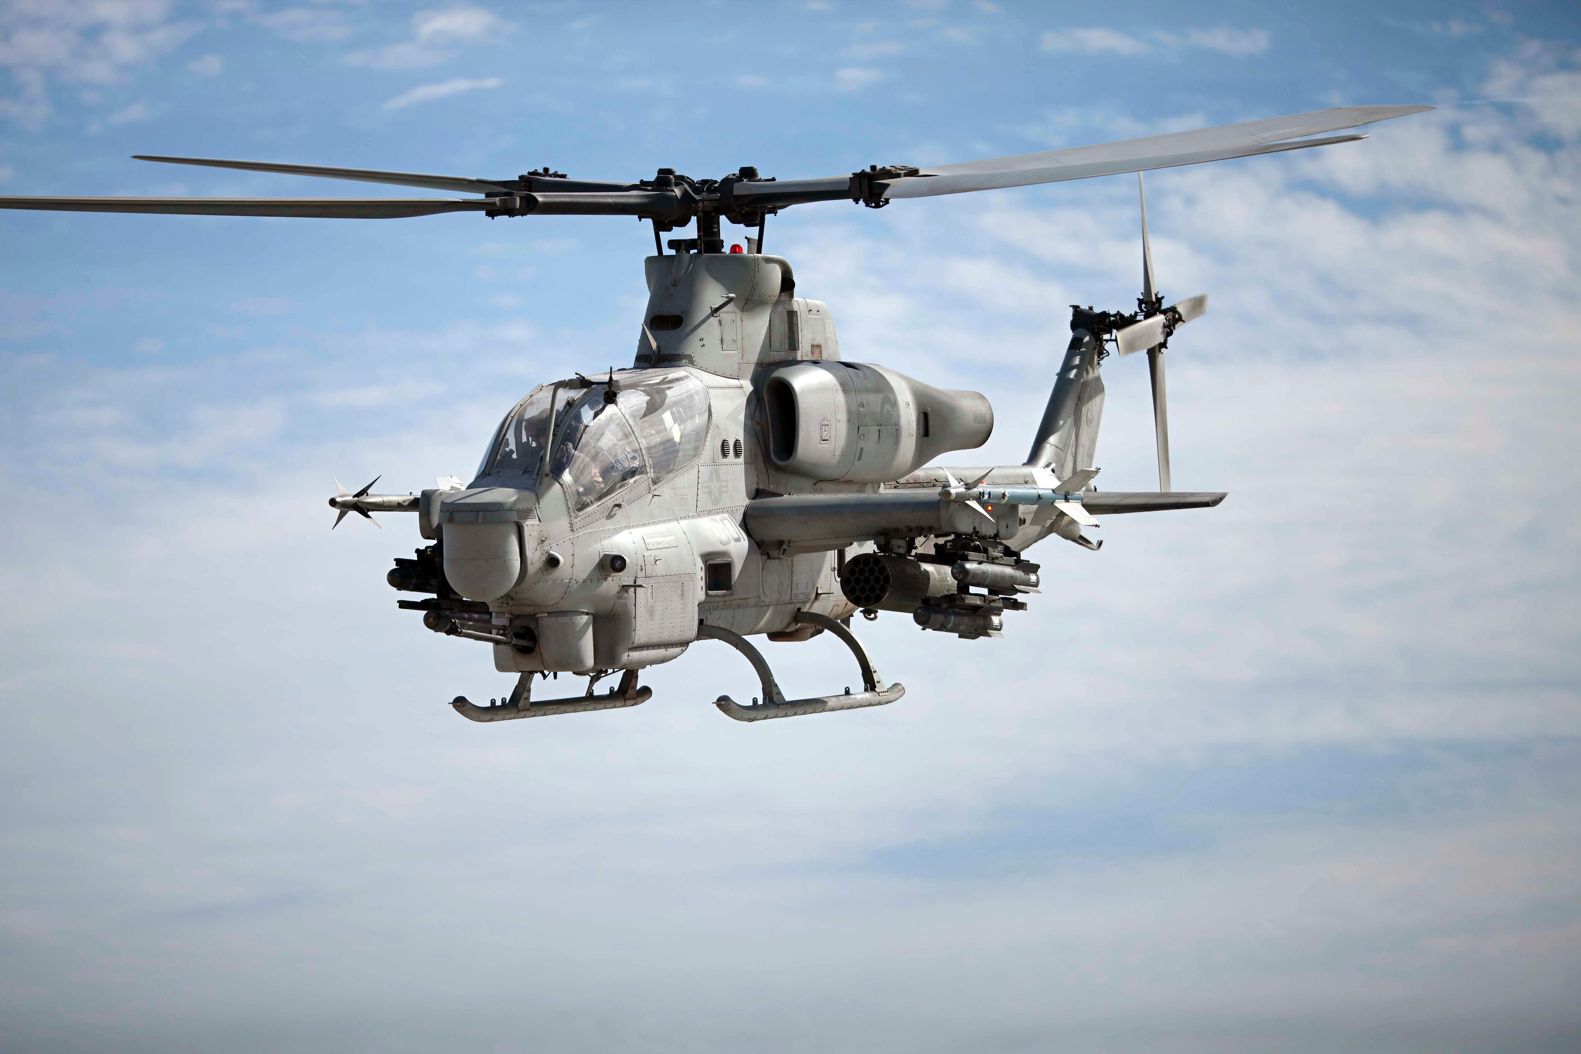
Background
UH-1Y and AH-1Z are upgraded aircraft
  Replaced the legacy UH-1N and AH-1W
  Procured by USN/USMC from BHTI
  79 UH-1Ys and 34 AH-1Zs fielded at time of analysis
  Still in production at the time

Slide 4
Background
  New helicopter fleet replacing the existing fleet over several years
  Aircraft are purchased in lots over multiple years resulting in data spread over several ages (flight hour usage) for the fleet ranging from earliest to more recent deliveries
  Previous RAM efforts included:
    RCM Analysis – Determined initial failure mitigation strategies
    Reliability Block Diagrams – Evaluated Reliability, Availability, Maintenance policies, and top degraders

Slide 5
Background
  The goal was to improve current yearly sparing predictions for critical consumable (non-repairable) scheduled removal items
  Accurate spares will help ensure adequate materials are available to replace components while also minimizing logistics footprint and costs associated with “over-buying” or paying for “rush delivery”
  Available data consisted of install and removal records, reasons for removal, monthly aircraft usage data containing flight hours, landings, and flights per month for each aircraft

Slide 6
Approach
  Determined time to removals and current part ages from available data
  Performed Weibull Analysis on each component to determine failure behavior
  Input life model, current part age, and predicted usage rates into block model
  Simulated model to predict yearly spares over five years
  Validated spares predictions for year 1
  Updated model with new data and refine process to generate more accurate spares

Slide 7
Weibull Data Processing
  Two data sources were available for generating Weibull
    Replacement work order (MAFs) records.
      Source for suspension and failure data
      Provides aircraft ID (BUNO), install location (POS) date, malfunction code, squadron, discrepancy narrative, corrective action narrative, part number, etc. for each record
    Monthly flight data reports for each aircraft
      Source for aircraft usage data
      Provides the monthly usage for each aircraft by BUNO, usage data is provided in total flights, flight hours, and landings for the month

Slide 8
Weibull Data Processing
Generated Weibull data points
    Filtered work order data by part number
    Sorted data by BUNO/POS and Date
    Scrubbed data to get part install and removals in sequence (e.g. removal can only occur after install)
    Calculated the amount of usage on the aircraft from when the part was installed to when it was removed
    Decided on replacement record would be a suspension or a failure
    Determined current part ages based on the last data point for each BUNO/POS

Slide 9
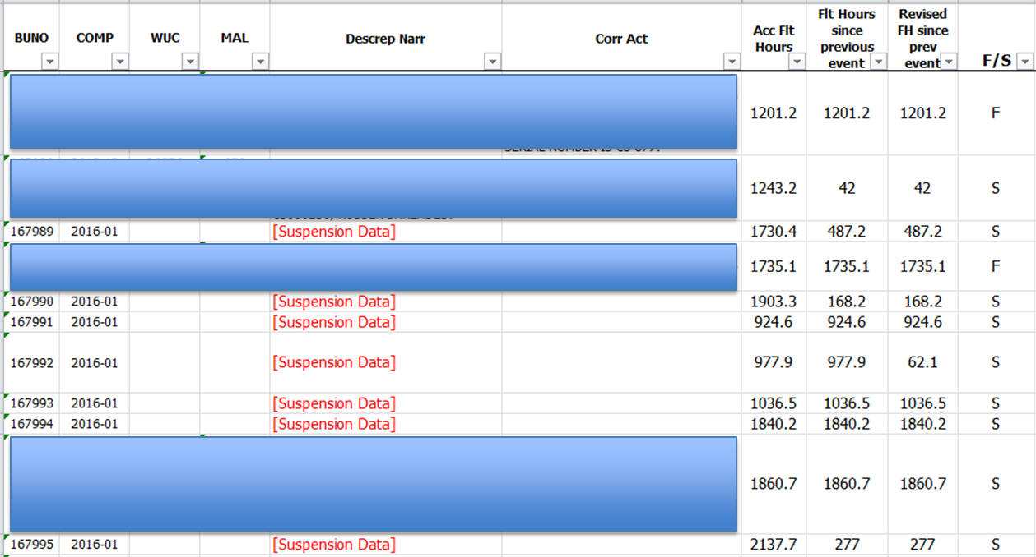
Weibull Data Processing

Slide 10
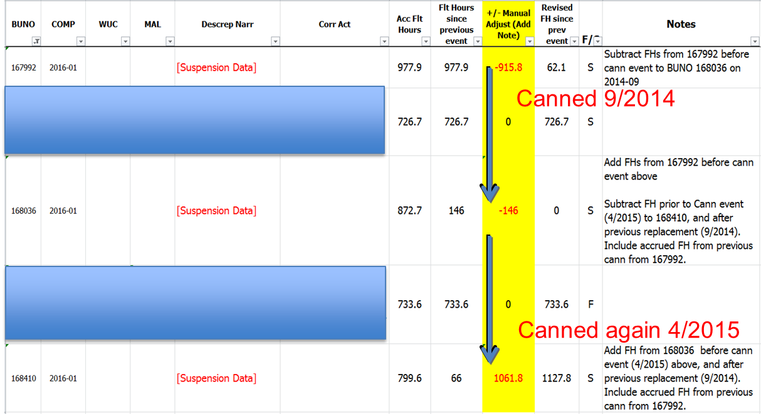
Weibull Data Processing
Made manual adjustments to the times to account for Cannibalized parts being installed during a replacement

Slide 11
Weibull Data Processing
Other Considerations
    Method assumes a new part is installed on the aircraft each time a replacement is required, unless cannibalization record is available
    Missing or incomplete replacement records can skew the data, used serial numbers when available to verify sequencing
    Failure data should only account for a single failure mode on a consumable item
    UH-1Y and AH-1Z data is combined into one Weibull due to limited data. Still not enough data on some parts
    As new data is made available, update data to make more robust Weibull models

Slide 12
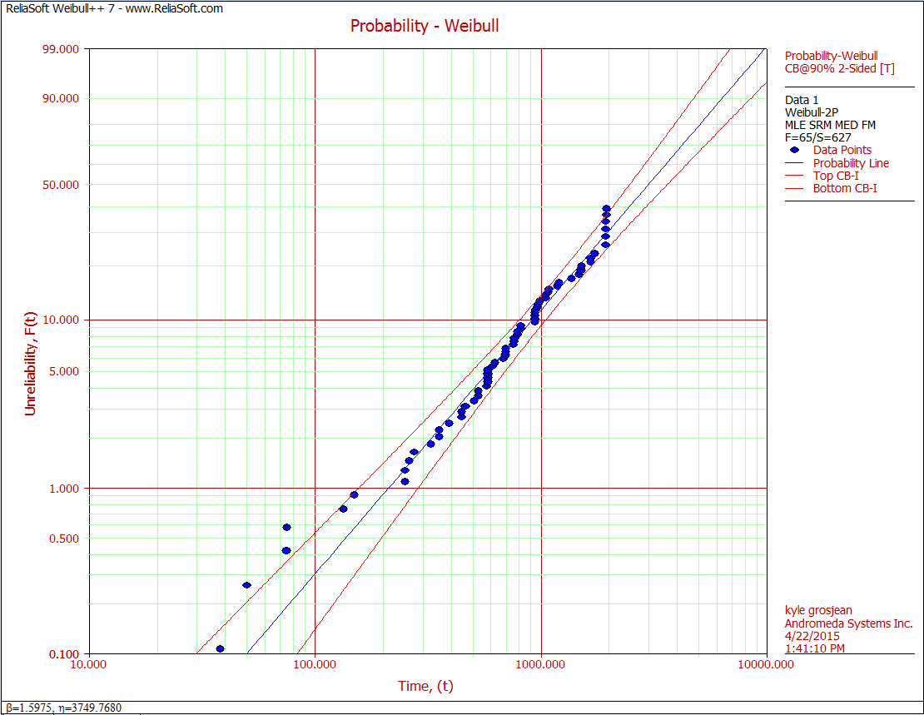
Weibull Model
Input F/S data into Weibull software
Used MLE fit due to large amount of suspensions

Slide 13
Spares Simulations
Three inputs are needed for each part on each aircraft
    Weibull Model – used parameters from Weibull Analysis
    Current Part Age – obtained from last record for each part location
    Planned Aircraft Usage - Assumed 316 FH/year for each aircraft (more on this later…)
Data for each part was entered into RBD and simulated
    1000 iteration simulation to determine average replacements over time
Simulate for 5 years with 5 increments to get yearly usage.
Summed spares required for each part location to determine fleet-wide total for each year

Slide 14
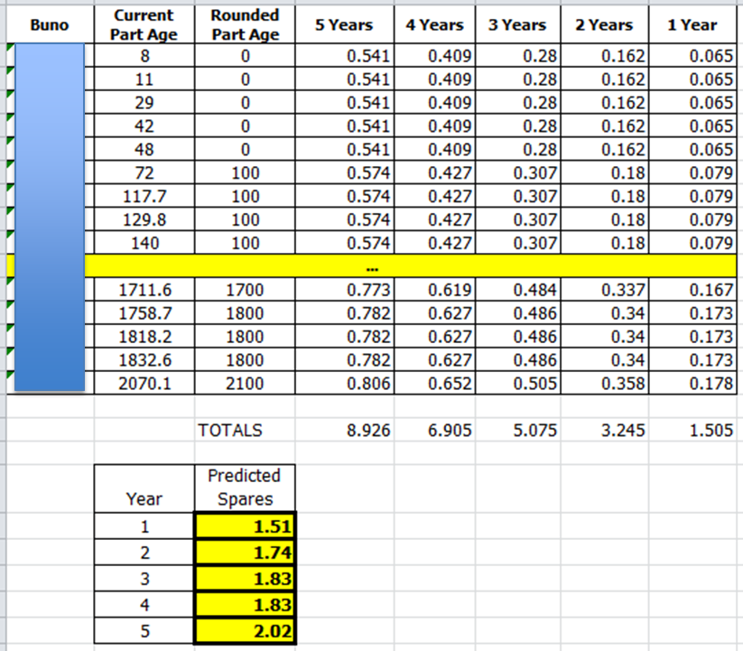
Spares Simulations

Slide 15
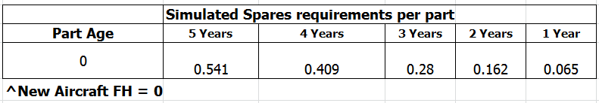
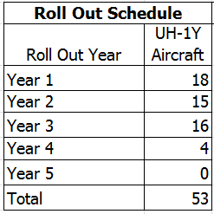
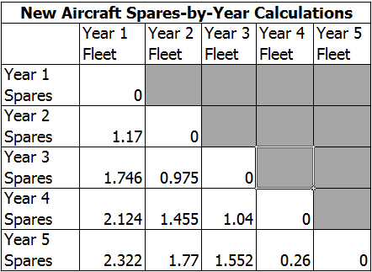
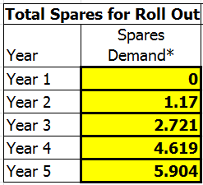
Spares Simulations
“Rookie” Aircraft Simulations – simulate a part with age zero and start spares as the aircraft arrive in the fleet

Slide 16
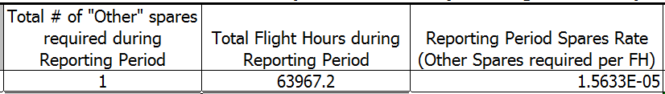
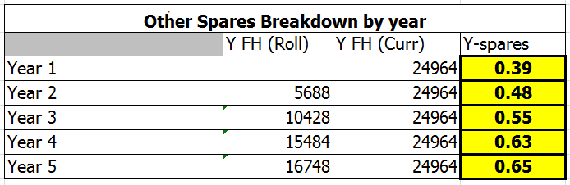
Spares Simulations
Accounting for Other Replacements – Assumed constant replacement rate

Slide 17
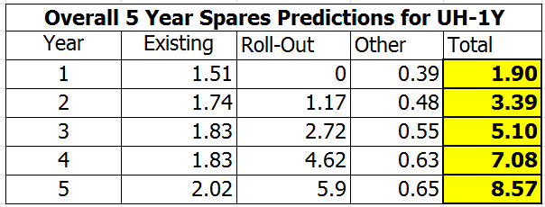
Spares Simulations
Add the 3 sources to get total predicted spares per year

Slide 18

Verification
After Year 1 replacement data became available, the prediction process was verified and refined
    compared actual replacements to year 1 predictions
Predictions were close, but could be improved
Determined process improvements and applied to future model and predictions
Possible sources of error
    Weibull model based on limited
    data
    Flight hour usage was assumed
    to be constant for each aircraft

Slide 19
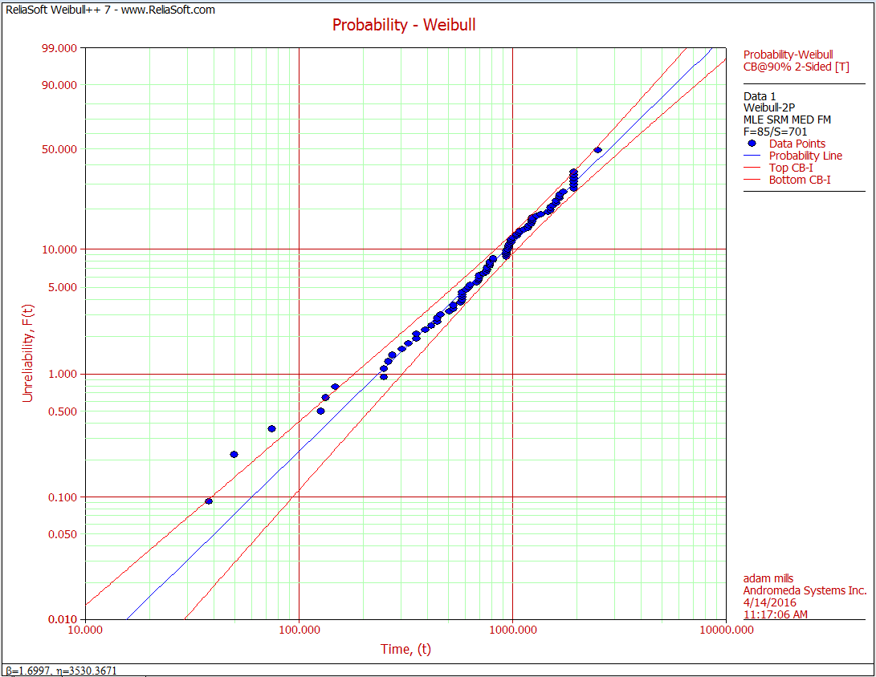
Improvements
Added data collected during the year 1 period
New model (Right) showed slight improvement to the previous (Left)

Slide 20
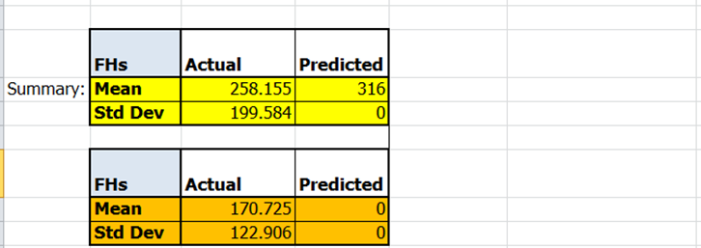
Improvements
Compared Actual Flight Hours to Predicted
    Average usage prediction that was applied to all aircraft was inaccurate
    Aircraft usage standard deviation was quite wide

Slide 21
Improvements
Decided to use a statistical model to generate future aircraft usage predictions
Created a model for the four separate yearly usage rate profiles:
    UH-1Y Aircraft that were existing in the fleet at the beginning of the year (“veteran” aircraft)
    UH-1Y Aircraft that entered the fleet during the year (“rookie” aircraft)
    AH-1Z Aircraft that were existing in the fleet at the beginning of the year
    AH-1Z Aircraft that entered the fleet during the year

Slide 22
Improvements
Used Flight Data report to determine the yearly usage for each aircraft profile
    First year for each aircraft was grouped in the “rookie” data set
    Subsequent years were grouped in the “veteran” data set
    Long term down aircraft were removed from consideration
Input each of the four data sets into Weibull++ 7 software and determined which model best fit the data
Performed Monte Carlo to get a random sample of yearly flight usage to compare to actual yearly usage
    Deleted values in the sample over the maximum actual yearly usage

Slide 23
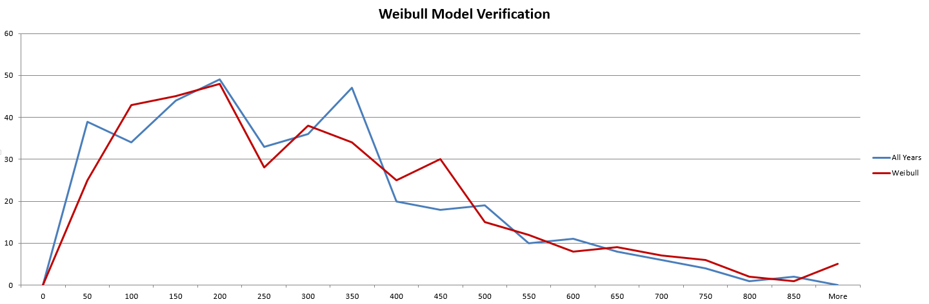
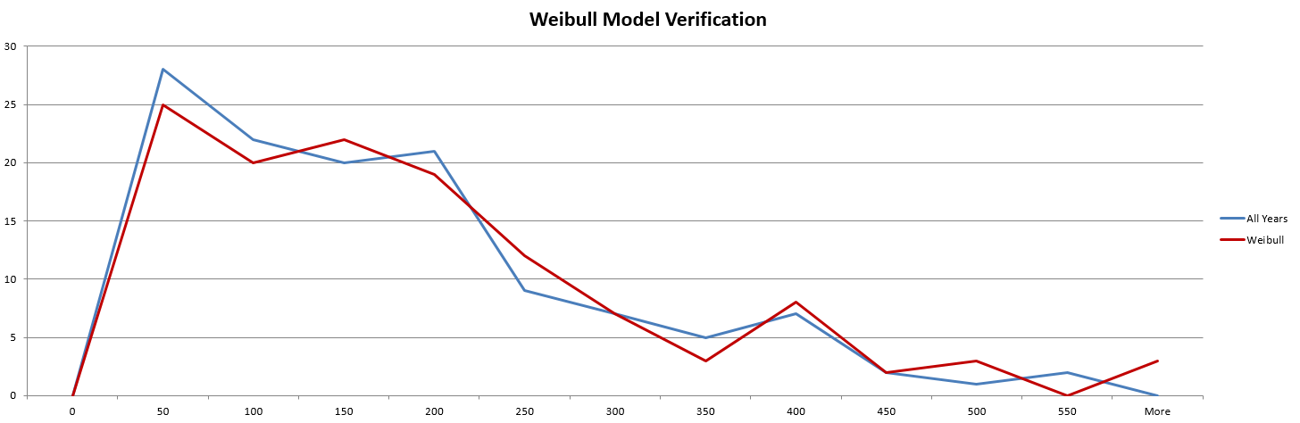
Improvements
UH-1Y Vet Aircraft (Weibull-2, β = 1.5888, η = 305.7131)
UH-1Y Rookie Aircraft (Weibull-2, β = 1.2168, η = 163.979)

Slide 24
Improvements
Back-tested improvements to the model and the usage predictions
Spares prediction accuracy improved significantly

Slide 25
Conclusions
Legacy spares predictions were often inaccurate, warranting a more analytical, engineering-based, approach
Inability to track item ages can impact Weibull model, the effect can be minimized with enough good data points and data scrubbing
Individual aircraft usage rate had a significant impact on the spares predictions. Overall average usage rates change year-to-year and do not apply to all aircraft.
Adding new field data provided refinements to the Weibull model and predicted spares over time.

Slide 26
Thank you for your attention.
Do you have any questions?

