Slide 1
Stair Navigation Enhanced Using Augmented Reality
Panuganti S¹, Chen H², Harper SA³
1: Electrical and Computer Engineering Department, The University of Huntsville
2: Industrial and Systems Engineering and Engineering Management Department, The University of Alabama in Huntsville
3: Kinesiology Department, The University of Alabama in Huntsville

Slide 2
Outline
Topic
Background/Context
System Breakdown
Features
Future Considerations/Methods

Slide 3
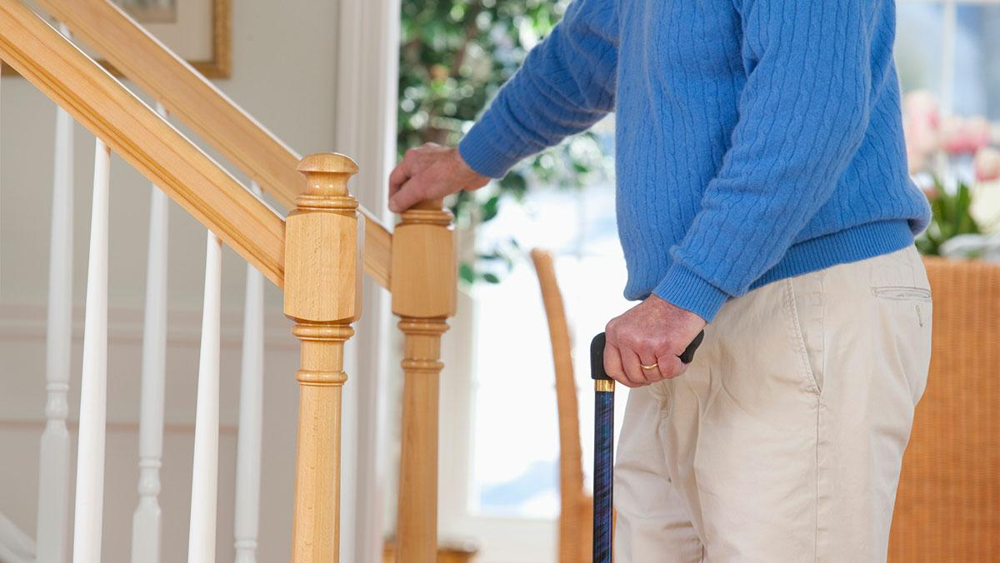
Background
Approximately 3000 people are injured daily due to falls on stairways in the US alone (1)
Vision impacts the nature of stair navigation, including foot placement and adjustment
Vision impairments can contribute to an increased fall risk by a factor of 2 or 3 (2)
Notes:
So for a bit of background into why we’re looking into stairway navigation; about 3000 people in US alone are injured due to falls on stairways. A big part of this is impacted by the role of vision, guiding foot placement. Increased fall risk due to vision deficits is a major concern.

Slide 4
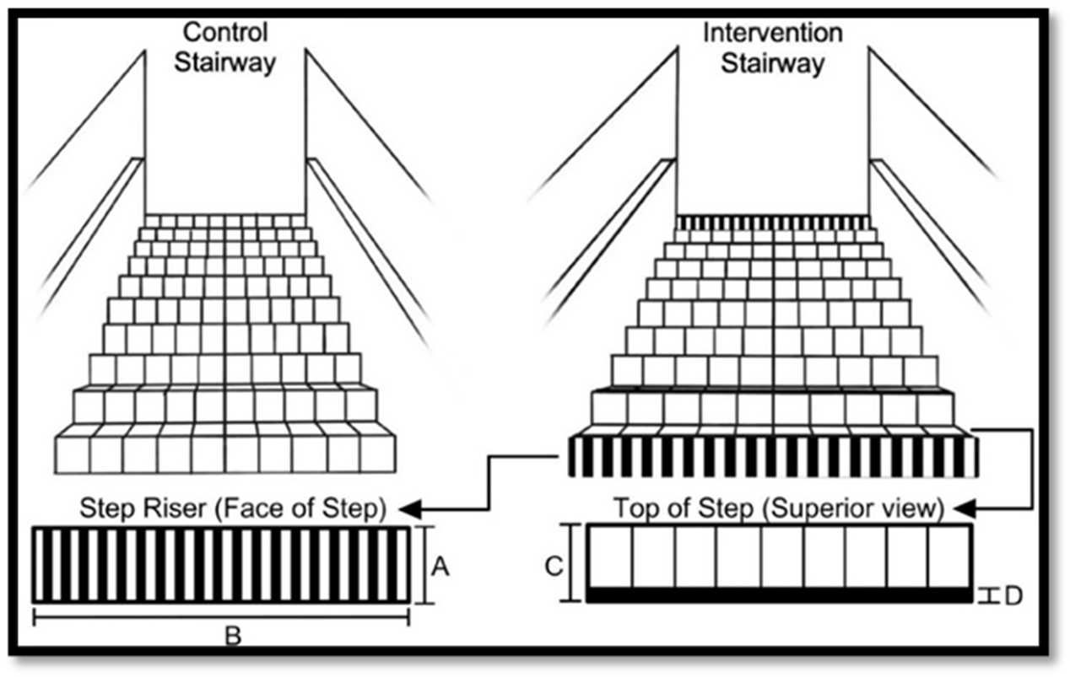
Stairs Research - Observational
Visual contrast in the real-world?
Fall-related events were reduced for the striped (visual contrast) stairway compared to the control stairway (4)
Illustration of control vs. stair high-contrast markings intervention
Notes:
So here we introduce the idea of visual contrast. In an observational study where participants were viewed from two different stairways. From this we know that there is a clear incentive into exploring stair contrast, tread, and how it impacts movement. From here we need to develop a method of study/testing

Slide 5
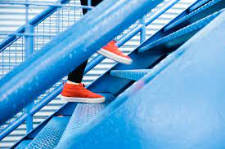
A Promising Intervention
Contrast markings increases likelihood of improved foot clearance, manipulating individuals' perception
Improve stairway navigation (e.g., low-vision)
Requires physical changes, impacting reproducibility
Affects friction, practicality, consistency
Notes:
If we are truly going to inform proper standards such as building codes and uniformity, we need a way to reliably produce conditions and measure the effectiveness of contrast. Impacts our ability to consistently place the tape, could affect the consistency of delivering the intervention, and it takes time to place the tape.

Slide 6
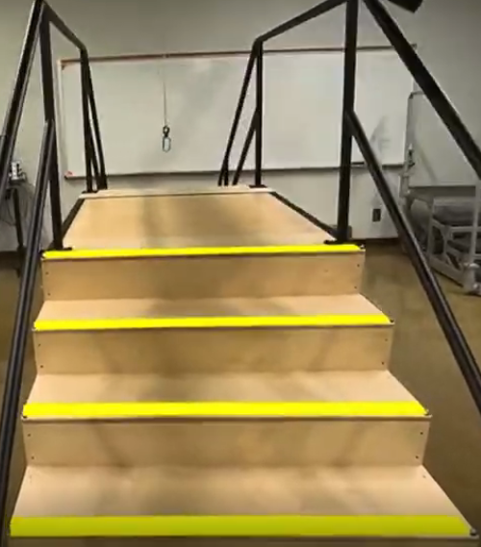
The Approach
Augmented Reality (AR) to provide contrast markings
Using Meta Quest 3/Unity-built program, retrofitting stairs with AR contrast markers
Assess individuals’ gait and responses to contrast markings
Notes:
Our solution to the issue of reliability is introducing Augmented Reality to provide the contrast marking. We have built a system that involves retrofitting stairs with AR markers, and then studying the effect of this contrast on individuals, stairway navigation, and their gait. In this way, we can avoid making a physical alteration, eliminating the cumbersome nature of placing physical tape.

Slide 7
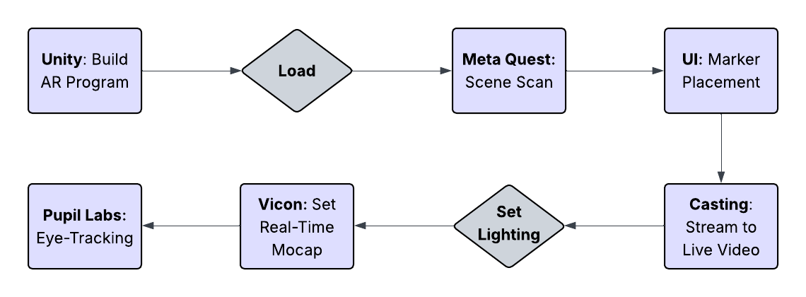
System Breakdown
Notes:
So just to define the system, we use the Unity development software to build the AR program. This is loaded into the Meta Quest, our designated delivery platform. From where, we also provide a scene scan, or a room scan in the Quest to load in the stair environment. Then, through a UI setup, the AR markers

Slide 8
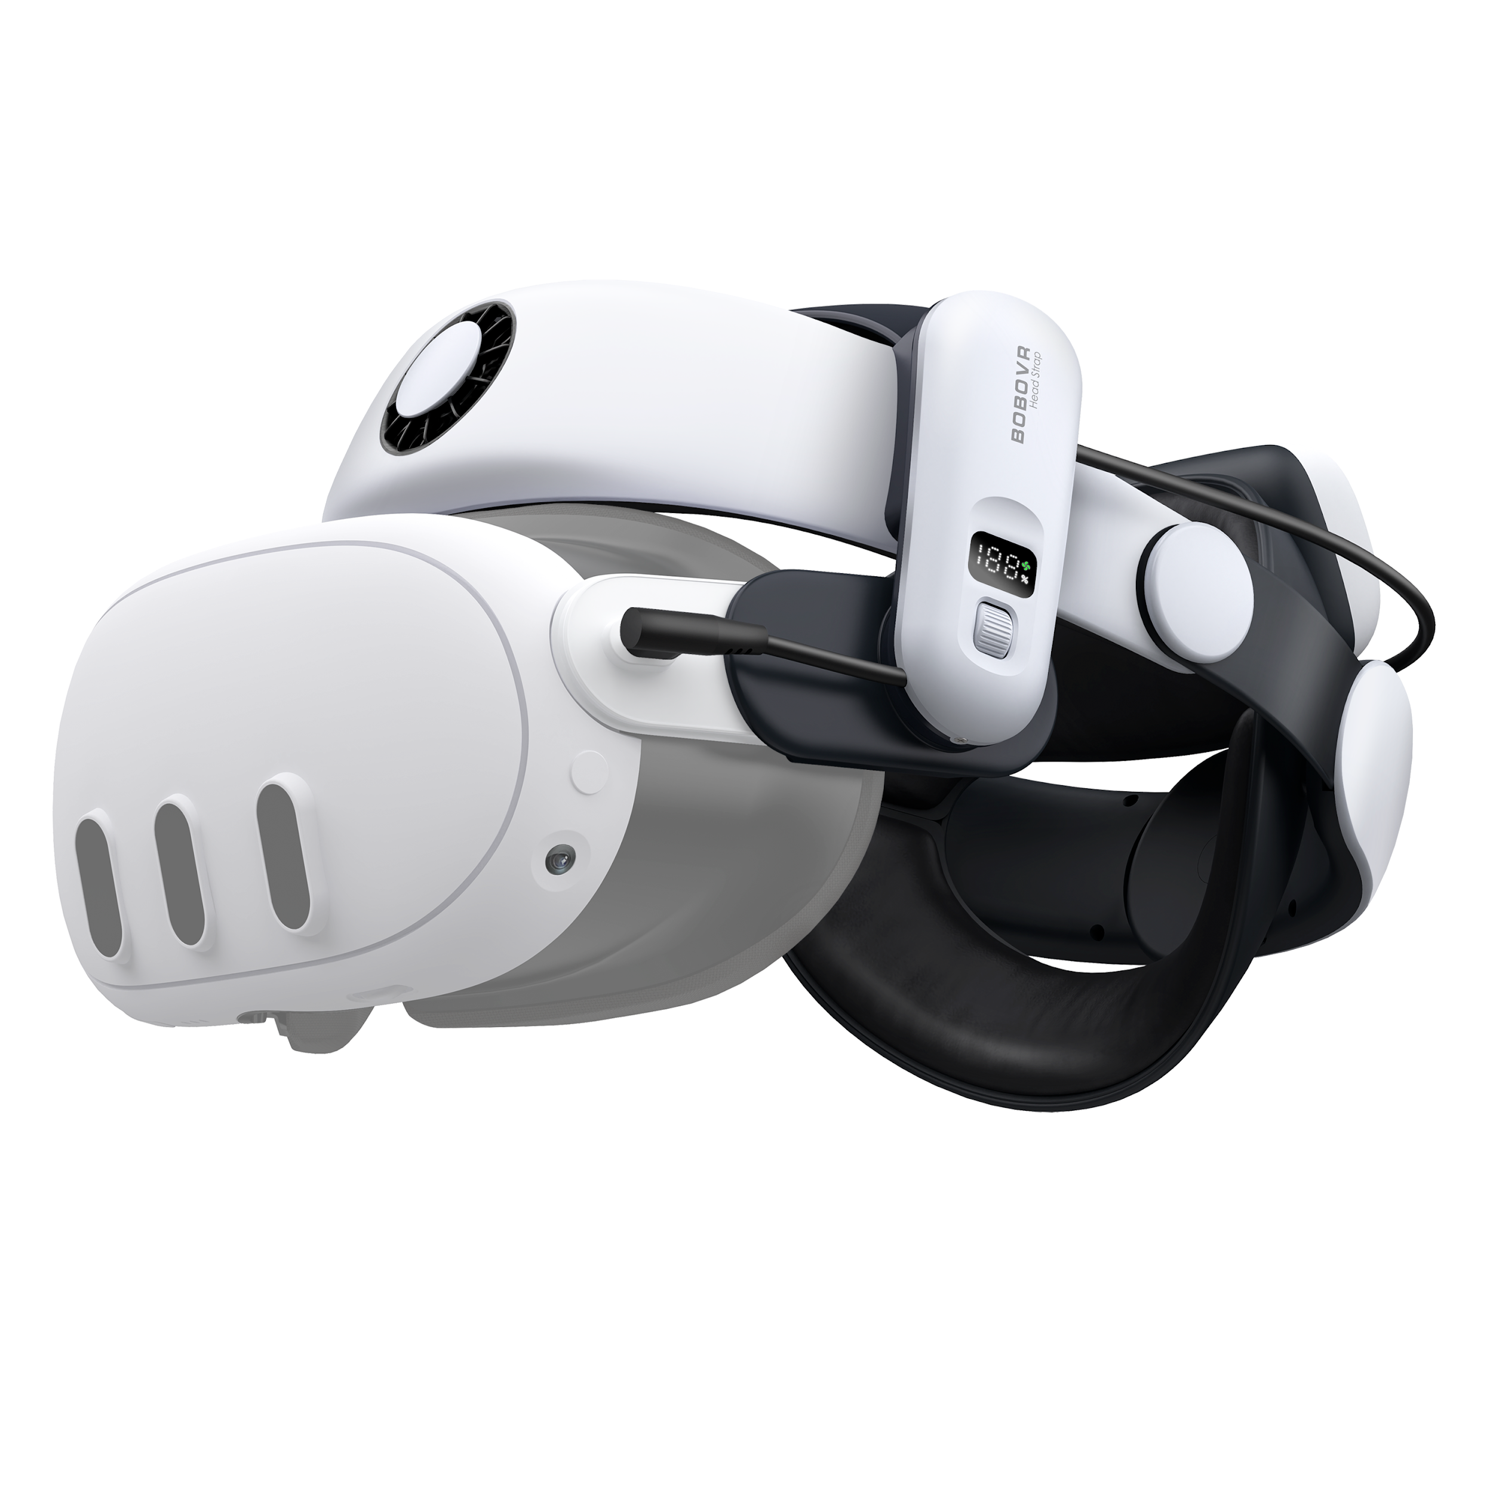
Meta Quest 3
This product was designated as the chosen delivery platform for the program
  Integrated software libraries → quicker development
  Passthrough/Efficient Performance in mixed reality
  Accessibility and Usability
  Cost
Limitations:
  Bulky
  Field of View
  One size doesn’t fit all
Notes:
Give information about why we chose the Meta Quest 3 and its specific advantages/disadvantages, bring up BOBO VR extensions

Slide 9

Unity
Large-scale documentation and features pre-built for AR
Interfaces well with the Meta environment
Relatively Easy to Get Started
C# code base is much faster to write and modify
Notes:
Talk about why Unity, what makes this platform viable, and the means for which it is integrated into the overall system, and the reliability aspect of C#

Slide 10
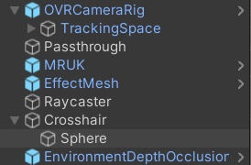
Meta Features
Meta plugins in Unity interface directly with the Quest build
  Meta Reality Utility Kit → loads the scene environment
  OVRCameraRig → tracks headset in a space
  Effect Mesh → construct AR elements
  Passthrough → Enable AR space
Plugins enabled a much quicker turnaround time

Slide 11
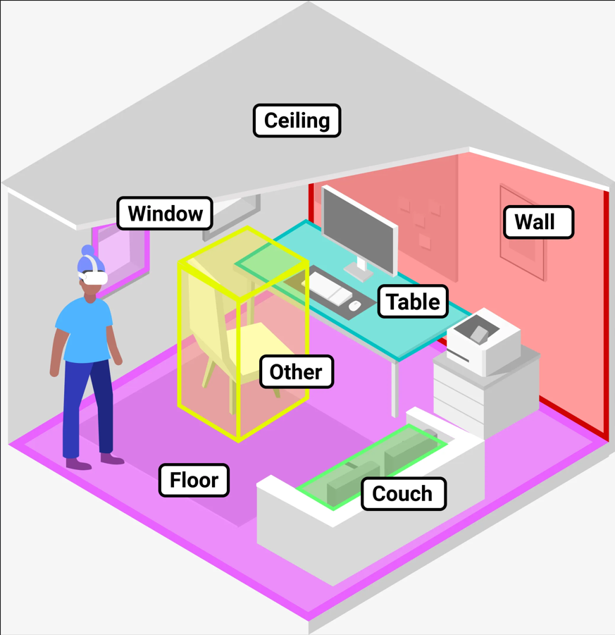
Environment Setup
Quest’s space setup tool
Quest overlays on the real environment by scanning the physical surroundings
Scan can be tuned and adjusted based on need
Required adding volumes manually (for stairs)
Notes:
So, we build out a scene in the headset using the scene scan feature. It tracks different elements of the room around the user, and detects objects and the overall layout of a space. Since we needed to load in a stair environment. Use for many

Slide 12
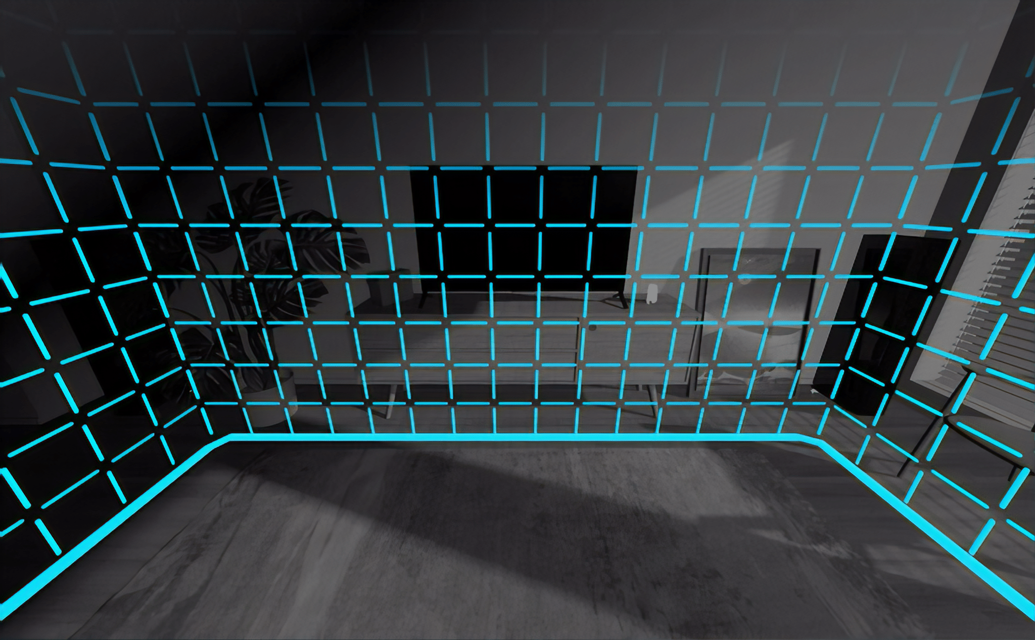
Boundary
Default setting is the stationary boundary
Quest ensures a “play area,” restricting range of user
Stepping out halts program, hindrance to AR markers
Manipulated by setting floor height and drawing room-scale
Notes:
Part of the process is setting the proper boundary for enough range and elevation of staircase. Meta was not built for staircase navigation, so by setting the floor condition higher than normal, we could get the full range of the stair case while in program.

Slide 13
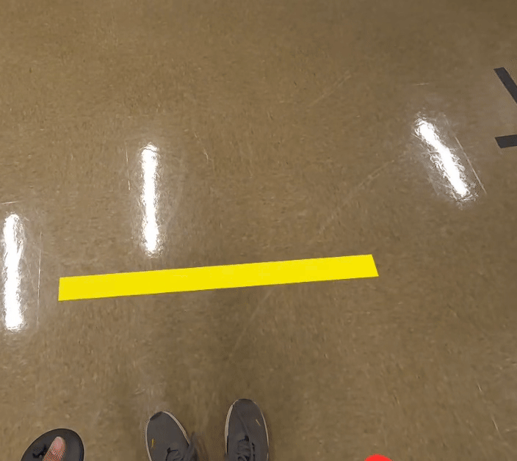
Occlusions
The program alone cannot detect obstructions to AR features
Depth manager triggers when individual’s feet cover AR markers
Hard/Soft Occlusion: more/less performance to strengthen the feature
Notes:
Slides 10, 11, 12 go over the way the scene is broken down and implemented in the headset

Slide 14
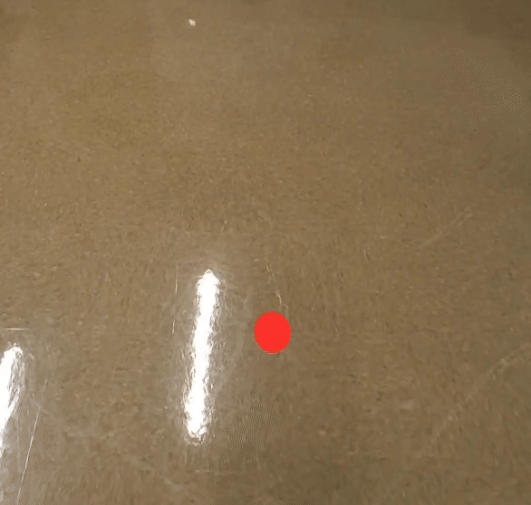
UI Elements
Crosshair for consistent marker placement
Controller-based inputs for testing purposes
Customizable Features:
  Dynamic placement
  Rotation and dragging
  Adjustable color/contrast
  Scaling along axes
- Real-time visualization

Slide 15
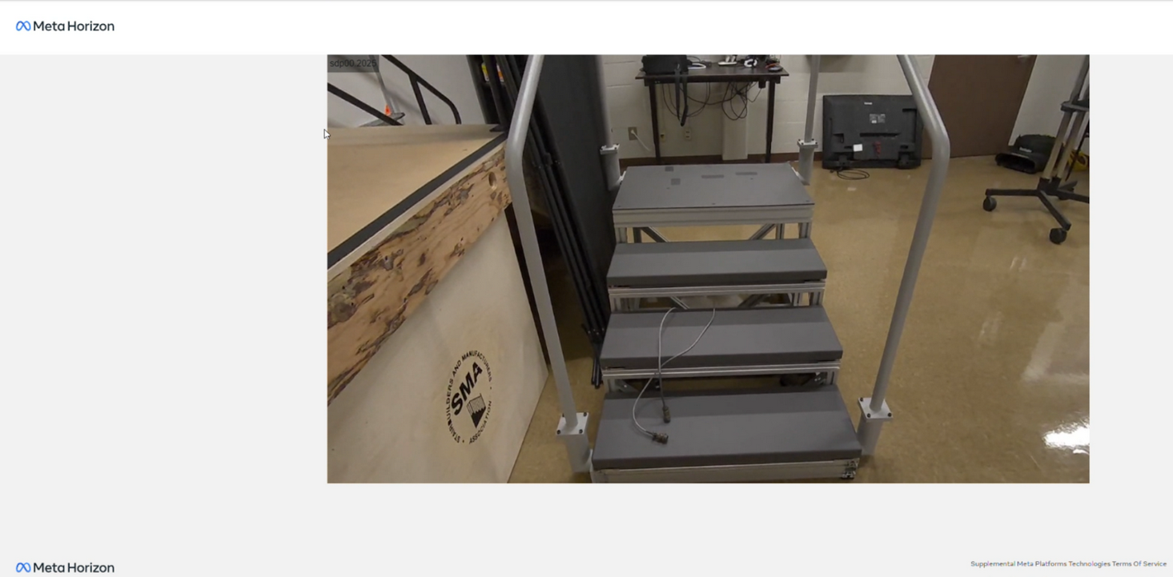
Real-Time Casting
Active monitoring of the system necessary to assess system viability
Via web, casting incorporated to view the AR perspective externally

Slide 16
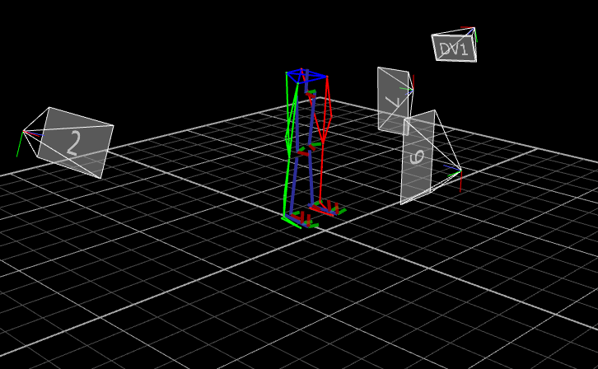
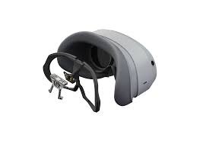
Eye-Tracking and Motion Capture
Vicon Motion Capture to assess foot clearance on stairsteps
Pupil Labs eye-tracker was used alongside the AR program to manipulate perception
Python script to sync time across devices/tools
Notes:
Talk about how these tools were another component of the overall study and how they fit with the overall program

Slide 17
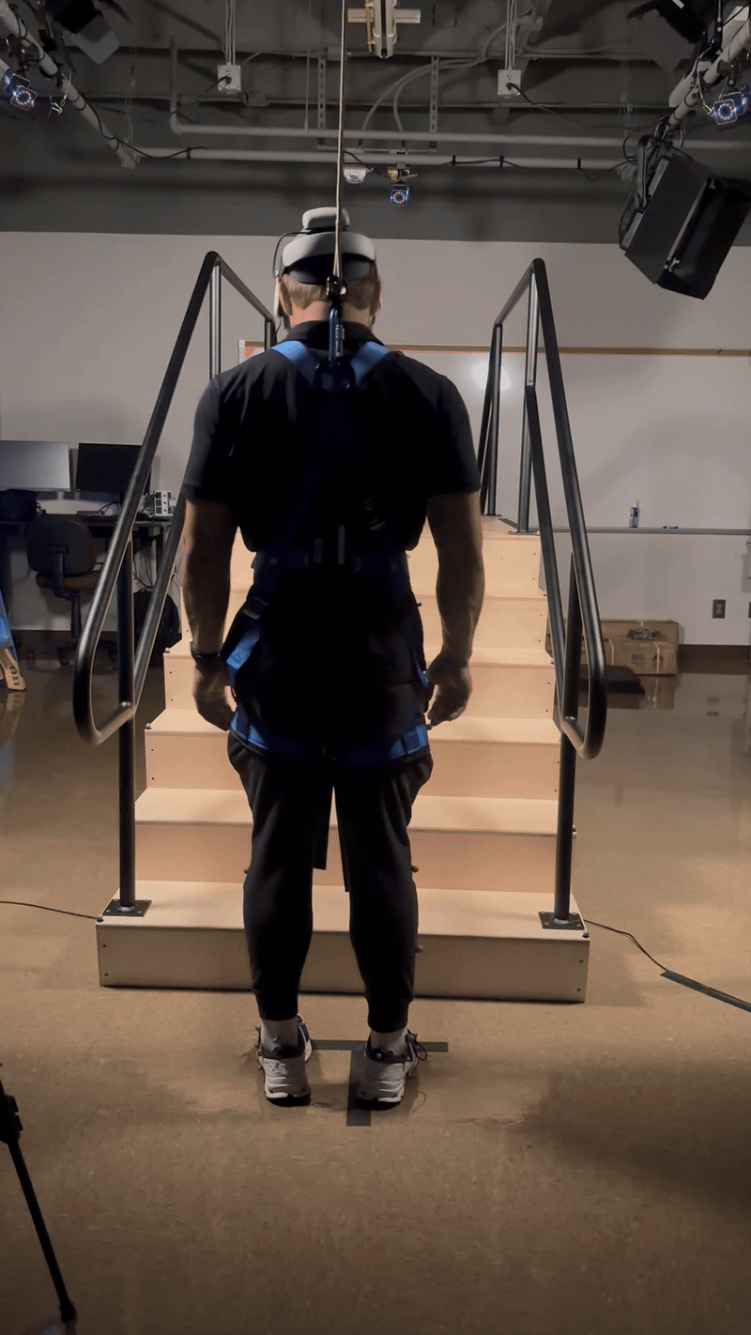
Methods
Program implemented as a setup tool in the stair-based navigation study
Conditions: (e.g., dark, grey, yellow, opaque markers) in low and standard lighting
Quantitative Results from mocap, eye tracking, and foot clearance
Notes:
Talk about how these tools were another component of the overall study and how they fit with the overall program

Slide 18
Future Considerations
Object/Stair Detection for automated placement of markers
Real-time adjustment based on user’s characteristics
Dynamic adjustment of contrast based on lighting condition
Uniform marker placement based on staircase
Cater to individuals’ specific vision needs
Notes:
Speak about some of the drawbacks of the current system and how it can be improved in future iterations going forward; Emphaisze that this is a preliminary measure. User's Charactersitics: Height, Vision, Demographic, etc; Uniform Placement: Markers can adjust to different staircases while still providing same baseline tread edge

Slide 19
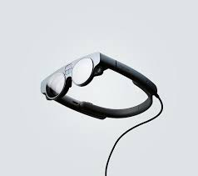
Magic Leap 2
Possible alternative to the Meta Quest 3
Lightweight and comfort fitting to the individuals’ heads
More expensive, but includes more advanced software plugins
Able to provide specific prescriptions based on individual’s vision needs
Notes:
This can be brought up as a future consideration and future validation item, Meta Ray-Ban

Slide 20

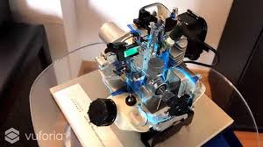
Vuforia AR Engine
Hypothetical step forward towards object detection and improving the system
Initially a proposed solution, but eventually scrapped for optimization concerns
Introduces an important consideration towards autonomy of the system
May eliminate need for manual marker placement
Notes:
Might talk about how it was an initial proposed solution, scrapped due to optimization issues, but could be used if improved

Slide 21
Acknowledgements
Thank You to University of Alabama In Huntsville Charger and Robotics Lab (CRABLAB) and HARPER Lab for supplying equipment, tools, and space for development
Funding
Grant support provided by the Human Factors and Ergonomics Society; University of Alabama in Huntsville Research or Creative Experience for Undergraduates

Slide 22

Thank You!

Slide 23
References
(1): Blazewick DH, Chounthirath T, Hodges NL, Collins CL, Smith GA. Stair-related injuries treated in United States emergency departments. Am J Emerg Med. 2018;36(4):608-14. Epub 2017/09/28. doi: 10.1016/j.ajem.2017.09.034. PubMed PMID: 28947224.
(2): Kingston JT. Visual Impairment and Falls: Outcomes of Two Fall Risk Assessments after a Four-Week Fall Prevention Program. Journal of Visual Impairment & Blindness. 2018;112(4):411-5. doi: 10.1177/0145482X1811200408.
(3): Killeen OJ, De Lott LB, Zhou Y, Hu M, Rein D, Reed N, Swenor BK, Ehrlich JR. Population Prevalence of Vision Impairment in US Adults 71 Years and Older: The National Health and Aging Trends Study. JAMA Ophthalmology. 2023. doi: 10.1001/jamaophthalmol.2022.5840.
(4): Harper, Sara A, Brown, Chayston B, Dakin, Christopher J. Real-World Stairways: Need for Visual Contrast Enhancements to Mitigate the Hazards of Variable Step Geometry
(5): Mixed Reality Utility Kit Documentation: https://developers.meta.com/horizon/documentation/spatial-sdk/spatial-sdk-mruk/
(6): Barnes, Emma L, Harper, Sara A. Step By Step: Enhancing Stair Use with Augmented Reality Cues. 2025

Slide 24
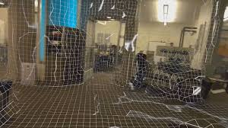
Transferability
System is designed with versatility in mind
Program can be used with multiple staircases/environments given room scan
Customization fosters interventions

Slide 25
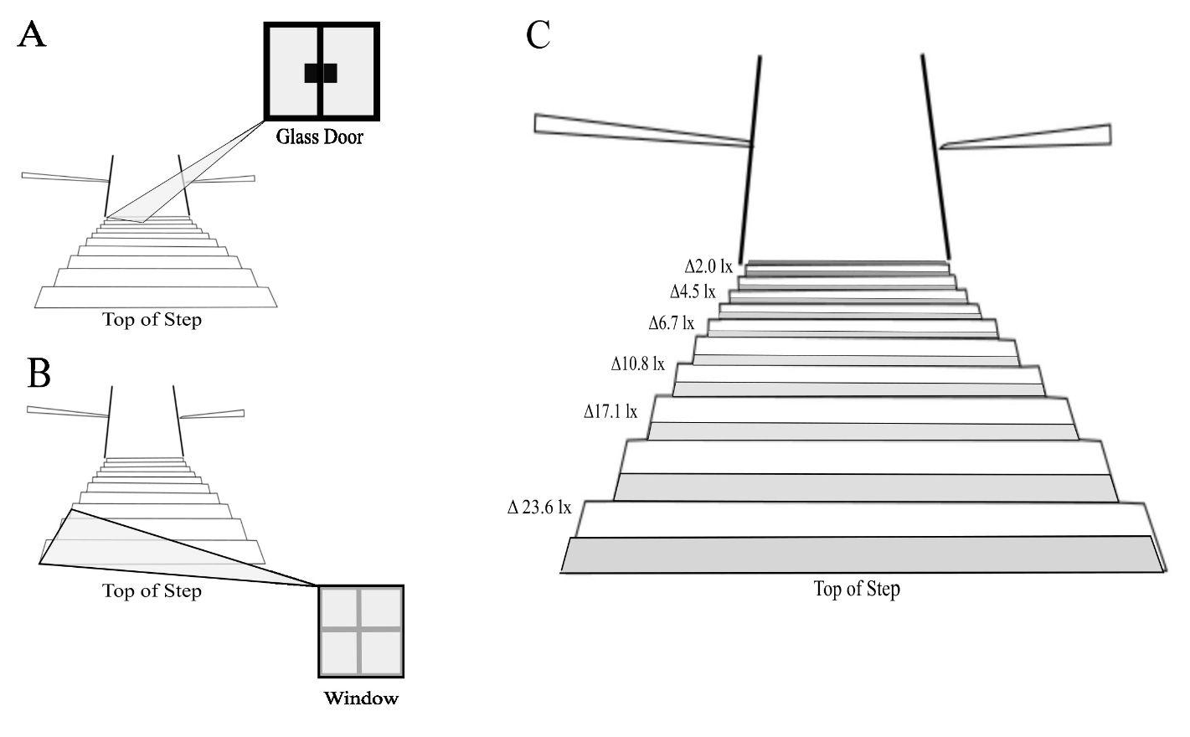
Stairs Research - Observational
Visual contrast + descending gait speed
Descending gait speed was significantly slower on the intervention stairway (Linear mixed effects model: standardised coefficient = −0.07, 95% CI = [−0.12, −0.02], p = .010) compared to the control and may be impacted by illuminance.
Slowed gait speed could be due to changes in gait kinematics (e.g. foot clearance) and may reduce fall-risk.

Slide 26
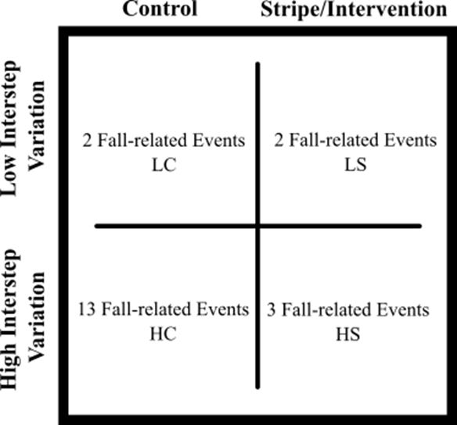
Stairs Research - Observational
Inter-step variations and visual contrast
The flights that had 14 mm in inter-step riser height variation and 38 mm in inter-step depth variation were associated with 80% of the fall-related events observed.
For stairs with high variability in step dimensions, 13 of 16 (81%) fall-related events occurred on the control stairway (no striping) compared to 3 of 16 (19%) on the high-contrast striping stairway.
Monte Carlo simulation - conditions likely did not occur by chance, with probability = 0.0358.

