Slide 1
AI and the Future of Reliability Engineering in Sustainment
A look into the future and how AI is changing Reliability Engineering

Slide 2
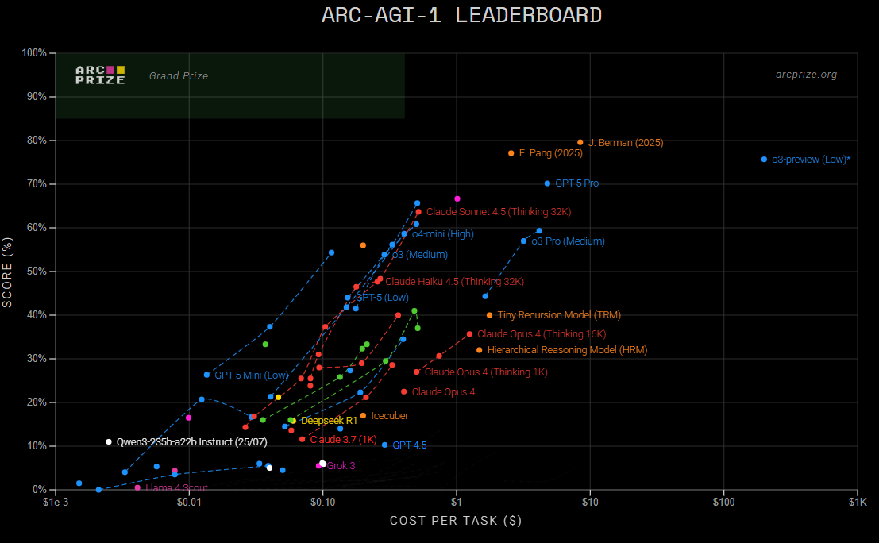
The Changing Landscape
AI Is getting smaller, smarter, and faster.
Deploying thinking models that make critical decision at the edge is no longer a dream, its reality.
https://arcprize.org/leaboard
Notes:
Talk about TRM and how smaller models are now outperforming massively scaled models.
Also talk about Apriel – 15b – thinker

Slide 3

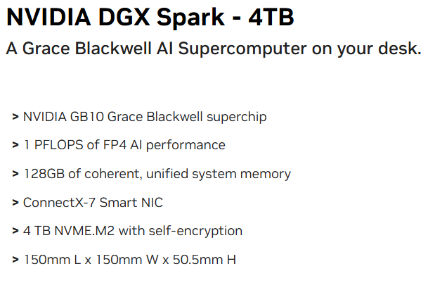
The Changing Landscape
Compute is getting cheaper and more efficient
This can train/deploy a 200B parameter model.
It consumes 700W max.
https://marketplace.nvidia.com/en-us/developer/dgx-spark/
Notes:
Talk about the DGX mini and the AGX series compute and how the combination of these smaller compute hardware combine with smaller models to make more effective agents.

Slide 4






The Rise of Agentics
Agentic workflows are dominating the consumer market
The DoD will be no different
AI will not only handle the heavy data lifting, it will be assisting in planning, documenting, and executing missions
These large agentic systems require Reliability
Notes:
Talk about the compute stack and how there are really three entities for agentics. UI, LLM, MCP

Slide 5
Powerful Agentic Workflows
Notes:
The Plan-Act agentic framework is an architectural pattern for AI systems that enables autonomous, goal-oriented behavior by systematically separating high-level strategy generation from low-level action execution. This approach allows agents to tackle complex, multi-step tasks more effectively and reliably than traditional AI models.

Slide 6
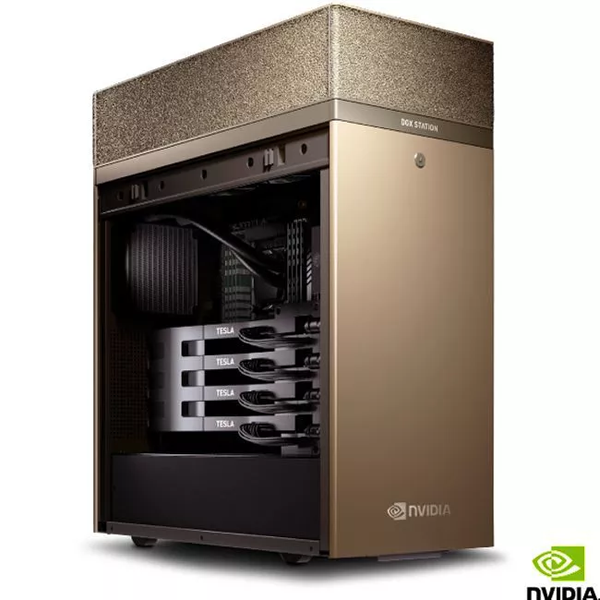

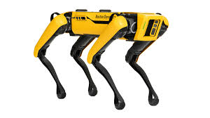

The Three Computer Solution
DGX
Training
OVX
Simulation
AGX
Autonomy
Notes:
Talk about the combination of these three entities and how they make the learning cycle for AI complete.

Slide 7

Simulation for Measuring Decision Reliability
To understand the performance of an agentic system we need to be able to simulate its actions in scenarios millions of times.
This process can be combined with reinforcement learning to improve its performance.
Notes:
Talk about in the field use cases of AI using simulation to play out scenarios to stochastically determine what to expect next or what actions to take to increase the chances of success.

Slide 8

Faster than Real Time
Genesis is a physics simulation that is 430000 times faster than reality
In this simulation an agent can learn faster than reality and it can plan and play out hundreds of thousands of scenarios
This is the new HALT for AI
https://genesis-embodied-ai.github.io/
Notes:
Talk about how faster than real time increases the sample size of possible simulations and contributes to the overall distribution of what can be known for AI.

Slide 9
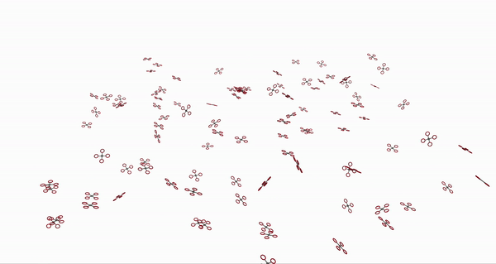
Devices are learning faster
Platforms will learn hundreds of times faster than humans
They will optimize their decision making just as fast. Optimizing mission success and mission reliability.
https://github.com/arplaboratory/learning-to-fly

Slide 10
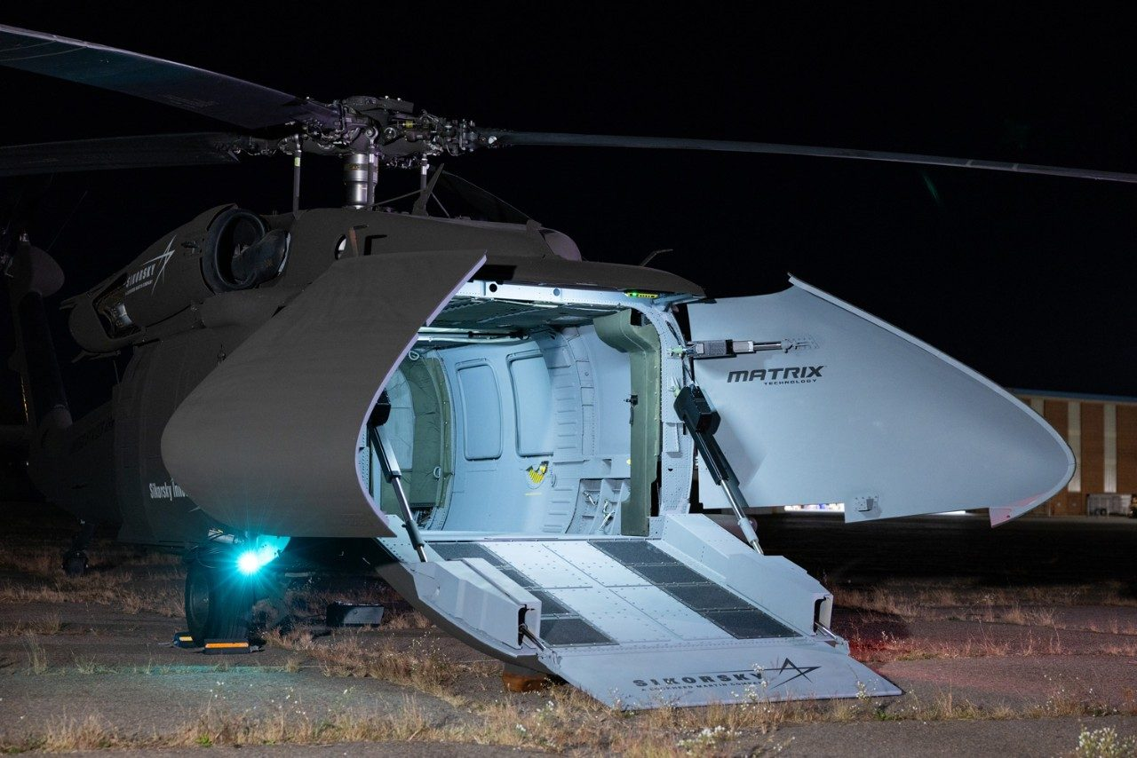
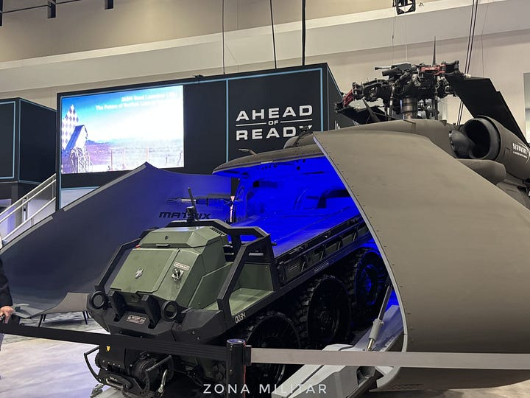
Agentics and Autonomy
Large autonomous systems will carry the heavy compute for forward deployed networks
Smaller autonomous systems will gather data and perform independent and swarmed behaviors in the field
Notes:
Talk about how agentics is tieing all of autonomy and AI together into a single networked decision making entity

Slide 11
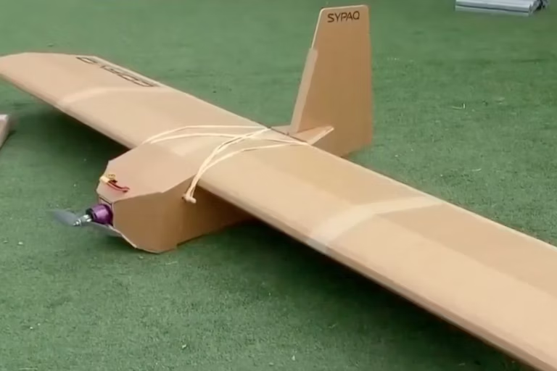
What NOT to think…
Drones don’t require reliability or sustainment…
Low purchase cost means low cost of ownership….
What we buy today we will use in the next 5 years….
https://theconversation.com/ukraine-war-australian-made-cardboard-drones-used-to-attack-russian-airfield-show-how-innovation-is-key-to-modern-warfare-212629

Slide 12
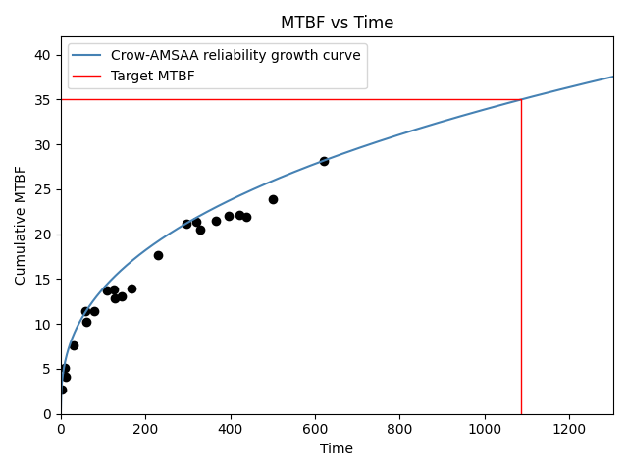
Reinforcement Learning and Reliability Growth
How will we ensure mission success?
Through classical reliability availability and maintainability practices
The reinforcement learning reward curve will be our new reliability growth curve
Notes:
Talk about the metrics and performance measures that are already in place that we can focus on to know that we are increasing the reliability of AI systems and talk about how we can use these as a format or a guide to measure growth of the systems over time and set metric thresholds.

Slide 13
Benchmarks
Establishing effective benchmarks will become the most important part of AI development
The metric defines the performance
Notes:
Talk about the importance of choosing the correct benchmarks and having a place to test AI and prove its value on unseen test data.

Slide 14
Agentics on a Spark

Slide 15

Questions?

