Slide 1
Improving UAV Autonomy for Search & Rescue
Presented by Jamie Roberson
On behalf of the SAPIENCE team: Jamie Roberson, Hailey Hicks, Jackson Neese, Brandon Rostenbach, David Sharpe, Joey Schwalb, Dr. Howard Chen, Dr. Bryan Mesmer

Slide 2
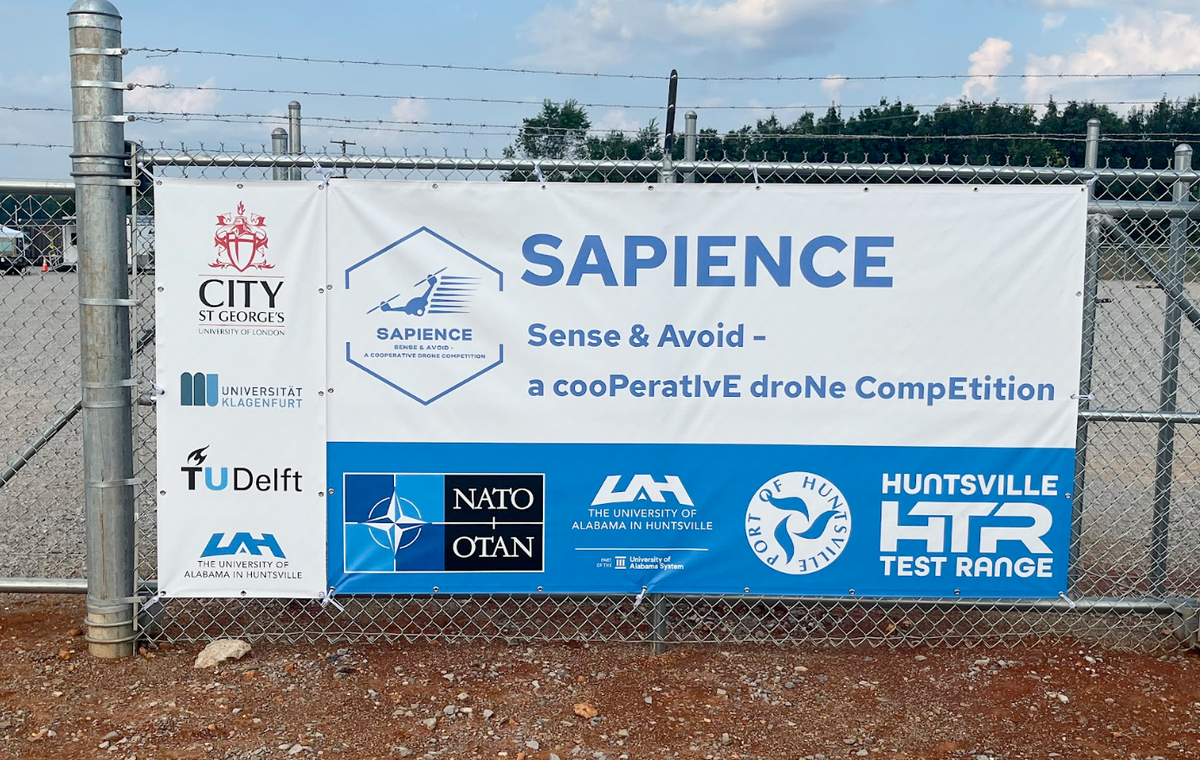
SAPIENCE Overview
SAPIENCE is a program sponsored by the NATO SPS (Science for Peace and Security) Program
Primary focuses:
Search & Rescue
Perception Autonomy
Cooperative Drone Swarms
Includes 3 competitions including 4 universities
Previous competition was held here in Huntsville recently

Slide 3
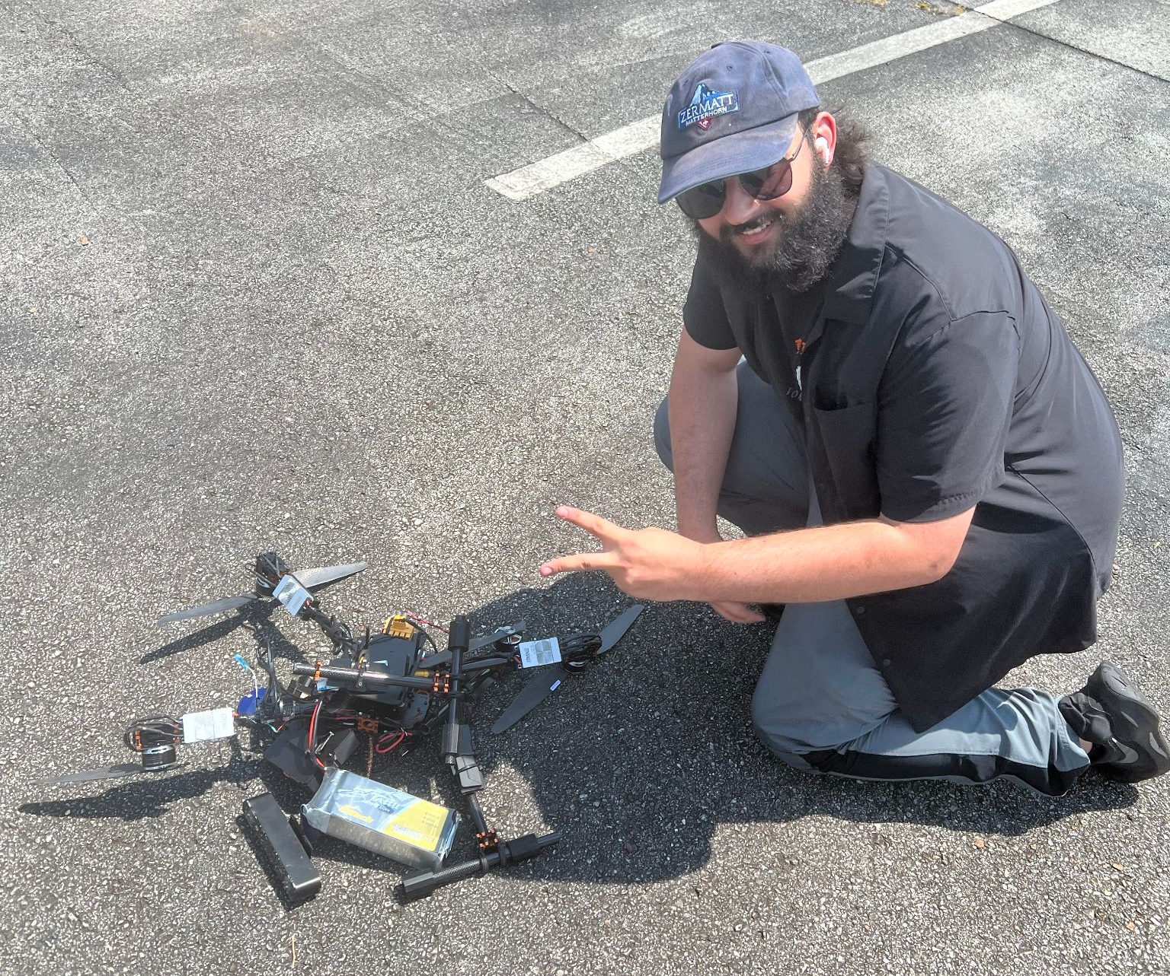
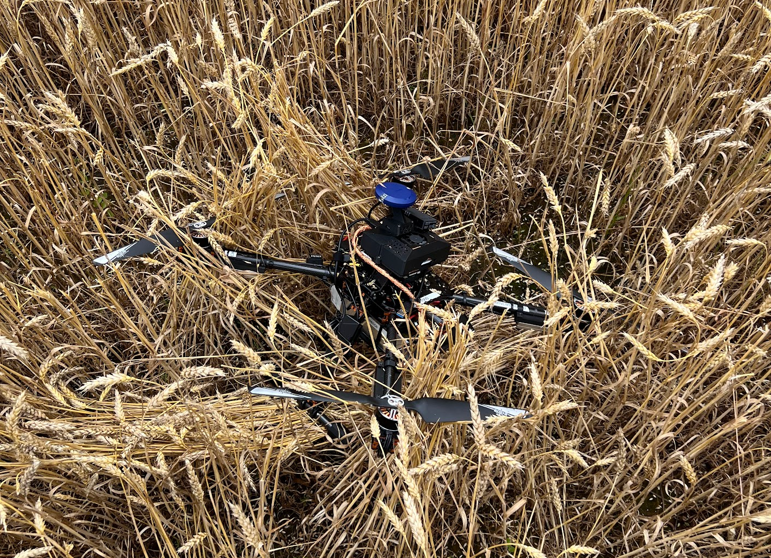
The Need For Reliability
Next competition is in the Netherlands in March 2026
Little time for development and high transport cost
Autonomous systems are highly complex
One small error can cascade
6 person team comprised of only students
Large errors can be costly for both time and money
Drone crash can set us back weeks
Money is a limited resource; we can’t buy the best sensors
Two main approaches to get reliability: design and management

Slide 4
Designing for Reliability

Slide 5

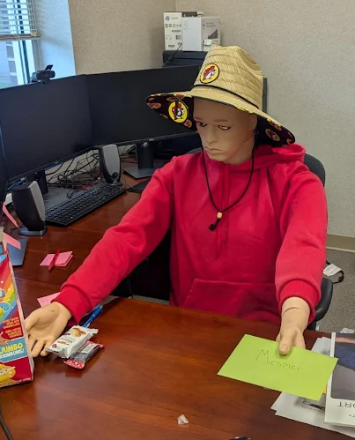
What We Know About Competition 3
GPS-denied arena
GPS only to be used as a backup
Hybrid indoor-outdoor scenario
Need to fly in and out of buildings
Collaborative swarming
Delft, Netherlands in March – weather is pretty cold (30-50℉)
Need to plan to bring everything and spares to competition
Likely need to be able to map and detect people (based on previous competitions)

Slide 6
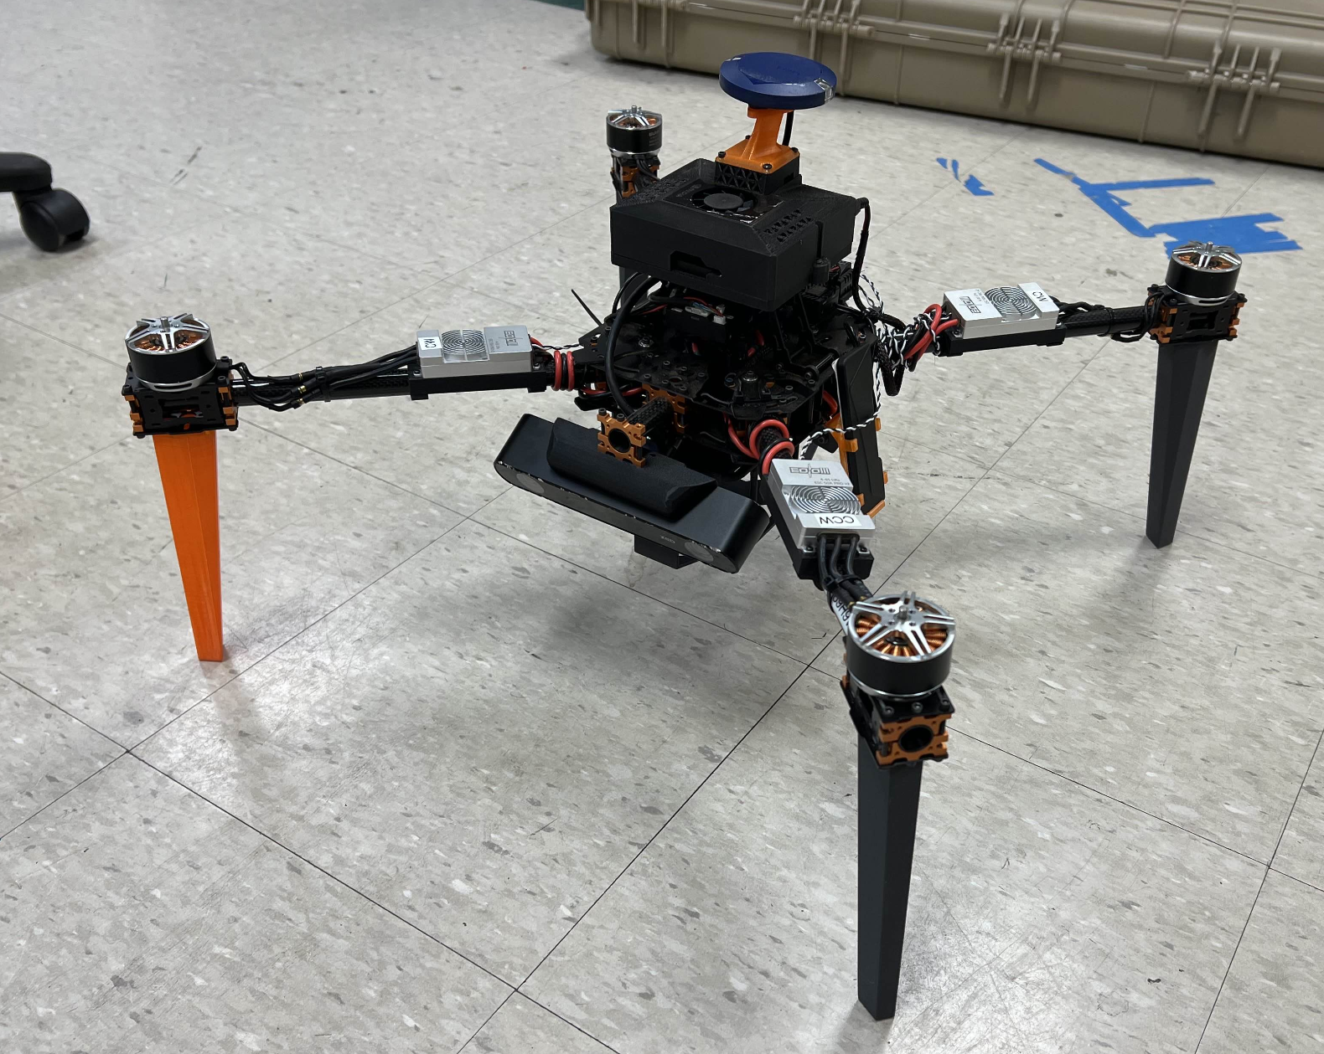
Hardware & Sensors
Plug & play parts
Need to be able to support multiple configurations (LiDAR and Visual)
Wire harnesses
Flight testing every two weeks to ensure hardware issues are noticed and improved quickly
Herelink Controller with visual display to understand what is happening and display errors

Slide 7
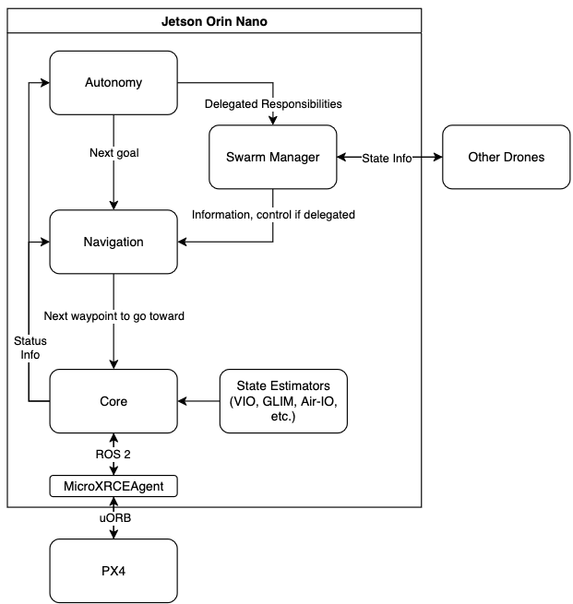
Software Design (1/2)
Division of responsibilities
Core - standardises interfaces with our Pixhawk FMU
Navigation - handles path planning and avoidance
Autonomy - handles decision making toward mission objectives
Swarm Manager - handles swarming and position transforms

Slide 8
Software Design (2/2)
Design allows for unit testing of components and integration testing
Microservice-like architecture comes with the benefits of scalability and resilience
Safety mechanisms (like taking manual control or falling back on GPS position) built into autonomy system

Slide 9

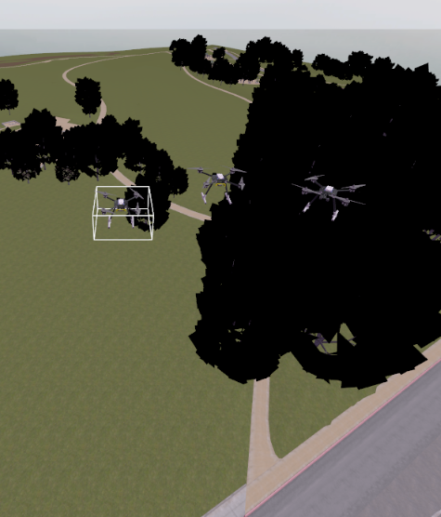
Testing Software Before Deployment
Gazebo: simulation environment for ROS 2 that allows us to test code before deployment
Not 100% accurate, but good enough for testing logic and debugging
Gazebo has plugins that emulate Pixhawk flight hardware for our testing
If code is deemed stable via Gazebo testing, time to put it on a drone

Slide 10


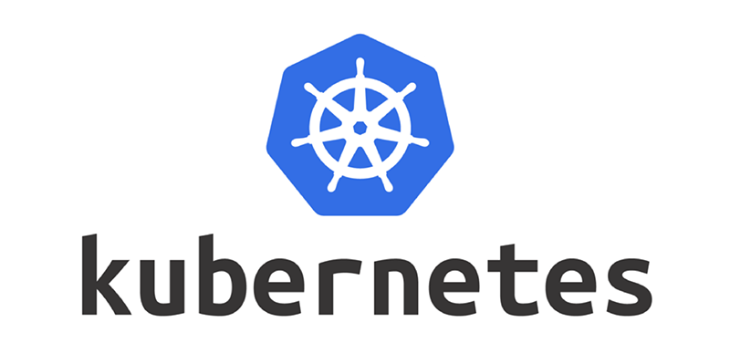
Deploying Software
Components run in ROS 2 middleware
Each component runs in Docker containers
Code should work the same as when it was in Gazebo
Deployed to each drone via Kubernetes
Provides monitoring tools, self-healing, resource management, etc.
Discrete control of what runs on each drone
Command line tool called skynet
Abstracts away Kubernetes and Docker details
Allows us to run the swarm with a single command
Monitor everything via a single command

Slide 11
Managing a Team

Slide 12
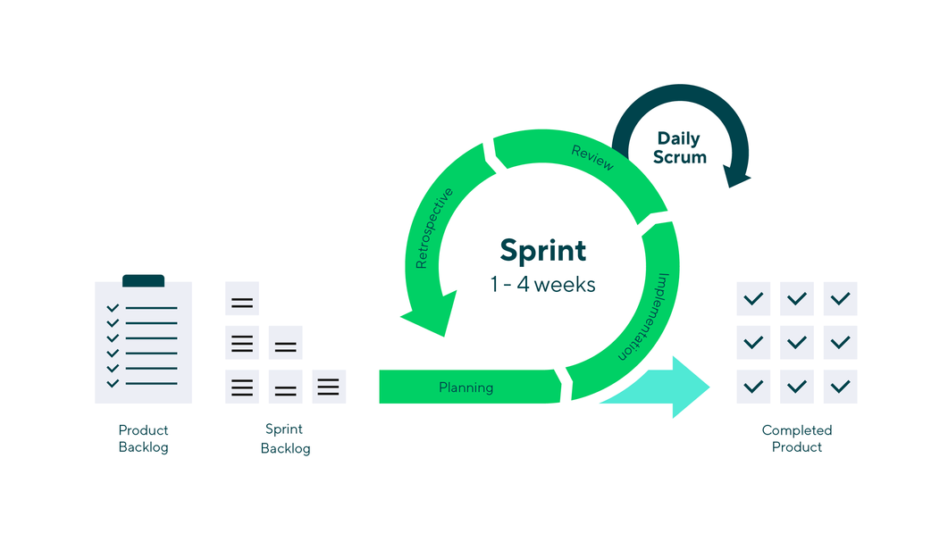
Planning for Time
Big goal off in the distant future: how do we get there? Biweekly testing events
Testing events take at least a day of preparation and a day of completion
Time and effort to schedule and execute flights
Keep meeting short; approx. 1 hour a week
Monthly progress update meeting at the end of month; high level overview of progress

Slide 13
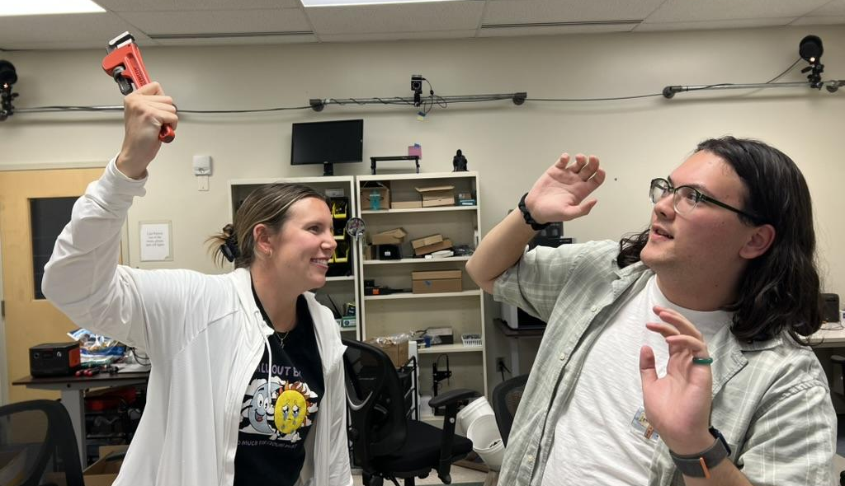
Managing People
Team meetings provide consistent line of communication
Constant testing events allow for people to know what to do imminently
With how complex the project is, someone needs to be able to organise all the work – Systems Engineering
Make sure deadlines are met & systems integrate
Handles administrative tasks
Develops testing plan and handles logistics
Keeps everyone in order

Slide 14
Conclusion

Slide 15
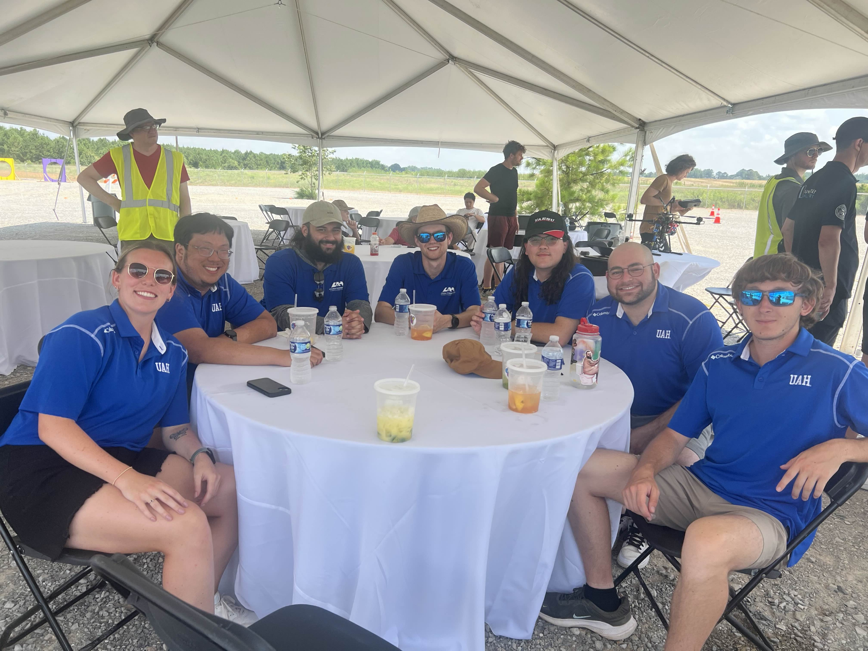
Lessons Learned from Competition 2
Consistent test flights with proper planning was incredibly useful
Every two weeks at minimum for the rate of our development
Setting clear short-term and long-term goals combined with systems engineering helped
Creating a modular autonomous navigation framework helps when mission objectives change
As a result, we went from not finishing Competition 1 to getting 2nd in Competition 2

Slide 16
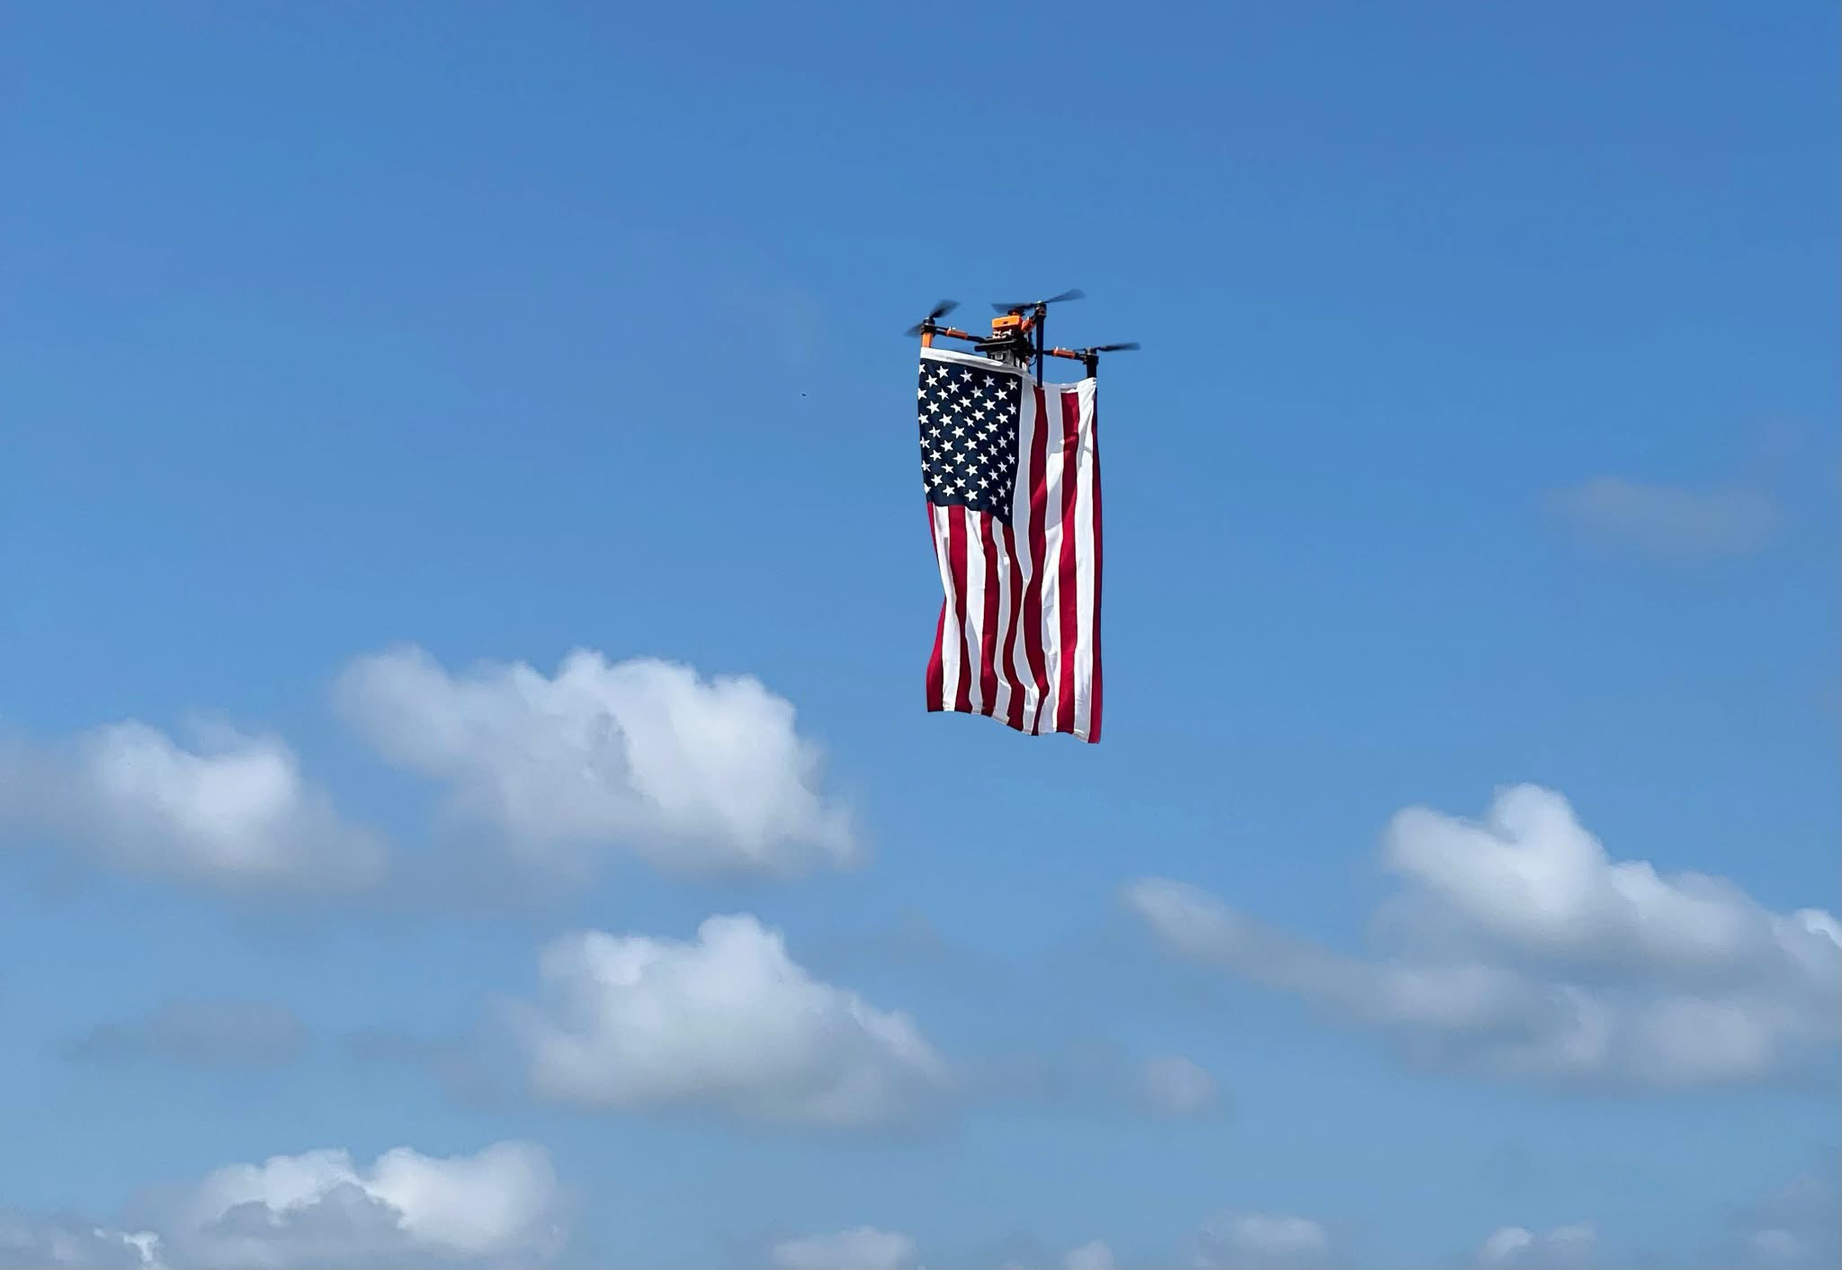


Partnerships
UAH CRABLAB (Dr. Chen)
Development space, technical knowledge on robotics
UAH RSESC/A2R
Technical knowledge, outdoor testing space, Part 107 pilots
Huntsville Test Range
Outdoor testing space

Slide 17
Questions?

