Slide 1
An overview of Reliability Engineering
Tools and techniques
Fayssal M. Safie, Ph. D.,
A-P-T Research, Inc.
RAM XVII Workshop Tutorial
Huntsville, Alabama
November 5-6, 2025

Slide 2
Introduction
This tutorial is a brief summary of a three-day reliability engineering course offered by A-P-T Research, Inc.
The course is intended to provide a better understanding of reliability engineering as a discipline with focus on the reliability analysis tools and techniques and their application in technical assessments and special studies.
The material in the course is based on over 30 years of extensive industry and Government experience in reliability engineering and risk assessment.
For offerings, contact: Heather Danial, 256-327-3373,
training@apt-research.com.
Note: Attendees of the full course will be credited with 2.0 Continuing Education Units (CEU).

Slide 3
Table of Contents
This tutorial covers in details sections shown in blue.
Introduction
Probability Basics
Reliability Engineering Overview
Reliability Allocation
Reliability Prediction
Reliability Demonstration
Failure Modes and Effects Analysis (FMEA)
Reliability Growth
Fault Tree Analysis (FTA)
Event Tree Analysis (ETA)
Probabilistic Risk Assessment (PRA)
Human Reliability – Understanding Operator Error
Availability Analysis
Accelerated Testing
Parts Derating
Sneak Circuit Analysis
Concluding Remarks
Summary Tables

Slide 4
SEAC Courses
System Safety
Software System Safety
Explosives Safety
Launch Safety (inactive)
Risk Management
Reliability Engineering
Probabilistic Risk Assessment (PRA)

Slide 5
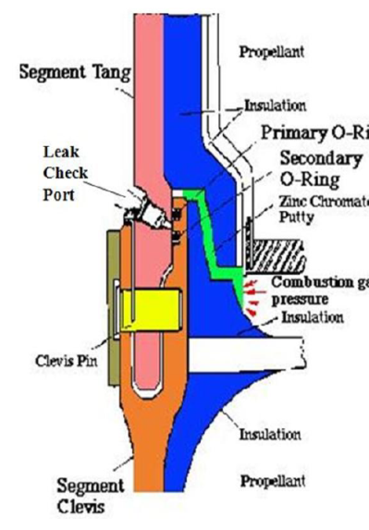
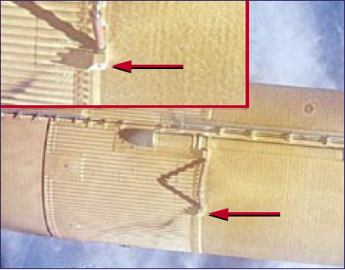
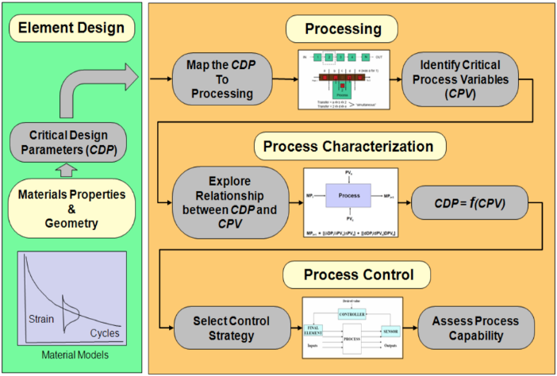
Reliability Engineering Overview
Design
Reliability
Process
Reliability

Slide 6
Definitions
Reliability Engineering is the engineering discipline that deals with how to design, produce, ensure, and assure reliable products to meet pre-defined product functional requirements.
Reliability Metric is the probability that a system or component performs its intended functions under specified operating conditions for a specified period of time. Other measures used: Mean Time Between Failures (MTBF), Mean Time to Failure (MTTF), Safety Factors, and Fault Tolerances, etc.
Operational Reliability Prediction is the process of quantitatively estimating the mission reliability for a system, subsystem, or component using both objective and subjective data.
Design Reliability Prediction is the process of predicting the reliability of a given design based on failure physics using statistical techniques and probabilistic engineering models.
Process Reliability is the process of mapping the design drivers in the manufacturing process to identify the process parameters critical to generate the material properties that meet the specs. A high process reliability is achieved by maintaining a uniform, capable, and controlled processes.
Reliability Demonstration is the process of quantitatively demonstrating certain reliability level (i.e., comfort level) using objective data at the level intended for demonstration.
Notes:
6

Slide 7
Why Reliability Engineering
Reliability engineering is a design-support discipline.
Reliability engineering is critical for understanding component failure mechanisms and identifying critical design and process drivers.
Reliability engineering has important interfaces with, and input to, design engineering, maintainability and supportability engineering, test and evaluation, risk assessment, risk management, system safety, sustainment cost, and quality engineering.

Slide 8
Selected Elements of
A Reliability Engineering Case
Reliability Program Management & Control
Reliability Program Plan
Contractors and Suppliers Monitoring
Reliability
Program Audits
Reliability
Progress Reports
Failure Review Processes
Process
Reliability
Reliability
Requirements
Selected Design
Reliability Elements
Identification of Design Reliability Drivers
Reliability Requirements Analysis
Failure Modes and Effects Analysis
Identification of Critical Process Parameters
Reliability Requirements Allocation
Probabilistic structural Design Analysis
Process Characterization
Reliability Prediction
Human Reliability
Analysis
Process Uniformity
Reliability
Case
Accelerated Testing
Process Capability
Sneak Circuit Analysis
Process Control
Parts Derating
Process Monitoring
Reliability Testing
A comprehensive reliability program is essential to address the entire spectrum of engineering and programmatic concerns, from loss of function and loss of life to sustainment and system life cycle costs.

Slide 9

Design it Right and Build it Right
Design Reliability
Process Reliability
µ_{s}
µ_{S}
Notes:
“Design it right and Build it right”
The design part is mainly driven by the Loads and environment vs. capability. The process part is driven by process capability, process uniformity, and process control. This chart is a notional process chart where critical design parameters (on the left) are mapped in the process (on the right). The result is a set of critical process variables which are assessed for process capability, process uniformity, and process control.

Slide 10

Design Reliability
The Challenger Accident
Causes and
Contributing Factors
The zinc chromate putty frequently failed and permitted the gas to erode the primary O-rings.
The particular material used in the manufacture of the shuttle O-rings was the wrong material to use at low temperatures.
Elastomers become brittle at low temperatures.
Notes:
This is a schematic of a SRM field joint identifying the leak path of the combustion gas and how it would escape to the outside. Zinc chromate putty, added between the joint segments to protect the O-rings from high temperature and high pressure gases, frequently failed.

Slide 11


Process Reliability
The Columbia Accident
Causes and Contributing Factors
Breach in the Thermal Protection System caused by the left bipod ramp insulation foam striking the left wing leading edge.
There were large gaps in NASA’s knowledge about the foam.
Dissections of foam revealed subsurface flaws and defects as contributing to the loss of foam.
Notes:
In summary, we can trace the root cause of the Columbia accident to Physical and organizational causes. The physical cause was a breach in the Thermal Protection System caused by the left bipod ramp insulation foam striking the left wing leading edge.
Organizational Root Causes include:
Compromises that were required to gain approval for the Shuttle
Subsequent years of resource constraints
Fluctuating priorities
Schedule pressures
Mischaracterization of the Shuttle as operational rather than developmental
Lack of an agreed national vision for human space flight
Reliance on past success as a substitute for sound engineering practices
Organizational barriers that prevented effective communication of critical safety information and stifled professional differences of opinion
Lack of integrated management across program elements, and
The evolution of an informal chain of command and decision-making processes that operated outside the organization's rules.

Slide 12
Reliability Check List
The following is a partial reliability check list:
Design Reliability
  Do we understand the design drivers?
  Do we understand the design uncertainties?
  Do we understand the physics of failure?
  Do we understand the failure causes?
  Do we have the right design margins?
Process Reliability
  Is the process capable of building the tolerances?
  Do we have process uniformity?
  Do we have process control?
Reliability Analysis and Testing
  Have we done a timely FMEA consistent with design timeline?
  Do reliability predictions support the goals and requirements of the program?
  Have we done enough reliability testing and demonstration to support the design?
Systems Engineering
  Do we understand the requirements?
  Are we part of system integrated analysis environment?
Notes:
This chart shows a partial list of the major elements of a reliability check list

Slide 13
Reliability Metrics
There are many ways to measure and evaluate reliability. The following are the most commonly used across government and industry:
Mean Time Between Failures (MTBF)/
Mean Time to Failure (MTTF)
  MTBF is a basic measure of reliability for repairable items. MTBF is the expected value of time between two consecutive failures, for repairable systems
  MTTF is a basic measure of reliability for non-repairable systems. It is the mean time expected until the first failure.
Predicted Reliability Numbers
  Reliability prediction is the process of quantitatively estimating the reliability using both objective and subjective data (e.g. 0.99999).
Notes:
Summarize

Slide 14
Reliability Metrics (Continued)
Demonstrated reliability numbers
  Unlike reliability prediction, reliability demonstration is the process of quantitatively estimating the reliability of a system using objective data at the level intended for demonstration. In general, demonstrated reliability requirement is set at a lower level than predicted reliability. It is intended to demonstrate a comfort level with a lower reliability than the predicted reliability because of the cost involved (e.g., 0.99 with 90% confidence).
Safety factors
  Safety factor (SF) is a term describing the capability of a system beyond the expected loads or actual loads (e.g., safety factor of 2).
Fault tolerances
  Fault tolerance is the property that enables a system to continue operating properly in the event of the failure of some of its components (e.g., one fault tolerance means you can tolerate one failure and still operate successfully).
Notes:
Summarize

Slide 15
“How Reliable is Reliable Enough?”
In reliability engineering, no one likes things to fail. We don’t like bridges to collapse and we don’t like nuclear plants to leak radioactive material.
Engineers still have to address the question “How reliable is reliable enough?” Is it one in a thousand? One in ten thousands? One in a million?
The answer is: It depends. For example, “reliable enough” for a critical situation might mean a high safety factor (e.g., 2.0 or better), or high reliability (e.g., 0.999999 or better). For degraded performance, a lower safety factor or lower reliability might be acceptable.
For these reasons, engineers must design things to certain reliability specifications depending on the safety and economics of the situation, technology availability, and design constraints.
Notes:
Summarize

Slide 16
Reliability Relationship to other disciplines

Slide 17
Reliability Relationship To Maintainability, Supportability, and Affordability
A comprehensive reliability program is essential to address the entire spectrum of engineering and programmatic concerns, from loss of function and loss of life to sustainment and system life cycle costs.
Reliability
Maintainability
Supportability
Cost of logistics support & infrastructure
Failure
Identification and Analysis
Critical Items
Identification
Design Mitigation and Critical Process Control
Level of Repair
Spares
Facilities
Maintenance
Labor
Materials
Maintenance Support, etc.
Preventive Maintenance
Cost of preventive maintenance
Corrective Maintenance
Cost of corrective maintenance
AFFORDABILITY
Cost of loss
Failures
Loss of life/Mission/Space System, Stand Down, etc.
Cost of development testing, certification,
and sustaining engineering
Redesigns
Notes:
Reliability is a critical input for Availability and Affordability. Reliability analysis is critical for understanding component failure mechanisms and integrated system failures; and identifying reliability critical design and process drivers.
Reliability analysis and data feeds maintainability and engineering and improves design by identifying critical failures, reducing maintenance manpower needs, reducing lifecycle cost, and provides data essential for project management

Slide 18
Reliability Relationship to Life Cycle Cost
TOTAL COST OF
OWNERSHIP
Cost
Unscheduled
Maintenance
Purchase Price
Scheduled
Maintenance
Level of Reliability
Notes:
Note: an error in the program was discovered which draws these graphs. While a work around was available, it was thought that the student would benefit from reconstructing the graph.
How can cost be documented and how can improvement be shown?

Slide 19
Reliability Relationship to Safety
 | Reliability | Safety
Roles | To ensure the product functions successfully. | To ensure the product and environment are safe and hazard free.
Requirements | Design function specific within the function boundary. Internally imposed. | Non-function specific such as “no fire,” “no harm to human beings.” Externally imposed.
Approaches | Bottom-up and start from the component or system designs at hand. | Top-down and trace the top-level hazards to basic events, then link to the designs.
Analysis Boundaries | Focus on the component or sub-system being analyzed (assumes others are at as-designed and as-built conditions). Component interactions and external vulnerability and uncertainty are usually not addressed. | System view of hazards with multiple and interacting causes. External vulnerability and uncertainty may be required to be addressed.
  Safety and Reliability are unique but closely related —
  they complement each other and need to be integrated.
Notes:
This chart shows the difference and the relationship between reliability and safety. Safety and Reliability are unique but closely related — they complement each other and need to be integrated.
19

Slide 20
The Reliability - PRA Link
Design Reliability
(Based on Physics and Design and Test data)
Process Reliability
(Process Capability, Uniformity and Control)
Demonstrated Reliability
(Based on
Objective Data)
Operational Reliability
(based on objective and subjective data)
Surrogate Data, Test Data, Field Data, Generic Data
Bayesian Analysis
Probabilistic Risk Assessment

Slide 21
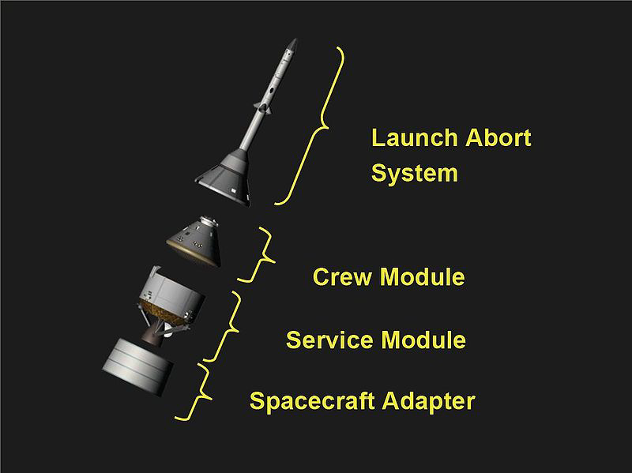
Reliability requirement Allocation

Slide 22
Reliability Allocation Definitions
Reliability allocation is the process of allocating the system reliability requirement or goal down to the subsystems level through apportionment.
In general, reliability allocation is intended to drive a process to improve the product reliability during the design development process through prediction down to the subsystem or component levels.
Note: Quantitative reliability requirements can be predicted, demonstrated, or both, depending on the objectives and the economics of the project or the program.
  Predicted reliability requirement calls for estimating the reliability using both objective and subjective data, where reliability prediction is performed to the lowest identified level of design for which data is available.
  Demonstrated reliability requirement calls for estimating the reliability of a system using objective data at the level intended for demonstration. Demonstrated reliability requirement is intended to provide empirical evidence of design reliability and can’t be allocated.
Notes:
Go over the content of the chart.
We all need to understand that reliability allocation is not a number game. Reliability allocation is intended to drive a process to improve the product reliability during the design development process through prediction down to the subsystem or component levels.

Slide 23

Reliability Allocation Process
Reliability allocation involves solving the following inequality:
$$f(R_{1},R_{2},…,R_{n})≥R_{s}$$
where:
R_{i} is the reliability allocated to the i^{th} subsystem/component.
f is the functional relationship between the subsystem/component and the system.
R_{s} is the required system reliability.
Notes:
Explain the general reliability allocation inequality.
It is basically allocating the system reliability R_{s} to the subsystems 1, 2, …, n in such a way that the subsystem reliabilities combined will be equal or exceeds the stated reliability requirement or goal.

Slide 24
Reliability Allocation Methods/Techniques
Several techniques have been used over the years for reliability allocation. Commonly used techniques are:
  The simplest technique is Equal Apportionment, which distributes system reliability equally among all the subsystems.
  The ARINC apportionment method designed by ARINC Research Corporation, a subsidiary of Aeronautical Radio, Inc (ARINC).
  The AGREE apportionment method, designed by the Advisory Group on Reliability of Electronic Equipment (AGREE)
Both the AGREE and ARINC techniques take additional weighting factors into consideration during allocation.
To obtain good results, it is important to choose an appropriate apportionment method based on the system reliability requirement and the system properties.
The following charts cover the Equal Apportionment and the ARINC
Methods. The AGREE method is included in the backup section.
Notes:
Several techniques have been used over the years for reliability allocation. In this module, we will address only three of these techniques.
How many of you have done reliability allocation?
Which method you used for that?

Slide 25


Reliability Allocation Methods/Techniques
Equal Apportionment
  The simplest apportionment technique is to distribute the reliability uniformly among all components. This method is called equal apportionment.
  Equal apportionment assumes a series of n subsystems, all in series and having an exponential failure distribution. Each subsystem is assigned the same reliability. The mathematical model can be expressed as:
  Where:
    R* is the required system reliability
    R*_{i} is the reliability requirement apportioned to subsystem i
    n is the total number of subsystems.
Notes:
The simplest apportionment technique is to distribute the reliability uniformly among all components. This method is called equal apportionment.
Explain the rest of the chart

Slide 26
Equal Apportionment Example
Consider a proposed communication system which consists of three subsystems (transmitter, receiver, and coder), each of which must function if the system is to function. Each of these subsystems is to be developed independently. Historical data from previous programs showed that the three subsystems have very similar failure rates. What reliability requirement should be assigned to each subsystem in order to meet a system requirement R of 0.729?
The apportioned subsystem requirements are found as:
  R_{T} = R_{R} = R_{C} = (R)^{l/n} = (0.729)^{1/3} = 0.90
  Where R_{T}, R_{R}, and R_{C} are the transmitter, receiver, and coder reliabilities, respectively.
A reliability requirement of 0.90 should be assigned to each subsystem in order to meet a system reliability requirement of 0.729.
Notes:
This is a very simple and practical example.
Easy to solve! Just take the nth root of the requirement if you have n components with similar failure rates.

Slide 27
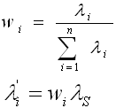
The ARINC Apportionment Method
The ARINC Apportionment Method assumes that all subsystems are in series and have an exponential failure rate. Allocations are derived based on weighting factors. The mathematical expression is:
Where, n is the total number of subsystems, λ_{i} is the present failure rate of the i^{th} subsystem, λ_{S} is the required system failure rate, and λ_{i}^{ʹ} is the failure rate allocated to the ith subsystem.
ReliaSoft Corporation, Lambda Predict, Tucson, AZ: ReliaSoft Publishing, 2007.
Notes:
The third reliability allocation method we are going to cover is the ARINC apportionment method.
The method uses current or historical failure rates to derive weighting factor for the new system.
The weighting factor for each subsystem is then multiplied by the system failure rate to get the failure rate for each subsystem.

Slide 28
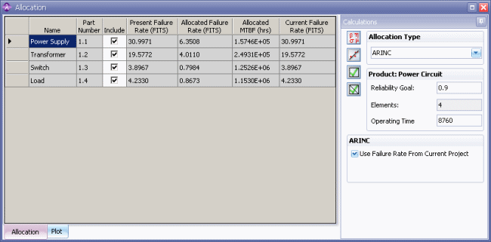
ARINC Apportionment Example
ReliaSoft Corporation, Lambda Predict, Tucson, AZ: ReliaSoft Publishing, 2007.
Notes:
In this example. we have 4 subsystems with current or historical failure rates. The reliability goal is 0.9 and the operating time is 8790 hours
Use the reliability formula for the Exponential distribution to get the required failure rate for the system
Derive the weighting factors for the subsystems. The weighting factors for each subsystem is derived by the dividing the current failure rate of the subsystem by the overall failure rate of the current system.
The subsystems weights are then multiplied by the new system required failure rate to get the allocated failure rates of the subsystems.

Slide 29
Reliability Allocation
Advantages
Main Advantages
  Reliability allocation helps optimize the best combination of component reliability improvements that meet the intended reliability goals and at sufficient allocated costs.
  It provides a realistic view of subsystem performance required to meet system objectives.
  It shows the most cost-effective areas for design improvements; and avoids putting design efforts into subsystems that may not gain any additional reliability by improvements.
Notes:
Explain the chart content.

Slide 30
Reliability Allocation
Limitations
Main Limitations
  Most allocation methods apply only to series configurations.
  The apportionment process of reliability values between the various subsystems in many cases has high level of subjectivity. It is usually made on the basis of achievable reliability, or any other factors considered appropriate by the analyst making the allocation.
  Most allocation methods require the availability of equipment historical data in order to reduce subjectivity and produce credible and reasonable allocation estimates.
Notes:
Explain the chart content.

Slide 31
Reliability Prediction
Failure
Region
Stress f(s)
Strength f(S)
µ_{s}
µ_{S}

Slide 32
Reliability Prediction - Definition
Reliability prediction is the process of quantitatively estimating the reliability using both objective and subjective data. It is one of the most common forms of reliability analysis.
Reliability prediction is performed to the lowest identified level of design for which data is available.
Reliability prediction techniques are dependent on the degree of the design definition and the availability of the relevant data.

Slide 33
The Bathtub Curve - Hardware Reliability
Infant Mortality
Region
(Decreasing
Failure Rate)
Wearout Region
(Increasing
Failure Rate)
Constant Failure Rate
Region (Design Life)
INSTANTANEOUS FAILURE RATE
(e.g., Process-Related
Failures)
Random Failures
(e.g., Physics-Related
Failures)
TIME
Notes:
Discuss areas of curve, how do failures differ?

Slide 34
Reliability Prediction
Using Reliability Block Diagrams (RBDs)

Slide 35
Reliability Block Diagrams
A Reliability Block Diagram (RBD) is a static form of reliability analysis using inter-connected boxes (blocks) to show and analyze the effects of failure of any component on the system reliability.
The diagram represents the functioning state (i.e., success or failure) of the system in terms of the functioning states of its components. For example, a simple series configuration indicates that all of the components must operate for the system to operate, a simple parallel configuration indicates that at least one of the components must operate, and so on.
Notes:
These are the first application of tools of reliability analysis. Other tools will be discussed in subsequent sections.

Slide 36
Reliability Block Diagrams
RBDs provide a success-oriented view of the system.
RBDs provide a framework for understanding redundancy.
RBDs facilitate the computation of system reliability from component reliabilities.
RBDs and fault trees provide essentially the same information. However, RBDs are easier to use and communicate.

Slide 37
Reliability Block Diagrams
Classifications
The most commonly used types of RBDs are:
  Simple series (all items have to function successfully)
  Simple active parallel (all items operating simultaneously in parallel and only one is needed)
  Standby parallel redundancy (alternate items are activated upon failure of the first item; only one item is operating at a time to accomplish the function)
  Shared parallel (failure rate of remaining items change after failure of a companion item)
  r-out-of-n Systems – Redundant system consisting of n items in which r of the n items must function for the system to function (voting decision).
  Combination of series and parallel systems
  Note: We will not cover shared and r-out-of-n Systems redundancy
Notes:
Read

Slide 38
Simple Series Reliability Block Diagrams
2-Components Case
The general expression for a series system with two components is:
R _{System} = R₁ × R₂
Example
R _{System} = R₁ × R₂
R _{System} = 0.99 × 0.95
General n Series Components Case
    R_{System} = R₁ R₂ R₃ ... Rn where R_{s} = probability that system will work.
R₁
R₂
R₁= 0.99
R₂=0.95
Notes:
Work with overhead projector.
Discuss
Fill in problem
Calculate the reliability for a 200 hour mission.
R ₂₀₀ = e ^{-λ1t1} = e^{-[( 120 x 10^6 )x 200 ]} = e ^{- 0.024}
R ₂₀₀ = 0.9763
R _{total} = R ₂₀₀ x R ₂₀₀ = 0.9763 x 0.9763 = 0.9531

Slide 39
Simple Active Parallel Reliability Block Diagrams
2-Components Case
The general expression for a parallel system with two components is:
  R_{System} = 1- (1-R₁)(1- R₂)
  If Q₁=1-R₁ and Q₂=1- R₂
  Then, R_{System} = 1-Q₁×Q₂
Example
The reliability of the redundant system
  R = 1-Q₁ Q₂ = 1- (0.01)(.0.01) = 0.9999
General n redundant components Case
R_{system} = 1-(Q₁Q₂Q₃...Q_{n} )
R₁
R₂
R₁=0.99
R₂=0.99
Notes:
Summarize

Slide 40
Standby Redundancy
The general reliability formula for n exponentially, identically distributed, and independent units in a standby redundant configuration (with perfect switching, R_{s} = 1) is:
Two Component Case
Assume, one shot switching reliability = 1, λ_{switch} = 0, failure rates are constant λ₁= λ₂ = 0.0001 and
Mission duration t₁ = t₂ = 1000 hrs.
Substituting λ =.0001 and t = 1000 into the
above equation we have:
R = ((λt)⁰/0!)e^{-λt} + ((λt)¹/1!) x e^{-λt}
R = ((1/1) e^{-λt} + ((λt)¹/1) x e^{-λt}
R = e^{-0.0001 x 1000}+(0.0001 x 1000) x e^{-0.0001x100}
R = 0.90484 +(0.1) x 0.90484 = 0.9953
n-1
R=Σ {(λt)^{i}/i!}e^{(-λt)}
i=0
λ₁
R_{switch}
λ₂
Notes:
Summarize

Slide 41
Complex System Reliability Block Diagrams
Assume
  R₁ = 0.99, R₂ = 0.999, R₃ = 0.95
  R₄ = 0.85, R₅ = 0.89, R₆ = 0.78
R4
R1
R2
R3
R5
Solving first for the parallel portion of the system we have:
  R_{X} = 1 - Q₄ Q₅ Q₆ = 1 - (1-0.85)(1-0.89)(1-0.78)
  R_{X} = 1- (0.15)(0.11)(0.22) = 1 - 0.00363 = 0.996
Now solving the series and then combine with parallel portion of the diagram, we have:
  R_{s} = R₁ R₂ R₃ R_{X}
  R_{s} = (0.99)(0.999)(0.95)(0.996) = 0.936
R6
Notes:
Show how the problem can be continually reduced to a collection of series and parallel groups of units and finally to a single series redundancy.
Some complex systems may not yield to this type of analysis, but then they probably should not have been designed that way. We need to help the designer to learn to “Design for Reliability”.

Slide 42
Physics Based
Reliability Prediction

Slide 43
Physics-Based Reliability Prediction
Physics-based reliability prediction is a methodology to assess component reliability for given failure modes.
The component is characterized by a pair of transfer functions that represent the load (stress, or burden) that the component is placed under by a given failure mode, and capability (strength) the component has to withstand failure in that mode.
The variables of these transfer functions are represented by probability density functions.
The interference area of these two probability distributions is indicative of failure.
Failure
Region
Stress f(s)
Strength f(S)
µ_{s}
µ_{S}

Slide 44
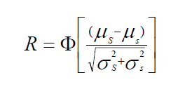
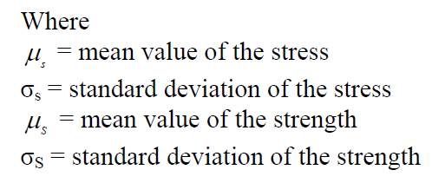
Physics Based Reliability Prediction
The Normal Case
Failure
Region
Stress f(s)
Strength f(S)
µ_{s}
µ_{S}
Assuming both the stress and strength are normally distributed, the following expression defines the reliability for a structural component. If
Note 1: In general, reliability is defined as the probability that the strength exceeds the stress for all values of the stress.
Note 2: Normality assumption does not apply to all engineering phenomena; and, under these special circumstances when the Normal does not apply, different methodology is used to determine reliability. As long as the engineering phenomena can be modeled, by whatever distribution, reliability could be obtained by methods such as the Monte Carlo method. Since the overwhelming majority of engineering phenomena do follow the normal distribution, the normality assumption is certainly the place to start.

Slide 45
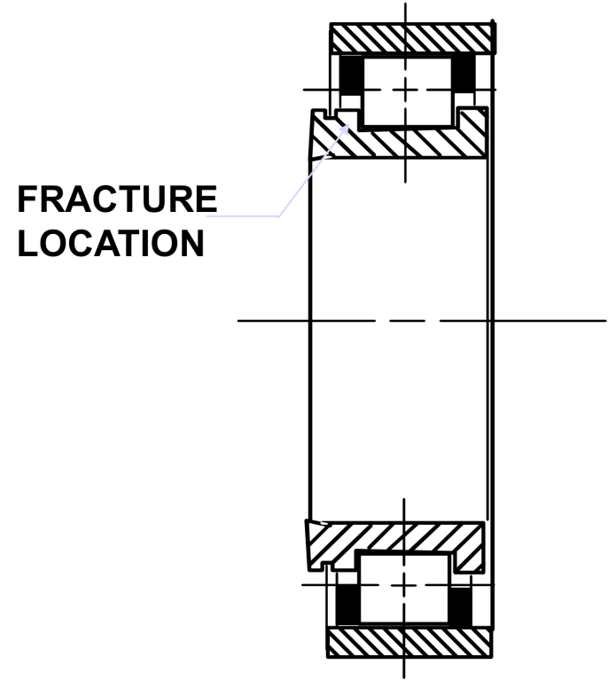
Physics-Based Reliability Prediction
A Rocket Engine Roller Bearing Example
During rig testing, the High Pressure Fuel Turbo-pump (HPFTP) Bearing of the Space Shuttle Main Engine (SSME) experienced several cracked races. Three out of four tests failed (440C bearing races fractured). As a result, a study was formulated to:
  Determine the probability of failure due to the hoop stress exceeding the material’s capability strength causing a fracture.
  Study the effect of manufacturing stresses
  on the fracture probability for two different
  materials, the 440C (current material) and
  the 9310 (alternative material).
The hoop stress is the force exerted
circumferentially (perpendicular both to
the axis and to the radius of the object)
in both directions on every particle in the
cylinder wall. Along with axial stress and radial
stress, circumferential stress is a component of the
stress tensor in cylindrical coordinates.

Slide 46
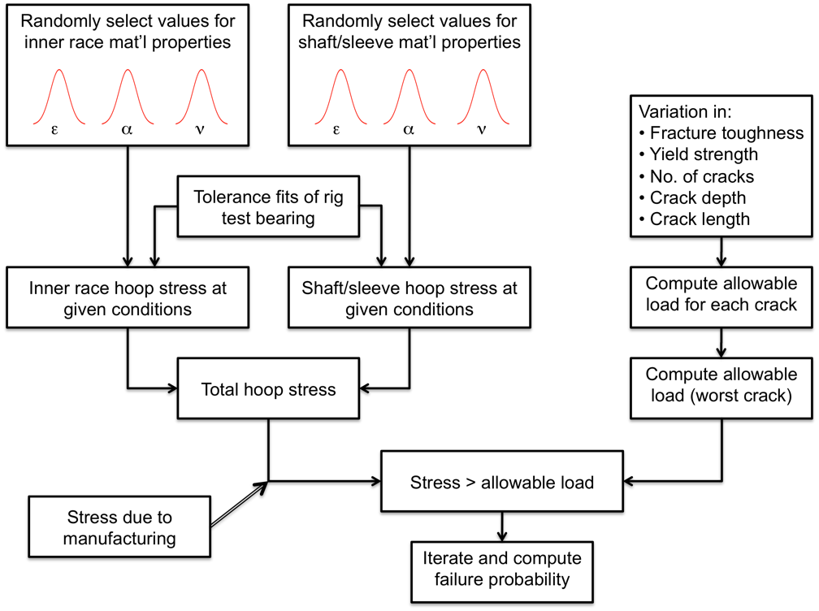
Physics-Based Reliability Prediction
A Rocket Engine Roller Bearing Example
The Simulation Model

Slide 47
Physics-Based Reliability Prediction
A Rocket Engine Roller Bearing Example
The Simulation Model
Since this failure model is a simple overstress model, only two distributions need to be simulated: the hoop stress distribution and the materials capability distribution.
In order to calculate the hoop stress distribution it was necessary to determine the materials properties variability.
Of those materials, properties that affected the total inner race hoop stress, a series of equations was derived which mapped these life drivers (such as modulus of elasticity, coefficient of thermal expansion, etc.) into the total inner race hoop stress.
In order to derive these equations, several sources of information were used which included design programs, equations from engineering theory, manufacturing stress data, and engineering judgment. This resulted in a distribution of the total hoop stress.

Slide 48
Physics-Based Reliability Prediction
A Rocket Engine Roller Bearing Example
The Simulation Model
In a similar fashion, a distribution on the materials capability strength was derived.
In this case, life drivers such as fracture toughness, crack depth/length, yield strength, etc., were important. The resulting materials capability strength distribution was then obtained through a similar series of equations.
The Monte Carlo simulation in this case would calculate a random hoop stress and a random materials capability strength. If the former is greater than the latter, a failure due to overstress occurs in the simulation. Otherwise, a success is recorded.
The simulation was run for two different materials: 440C (current material) and 9310.
After several thousand simulations are conducted, the percent which failed are recorded.

Slide 49
Analysis Results
Test Failures | Race Configuration | Failures in 100,000 firings**
3 of 4 | 440C w/ actual* mfg. stresses | 68,000
N/A | 440C w /no mfg. stresses | 1,500
N/A | 440 C w/ ideal mfg. stresses | 27,000
0 of 15 | 9310 w/ ideal mfg. stresses | 10
* ideal + abusive grinding
** Probabilistic Structural Analysis
The results of this analysis clearly showed that the 9310 material was preferred over the 440C in terms of the inner race fracture failure mode.
Manufacturing stresses effect for the 440C material was very significant.
Material selection has a major impact on reliability.
Probabilistic engineering analysis is critical to perform sensitivity analysis and trade studies for material selection and testing.

Slide 50
Reliability Prediction
Based on Operational Data

Slide 51
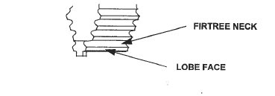
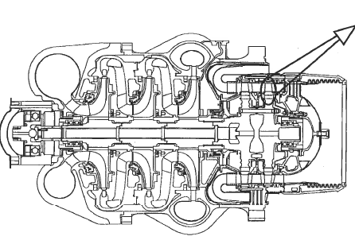
High Pressure Fuel Turbo-Pump (HPFTP)
First Stage Turbine Blade Example
During the inspection of the High Pressure Fuel Turbo-pump (HPFTP) Turbine blades of the Space Shuttle Main Engine (SSME) cracks were found in the blade firtree area. As a result, a study was formulated to determine the Space Shuttle flight risk due to a HPFTP first stage turbine blade failure.
HPFTP

Slide 52
HPFTP Turbine Blade Example
Background
A crack was found in a first stage turbine blade in HPFTP development unit 2423 during dye penetrant inspection 1/19/96.
The subject blade had accumulated 20 starts and 9,826 seconds of operation.
A total of 34 blade sets of the current configuration have been dye penetrant inspected, with no other crack being found.
Metallurgical evaluation of the blade showed:
  Fracture is hydrogen-assisted cracking.
  Fracture origin approximately in middle of bottom firtree lobe − starting on pressure side.
  No clear evidence of crack progression.

Slide 53
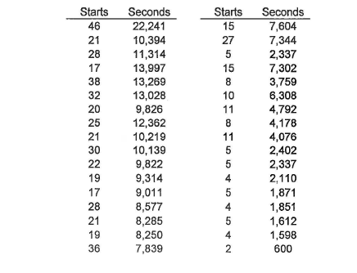
HPFTP Turbine Blade Example
Assumptions
A crack in a
blade is a failure.
Only last dye penetrant inspection times are used
(34 sets).
One failure (crack) at 20 starts and 9,826 seconds.
Assumptions and Database

Slide 54
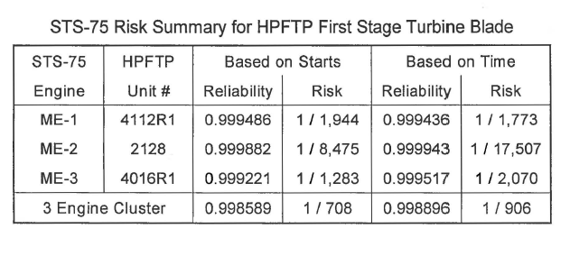
HPFTP Turbine Blade Example
Analysis Results
The starts and run time for the three pumps:
  2 STARTS / 817 SEC
  2 STARTS / 780 SEC
  4 STARTS / 1856 SEC
Weibull model was used for reliability predictions.
Concluding Remarks
Manufacturing records review for the flight set showed no discrepancies.
Fleet leader blade set with 22,241 seconds and 46 tests.
53 blade sets were tested greater than the flight units.
Flight reliability was assessed and risk was accepted by Shuttle program.

Slide 55
Reliability Prediction
Advantages
Main Advantages
Allows the analyst to quantitatively and statistically analyze the relative reliability during the design or operational phase.
Can aid in determining the resource allocation during the test and evaluation phase.
Provides a means to quantify the uncertainty of design variables and their impact on reliability and risk.
Identifies regions of high risk in a design.
Provides a means to compare competing designs.
Can reduce unnecessary conservatism.
Estimates of the failure rates of components generated by reliability predictions are critical input to safety, maintainability, supportability, and cost.
Reliability predictions are also the main source of data for Probabilistic Risk Assessments (PRAs).

Slide 56
Reliability Prediction
Limitations
Main Limitations
Reliability prediction can be resource intensive.
The analyst must have knowledge of engineering disciplines and experience in probability and statistics.
For reliability predictions using historical population, data used must be very close to the as-planned design population to be viable. Extrapolation between populations can render the technique nonviable.
For physics-based reliability predictions, it may be difficult to get an accurate and detailed description of failure modes, failure mechanisms, and acting loads and environments (i.e., determining the density functions of the random variables in the load and capability transfer functions).

Slide 57
Reliability Demonstration
1.0
It takes about 13 tests with zero failures to get the reliability comfort level of 0.95 at 50% confidence
Reliability
Number of Tests
Notes:
The following charts addresses only one out of many techniques used for reliability demonstration.

Slide 58
Reliability Demonstration Definition
Reliability Demonstration is the process of quantitatively estimating the reliability of a system using objective data at the level intended for demonstration.
It is used to provide empirical evidence of design reliability.
It is the process of demonstrating the reliability of a design through testing and operation.
It applies from test and evaluation through operation.
Models and techniques used in reliability demonstration include Binomial, Exponential, Weibull models, etc.
Notes:
Unlike reliability prediction which is defined as the process of quantitatively estimating the reliability using both objective and subjective data, reliability demonstration is defined as the process of quantitatively estimating the reliability of a system using objective data at the level intended for demonstration.

Slide 59
Reliability Demonstration
Commonly Used Distributions
There are a variety of probability distribution functions used for calculating reliability demonstration.
They cover both discrete and continuous data cases.
The most commonly used distributions are: The Exponential distribution for continuous data and the Binomial distribution for discrete data.
In the following charts we will cover the Binomial distribution for discrete data. The Exponential distribution for continuous data is included in the backup section.
http://reliabilityanalyticstoolkit.appspot.com/
Notes:
The most commonly used distributions are: The Exponential distribution for continuous data and the Binomial distribution for discrete data.
In the following charts we will cover in details the Exponential distribution for continuous data and the Binomial distribution for discrete data.

Slide 60
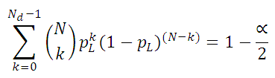
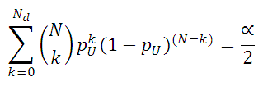
Reliability Demonstration
The Binomial Distribution Case - Exact Method
Two-sided confidence, exact method
  For a sample size of (N), a number of defects/failures of (N_{d}), and a confidence level of (1 – α)X100:
    The equation to calculate the Binomial lower limit of the two-sided confidence interval, p_{L}
    The equation to calculate binominal upper limit of the
    two-sided confidence interval, p_{U}
  The following equations are solved iteratively to determine the two-sided upper confidence limit (p_{U}) or two-sided lower confidence limit (p_{L}):
    https://reliabilityanalyticstoolkit.appspot.com/binomial_confidence_details
Notes:
We finished talking about how to establish confidence intervals for the continuous case using the exponential.
Now, we are going to talk about the discrete case using the Binomial.
Explain the two-sided case for the exact solution!

Slide 61
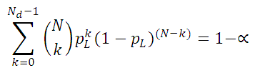
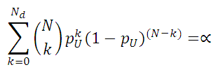
Reliability Demonstration
The Binomial Distribution Case - Exact Method
One-sided confidence, exact method
The calculation method for single sided limits are nearly identical to the two-sided case, except all the α is in either the upper or lower tail of the distribution
  The equation to calculate binominal lower single-sided confidence limit
  The equation to calculate binominal upper single-sided confidence limit
  The following equations are solved iteratively to determine the single-sided upper confidence limit (p_{U}) or single-sided lower confidence limit (p_{L}):
Note 1: For the zero failure case, the Binomial upper limit on the probability of failure is: P_{U}= 1- α^{1/n} , and the reliability Lower confidence Limit:
R_{L}=1- P_{U} = α^{1/n} Where α = 1- Confidence Level
    https://reliabilityanalyticstoolkit.appspot.com/binomial_confidence_details
Notes:
Explain the one-sided case for the exact solution!

Slide 62
The Binomial Distribution Case
One-sided Exact Method Example
Demonstrated Reliability* at 50% confidence
Using the Binomial Model With Zero Failure Case
Number of tests | Reliability* | 1-Reliability
1 | 0.500 (50.0%) | 0.500
2 | 0.707 (70.7%)** | 0.293
3 | 0.794 (79.4%) | 0.206
4 | 0.841 (84.1%) | 0.159
5 | 0.871 (87.1% | 0.129
6 | 0.891 (89.1%) | 0.109
7 | 0.906 (90.6%) | 0.094
8 | 0.917 (91.7%) | 0.083
9 | 0.926 (92.6%) | 0.074
10 | 0.933 (93.3%) | 0.067
11 | 0.939 (93.9%) | 0.061
12 | 0.944 (94.4%) | 0.056
13 | 0.948 (94.8%) | 0.052
*Reliability as a metric is the probability that an item will perform its intended function for a specified mission profile.
**A reliability, R, at 50% confidence level of 0.707, for example, means, 50% of the time the probability of success will be as good as or exceeds 0.707. Mathematically: P(R≥0.0.707)=0.5
1.0
It takes about 13 tests with zero failures to get the reliability comfort level of 0.95 at 50% confidence
Reliability
Number of Tests
Notes:
The message from this chart is that it takes only 13 tests with zero failures to get the reliability comfort level of 0.95 at 50% confidence. Because of the cost involved, in general, reliability demonstration are not intended to show too many nines. It is intended to demonstrate a certain comfort level to support a specific design

Slide 63
Reliability Demonstration
Advantages
  Provides empirical information on reliability.
  Reduces the uncertainty of analytically based reliability estimates.
  Supports the determining of the resource allocation during the test and evaluation phase.
  Used to support the reliability prediction of a design through testing and operation.
Notes:
Explain the advantages of reliability demonstration.

Slide 64
Reliability Demonstration
Limitations
  Dedicated pre-operational demonstration testing cannot be performed for high levels of design indenture (e.g., launch vehicle) due to cost and schedule constraints.
  Reliability testing at lower-levels of design indenture is highly limited due to the same constraints (i.e., cost and schedule).
  Data from piggyback demonstration through other engineering testing can lack the resolution desired for good reliability modeling.
Notes:
Explain the limitations of reliability demonstration.

Slide 65
Concluding Remark
Reliability is an engineering discipline that provides a critical design function which involves the application of engineering principles to the design and processing of products, both hardware and software, for the purpose of meeting product reliability requirements or goals.
Notes:
Go over the concluding remarks as listed.

Slide 66
Bibliography

Slide 67
Bibliography
Challenger The Final Voyage, Lewis, S. R., New York: Columbia University Press, 1988
Designing for Reliability and Safety Control, Ernest J. Henley and Hiromitsu Kumamoto, Prentice Hall; 1985
Engineering Reliability — New Techniques and Applications, B. S. Dhillon and C. Singh, John Wiley & Sons; 1981
Handbook of System and Product Safety, Willie Hammer, 1972, Prentice-Hall; 1972
Introduction to System Safety Engineering, W. P. Rogers, John Wiley and Sons,1980
Modarres, M., Kaminsky, M., & Krivtsov, V. (2010). Reliability Engineering and Risk Analysis, 2nd Ed. Boca Raton: CRC Press.
NASA/SP-2009-569, “Bayesian Inference for NASA Probabilistic Risk and Reliability Analysis”
NASA Systems Engineering Handbook, NASA/SP-2007-6105
Reliability in Engineering design, Kailash Kapur, Published by John Wiley & Sons,1977

Slide 68
Bibliography
Reliability Engineering and Risk Assessment, Ernest J. Henley and Hiromitsu Kumamoto, Prentice Hall; 1991
Reliability Engineering Handbook: Vol 1 and 2 Hardcover, Dimitri B. Kececioglu, Prentice Hall, 2002
Systems Engineering “Toolbox” for Design-Oriented Engineers, NASA Reference Publications 1358
Safie, F . and Fox, E. P. , AIAA/SAE/ASME 27th Joint Propulsion Conference, June 1991. "A Probabilistic Design Analysis Approach For Launch Systems
Notes:
Go over the references with the class.

Slide 69
Backups
The agree apportionment method

Slide 70
The AGREE Apportionment Method
.
The AGREE apportionment method determines a minimum acceptable mean life for each subsystem in order to fulfill a minimum acceptable system mean life.
The AGREE method assumes that all subsystems are in series and have an exponential failure distribution. This method takes into account both the complexity and the importance of each subsystem.
Notes:
This is another commonly used allocation method, the AGREE method. It is more complex than the equal apportionment method but not difficult to apply. This method takes into account both the complexity and the importance of each subsystem.

Slide 71


The AGREE Apportionment Method
The mathematical model:
  Let:
  i = a counter representing each module, i = 1, 2, 3 …, n
  t = system operating time
  R(t) = system reliability requirement at time t
  For n total modules in the system, the contribution of each
  module containing m components to the overall system reliability is:
  R(t_{i}) =
  Where,
  m_{i} is the number of components in module i.
  t_{i} = operating time of module i
Notes:
Explain the mathematical model and how it works, then go through the examples.

Slide 72
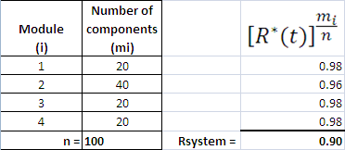
The AGREE Apportionment Method
Example 1
Allocating the System Reliability
Notes:
This is a very simple example using the Agree method where we allocated reliability among 4 modules with module 2 is twice as complex (40 components) as the other modules (20 components). Just applying the formula in the top righthand corner of the table.

Slide 73

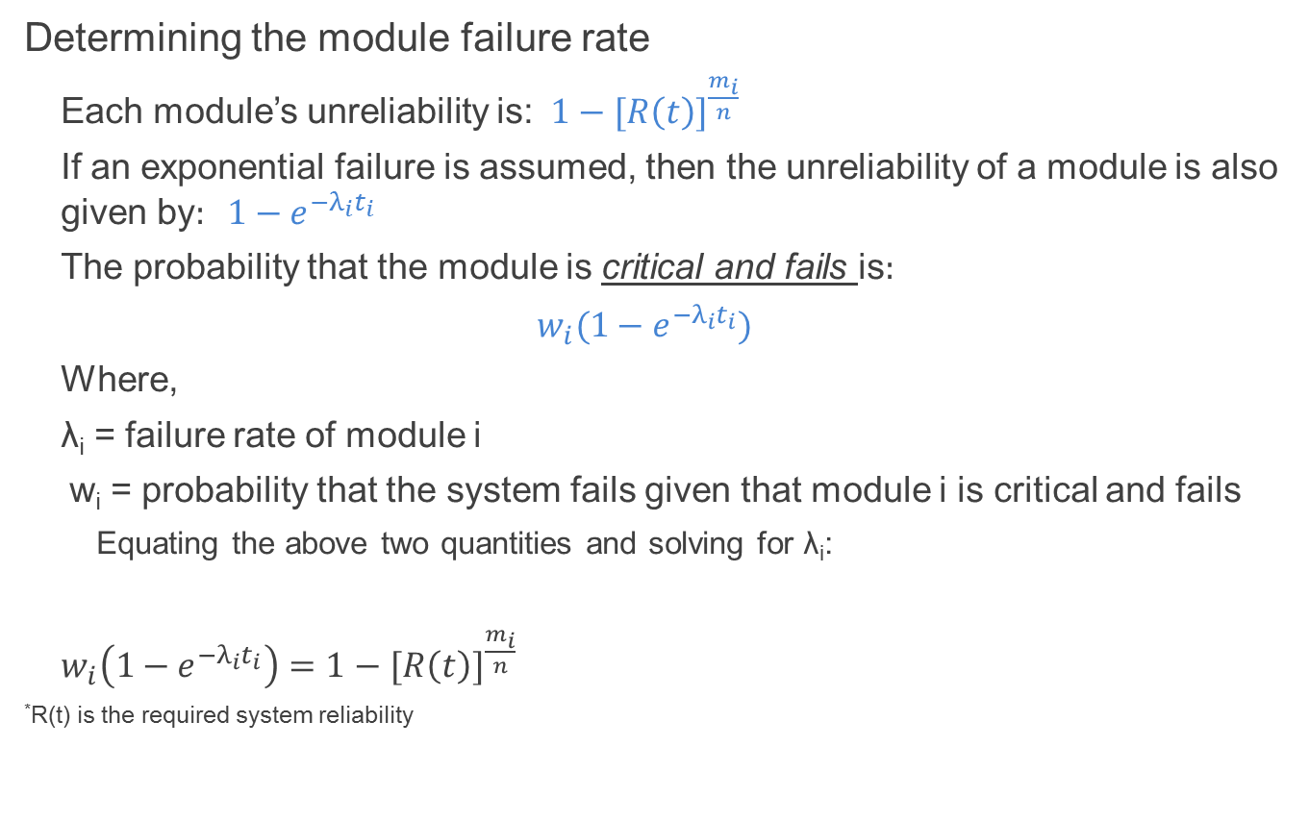
The AGREE Apportionment Method
Determining the module failure rate
  Each module’s unreliability is:$1−{[R\left(t\right)]}^{\frac{m_{i}}{n}}$
  If an exponential failure is assumed, then the unreliability of a module is also given by$: 1−e^{−λ_{i}t_{i}}$
  The probability that the module is critical and fails is$:$
  $$w_{i}(1−e^{−λ_{i}t_{i}})$$
  Where,
  λ_{i} = failure rate of module i
  w_{i} = probability that the system fails given that module i is critical and fails
    Equating the above two quantities and solving for λ_{i}:
  $w_{i}\left(1−e^{−λ_{i}t_{i}}\right)=1−$ ${[R\left(t\right)]}^{\frac{m_{i}}{n}}$
*R(t) is the required system reliability
Source: http://www.reliabilityanalytics.com/blog/2011/10/09/reliability-allocation/
Notes:
This is the formulation where we want to allocate the failure rate rather than the reliability.
Explain briefly the formula for the failure rate allocation.

Slide 74
The AGREE Method
Example 2
A system has four subsystems, each with 20 modules. The required system reliability is 0.9 for a four hour mission. Assume all subsystems are critical (i.e. the probability that the system fails when a subsystem fails is 1.0). What should the allocated module reliability and failure rate be if:
  All subsystem are equally important?
  Module 3 becomes twice as complex as the other modules?
  Module 3 is only 10% as important as the other modules?
Notes:
In this example we look at the sensitivity of the allocated failure rate due to varying the complexity and the importance factors.
What happens to the allocated failure rate if the complexity factor goes higher? The failure rate will be higher.
What happens to the allocated failure rate if the importance factor goes higher? The failure rate will be higher.

Slide 75
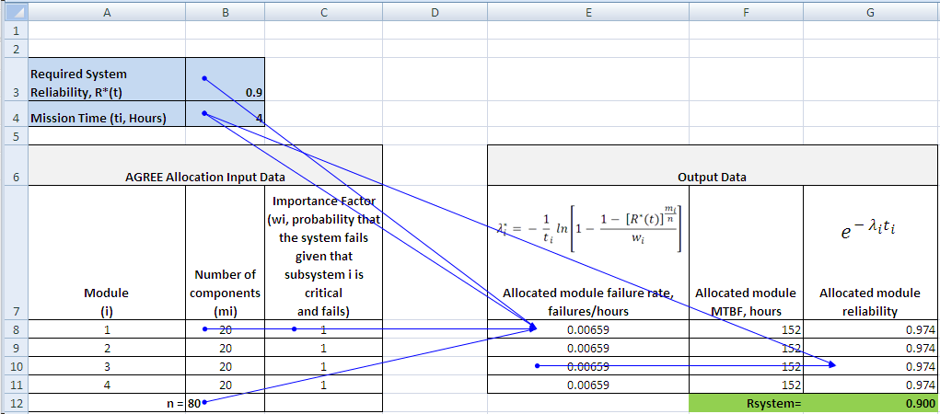
Reliability Allocation AGREE Example
Question 1
Answer 1: For the stated inputs, each subsystem must have an MTBF of 152 hours. The reliability of each subsystem must be 0.974, which when multiplied together results in an overall system reliability of 0.90.
Source: http://www.reliabilityanalytics.com/blog/2011/10/09/reliability-allocation/
Notes:
Explain the content of the chart.
For the stated inputs, each subsystem must have an MTBF of 152 hours. The reliability of each subsystem must be 0.974, which when multiplied together results in an overall system reliability of 0.90.

Slide 76
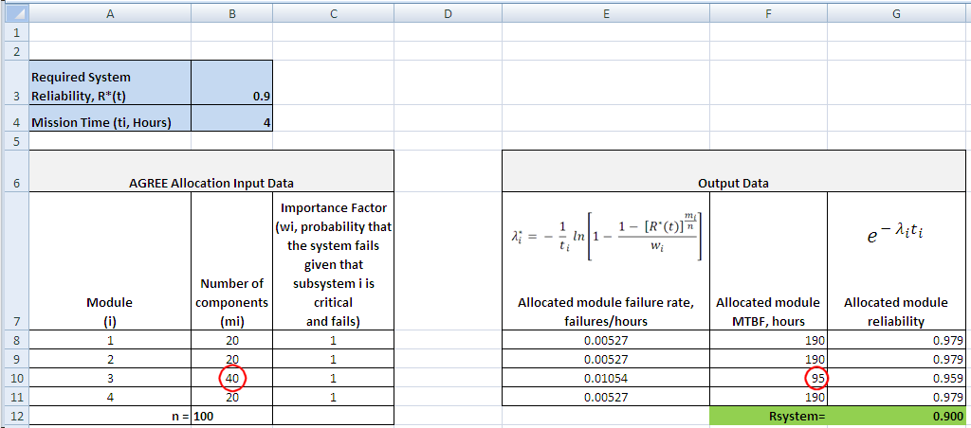
Reliability Allocation AGREE Example
Question 2
Answer 2: If module 3 has 40 components instead of 20, this module now has an allocated MTBF of 95 hours and the remaining three modules must have an MTBF of 190 hours to achieve the overall system reliability goal of 0.9 for a 4 hour mission.
Source: http://www.reliabilityanalytics.com/blog/2011/10/09/reliability-allocation/
Notes:
Explain the content of the chart.
If module 3 has 40 components instead of 20, this module now has an allocated MTBF of 95 hours and the remaining three modules must have an MTBF of 190 hours to achieve the overall system reliability goal of 0.9 for a 4 hour mission.

Slide 77

Reliability Allocation AGREE Example
Question 3
Answer – 3: If the quantity of components is put back to 20, but module 3 now has an importance of only 0.1, meaning that 90% of the failures will not cause the system to fail, the allocated MTBF for this module is only 13 hours instead of 152 hours. Note, the product of the module reliability values, 0.684, does not equal the requirement of 0.9 because not all failures of module 3 will cause a system failure.
Source: http://www.reliabilityanalytics.com/blog/2011/10/09/reliability-allocation/
Notes:
Explain the content of the chart.
If the quantity of components is put back to 20, but module 3 now has an importance of only 0.1, meaning that 90% of the failures will not cause the system to fail, the allocated MTBF for this module is only 13 hours instead of 152 hours. Note, the product of the module reliability values, 0.684, does not equal the requirement of 0.9 because not all failures of module 3 will cause a system failure.

Slide 78
Backup
Confidence interval-The Exponential Case

Slide 79
Confidence Intervals
Continuous Data – The Exponential Case
For estimating confidence intervals for the MTBF, two cases have to be considered:
  Failure terminated case: A test that is run until a pre-assigned number of failures have occurred.
  Time terminated case: A test that is stopped after a pre-assigned number of test hours have accumulated.
The formula for the confidence interval employs the χ² (chi-square) distribution.
For tests with no failures occurring, only the one-sided lower confidence limit can be calculated.
Notes:
In the following charts, we will consider two cases to establish confidence on the MTBF of the Exponential
A test that is run until a pre-assigned number of failures have occurred.
A test that is stopped after a pre-assigned number of test hours have accumulated

Slide 80




Confidence Intervals
Exponential Example
One-sided Confidence interval
  Lower limit, Failure Terminated.
  Lower limit, Time Terminated.
Two-sided Confidence interval
  Lower and Upper Limits, Failure Terminated
  Lower and Upper Limits, Time Terminated
Where:
T = total accumulated unit-hours
r = total number of failures
(1 – α)×100 = confidence level (%)
http://reliabilityanalyticstoolkit.appspot.com/confidence_limits_exponential_distribution
Notes:
Explain the chart without getting too deep in the math.

Slide 81
Confidence Intervals
Exponential Example
Transport vehicle example: One failure in 100 hours of operation
Confidence bounds – Time Terminated | MTBF at 50%
One-sided lower 50% limit | 60
Two-sided 50% limits | 37 − 348
For the operating time = t, the Reliability is:
R(t) = e^{-(t/ MTBF)}
For the t = MTBF, the Reliability is:
R(MTBF) = e^{-(MTBF/ MTBF)} = e⁻¹ = 0.368 = 36.8%
Notes:
This is an example of establishing confidence limits for the time terminated testing case.

