Slide 1
I Want You to Feel Safe Enough to Fly on This – A Personal Look at Spaceflight Reliability
Quinn Slaugenhoupt – Bastion Technologies
2025 RAM XVII Training Summit

Slide 2
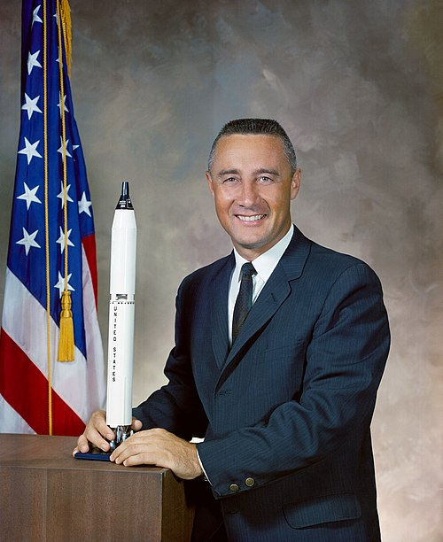
Overview
Introduction
What is at stake?
Probabilistic Risk Assessment (PRA)
History
Statistics
You
Improving reliability
“If we die, we want people to accept it. We are in a risky business, and we hope that if anything happens to us, it will not delay the program. The conquest of space is worth the risk of life. Our God-given curiosity will force us to go there ourselves because in the final analysis, only man can fully evaluate the moon in terms understandable to other men.”
  On the dangers and importance of the mission of going to the moon in Gemini : A Personal Account of Man's Venture Into Space (1968) by Virgil I. Grissom

Slide 3
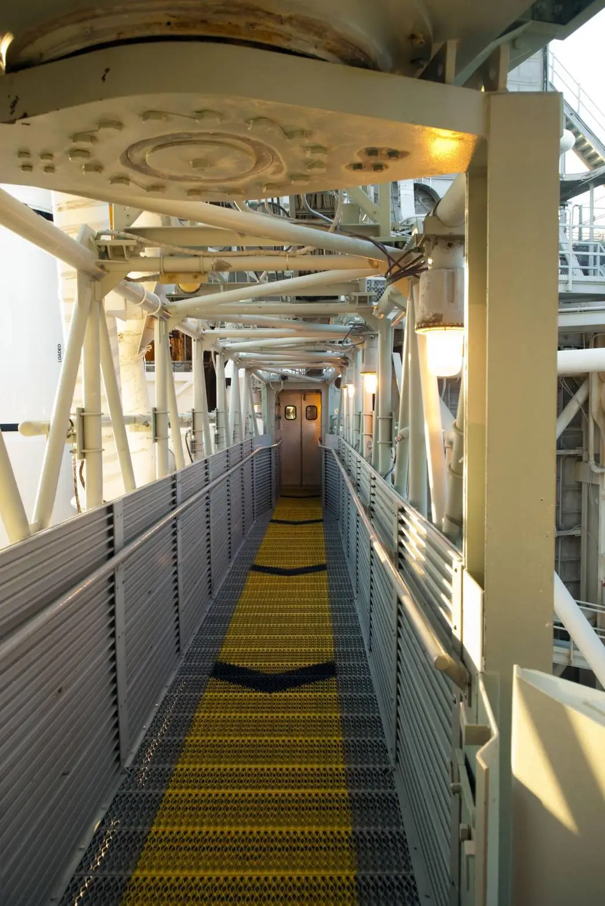
Intro
Do you feel safe enough to fly on this?
Is it enough to just analyze and certify a vehicle for flight?
Astronauts face the most dangerous environments and conditions in space travel
Every mission: life or death decisions
What goes into the calculated risks of spaceflight?
Personally, what is an allowable amount of risk if you were on board? What about someone else?

Slide 4
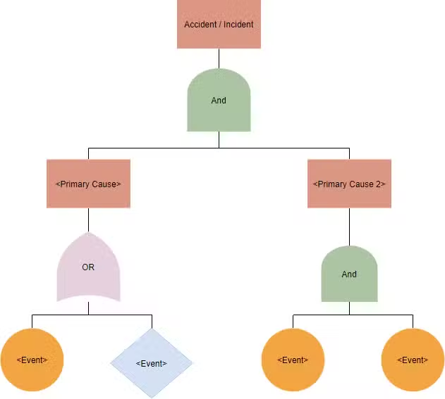
Probabilistic Risk Assessment (PRA)
What is PRA?
  A quantitative methodology for assessing risk by analyzing potential failures, their likelihoods, and the resultant consequences.
  Fault Tree Analysis (FTA) - a top-down, deductive assessment technique that includes a logic diagram that identifies the root cause of an undesirable event/failure.
NASA PRA
  NASA risk assessment for the Artemis missions
  Loss of Crew and Loss of Mission scenarios
  Down to subsystems and individual components

Slide 5


History
PRA
  Began with actuarial work in insurance
  1960s-70s: used to initially assess shuttle but primarily started within the nuclear industry (Rasmussen Report 1975)
Shuttle:
  PRAs implemented after the Challenger disaster
  Before Challenger, the PRAs were abandoned due to perceived high risk
  After Challenger, initial PRAs revealed a close to 1 in 100 chance of failure

Slide 6
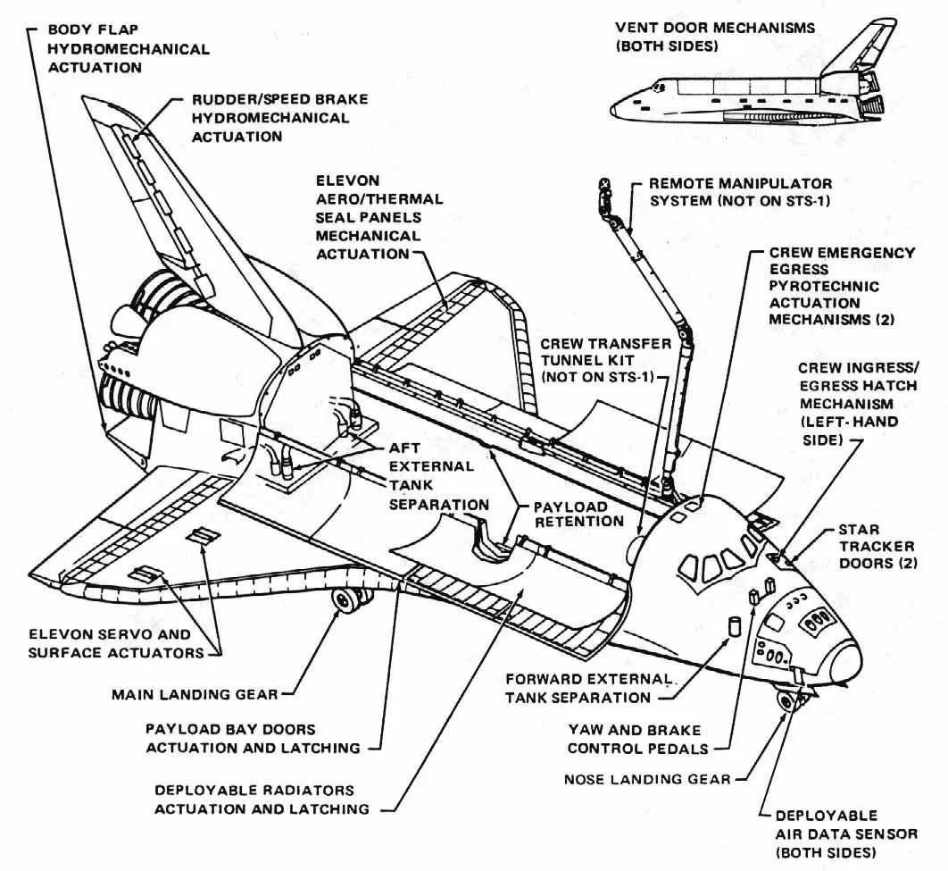
How PRA is Used / Why it Matters
Risk data from engineering, manufacturing, historical, and generic data sets.
Probabilities / failure rates; Estimating with Uncertainty!
Estimation of reliability / risk, identifying high-risk scenarios
Reporting – drives design changes and informs
Allows for educated risk decision making, even in real-time with missions!
Redundancy; abort procedures
Designing for safety

Slide 7
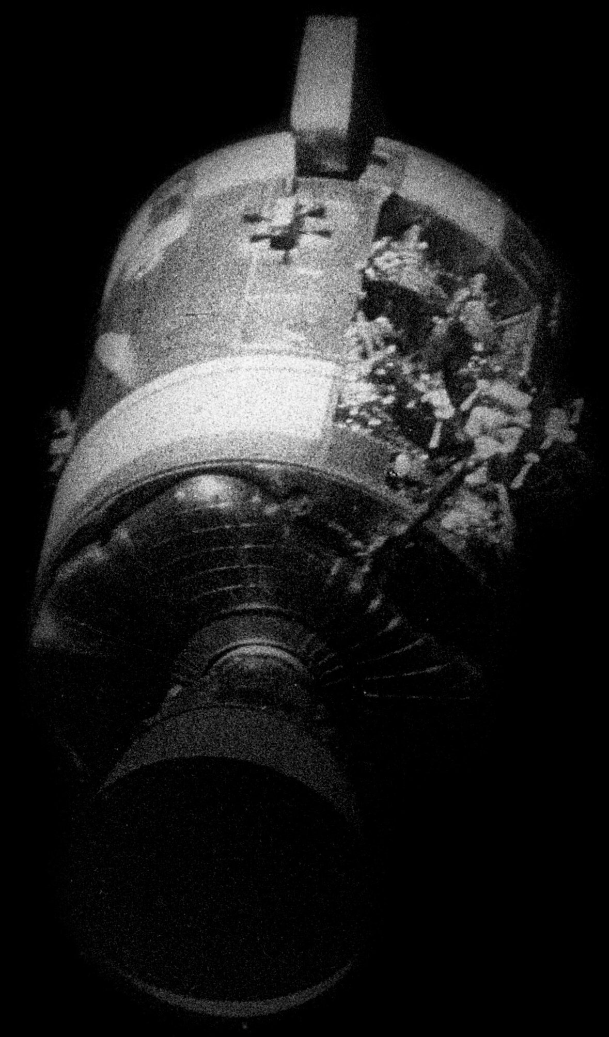
Real World Example – Apollo 13
7th Crewed mission of the Apollo space program
Would have been the 3rd moon landing
2 days into the mission, an oxygen tank exploded in the service module, disabling its electrical and life-support systems.
Fortunately, the team was able to abort and, despite a very uncomfortable return to Earth, they made it home safe.
PRA helps anticipate these possible life-threatening failures, as well as provide insight into how to respond accordingly in failure scenarios.
Pictured: Odyssey's damaged service module, as seen from the Apollo Lunar Module Aquarius, hours before reentry

Slide 8

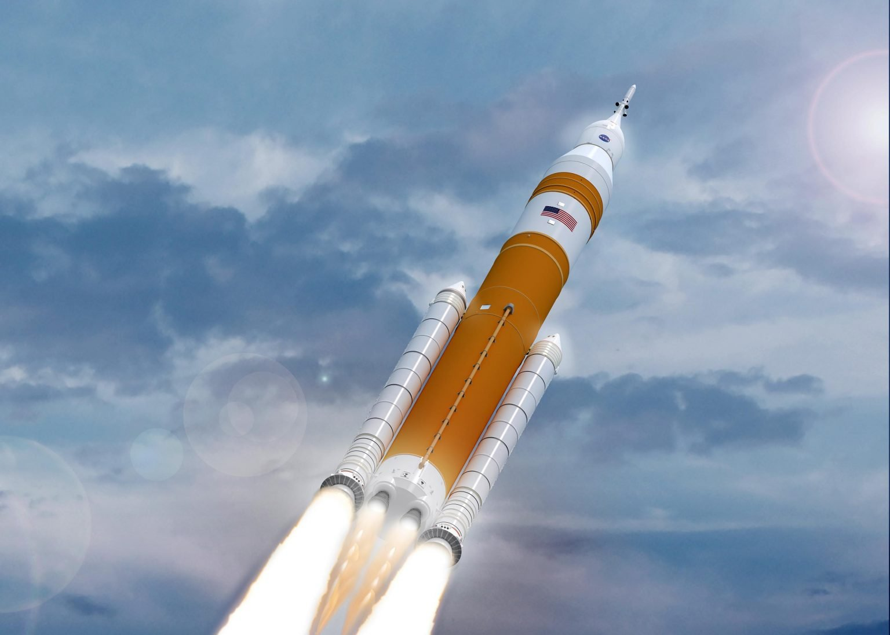
What are the odds?
Analyzing vehicles today…
NASA PRA Human Landing System memo:
  Loss of Crew < 1 in 75
  Loss of Mission < 1 in 10
Planes: The annual risk of being killed in a plane crash for the average American is about 1 in 11 million.
Cars: The annual risk of being killed in a motor vehicle crash for the average American is about 1 in 5,000.
Taking responsibility and running the risk

Slide 9

You
Calculated risk
Could you confidently go?
How do you feel sending others?
Thinking about these things, surely bolstering reliability is something you would want!

Slide 10
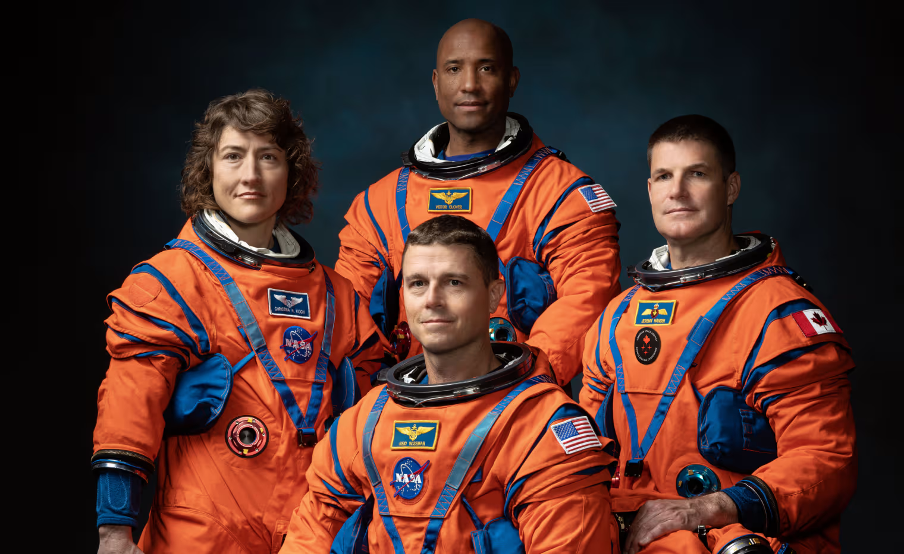
Improving Reliability / Conclusion
PRA is much more than just the numbers; it is about protecting lives!
Every calculation and decision reflects real human risk
Responsibility is on all of us as if we were in the space suits
PRA gives us the tools to protect the most valuable thing, people!

Slide 12
Backup

Slide 13
References
“Apollo 13.” Wikipedia, en.wikipedia.org/wiki/Apollo_13. Accessed 14 Oct. 2025.
“Gus Grissom.” Wikipedia, en.wikipedia.org/wiki/Gus_Grissom. Accessed 14 Oct. 2025.
“How Risky Is Flying?” NOVA / PBS, www.pbs.org/wgbh/nova/planecrash/risky.html. Accessed 14 Oct. 2025.
NASA. “Mechanical Subsystems.” NASA, www.nasa.gov/image-detail/shuttle-9/. Accessed 14 Oct. 2025.
NASA. “Symbols of NASA.” NASA, 27 July 2017, www.nasa.gov/history/symbols-of-nasa/. Accessed 14 Oct. 2025.
NASA. “Walkway to Space.” NASA, 29 June 2011, www.nasa.gov/image-article/walkway-space/. Accessed 14 Oct. 2025.
NBC News. “NASA Announces Astronauts Will Orbit Moon Next Year.” NBC News, www.nbcnews.com/science/space/nasa-announces-astronauts-will-orbit-moon-year-rcna77896. Accessed 14 Oct. 2025.
“NASA Artemis Missions Set to Begin Next Year as SLS Rocket Costs Climb.” SciTechDaily, scitechdaily.com/nasa-artemis-missions-set-to-begin-next-year-as-sls-rocket-costs-climb/. Accessed 14 Oct. 2025.
TicketSchool. “Is a Defensive Driving Course Worth It?” TicketSchool Blog, ticketschool.com/blog/is-a-defensive-driving-course-worth-it/. Accessed 14 Oct. 2025.
Traeger, Sebastian. “Fault Tree Analysis (FTA) Guide: Process, Symbols & Examples.” Reliability, 25 Apr. 2025, reliability.com/resources/articles/fault-tree-analysis-fta-guide/. Accessed 14 Oct. 2025.
U.S. Nuclear Regulatory Commission. “About NRC.” NRC, www.nrc.gov/about-nrc. Accessed 14 Oct. 2025.
Wikiquote contributors. “Gus Grissom.” Wikiquote, en.wikiquote.org/wiki/Gus_Grissom. Accessed 14 Oct. 2025.
“Starchxser1 Confused Meme – Starchxser1 Confused.” Tenor, tenor.com/view/starchxser1-confused-gif-16246979512906471850. Accessed 14 Oct. 2025.

