Slide 1
Digital Engineering: A Systematic Literature Review of Strategies, Components, and Implementation Challenges Post-2018 DoD Strategy
Landon Womack, PhD Student, UAH
Ana Wooley, Assistant Professor, UAH

Slide 2

Agenda
What is Digital Engineering?
Methodology
Results/Discussion
Conclusion
Objectives

Slide 3
WHAT IS DIGITAL ENGINEERING?

Slide 4
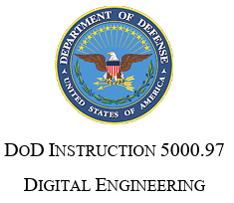



WHAT IS DIGITAL ENGINEERING?
“DE is the creation of computer readable models to represent all aspects of the system and to support all the activities for the design, development, manufacture, and operation of the system throughout its lifecycle.”
"DE is an integrated digital approach using authoritative sources of system data and models as a continuum through the development and life of systems."
“DE is a means of using and integrating digital models and the underlying data to support the development, test and evaluation, and sustainment of a system.”
Notes:
https://inl.gov/digital-engineering/
Changed Definition to be from source. https://sebokwiki.org/w/images/sebokwiki-farm%21w/c/cf/Guide_to_the_Systems_Engineering_Body_of_Knowledge%2C_v._2.4%2C_Part_8.pdf pg. 52. 55 on pdf
https://www.mitre.org/sites/default/files/2021-12/pr-21-1658-Common-Basis-for-Digital-Engineering-Discussions.pdf?#page=10.08 pg.2. 10 on pdf

Slide 5
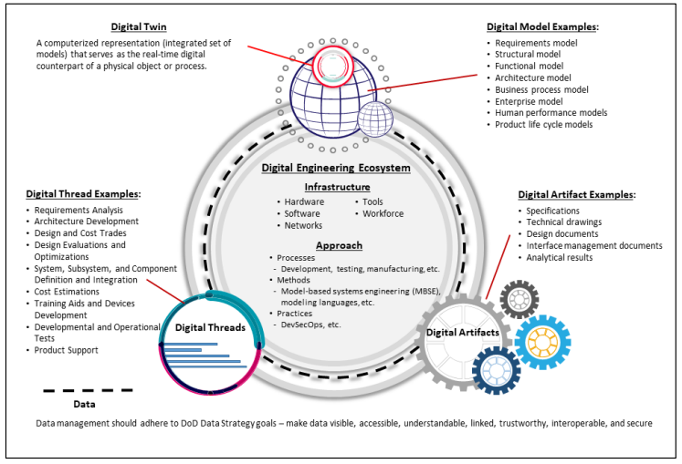
WHAT IS DIGITAL ENGINEERING?
Digital Engineering is about getting into a digital workflow!
Digital Models
Moves away from document-based processes to model-based representations of systems.
Emphasizes the use of authoritative data as a shared, consistent source of truth.
Enables simulation, analysis, verification, and collaboration in a virtual environment.
Supports real-time decision-making through a continuous digital thread.
Drives efficiency, traceability, and innovation across complex engineering programs
Digital Engineering Ecosystem
Digital Thread
Digital Artifacts
DOD INSTRUCTION 5000.97 DIGITAL ENGINEERING (2023)

Slide 6
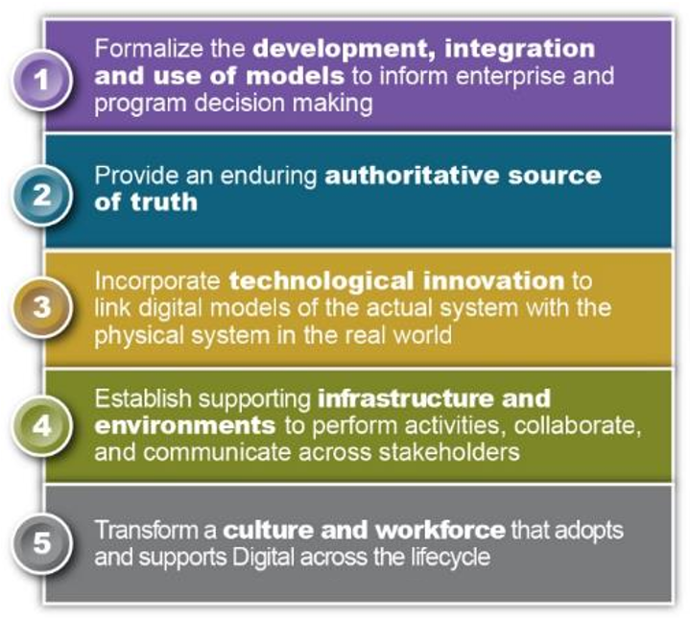
WHAT IS DIGITAL ENGINEERING?
Office of the Deputy Assistant Secretary of Defense for Systems Engineering. “Department of Defense Digital Engineering Strategy,” 2018

Slide 7
OBJECTIVES

Slide 8
SYSTEMATIC LITERATURE REVIEW OBJECTIVES
Develop a shared understanding of DE concepts, methodologies, and implementation practices
Identify existing studies, frameworks, challenges, and best practices related to DE knowledge and skills
Evaluate the extent to which the five strategic goals outlined in the 2018 DoD Digital Engineering Strategy have influenced academic literature in DE

Slide 9
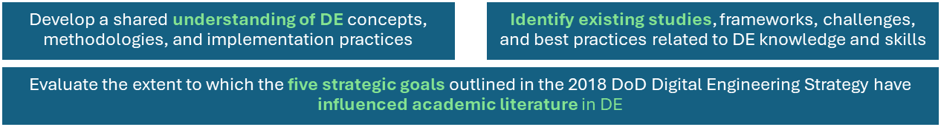
OBJECTIVES
RQ1
How is DE defined in the literature?
RQ2
What are the motivations and benefits, stated in the literature, to apply DE?
RQ3
What DE components (e.g., Digital Twins, MBSE, Digital Threads, Authoritative Source of Truth) are most commonly mentioned when talking about DE?
RQ4
What are the key challenges in implementing digital engineering, and what solutions have been proposed?
RQ5
To what extent do academic publications explicitly reference or align with the five strategic goals of the 2018 DoD Digital Engineering Strategy?

Slide 10
METHODOLOGY

Slide 11
METHODOLOGY
Step 1: Literature Search
Step 2: Literature Selection
Step 3: Review Process
Keywords
Title: “digital engineering”
RQ1
Title and abstract elimination
Careful analysis of the title and abstract to eliminate unrelated papers
Full text elimination
Careful analysis of the full text to eliminate unrelated papers
Preliminary results
75 publications
RQ2
Confined to:
Type: Journal and conference papers and forum
Language: English
Removal of duplicates
71 unique titles
RQ3
71 relevant publications
56 relevant publications
56 relevant publications
RQ4
Search Engines
INCOSE
Science Direct
IEEE Xplore
ARC (Aerospace Research Central )
ACM (Association for Computing Machinery )
RQ5

Slide 12
METHODOLOGY
13 reviewers: Each paper was reviewed by at least two independent reviewers to ensure redundancy and reduce individual bias.
A cross-checking phase: Each reviewer was assigned 5 papers to review data entries previously submitted by their peers. Discrepancies were identified, discussed, and reconciled.
Reviewers updated a shared spreadsheet with final, consensus-based answers and filled in responses to additional questions added based on observations from prior class discussions.
Extracted data included: Study objectives, key findings and contributions, identified challenges and proposed solutions, motivations and benefits of DE adoption, and future research opportunities across different industries. The data was compiled collaboratively, allowing for thematic synthesis and cross-study comparisons.

Slide 13
RESULTS

Slide 14
OVERALL RESULTS
Publication Type
Search was performed on October 3rd, 2024
Conference papers spiking right after 2018, the release of the 2018 DoD Digital Strategy

Slide 15
RESULTS – RQ1: How is DE Defined?
Indicating that authors either formulated their understanding or assumed the concept was well-known enough not to require citation
Only 23 out of 56 papers (41%) provided a DE definition
Definition Source | Frequency | % of Definitions
DoD(DoD DE Strategy 2018 and Defense Acquisition Glossary 2017) | 13 | 56.5%
No Reference Provided | 8 | 34.8%
Other Sources | 2 | 8.7%
Total | 23 | 100%
Notes:
DAU(defense acquisition glossary 2017)

Slide 16
RESULTS – RQ2: Motivations to Apply DE
First, let’s analyze the applications of case studies!
Case Study Applications
MBSE | 9
ASOT | 4
Simulation | 4
Digital Thread | 3
Digital Twin | 2
Augmented Reality | 1
Ontology | 1
SoS, E2E Modeling | 1

Slide 17
RESULTS – RQ2: Motivations to Apply DE
Case Study Applications Domains

Slide 18
RESULTS – RQ2: Motivations to Apply DE
56 papers reviewed, 47 papers (87.5%) explicitly discussed motivations or benefits associated with adopting DE

Slide 19
RESULTS – RQ3: Most Common DE Components
Frequency of DE components mentions
DE components mentions by industry
Simulation and MBSE are consistently mentioned across papers, likely to their maturity, tool support, and already incorporated within defense/aerospace workflows.

Slide 20
RESULTS – RQ3: Most Common DE Components
Mentions of DE software tools

Slide 21
RESULTS – RQ4: Challenges and Solutions in Implementing DE
These barriers were then examined across sectors. The top 4 sectors were chosen and analyzed on the proportional frequency of barriers approached in the literature reviewed.
To analyze challenges, barriers were categorized into four key types.
Category | Key Barriers
Technical | Interoperability, data integration, lack of standardization
Cultural | Organizational resistance, workforce skill gaps, and inadequate training
Financial | High initial investment and unclear return on investment
Regulatory | Data security and compliance restraints

Slide 22
RESULTS – RQ4: Challenges and Solutions in Implementing DE
To analyze solutions, keywords were consolidated into 15-category classification schema.
Solutions
Digital Engineering Frameworks & Models
Ontology & Semantic Integration
Standardization & Metrics
Assessment, Capability, Competency Development
Digital Threads & ASoT
Governance & Leadership
Machine Learning & Optimization
Simulation & Digital Twins
Human Integration & Visualization
Modular Reuse & Interoperability
Training & Workforce Knowledge
Cybersecurity & Infrastructure
Data Management & Archival
Decision Analytics & Resource Optimization
Spatial & Discretization Methods
Governance & Leadership (14)
Emphasize structural oversight, leadership engagement, and quality assurance practices that facilitate model traceability, configuration control, and institutional readiness.
Simulation & Digital Twins (13)
Real-time virtual feedback loops, enabling validation of system behavior under varying conditions before physical prototyping.
Most frequently cited (15) solution Developing and adopting standardized metrics taxonomies, data interfaces, and compliance with domain-specific frameworks.
Illustrate a collective acknowledgment that interoperability, data consistency, and validation protocols are essential to DE integration.

Slide 23
RESULTS – RQ4: Challenges and Solutions in Implementing DE
Methodological innovation within DE research landscape
Empirical findings, discussed challenges and benefits, or evaluated existing tools, insights into recurring problems, adoption barriers, or sector-specific considerations
Introduced an original concept, framework, or structured process aimed at advancing DE implementation in practice
12 of the 33 new framework papers (36.4%) explicitly cited 2018 DoD DE Strategy as a basis for their framework development

Slide 24
RESULTS – RQ4: Challenges and Solutions in Implementing DE
Barriers among the defense sector
Barriers among the non-defense sector

Slide 25
RESULTS – RQ5: Influence of the 2018 DoD DE Strategy
43% of the reviewed papers explicitly listed funding sources.
Funding category breakdown

Slide 26
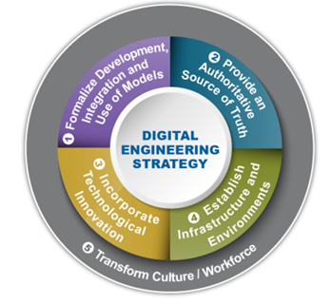
RESULTS – RQ5: Influence of the 2018 DoD DE Strategy
20 out of 56 (36%) explicitly references the 2018 Digital Engineering Strategy
8 papers explicitly mention all 5 goals.
4 papers explicitly mention 4 goals(1,2,3,5)
1 paper explicitly mentions 3 goals (1,2,3)
1 paper explicitly mentions 2 goals (2,3)
2 papers only mention 1 goal (2)

Slide 27
RESULTS – RQ5: Influence of the 2018 DoD DE Strategy
Goal 1 (Formalize Models/Decision-Making): Commonly linked to MBSE, digital surrogates, and methods for model development and use.
Goal 2 (Authoritative Source of Truth): Extends MBSE into data integration, standardization, and unified model repositories.
Goal 3 (Technological Innovation): Tied to research on model-based testing, digital surrogates, and analytics-driven design.
Goal 4 (Infrastructure/Environment): Less frequent; focuses on improving digital engineering tool chains and acquisition systems.
Goal 5 (Transform Culture/Workforce): Addresses workforce training, development, and organizational adaptation for DE adoption.

Slide 28
CONCLUSION

Slide 29
CONCLUSION
Definition of Digital Engineering
Benefits of Digital Engineering
47/56 papers (87.5%) report benefits, primarily efficiency, integration, and cost reduction.
Only 23 of 56 papers (41%) define DE, and 56.5% of those reuse DoD wording, indicating the concept of DE is well known to not require a definition or potential fragmentation of what DE means.
Common Components of Digital Engineering
Simulation (39 mentions) and MBSE (37) are the most frequently listed components within Digital Engineering, showing a strong bond with the ideas of Systems Engineering.

Slide 30
CONCLUSION
Challenges and Solutions to Digital Engineering Implementation
The main barriers are interoperability and standardization gaps, governance and workforce issues, and unclear ROI, and the leading solutions are standardization and metrics (15 papers), governance and leadership (14), and simulation and digital twins (13), and 33/56 (59%) propose new frameworks.
DoD Strategy’s Lasting Influence to Digital Engineering
20/56 (36%) explicitly cite the 2018 DoD DE Strategy, with strongest alignment to Goals 1–3 and weaker coverage of Goals 4–5.

Slide 31
THANK YOU!
Landon Womack, PhD Student, UAH
Ana Wooley, Assistant Professor, UAH

