Slide 1




NOV STC Testing

Slide 2
Agenda
STC Facility and Purpose
Purpose of Testing
Quick overview of concepts out of academic research
Specific Machinery Chosen for Testing
Results of Testing
Where NOV is going

Slide 3

Aspects & Impacts Sustaining gains
People
Equipment- Infrastructure
Something Else
Aspect is a cause or reason
Impact is an effect or result

Slide 4
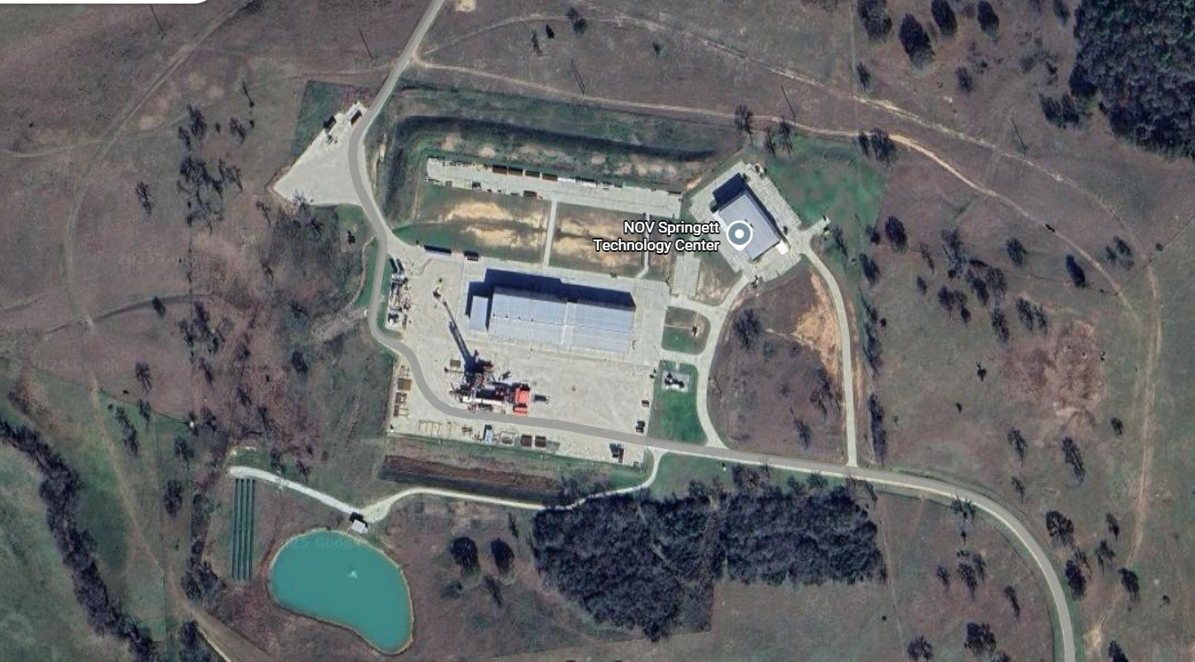
STC Facility Purpose and History
Oct 2014
Start Drill Ops
Start of Facility
Example Partners
Industry
-Shell
-Exxon
-Halliburton
-Acacia Energy Solutions
-Vendors
-Start-ups - Tech Review
University
-UT RAPID
-TX A&M
-SMU
-LSU
-OU
Coil Tubing- Extended Reach
Renewable Tech
Completion Tech
Emissions Monitoring
Lab Bay
Drill Ops
Geothermal
Tech
Renewable Tech
Research & Accelerating Products to Market
Drilling Space: 2,800acres → 12,000ft Depth w/ 10,000ft Horizontal Reach
To Date: >70 well programs

Slide 5

Purpose of Testing
Statement of Fact:
Diesel Engines will continue to play a vital role industry and consumer.
Consideration:
Key infrastructure not supportive remote for newer technologies.
AI Generated Image

Slide 6



Purpose w/ Value
There is a reality to life
No Deleterious Effect
High Value Categorical Areas
-Emissions
-Fuel
-Performance
-Machine Longevity
-Extension of Oil Life

Slide 7
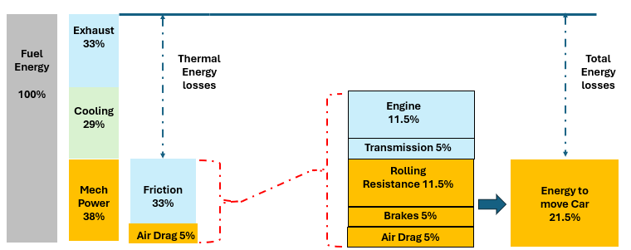
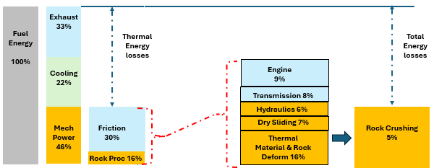
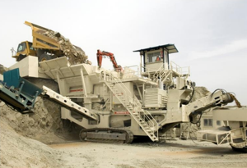
Energy Usage in a Machine
Where does it go
Fenske, G. Ajayi, L. et al. (2014) Engine Friction Reduction Technologies. Argonne National Laboratory Project ID #: FT012 June 19’th, 2014. ft012_Fenske)2014_p (presentation)
Holmberg, K., et al. (2017) Global Energy Consumption Due to Friction and Wear in Mining Industry. Accepted for publication in Tribology International, 5.5.2017.

Slide 8
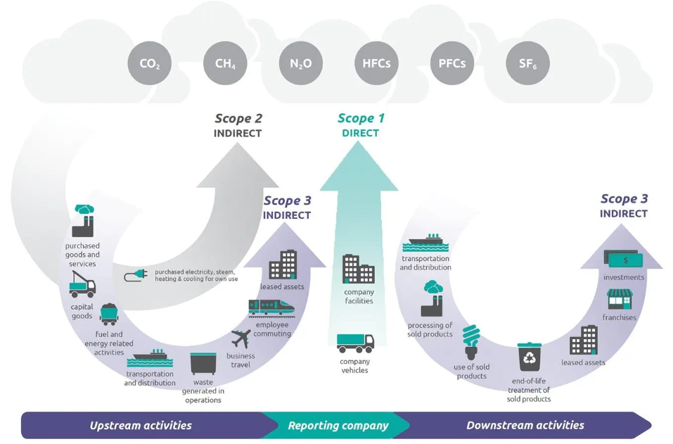
Factors of Testing Direction
Source: https://www.csl.com/we-are-csl/vita-original-stories/2023/explainer-what-are-scope-1-and-scope-2-emissions-targets
Keeping things simple is helpful

Slide 9

Testo 350 Instrument
-Easy to operate/maintain while being able to be used for EPA measurements.
-Accurate snapshot emissions
-Easy to train people in use and collection of emission data
Instrument set-up to measure NOx, CO, CO2 (by IR measure vs. calc), SOx, Exhaust Temp
Have kit, pitot tube, to measure exhaust flow (required to convert ppm to lb/hr)

Slide 10
Research on Coolant Temperature
Engine coolant temperature directly impacts performance, efficiency, and emissions.
Lower coolant temperatures:
Improve heat transfer.
Reduce metal temperatures in the cylinder head, cylinder, and piston.
Lower average gas temperature and pressure.
Increase frictional losses and reduce work transferred to the piston.
Cause higher thermal stresses due to larger temperature gradients.
Emission impacts:
Changes in gas temperature affect formation of NOₓ, CO, CO₂, and unburned hydrocarbons.
Reference: Heywood, J.B., 1988, "Internal Combustion Engine Fundamentals," McGraw-Hill

Slide 11
Why is Temp Important
Gensets (e.g., for portable power fleets)
experience power derating at high ambient temperatures.
Slower rise to operating limits
extends engine performance range.
Greater rated power availability
in hot conditions offers a competitive edge over systems without this capability.

Slide 12

Oil Sampling
This can be an installed sensor…
Comes up again later
TBN (Total Base Number): measures the amount of alkaline additives in the oil. These additives help neutralize acids that form during engine operation, such as those from fuel combustion or oil oxidation. A higher TBN indicates a greater capacity to neutralize acids, which can prolong the oil's life and protect the engine.
TAN (Total Acid Number): measures the amount of acids present in the oil. These acids can be corrosive and damaging to engine components. A rising TAN indicates that the oil is becoming more acidic and may need to be changed.
TBN & TAN should ideally be monitored together → TBN should be higher than TAN so oil can effectively neutralize acids. Good for monitoring necessary oil changes.

Slide 13
What tests selected and why

Slide 14
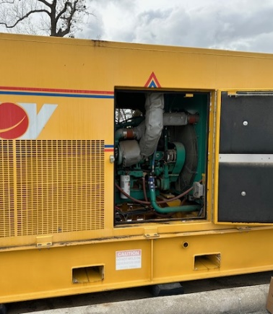
Portable Power Unit
Has historical Data, directly from NOV Portable Power Fleet
Unit can be run without impacting field operations
Unit can control working load on machine
Many facilities have varying sizes of stand-by power
Cummins Model: QSM11-G4 NR3 10.5L

Slide 15
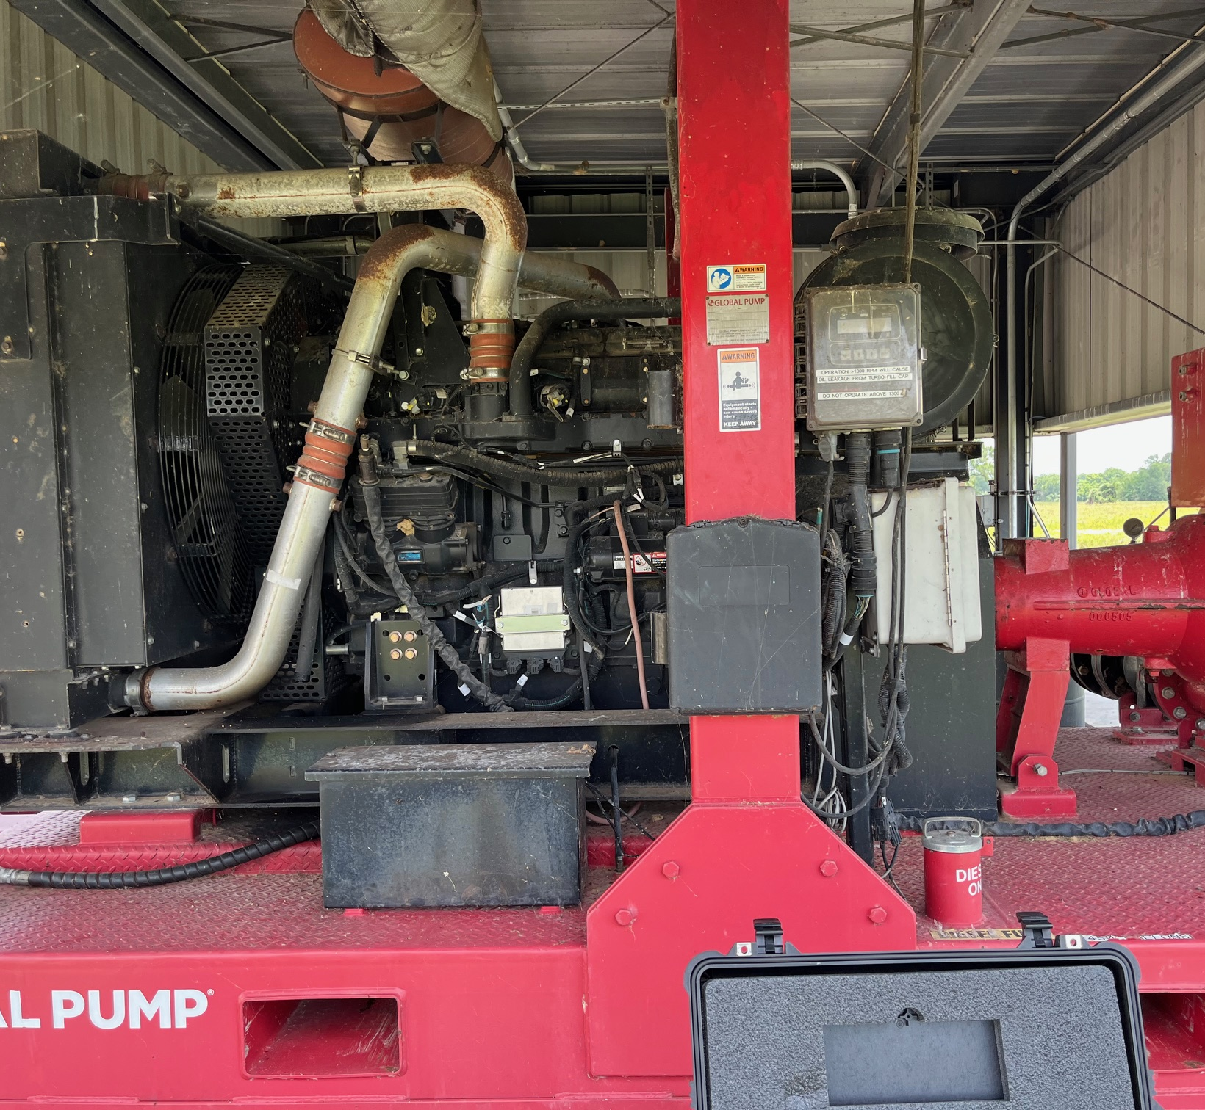
Pond Pump
Can run more routinely than Portable Power unit for building.
Reflective of many utilitarian diesels throughout NOV
-Diesel Driven equip including mobile rig size
-Diesel driven auxiliaries
-Diesel portable equipment
Typically, Higher emissions
John Deere Model: 6135HF485 13.5L

Slide 16
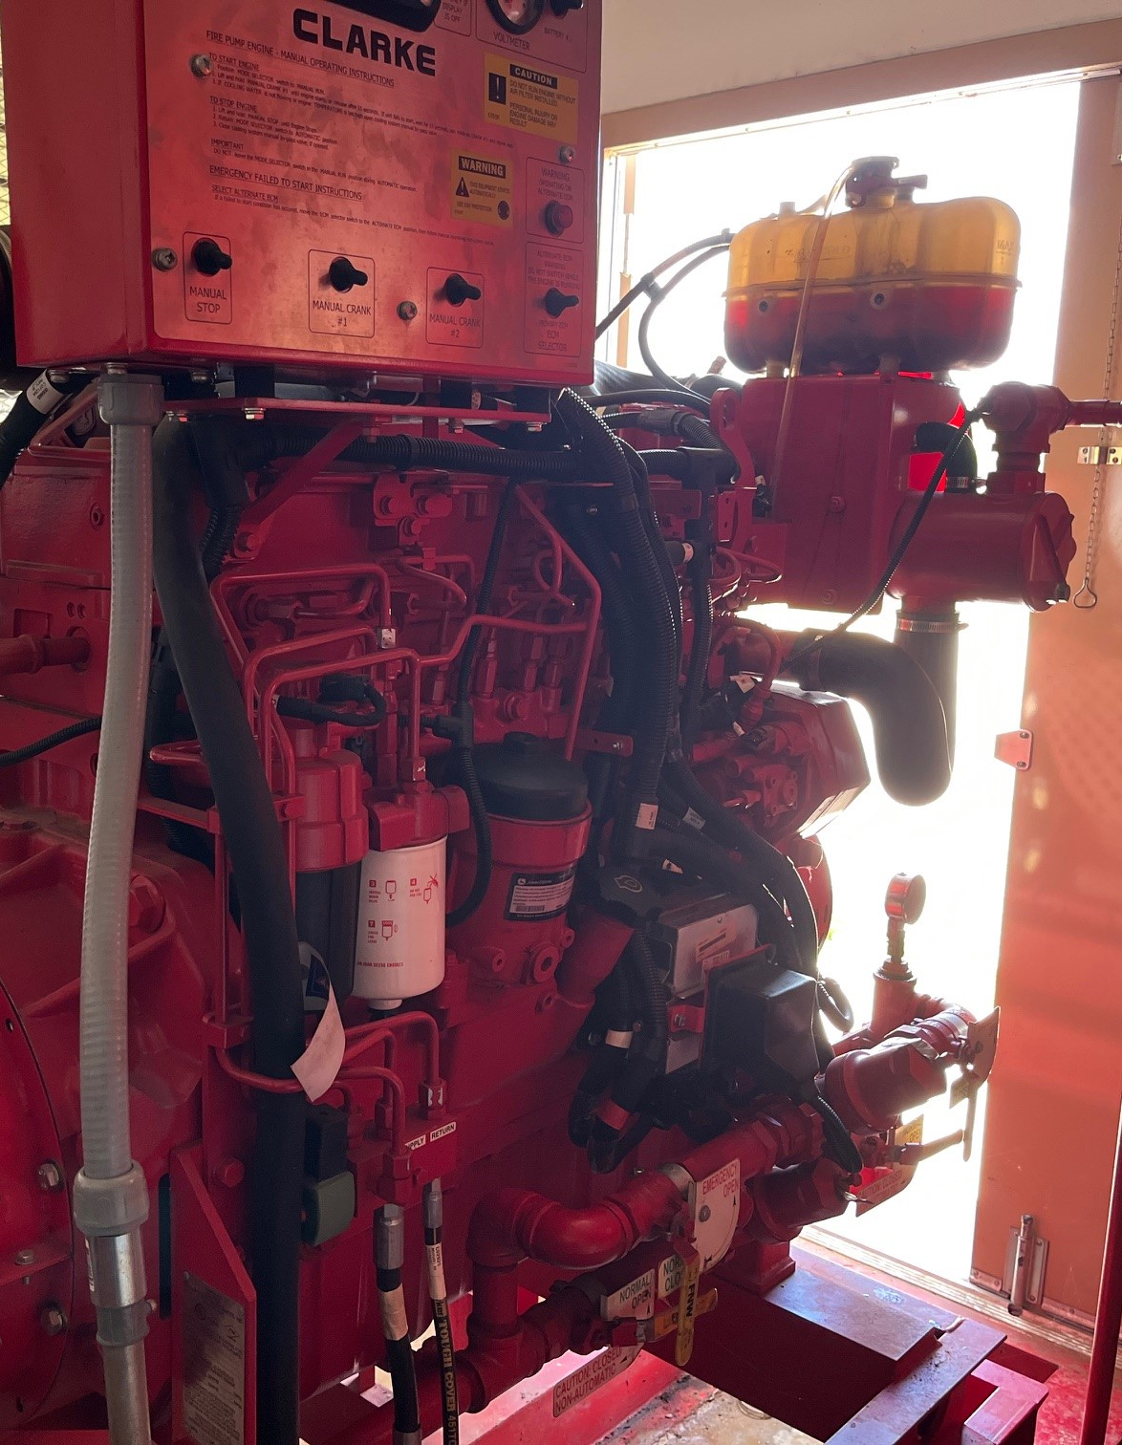
Fire Pump
Must be run by insurance requirements on a very controlled duty cycle.
Most facilities in the NOV network have a similar system
John Deere Model: 6090HFC47 9L

Slide 17
Pond Pump Current Testing
There is an Anomally in this test given the extreme difference between NOx readings, even though at the same load levels.
This machine was at Low Oil Level and could be burning oil

Slide 18
Fire Pump Current Testing
Reduction
CO= 10.5%
NOx= 20.9%

Slide 19
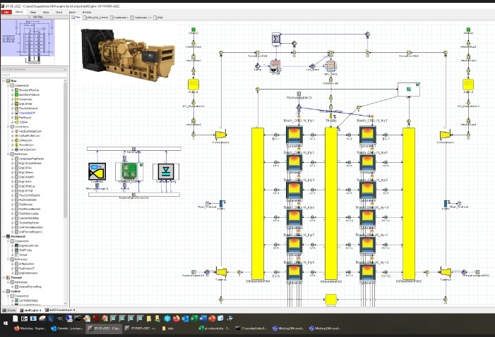
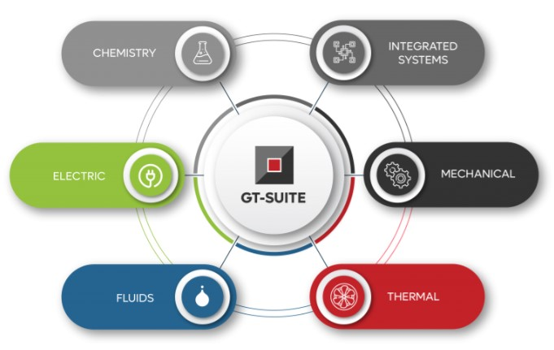
CAT 3512C
Digital Twin Model
And Where Else are we headed?

Slide 20
CAT 3512C Model
Added Features to Prime1
-Real Fuel Consumption meter (KRAL sensor)
-Continuous Emissions Monitoring System
-Maestro Control System to Prime1 Amphion Control System

Slide 21

















Stewardship
Events
Data Hierarchy
Hierarchy
Real Time
Process
Data
Data Analysis
Other
Consolidation
Cloud Services
Maint
Data Solutions
Matching
Reports
Sensors
Data Cleansing & Formatting
Data Quality
Advcd
Process
MetaData
Data Model
Reporting & Visualization
IOT Device
Site
Info
Op Systems
Extract Transform
Master Data Management
Extract Transform
Consumption Layer
Report
Data
Raw Data Storage – Data Lake
SSO Integration - Security
Outside use
Blockchain Potential
Data Management Perspective -ELT {Extract-Load-Transform}

Slide 22
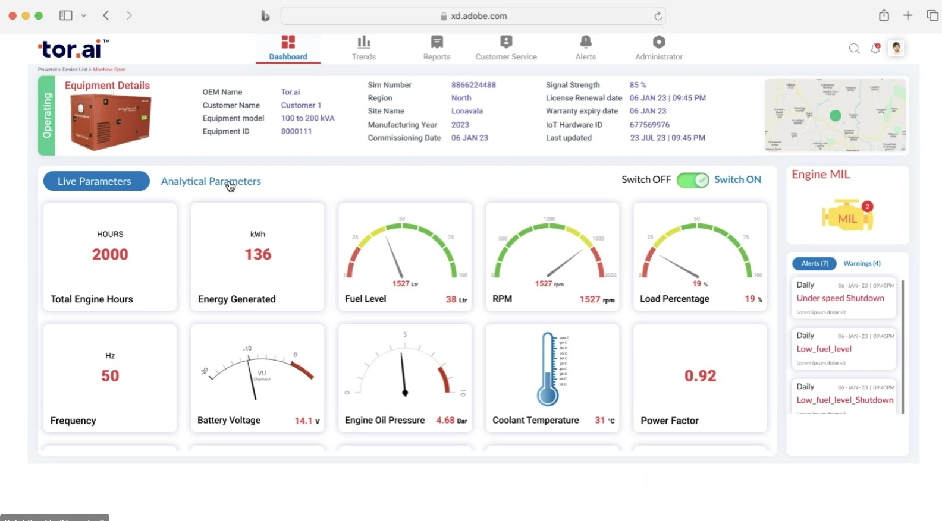
Remote Monitoring Component
Stand-by Genset Example – Simple Dashboard

Slide 23
Conclusion Discussion
Where do we see the horizon
What we are learning
Keeping it simple is an aspect.

Slide 24

Bio – Me in a nutshell
Chuck Wright
Industry Experience
-With NOV for 18 years started in ReedHycalog -Pressurized Drilling Laboratory and currently Corporate R&D Manager multi-disciplinary research and pilot testing. Built out facility and testing capabilities at STC over 10 years.
-Spent 6 years w/ Solar Turbines (Caterpillar) as Plant Engineer (PetroChemical & Power Generation) and as Senior Reliability Consultant on major projects petrochemical and offshore.
Military Service
23 years service, retired, US Navy
11 years active-duty Nuke ET (Reactor Operator) on submarines
12 years Naval Reserve with Direct Commission as Supply Officer
Education:
Nuclear Engineering Thomas Edison
MBA University Phoenix
Advanced Technology - MIT
Not allowed to Sky Dive or Scuba Dive until all kids in college
fourth child graduated in May…
And I love Volcano walking…

Slide 25
ENGAGEMENT METRICS
IMPACT FACTOR | MEASUREMENT | TARGET | ACHIEVED
Factor | Percentage (%)

Slide 26
Research on Coolant Temperature
Coolant Temperature Engine Operating
“The engine coolant temperature affects engine performance, efficiency, and emissions. Lower coolant temperature increases heat transfer and reduces temperatures of the metal of cylinder head, cylinder, and piston. However, this lowers the average gas temperature and pressure, increases frictional losses, and reduces the work per cycle transferred to the piston. Thermal stresses due to temperature gradients increase with lower coolant temperatures. Changes in gas temperature due to the change in coolant temperature influence the emission formation of nitrogen oxides, carbon monoxide, carbon dioxide, and unburned hydrocarbons”
Reference: Heywood, J.B., 1988, "Internal Combustion Engine Fundamentals," McGraw-Hill Book Company, New York.
Gensets, like for Portable Power Fleets, have power derating (cannot reach full power) when temperatures push higher. Stretching the time it takes for the engine to hit op limits means greater available rated power during higher temperatures → competitive advantage over machines w/out.

