Slide 1

Designing Reliable AI: The Role of Dynamic Explanations in Enhancing Trust, Attention, and Usability in Human-AI Teaming
RAM XVII Training Summit
Dylan Wright
Graduate Student
Department of Computer Science
University of Alabama in Huntsville

Slide 2
Outline
Introduction | Perception and attention bottlenecks in high-stakes decision making
Background | Current research in AR, XAI, and the human-AI teaming gap
Research Objectives | Aligning explanations with OODA stages in AR
Study Design | Hostage rescue simulation, static vs. perceptually aligned explanations, data collection
Results | Objective performance (time, density, pacing), Biometric analysis (gaze, HMD data), Subjective survey insights (trust, workload, attention)
Conclusion | Contributions, discussion, future work

Slide 3
Introduction

Slide 4
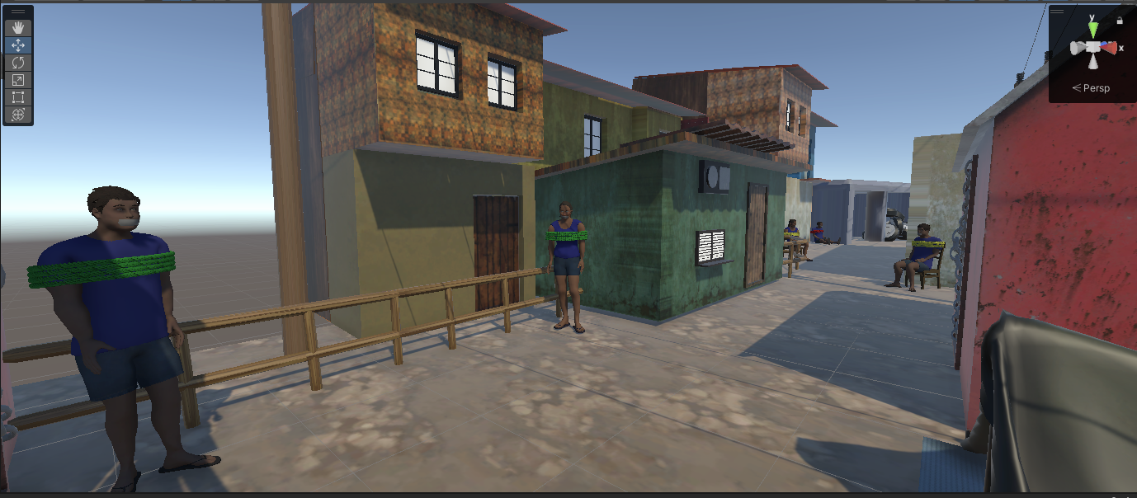
Quick! Who Do You Rescue First?
Notes:
Let’s start with a scenario.
You enter this environment alone, on your own, and see multiple hostages who all need help. The question is simple but difficult: Who do you rescue first?
Do you go for the closest? The most injured? The one hidden away?
(Pause 1-3s)
This is the kind of high-stakes decision where every second matters, and yet human attention is limited.
That balance between urgency and overload is the core problem my research addresses.

Slide 5
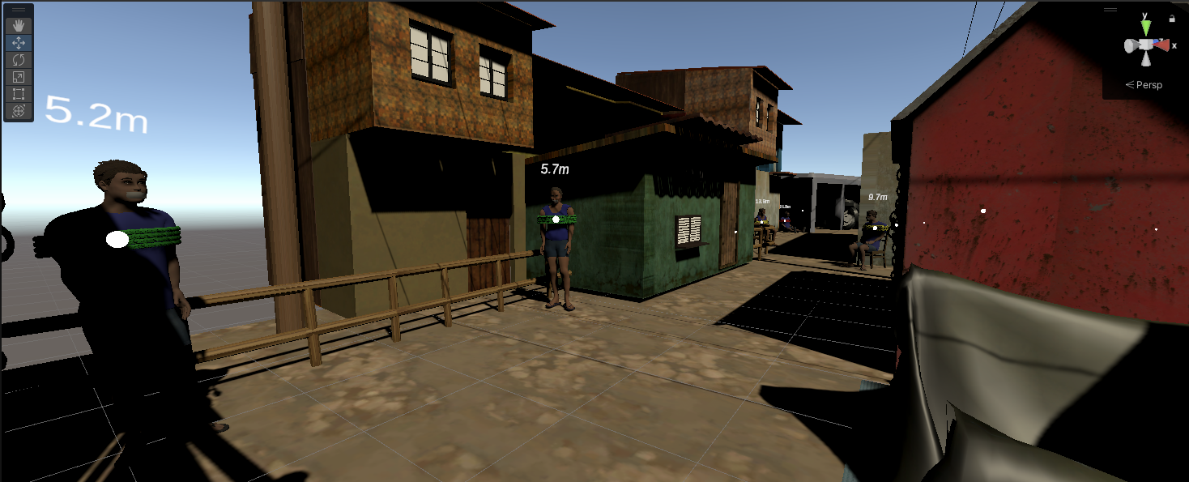
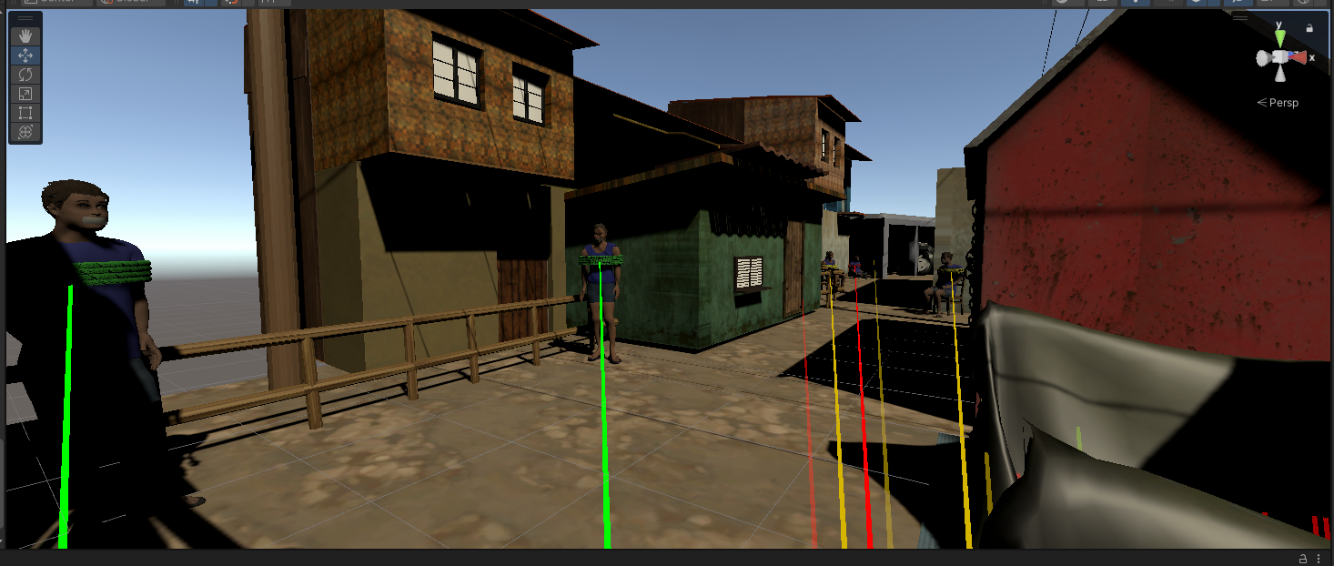
Explanations in Action:
Static vs Perceptually Aligned
Static Explanations
Perceptually Aligned Explanations
Notes:
Now let’s imagine you’re not entirely on your own. You’re supported by a drone equipped with state of the art image detection AI that can spot hostages for you.
On the left, you see the static explanations → simple pinpoints or labels that tell you where hostages are located. This helps with perception, but it leaves the sensemaking up to you.
On the right, you see the perceptually aligned explanations → tethers that adapt to urgency, occlusion, and triage level. These don’t just tell you where someone is, they help you prioritize and anticipate.
From a user’s perspective, both of these are a form of explainable AI. But they’re very different in how they support Situational Awareness.
And that’s the problem I set out to study: not just whether explanation delivery changes hard measures like performance, but how it shapes the full picture:
objective outcomes, subjective perceptions of trust and workload, and biometric signals of attention. This fusion is what makes my study novel.

Slide 6
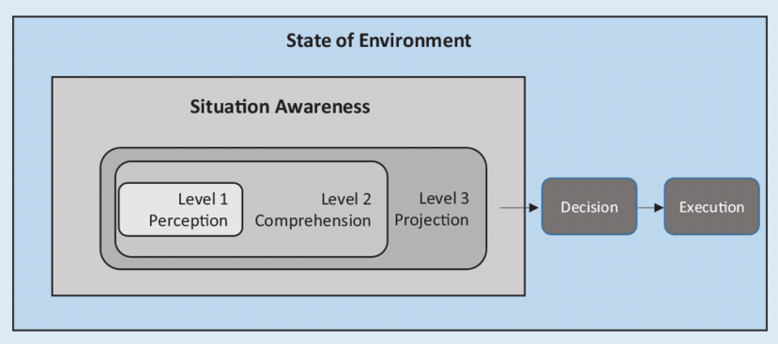
Situational Awareness (SA) Shapes “Who You Rescue First”
Endsley’s 3-Level SA model diagram (Perception → Comprehension → Projection)
SA defines what you notice, what you understand, and what you anticipate
XAI overlays can map onto each level
  Decision of “who first?” depends on how much SA is supported
Endsley's model of Situational Awareness
Notes:
(Why this matters 2-3 min)
Let’s review how this type of problem “Who do you rescue first?” has been studied in human factors. Endsley’s model of situational awareness describes three levels.
At Level 1, Perception, we simply notice what’s in the environment → in our case, the presence of hostages.
At Level 2, Comprehension, we interpret that information → understanding which hostages are more critical or what threats exist.
At Level 3, Projection, we anticipate what will happen next → if I delay rescuing this person, will they survive?
The ability to cycle smoothly through these levels is what enables effective decisions in high-stakes contexts.
In my study, static explanations mainly support perception and comprehension,
while perceptually aligned explanations begin to help with projection.
This distinction is important because projection is where time pressure and limited attention most often break down.

Slide 7
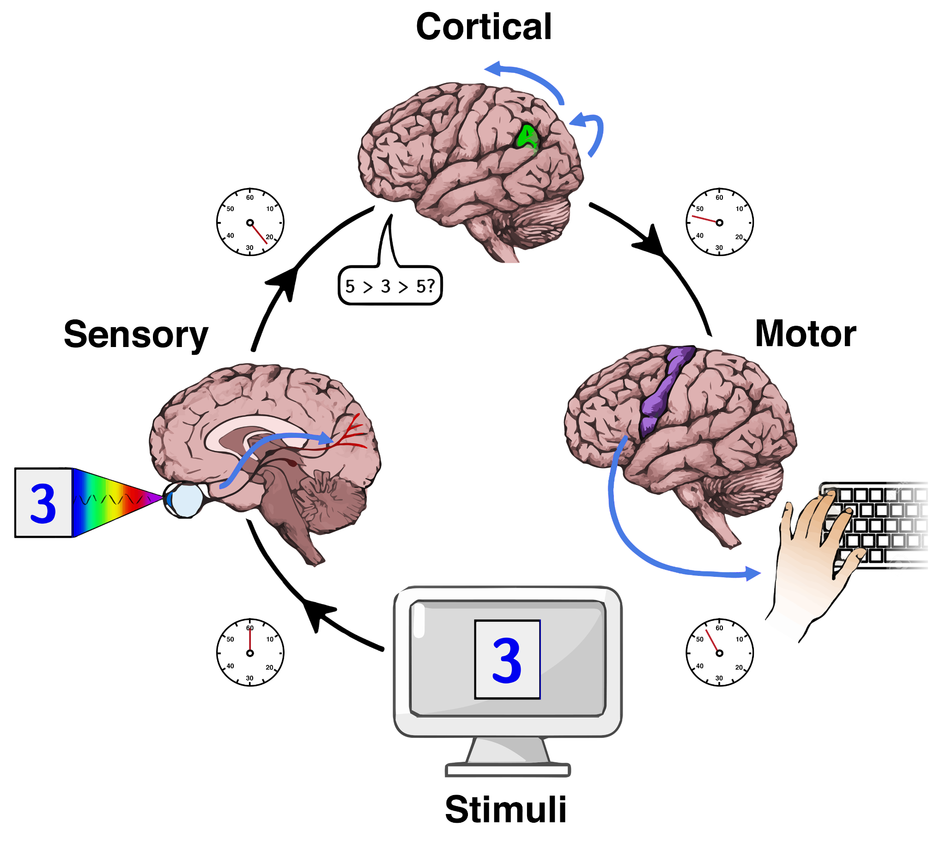
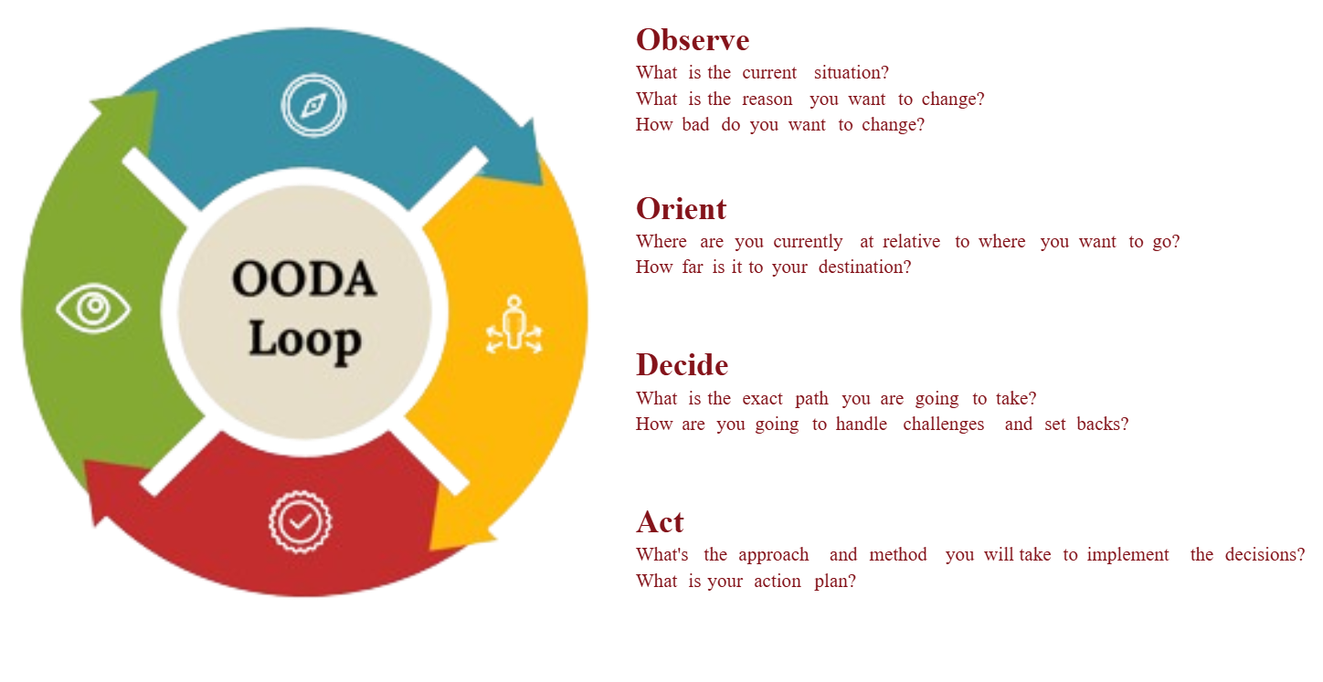
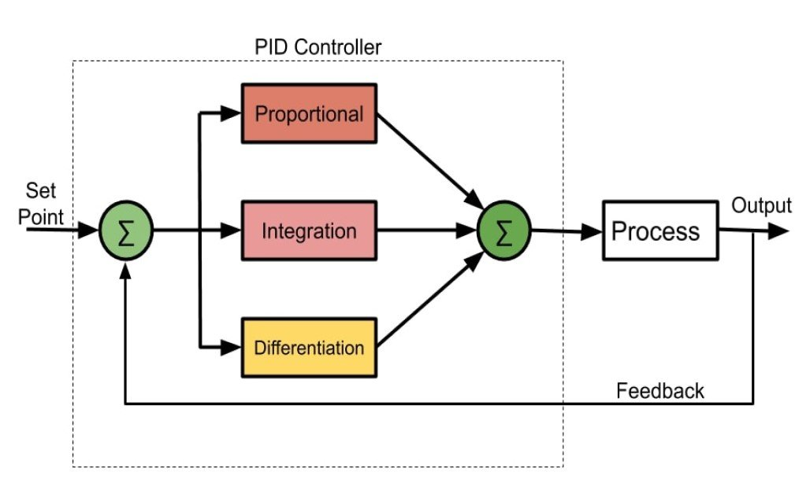
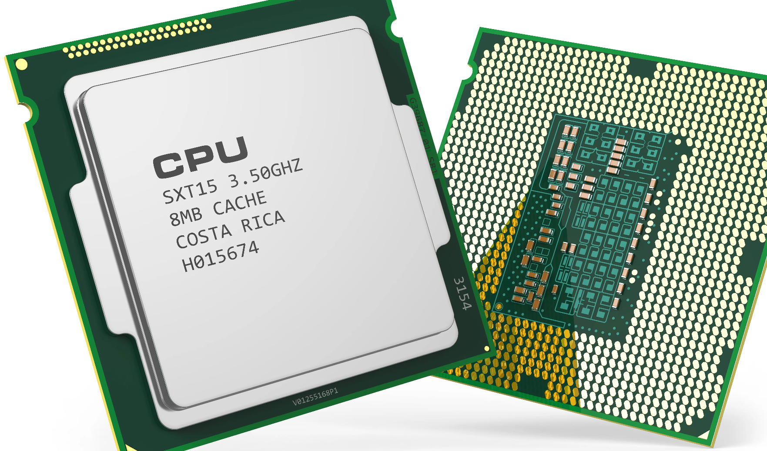
OODA & the Limits of Human Speed
Humans process in ~200–300 ms, capacity fixed by biology
Computers cycle in microseconds to nanoseconds, evolving ever faster
Human decisions still follow cyclical OODA patterns: Observe → Orient → Decide → Act
200 - 300 milliseconds
~1–5 ms
Notes:
OODA loop: Observe, Orient, Decide, Act. It’s a simple model of how humans make decisions → we continuously cycle through these four stages
Now here’s the problem: humans are bounded by biology. Just to process a stimulus and respond takes about 200–300 milliseconds.
That doesn’t change with technology → our brains are essentially the same speed they’ve always been.
(Skip this part)
Computers, on the other hand, operate on control loops measured in microseconds or even nanoseconds.
They can cycle thousands or millions of times before a human completes a single OODA loop.
So the mismatch is clear: human decision-making remains cyclical and relatively slow, while machines evolve ever faster.
And this gap is exactly where breakdowns occur in high-stakes environments → especially in the Observe and Orient stages where attention and sensemaking live.

Slide 8
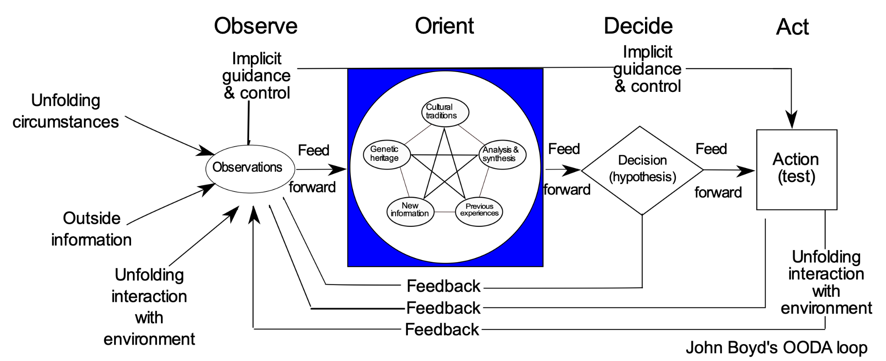
The OODA Loop Bottleneck
Four recurring stages: Observe → Orient → Decide → Act
Observe + Orient: foundation of perception and sensemaking
Bottleneck: human attention, overload, and fatigue slow these stages
Advantage: faster, more accurate loops win in high-stakes domains
Notes:
This is the extended version of John Boyd’s OODA loop.
It’s not just a simple four-step cycle: each stage has feedback loops and dependencies.
What you observe feeds into orientation, but orientation itself is shaped by prior experiences, cultural factors, analysis, and synthesis.
Those in turn feed back into what we notice and how we decide.
In practice, this means the OODA loop isn’t linear.
It’s recursive, constantly updating as circumstances unfold.
The further down you go into Observe and Orient, the more complex and fragile things get.
And this is exactly where the bottleneck lives: human attention, sensemaking, and prioritization.
Under stress or overload, Observe and Orient slow down, and the whole loop breaks. Leading to decision paralysis and delayed or suboptimal actions.
This is the part of OODA my research focuses on.
The challenge is: how can technologies like AR and XAI support humans in these early stages, so the cycle keeps moving under pressure?

Slide 9
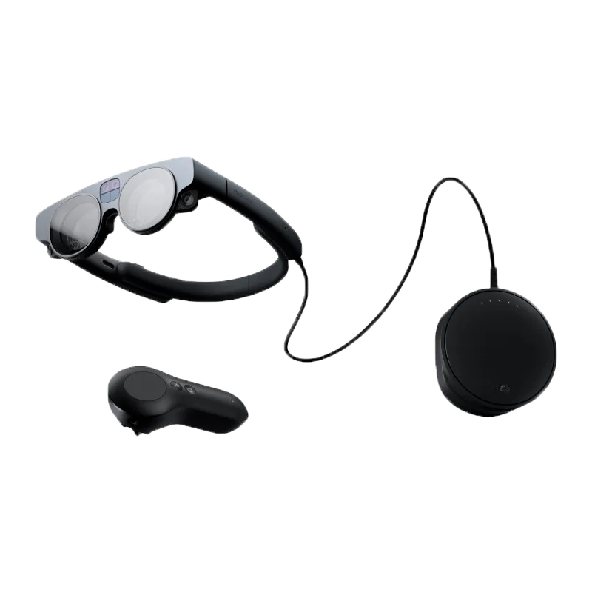


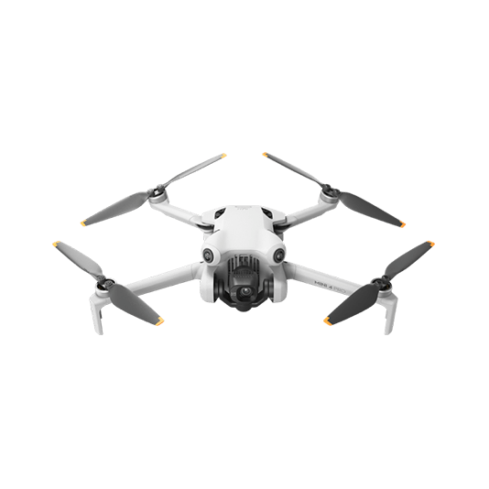
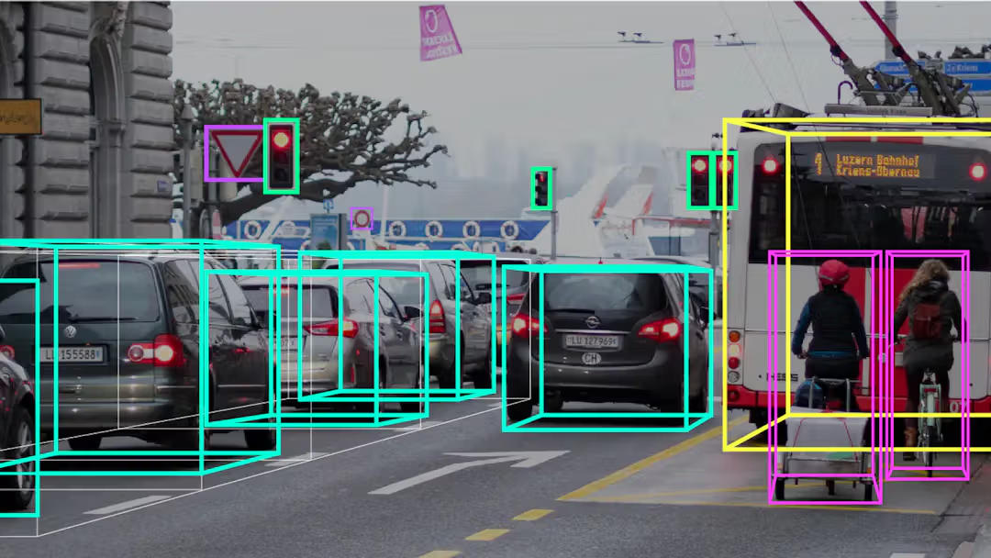

Augmenting OODA
with AR, XAI, and Autonomous Agents
AR and autonomous agents already accelerate the Observe stage
  Via sensors, object detection, real-time overlays
Human bottleneck in Orient -> sensemaking and aligning perception under pressure
Most XAI focuses on outputs, not on human orientation (trust, workload, attention)
  Explanations must align human perception and build trust in human-AI teams
Notes:
So here’s where it starts to come together.
Computers, sensors, and autonomous systems are already excellent at the Observe stage
they can process inputs at thousands of hertz, with microcontrollers, IMUs, and object detection pipelines that leave human attention in the dust.
But humans don’t live in the Observe stage alone → we have to Orient.
That’s sensemaking, prioritization, aligning perception under stress → and that’s the real bottleneck.
What’s striking is that most of today’s XAI work stops at outputs: they give you a saliency map, a confidence score, or some textual justification.
But they rarely help a human orient inside a high-stakes environment.
That’s why the critical research question is:
how do we design explanations that not only inform, but also align with human perception, reduce workload, and build trust?
This is the seam where AR, XAI, and human decision-making actually meet.

Slide 10
Background
Notes:
Here’s how the military has tried to solve similar problems
and here’s where my work picks up

Slide 11
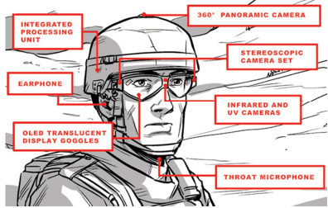
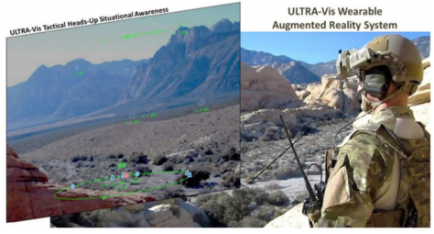
Military Research - HMD AR Tools
IARM: integrates AR displays + data services → supports tactical decision-making
ULTRA-Vis: lightweight holographic display → overlays hazards, forces, vehicles
  Both aim to improve awareness in complex environments
Intelligent Augmented Reality Model project (iARM)
Urban Leader Tactical Response, Awareness and Visualization project (ULTRA-Vis)
Notes:
To ground this in reality, let’s look at how the military has approached AR decision support.
iARM (DARPA/Tanagram Partners): focused on integrating AR displays with data services
→ the goal was to give soldiers a unified, digital view that improves tactical decision-making.
ULTRA-Vis (DARPA): developed a lightweight holographic display overlaying hazards, friendlies, and vehicles directly into a soldier’s field of view.
Both of these aimed to improve situational awareness in complex environments.
But they’re mostly technology-focused prototypes.
What’s still missing is an understanding of how these tools interact with human perception, trust, and workload.

Slide 12
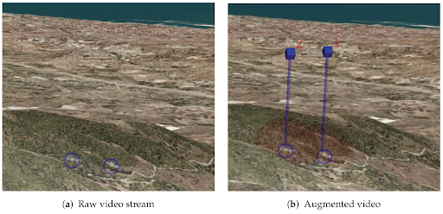
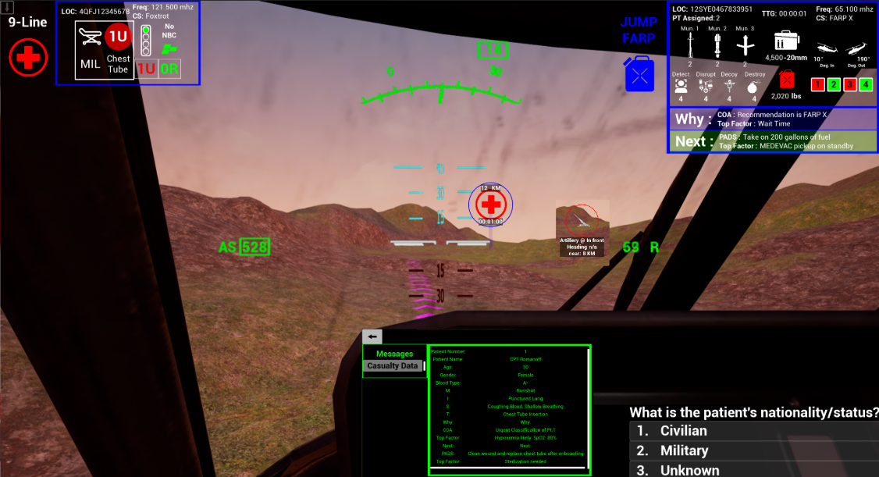
Military Research - Pilot AR Tools
MALE UAV (ISTAR): medium-altitude UAV with AR-supported intelligence, surveillance, and reconnaissance
DIG Study (Harnett et al.): dynamic infographics to reduce MEDEVAC reporting workload
  Both highlight accelerating Observe + Orient in time-critical missions
MALE UAV ISTAR AR Tool
(Sensors 2017 — UPM & UZH)
Dynamic Infographics
(Harnett) MEDEVAC pilots aided in 9-Line reporting
Notes:
Beyond head-mounted AR, research has also looked at pilots and UAV operators.
The MALE UAV ISTAR project (UPM/Zurich, with Airbus testing): created AR overlays for UAV operators
→ highlighting routes, waypoints, and targets to reduce cognitive burden and misinterpretation.
(Skip details, mention keep moving)
The DIG med-evac pilot study (Gina Harnett): used dynamic infographics to help pilots report critical 9-line information during medical evacuations under stress.
Both show that AR + decision support can accelerate Observe and Orient, but again, the gap is in how humans actually perceive and trust those supports under time pressure.
That’s the gap my research steps into
not just the tech, but the human experience of teaming with it.

Slide 13
Research Objectives
Notes:
1 slide

Slide 14
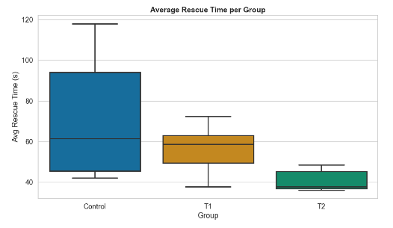
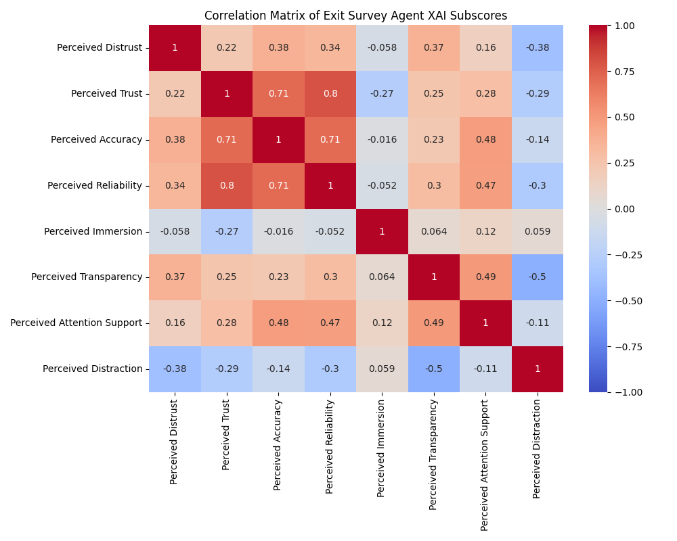
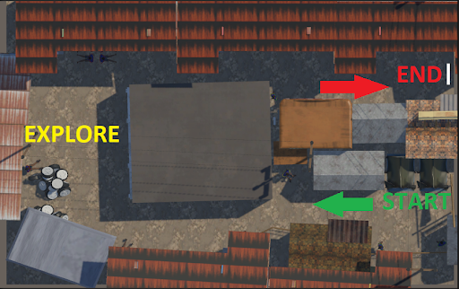
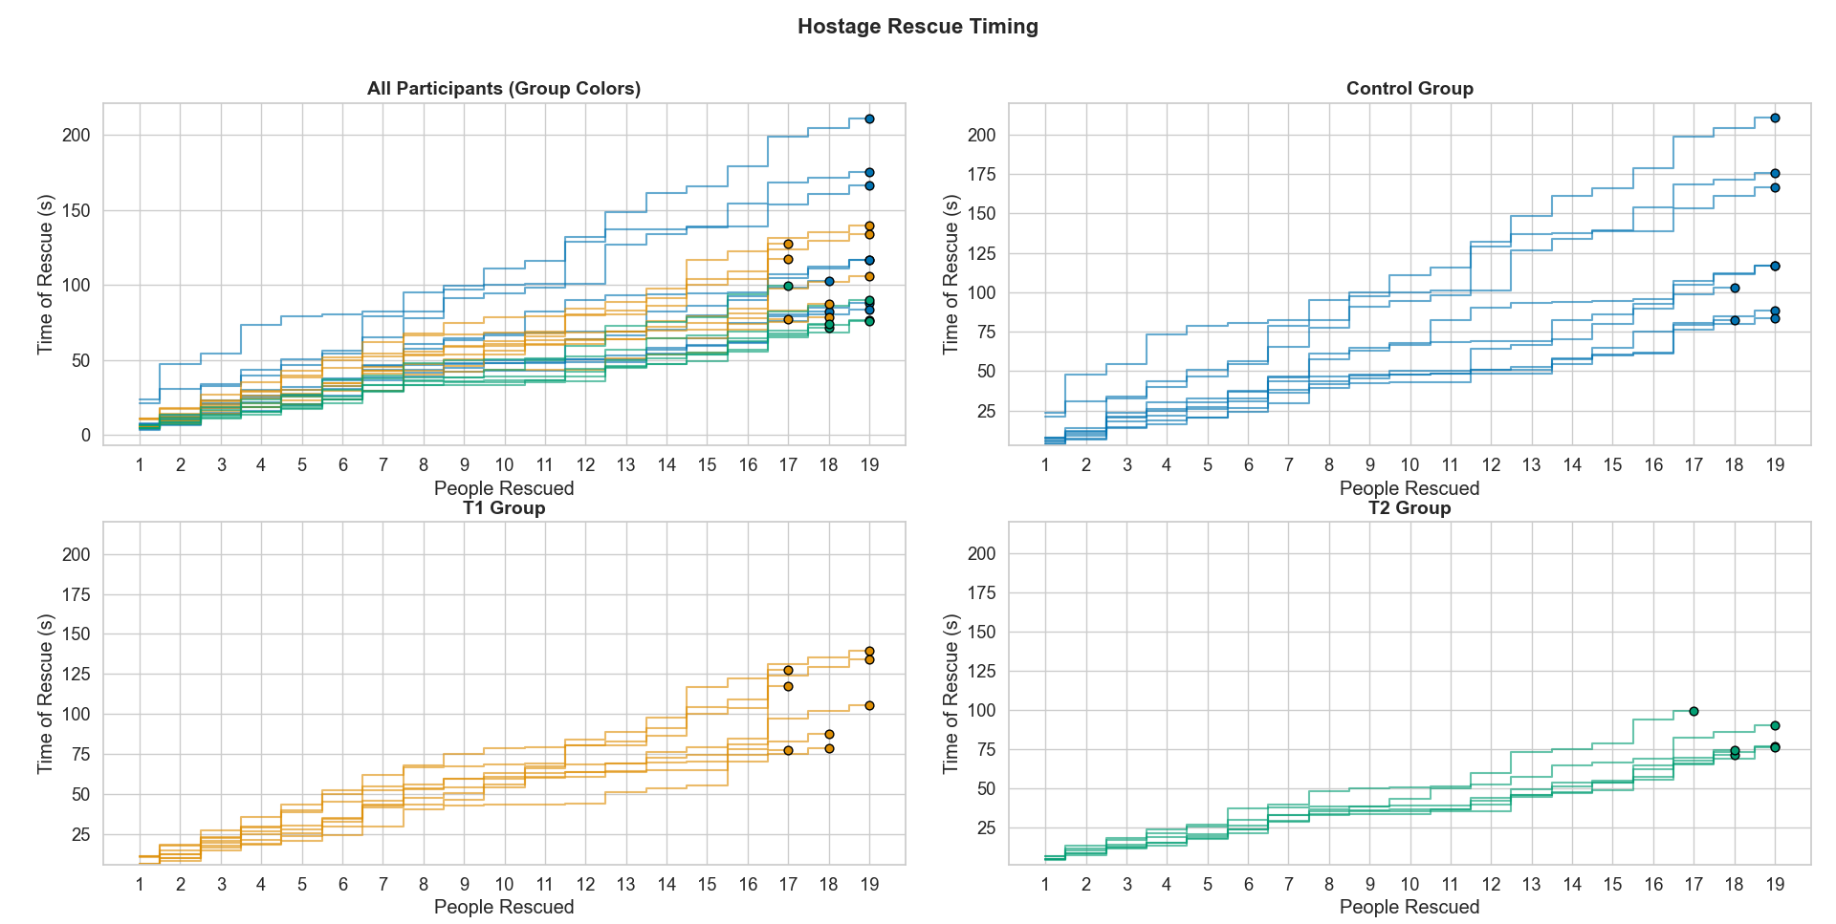
Research Objectives
Develop an OODA-centric framework for Explainable AI in Augmented Reality
Design and implement a high-fidelity hostage rescue simulation testbed (Unity + Magic Leap 2)
Evaluate how AI explanation modality (static vs. perceptually aligned) affect performance, subjective experience, cognitive workload, and trust
Contribute empirical insights into human–AI teaming in high-stakes environments
Notes:
Up to this point, I’ve shown you the theory and the gaps. Now here’s how my work responds.
First, I developed an OODA-centric framework for explainable AI in AR → framing explanations not as static outputs, but as supports across the decision cycle.
Second, I built a high-fidelity hostage rescue simulation — using Unity and the Magic Leap 2 — so participants could actually experience these decision pressures in a controlled environment.
Third, I evaluated explanation modality: static vs. perceptually aligned. Looking not just at performance, but also at subjective experience, cognitive workload, and trust — tying back to Endsley’s SA model.
Finally, this work contributes empirical insights into human–AI teaming — showing how explanations can shift outcomes in high-stakes environments.

Slide 15
Study Design

Slide 16
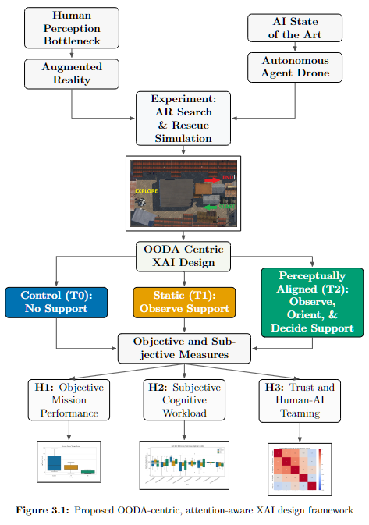
Design & Hypotheses
01
H1 (Objective Performance):
Perceptually aligned explanations → faster rescues, fewer missed hostages
02
H2 (Subjective Workload):
Perceptually aligned explanations → lower cognitive workload, better attentional support
03
H3 (Trust in AI):
Perceptually aligned explanations → higher calibrated trust and reliance under pressure
Notes:
(Be here by 10-15 min)
In the AR search-and-rescue simulation, participants have to save hostages under time pressure.
They were placed in one of three conditions:
T0: Control – no AI support.
T1: Static explanations – overlays showing information but not adapting.
T2: Perceptually Aligned explanations – dynamic cues that adapt to context (Observe, Orient, Decide).
From this setup, I tested three hypotheses:
H1: Dynamic explanations improve objective performance → faster rescues, fewer hostages missed.
H2: Dynamic explanations reduce subjective workload → lower cognitive strain, better attentional support.
H3: Dynamic explanations improve trust in AI → participants are more willing to rely on the system when under pressure.
These map directly onto the OODA bottlenecks we discussed: performance, perception, and trust.

Slide 17
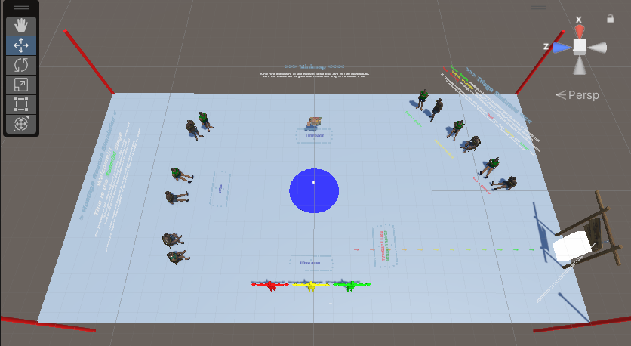
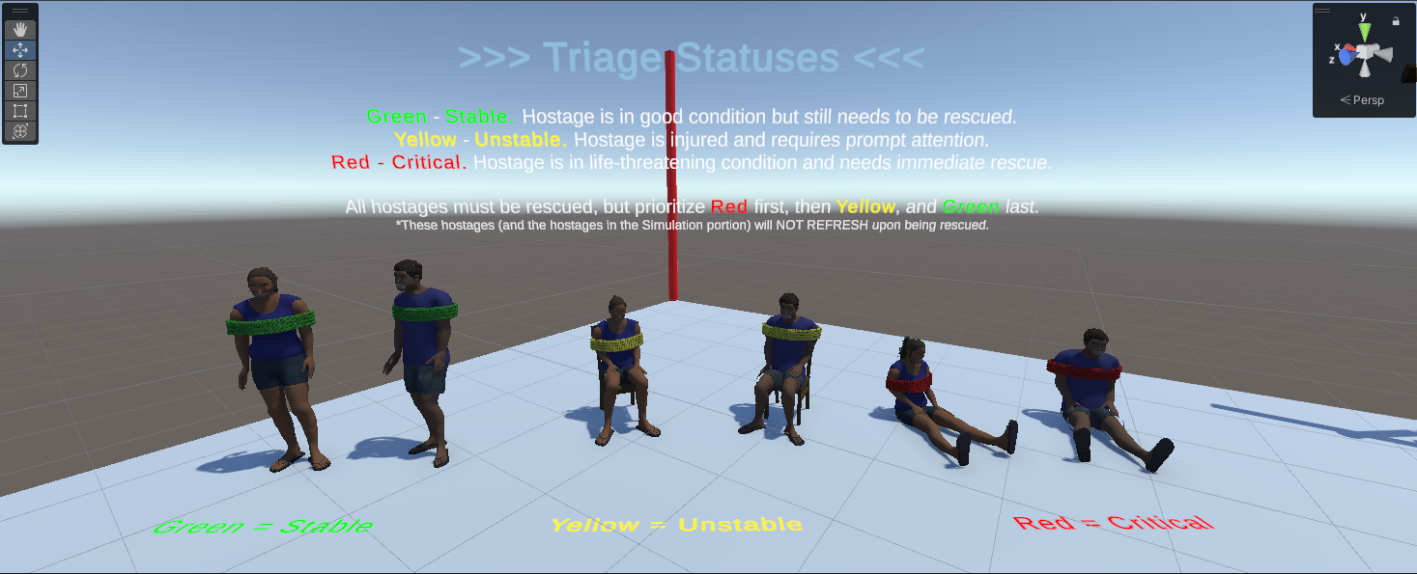

Simulation Setting & Hostage
Notes:
Here’s what the participants actually experienced inside the simulation.
They began with a tutorial phase: a short acclimation period where they got comfortable moving in AR and learned how to interact with the hostages.
Before starting, they were primed with their mission: rescue as many hostages as possible, as quickly as possible.
Hostages were assigned triage categories—green, yellow, red—mirroring real-world medical urgency. This created an added layer of prioritization: do you go for the easy rescues, or the critical but harder ones?
The layout forced participants to utilize the entire space, moving through a kind of horseshoe-shaped exploration path from start to end.
This design kept them under constant time and attention pressure, much like a real high-stakes environment.

Slide 18
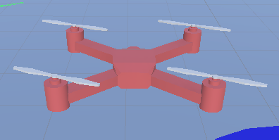
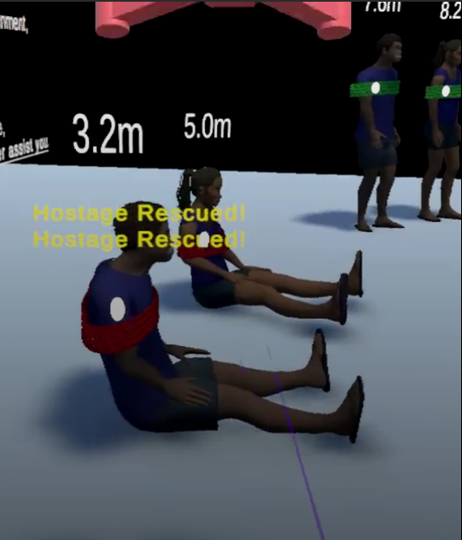
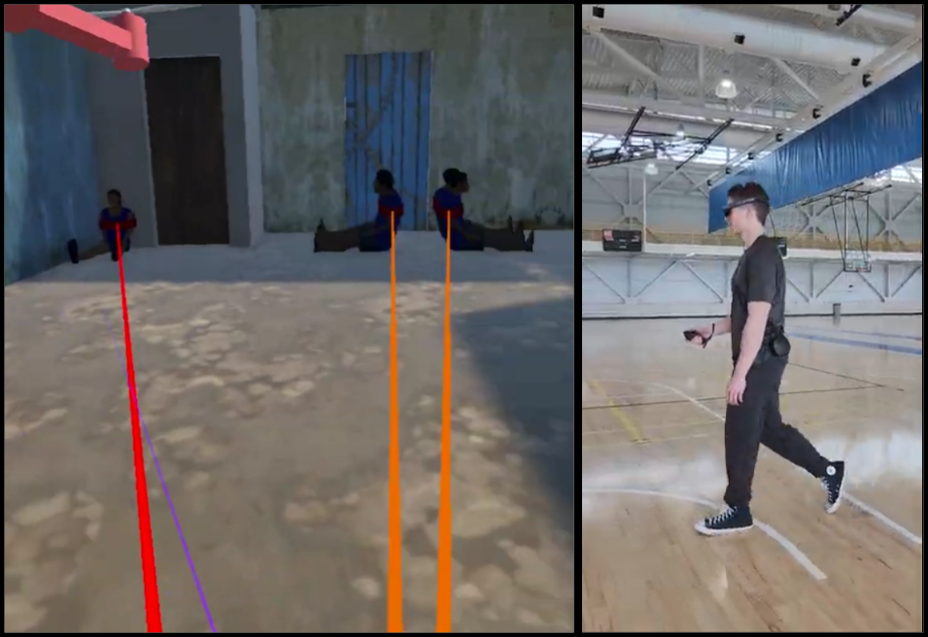
Hostage Triage & Drone XAI
Blue = Control
Orange = T1/Static
Green = T2/Perceptually Aligned
Notes:
Now here is how the actual rescue portion looked from the headset:
In blue, the control group had no support. Participants relied entirely on their own perception and memory of the environment.
In orange, the static condition (T1), participants received fixed overlays — simple distance labels and a 3D sphere centered at the core of AI drone spotted hostages, but the text and 3D sphere was fixed. It provided information, but didn’t guide attention dynamically.
JUST the Observe phase of OODA, like most XAI systems.
In green, the perceptually aligned (T2) condition added dynamic tethers. These tethers changed based on context. The opacity shifted if a hostage was occluded or visible, the base color reflected the triage category, and the shading varied as you moved closer or further away. Importantly, the tether was anchored just in front of the operator’s waist, so no matter where they turned, it remained visible and could guide attention in a full 360 degrees.
Provide support across Observe, Orient, and even Decision parts of OODA.
The question: from no assistance → static information → dynamic, perceptually aligned support:
How does each of these explanation modalities change not just task performance, but also subjective performance (workload, trust, and user experience), and even biometrics?

Slide 19
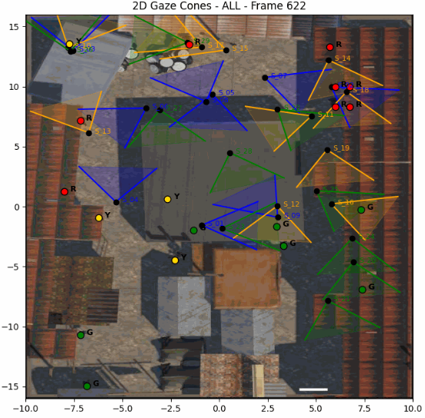
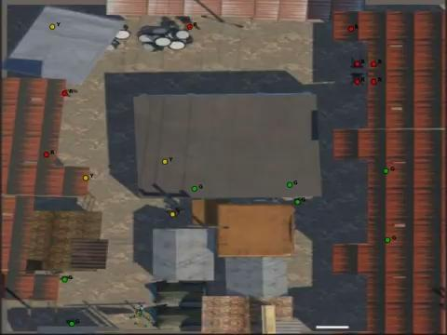
Rescue Simulation
Notes:
Skip x frames, can insert extra frames

Slide 20
Results

Slide 21
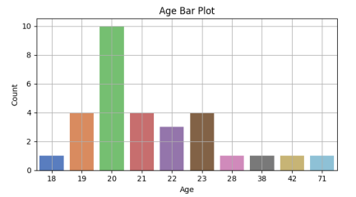
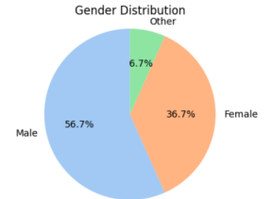
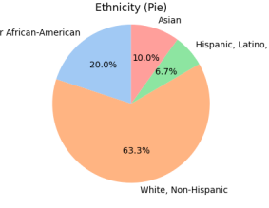
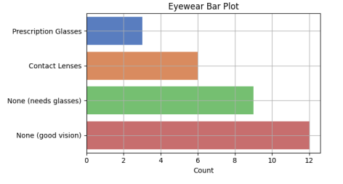
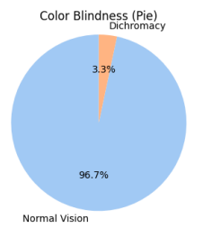
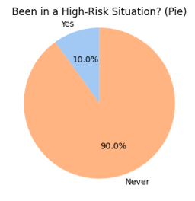
Demographics (n=30)
Age
Gender
Ethnicity
Eyewear
Color Blindness
High Risk
Notes:
Majority 19-23
Typical distribution you would find on UAH campus
Some of the participants with prescription glasses either wore them underneath the headset, or took them off for the trial without issue.

Slide 22
H1: Objective Performance

Slide 23
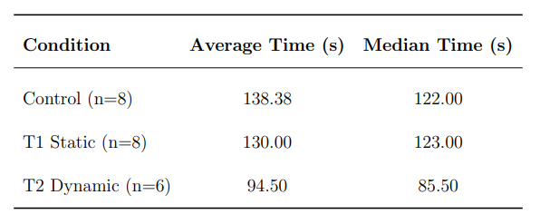
H1 - Objective Performance
AVG Rescue Timing per Group
Mission Completion per Group
Notes:
The final analysis JUST FOR Objective Performance included 22 participants — 8 in the Control group, 8 in the Static condition, and 6 in the Dynamic condition.
A few participants had technical issues that affected their performance logs (glasses, headset losing tracking), or misunderstood the rescue prompt and spotted everyone then went back to rescue them. So for those cases, their objective performance measures were removed.
However, their survey responses were still valid, so we retained those for the subjective analysis in Chapter 4. This way, the comparisons you’re about to see are based on valid performance data.

Slide 24
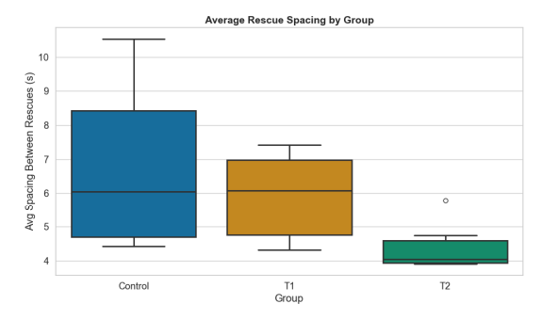
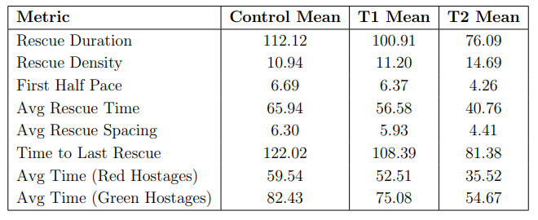
H1 - Objective Performance
Rescue Spacing per Group
Miscellaneous Measures
Notes:
Rescue spacing reduction shows the fluidity of rescue, how they moved from one to the next rescue:
objectively capturing rescue smoothness / similar to how smooth the OODA cycling is physically playing out
Miscellaneous metrics further illustrate some unique differences
Bar charts comparing on next slide

Slide 25
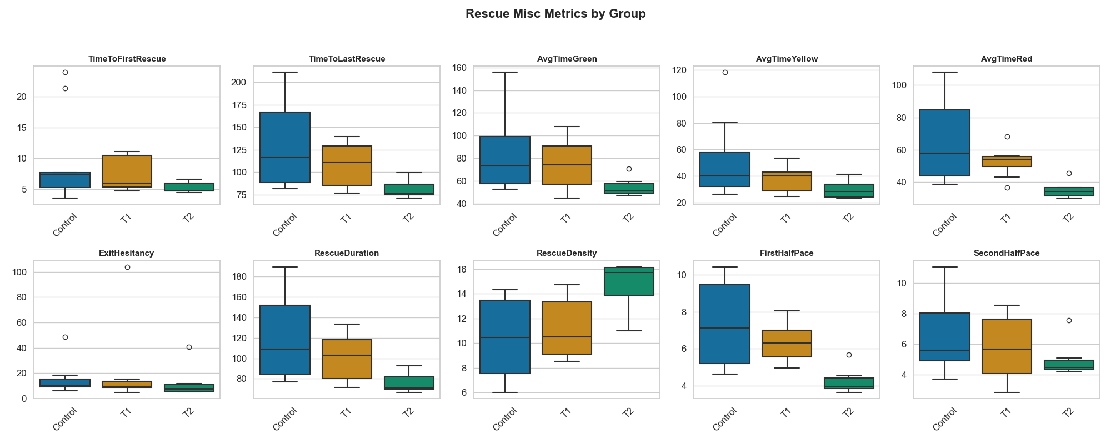
H1 - Objective Performance
Miscellaneous Measures (Box = Significant)
Notes:
- TimeToFirstRescue: seconds to first hostage rescue.
- TimeToLastRescue: seconds to last hostage rescue.
- AvgTimeGreen, AvgTimeYellow, AvgTimeRed: average rescue time per color.
Distinct speedup on the green and red, high and low urgency for T2.
- ExitHesitancy: time (s) from last rescue to scene end.
- RescueDuration: total time (s) from first to last rescue. (more true measure of performance in case of lingering at start/end)
- RescueDensity: rescues per minute across active rescue duration.
- FirstHalfPace: avg spacing (s) between rescues in the first half. (Split at half their total rescue time)
- SecondHalfPace: avg spacing (s) between rescues in the second half.
Difference between first half pace and second half pace shows how quickly users ADAPTED to the system
Very interesting to see that in the second half, the pacing was together among groups, but at the start it was intuitive for T2 users.

Slide 26
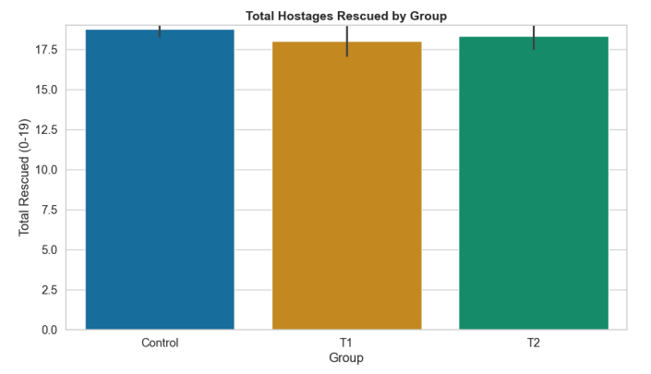
H1 - Objective Performance
Total Rescued per Group (19 = Max)
Notes:
Total hostages rescued
The only time people missed hostages were at the start, whether they turned around or looked over their shoulder or if they continued down the entry hallway area

Slide 27
H1 - Objective Performance
Total Rescued per Group (19 = Max)
Notes:
Stepwise graph for performance
Here we see clusters for blue are random, scattered
T1 tighter cluster, T2 tightest
Very distinct difference between group behaviors, meaning that we can really see how the explanations affected behavior
Perceptually Aligned supports performance -> H1
Circle back to OODA. Double down on novelty.

Slide 28
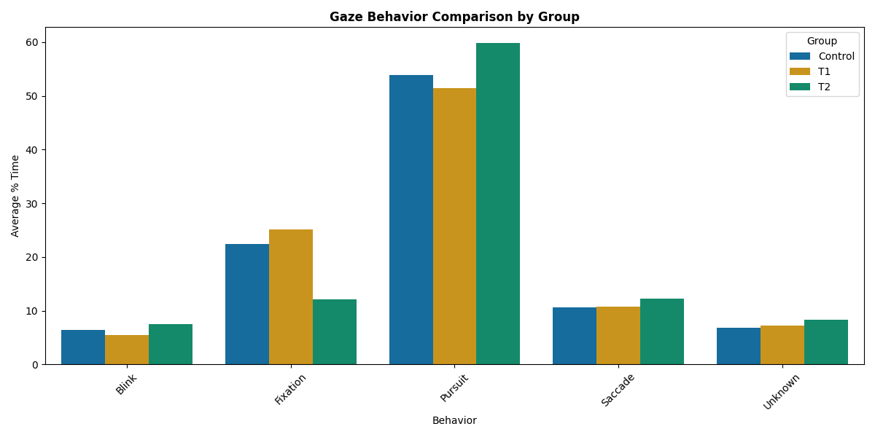
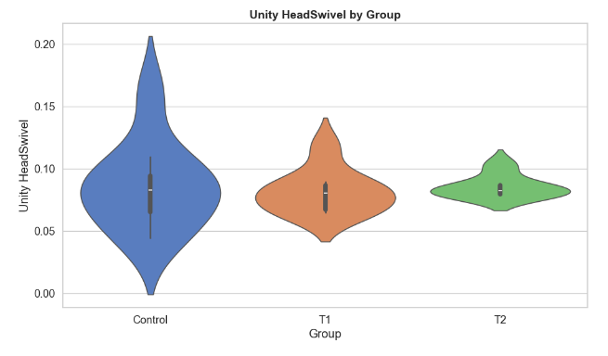
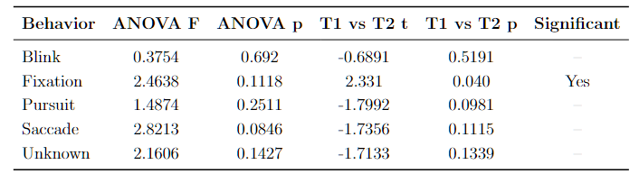
H1 - Cognitive Performance
Head Swivel (XZ-Plane)
Gaze Behavior Breakdown
Notes:
On the left, you see a breakdown of gaze behaviors.
Participants spent their visual attention across categories like blinks, fixations, pursuits, and saccades.
What’s important here is that fixation — the moments when someone locks their eyes to process details — differed significantly across conditions.
The Static group actually showed an increase in fixation from control, and The Perceptually aligned group (green) showed a more efficient fixation pattern,
This suggests T2 participants were processing relevant information faster and more effectively.
Pairing this with head movement: On the right, we looked at head swivel in the XZ-plane, which essentially measures how much participants scanned their environment.
This reflects search effort and cognitive load. You can see that Control participants showed wider variability, while the T1 and T2 conditions were tighter — they didn’t need to swivel as much because explanations were guiding their attention.
Not just looking, but going.
Unique because Objective, physiologically measured, definite improvement in Cognitive performance AND task performance.
Why Story matters? Novelty. Contributions
Finally, the table at the bottom summarizes the statistical tests.
Fixation was the only behavior with a statistically significant difference, showing that the Perceptually Aligned explanations directly shaped where and how participants allocated their visual attention.
That’s evidence of cognitive performance being supported by perceptually aligned XA

Slide 29
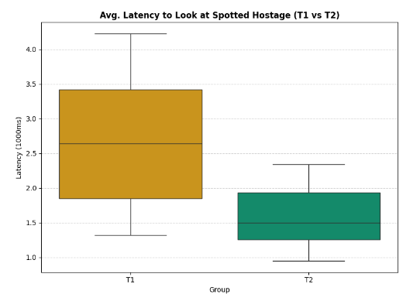
H1 - Cognitive Performance
Reduction of 1,150 ms (or 43.5%)
Average latency (ms) between XAI cue and
participant’s gaze fixation on the corresponding spotted hostage
Notes:
This is the metric that really drives home my first hypothesis.
This is the latency between an AI cue and when the participant’s eyes actually fixated on the corresponding hostage.
In other words — how quickly did the participant notice what the AI was trying to draw their attention to?
The results are very clear. In the Static condition (T1), participants took much longer to look where the AI pointed. But in the Dynamic condition (T2), that delay was reduced by over 1,150 milliseconds — about 43% faster.
This tells us that perceptually aligned explanations aren’t just making the interface look cleaner
— they’re directly priming human attention, speeding up sensemaking, and reducing the cost of searching under pressure.
This is the strongest evidence that the bottleneck in the OODA loop — Observe and Orient — can actually be accelerated when explanations are designed to align with human perception.

Slide 30
H2 & H3: Subjective Workload & Trust

Slide 31
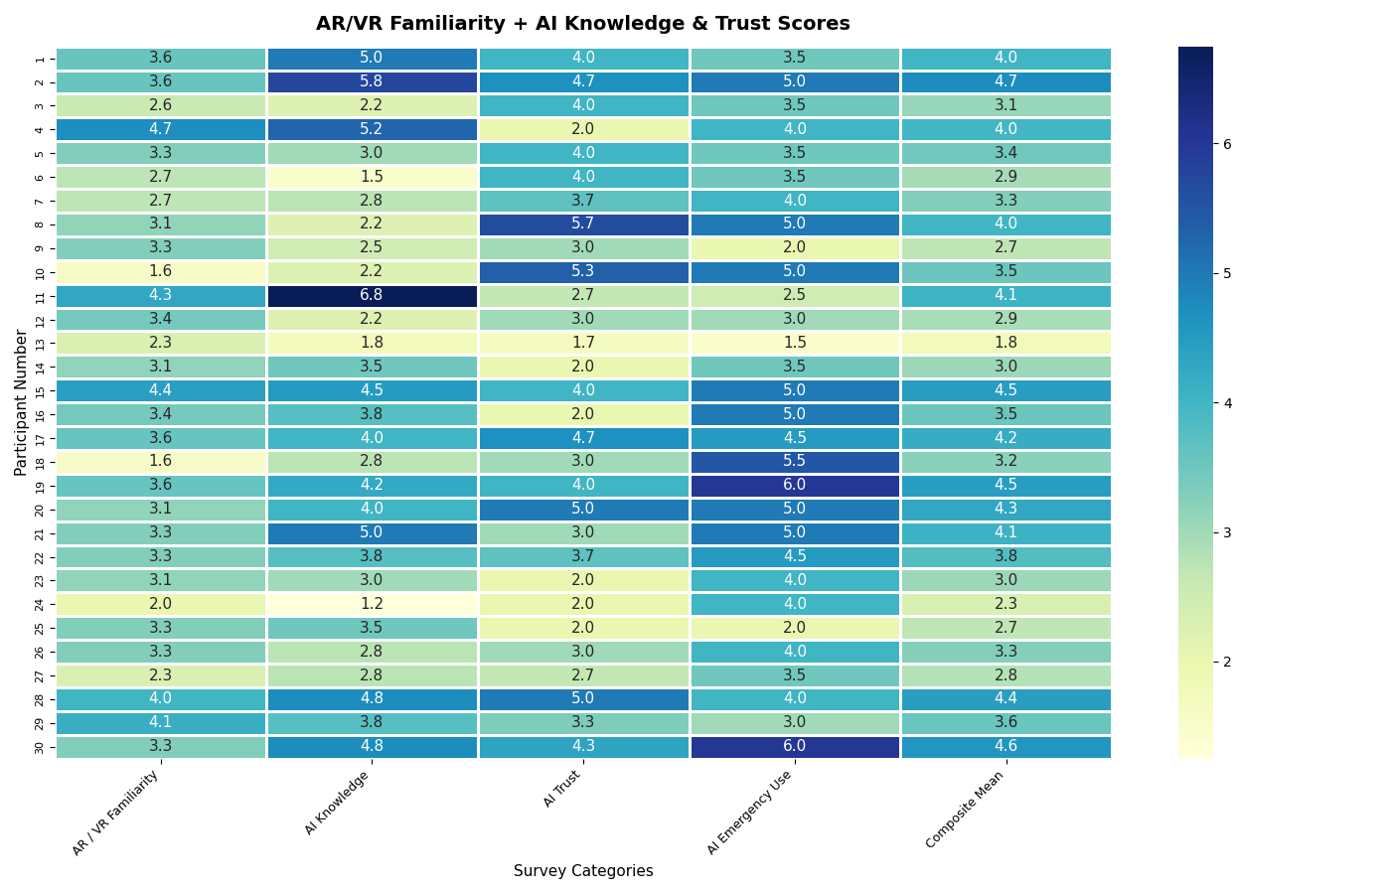
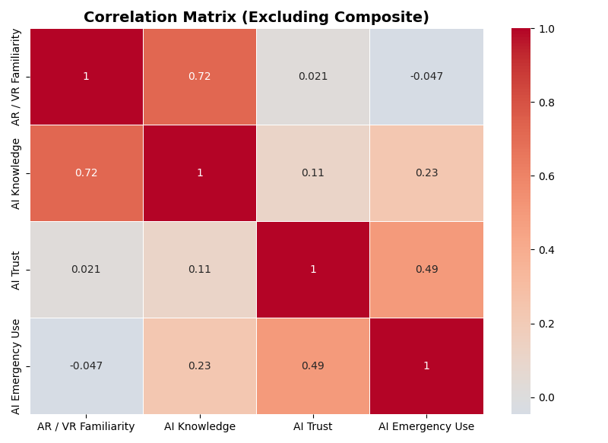
Introductory Survey
AI/AR Familiarity and Trust in Emergency
Notes:
Assess basic attitudes of participants.
subset of participants reported high familiarity with AI technology but low trust in its use during emergencies
participants who expressed the highest levels of trust and willingness to rely on AI in emergencies often reported neutral or limited technical familiarity.
Participants who trusted AI generally would also use it in an emergency situation
participants who reported higher familiarity with
AR/VR technologies were also more likely to indicate familiarity with AI systems, reflecting shared exposure to emerging technologies

Slide 32
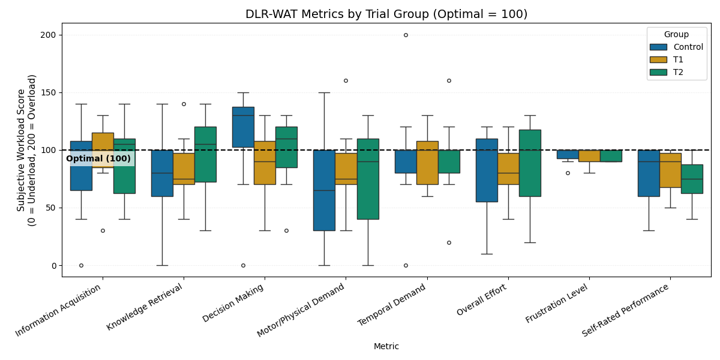
H2: Subjective Workload
DLR-WAT
Notes:
Here to measure Subjective experience: the DLR-WAT survey, which measures workload across multiple dimensions.
The optimal score is set at 100 — that’s the spot where task demand and human capability are in balance.
Scores above or below represent overload or underload.
In decision-making, participants with perceptually aligned explanations (T2) reported noticeably less overload than the Control group. That suggests the dynamic cues helped them prioritize targets more confidently and efficiently. T1 expressed underload, meaning static explanations leave some cognitive resources unused.
In motor and physical demand, the T2 group avoided the underload trends we saw in Control and T1. That tells us dynamic guidance promoted purposeful navigation rather than aimless searching.
So overall, dynamic explanations seemed to hit the balance point — reducing both overload and underload at the same time. In other words, participants stayed engaged without being overwhelmed
*Small note: The wording of the DLR WAT is not user friendly, and so many participants were not sure what was meant by “Temporal Demand” in particular.

Slide 33
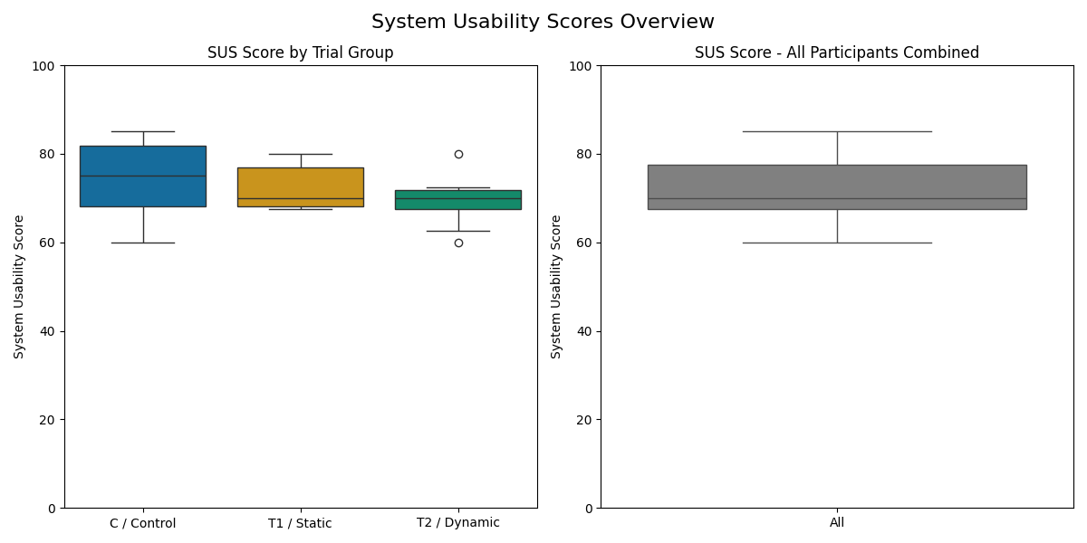
H2: Subjective Usability
System Usability Scores
Notes:
Scores across all groups were consistently above the neutral benchmark of 68, indicating that participants generally found the simulation and interface to be well-structured and usable.

Slide 34
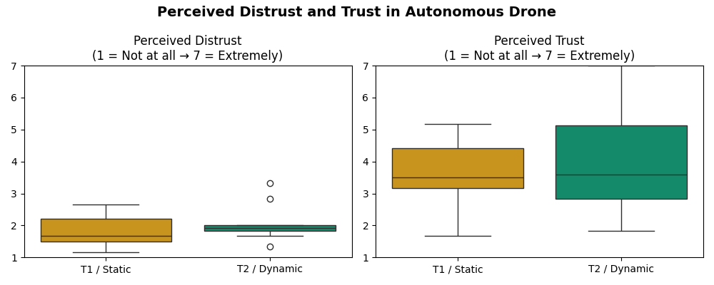
H3: Subjective Trust
Distrust vs Trust in Companion Drone
Notes:
trust in the autonomous drone.
On the left, we see perceived distrust ratings. Notice distrust stayed consistently low, with very little variation between participants.
On the right, we see trust ratings. Here, participants in T2 condition generally reported higher levels of trust than those in the static condition, and importantly, the distribution is wider.
What’s interesting here is the contrast between distrust and trust.
In the both conditions, distrust scores are clustered at the low end — participants consistently did not feel misled or confused by the respective system.
But when we look at trust, the range actually widens for both groups. Some participants reported very high trust, while others were more cautious.
Looking at T2 this data suggests that participants more consistently understood the boundaries and limitations (tight clustered distrust) of the perceptually aligned explanations. From there, their actual trust level seemed to depend on their personal attitudes toward relying on AI under pressure, generally with it being favorable.
At least a little bit more favorable than T1 static.
Overall these metrics tried to capture how explanations might calibrate trust, to measure how much people choose to lean on the system based on their comfort and experience.

Slide 35
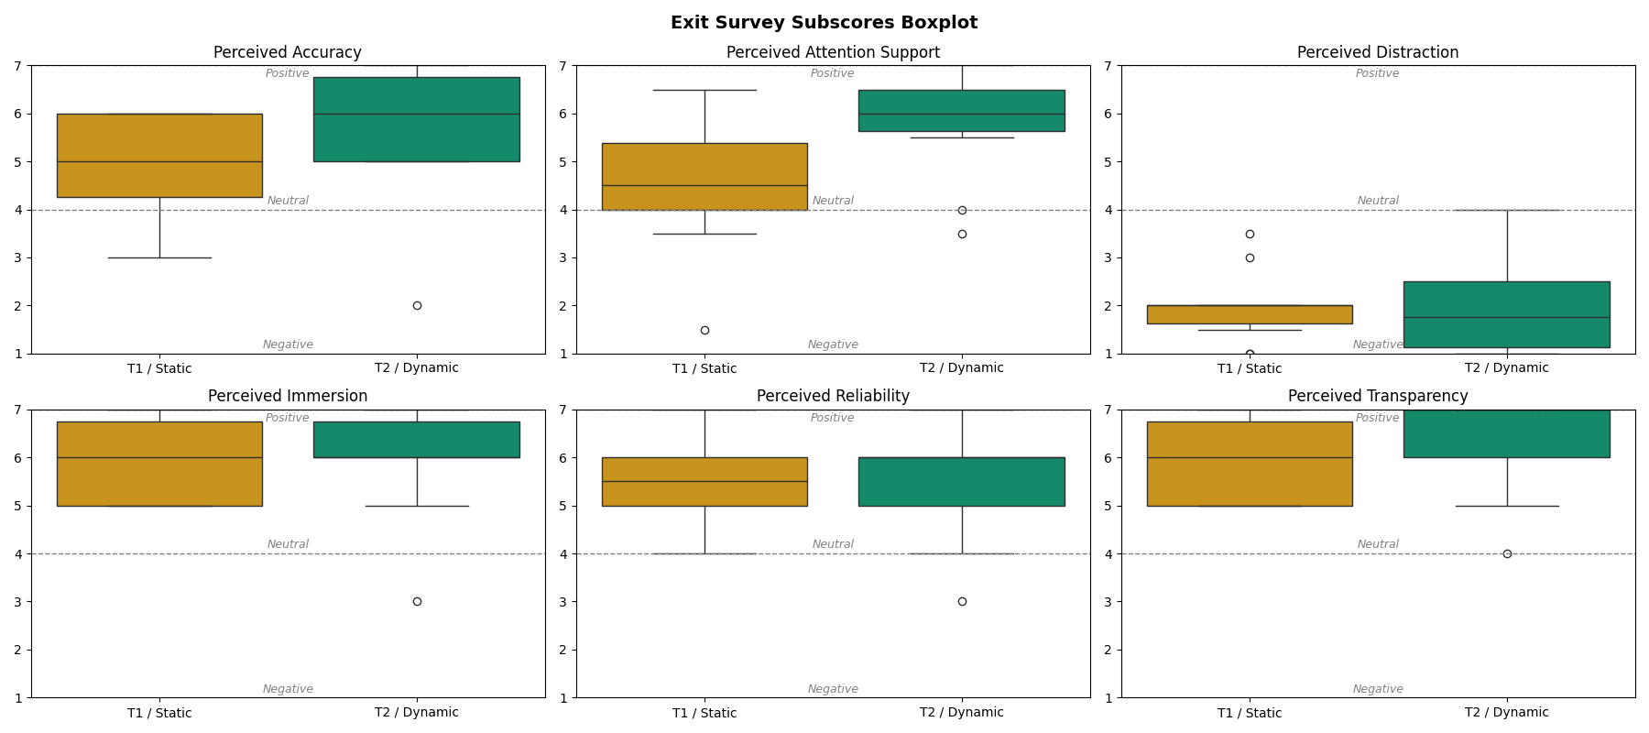
H3: Subjective Trust
Perceived XAI Subscores (Red = Significant, Green = Slight Increase)
Notes:
Here, we break trust down into more specific dimensions.
The most important result is Perceived Attention Support (red box). Participants in the T2 condition consistently rated the system as giving stronger, more useful support for guiding their attention — and this difference was statistically significant.
We also see notable but smaller improvements (green boxes) in accuracy, immersion, reliability, and transparency. These weren’t statistically significant, but they do suggest that participants felt the dynamic system was nudging them in the right direction across multiple aspects of trust.
On the other hand, perceived distraction stayed flat across both conditions — so participants didn’t feel that the extra cues cluttered or interfered with their task. That’s a good sign: we’re adding support without adding perceived noise.
Overall: the T2 perceptually aligned explanations were actually felt by participants as more trustworthy and supportive in the moment, especially in terms of attention guidance.

Slide 36
H2 & H3: Subjective Perception
Correlation Matrix of XAI Subscores (Green = Cluster)
Notes:
This correlation matrix helps us see which perceptions of the system tend to move together.
We see a clear cluster of perceived trust, accuracy, and reliability — these three strongly reinforce one another. If participants trusted the drone, they also tended to rate it as accurate and reliable.
Attention support ties into that cluster as well, linking most strongly with accuracy, reliability, and transparency. In other words, when explanations helped direct attention, participants also judged the system as more accurate and dependable.
On the other side, perceived distraction works as the opposite. It correlates negatively with trust, reliability, and even distrust itself — meaning participants who felt distracted tended to disengage from the system, eroding confidence.
Together, this shows that designing explanations that support attention doesn’t just make the task easier — it cascades into perceptions of accuracy, reliability, and trust, which are the foundations of effective human–AI teaming.

Slide 37
Conclusion

Slide 38
Summary
01
02
03
H1 (Objective Performance):
H2 (Subjective Workload):
H3 (Trust in AI):
Perceptually aligned explanations → faster rescues, fewer missed hostages
Perceptually aligned explanations → lower cognitive workload, better attentional support
Perceptually aligned explanations → higher calibrated trust and reliance under pressure
Notes:
Now that we’ve seen the results, let’s bring it back to the central hypotheses:
H1 (Objective Performance): Dynamic, perceptually aligned explanations clearly improved performance. Participants rescued hostages faster and missed fewer overall.
H2 (Subjective Workload): We also saw workload benefits. Dynamic cues reduced cognitive strain and helped participants feel more supported in prioritizing targets.
H3 (Trust in AI): Trust outcomes were more nuanced. Distrust was consistently low in the dynamic condition, but trust itself showed more variance — some participants leaned in heavily, others more cautiously. Still, the explanations calibrated trust under pressure.
So overall, all three hypotheses were supported: perceptually aligned explanations didn’t just boost performance, they helped with workload and calibrated trust.
This reinforces the argument that perceptually aligned XAI makes a measurable difference in high-stakes teaming.

Slide 39
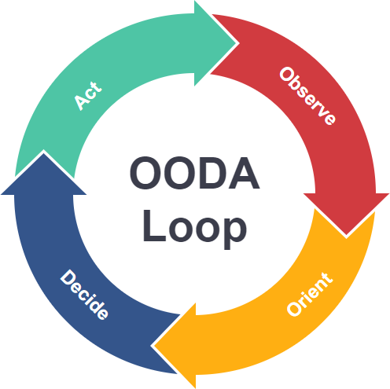
Contributions
Framework: Proposed an OODA-centric model for aligning AR and XAI in high-stakes decision-making
Testbed: Developed an AR hostage rescue simulation (Unity + Magic Leap 2) for controlled study of human–AI teaming
Pilot Study: Collected real user data
  Measured (1) objective performance, (2) subjective experience (trust, workload, usability) and (3) biometric measures (eye-tracking, behavior)
Analysis of AI Explanation Modalities: Compared none (T0), static (T1), and perceptually aligned (T2) explanations
  Found that any explanation improved performance compared to none
  Dynamic explanations consistently outperformed static in performance, workload, and trust
Notes:
To summarize the key contributions of this work:
Framework: First, I proposed an OODA-centric framework for aligning AR and XAI — connecting explanations to the actual decision-making cycle.
Testbed: Second, I developed a high-fidelity hostage rescue simulation using Unity and Magic Leap 2. This gave us a controlled way to study real human–AI teaming.
Pilot Study: Third, we actually collected user data — not just performance, but also subjective measures like workload and trust, plus biometrics like gaze behavior.
Analysis of Explanation Modalities: Finally, we compared conditions with no support, static support, and dynamic support. Any explanation improved outcomes compared to none, but dynamic explanations consistently outperformed static across performance, workload, and trust.
Together, these contributions move us toward designing explanation systems that don’t just justify AI decisions,
but actively support human perception and action in the moment

Slide 40
Future Work
Real-Time Adaptive XAI - explanation delivery that adapts to user workload, attentional state, or stress signals (e.g., gaze, heart rate, neural indicators)
Multi-Modal Explanations - Combine visual cues with auditory, haptic, or linguistic channels to create richer, multimodal explanation strategies
Longitudinal Studies - How user trust, workload, and reliance evolve across repeated exposure, prolonged missions, or extended training
Human–Robot and Multi-Agent Teaming - scale to multi-human, multi-agent environments where shared situational awareness is distributed across a team
Field Validation - Transition from simulation to semi-controlled or real world environments to evaluate robustness in authentic, high-stakes contexts.
Notes:
Based on what we learned and what worked in this pilot study — where do we take this next?
Move from static/dynamic to truly adaptive: Imagine explanations that tune themselves based on the user’s current state — if their gaze is wandering, or workload spikes, the system adjusts support in real time.
Visual is just the beginning: Think of combining visual overlays with haptics, audio prompts, or even natural language to create richer explanation strategies. The goal is not more clutter, but more channels working together seamlessly.
Trust evolves over time: Right now we tested one-off exposure. But what happens over days, weeks, or prolonged missions? Do people over-trust? Do they adapt and get faster?
From individual to team scale. In reality, operators rarely act alone. Future environments will involve multiple humans and autonomous systems coordinating simultaneously. This raises questions of how explanations should be distributed across a team — who needs to see what, when, and at what level of detail.
From lab to the field. Our testbed gave us controlled, measurable insights — but the ultimate validation is in semi-controlled or live environments. The challenge is robustness under noise, unpredictability, and the stakes of real-world missions.
So the future work is really about scaling along two axes: deeper personalization to the individual, and broader integration across multi-agent systems and real environments.

Slide 41
Papers and Presentations
Conference Papers
Wright, Dylan. Explaining at the Speed of Sight: Attention-Aware XAI for OODA-Inspired AI Design. Submitted to IEEE International Conference on Cognitive Machine Intelligence (CogMI 2025).
Journal Articles (Work in Progress)
Wright, Dylan. Perceptually Aligned Explanations in AR: Evaluating OODA-Centric XAI with Human Performance, Workload, and Trust. In preparation for submission to IEEE Transactions on Human-Machine Systems.
Presentations & Technical Contributions
Wright, Dylan. Integrating Autonomous Agents into the OODA Loop for Optimized RAM Operations. Presented at RAM XVI Training Summit, Society of Reliability Engineers, U.S. Space & Rocket Center, Huntsville, AL. Awarded 3rd place
Wright, Dylan. Enhancing OODA with Augmented Reality in Simulated Environments. Presented at HFE Technical Advisory Group #76, Department of Defense, Marshall Space Flight Center, Huntsville, AL (Apr 2024).
Notes:
(45 min total, emphasize parts of story)
To close, I’ll briefly highlight my scholarly output so far:
I’ve submitted my core paper to IEEE CogMI 2025 under the title Explaining at the Speed of Sight, where I frame this work as attention-aware XAI, directly linked to the OODA loop.
I’m preparing a journal article for IEEE Transactions on Human-Machine Systems — this will expand the results and dig deeper into the fusion of biometrics, subjective measures, and performance data
Alongside those, I’ve already been active in presenting to professional communities. For example, at the RAM XVI Training Summit, I presented on integrating autonomous agents into the OODA loop. That presentation was awarded 3rd place and $500.
I spoke at the Department of Defense HFE Technical Advisory Group at Marshall Space Flight Center, where I presented the early design foundations of this AR/OODA research.
This work is finding an audience across academic, engineering, and defense communities.

Slide 42
Q&A

Slide 43
End

Slide 44


Extras
POV Tutorial + Rescue trial demo of T1 Static (left)
POV Tutorial + Rescue trial demo of T2 Dynamic (right)

Slide 45



Extras
Rescue Path videos T0-T2 + ALL

